Slide 1
New appraiser training
Welcome to day one
Facilitators:
Organiser:
Date, Venue
Notes:
Introducing facilitators as individuals and welcoming delegates to the event
The title slide with the preferred names of the training facilitators, any additional facilitators and any organisers present
There should be no-one in the room who is not introduced
If there are observers/administrators they should also be introduced

Slide 2

Housekeeping
Notes:
Housekeeping prompts about:
Mobile phones
Fire drills
Comfort breaks
Timings - lunch and finish are sacrosanct – coffee break may be flexible (depends on arrangements in venue and facilitator preferences)
Depending on who commissioned the training, the training specification might include various local or speciality specific needs which are given time in the programme on day 2. They may need appropriate resources.
You may need to tailor the materials and your presentation to the delegates prior experience of appraisal and specific needs. All key areas need to be touched on but the length of time spent on each and the specifics of the discussion will vary. It is particularly important to identify those who are volunteers and those who have been “told to come”.
This is the moment to rearrange the room if you have people who are there solely to observe so that they do not disrupt the exercises - by putting them on a separate table?
It is also a good time to move people around if the group is mixed to ensure a mixture of primary/secondary/independent doctors

Slide 3
Ground rules
Confidentiality
Listen
Respect
Participate
Punctuality
Have fun!
Notes:
Rather than spending a long time devising the ground rules – use this prepared set and ask for any additions from the group
Make sure these ground rules are written up on a flip chart/on the wall prior to the event - then there is a forum to add anything the group choose to expand on
It is important to check that there is a shared understanding about what confidential means in this setting and that everyone is comfortable with the idea that the learning is to be shared and used for benchmarking with other appraisers but specific anecdotes might be very private and should not be retold without explicit permission
Use participate to make clear your preferences about “chipping in” and what will happen to an issue raised that cannot be dealt with immediately (have a second flip chart to “park” it on?)
This is also a good time to mention the delegate pack and how it works so that delegates are comfortable with the numbering and how to find things later on
Emphasising that the training should be fun may help the delegates to relax and set the tone for the event

Slide 4
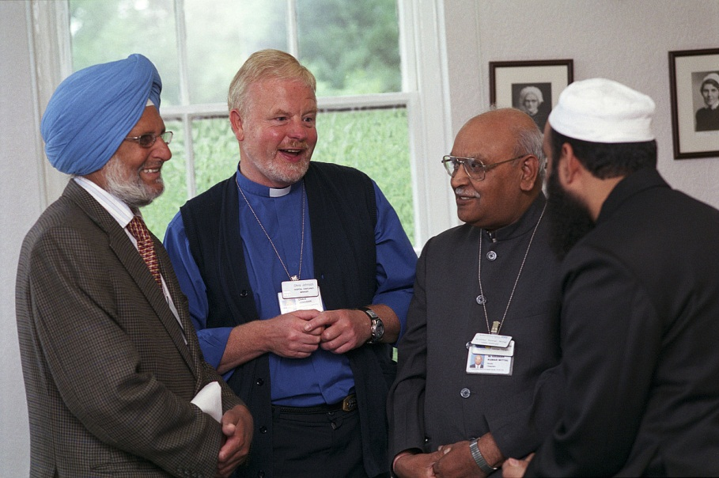
Who are you and why are you here?
Notes:
In new appraiser training it is important to go quickly around the room, asking participants to introduce themselves and explain their expectations of the training, based on their past experiences, so that the group starts to develop an identity
Asking people to introduce themselves directly to the group without doing any pair work ensures that the responses are absolutely accurate
Asking…
Why are you here?
Why do you want to become an appraiser? Or even
What do you bring that will make you a good appraiser?
…is very enlightening in identifying the enthusiasts, and the “pressed men”. If you can, record the answers for reference in the feedback.

Slide 5
Aims and objectives
By engaging with this training, you will be:
familiar with the principles and processes underpinning medical appraisal for revalidation
able to apply the key principles consistently
able to demonstrate that you have the core competencies required to be a medical appraiser
confident about your own skills in delivering and writing up an effective medical appraisal for revalidation for a colleague
Notes:
It is essential that appraisers are confident in the key principles and in their own competence by the end of the two days training. Remember to check at the end of the event that the delegates do feel confident about going on to deliver appraisals consistently well
.
Appraisers need to be able to work as expert professionals and know the principles to work to. There is not going to be a tick box approach to something that needs to reflect the complexities of real life.
It is important to emphasise that these two days have a summative element. Delegates will get verbal and written feedback on their performance and facilitators will make a recommendation that they are (or are not) suitable for appointment as an appraiser at this time, based on whether they have been able to demonstrate key skills.
The feedback has a formative basis: the aim is to help improve skills throughout the course and to give every opportunity to demonstrate the core competencies being assessed
“Passing” this training by demonstrating all the competencies assessed does NOT guarantee an appraisal job; in many organisations it will still be dependent on what is available and on interview. (This may or may not need to be said depending on who is being trained – may not be applicable where recruitment and selection have occurred prior to training.)

Slide 6

Your aims and objectives
Notes:
Use this slide as a background to gather delegates’ aims and objectives at this early stage – put them up on the second flipchart so that they can be referred to during the event
Delegates will have other chances to think about what they want to get out of the training during other exercises and things can be added throughout the two days as long as the flipchart of needs is addressed by the end
Occasionally an individual may have a specific agenda/need that is not suitable for the event – these can be ‘parked’ and/or the individual asked to speak to the facilitators over coffee etc.

Slide 7
Definitions
Appraisal
Assessment
Formative/Summative
Performance
Review
Revalidation
Notes:
7
Generate discussion about what appraisal is and is not
Try and emphasise that although revalidation is summative, it is an easy hurdle for most doctors as 98% or so will have no difficulty in demonstrating that they are up to date and fit to practise once they understand what the GMC requirements are
Appraisal should be a positive experience for a doctor and provide support and challenge for their professional development in a formative and developmental way
Assessment can be used in a formative way to help doctors to calibrate their performance and to define what steps they need to take in order to improve.

Slide 8
Qualities of a good appraiser
Exercise:
What are the qualities of a good appraiser?
Write down one quality per post-it note
Group answers under the three headings:
    knowledge
    skills
    attributes
Based on Bloom’s Taxonomy: Cognitive; Psychomotor; Affective
Notes:
Put the three divisions up on the wall with plenty of space between them: Knowledge, Skills and Attributes
Ask the delegates to generate as many qualities of a good appraiser as they can, one quality per post it note and then go and add them to the area they think that they most naturally come under e.g. knowledge of electronic platforms vs. communication skills vs. empathy (You will need plenty of post-it notes!)
This should be quick and generate a buzz of activity
Multi-coloured post-its are especially good
The key teaching points are to identify that there is relatively little specific knowledge required and the skills and attributes are actually those of a good doctor, so, although they can be enhanced through training, the delegates will already have strong baseline skills and attributes to draw on.
Note full reference for model - Bloom, B. S., Engelhart, M. D., Furst, E. J., Hill, W. H., & Krathwohl, D. R. (1956) Taxonomy of educational objectives: the classification of educational goals; Handbook I: Cognitive Domain New York, Longmans, Green.

Slide 9
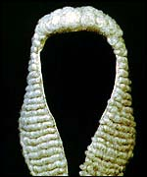
Important terms used
Professional judgement
The equivalent of the clinical judgements that
we are all used to making everyday as clinicians
(not a judicial process).
Reflection
“Good Medical Practice requires you to reflect on your practice and whether you are working to the relevant standards” (Supporting information for appraisal and revalidation, GMC, 2012)
Notes:
Appraisers need to have a shared understanding about these key terms and not exploring this can lead to misunderstandings in training – so address it early and guillotine the discussion if necessary
There are real anxieties in some quarters about “judging the information not the person”. Professional judgement is a decision-making process about whether there is a cause for concern or action that derives from expertise in the field, self-awareness and calibration of decision making. It is about being able to deal with uncertainty and being comfortable with when to ask for help. It is not about pass/fail or guilty/not guilty. Appraisers are not judges! It is best thought of as being like the clinical judgements that doctors are used to making every day
Similarly the word ‘reflection’ can be poorly understood and some doctors may feel it is like “woolly navel-gazing” rather than a specific process of review and analysis leading to improvements in performance. It is a term used by the GMC so it is important that appraisers feel comfortable about using it and do not find it a difficult concept. Some doctors find that the use of structured reflective templates is a useful way into understanding reflective skills, though a very reflective doctor may find a template too constraining.

Slide 10
Introducing the ‘Competency framework for medical appraisers’
Some competency areas must be recruited and selected for, some will be developed “on the job”, but core competencies can be trained
Exploring the ‘Competency framework for medical appraisers’:
  Professional responsibility
  Knowledge and understanding
  Professional judgement
  Communication skills
  Organisational skills
Notes:
The NHS Revalidation Support Team’s ‘Competency framework for medical appraisers’ is an appendix of Quality Assurance of Medical Appraisers (RST, 2014) and groups the core competencies that all appraisers should be able to demonstrate into the five headings here. The competency framework is in the materials provided and it may be useful for reflection to revisit it occasionally.
Make the point that some competencies must be recruited and selected for whereas others can be enhanced through training

Slide 11
Self-assessment of appraiser competencies
In your file you have a copy of the ‘Competency framework for medical appraisers’ and the ‘Self-assessment of competencies’.
Take a moment to complete the self-assessment with a ‘B’ in the box that most accurately represents your current (baseline) state of confidence against each competency.
Notes:
Ask delegates to turn to the copy of the self-assessment form provided in the resource pack. (QAMA Appendix 4, RST 2014) This is used to gauge increases in confidence between the beginning and the end of the event – an important part of the feedback about whether we are achieving our objective of training appraisers who are confident about going on to deliver medical appraisals for revalidation.
Remind delegates that they have seen it before in the pre-work, but explain that because we are using it for evaluation we need them to fill in this copy with a ‘B’ (for Baseline / Before) in the appropriate boxes at this point at the beginning of training and that we will ask them to do it again at the end of the training, with an ‘A’ (for After) so that we can assess gains or decreases in confidence. Point out that this is also a chance to remind themselves of the competencies in the framework.
Ask whether as a result of reviewing the competency framework there are any additional learning needs that should be added to the aims and objectives flip chart and capture them if there are

Slide 12
What do you need to develop?
Professional judgement – to analyse and synthesise information presented at appraisal and to judge engagement and progress towards revalidation.
Judges engagement, and ensures that the whole scope of practice is reviewed
Evaluates the portfolio of supporting information and the pre-appraisal documentation effectively and consistently
Judges progress towards revalidation appropriate for the stage of the revalidation cycle accurately
Reviews the previous PDP and ensures the new PDP reflects the doctor’s development needs (not new but enhanced)
Judges whether there is a patient safety issue or emerging concern and takes appropriate action (very rare and not new)
Notes:
The important competence of professional judgement makes explicit some decisions that appraisers have to make - about engagement, covering the whole scope of practice, the appropriateness of the supporting information and progress towards revalidation.
The sign-off statements provide a focus for the decision-making processes.
Raising a concern will be a trigger for the responsible officer to find out more and triangulate with other sources of information. It may lead to no action being deemed necessary, through increased support and/or remediation, to entry into poor performance processes, depending on the nature of the concern and any other evidence.
The calibration of professional judgements with other appraisers is a key skill that needs continual updating

Slide 13
What just needs practice?
Professional responsibility: to maintain credibility as a medical appraiser
Knowledge and understanding: to understand the role and purpose of the medical appraiser and to be able to undertake effective appraisals
Communication skills: to facilitate an effective appraisal discussion, produce good quality outputs and to deal with any issues or concerns that might arise
Organisational skills: to ensure the smooth running of the appraisal system, including timely responses and sufficient computer skills to be an effective medical appraiser
Notes:
OK, there are some elements of knowledge and understanding about the nature and purpose of appraisal and revalidation and how the two should fit together seamlessly into one process that may feel new, and there is a need to keep up to date with the local and speciality specific context and portfolio requirements, but all new appraisers will have already had appraisals themselves, so the point is that relatively little is really new
Does this fit with the self-reported level of confidence in self assessment?
Where there is a mismatch, this training should seek to build confidence e.g. there is an exercise on dealing with any issues or concerns that arise in appraisal because that is such an important skill and must be applied consistently across all appraisals.

Slide 14
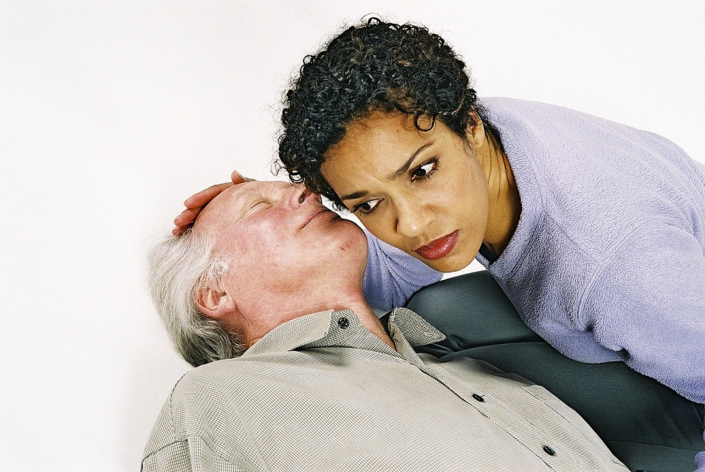
Active listening
Notes:
Demonstrating active listening skills - and also the opposite!
In pairs (with a facilitator to act as a partner if an odd number)
Share details of something that interests you/that most people would not know about you, with your partner (make sure that delegates know they will not have to feed this back)
For the first minute or so, your partner will employ active listening techniques, then, at a point they decide, they will deliberately start to not listen/“switch off”.
It can be run very quickly as the impact is felt in the first 10 seconds of not being listened to.
This reinforces the importance of active listening as a key appraiser competency and communication skill
Debrief: All of us use similar techniques to signal that we are not listening. Which of them are the biggest potential pitfalls for appraisers? Which of you have had the experience during an appraisal of feeling that the appraiser was not listening? How did it make you feel?
The key learning points to emphasise are that the delegates are all already trained to be good active listeners, but the experience of not being listened to is powerful and good appraisers can inadvertently send the wrong signals in the first few seconds if they are fiddling with paperwork and not making eye contact.

Slide 15

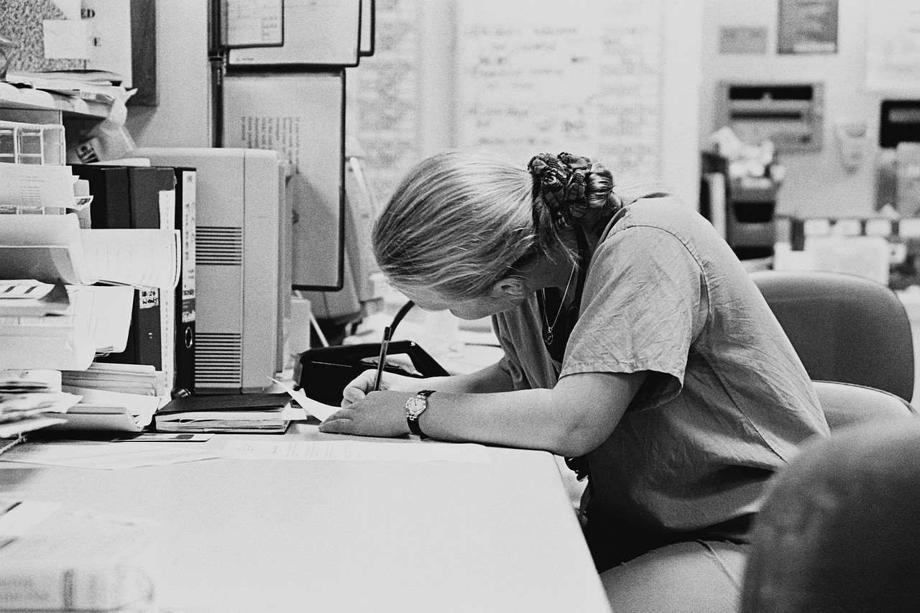
Are they listening?
Notes:
Take home message:
A doctor will not think you are listening if you are not displaying the behaviours associated with active listening – in particular if you are looking at the paperwork and not making eye contact.

Slide 16
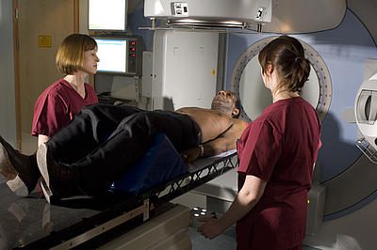
What do doctors fear from revalidation?
Notes:
Acknowledge that there is a lot of anxiety about revalidation
Ask what feeds that fear?
Uncertainty – we now have increasing certainty
High stakes – but the standard is of being up to date and fit to practise – we all want our doctors and those looking after our families to meet those standards
Being found wanting – but the standard is not perfection and the measure is not going to change over time
Being on an uncontrollable journey – but unlike in cancer, the outcome is within their control

Slide 17
The purpose of revalidation
To assure patients and public, employers and other health care professionals that licensed doctors are up to date and fit to practise.
By building a portfolio of supporting information as defined by the GMC and reflecting on the whole of a doctor’s scope of work during an annual process of medical appraisal.
Although revalidation will be periodic (with a five-year cycle being the norm), any performance/health/conduct issues will be dealt with as soon as they arise.
If no issues arise, then the GMC will revalidate the doctor and reissue their licence to practise.
Notes:
Revalidation is about being up to date and fit to practise
Demonstrating that a doctor is up to date and fit to practise is achieved by building a revalidation portfolio of supporting information over a five-year cycle. The appraiser must be trained to support the doctor in doing this.
The whole of the documentation relating to the appraisal and the supporting information will all be available to the responsible officer, should he request it, and possibly to other named parties in accordance with local policy. This is important and therefore worth emphasising so that doctors and appraisers know that they must be careful not to include personally identifiable information (eg colleague names) in their documentation and they should write all their reflections in a professional manner.
Most doctors will participate in annual appraisals without difficulty and renew their license to practice without any final high stakes test
Only those doctors who have some exceptional circumstance that prevents them from completing the annual medical appraisal process satisfactorily will automatically trigger increased scrutiny and even then it will usually be a “white flag” of something quite acceptable (maternity, long term sickness, sabbatical)
A serious cause for concern due to performance, conduct or health would be a “red flag” that would trigger immediate investigation and suspend the annual appraisal process until the outcomes of the investigation were clear
Of course, some doctors will randomly have increased scrutiny as part of a quality assurance process to ensure that positive recommendations to revalidate are benchmarked at the right level

Slide 18
The purposes of medical appraisal:
To enable doctors to discuss their practice and performance with their appraiser in order to demonstrate that they continue to meet the principles and values set out in Good Medical Practice and thus inform the responsible officer’s revalidation recommendation to the GMC.
To enable doctors to enhance the quality of their professional work by planning their professional development.
To enable doctors to consider their own needs in planning their professional development.
and may also be used:
To enable doctors to ensure that they are working productively and in line with the priorities and requirements of the organisation they practise in.
Notes:
Four purposes of medical appraisal for revalidation taken from the Medical Appraisal Guide (MAG)
Appraisal is usually about quality improvement in patient care through personal and professional development – but is also about supporting doctors in demonstrating that they are up to date and fit to practise by helping them develop an appropriate portfolio of supporting information, and helping doctors to ensure that they are fit for purpose in the context within which they work
Most doctors should have no difficulty in demonstrating that they are up to date and fit to practise and should spend almost all their time discussing:
their reflections on what they have been doing over the previous year, and
their continuing professional development and how to improve the quality of their practice by reflecting on their work, challenges, achievements and aspirations and deciding where it is most appropriate to focus their efforts in the coming year.
The MAG makes it explicit that in some places appraisal is used for service development and that this is a legitimate purpose of appraisal. This is distinct from job planning as it is recommended that the two processes should be separated as far as possible because of the conflicts of interest between performance management and medical appraisal. However, it is recognised that, in some places, appraisal and job planning can take place one after the other if the process is well-managed, appropriate safeguards put in place and training given to the appraisers.

Slide 19
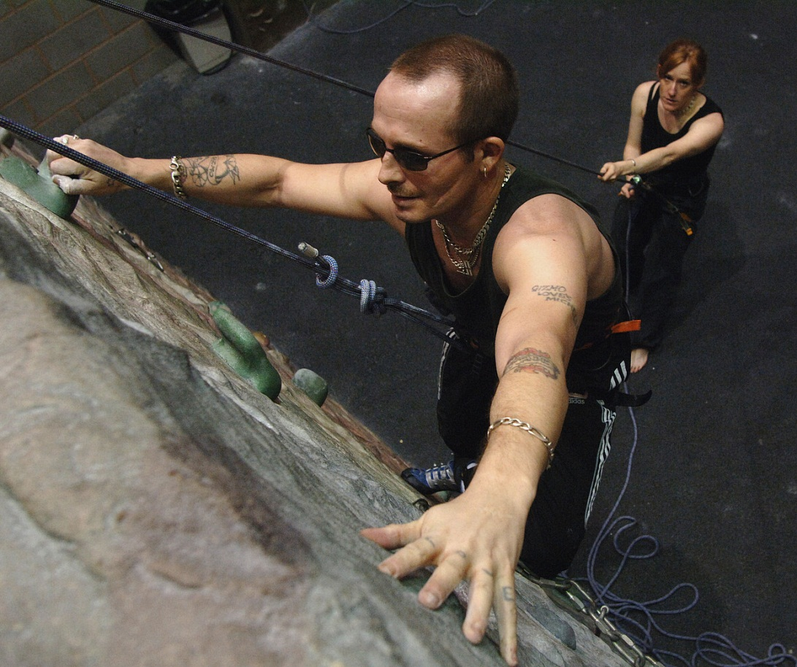
Supporting and challenging
Notes:
So being an appraiser is really all about supporting and challenging doctors, in the sense of promoting their personal and professional development and quality improvements in practice.
This blind climber is being supported by his instructor and challenged by what he has set himself to do.

Slide 20
Who does what in medical appraisal for revalidation?
Doctors collect portfolios of supporting information and reflection
Appraisers appraise
Responsible officers make recommendations
The GMC revalidates and issues licences to practice
Notes:
Doctors need guidance on what to collect in their portfolio of supporting information but it is their professional responsibility to engage with the process
Appraisers need to be trained and supported, and to calibrate their decision making processes regularly, to perform effective medical appraisals for revalidation
Responsible officers need to be trained and supported, and to calibrate their decision making processes regularly, to make appropriate quality assured revalidation recommendations to the GMC
The GMC makes the revalidation decision – and issues licenses to practise.
It is important that these roles are not confused! Appraisers do not make recommendations although their input allows the RO to focus attention appropriately.

Slide 21
The responsible officer recommendation
The responsible officer makes one of the following recommendations to the GMC, about a doctor with whom there is a prescribed connection, based on the triangulation of information from appraisal, clinical governance and any other source:
  revalidate
  defer
  notification of failure to engage
Notes:
The role of the responsible officer is defined by legislation
The responsible officer has only three choices when making a recommendation to the GMC:
A positive revalidation recommendation – where there are no concerns and the portfolio is complete
A recommendation to defer for a period of time (up to 12 months) – where a doctor may need additional time or support/remediation to complete a full appropriate portfolio of supporting information or for an investigation to come to a conclusion
A recommendation to the GMC that the doctor has failed to engage in the medical appraisal process and so there is insufficient information to make a revalidation recommendation but a deferral recommendation is also not appropriate. The GMC will deal with those doctors who fail to engage.

Slide 22
The role of the responsible officer
To make a recommendation about a doctor’s fitness to practice to the General Medical Council.
To be accountable for the quality assurance of the appraisal and clinical governance systems.
To be accountable for the provision of support and remediation where a need is identified.
To be accountable for the pre-employment checks of fitness to practice, including identity and language checks.
The revalidation of the responsible officer will include being able to demonstrate appropriate levels of quality assurance in the organisation for which they act.
Notes:
The role of the responsible officer is defined by legislation and is more than just making revalidation recommendations. There are limits to the role – only the GMC will be able to make a revalidation decision – but it will be based on the responsible officer recommendation.
It is important that issues or concerns about a doctor are addressed as they arise and not left until the revalidation recommendation is due.
Ultimately whether an issue is brought to light through the appraisal or clinical governance routes, it will be the responsibility of the responsible officer to ensure that it is dealt with promptly, appropriately and efficiently. Doctors may need specific support or remediation, but if this fails then the responsible officer will refer the issue to the GMC.

Slide 23

Medical appraisal and revalidation must be a fair and transparent process
Notes:
Any summative process must be transparently fair and equitable or it will lack credibility
Revalidation must demand the same whatever the experience or roles of an individual doctor
There needs to be a level playing field and a doctor should not fail to revalidate at the end of the revalidation process because of a poor starting position: there is time to build up the portfolio of supporting information so that by the revalidation recommendation date, every doctor is in a position to demonstrate that they are up to date and fit to practise. If necessary, doctors can be deferred in order to have the time to ensure their portfolio of supporting information is complete
However, it is equally inappropriate to “dumb down” the appraisal process in areas where it is well-established and the standards of supporting information are already high.
Experienced doctors with good portfolios of supporting information will not be supported in their drive for quality improvement if they are not challenged against the context within which they work.
While it would be inappropriate to make their supporting information a revalidation issue when the standards are clearly adequate, it is legitimate to challenge them on the quality of their portfolio, as part of the quality improvement agenda for medical appraisal

Slide 24
Medical Appraisal Guide and MAG Model Appraisal Form
Notes:
The process that appraisers use for medical appraisals for revalidation is set out in the Medical Appraisal Guide (RST, 2013) and mirrored in the MAG Model Appraisal Form
Doctors can use whichever tool or format they prefer (or their designated body mandates) for their appraisal but we suggest that whatever tool is chosen it must meet the requirements of following the MAG process (asking for the six types of supporting information and reflections esp. on achievements, challenges and aspirations and the summary being written up under 4 domains and general comments and including the five post appraisal sign-off statements) in order for the doctor to be set up properly for their revalidation recommendation date.
Doctors can only prepare effectively if they are fully aware of what they are preparing for

Slide 25
The MAG Model Appraisal Form (MAGMAF)
An interactive pdf; free of charge
Needs Adobe Reader 9 (also free to download) or later and Windows 2007 or later but it works on PCs and Macs (as long as Adobe Reader is the default instead of Mac Preview)
Follows the MAG appraisal process
Simple and easy to use
Supporting information can be attached
The whole form can be e-mailed to your appraiser
A new form can be generated post appraisal that pre-populates with basic information for the following year.
Notes:
Some trainers may prefer to omit this slide or substitute one about their preferred tool

Slide 26
Medical appraisal: the process
Appraisal covers the whole scope of the doctor’s work
Guidance and training
Scope and nature of work
Inputs
Outputs
Personal
development
plan
Quality assurance
Confidential
Supporting
information
Reflection
Summary of appraisal
Appraisal
discussion
Personal development plan review
Appraiser statements
Challenge
Achievements Challenges Aspirations
Sign-off by appraiser and doctor
Notes:
Introducing the structure of medical appraisal as inputs, discussion and outputs

Slide 27

Whole scope of work – for every medical role you have, please consider…
How did you qualify for this role?
How do you keep up to date in this role?
How can you demonstrate that you are fit to practise in this role?
What feedback do you get about your performance in this role?.
Notes:
It is very important that the appraisal covers the whole of a doctor’s scope of work i.e. every role for which they use their medical qualification. Revalidation will be about actual roles performed now, not what was qualified for originally.
Think of a doctor as a Swiss Army Knife with lots of tools at their disposal that can be used for different purposes: doctors may use their medical qualifications for lots of different functions
New appraisers should be reminded that appraisal will be a new part of their scope of work

Slide 28
Good Medical Practice: four domains
Knowledge, skills and performance
Safety and quality
Communication, partnership and teamwork
Maintaining trust
Notes:
The GMC Good Medical Practice is divided into four domains under which all doctors have to reflect on their practice across the whole of their scope of work
This is the way the appraisal has to be written up, with the addition of a general comments box.
How to write up a useful and succinct summary in this structure is best learned through experience, practice and feedback. Appraiser support groups may provide useful benchmarking. The basics will be covered on Day Two of new appraiser training.

Slide 29
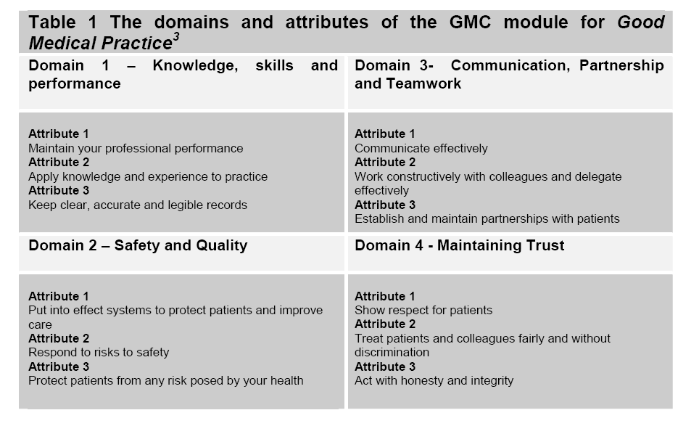
Each domain is underpinned by three attributes
Notes:
Each domain has three attributes.
The point of providing supporting information is to demonstrate that the doctor is working to all 12 attributes
The RST Pathfinder Pilots in 2010/11 showed that it was possible to map supporting information to all 12 attributes but that the exercise of doing so added a burdensome level of complexity and subjectivity and that well chosen supporting information fulfilling the GMC guidance would necessarily cover all 12 attributes over a five-year period. In order to ensure that producing the portfolio is simple and proportionate, mapping to the attributes has been removed from the Medical Appraisal Guide (RST, 2013) process for medical appraisal.

Slide 30
Declarations before the appraisal discussion
Doctors should make declarations that are visible to the appraiser that demonstrate:
Acceptance of the professional obligations placed on doctors in Good Medical Practice in relation to probity and confidentiality
Acceptance of the professional obligations placed on doctors in Good Medical Practice in relation to personal health
Personal accountability for accuracy of the supporting information and other material in the appraisal portfolio.
Notes:
These pre-appraisal sign-off statements, taken from the Medical Appraisal Guide, give a written record that the doctor has considered the professional obligations upon them and mean that a doctor can be held to account should it subsequently be found that they have deliberately misrepresented themselves
Organisations have an obligation to assist doctors in collecting supporting information for appraisal. A doctor cannot be held responsible for genuine errors in information that has been supplied to them.

Slide 31
Key messages 1
First, do no harm:
The appraisal should be a positive experience for the doctor
The effort needs to be proportionate
Appraisers must not take on inappropriate
roles even if they have the skills
Notes:
Doctors are all aware of the principles of the Hippocratic oath.
Good doctors who are trying hard to engage should find the appraisal a reassuring process that ensures they have a suitable revalidation portfolio that demonstrates that they are up to date and fit to practise and promotes their continuing professional development and quality improvement. They should not be “bruised” by a process that makes them feel inadequate when there are no serious concerns. Instead they should be empowered to make positive changes for the benefit of themselves and their patients.
The RST Pathfinder Pilots made it very clear that appraisal and revalidation processes must be streamlined and simple so that doctors are not taken away from front line care disproportionately. The portfolio of supporting information must not take excessive time and effort to collect.
Appraisers have a lot of skills but should not become the doctor’s GP/doctor, or ongoing mentor – the role of appraisal is to move doctors on to finding appropriate ongoing support if it is needed. Protecting appraisers is also important
A lot of counselling or mentoring skills may be used in appraisal but it is a once a year intervention and mentoring and coaching are ongoing relationships. ‘Find a mentor/coach…’ may be a very useful PDP objective!
31

Slide 32
The appraisal balance
Revalidation
Professional Development
Quality Improvement
Notes:
The balance in most appraisal discussions should be heavily weighted in favour of professional development as a way to drive quality improvements in patient care or medical practice, because most of the baseline requirements for revalidation should be easily met in the portfolio of information provided before the appraisal discussion
Doctors frequently express the desire to be challenged in the areas of personal and professional development in order to deliver quality improvement for patients – and challenge is a key purpose of appraisal
This is NOT to say that patient safety and revalidation is less important, just that it will take less time in the appraisal (for most doctors) than promoting quality improvements

Slide 33
Key messages 2
If in doubt – ask:
Appraisers should have a low threshold for seeking advice (and know the appropriate contact details)
Appraisers need access to professional support structures
The doctor being appraised is the expert
Supporting information needs to be set in context
Notes:
Doctors are trained to come to quick conclusions and act on their decisions.
In appraisal, particularly pre-appraisal, it is important to bear in mind that the doctor being appraised is the only person who can put all their pre-appraisal documentation into context.
A professional judgement about the quality of a piece of supporting information will be informed by benchmarking with other appraisers, but there are no absolutes and the appraiser will need to understand the context for the doctor being appraised before coming to any conclusions.
Traditionally the requirement for the appraisal discussion to be confidential has sometimes been taken to extremes and left appraisers feeling very vulnerable with difficult issues to assess and without the experience to calibrate their responses.
For revalidation, it is important that the appraisal policy makes clear that the appraiser may, from time to time, need to seek advice, and give the name and contact details of the appropriate person/people.
Appraisers need to be trained to have a lower threshold for seeking advice on “soft” issues so that standards are applied consistently and so that appraisers are supported in making appropriate and consistent decisions.
33

Slide 34

Coffee
Notes:
Time for a break
Remind people what time to return

Slide 35
Supporting information
Exercise:
What would you use to affirm the quality of your own practice? Write it down
Only one type of supporting information per post-it note
Once generated…
Post up under relevant domain of Good Medical Practice
Notes:
This is a chance for the participants to take ownership of supporting information before looking at what the GMC requires.
Hopefully the suggestions will align but it also affords an opportunity to discuss the difference between GMC requirements (base line) and college (best practice) guidance
Most appraisers, even the very experienced, find it hard to resist the temptation to try to give a black and white answer to what supporting information is required, but actually this is an area that needs a lot of professional judgement as there are perfectly reasonable exceptions to almost every requirement (eg histopathologists do not see patients as such…)

Slide 36
Levels of supporting information
Personal
Aspirations
Supporting information that promotes reflection ,
may be about the current working environment or areas for future growth and development
Organisational and individual information
Professional development
Mandatory requirements may be made contractually by the employing organisation
Supporting information defined by the employing organisation or specialist body
(Fitness for purpose)
GMC guidance is the essential basis for all revalidation decisions
Supporting information defined by the General Medical Council
(Fitness to practise)
Revalidation
Notes:
A reminder that supporting information may be defined by the GMC as essential for revalidation, or it may be required by the organisation or speciality, or it may be selected and provided by the individual because it is of particular relevance to their individual professional or personal development.
Not all supporting information is defined by the GMC. What is required of an individual will depend on the year of the revalidation cycle and the context within which they are working. The GMC requirements provide the foundation for the appraisal portfolio and are used to demonstrate fitness to practise as a doctor. The detailed guidance has been delegated by the GMC to the Royal Colleges and Faculties, who, together with the employing organisation may have specific requirements for demonstrating contractual fitness for purpose as a specialist or employee. But what is provided by the individual is likely to be of most relevance in driving quality improvements in patient care.
Doctors who choose to include more than the GMC/organisational minimum should be able to demonstrate that there is a value in what they have included and that the effort made in collection has not been disproportionate or unreasonably taken them away from patient care. Appraisers should be trained to support doctors in prioritising what they include in their portfolio.
The shape could probably be represented the other way up with the GMC foundation as a small triangle and each level above getting broader: the idea is to emphasise the GMC supporting information as being a foundation, even though in some ways for most doctors it will be the smallest part.

Slide 37

GMC requirements for supporting information for revalidation
Notes:
This document should be included in pre-course reading / e-learning modules and every appraiser needs to be thoroughly familiar with it.
It underpins all professional judgements about supporting information

Slide 38
GMC supporting information principles
General information – providing context about what you do in all aspects of your work
Keeping up to date – maintaining and enhancing the quality of your professional work
Review of your practice – evaluating the quality of your professional work
Feedback on your practice – how others perceive the quality of your professional work
Notes:
The GMC document (pre-course reading) states: “The supporting information that you will need to bring to your appraisal will fall under four broad headings…” as above.
The key learning point for appraisers is that the GMC requirements are the absolute baseline for all doctors (and the ultimate indicators of fitness to practise).
College and organisational requirements can be contractually enforced (and considered as indicators of fitness for purpose)
As long as the four broad principles of supporting information (describes whole scope of work, demonstrates keeping up to date, demonstrates review of practice and feedback on practice) are covered and the six types of supporting information (next slide) are provided, it would be hard to justify a decision that a doctor could not revalidate (as a doctor) on the basis of their supporting information.

Slide 39
GMC supporting information requirements
The GMC requires six types of supporting information:
Continuing professional development
Quality improvement activity
Significant events
Feedback from colleagues
Feedback from patients (where applicable)
Review of complaints and compliments
Notes:
The GMC document (pre-course reading) states: ”There are six types of supporting information that you will be expected to provide and discuss at your appraisal at least once in each five-year cycle. They are…” as above.
The GMC also says: “The nature of the supporting information will reflect your particular specialist practice and your other professional roles. For example, an appropriate quality improvement activity will vary across different specialties and roles.”
It is important that this is understood to ensure that doctors who have particular issues e.g. locums or doctors working in isolated practice can find appropriate ways to demonstrate their competence across all 12 attributes even if they are not able to do what a more mainstream doctor could or what their Royal College or Faculty guidance says.

Slide 40
Continuing professional development (CPD)
The GMC states: “There should be a discussion on CPD at each appraisal meeting”
How do you keep up to date?
How do you identify what you need to learn?
What have you reflected on in your learning this year?
What are the main things you have learned this year?
What changes have you made as a result of what you have learned?
How have you shared your learning with others?
How do you keep the recording of your CPD proportionate?
Quote taken from Supporting Information for appraisal and revalidation (GMC, 2012)
Notes:
The quote is from: Supporting Information for appraisal and revalidation (GMC, 2012)
Useful stem questions on CPD
CPD should focus on outcomes or outputs rather than on inputs and a time-served approach. You should evaluate what you have learned and understood from your CPD activity and how it may impact on and improve your performance. (GMC Supporting information…)
It should be needs-based
It should be influenced by participation in clinical governance
Lessons learned, encouraging excellence and identifying examples of good practice can easily be introduced when considering CPD

Slide 41

Think about the impact…
…of what you learn on what you do
Patients
Patients
Patients
Doctor
Patients
Service
Notes:
Attendance at a CPD event does not necessarily imply learning has taken place – what impact has it had?
The GMC statement on reflection emphasises that the skill to be demonstrated in the revalidation portfolio is reflection: “Good Medical Practice requires you to reflect on your practice and whether you are working to the relevant standards” (Supporting information for appraisal and revalidation, GMC, 2012)
The GMC requires a reflection on impact in terms of lessons learned and demonstration of change as a result (as above)
Impact is demonstrated through the reflective note that the doctor makes about the learning event (e.g. date, title, hours spent, what you learned, further actions, who you shared it with and what the impact was) or in the appraisal discussion

Slide 42
Quality improvement activity (QIA)
The GMC states: “Involvement in QIA is expected at least once every revalidation cycle; however, the extent and frequency will depend on the nature of the activity…you should discuss and agree the frequency of the QIA with your appraiser.”
Your Quality Improvement Activity (QIA) should be relevant to your work
  Clinical audit
  Review of clinical outcomes
  Case review or discussion – shared with a colleague(s)
  Audit and monitor the effectiveness of a teaching programme
  Evaluate the impact and effectiveness of…health policy
Notes:
The quote is from: Supporting Information for appraisal and revalidation (GMC, 2012)
Discussing the QIA will involve the doctor demonstrating that they have actively participated in a QIA or clinical audit relevant to their work, evaluated and reflected on the results, taken appropriate action in response to the results and closed the loop through repeat of the activity or reaudit.
While individual colleges and faculties may require a particular type of QIA, the GMC does not, and doctors in unusual situations are encouraged to find innovative ways of demonstrating that they reflect upon what they actually do in practise.
The appraiser is expected to exercise professional judgement about the appropriateness of the supporting information in this area, as in all others.

Slide 43
Significant events
The GMC states: “You should discuss significant events
involving you at appraisal with a particular emphasis on
those that have led to a specific change in practice or
demonstrate learning”.
A GMC significant event is any “unintended or unexpected event, which could or did lead to harm of one or more patients”
Please ensure you are familiar with your organisation's local processes and agreed thresholds for recording incidents
All such significant events involving you should be discussed at appraisal - or a statement made that there have been none
Other ‘significant events’ may be quality improvement activities
Notes:
The quote is from: Supporting Information for appraisal and revalidation (GMC, 2012)
The GMC states that a significant event (also known as an untoward, critical or patient safety incident) is any unintended or unexpected event, which could or did lead to harm of one or more patients. This includes incidents which did not cause harm but could have done, or where the event should have been prevented.
Further guidance on significant events as supporting information is available from the GMC and from the National Patient Safety Agency. Please also ensure you are familiar with your organisation's local processes and agreed thresholds for recording incidents.
All significant events involving you should be discussed at appraisal or a statement made that there have been none
In primary care in particular, significant event audit has evolved as an important tool in improving practice. Where these have been undertaken and don’t meet the GMC definition above, they should be included as supporting information for quality improvement activity.
Please note:
You do not need to list any significant events where your only involvement was in the investigation unless that is an important part of your scope of work.
It is not the appraiser's role to conduct investigations into serious events. Organisational clinical governance systems and other management processes are put in place to deal with these situations.
Please ensure you are familiar with your organisation's local processes and agreed thresholds for recording significant events.

Slide 44
Colleague and Patient feedback
The GMC states: “ Feedback should be formally sought at least once per revalidation cycle, normally every five-years.” (and will always be needed by the revalidation recommendation year)
You should seek feedback from colleagues and patients and review and act upon that feedback where appropriate
Feedback will usually be collected using standard questionnaires that comply with GMC guidance
The questionnaire must be administered independently of the doctor and the appraiser
Discussion during the appraisal should highlight areas of good performance and identify areas for further development
Notes:
The quote is from: GMC Supporting Information for appraisal and revalidation (GMC, 2012)
Normally the requirement is for reflection on one formal set of colleague and patient feedback to be included in appraisal per revalidation cycle. If the results are poor, it is suggested that the feedback surveys are repeated after making an action plan and implementing changes in order to demonstrate improvement.
The feedback must:
cover the current scope of work
have enough respondents to get an overview (Each tool has its own numbers: 15 colleagues, 34 patients are suggested, but not mandatory, for the GMC questionnaire; professional judgment may be needed depending on the context within which the doctor works)
be externally collated and anonymised before being fed back to the doctor for their personal reflections so that respondents are assured that they can comment freely
include self-assessment (discrepancies with rater scores can be revealing – many doctors rate themselves lower than their feedback suggests they should)
include benchmark data from others doing the same questionnaire (this will become more useful as the benchmark data includes a greater variety of doctors, but beware falsely high scores because early adopters of the tools have been keen doctors in stable working environments)
Doctors must:
reflect on the outcomes and what it means for their practice and behaviour
include their reflection in the pre-appraisal documentation
discuss the feedback and their reflections on it during the appraisal discussion
Feedback that meets these requirements and has been done within the past five years will be eligible to be submitted as part of the revalidation portfolio of supporting information. Appraisers will have discretion to determine whether feedback is suitable and to make professional judgments about circumstances where variation in the guidance is called for (eg an unusually low number of respondents for a doctor working in unusual cirumstances)

Slide 45
Review of complaints and compliments
The GMC states: “A complaint is a formal expression of dissatisfaction or grievance…You should discuss any change in your practice that you have made as a result of any complaints or compliments you have received since your last appraisal”.
Complaints and compliments should be seen as another type of feedback
It is how you dealt with the complaint rather than the number that should be the focus of discussion in the appraisal
You will be required to make a statement that there have been no complaints about you or your team in a given appraisal period if there have not been any
Notes:
The quote is from: GMC Supporting Information for appraisal and revalidation (GMC, 2012)
The GMC is concerned about reflection on:
Awareness of the complaints procedures and any complaints about the doctor or the team
Participation in the investigation and response to complaints where appropriate
Actions taken in response to the complaint
The identification of opportunities for professional development
Those who are involved in the investigation of complaints do not need to include every complaint they have investigated, if they were not about them or their team and there was no personal learning to reflect on – but they should reflect that this is part of their scope of work and demonstrate how they keep up to date, review what they do and get feedback in this area
There may be a need to ensure that the organisation has systems to let doctors know about any complaints that may have been received about them. A doctor cannot be held accountable for information that they do not know about - but wilful ignorance is no excuse.
If there have not been any complaints then a statement to that effect will be required

Slide 46
Supporting information scenarios
Exercise:
Look at the supporting information scenarios given.
Consider the decision point and decide on your course of action. Write it down.
Review your answers with the supporting information algorithm and teaching points as an aide memoire and discuss with the person next to you.
Share your answers with the group.
Notes:
This exercise is designed to provide an entry point into developing consistency in decision-making across all appraisers
Appraisers need to take into account the complexities of real life. They are trained to do no harm and, if in doubt, to ask.
There will inevitably be exceptions to any rule and appraisers need to be able to deal appropriately with doctors from a huge variety of different contexts. This may initially be uncomfortable but it fits with the idea of doctors as professionals making expert clinical judgements where exactly the same principles apply.
Appraisers should understand that their professional judgements about supporting information will need further modification and benchmarking over time within a peer support system / network of some sort
More scenarios are explored in the worked examples in the resource pack and there is an algorithm for those who like visual prompts for decision-making processes

Slide 47
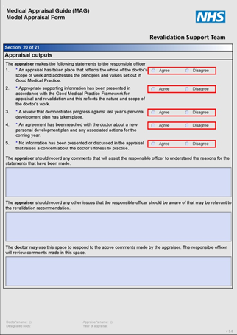
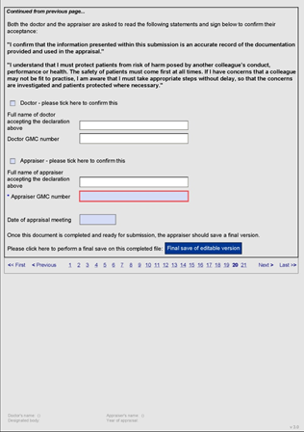
Outputs of appraisal
Notes:
Quick screen shot to show what the outputs of appraisal look like in the MAG MAF form.
Detail comes in the next few slides.

Slide 48
Outputs of appraisal: statements one and two
An appraisal has taken place that reflects the whole of a doctor’s scope of work and addresses the principles and values set out in Good Medical Practice.
Agree/Disagree
2. Appropriate supporting information has been presented in accordance with the Good Medical Practice Framework for Appraisal and Revalidation and this reflects the nature and scope of the doctor’s work.
Agree/Disagree
Notes:
Appraisers can be trained to use their professional judgement about engagement in the appraisal process and how to sign the statements agreed for the roll out of revalidation.
They should discuss the issues around these three areas: the appraisal taking place, the whole scope of work being covered and the supporting information being appropriate according to the GMC guidance.

Slide 49
Outputs of appraisal: statements three and four
A review that demonstrates progress against last year’s personal development plan has taken place.
Agree/Disagree
An agreement has been reached with the doctor about a new personal development plan and any associated actions for the coming year.
Agree/Disagree
Notes:
It is important to make a statement to the responsible officer about having appropriate levels of achievement against last year’s PDP. Dropping, modifying or carrying forward individual objectives may be appropriate (and some may have a time scale of over one year) but over a five year cycle there needs to be a clear demonstration of progress with the PDP objectives.
There is also a separate statement about the new PDP confirming that it is derived from the appraisal discussion and the supporting information presented. It will be informed by what is needed to make a good revalidation portfolio and promote quality improvement.

Slide 50
Outputs of appraisal: statement five
No information has been presented or discussed in the appraisal that raises a concern about the doctor’s fitness to practise.
Agree/Disagree
Notes:
It is important to make a statement to the responsible officer about having no concerns about the doctor’s fitness to practise arising from the appraisal discussion and supporting information presented
This statement is to be made in the context of a declaration about understanding the obligations of Good Medical Practice

Slide 51
Outputs of appraisal: additional information for the RO
The appraiser should record any comments that will assist the responsible officer to understand the reason for the statements that have been made.
The appraiser should record any other issues that the responsible officer should be aware of that may be relevant to the revalidation recommendation.
The doctor may use this space to respond to the above comments made by the appraiser. The responsible officer
will review comments made in this space.
Notes:
This additional information will ensure that the responsible officer is given the contextual information that enables them to make sense of the sign-off statements.
Sometimes the appraiser will “disagree” with a statement, but there may be an entirely appropriate reason for this e.g. PDP objectives not met because circumstances changed dramatically and a different PDP was created and met.
While exceptional circumstances will be recorded elsewhere, it may also enable the responsible officer to see at a glance where particular circumstances apply e.g. maternity leave, sabbatical, long-term illness.
Experience teaches us that it is better to leave the boxes blank when everything is going well rather than entering a null answer such as “n/a” as leaving it blank makes populating the RO dashboard easier

Slide 52
Confirmation of understanding of GMP obligations
Both the doctor and the appraiser are asked to read and sign the following statements to confirm their acceptance:
I confirm that the information presented within this submission is an accurate record of the documentation provided by the doctor and used in the appraisal.
I understand I must protect patients from risk of harm posed by another colleague’s conduct, performance or health. The safety of patients must come first at all times. If I have concerns that a colleague may not be fit to practise, I am aware that I must take appropriate steps without delay, so that the concerns are investigated and patients protected where necessary.
Notes:
The responsibility is for the appraiser or doctor to raise the concern, it is not to make a decision about whether patients or a colleague are actually at risk
Further investigation, triangulated with other sources of supporting (or refuting) information, will be necessary for the responsible officer to make a final decision about the most appropriate course of action
This statement will need to be signed-off by the doctor and the appraiser. Having signed it, there is an imperative need to do something proactive to raise the concern if there is an issue. Doctors and appraisers must not just assume that the RO will eventually see the statements and pick up an issue.
Once these sign-offs are in place, the documentation is completed and the MAG Model appraisal form offers the appraiser (who signs second) the chance to do the “Final Save of the editable Version” and then “Lockdown and Submit”

Slide 53
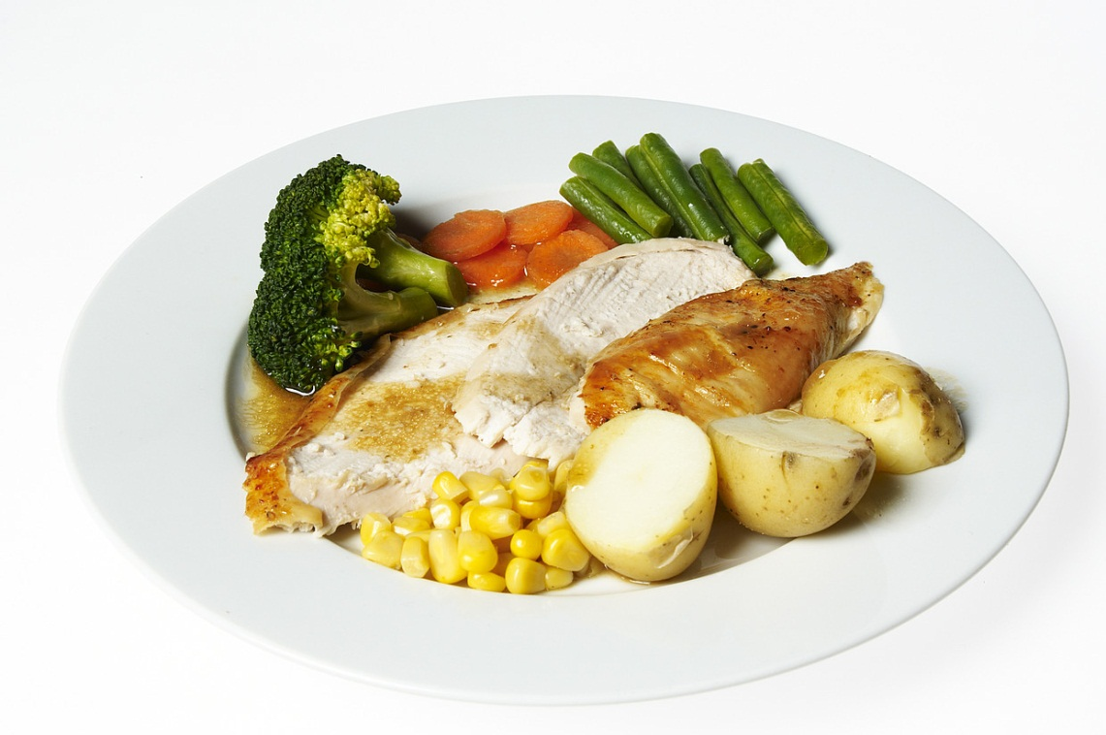
Enjoy your lunch
Notes:
Remember to let delegates know exactly when they need to get back after lunch
Change the image to suit your training if you wish

Slide 54




Providing a professional appraisal
Notes:
Reading the briefing notes on providing a professional appraisal was part of pre-course preparation
Delegates should recognise that different organisations/appraisal policies will raise different issues but key concerns may include:
Confidentiality (dealt with explicitly in the introduction to the appraisal discussion and the next exercise)
Venue being private/confidential, with freedom from interruptions and IT/resources. Appraisers need to recognise the risk if they allow an appraisal to take place in their own home even if they have a home office environment and protect themselves by getting the agreement in writing prior to the appraisal
Time taken
Providing protected time when fresh and able to fully engage. If an appraisal is taking place out of normal working hours, again getting explicit written agreement beforehand is a wise safety net in case there are later charges of collusion/accusations.
Ensuring that there are no incomplete appraisals (i.e. not fully signed off with all paperwork complete by 4 weeks after the appraisal date)
Data protection - there should be no patient or colleague identifiable details and any electronic communication should be over secure e-mail (e.g. nhs.net)
Local policies can be explored in more detail on day two

Slide 55
Duties of a doctor
43. “You must protect patients from risk of harm posed by another colleague's conduct, performance or health. The safety of patients must come first at all times. If you have concerns that a colleague may not be fit to practise, you must take appropriate steps without delay, so that the concerns are investigated and patients protected where necessary. This means you must give an honest explanation of your concerns to an appropriate person from your employing or contracting body, and follow their procedures.”
Good Medical Practice (GMC, 2006)
Notes:
This is a direct quote from Good Medical Practice (GMC, 2006) section 43
It underlines the need for appraisers who are in any doubt to discuss their concerns
One aim of this section of the training is to ensure that every appraiser trained is completely clear about who the appropriate person from the employing or contracting body is and how to contact them
Having the right names and contact details/processes for the audience prior to training is essential as all appraisers need to go away with this key knowledge. It can be an action point for individual appraisers to take away from the day to find out for themselves.
If not already covered this is also a good place to explore the new reality that there are many other occasions when confidentiality will be breached to a minor degree – to allow quality assurance and collation of constraints or learning needs, to raise an issue and ask advice (highlighted by the new emphasis on asking others in order to moderate/benchmark decisions). These should be clearly understood by both parties and explicit in the appraisal policy

Slide 56

Demonstrating an introduction
Notes:
It is essential that appraisers make the limits of confidentiality explicit, even if it is not the first appraisal with that doctor.
It is worth asking for a show of hands to see how many doctors in the room are already used to an explicit reference to confidentiality as part of the introduction to their appraisal when they have been appraised, as this will highlight how much time to spend on this area of training.
If only a few hands go up, acknowledge that one learning point from this exercise is to drive appraisal policies to make the limits of confidentiality explicit and to suggest to new appraisers that they go back to their organisations looking for a standard written explanation of the limits of confidentiality that is always shared pre-appraisal. Note that people do not always read policies or even introductory letters/e-mails, so it is still worth touching on at the beginning of the appraisal when it sets the professional boundaries in place for the discussion
Acknowledge that it can feel artificial to have to actually make an introduction and say out loud what is needed to make the GMC requirements explicit
The form of words offered in the pre-course reading may help some appraisers by providing an example (See ‘Providing a professional appraisal’)
Rehearsal and observation of how another appraiser does it makes it feel more comfortable – so use role play by the facilitators– making an introduction as if we were about to start an appraisal – or ask appraisers in pairs to have a go
If new appraisers do not feel that this effort will make their own lives easier in the long run, they are unlikely to make it part of their routine – but remind them that it will be assessed in the feedback exercise and the partial appraisal during the training

Slide 57

Questioning skills
What? How?
Why? Where?
When? Who?
Notes:
Ask each delegate to write down a suitable opening question on a post-it note, then share with the group.
Rudyard Kipling (1902) The Elephant’s Child
‘I keep six honest serving men,
(They taught me all I knew);
Their names are “What”? and “Why?” and “When?”,
And “How?” and “Where?” and “Who?”’
How many of the opening questions used one of these as the entry point?
“Tell me about…” is another good opener.

Slide 58
Questions, questions…
Open to funnel
  Open, probe, re-cap, close
Paired (good/bad, etc.)
Real detail
  Difficult decisions
  Stressful events
Be inquisitive
No assumptions
Notes:
The communication skills section of the resources provides a useful introduction to questions that may be helpful in appraisal
This slide is a structure to guide question preparation
Point out the stem questions in the resources
Emphasise that there is no need to learn the stem questions and that to use them rigidly would inhibit the flow of the appraisal discussion. However, for a new appraiser it is often useful to feel that there is a prepared open question or two “in reserve” to alleviate the fear that conversation might dry up on the day.

Slide 59
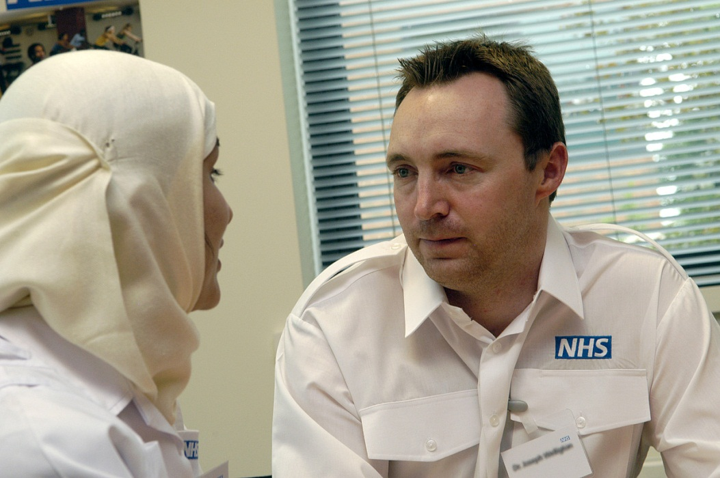
Giving and receiving feedback
Where
How?
What?
When?
Notes:
Ask the group for examples of good and bad experiences of giving and receiving feedback.
Think about Where? (in private) How? (sensitively and at the right pace for the doctor) What? (specific examples of things that went well or could have gone better) When? (when the doctor invites it, or opportunistically when a chance arises, or during the appraisal)
Resources on these questions are provided
Appraisal reviews and demands reflection on all areas of a doctor’s scope of work

Slide 60
‘Pendleton’s Rules’ of Feedback
Appraiser clarifies matters of fact, and prompts…
Doctor to identify what went well
Appraiser highlights observations that confirm what went well, and asks…
Doctor to discuss what did not go well and how they could improve this aspect of performance
Appraiser confirms/refutes doctor’s feelings and shares observed areas for improvement
Appraiser and doctor agree areas for improvement and formulate an action plan, ending on a positive note
Notes:
Ask how many of the delegates are already familiar with Pendleton’s Rules? What do they remember about them?
Signpost the resources on giving and receiving feedback in the resource folder
Explain that this is the preferred model for this course because it is simple and lends itself well to appraisal.
Doctor’s in training exposed to this repetitively can find it annoying/frustrating because it can feel formulaic but for a doctor being appraised the questions come naturally as part of the appraisal discussion and the “rules” need not be obvious to the doctor at all!
In the feedback exercise we are about to do, the appraiser spends 10 minutes ‘appraising’ the doctor on an area of their work that is a current issue that the doctor wants to discuss. They will rehearse the introduction and the appraiser will demonstrate their active listening, questioning and summarising skills. It is the observer who is giving the feedback and who has to play by Pendleton’s Rules!
Ref for Pendleton’s rules: The Consultation: An approach to learning and teaching (Pendleton, Schofield, Tate & Havelock, Oxford University Press, 2003)

Slide 61
Feedback summary
Establish empathy
Balance challenge with support
Have the evidence: specific examples
If resistance is encountered point it out and ask why
Review specific incidents in detail
Point out patterns of behaviour
Don’t duck issues: collusion causes problems
Allow time out if necessary
Negotiate if appropriate
Notes:
All the usual do’s and don’ts of giving feedback apply particularly when giving difficult feedback

Slide 62
Rehearsing feedback skills
In your appraisal trios…
Time | Appraiser | Doctor | Observer
14:30 | A | B | C
14:45 | B | C | A
15:00 | C | A | B
Finish exercise at 15:15 and go for tea
Notes:
62
Remind the observers to be time-keepers for the appraisal pair who only have 10 mins.
Highlight 10 mins for appraisal exercise, followed immediately by 5 mins for feedback led by observer in trio. The observer will often need prompting to remember to let the doctor analyse what went well first, especially in the first round of feedback. Doctors often go straight into what they wish they had done differently and need to be brought back into the feedback structure.
Break for tea at 15:15 with the plenary to follow at 15:30 – this allows for groups running at slightly different timings and for everyone to let off steam over tea!

Slide 63
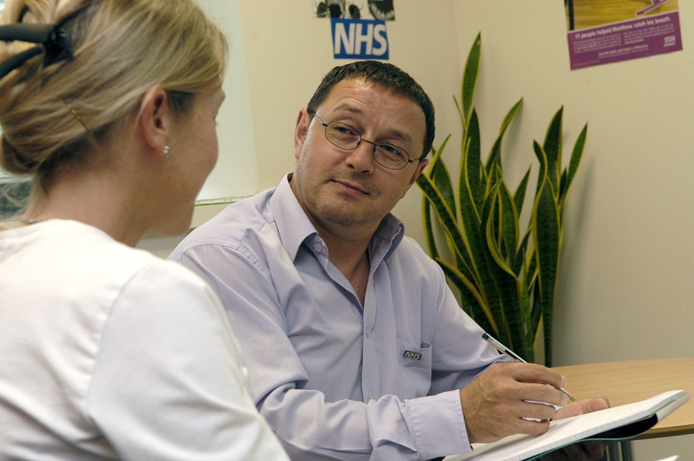
Rehearsing interview and feedback skills - plenary
Notes:
63
The plenary for the feedback exercise is about identifying common themes:
Time goes fast
It is sometimes possible to get into very deep areas even in a very short time
The first appraiser has the most difficult job as good techniques and top tips may be modelled by watching the others perform
What are the themes for this group?
Use the session to affirm skills that the facilitators have observed

Slide 64
Getting ready for day two
Read, reflect and review what you have learnt today.
Share what you are going to prepare for your partial appraisal on day two with your “appraiser” if it has not already been shared before the training
Check the preparation resources in your pack.
Notes:
The better a delegate has prepared the more likely it is that they will be able to use what they have done for their own annual appraisal and the more they will get out of the partial appraisal exercise.
Check that everyone is clear who is going to be appraising whom in the trios
Share the pre-appraisal documentation prior to day two, so that the delegates can prepare for their turn at the appraiser role in each trio for the partial appraisal. If the two days are run consecutively, it is essential to share well in advance of day one, but, in every case, the end of the first day is a chance to check that everyone has everything that they need.
Some training courses may be set up to allow a full appraisal on each other to be undertaken between the two days of the course. Even in these cases it is good to demonstrate skills in a directly observed exercise on day 2.

Slide 65

Questions and answers
Notes:
This is the conclusion and Q&A session. It is important to have dealt with any issues that have been “parked” and to check out a shared understanding and comfort level before delegates depart.

Slide 66

Have a good evening
Notes:
Day one is quite intense and many delegates will have commitments during the evening.
Prompt them to relax in order to assimilate all that they have covered today.
Remind them that the start needs to be prompt for day two.

