Slide 1
Average time taken for different stages
7-10 days from infection to hospitalisation
15-30 days from infection to death or discharge
Infection to symptoms
5 days
Symptoms to hospital admission
2-5 days
Hospital admission to death or discharge from hospital
9-19 days
Indicative timings given, varies significantly by individual

Slide 2
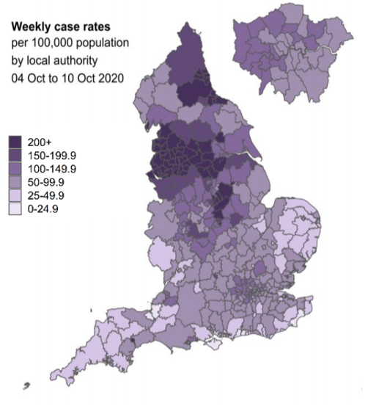
Geographical spread of COVID-19 in England
Start of October
Source: Data from Pillar 1 and 2 testing. Figure by Outbreak Surveillance Team, Public Health England, and ONS 2019 mid-term population estimates

Slide 3
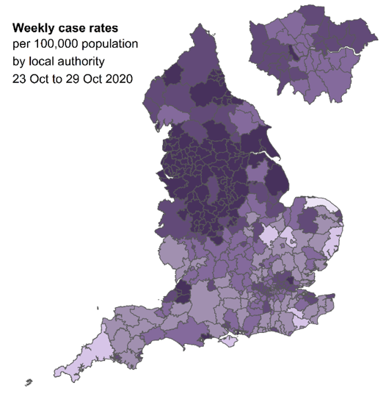
Geographical spread of COVID-19 in England
Start of October
End of October
Darker areas show where cases are higher
Source: Data from Pillar 1 and 2 testing. Figure by Outbreak Surveillance Team, Public Health England, and ONS 2019 mid-term population estimates

Slide 4
Number of people in inpatient beds in England
COVID-19 hospital inpatients since August
10,971
October
September
August
Includes all people in an NHS or independent sector inpatient bed with a positive test for COVID-19.
Source: https://www.england.nhs.uk/statistics/statistical-work-areas/covid-19-hospital-activity/

Slide 5
Number of people in inpatient beds in England per 100,000 population by region,
7 day rolling average from 1 August
COVID-19 hospital inpatients since August
North West
North East and Yorkshire
Midlands
London
East of England
South West
South East
Includes all people in an NHS or independent sector inpatient bed with a positive test for COVID-19.
Source: https://www.england.nhs.uk/statistics/statistical-work-areas/covid-19-hospital-activity/

Slide 6
England new SPI-M combined projection bed usage
Current number of COVID-19 inpatients (acutes)
Current available capacity
Source: https://www.gov.uk/government/publications/slides-to-accompany-coronavirus-press-conference-31-october-2020

