Slide 1
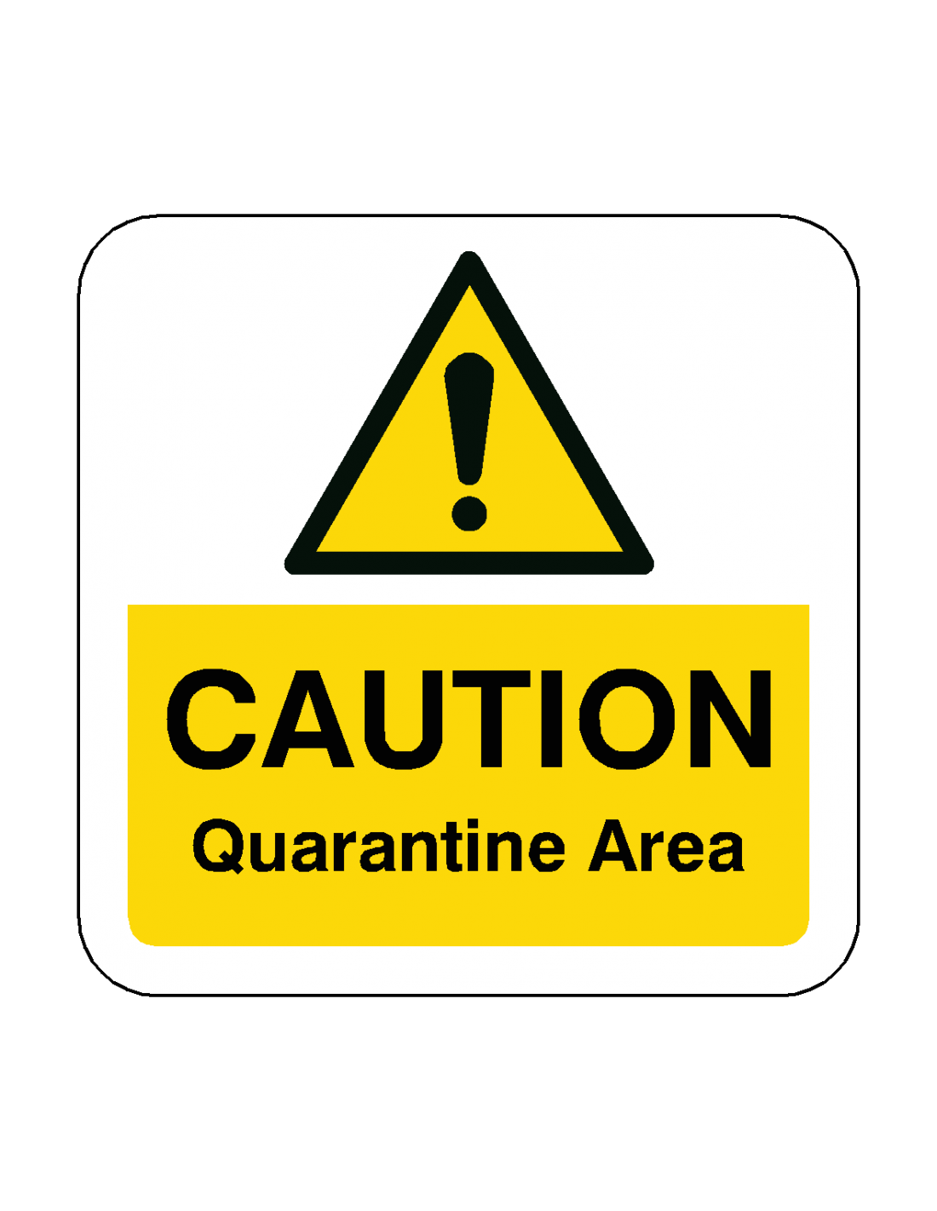
Report a Cold Chain Breach
Don’t dispose of any vaccines or storage equipment.
Quarantine affected vaccines (in a fridge at 2°C to 8°C). Label as ‘not for use’. Do NOT administer to patients.
Note quantity, batch numbers, expiry date, and position in fridge for all affected vaccines. Investigate whether patients were affected.
Contact manufacturers to confirm if any vaccines can be used ‘off label’. Discard vaccinations only in line with manufacturers advice.
Contact your local SIT; see QR code below for website and details.
Report the incident on:
www.immform.dh.gov.uk detailing vaccines wasted and the cause of the incident.
Designed and produced by East of England Screening and Immunisation Team

