Slide 1
Cervical screening quarterly update session
Screening and Immunisation Teams -
East of England
East Anglia (Norfolk and Waveney, Suffolk, Cambridgeshire and Peterborough), Essex,
Hertfordshire, Bedfordshire, Luton and Milton Keynes Screening & Immunisation Team
Presented by: Screening and Immunisation Team
Notes:
Standard title slide

Slide 2
Reminders!
Support sessions for sample takers and cervical screening administrators
East of England (EofE) only
Most of EofE samples are sent to Norfolk and Norwich lab.
A few practices in Essex send to Cervical Screening London (CSL) lab.
A few practices in HBLMK send to Berkshire and Surrey lab.
Questions and comments can be added to the comment box through the meeting.
Please remain muted throughout the meeting.
A reminder that this is not sample taker training, or part of your 3 yearly update training/CPD.
Feedback form- how useful you are finding the sessions? Who is attending? etc..
Relevant slides/Q&A document and certificates of attendance will be available on our Cervical Screening web pages we will NOT be emailing out any slides. This will be available at the latest 30th May.
Notes:
Plain slide with subhead and bullets

Slide 3
Objectives for these sessions
Informal supportive sessions
Platform for issues to be discussed
Update on upcoming changes
Shared learning
To understand the cervical screening programme further
Get to know your Screening and Immunisation Team and the NNUH lab ☺

Slide 4
Our Screening and Immunisation Team
We are one team, however we do cover different areas
Screening and Immunisation Team - Norfolk and Waveney, Cambridgeshire and Peterborough
Jamie Scott- all East Anglia
Leanne Mann - Norfolk and Waveney
Melanie Vincent - Suffolk and Northeast Essex
Claire Wright - Cambridgeshire and Peterborough (Maternity leave)
Screening and Immunisation Team – Essex (and Suffolk)
Hayley McCarthy - all Essex and Suffolk
Tom Davis - Mid and South Essex
Screening and Immunisation Team - Hertfordshire, Bedfordshire, Luton and Milton Keynes Screening & Immunisation Team
Olivia Morgans - HBLMK and West Essex

Slide 5
National screening programmes
Adult and young person screening programmes
AAA screening
Diabetic eye screening
Cancer screening programmes
Bowel cancer screening
Breast screening
Cervical screening
Antenatal and newborn screening
Sickle cell and thalassaemia screening
Infectious diseases screening
Fetal anomaly screening
Newborn hearing screening
Newborn and infant physical examination
Newborn blood spot screening

Slide 6
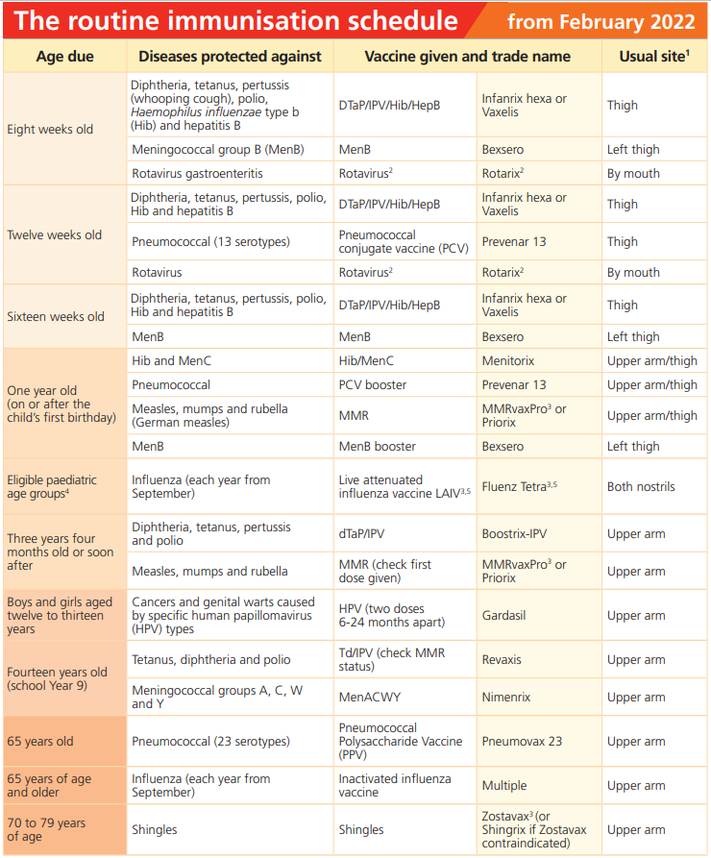
Travel and OH vaccines not S7a
https://www.gov.uk/government/publications/the-complete-routine-immunisation-schedule
Immunisation against infectious disease - GOV.UK (www.gov.uk

Slide 7
Welcome!
Today’s discussion points
Screening and Immunisation Teams new website
Eve Appeal- Helen Hyndman
Transgender patients
Cervical Screening Management System
Patients who have been seen in Colposcopy
Please remember…
Next sessions
useful email addresses

Slide 8
The Eve Appeal

Slide 9
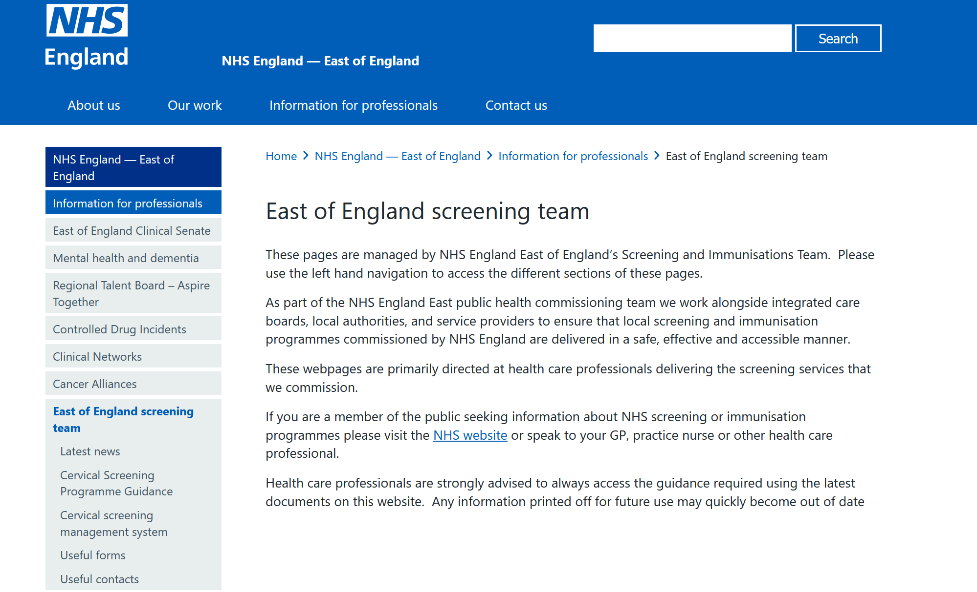
Updates
We have developed a series EoE Screening web pages where you can access Guidance/Forms/contacts/latest news. Please check regularly for updates

Slide 10
Trans men and non-binary people assigned female at birth
Registered with a GP as female
If a patient is between the age of 25 to 64 and registered with a GP as female, they will be routinely invited for cervical screening.
Registered with a GP as male
If a patient is between the age 25 to 64 and registered with a GP as male, they not be automatically invited for cervical screening. However, if the patient has not had a total hysterectomy and still has a cervix, they should still be invited for cervical screening. Patients can now be registered as male and ‘opt in’ to receive routine cervical screening invitations. These patients will then be included in the national call/recall database and will be routinely invited for screening.
Taking a sample
If you take a sample for a transgender patient, please state this clearly on the request form. Sample takers can now generate a request for cervical screening for trans gender patients using ICE/ ICE-NI.

Slide 11
New processes
The Screening gender ‘Opt in’ form can be found on CSAS website- Forms – NHS Cervical Screening Administration Service please follow the guidance on the website.
1. Complete the form electronically.
2. Print the form and add the wet signature.
3. Scan and upload this form via the CSAS online Gender Opt-In submission form which can be found on the GP practices and primary care page of the CSAS website.
4. Keep the original copy in your files. If there is no next test due date supplied, the participant will receive an invite to the programme shortly
The form also includes further information for the patient ‘Opting into the NHS Cervical Screening Programme – information for trans men and non-binary people’ This includes what happens to the patients previous screening history if they have new NHS number.

Slide 12
Trans women and non-binary people assigned male at birth
If your patient is a trans woman or non-binary person assigned male at birth, they will not need to be screened as they do not have a cervix. These patients can be ceased using the ‘No Cervix’ ceasing form on CSAS website or via your PNLs.
Registered with a GP as female
If a patient is registered with a GP as female, they will be routinely invited for cervical screening unless CSAS has already been informed they are not eligible.
Registered with a GP as male
If you are registered with a GP as male, you will not be invited for cervical screening.

Slide 13
Cervical Screening Management System
Training on how to use the new NHS Cervical Screening Management System (CSMS) is available on the NHS Learning Hub.
Training is delivered in 2 parts and takes approximately 2 hours to complete. It does not need to be completed in one go.
You can also access the training and guidance here- Guidance for system users - NHS England Digital
Please note all practices should be actioning their prior notification lists (PNLs) regularly as well reviewing non responder lists and sending further communication to the relevant patients. These should be actioned weekly.

Slide 14
Patients who have been seen in Colposcopy
Any patient who is referred to colposcopy is automatically put on a 12-month recall on the CSMS. This is a failsafe and within that time the patient will be seen in colposcopy. After the patient has been seen the colposcopy clinic will then discharge the patient and inform CSAS of the patients next test due date depending on their treatment and results. The GP practice will receive a discharge letter that states what the patient has had done and the next steps.
When a patient is referred to colposcopy, they will be assessed and may require further treatment. Once this has taken place a number of patients will require their follow up cervical screening sample to be taken in colposcopy rather than routinely at their GP practice.
These patients will still appear on your GP system and may also appear on your PNLs to inform you they need to be called for screening. It is very important that these patients are seen in colposcopy for the smear test rather than their GP practice.
Please make sure that when you answer your PNLs that you are checking to see if patients is still under the care of colposcopy, if so then these patients should not be invited into GP practice for their screening. The patient would have been told they require follow up in colposcopy.

Slide 15
Please remember…
All sample takers need access to:
Cervical Screening Management System (CSMS)
Cervical Sample Taker Database (CSTD)
should use ICE-NI/ICE for request forms. If ICE-NI/ICE is not available, then please use request forms on CSMS.
If taking samples in extended access, please see CSMS forms.
All Sample Taker should use their Sample Taker Code on all request forms (this is issued when you register on the CSTD) rather than your NMC PIN.

Slide 16
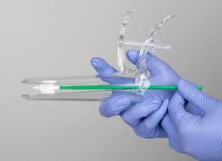
Please remember…
Use ICE-NI/ICE request forms- when a patient is attending their cervical screening appointments make sure that CSMS has been checked for patients correct address and patients' history
Remind younger eligible patients that just because they may have had the HPV vaccine, they should still attend their cervical screening appointment when they are due.
When checking to see if a patient is due for screening, don’t just reply on the practice clinical system, check CSMS

Slide 17
Date of next drop in session
Admin special- 7th July (TBC)
Wednesday 10th September

Slide 18
Screening and Immunisation contact details
East Anglia
Screening: england.ea-phsi@nhs.net Immunisations: england.eaimms@nhs.net
Essex
Screening: england.essexatscreening@nhs.net Immunisations: england.essexatimms@nhs.net
HBLMK Cancer screening: england.cancerscreening@nhs.net
Screening: england.screening1@nhs.net Immunisations: england.immsqa@nhs.net
Website: https://www.england.nhs.uk/east-of-england/information-for-professionals/east-of-england-screening-team/
Notes:
Standard title slide

