Slide 1
Immunisation Lead Drop-in Sessions
May 2025
Lucy Blatch and Mel Vincent
Screening and Immunisation Coordinators
NHSE​

Slide 2
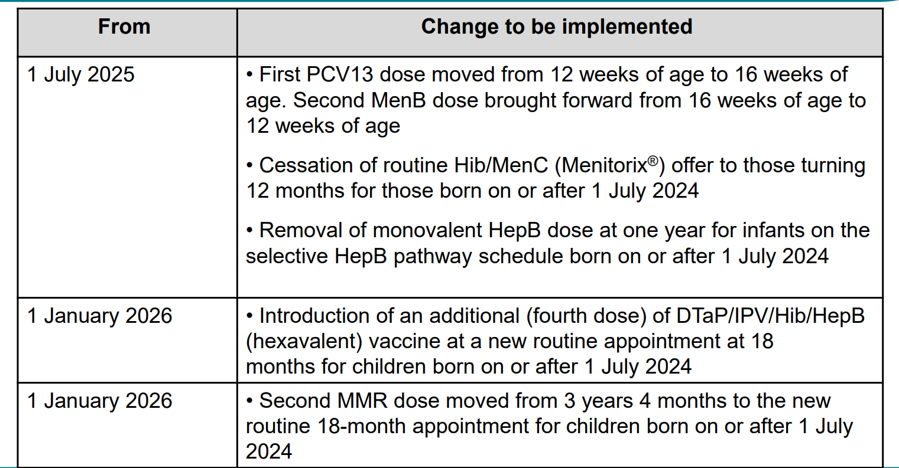
Routine Childhood Schedule Changes
On 30th April UKHSA published a letter detailing the changes to the routine schedule. Some of these changes will begin on 1 July 2025 and others on 1 January 2026.
This session aims to highlight the changes and what that means for you in practice.

Slide 3
Changes to the infant schedule
MenB
From 1 July 2025, changes are being made to the infant schedule at 8, 12
and 16 weeks of age:
• the meningococcal B vaccine, previously offered at 8 and 16 weeks will
be offered at 8 and 12 weeks of age
Following introduction of the routine MenB vaccination the peak of infection has shifted from 5 to 6 months to 1 to 3 months of age. This means it would be beneficial to move the second dose of MenB at 12w to provide earlier protection.
Although previously an 8-week interval between doses of MenB vaccine was recommended, evidence from a recent study showed a good response was made when the 2 doses were given 4 weeks apart

Slide 4
Changes to the infant schedule
PCV
From the 1 July 2025
the pneumococcal conjugate vaccine (PCV13) previously offered at 12
weeks of age will be offered at 16 weeks of age
Moving the PCV dose to 16 weeks avoids increasing the number of injections at the second vaccination
appointment at 12 weeks.
Young children will be protected by very high levels of herd immunity against the pneumococcal vaccine
serotypes until they receive their dose of PCV13 at 16 weeks.

Slide 5
Implementing the changes
From 1 July 2025:
• children who have not yet received their 12-week vaccinations by 1 July 2025, should be
vaccinated as per the new schedule timings (second MenB at 12 weeks and first PCV13
at 16 weeks)
• children who have already received their 12-week PCV13 vaccination prior to 1 July 2025
should remain on the previous schedule and be invited for their second MenB vaccine at
16 weeks of age

Slide 6
Overview of changes in the second year of the routine schedule
Men group C
manufacturing of Hib/MenC (Menitorix®) vaccine has been discontinued
• this is a commercial decision made by the manufacturer (GSK)
• as this is the only Hib/MenC vaccine available, changes to the routine infant schedule are
necessary
• the UKHSA estimates that the central stock of this vaccine will be depleted by mid-2025
• in light of this, after thorough consideration, the JCVI has advised that MenC vaccine is no
longer required in the childhood schedule
• this is due to the success of Meningococcal C containing vaccine programmes and the
subsequent decline of invasive Meningococcal C disease
• a further significant decline in the spread and detection of invasive
meningococcal disease (IMD) was seen because of the implementation of social distancing
and lockdown measures as part of the response to the COVID-19 pandemic
• there is still a continued need for a dose of Hib vaccine during the second year of life
Modelling work found that indirect protection against MenC disease in infants is sustained by the adolescent MenACWY programme (that began in 2015).

Slide 7
Overview of changes in the second year of the routine schedule
Hib
Prior to the introduction of the Haemophilus influenzae type B (Hib) vaccine, about 1 in 600 children
developed Hib disease prior to their fifth birthday.
• in the pre-vaccine era, the most common presentation of invasive Hib disease was meningitis (60% of all
cases), but it also presented as epiglottitis (15%), bacteraemia (10%), septic arthritis, osteomyelitis,
cellulitis, pneumonia and pericarditis
• individuals can carry Hib bacteria in their nose and throat without showing signs of the disease – before
Hib vaccine was introduced, 4% of pre-school children carried the Hib organism
• the Hib vaccine stops children from carrying the organism in their nose and throat and transmitting the
infection to others – after the vaccine was introduced, carriage rates fell below the level of detection
• as a result, since the introduction of the highly successful Hib immunisation programme in the UK in 1992,
disease incidence has fallen in all age groups, not just in those who have been vaccinated
• however, as immunity following a 3-dose primary course of Hib vaccination in infancy wanes, a fourth
(booster) dose during the second year of life is needed to continue to prevent transmission in the
community and maintain herd immunity

Slide 8
Overview of changes beginning 1 January 2026
Hib
The JCVI advised that the following changes should come into effect nationally once the current
supply of Menitorix® vaccine has been exhausted:
• an additional dose of a Hib-containing multivalent vaccine (the hexavalent
DTaP/IPV/Hib/HepB vaccine which is given in infancy) should be administered at age 18
months
• this replaces the Hib component of the Hib/MenC (Menitorix®) vaccine given at 12 months
• it requires the introduction of a new appointment at 18 months of age
• the new 18 months appointment provides an opportunity for the second dose of MMR
vaccine to be brought forward from 3 years 4 months to 18 months of age
• it will also boost protection to the other antigens in the hexavalent vaccine
The JCVI will keep emerging evidence, including ongoing epidemiology and disease incidence under review.

Slide 9
MMR
The new 18 months appointment provides an opportunity for the second dose of MMR vaccine to be brought
forward from 3 years 4 months to 18 months of age
• the main reason for bringing the second dose of MMR forward is to improve coverage and reduce the
likelihood of measles outbreaks
• in areas of London where the second dose of MMR was brought forward in response to local measles
outbreaks in the 2000s, second dose coverage increased by an average of 3.3%
• several London boroughs have continued to administer the second MMR at age 18 months to improve
their vaccine uptake
• the JCVI considers the likely added benefit of increasing uptake of second MMR further justifies the additional routine immunisation appointment
• if the second MMR is not received at 18 months, there is a further opportunity to give it at 3 years and 4 months with the dTaP/IPV booster vaccine

Slide 10
General information
There are no new vaccine products in the amended schedule – the hexavalent vaccine administered at age 18 months is the same vaccine that is given at 8, 2 and 16 weeks of age.
• hexavalent vaccines for the 18-month appointment should be ordered via the
ImmForm website
• monovalent Hepatitis B vaccine for children on the selective HepB
pathway should be ordered directly from the manufacturer
• the UKHSA will publish PGD templates updated in line with the changes to the
childhood schedule (will be available to download from the Immunisation PGD
templates collection webpage)

Slide 11
Timeline and eligibility
All children who have their first birthday on or after 1 July 2025 (DOB
on/after 01/07/24):
• should still be offered first MMR, second PCV13 and third MenB at their oneyear-of-age vaccination appointment but will not be offered Hib/MenC (Menitorix®)
• should be offered a hexavalent (DTaP/IPV/Hib/HepB) booster dose at a new 18-month routine vaccination appointment (starting from 1 January 2026)
• will be offered their second dose of MMR at the 18-month appointment
• should then attend at 3 years 4 months of age for their dTaP/IPV booster vaccine

Slide 12
Timeline and eligibility
Children who turned one year of age on or before 30 June 2025 (DOB
on/before 30/06/24):
• should continue to be offered Menitorix® at their one-year-of-age vaccination
appointment as per the previous schedule along with their first MMR, second
PCV13 and third MenB
• if the national supply of Menitorix® is exhausted before children in this birth
cohort receive it (for children who are late coming for their one-year
vaccines), these children should be offered a hexavalent vaccine instead of
Menitorix® (alongside their PCV13, MenB and first MMR)
These children should then be offered their booster dose of dTaP/IPV vaccine
at 3 years 4 months, along with their second dose of MMR.

Slide 13
Significant messages
manufacturing of the Hib/MenC (Menitorix®) vaccine has been discontinued and stock of this vaccine will be depleted by mid-2025
whilst vaccination against MenC in early childhood is no longer considered necessary, vaccination against Hib in the second year of life needs to continue, the JCVI therefore recommended that an additional dose of a Hib-containing vaccine (DTaP/IPV/Hib/HepB vaccine) should be administered at a new vaccination appointment at age 18 months
this new 18-month appointment also provides an opportunity for the second dose of MMR vaccine to be moved from 3 years 4 months to 18 months of age
from 1 July 2025 Menitorix® will no longer be offered at 12 months and from 1 January 2026, an additional dose of DTaP/IPV/Hib/HepB vaccine will be offered at a new 18-month appointment
additionally, from 1 July 2025, the order of vaccines in the infant schedule will change: MenB vaccine will be given at 8 and 12 weeks and PCV13 will be given at 16 weeks

Slide 15
Routine Childhood Schedule Changes

Slide 16
Resources
Changes to the routine childhood vaccination schedule from 1 July 2025 and 1 January 2026 letter - GOV.UK Letter
Changes to routine childhood immunisation programme: 2025 and 2026 - GOV.UK Slide set
Please continue to review our latest news page on our website as this has up to date information
NHS England — East of England » Vaccination Programme latest news
Joint Committee on Vaccination and Immunisation (JCVI) statement on changes to the childhood immunisation schedule - GOV.UK

Slide 17
Discussion/ Questions?
Notes:
MMR offer for gelatine free Priorix vaccine to all?
Shingles f2f event?
Cold chain- off label vaccine use

Slide 18
End slide
For Immunisation Queries
East Anglia (Norfolk, Suffolk, Cambs & Peterborough): england.eaimms@nhs.net
Hertfordshire, Bedfordshire, Luton and Milton Keynes (HBLMK): england.immsqa@nhs.net
Essex: england.essexatimms@nhs.net

