Slide 1
Deep-dive training session
Vaccine wastage & immunisation incidents
Immunisation team
Herts & WE + BLMK
Notes:
Standard title slide

Slide 2
“Housekeeping”
Ask questions – please use the ‘Chat’.
Confidentiality & professional etiquette.
We work from home and apologise for any unexpected interruptions
The more you interact = the more you will get from the session so please ask questions or share scenarios
Notes:
Plain slide with subhead and bullets

Slide 3
Aims of the session
Quick updates re: expected changes & recording immunisation histories
Reporting vaccine wastage on ImmForm
Incident management
Incident reporting
Reducing incidents
Notes:
Plain slide with subhead and bullets

Slide 4
1. Expected changes – 2025/2026
We will send out comms and update you once changes have been fully “signed off”
Expected end 2025 / early 2026 (awaiting confirmation):
Additional Hib at 18 months
MMR2 brought forward to 18 months (expected to include Varicella – MMRV)
MenC will not be offered at 12 months (due to success of MenACWY)
Extension to the shingles programme (immunosuppressed from 18y, immunocompetent from 50y, + one-off dose to 80+)
Notes:
Plain slide with subhead and bullets

Slide 5
Recording immunisation histories
Please do not scan on immunisation histories
The information needs to be entered onto the record fully
This means it can be coded and “read” by the system
This ensures those with outstanding immunisations are called / recalled appropriately
Also stops people being called when they do not need to be = saving clinical time
Notes:
Plain slide with subhead and bullets

Slide 6
Notes:
Plain slide with subhead and bullets

Slide 7
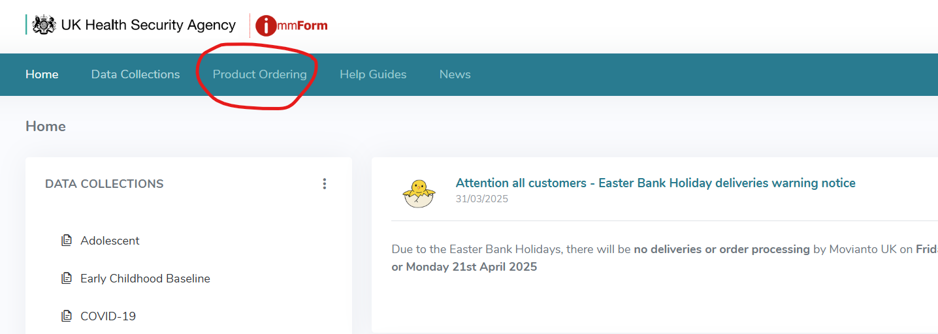
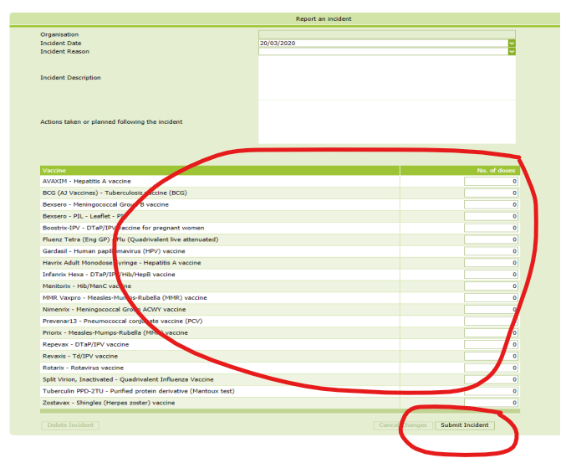
2. Reporting vaccine wastage on ImmForm
Any vaccines ordered through ImmForm which need to be disposed of, UKHSA require a ‘Stock Incident Form’ to be completed on the ImmForm website.
From the ImmForm home page click on ‘Product Ordering’
Navigate to the ‘Stock Incident’ tab and select ‘Add Stock Incident’
The following form allows you to enter, in doses, the lost vaccines
You can select the incident reason from the dropdown box and if required add further information in the incident description
5. Once completed click the ‘Submit’ button.
NOTE:
All English customers should also report the incident to their respective NHS England Screening and Immunisation Team (SIT)
Notes:
Plain slide with subhead and bullets

Slide 8
When to use ImmForm
ImmForm Notification Required | ImmForm Notification NOT Required
If vaccines have expired and need to be discarded | If vaccines have been involved in a cold chain breach but manufacturers have advised they can be used off-label
If vaccines have been involved in a cold chain breach and manufacturers have said they will need to be discarded
Notes:
Plain slide with subhead and bullets

Slide 9
Vaccine wastage
Do NOT discard any vaccine until after discussion with manufacturers and they have confirmed that the vaccines cannot be used.
Any vaccine that must be discarded (instructed by manufacturer) must be reported on ImmForm.
Vaccine wastage cost £5.7 million of NHS funds in 2019, £4.4 million was this avoidable.
The vaccine is referred to as being used ‘off-label’ if it has been stored in a way other than that described in its licence.
The decision to allow the vaccine to be used ‘off-label’ will only be taken if the vaccine is still considered to be safe and effective.
The PGD’s cover off-label vaccine use.
Notes:
Plain slide with subhead and bullets

Slide 10
Off-label use
Off-label: when a medicine / vaccine is used in a way other than what is described in the license (includes storage).
PSDs are NOT required for off-label use!
PGDs cover off-label use (including where vaccines have been involved in a cold chain breach but deemed safe and effective for use by manufacturers).
Immunisers discretion as to whether a patient / parent is told that a vaccine is being given off-label.
Many medicines and some vaccines are given off-label: pertussis vaccine (pregnancy), MenB vaccine (schedule), medication for children (age).
Resources to help with any conversation: off-label use.
Notes:
Plain slide with subhead and bullets

Slide 11
EoE Website
NHS England — East of England » Vaccine and cold chain incident management
Notes:
Plain slide with subhead and bullets

Slide 12
3. Incident management
For vaccines to be safe and effective they must be stored and administered correctly.
Vaccines are sensitive to heat, cold and light.
Limit quantity of stock to that needed for 2 weeks, in case of fridge failure.
Have a nominated cold chain lead.
All practice staff trained and updated on the cold chain and their role – e.g. reception staff receiving vaccines.
All staff know what to do in case of a cold chain breach.
Notes:
Plain slide with subhead and bullets

Slide 13
Excursion / cold chain breach
An “excursion” or cold chain breach, is when vaccines have been out of the cold chain for more than 20 minutes.
Visit: NHS England — East of England » Vaccine and cold chain incident management.
Notes:
Plain slide with subhead and bullets

Slide 14
Immunisation incident
Immunisation-related incident is noted in the practice
Cold Chain Breach
Have you reported the incident to your Screening & Immunisation Team?
Identify patients affected by the incident
≥ 20 mins?
Yes
No
Have all staff received incident / cold chain training?
Communicate to the patient(s) and document the incident – ensure access to medical support if required
Follow the steps in the Cold Chain Policy / Toolkit, available from NHSE Website (toolkit flowchart on next slide)
Ensure fridge, thermometer and data logger are all working and that cold chain is restored and maintained – check training for all staff
Follow the National Vaccine Incident Guidance
Notes:
Plain slide with subhead and bullets

Slide 15
First step – do not dispose of anything involved!
Ensure that none of the potentially affected vaccines are administered to patients
This information is needed for when you speak to the manufacturers
Vaccines should only be discarded if manufacturers advise that is necessary
We can support you - you can contact us at any stage throughout this process
Any vaccine wastage must be reported on ImmForm

Slide 16
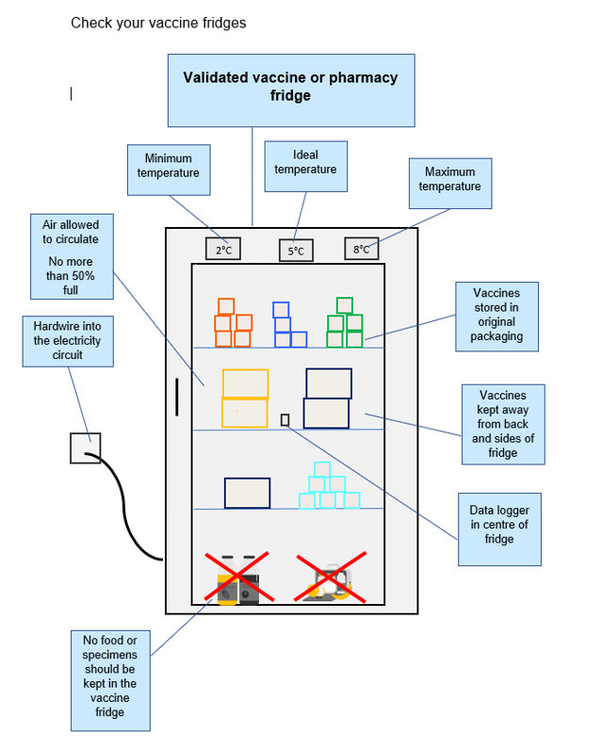
Vaccine storage
Keep vaccines from manufacture to administration:
In a validated vaccine fridge or transporting system at 2-8⁰C, aiming for a midpoint of 5⁰C.
In original packaging to protect from light and other damage.
Away from the back or sides of the fridge, with sufficient space for air to circulate.
Notes:
Plain slide with subhead and bullets

Slide 17
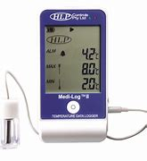
Data loggers
Placed in the centre of the fridge
Data must be downloaded regularly and checked – best practice is daily (at least weekly)
Data is vital in the case of a fridge failure
Do you have data loggers in your vaccine fridges?
Notes:
Plain slide with subhead and bullets

Slide 18
Vaccine stability
Modern vaccines are created to be stable!
Cold chain policy: do NOT discard any vaccines until after speaking with the manufacturers.
Stability data (SPS tool) demonstrates the stability of most vaccines that are used in the routine schedule.
SPS tool can be used as additional knowledge but should not replace contacting the manufacturers.
Link: SPS Stability Tool.
Notes:
Plain slide with subhead and bullets

Slide 19
Infanrix Hexa DTaP/IPV/Hib/HepB 8, 12 & 16 weeks

Slide 20
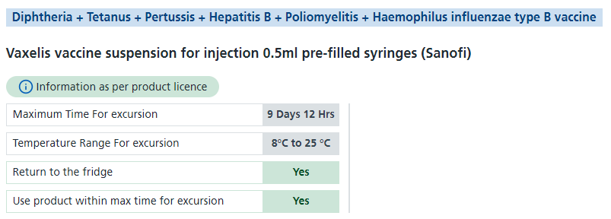
Vaxelis DTaP/IPV/Hib/HepB 8, 12 & 16 weeks

Slide 21
Shingrix Shingles 65 years

Slide 22
4. Incident reporting
All incidents need to be reported somewhere!
Type | Manufacturers | Screening & Immunisation Team | ImmForm | Within the practice
Immunisation incident, i.e. administration | ✓* | ✓ | ✗ | ✓
Cold chain breach | ✓ | ✓ | ✓* | ✓
Expired stock | ✗* | ✗* | ✓ | ✓
Errors do happen! Please contact us for support: england@immsqa@nhs.net
Notes:
Plain slide with subhead and bullets

Slide 23
How to report
If there has been an immunisation-related incident in your practice, contact the Screening & Immunisation Team (SIT) within NHS England for support and guidance: england.immsqa@nhs.net
Links to all resources, i.e. cold chain policy, toolkit, national guidance, etc. can be found here: NHSE Vaccine and Cold Chain Incident Management
Incident reporting form can be found here: NHSE Incident Form
When appropriate to do so, please complete an incident form and send to either england.immsqa@nhs.net (SIT direct team inbox) or to our Regional Vaccination Operational Centre (RVOC): england.eoe-vacprg@nhs.net
Please ensure that you are available to answer any requests for further information or outcome(s), or copy a colleague

Slide 24
Reducing incidents
How to prevent incidents?
Ensure enough clinic time to minimise risk of errors
Awareness of admin and reception staff – booking into correct clinic space (with correct interval!)
Check you have the right patient
Double check – what has the patient come for? Check the record (what have they already had? Is this immunisation due?)
Check you have the right vaccine (check condition, expiry date, any preparation required, that it has been stored correctly)

Slide 25
Reducing incidents
8 R’s
Right patient ✓
Right vaccine (and diluent where applicable) ✓
Right to give (no contraindications, and consent) ✓
Right time (age, interval, expiry date of vaccine) ✓
Right dose ✓
Right route (check needle gauge, length and technique) ✓
Right site ✓
Right documentation (what patient has already had / needs and any contraindications) ✓

Slide 26
The 8 R’s!
RCN best practice guidelines: 009-860.pdf

Slide 27
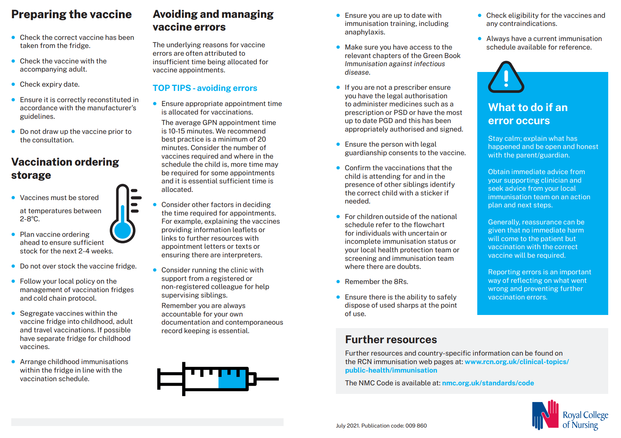

Slide 31
Scenario
A baby is travelling for a month – can I administer the 16-week immunisations early?
If advice has been sought beforehand and information is shared with parents to make an informed choice, and this is recorded – this would not need to be treated as an incident.
Advice: National Vaccine Incident Guidance
Imms due at 16-weeks: hexavalent & MenB
Hexavalent advice: If one of these doses is given up to a week early, either inadvertently or deliberately, for example, for travel reasons, then this can be counted as a valid dose and does not need to be repeated. However, no more than one dose should be given early in the 3-dose schedule.
MenB advice: Where Men B has inadvertently been given at less than an 8-week interval, an additional dose should be administered 4 weeks after the inadvertent dose was given to provide protection at a vulnerable age. (As the vaccine was trialled and licensed as a 3-dose schedule given at least one month apart in infancy, an additional dose is acceptable and would not be expected to produce side effects beyond what may be seen following the first or second dose). Dependent on duration of travel, parents may wish to postpone MenB until they return.

Slide 32
Scenario
Baby has received 12-week imms 3 weeks, 2 days after 8-week imms – what do I need to do?
This would be classed as an incident as it was an error – not planned, not an informed choice = follow incident management process.
Advice: National Vaccine Incident Guidance
Imms due at 12-weeks: hexavalent, PCV & rotavirus
Hexavalent advice: If one of these doses is given up to a week early, either inadvertently or deliberately, for example, for travel reasons, then this can be counted as a valid dose and does not need to be repeated. However, no more than one dose should be given early in the 3-dose schedule.
PCV advice: Where PCV has inadvertently been given at less than an 8-week interval, an additional dose should be administered 4 weeks after the inadvertent dose was given to provide protection at a vulnerable age (same advice as MenB).
Rotavirus advice: If a second dose of rotavirus vaccine is inadvertently given from 3 weeks after the first, no further doses are required as viral replication is likely to have occurred within this period. (If the interval between the 2 doses is less than 3 weeks, the infant should receive an additional dose of rotavirus vaccine at least 4 weeks from the first dose given and as long as the infant is still under 24 weeks of age at the time of the additional dose).

Slide 33
Scenario
Baby on the selective HepB pathway – missed 4-week monovalent dose, is now 6 weeks, 2 days and has received monovalent dose – what do I need to do?
This would be classed as an incident as it was an error – not planned, not an informed choice = follow incident management process.
Advice: National Vaccine Incident Guidance and Info4HP – Hexa
Birth, 4-week and 8-week doses should stimulate immunity to prevent virus replicating to high levels.
Doses at 12- and 16-weeks (& 1-year) help to provide longer term protection.
Where an early dose, i.e. 4-week, is missed = may increase the risk of the child becoming infected but cannot be reversed with additional doses.
If baby < 6 weeks = monovalent HepB (give 8-week imms at 8-weeks as normal).
If baby ≥ 6 weeks = do not give monovalent HepB – give 8 week-imms at this age (second and third hexa and rotavirus doses adhere to 4-week interval, MenB adhere to 8-week interval, with HepB booster at 1-year).
Testing of these children at 12 months is vital to check whether they were infected early in life as they missed an early dose.

Slide 34
Notes:
Plain slide with subhead and bullets

Slide 35
Questions…
Questions in the chat or hands up
Any other questions?
Notes:
Plain slide with subhead and bullets

Slide 36
Notes:
Plain slide with subhead and bullets

Slide 37
E-mail: england.immsqa@nhs.net
Website: NHS England — East of England Slides and certificates will be uploaded here
Training created in accordance with Immunisation training standards for healthcare practitioners - GOV.UK

