Slide 1
Immunisation training
Registered Immunisers
Immunisation team
Herts & WE + BLMK
Notes:
Standard title slide

Slide 2
“Housekeeping”
Ask questions – please use the ‘Chat’.
Move around / go to the toilet / answer a phone call: mute, turn off your camera & rejoin us when you can.
Please ensure your speakers are on and volume turned up for the videos. If you are unable to hear the videos, it may be your speakers, or your organisation’s IT policy (VPN).
Confidentiality & professional etiquette.
Potentially distressing images / videos.
Certificates and the slides will be uploaded to our website after the session
We work from home and apologise for any unexpected interruptions
Notes:
Plain slide with subhead and bullets

Slide 3
Aims of the session
Recap on knowledge of immunisations
Discuss incident management
To share updates on the programme
To understand who delivers which parts of the programme
To understand your role in relation to immunisations
Notes:
Plain slide with subhead and bullets

Slide 4
Delivery of immunisations
JCVI
UKHSA
NHSE
Providers

Slide 5
Childhood routine immunisations
Team inbox
Training sessions
Newsletter
EoE Maternity Imms Forum
Incident support
Flu commentary
PGDs
Non-responder pathway
CHIS (RAG rated / MMR)
CSAIS (maternity & schools)
FDP (RAVS / NIVS)
Immunisation Boards
COVER stats
DPH report
This is why you are “here” today!
Improving immunisations
Data / Reporting
Supporting providers
Collaboration
Evolving practice
Selective immunisations
Maternity immunisations
ICB & NHSE action plans
School’s Groups
Maternity Imms Group (HWE / BLMK)
GP / Pharmacy flu project
CHIS – waiting lists
Flu planning group
NHSE & UKHSA meetings
GRT project
SEND project
Learning from incidents
Paeds imms service
Call & Recall service
Communicating & supporting changes to immunisation programmes
Adult immunisations

Slide 6
Immunisation Queries - Inbox
england.immsqa@nhs.net
Generic inbox, managed by the Screening & Immunisation Team (SIT).
For professional immunisation queries only, please do not share with patients / parents.
No patient identifiable information / details (PII / PID).
Aim to respond within 2 working days.
Child Health Information System / CHIS is not public-facing service – please do not share telephone numbers with parents / patients.
Notes:
Plain slide with subhead and bullets

Slide 7
Why we immunise and background of vaccination programmes

Slide 8
The 2 public health interventions that have had the greatest impact on the world’s health are clean water and vaccines.
“
”
World Health Organization (WHO)

Slide 9
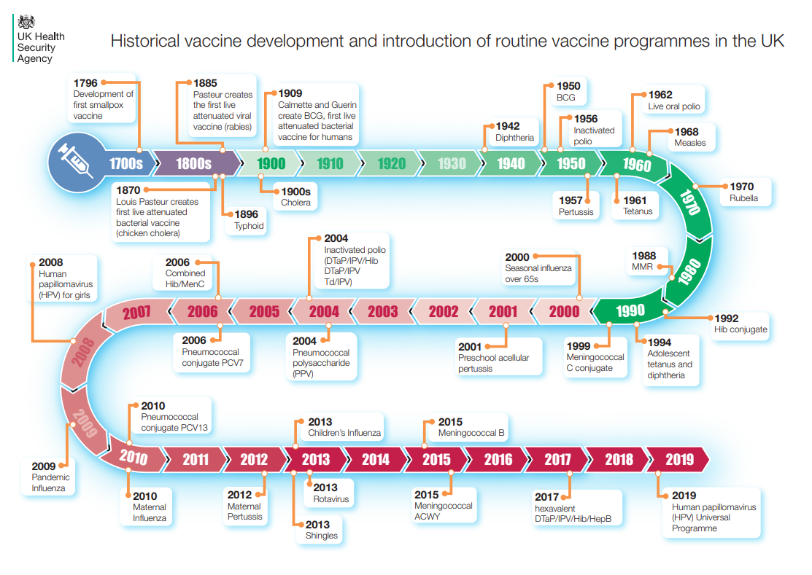
Notes:
Plain slide with subhead and bullets

Slide 10
How do vaccines work?
https://youtu.be/-muIoWofsCE?si=TISHNs48khnnNV4-
Notes:
Plain slide with subhead and bullets

Slide 11
Why do we immunise?
Immunisations don’t just protect the people receiving them, but also their family and community.
Immunisations protect all of us by eliminating infections from the country.
This is also known as “herd immunity”.
“Herd immunity” is only reached if uptake is ≥95%.
Notes:
Plain slide with subhead and bullets

Slide 12
Herd Immunity
https://youtu.be/8BUCi5Tuzms?si=_BrII_D6_KWZSSXF
Notes:
Plain slide with subhead and bullets

Slide 13
Barriers to immunisation
Duration of appointments – lack of time
Lack of availability of appointments – not out of traditional working hours
Booking systems – long waits on the phone
Staff shortages
Clinical priorities
Under-served communities / inclusion health groups
Non-English-speaking families / different cultures and beliefs
Knowing which service undertakes which part of the programme
Organisational culture (does your organisation see immunisations as a priority?)
Notes:
Plain slide with subhead and bullets

Slide 14
A world without vaccines
https://youtu.be/yi7gyTqweZc?si=egQ7MqTKtAs3FNW4
Notes:
Plain slide with subhead and bullets

Slide 15
The UK vaccination schedule

Slide 16
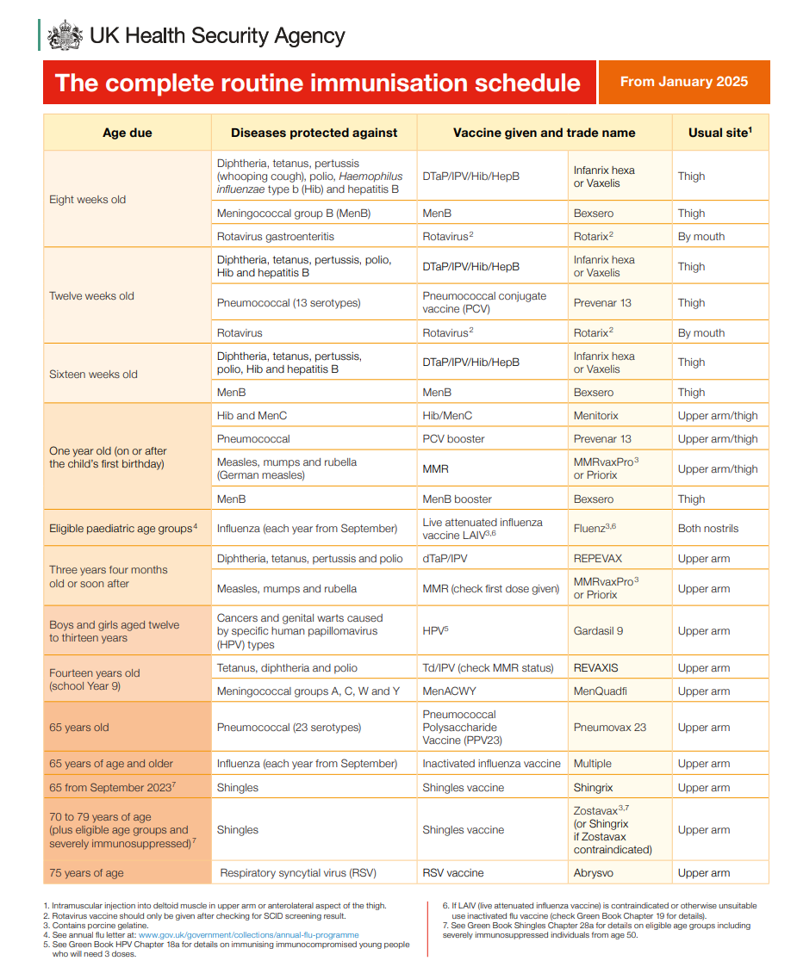
The complete routine immunisation schedule from Jan 2025
Notes:
Plain slide with subhead and bullets

Slide 17
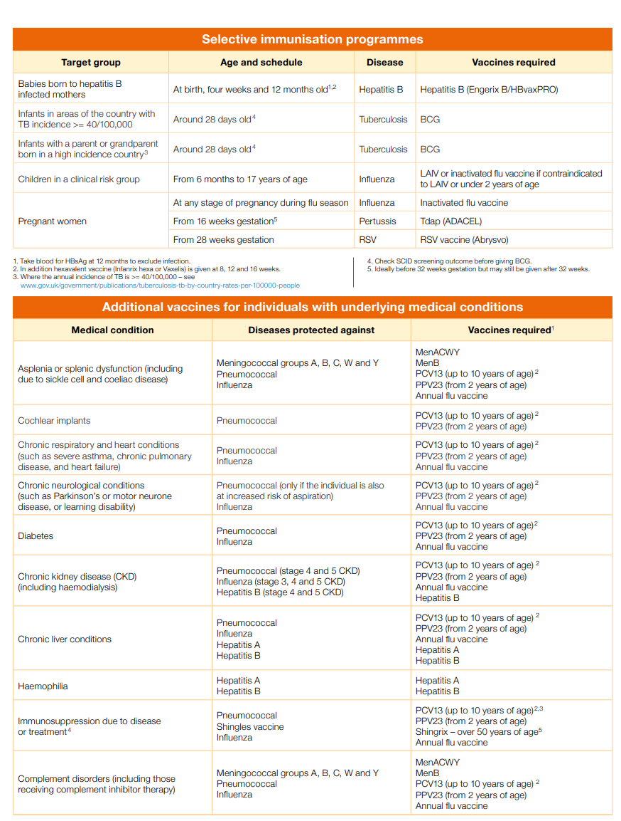

Slide 18
Expected changes – 2025/2026
Expected end 2025/ early 2026 (awaiting confirmation):
Additional Hib at 18 months.
MMR2 brought forward to 18 months (expected to include Varicella – MMRV)
MenC will not be offered at 12 months (due to success of MenACWY).
Notes:
Plain slide with subhead and bullets

Slide 19
Possible further expansion to the shingles programme
JVCI recommendations – not yet put into practice
Bringing the age for those with immunosuppression down to 18 years, those who are immunocompetent to 50 years.
Expanding the programme to those age 80+ - could be a one-off dose of Shingrix.
(These are published JVCI recommendations but have no start date or implementation plan yet).

Slide 20
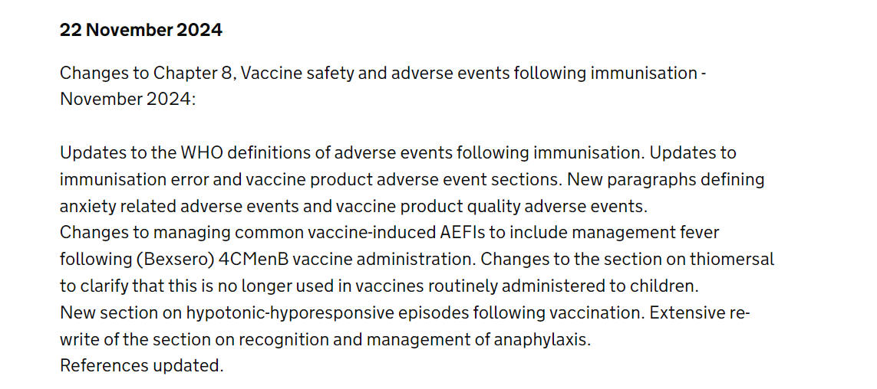
Green Book Updates Nov - 2024
Chapter 2: Consent

Slide 22
Changes to the incomplete immunisations schedule
OPV update
Awaiting updated Green Book chapter to reflect this change
F/IPV (fractional IPV), also needs to be discounted as a dose as per the National immunisation team

Slide 23
Timings of immunisation
Routine immunisation schedule is NOT random.
Timings of immunisations are scheduled according to when the individual is MOST vulnerable to the virus / disease.
This is why immunisations should NOT be delayed.
Takes approximately 2 weeks following immunisation for a satisfactory immune response.
Notes:
There are some adjustments and considerations such as giving early due to long period of travel. Always consult the Green Book or us prior to giving

Slide 24
Vaccines and disease groups

Slide 25
Use of Paracetamol (Calpol)
Fever can be expected after any vaccination, but more common after MenB (offered at 8 & 16 weeks and 1 year).
Give paracetamol soon after MenB vaccination, not before and not waiting for the fever to develop.
Paracetamol is only for use from 2 months of age onwards (and if over 4kg).
For premature babies, a prescription can be requested if needed (based on weight) from GP/prescriber.
Paracetamol should not be given routinely for any other immunisations as its use has not been shown to prevent febrile convulsions but may lower the antibody response to a vaccine.
Notes:
Plain slide with subhead and bullets

Slide 26
Porcine Gelatine
Vaccine Ingredients
Collagen from pigs.
Used in some vaccines as a stabiliser.
Muslim and Jewish groups (and some others) may consider any medicines / vaccines containing any porcine (pork) products to be forbidden.
Notes:
Plain slide with subhead and bullets

Slide 27
Porcine Gelatine - Vaccines
Vaccines containing porcine | Protects against… | Porcine-free alternative
Fluenz (nasal flu vaccine for children) | Flu | Inactivated flu vaccine (not nasal, and not as effective)
MMRVaxPro | Measles, mumps & rubella | Priorix
Varivax | Chickenpox | Varilrix
Notes:
Plain slide with subhead and bullets

Slide 28
Thiomersal – giving context
A compound containing ethyl mercury.
Used as a preservative for vaccines - to prevent bacterial and fungal growth in multi-dose vials.
In many countries, a preservative is a regulatory requirement.
There is no evidence to suggest that the amount of thiomersal used in vaccines poses a health risk (World Health Organization).
Thiomersal doesn't have the same chemical structure as the mercury that can contaminate fish and build up in the body. That is methyl mercury, which can cause major health issues.
Notes:
Plain slide with subhead and bullets

Slide 29
Thiomersal & vaccines in UK
Most single-dose vaccines do not contain thiomersal because they are used only once – very little risk of contamination.
Thiomersal was removed from UK vaccines between 2003 and 2005.
No longer found in any of the childhood or adult vaccines routinely used in the UK.
In the US, UK and Europe, thiomersal was removed from vaccines as a precaution. However, there was no evidence that thiomersal in vaccines caused harm.
Notes:
Plain slide with subhead and bullets

Slide 30
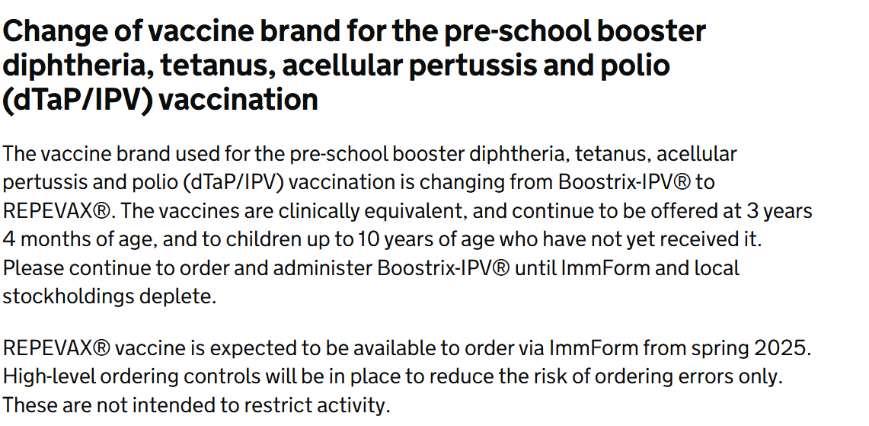
Change of vaccine for PSB

Slide 31
MenACWY Vaccine
MenACWY vaccine changing from Nimenrix to MenQuadfi from 1st September 2024. MenQuadfi is a prefilled syringe, so no reconstitution is needed, but does not come with needles. Needles will need to be procured by providers through their usual procurement routes as part of consumables. Existing PGD applies as already covers use of MenQuadfi.

Slide 32
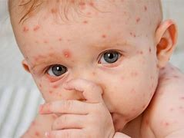
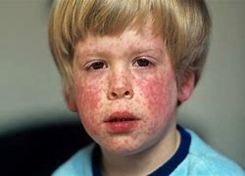
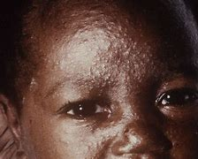
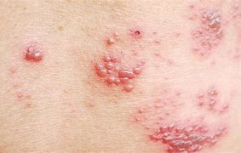
Can you identify these…?
Measles
Chickenpox (Varicella Zoster)
Rubella (German Measles)
Measles
Shingles (Herpes Zoster)
Notes:
Plain slide with subhead and bullets

Slide 33
Measles
https://youtu.be/sCi2CLo6wdQ?si=1RTlS0aby6k6TCUj
**Video from 2018
Notes:
Plain slide with subhead and bullets

Slide 34
Case numbers
Since 1 October 2023, in England there have been 1109 laboratory confirmed measles cases:
17 cases were reported in October 2023
41 in November 2023
153 in December 2023
274 in January 2024
253 in February 2024
299 in March 2024
72 (to date) in April 2024
The majority (706 of 1109, 63.7%) of these cases were in children aged 10 years and under, and 28.8% (319 of 1109) in young people and adults aged 15 years and over.
Latest measles statistics published - GOV.UK (www.gov.uk)
Notes:
Plain slide with subhead and bullets

Slide 35
Suspected cases
Any suspected case of measles MUST be notified to the Health Protection Team (HPT).
Careful management of suspected cases is crucial to prevent the spread of the virus.
HPTs provide support to health professionals, undertake local disease surveillance, investigate and manage health protection incidents.
Email: PHE.EoEHPT@nhs.net
Tel: 0300 303 8537
Notes:
Plain slide with subhead and bullets

Slide 36
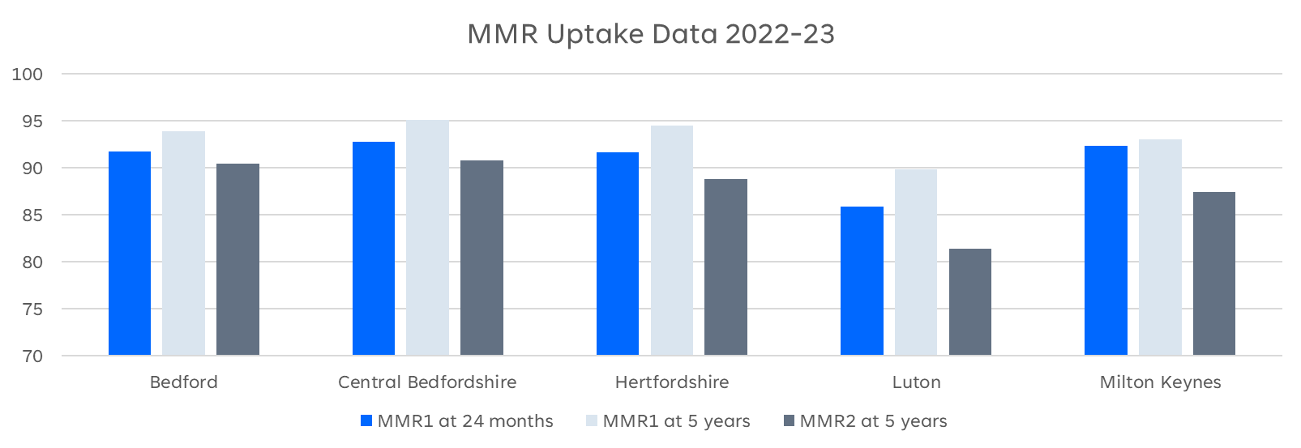
MMR Uptake
Notes:
Plain slide with subhead and bullets

Slide 37
MMR
Measles: one dose of vaccine is 95% effective in preventing measles.
This is why the first dose is so important (at 12-13 months).
Mumps: one dose is 72% effective, rising to 86% after two doses.
Rubella: one dose is 89% effective.
Notes:
Plain slide with subhead and bullets

Slide 38
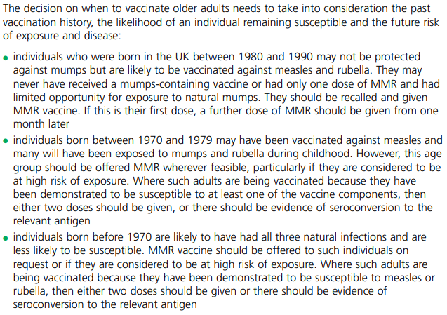
MMR
Current guidance is that staff should have a record of having x2 measles-containing vaccines.
Measles: the green book, chapter 21 - GOV.UK
Notes:
Plain slide with subhead and bullets

Slide 39
MMR and Rubella immunity
Frequently asked question!
Though the Green Book says that 2x MMR is enough, UKHSA have advised that 1x further MMR can be given in special circumstances.
If a patient has had an immunity test – for example prior to fertility treatment, one extra dose of MMR can be given – for reassurance purposes.
No further doses or immunity tests are recommended.

Slide 40
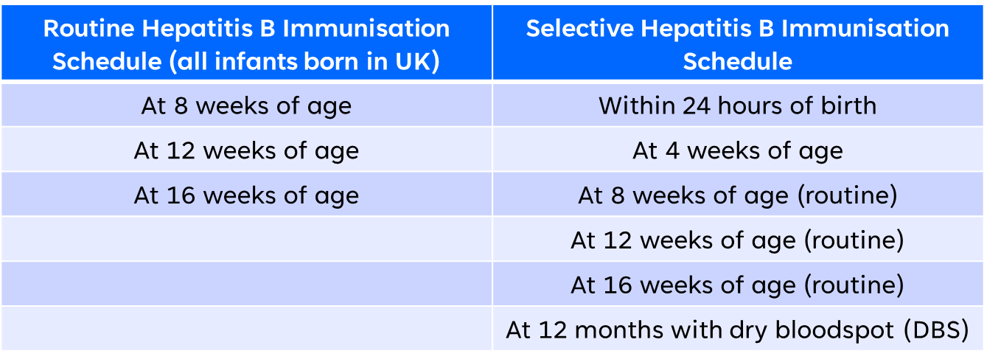
Hep B
Infants born to mothers who screened positive in pregnancy for Hepatitis B are offered the selective Hep B immunisation schedule.
Infants born to HepB+ fathers = 1 dose of HepB vaccine prior to discharge from hospital
The 4 week and 12-month doses/DBS are administered by CSAIS in our region
Notes:
CSAIS will keep on books up to age 5 and continue to invite

Slide 41
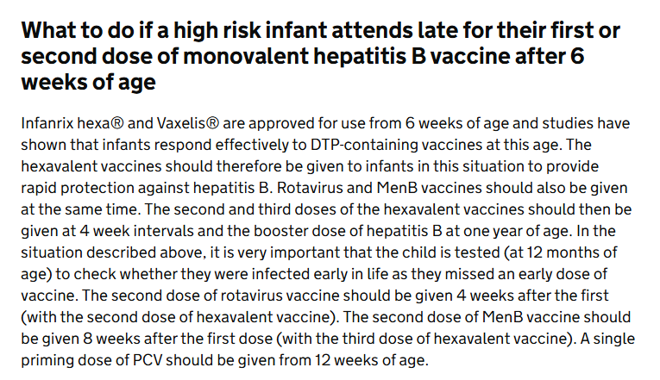
**Important Reminder**
Hep B must be given at 6 weeks in practice if missed 4-week dose.
Hexavalent DTaP/IPV/Hib/HepB combination vaccine: information for healthcare practitioners - GOV.UK

Slide 42
BCG
BCG vaccination is recommended for babies (at 28 days old) who are at higher risk of contracting TB (SCID result must be checked), such as those who:
are born in areas of the UK where TB rates are high;
have a parent or grandparent who was born in a country where there's a high rate of TB;
live with, or are close contacts of, someone with infectious TB.
You can check high incidence countries here.
Hertfordshire Community Trust (HCT) CSAIS provides BCG vaccination for HBLMK and West Essex.
They accept referrals for any child up until their 16th birthday, who meets one of the above criteria.
Notes:
Plain slide with subhead and bullets

Slide 44
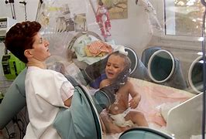
SCID
Severe combined immunodeficiency (SCID)
Group of rare, inherited disorders.
Affected infants become seriously unwell in the first few months of life.
Without treatment, these children usually die by 2 years of age.
Pilot of screening began in September 2021, in targeted areas (awaiting evaluation).
SCID results (if part of the pilot) should be known before administering a live vaccine (i.e., Rotavirus, BCG, MMR, nasal Flu, Chickenpox).
All practitioners should check for a result whether they are in the pilot area or not
If no SCID result can be found – vaccination can go ahead (as per Rotavirus HCP guide Rotavirus vaccination programme: information for healthcare professionals - GOV.UK)
Notes:
Plain slide with subhead and bullets

Slide 45
Pertussis
Pertussis or whooping cough is a highly infectious disease which can lead to serious complications including death.
The disease is especially severe in newborn babies and is a major cause of infant death worldwide.
World Health Organization (WHO) estimated that in 2008 there were 16 million cases of pertussis, and 195,000 children died from the disease.
WHO estimated that global vaccination against pertussis averted about 687,000 deaths in the same year.
In 2012 the UK experienced a nationwide outbreak (epidemic) of pertussis. There were over 9,300 cases in England alone – more than ten times as many as in recent years.
Notes:
Plain slide with subhead and bullets

Slide 46
Cases
Have seen an increase in the number of cases of pertussis in England:
The increase in cases occurred across all age groups including the <1-year olds and sadly 10 infant deaths Jan – Dec 2024 in England.
Time period | No. of cases (Pertussis / Whooping Cough)
2023 | 858
Jan – Dec 2024 | 14,905
Confirmed cases of pertussis in England by month - GOV.UK (www.gov.uk)​
Notes:
Plain slide with subhead and bullets

Slide 47
Pertussis vaccine uptake
Notes:
Plain slide with subhead and bullets

Slide 48
Notes:
Plain slide with subhead and bullets

Slide 49
Pertussis vaccine safety
A study of 20,000 pregnant people who had received a pertussis vaccine in the UK compared with a matched, historical unvaccinated cohort of pregnant women in the UK.
No increased risk was found when compared to historical and unvaccinated controls for:​
Stillbirth/Neonatal death ​
Pre-eclampsia/Eclampsia
Placenta praevia ​
Intra-uterine growth restriction/Low birth weight
Caesarean section​
Postpartum haemorrhage
Premature labour ​
Safety of pertussis vaccination in pregnant women in UK: observational study | The BMJ
Notes:
Plain slide with subhead and bullets

Slide 50
Pertussis vaccine side effects
Most Common: redness, pain, swelling at the injection site​
Less Common: pyrexia (>37.5⁰C), haematoma, induration (skin hardening), pruritus (itchy skin) and warmth at the injection site​
Uncommon: swelling of vaccinated limb, pyrexia (>39.5⁰C), chills, pain​.
Safety of pertussis vaccination in pregnant women in UK: observational study | The BMJ
Notes:
Plain slide with subhead and bullets

Slide 51
Let’s have a break!
Notes:
Plain slide with subhead and bullets

Slide 52
*Trigger warning*
Notes:
Plain slide with subhead and bullets

Slide 53
Immunisations in pregnancy
Flu vaccine – all pregnant people are eligible at any stage during their pregnancy throughout flu season (1st September – 31st March).
Pertussis vaccine (whooping cough) – all pregnant people are eligible from 16 weeks – 32 weeks gestation ideally (available all year). Can be given up to 2 months post-birth.
COVID vaccine – Autumn programme
NEW – RSV vaccine (eligible from 28 weeks gestation up until birth, ideally given by 36 weeks).
Notes:
Plain slide with subhead and bullets

Slide 54
Why we vaccinate in pregnancy
Children in early infancy do not have effective antibody responses to many vaccines.
Results in increased susceptibility or severity infections.
Vaccine-preventable infections are among the leading causes of morbidity in pregnant people.
Immunisation during pregnancy generates maternal immune protection as well as transfer of antibodies across the placenta and via breastfeeding to provide early infant protection (before they reach the age to get their vaccines).
Notes:
Plain slide with subhead and bullets

Slide 55
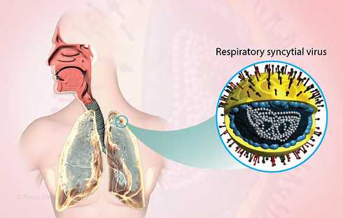
RSV
Respiratory syncytial virus.
Viral pathogen - respiratory infections, can trigger pneumonia or bronchiolitis, characterised by inflammation in the airways.
Very common - globally, infects up to 90% of children within the first 2 years of life and frequently reinfects older children and adults.
More common during winter, especially in temperate countries like the UK.
Roughly 33 million cases, 3.6 million hospital admissions, and 100,000 deaths globally each year in children under 5 years old.
Second largest infectious cause of death in children under one year of age, after malaria.
Notes:
Plain slide with subhead and bullets

Slide 56
RSV vaccine
JCVI recommendation - maternal vaccination programme –started September 2024.
RSV vaccine cannot routinely be given at the same time as pertussis, so it’s going to be vital to keep motivation for vaccination high, so that we can save babies lives​.
As with Pertussis, RSV vaccine needs to be offered for each pregnancy that an individual has – “every baby needs the protection, so every pregnancy needs the vaccine!”
Notes:
Plain slide with subhead and bullets

Slide 57
RSV Incidents
Increase of immunisations being given below 28 weeks gestation
Even if advised by a midwife – RSV is to be given after 28 weeks gestation
Anything under this is classed as an incident and needs to be reported to us
Vaccine needs to be repeated if given under 16 weeks gestation

Slide 58
RSV Coding
Some babies receive Palivizumab (or similar treatment) in hospital
This is an immunoglobulin treatment and not a vaccine
It should not be recorded as “RSV vaccine”, as this then causes reports to show children receiving Abryvso
The correct SNOMED code is:

Slide 59
Clinical trial
Notes:
Plain slide with subhead and bullets

Slide 60
RSV programmes
Programme was introduced on 1st September 2024.
Pregnant people: vaccinated in maternity units, community clinics and GP practices.
Pregnant women can have Abrysvo® co-administered with inactivated influenza vaccine, COVID-19 vaccine and/or anti-D immunoglobulin, if necessary. When more than one vaccine is administered, it should be at different sites, preferably different limbs.
If a pertussis containing vaccine has not been given by the time of attendance for RSV vaccine, both vaccines can be given at the same appointment to ensure prompt development of immune response (but not routinely scheduled to be given together).
Protection is effective for approx. 6 months (i.e. the period of greatest vulnerability)​.
Pregnant people: vaccinated from 28 weeks gestation up until birth (for every pregnancy). Abrysvo®
Older adults (75+): vaccinated on or after 75th birthday (with an initial catch-up for those 75 to 79 on 1st September 2024). Abrysvo®
Introduction of new NHS vaccination programmes against respiratory syncytial virus (RSV) - GOV.UK (www.gov.uk)
Respiratory syncytial virus (RSV) immunisation programme for infants and older adults: JCVI full statement, 11 September 2023 - GOV.UK (www.gov.uk)

Slide 61
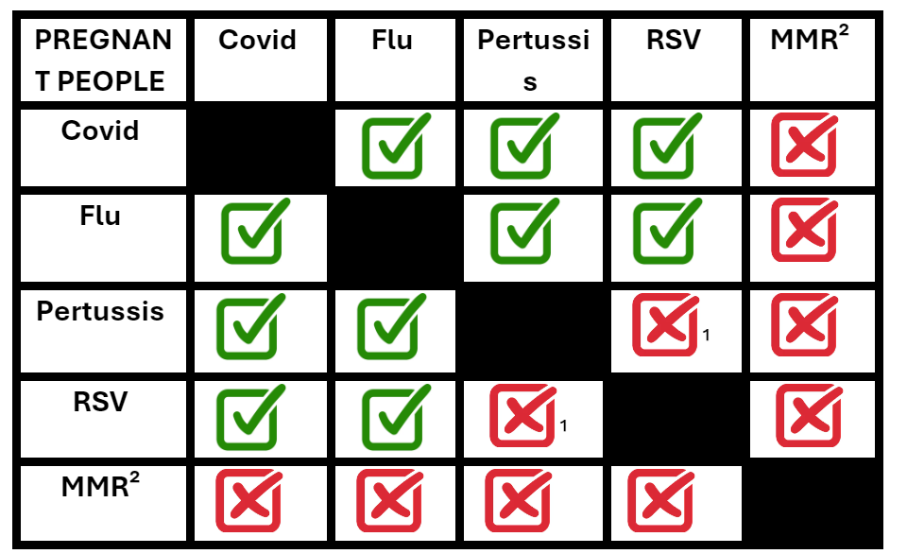
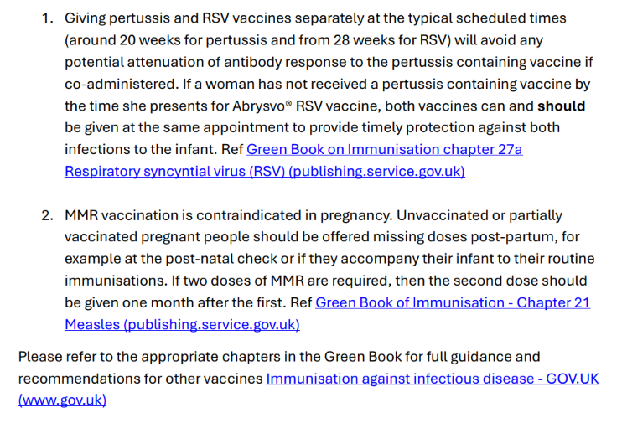
Coadministration – Pregnant Women
Notes:
Plain slide with subhead and bullets

Slide 62
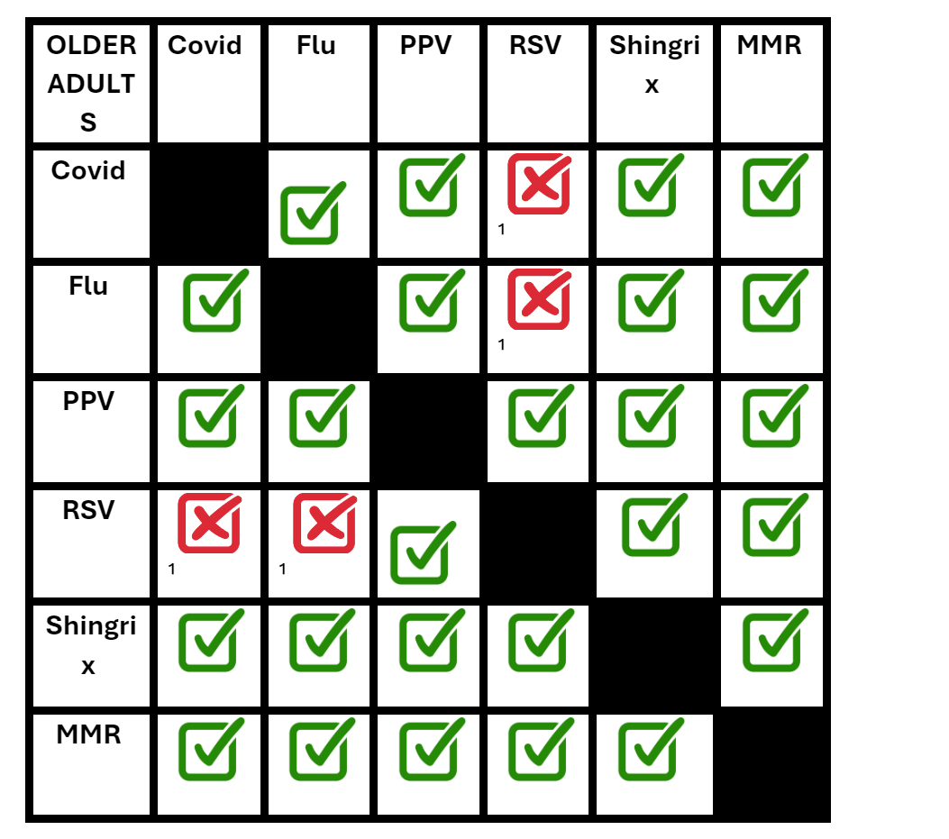
Coadministration of vaccines – Older Adults
Vaccines can be given together if you have a patient who is unlikely to return but the efficacy may be reduced
Notes:
Plain slide with subhead and bullets

Slide 63
Shingles
https://youtu.be/VVsDU8JbDgQ?feature=shared
Notes:
Plain slide with subhead and bullets

Slide 64
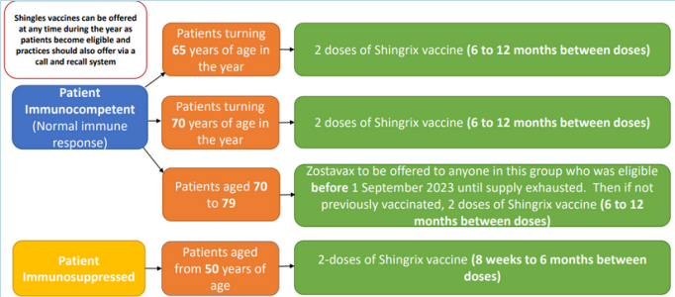
Shingles
Shingles eligibility calculator - from September 2023 - Health Publications
Notes:
Plain slide with subhead and bullets

Slide 65
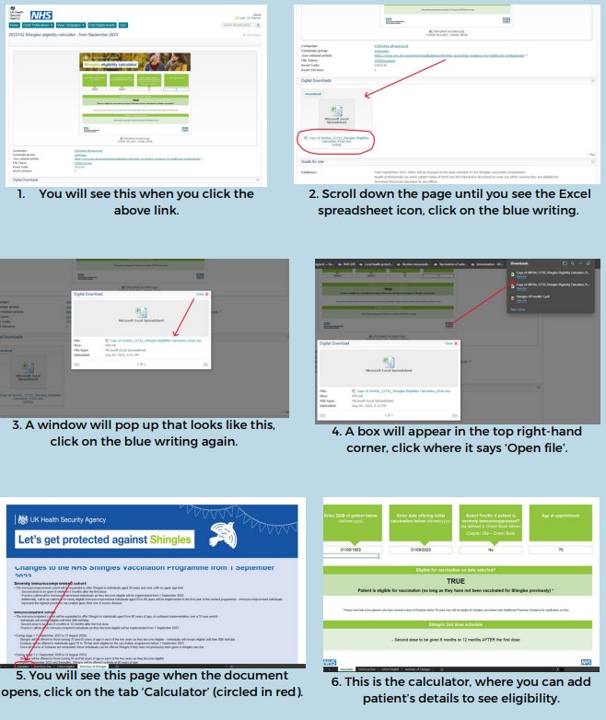
Shingles
Shingles eligibility calculator - from September 2023 - Health Publications
Notes:
Plain slide with subhead and bullets

Slide 66
Pneumococcal
PCV13 is given to all babies at 12 weeks and one year of age.
PPV23 is given as a one-off dose to ‘at-risk’ groups from 2 years to 64 years, 5 yearly boosters to certain groups and a one-off dose to healthy adults aged 65 and over.
5 yearly boosters - for patients with asplenia, splenic dysfunction or chronic renal disease. Includes coeliac disease and sickle cell disease.
Notes:
Plain slide with subhead and bullets

Slide 67
Vaccination Procedures
Where/Who/How?!

Slide 68
CSAIS
Community and School-aged Immunisation Service.
Administer vaccines cradle to grave – run community clinics.
HCT covers Hertfordshire, BLMK and West Essex (hct.immsenquiries@nhs.net).
They administer the selective Hep B schedule, BCG, all school-aged immunisations (including flu), and some maternity immunisations (sub-contracted).
Health visitors, school nurses, GPs and parents can refer to CSAIS.
Also run drop-in services – advertised by Local Authorities.
Notes:
Plain slide with subhead and bullets

Slide 69
Patient Group Direction / Patient Specific Direction
PGDs can be found here: NHS England — East of England » Patient Group Directives
Expiry dates for each PGD can be found here: Plain document (england.nhs.uk)
Many queries can be answered by checking the PGD.
Off-label use.
When you would use a PSD – secondary care request.
Notes:
Plain slide with subhead and bullets

Slide 70
Off-label use
Off-label: when a medicine / vaccine is used in a way other than what is described in the license (includes storage).
PSDs are NOT required for off-label use!
PGDs cover off-label use (including where vaccines have been involved in a cold chain breach but deemed safe and effective for use by manufacturers).
Immunisers discretion as to whether a patient / parent is told that a vaccine is being given off-label.
Many medicines and some vaccines are given off-label: pertussis vaccine (pregnancy), MenB vaccine (schedule), medication for children (age).
Resources to help with any conversation: off-label use.
Notes:
Plain slide with subhead and bullets

Slide 71
EoE Website
Notes:
Plain slide with subhead and bullets

Slide 72
Consent
Does not need to be physically signed – can be verbal.
The patient / parent / guardian must have a clear understanding.
Informed choice.
If someone who does not have parental rights is bringing the child, you need to be clear that consent has been given from the parents.
(GB on consent has been updated):
Notes:
Plain slide with subhead and bullets

Slide 73
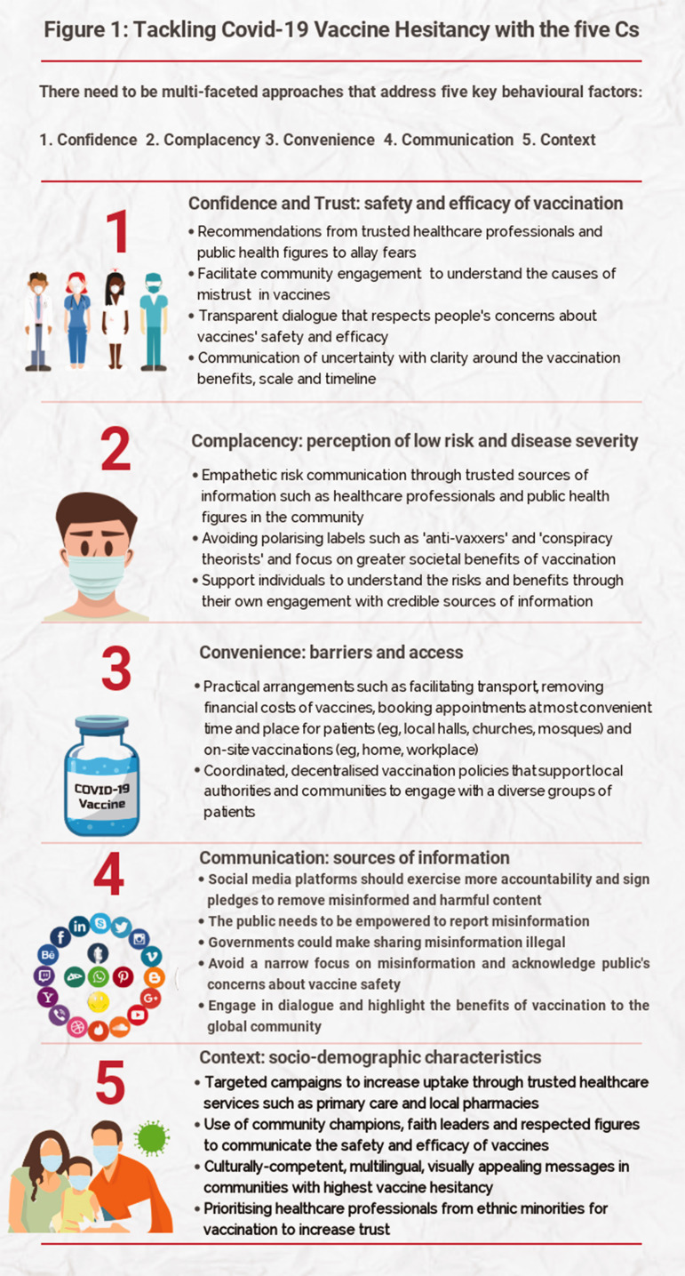
Vaccine hesitancy
Confidence – are they recommended by trusted healthcare professionals?
Complacency – perception around the risk / severity of the disease.
Convenience – are vaccines accessible?
Communication – social media, misinformation.
Context – targeted campaigns, different languages, representation.
Notes:
Plain slide with subhead and bullets

Slide 74
How to talk about vaccines
Simple language
With confidence
Remain non-judgemental
Leave space to ask questions
Signpost to non-Gov, non-NHS sites such as the Vaccine Knowledge Project.
(Home | Vaccine Knowledge Project – also has videos and resources which can be shared if appropriate)
Notes:
Plain slide with subhead and bullets

Slide 75
Vaccine administration and incidents
Recent incidents across EoE: increase in Fluenz being given to children under the age of 2.
Wrong vaccine given in baby clinic.
Wrong flu vaccine given to ‘at-risk’ adult.
Prevention?
Ensure enough clinic time to minimise risk of errors.
Awareness of admin and reception staff – booking into correct clinic space.
Double check – what has the patient come for?
Errors do happen! Please contact us on england@immsqa@nhs.net

Slide 76
The 8 R’s!
RCN best practice guidelines: 009-860.pdf

Slide 77
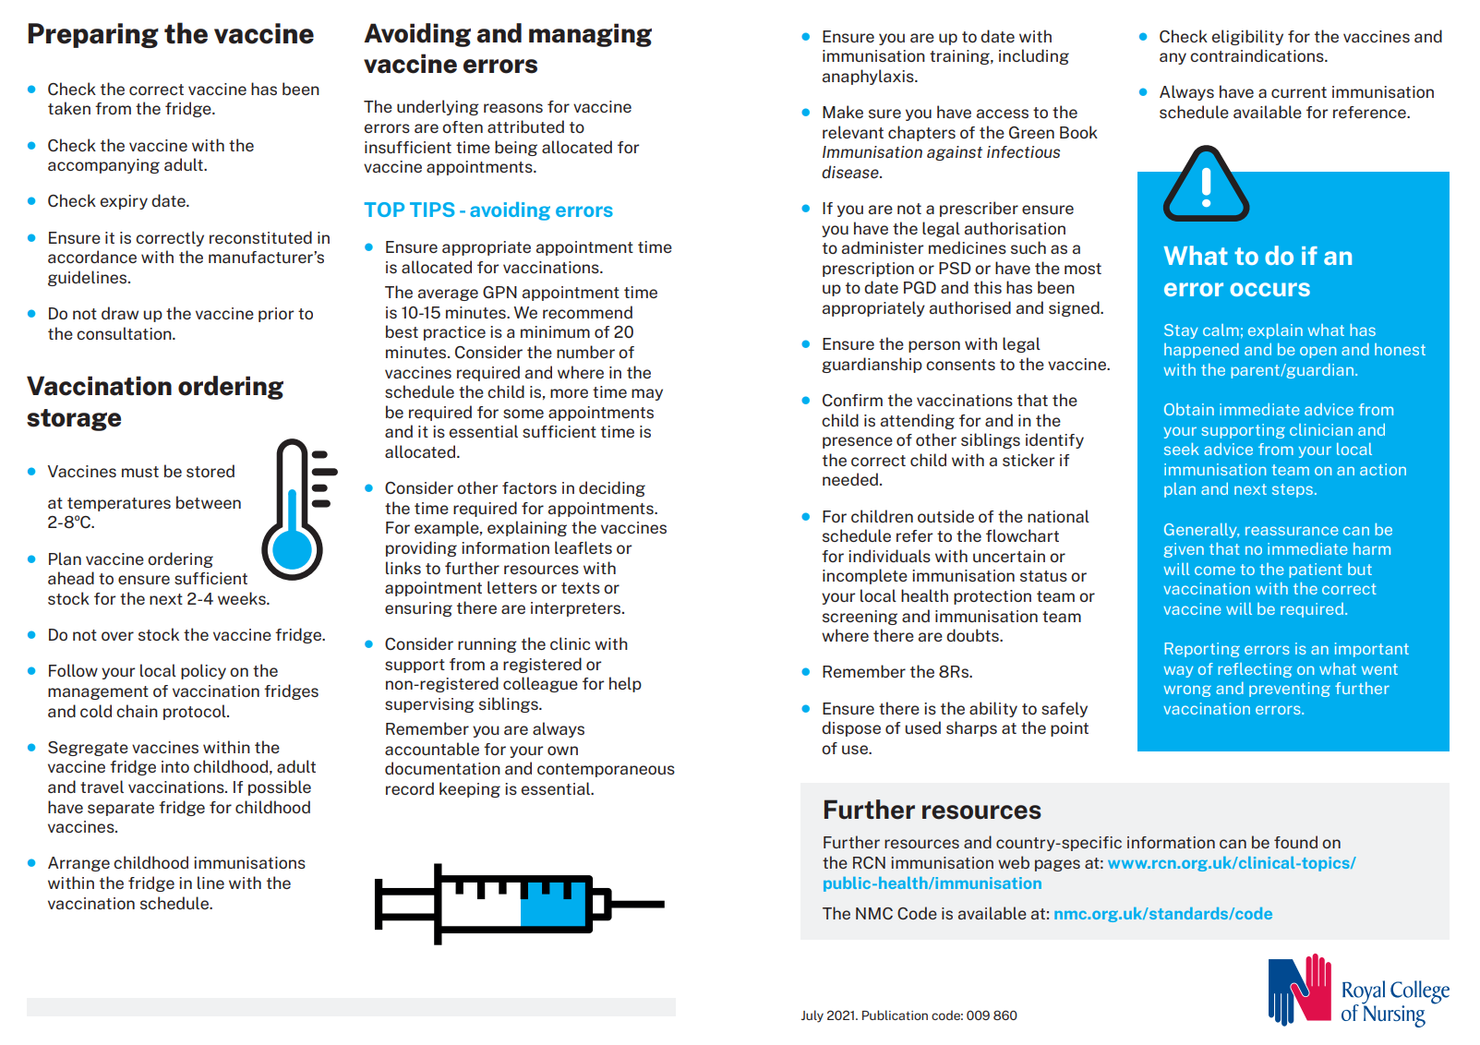

Slide 78
Cold chain
For vaccines to be safe and effective they must be stored and administered correctly.
Vaccines are sensitive to heat, cold and light.
Limit quantity of stock to that needed for 2 weeks, in case of fridge failure.
Have a nominated cold chain lead.
All practice staff trained and updated on the cold chain and their role – e.g. reception staff receiving vaccines.
All staff know what to do in case of a cold chain breach.
Notes:
Plain slide with subhead and bullets

Slide 79
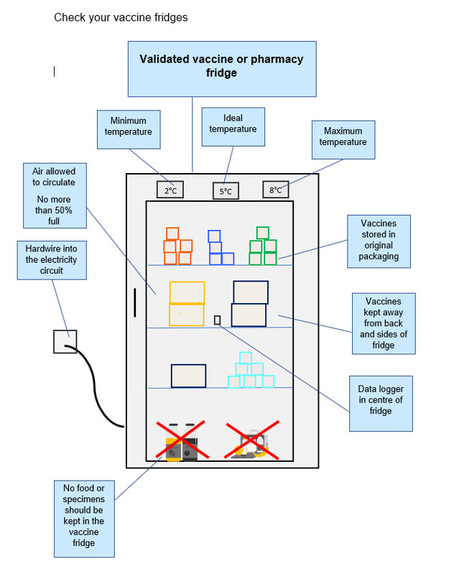
Vaccine storage
Keep vaccines from manufacture to administration:
In a validated vaccine fridge or transporting system at 2-8⁰C, aiming for a midpoint of 5⁰C.
In original packaging to protect from light and other damage.
Away from the back or sides of the fridge, with sufficient space for air to circulate.
Notes:
Plain slide with subhead and bullets

Slide 80
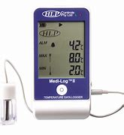
Data loggers
Placed in the centre of the fridge.
Data must be downloaded regularly and checked – best practice is daily.
Data is vital in the case of a fridge failure.
Notes:
Plain slide with subhead and bullets

Slide 81
Excursion / cold chain breach
An “excursion” or cold chain breach, is when vaccines have been out of the cold chain for more than 20 minutes.
Visit: NHS England — East of England » Vaccine and cold chain incident management.
Notes:
Plain slide with subhead and bullets

Slide 82
First step – do not dispose of anything involved!
Ensure that none of the potentially affected vaccines are administered to patients
This information is needed for when you speak to the manufacturers
Vaccines should only be discarded if manufacturers advise that is necessary
We can support you - you can contact us at any stage throughout this process
Any vaccine wastage must be reported on ImmForm

Slide 83
Vaccine wastage
Do NOT discard any vaccine until after discussion with manufacturers and they have confirmed the vaccines cannot be used.
Any vaccine that must be discarded (instructed by manufacturer) must be reported on ImmForm.
Vaccine wastage cost £5.7 million of NHS funds in 2022.
The vaccine is referred to as being used ‘off-label’ if it has been stored in a way other than that described in its licence.
The decision to allow the vaccine to be used ‘off-label’ will only be taken if the vaccine is still considered to be safe and effective.
The PGD’s cover off-label vaccine use.
Notes:
Plain slide with subhead and bullets

Slide 84
Vaccine stability
Modern vaccines are created to be stable!
Cold chain policy: do NOT discard any vaccines until after speaking with the manufacturers.
Stability data (SPS tool) demonstrates the stability of most vaccines that are used in the routine schedule.
SPS tool can be used as additional knowledge but should not replace contacting the manufacturers.
Link: SPS Stability Tool.
Notes:
Plain slide with subhead and bullets

Slide 85
Infanrix Hexa DTaP/IPV/Hib/HepB 8, 12 & 16 weeks

Slide 86
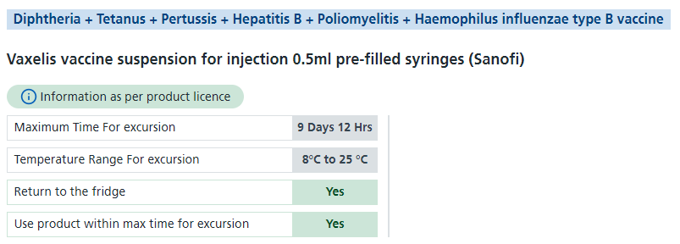
Vaxelis DTaP/IPV/Hib/HepB 8, 12 & 16 weeks

Slide 87
Shingrix Shingles 65 years

Slide 88
GP contract
Do you know who your immunisation lead is?
The current GP contract came in on 1st April 2021.
5 core standards for immunisation .
Practices must have a nominated immunisation lead.
Non-attenders must be contacted after invitations sent by CHIS.
Call and recall for adult programmes.
Notes:
Plain slide with subhead and bullets

Slide 89
Immunisation lead role
The nominated person will be responsible for following up recurrent non-attenders.
Notes:
Plain slide with subhead and bullets

Slide 90
Opportunistic immunisation
Practices should give opportunistic vaccination to school-aged children if requested by parent, however they should be first directed to the Community School-aged Immunisation Service (CSAIS).
Includes HPV, MenACWY and Revaxis vaccinations.
CSAIS will continue to administer, and offer catch up clinics, but these can also be given in general practice.
If you do administer to a school aged child, please inform CSAIS to avoid duplication.
RSV should be offered opportunistically to pregnant women (28 weeks gestation and over).
Notes:
Plain slide with subhead and bullets

Slide 91
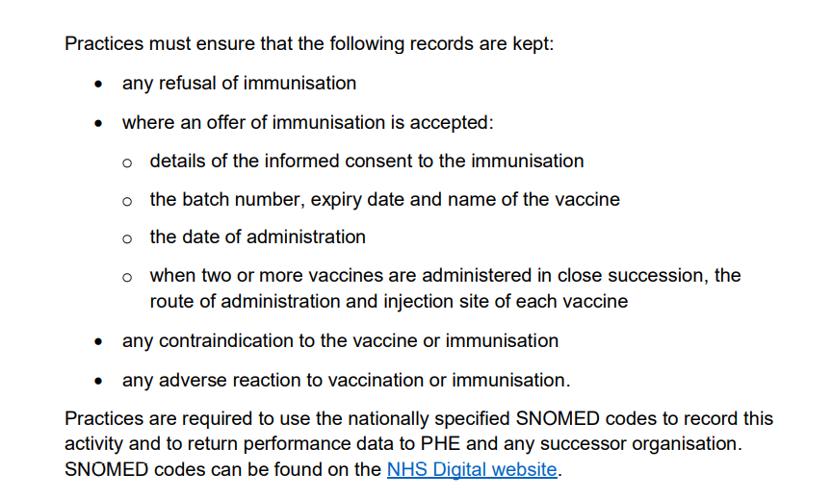
Record keeping
Notes:
Plain slide with subhead and bullets

Slide 92
Call & recall
Practices should invite 100% of their eligible population.
Appointments should be accessible and at a range of times across the week.
Practices should look to making these appointments available to book online.
Practices can collaborate across PCNs to help cover their eligible population.
CHIS can help with equation to see how many appointments are needed a week to avoid waiting list.
Parents of children who do not attend should be contacted after their invitations from CHIS.
Recall should ideally extend beyond three contacts until vaccination has been completed – unvaccinated patients should be flagged.
Ideally, need a ‘Decline’ or for the child to be vaccinated (need an outcome!)
Notes:
Plain slide with subhead and bullets

Slide 93
Immunisation Admin
Managing your “DNA lists” – cleaning up your clinic lists and working with CHIS
Do you need to return uploads to CHIS? (usually EMIS practices)
What is your waiting list like? – If you are sent a list to work through and need further support please contact us
We will contact practices with increasing waiting lists to review
Do you have enough appointments a week? CHIS can review this.
Immunisation histories: are these being recorded into the template - not just scanned into notes?
Following the DNA/ non responder pathway.
If you book your own appointments for patients, please task or email cms.chis@nhs.net to inform, this avoids duplication of appointments

Slide 94
Please ensure you are recording immunisations as “declined” and not “refused”
This impacts the way in which Child Health send their letter invitations
Refusals can be used in extreme circumstances
Contact CHIS via Task or email (cms.chis@nhs.net) when you receive a decline. They can update the system their end and pause the invitations until the next immunisations due.
If you have a patient who is adament they never want to be contacted please contact ourselves and the CHIS team

Slide 95
DNA pathway
Currently being updated, watch this space…

Slide 96
Improving uptake
Offer a wide range of appointments including earlier and later appointments.
Could you consider a weekend clinic?
Use of booking links via Accurx and text messaging systems – avoids long waits on hold.
Engagement – practice put on a “superhero” immunisation session, CSAIS had an animal themed drop-in – both well received and popular clinics.
Communication – have you got information on walls and in waiting rooms?
Opportunistic immunisation and making every contact count – offering when a patient has come in for something else.

Slide 97
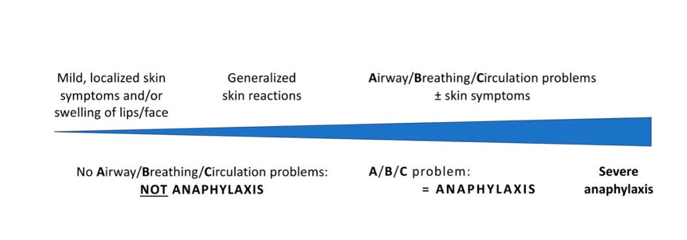
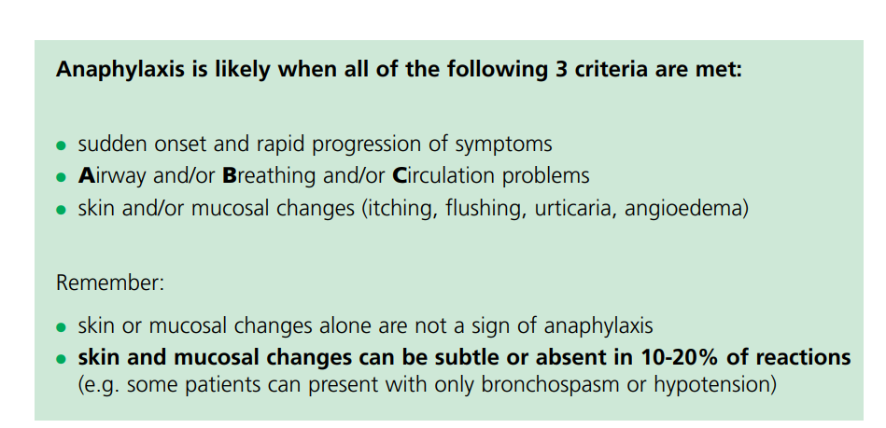
Anaphylaxis Management
Chapter 8 The Green Book – Recently updated
Green Book chapter 8 Vaccine Safety

Slide 98
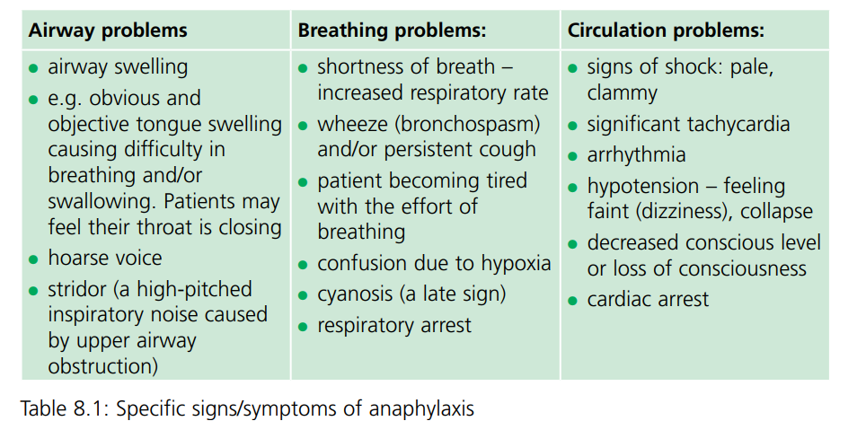
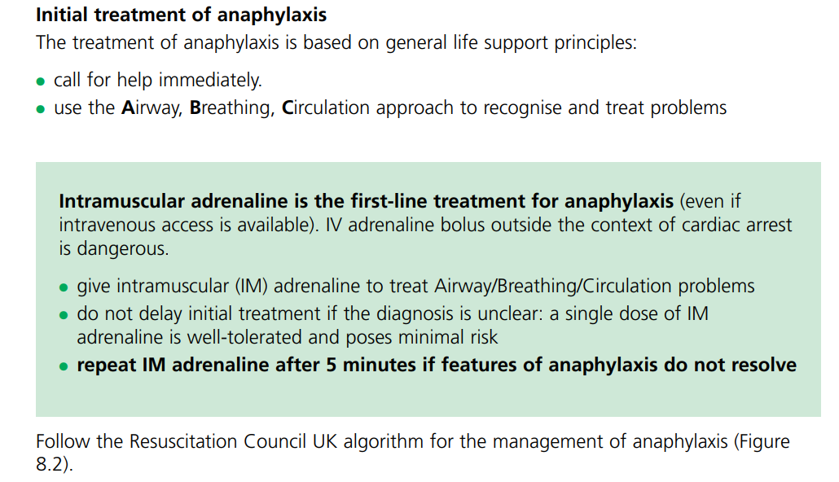
Anaphylaxis cont:

Slide 99
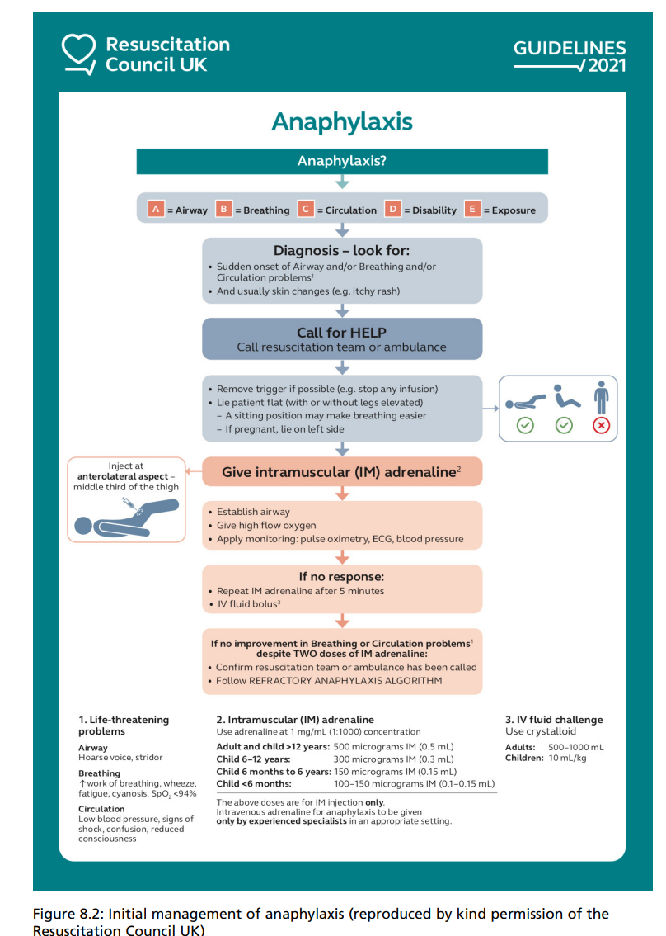

Slide 100
Sessions - 2025
Session | Date / Time
Annual update (3 hours) | Wednesday, 12th March – 9:30-12:30pm Wednesday, 11th June – 9:30am-12:30pm Thursday, 11th September – 12-3pm Tuesday, 9th December – 9:30-12:30pm
Deep-dive sessions (1.5 hours) | Thursday, 1st May – 1-2:30pm Tuesday, 14th October – 1-2:30pm
Flu update (1 hour) | Dates TBC
Notes:
Plain slide with subhead and bullets

Slide 101
Feedback
Notes:
Plain slide with subhead and bullets

Slide 102
Notes:
Plain slide with subhead and bullets

Slide 103
Questions..
Questions in the chat or hands up
Any other questions?
Notes:
Plain slide with subhead and bullets

Slide 104
E-mail: england.immsqa@nhs.net
Website: NHS England — East of England Slides and certificates will be uploaded here
Training created in accordance with Immunisation training standards for healthcare practitioners - GOV.UK

Slide 105
Key Documents
Cochrane Review confirms effectiveness of MMR vaccines | Cochrane UK
MMR Vaccine (Measles, Mumps and Rubella Vaccine) | Vaccine Knowledge Project (ox.ac.uk)
Immunisation against infectious disease - GOV.UK (www.gov.uk)
Vaccination of individuals with uncertain or incomplete immunisation status (publishing.service.gov.uk)
Home | Vaccine Knowledge Project (ox.ac.uk)
Pregnancy: how to help protect you and your baby - GOV.UK (www.gov.uk)
Notes:
Plain slide with subhead and bullets

Slide 106
Key Documents
Guidance on the hepatitis B antenatal screening and selective neonatal immunisation pathway - GOV.UK (www.gov.uk)
Vaccine update: issue 344, November 2023, pregnancy special - GOV.UK (www.gov.uk)
Videos about vaccines | British Society for Immunology
Latest measles statistics published - GOV.UK (www.gov.uk)
Quarterly vaccination coverage statistics for children aged up to 5 years in the UK (COVER programme): July to September 2023 - GOV.UK (www.gov.uk)
Notes:
Plain slide with subhead and bullets

Slide 107
Key Documents
What to do if you think your child has measles and when to keep them off school – The Education Hub (blog.gov.uk)
JCVI statement on a childhood varicella (chickenpox) vaccination programme - GOV.UK (www.gov.uk)
Campaign Resource Centre (dhsc.gov.uk)
How to talk about vaccines (who.int)
Vaccination against pertussis (whooping cough) for pregnant women - GOV.UK (www.gov.uk)
Respiratory syncytial virus (RSV) vaccination programme - GOV.UK (www.gov.uk)
Polio immunisation response in London 2022 to 2023: information for healthcare practitioners - GOV.UK
NHS England » General practice vaccination and immunisation services: standards and core contractual requirements
Notes:
Plain slide with subhead and bullets

