Slide 1
Cervical screening webinar
NHS Cervical Screening Programme
East of England Screening and Immunisation Team

Slide 2
Session outline
Background | Pam Hall
Extended screening intervals | Hayley McCarthy
Cervical screening invitations and reminders | Samar Pankanti
Text message reminders | Samar Pankanti
SBRI project with Appt Health | Pam Hall
Self-sampling | Tom Davis
Cervical screening drop in sessions | Melanie Vincent
Questions
Please put your questions in the chat. We will collate any questions that we don’t cover today and send responses when we send out the slides.
We can’t answer any individual clinical queries.
This isn’t a formal update session so there will not be a certificate of attendance.

Slide 3
Background

Slide 4
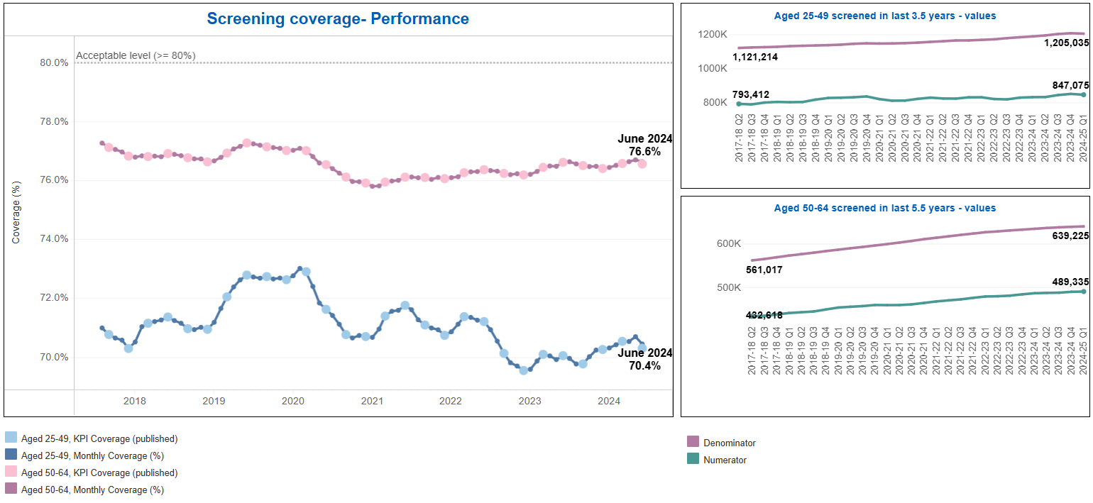
Cervical screening coverage – East of England
The national coverage standard is that 80% of the eligible population should have been screened within the previous 3.5 years (25 – 49) or 5.5 years (50 – 64).
Source: FutureNHS Workbook: CervicalReport

Slide 5
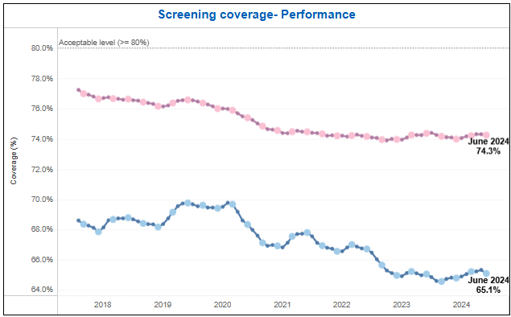
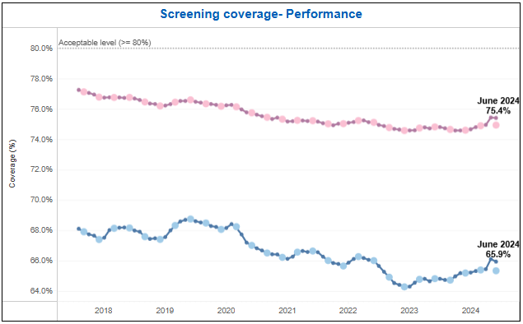
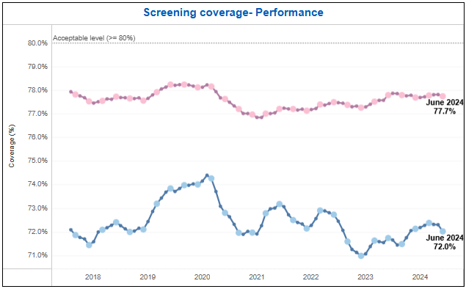
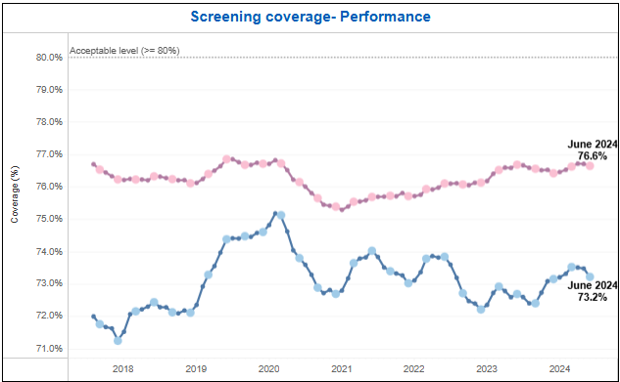
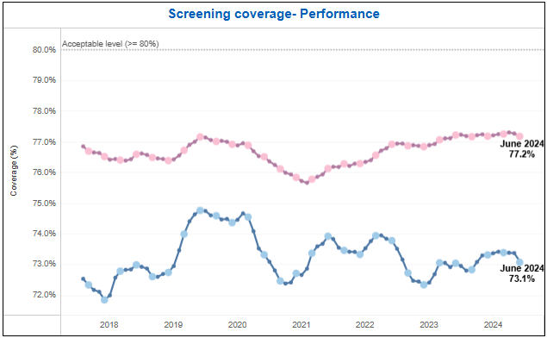
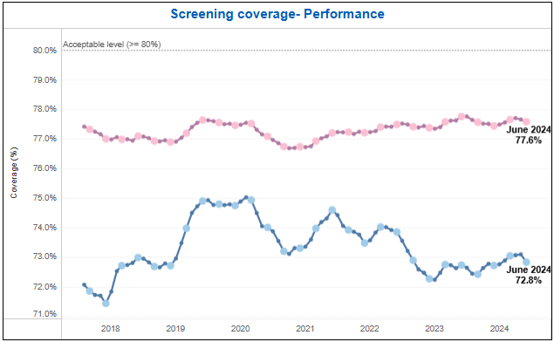
Cervical screening coverage – by ICB
BLMK ICB | Cambs and Peterborough ICB | Herts and West Essex ICB
Mid and South Essex ICB | Norfolk and Waveney ICB | Suffolk and North East Essex ICB
Source: FutureNHS Workbook: CervicalReport

Slide 6
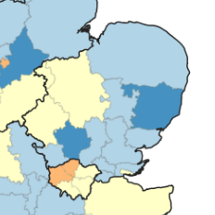
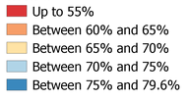
Cervical screening coverage – East of England map
Coverage, 25 – 49 years, March 2024
Coverage, 50 – 64 years, March 2024
Source: Cervical screening standards data report 2023 to 2024 - GOV.UK

Slide 7
Extended screening intervals

Slide 8
From 1st July 2025, the routine cervical screening interval for women and people with a cervix aged 25 – 49 years who test negative for HPV changed from 3-yearly to 5-yearly.
Before 1st July 2025 | After 1st July 2025
25 – 49 years old – every 3 years | 25 – 49 years old – every 5 years
50- 64 years old – every 5 years | 50- 64 years old – every 5 years

Slide 9
Background 1 - Rationale
HPV primary screening has been fully implemented in England since December 2019. This is a more sensitive and accurate test than the previous ‘smear’ test, which only looked for cervical cell changes.
HPV testing is the best way to find out at an early stage who is at higher risk of developing the cervical cell changes that over time could potentially lead to cervical cancer if left untreated.
This enables us to offer a more personalised approach to cervical cancer prevention based on an individual’s risk.

Slide 10
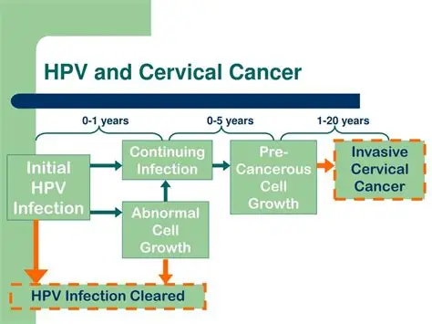
Background 2 – Why it is safe
Studies have shown that if a person tests negative for high-risk human papillomavirus (hrHPV), they are extremely unlikely to go on to develop cervical cancer within the next 10 years. A study in England, published by King’s College London, showed that 5-year screening intervals are as safe as 3-year intervals; the same number of cancers will be prevented, and less frequent cervical screening tests are needed.
Notes:
Natural history work suggests that at least 10 years elapses between acquiring hrHPV and developing cancer, the high negative predictive value of hrHPV testing and lower false negative rate means screening intervals can be lengthened in women who test negative for hrHPV. Primary cervical screening with high risk human papillomavirus testing: observational study | The BMJ

Slide 11
Background 3 - how the change was agreed
The UK National Screening Committee (UKNSC) reviewed robust scientific evidence and recommended a change to a 5-year screening interval for participants aged 25-49 years who test negative for hrHPV at their routine screen. The Department of Health and Social Care (DHSC) has accepted this recommendation.
Screening intervals will not be changed retrospectively. Participants aged 25 – 49 years who test negative on a routine primary HPV test collected on or after 1st July 2025 will move to a 5-yearly interval.
This move brings England into line with Scotland and Wales who have introduced this change, and with women aged 50 – 64 who are already invited every 5 years.

Slide 12
What is changing?
For cervical screening participants aged 25 – 49 years who have a routine screening sample taken on or after 1st July 2025:
Patients who test negative for HPV will be recalled in 5 years.
Patients who test negative for HPV but had a positive HPV result within the last 5 years that has not already been followed by a negative test will be recalled for screening in 3 years. This is because those with recent evidence of an HPV positive result have a higher chance of this happening again and so will not move to a 5-year interval straight away.

Slide 13
What is not changing?
Cervical screening pathway for patients who test positive for hrHPV.
Cervical screening pathway for patients aged 50 – 64 years. Patients will continue to be invited every 5 years.
HIV positive individuals will continue to be screened every year.
Cervical screening pathway for patients aged 25 – 49 years and who have never had an HPV test. Patients will continue to be invited every 3 years.
Cervical screening pathway for patients aged 25 - 49 years whose last screening test was part of an approved self-sampling evaluation and tested negative for HPV will remain on a 3-year recall interval until routine intervals in relation to self-sampling as part of the NHS Cervical Screening Programme are agreed.

Slide 14
FAQs - Extended intervals 1
Why are cervical screening intervals changing?
The Human Papillomavirus (HPV) causes nearly all cervical cancers. We now use a test which is more sensitive and accurate than the previous method (smear test) to look for HPV in your sample. This helps us offer a more personalised approach by finding out who is at higher risk of developing the cervical cell changes that over time, if left untreated, could lead to cervical cancer. This change from 3 to 5 yearly screening is backed by robust scientific evidence – studies have shown that if you test negative for HPV you are extremely unlikely to go on to develop cervical cancer within the next 10 years. So now we have this better test, you don’t need to be screened as often if you don’t have HPV.
Will everyone move onto this new 5 yearly screening pathway automatically?
No. Next test due dates will not be changed retrospectively; you will be invited at the interval in which you were advised of at the time of your last test. Only those who attend cervical screening on or after 1 July, and meet the clinical criteria, will have their next test due date set at 5 years. NHS England made this decision based on clinical advice from experts. Those aged 50 to 64 are already invited every 5 years.

Slide 15
FAQs - Extended intervals 2
So, will everyone aged 25-49 move to a 5-year screening if they test negative after 1 July?
No, not everyone. If your test result is negative but your last test (taken within the last 5 years) showed an HPV positive result, you will still be invited for screening in 3 years time so that we can continue to monitor your HPV status. If you test negative for HPV at that next test, then you’ll move to 5-year screening.
What happens if I test positive for HPV?
It’s important to remember that having HPV does not mean that you have or will develop cervical cancer. It is a common virus that most people will have at some point in their life without knowing, which usually goes away on its own. If HPV is found in your sample and there are no cell changes, you are invited for screening again in 1 year. If cell changes are found alongside HPV, you are referred directly to a hospital clinic for a colposcopy to check the cervix more closely. Further follow up and treatment will depend on the colposcopy findings.
I’m currently having treatment following a colposcopy, will I be put on 5- yearly screening?
Not immediately. You will be followed up according to the reason for your treatment. Once this is completed successfully you will move to 5 yearly screening.

Slide 16
FAQs - Extended intervals 3
I’ve had cervical cancer in the past, will I be put on 5-yearly screening
Most people diagnosed with cervical cancer receive follow-up care and monitoring by their hospital cancer team instead of returning to regular screening. Those people who are diagnosed with very early cervical cancer and remain in the Cervical Screening Programme will go onto 5-year routine recall once their 10 year follow up is successfully completed.
I’ve never been for cervical screening, even though I am eligible. Will I now move onto a 5-year recall if I do decide to come for a test?
Yes, if you come for screening and test negative for HPV you will be invited again in 5 years time.
I’m 25 and have been invited for my first ever screening. Will I automatically go straight onto a 5-year recall if I test negative?
Yes, if you test negative for HPV at your first ever test aged 25, your next test date will be in 5 years time.
06062025 NHS CSP - ESI master toolkit FAQ FINAL.pdf

Slide 17
Cervical screening invitations and reminders

Slide 18
Digital invitations and reminders
Digital invitations and reminder communications now being issued via the NHS App
If a digital invitation / reminder is not possible, a letter will be posted
Please encourage everyone to download the NHS App and enable notifications: www.nhs.uk/nhs-app/

Slide 19
Invitations and reminders in the Cervical Screening Programme in the East of England
 | National (via CSAS) | NECS / iPlato intervention | SBRI project with Appt Health
6 weeks before test due | Invitation via NHS App* or letter
2.5 weeks after first invitation |  | Reminder text message
18 weeks after first invitation if not tested | Reminder via NHS App* or letter
14 weeks after national reminder if not tested | Patient flagged as non-responder and GP practice notified |  | Engagement with non-responders in practices signed up to the project
*Invitations and reminder communications are now being sent via the NHS App. Patients who do not use the NHS App will receive a posted letter.

Slide 20
Text message reminders

Slide 21
NHS East of England commissioned NECS CSU and iPlato to deliver a text message reminder to women invited for screening from 2021
Text reminders are sent to eligible people two and half weeks after their first invite letter

Slide 22
Regional cervical screening SMS text reminder service findings - Feb 2024
Participants who received an SMS as well as an invitation letter are 2.57 times more likely to attend screening than those who are only sent a letter. This equates to over 245,000 extra screenings completed since 12/07/2021 in EoE. The largest predictor of whether a participant will attend is previous screening history. Participants whose previous screen was within the last 3.5 / 5.5 years (depending on age) are much more likely to attend, whether or not they receive an SMS. Deprivation has a clear effect on whether a participant attends screening, with those in the least deprived areas more likely to attend than those in more deprived areas. The likelihood that a participant will attend screening increases with age.

Slide 23
CSMS and text message reminders
In June 2024 a new Cervical Screening Management System (CSMS) replaced the old cervical screening call/recall system, NHAIS, which was accessed via Open Exeter
NECS and other partners had to upgrade their own platforms to be compatible with the new CSMS national system
As a result, there was a pause in regional text reminders
The text reminders are now back on and live from June 2025
EoE is also piloting direct booking from text messages in a small number of practices

Slide 24
SBRI project with Appt Health

Slide 25
Project outline
Appt Health working with 7 Cancer Alliances. Aiming to engage with ~40,000 patients per Cancer Alliance.
Team has sought RIDAC approval
Phase 1
Appt Health intervention will take over after national programme ends, and a patient has been identified as a non-responder.
Interventions designed to target 4 low-uptake patient sub-groups.
Patients will receive an accessible text message with 3 response options for invitation – link, phone-based or letter-based.
Information about slots available at practice or local practice hub.
Phase 2
Using data to identify patients unlikely to engage.
Then patient participation intervention to work with patient groups to understand barriers to accessing cervical screening.
Next steps
Webinars for GP practices to learn more about the projects.
Onboarding begins mid-July

Slide 26
Self-sampling

Slide 27
The UK National Screening Committee has recommended HPV self-sampling for under-screened groups (people who have never attended or rarely attend for screening).

Slide 28
What is changing?
Starting in 2026, patients in under-screened groups will be offered cervical self-sampling.
Patients who have never attended for cervical screening or who rarely attend will be able to request a kit and receive it in the post.
The self-sampling kits will test for HPV only, and patients who test positive will need to have a sample collected by a clinician, for cytology.
It is not yet known whether self-sampling is as good as sampling by a clinician for patients who regularly attend for screening.

Slide 29
Q&As – Self-sampling 1
When will HPV self-sampling kits be available? NHS England will roll out HPV self-sampling from early 2026.
Who can access the HPV self-sampling kits? HPV self-sampling will only be offered to those who rarely attend or who have never attended cervical screening. We will set out specific eligibility criteria in due course as the offer is developed.
Why is it restricted to this group only? This is because there is uncertainty about whether self-sampling is as good as clinician taken sampling for those who already regularly attend screening. For those who do not attend their appointments, any test is better than no test.
Is HPV self-sampling as good as a clinician taken cervical screening? A clinician-led test is the best option and has been shown to routinely detect HPV and prevent cancer. For those already attending routine cervical screening, a shift to self sampling might result in a programme that is not yet proven to be of equal efficacy. Further studies to consider whether self-sampling could be used across the whole population are being organised.
How does the HPV self-sampling kit work? A sample of cells will be self-collected from the vagina, which is a different method to a clinician-taken sample from the cervix. The self-sampling method tests for the presence of HPV only. People who test positive for HPV will still need to go for a clinician taken sample to get cytology (an examination of the cells of their cervix).

Slide 30
Q&As – Self-sampling 2
6. How will HPV self-sampling be offered to under-screened individuals? Those eligible will initially be contacted via the NHS App. They will be able to request an HPV self-sampling kit and receive it through the post. If the person does not have the NHS App, the invitation will be sent using another form of communication, to ensure no one is excluded. We encourage people to download the NHS App and ensure notifications are switched on. As part of the future roll out, we are also exploring offering kits in other ways including:
• an opportunistic offer from a healthcare professional – where eligible individuals are offered a self-sampling kit when they attend a primary care setting
• a direct mail-out – where eligible individuals are sent a kit directly to their home
• a combination of both approaches
The Cervical Screening Programme is currently in the design phase of this initiative and it’s subject to change. Further details about the new HPV self-sampling offer will be made available in due course.
20250624 HPV self-sampling QA Final.pdf

Slide 31
Cervical screening drop-in sessions
Quarterly sessions for everyone involved in the Cervical Screening Programme
Next session:
Wednesday 17th September – 1 – 2pm

Slide 32
Questions and discussion

Slide 33
Contact details for Screening and Immunisation Team
Mid and South Essex ICB | england.essexatscreening@nhs.net
Suffolk and North East Essex ICB
Cambridgeshire and Peterborough ICB | england.ea-phsi@nhs.net
Norfolk and Waveney ICB
Bedfordshire, Luton and Milton Keynes ICB | england.immsqa@nhs.net
Hertfordshire and West Essex ICB
We have developed a series of EoE Screening web pages where you can access guidance / forms / contacts / latest news. Please check regularly for updates

