Slide 1
Immunisation training
For those working in the 0-19 service (health visiting and school nursing)
Immunisation team
Herts & WE + BLMK
Notes:
Standard title slide

Slide 2
“Housekeeping”
Ask questions – please use the ‘Chat’.
Move around / go to the toilet / answer a phone call: mute, turn off your camera & rejoin us when you can.
Please ensure your speakers are on and volume turned up for the videos. If you are unable to hear the videos, it may be your speakers, or your organisation’s IT policy (VPN).
Confidentiality & professional etiquette.
Potentially distressing images / videos.
Certificates and the slides will be uploaded to our website after the session
We work from home and apologise for any unexpected interruptions
Notes:
Plain slide with subhead and bullets

Slide 3
Aims of the session
Increase confidence in talking to parents about immunisations
To understand some of the diseases we protect against
To understand who delivers the programme
To understand your role in relation to immunisations
Notes:
Plain slide with subhead and bullets

Slide 4
Delivery of immunisations
JCVI
UKHSA
NHSE
Providers

Slide 5
Childhood routine immunisations
Team inbox
Training sessions
Newsletter
EoE Maternity Imms Forum
Incident support
Flu commentary
PGDs
Non-responder pathway
CHIS (RAG rated / MMR)
CSAIS (maternity & schools)
FDP (RAVS / NIVS)
Immunisation Boards
COVER stats
DPH report
This is why you are “here” today!
Improving immunisations
Data / Reporting
Supporting providers
Collaboration
Evolving practice
Selective immunisations
Maternity immunisations
ICB & NHSE action plans
School’s Groups
Maternity Imms Group (HWE / BLMK)
GP / Pharmacy flu project
CHIS – waiting lists
Flu planning group
NHSE & UKHSA meetings
GRT project
SEND project
Learning from incidents
Paeds imms service
Call & Recall service
Communicating & supporting changes to immunisation programmes
Adult immunisations

Slide 6
Immunisation Queries - Inbox
england.immsqa@nhs.net
Generic inbox, managed by the Screening & Immunisation Team (SIT).
For professional immunisation queries only, please do not share with patients / parents.
No patient identifiable information / details (PII / PID).
Aim to respond within 2 working days.
Child Health Information System / CHIS is not public-facing service – please do not share telephone numbers with parents / patients.
Notes:
Plain slide with subhead and bullets

Slide 7
The 2 public health interventions that have had the greatest impact on the world’s health are clean water and vaccines.
“
”
World Health Organization (WHO)

Slide 8
How do vaccines work?
https://youtu.be/-muIoWofsCE?si=TISHNs48khnnNV4-
Notes:
Plain slide with subhead and bullets

Slide 9
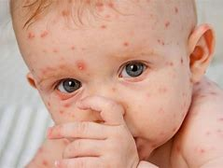
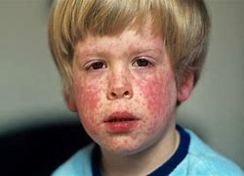
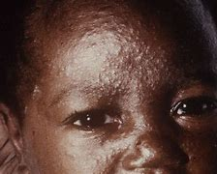
Can you identify these…?
Pay attention to texture and other symptoms
Measles
Chickenpox (Varicella Zoster)
Rubella (German Measles)
Measles
https://www.blackandbrownskin.co.uk
Notes:
Plain slide with subhead and bullets

Slide 10
Barriers to discussing immunisation
Lots to remember!
Timing of visits (New birth visit @ 10-14 days, immunisations start @ 8 weeks)
Duration of appointments – lack of time
Priorities (clinical presentation, i.e. feeding or maternal mental health)
Lack of confidence or knowledge
Under-served communities / health inclusion groups
Non-English-speaking families / different cultures and beliefs
Lack of continuity / therapeutic relationship
Organisational culture (does your organisation see immunisations as a priority?)
Notes:
Plain slide with subhead and bullets

Slide 11
Why do we immunise?
Immunisations don’t just protect the people receiving them, but also their family (multi-generational families).
Immunisations protect all of us by eliminating infections from the country.
This is also known as “herd immunity”.
“Herd immunity” is only reached if uptake is ≥95%.
Notes:
Plain slide with subhead and bullets

Slide 12
Herd Immunity
https://youtu.be/8BUCi5Tuzms?si=_BrII_D6_KWZSSXF
Notes:
Plain slide with subhead and bullets

Slide 13
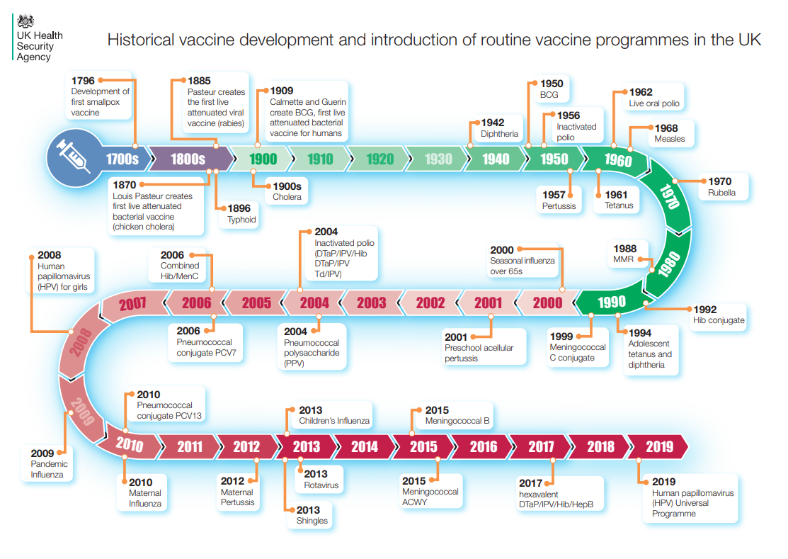
Notes:
Plain slide with subhead and bullets

Slide 14
A world without vaccines
https://youtu.be/yi7gyTqweZc?si=egQ7MqTKtAs3FNW4
Notes:
Plain slide with subhead and bullets

Slide 15
Timings of immunisation
Routine immunisation schedule is NOT random.
Timings of immunisations are scheduled according to when the individual is MOST vulnerable to the virus / disease.
This is why immunisations should NOT be delayed.
Takes approximately 2 weeks following immunisation for a satisfactory immune response.
Notes:
Plain slide with subhead and bullets

Slide 16
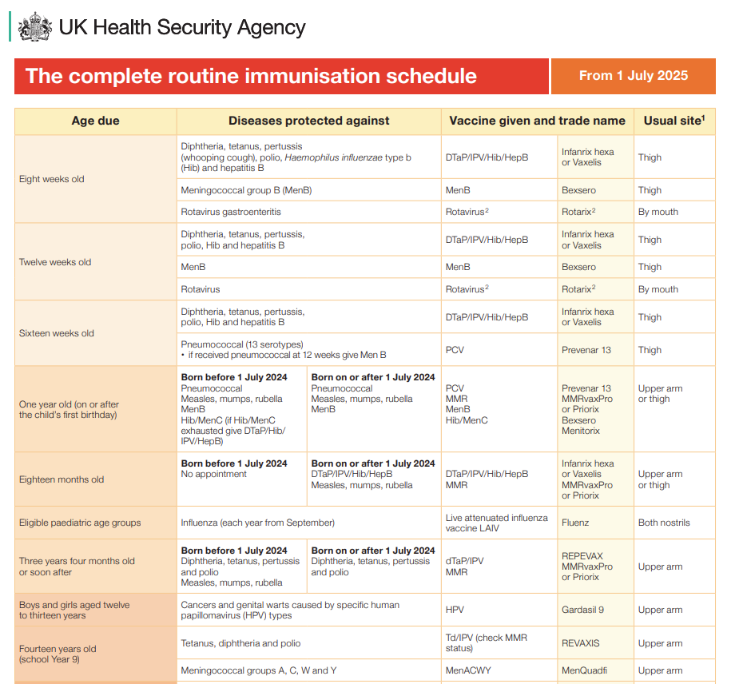
The complete routine immunisation schedule from Jan 2025
*does not include complete schedule – for adults as deemed not relevant for this training
Notes:
Plain slide with subhead and bullets

Slide 17
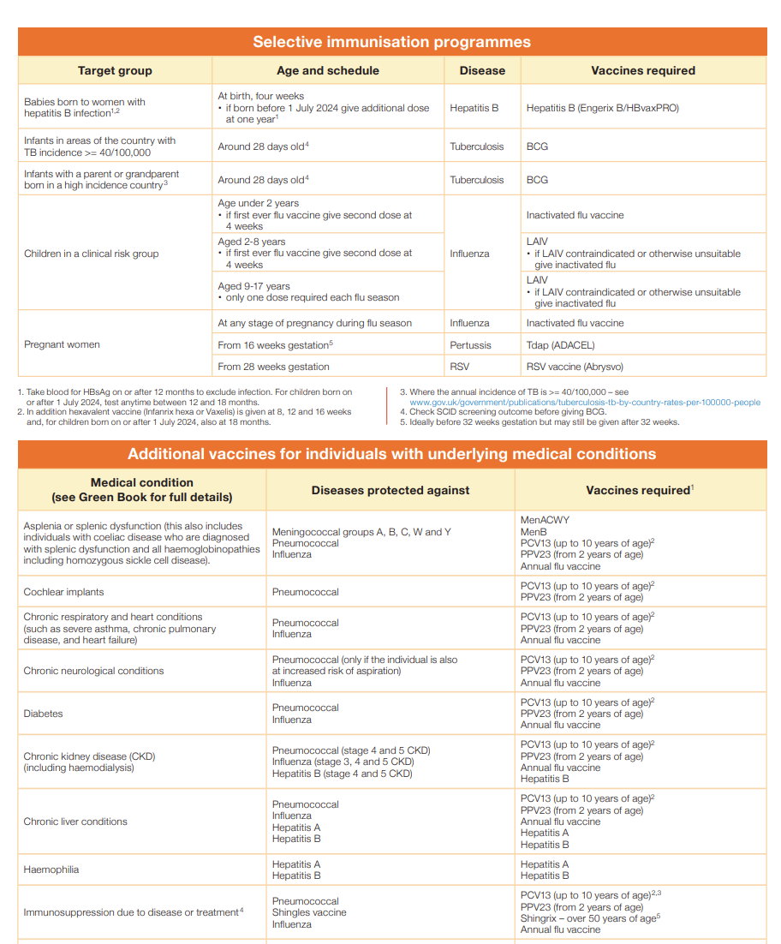
The complete routine immunisation schedule from Jan 2025
Notes:
Plain slide with subhead and bullets

Slide 18
Catching-up immunisations
Vaccination of individuals with uncertain or incomplete immunisation status
Notes:
Plain slide with subhead and bullets

Slide 19
Routine Childhood Schedule Changes
On 30th April UKHSA published a letter detailing the changes to the routine schedule. Some of these changes will begin on 1 July 2025 and others on 1 January 2026.

Slide 20
Routine Childhood Schedule Changes

Slide 21
Routine Childhood Schedule Changes

Slide 22
Resources
Calculator: Childhood immunisation eligibility calculator - Health Publications
Leaflet: A guide to vaccinations for children aged 18 months - Health Publications
Updated PCHR (“Red Book”): The PCHR | Health for all Children
To order Red Book inserts (free), contact:
sales@harlowsolutions.co.uk
or by telephone 0191 455 4286

Slide 23
Concerns around vaccines

Slide 24
Porcine Gelatine
Collagen from pigs.
Used in some vaccines as a stabiliser.
Muslim and Jewish groups (and some others) may consider any medicines / vaccines containing any porcine (pork) products to be forbidden.
Notes:
Plain slide with subhead and bullets

Slide 25
Porcine Gelatine - Vaccines
Vaccines containing porcine | Protects against… | Porcine-free alternative
Fluenz (nasal flu vaccine for children) | Flu | Inactivated flu vaccine (not nasal, and not as effective)
MMRVaxPro | Measles, mumps & rubella | Priorix
Varivax | Chickenpox | Varilrix
Notes:
Plain slide with subhead and bullets

Slide 26
Thiomersal – giving context
A compound containing ethyl mercury.
Used as a preservative for vaccines - to prevent bacterial and fungal growth in multi-dose vials.
In many countries, a preservative is a regulatory requirement.
There is no evidence to suggest that the amount of thiomersal used in vaccines poses a health risk (World Health Organization).
Thiomersal doesn't have the same chemical structure as the mercury that can contaminate fish and build up in the body. That is methyl mercury, which can cause major health issues.
Notes:
Plain slide with subhead and bullets

Slide 27
Thiomersal & vaccines in UK
Most single-dose vaccines do not contain thiomersal because they are used only once – very little risk of contamination.
Thiomersal was removed from UK vaccines between 2003 and 2005.
No longer found in any of the childhood or adult vaccines routinely used in the UK.
In the US, UK and Europe, thiomersal was removed from vaccines as a precaution. However, there was no evidence that thiomersal in vaccines caused harm.
Notes:
Plain slide with subhead and bullets

Slide 28
Measles
https://youtu.be/sCi2CLo6wdQ?si=1RTlS0aby6k6TCUj
**Video from 2018
Notes:
Plain slide with subhead and bullets

Slide 29
Outbreaks
Outbreaks in the Midlands area, North-East and London.
National catch-up programme for 6–11-year-olds.
Catch-up programme up to 25 years for outbreak areas (based on age on 31st August 2023).
The guidance for those who remain unvaccinated:
Should they have contact with a person who has measles, or contract measles themselves, they will need to isolate for 21 days.
No school for children for 21 days.
No work for adults for 21 days (where they are required to leave their home).
Notes:
Plain slide with subhead and bullets

Slide 30
Case numbers
Since 1 October 2023, in England there have been 1109 laboratory confirmed measles cases:
17 cases were reported in October 2023
41 in November 2023
153 in December 2023
274 in January 2024
253 in February 2024
299 in March 2024
72 (to date) in April 2024
The majority (706 of 1109, 63.7%) of these cases were in children aged 10 years and under, and 28.8% (319 of 1109) in young people and adults aged 15 years and over.
Latest measles statistics published - GOV.UK (www.gov.uk)
Notes:
Plain slide with subhead and bullets

Slide 31
Suspected cases
Any suspected case of measles MUST be notified to the Health Protection Team (HPT).
Careful management of suspected cases is crucial to prevent the spread of the virus.
HPTs provide support to health professionals, including local disease surveillance, alert systems, investigating and managing health protection incidents, national and local action plans for infectious diseases.
Email: PHE.EoEHPT@nhs.net
Tel: 0300 303 8537
Notes:
Plain slide with subhead and bullets

Slide 32
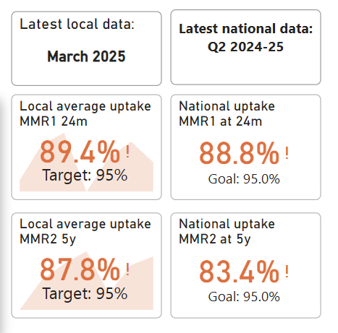
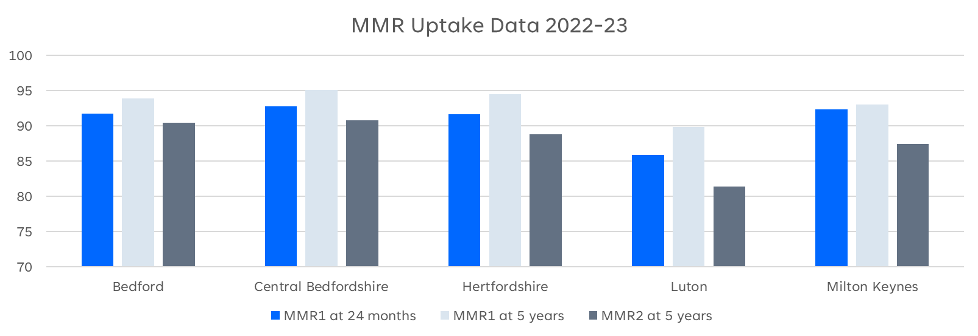
MMR Uptake
Notes:
Plain slide with subhead and bullets

Slide 33
MMR
Measles: one dose of vaccine is 95% effective in preventing measles.
This is why the first dose is so important (at 12-13 months).
Mumps: one dose is 72% effective, rising to 86% after two doses.
Rubella: one dose is 89% effective.
Notes:
Plain slide with subhead and bullets

Slide 34
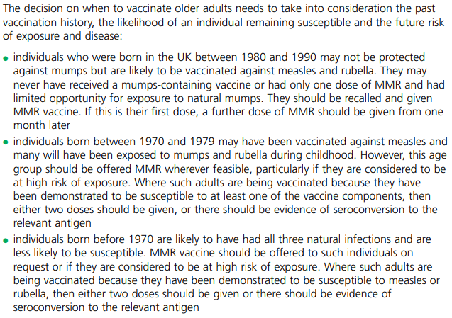
MMR
Current guidance is that staff should have a record of having x2 measles-containing vaccines.
Notes:
Plain slide with subhead and bullets

Slide 35
CSAIS
Community and School-aged Immunisation Service.
Administer vaccines cradle to grave – run community clinics.
HCT CSAIS covers East of England (hct.immsenquiries@nhs.net).
They administer the selective Hep B schedule, BCG, all school-aged immunisations (including flu), and some maternity immunisations (sub-contracted).
Health visitors, school nurses, GPs and parents can refer to CSAIS.
Notes:
Plain slide with subhead and bullets

Slide 36
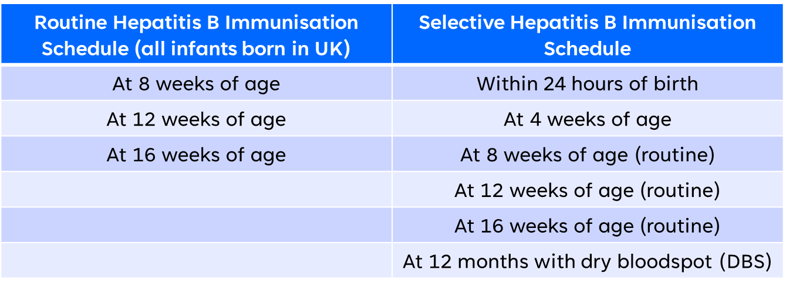
Hep B
Infants born to mothers who screened positive in pregnancy for Hepatitis B are offered the selective Hep B immunisation schedule.
Infants born to HepB+ fathers = 1 dose of HepB vaccine prior to discharge from hospital
Notes:
Plain slide with subhead and bullets

Slide 37
HepB Schedules
** CSAIS undertake 4-week, 12 month & DBS up until aged 5 years – then will be referred to GP to complete. GP can refer to Acute for serology.
Notes:
Plain slide with subhead and bullets

Slide 38
BCG
BCG vaccination is recommended for all babies at 28 days who are at higher risk of contracting TB (SCID result must be checked), such as those who:
are born in areas of the UK where TB rates are high;
have a parent or grandparent who was born in a country where there's a high rate of TB;
live with, or are close contacts of, someone with infectious TB.
You can check high incidence countries here.
Hertfordshire Community Trust (HCT) CSAIS provides BCG vaccination.
Referrals accepted for any child up until their 16th birthday, who meets one of the above criteria.
Notes:
Plain slide with subhead and bullets

Slide 39
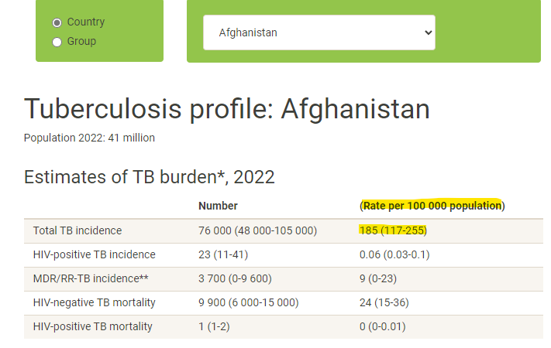
TB Incidence
High incidence countries = estimated incidence rate of 40 per 100,000 or greater
Select different countries using the drop-down menu
Here is the incidence (≥ 40 per 100,000 = high)
TB profile (shinyapps.io)
Notes:
Plain slide with subhead and bullets

Slide 40
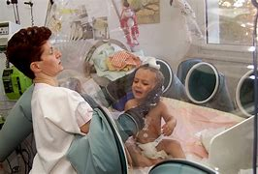
SCID
Severe combined immunodeficiency (SCID)
Group of rare, inherited disorders.
Affected infants become seriously unwell in the first few months of life.
Without treatment, these children usually die by 2 years of age.
Pilot of screening began in September 2021, in targeted areas (awaiting evaluation).
SCID results (if part of the pilot) should be known before administering a live vaccine (i.e., Rotavirus, BCG, MMR, nasal Flu, Chickenpox).
Notes:
Plain slide with subhead and bullets

Slide 41
Changes to immunisation programmes
HPV is now a one dose schedule (September 2023).
Respiratory syncytial virus (RSV) – decided to be a maternal immunisation programme, and 75+. Started 1st September 2024.
Maternal pertussis vaccine change as of 1st July 2024: from Boostrix-IPV to Adacel (Tdap – non-Polio containing) due to infants whose mothers had Boostrix showing lower antibody responses to Polio, although all remained above the protective threshold. (*Boostrix-IPV can still be used for those women who are contraindicated to receive Adacel, or if you do not have Adacel stock).
Immunisation Call & Recall Service.
Notes:
Plain slide with subhead and bullets

Slide 42
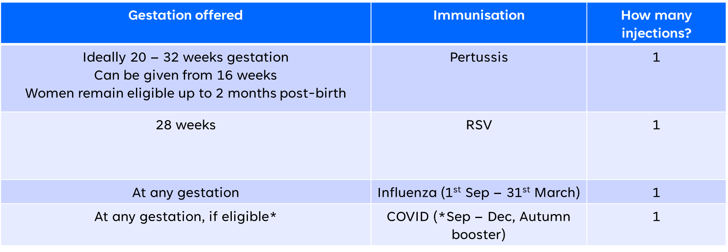
Pregnant people immunisations
Notes:
Plain slide with subhead and bullets

Slide 43
Why we vaccinate pregnant women / people
Children in early infancy do not have effective antibody responses to many vaccines.
Results in increased susceptibility or severity infections.
Vaccine-preventable infections are among the leading causes of morbidity in pregnant people.
Immunisation during pregnancy generates maternal immune protection as well as transfer of antibodies across the placenta and via breastfeeding to provide early infant protection (before they reach the age to get their vaccines).
Notes:
Plain slide with subhead and bullets

Slide 44
Uptake – pregnant women / people / ‘at-risk children’
‘At-risk’ = immunosuppressed, asplenia, chronic heart / kidney / liver disease, diabetes (amongst others).
Uptake for these vulnerable cohorts remains low.
Flu vaccine uptake – pregnant people: c. 35%
Pertussis vaccine uptake – c. 67%
COVID vaccine uptake – c. 7%
RSV vaccine uptake – c. 38% (new programme)
Notes:
Plain slide with subhead and bullets

Slide 45
Pertussis
Pertussis or whooping cough is a highly infectious disease which can lead to serious complications including death.
The disease is especially severe in newborn babies and is a major cause of infant death worldwide; the World Health Organization (WHO) estimates that in 2008 there were about 16 million cases of pertussis, and that about 195,000 children died from the disease.
WHO estimates that, in 2008, global vaccination against pertussis averted about 687,000 deaths.
In 2012 the UK experienced a nationwide outbreak (epidemic) of pertussis. There were over 9,300 cases in England alone – more than ten times as many as in recent years.
Notes:
Plain slide with subhead and bullets

Slide 46
Cases
Have seen an increase in the number of cases of pertussis in England:
The increase in cases occurred across all age groups including the <1-year olds and sadly 10 infant deaths Jan – Dec 2024 in England.
Time period | No. of cases (Pertussis / Whooping Cough)
2023 | 858
Jan – Dec 2024 | 14,905
Confirmed cases of pertussis in England by month - GOV.UK (www.gov.uk)​
Notes:
Plain slide with subhead and bullets

Slide 47
Pertussis vaccine uptake
Notes:
Plain slide with subhead and bullets

Slide 48
Notes:
Plain slide with subhead and bullets

Slide 49
Pertussis vaccine safety
A study of 20,000 pregnant people who had received a pertussis vaccine in the UK compared with a matched, historical unvaccinated cohort of pregnant women in the UK.
No increased risk was found when compared to historical and unvaccinated controls for:​
Stillbirth/Neonatal death ​
Pre-eclampsia/Eclampsia
Placenta praevia ​
Intra-uterine growth restriction/Low birth weight
Caesarean section​
Postpartum haemorrhage
Premature labour ​
Notes:
Plain slide with subhead and bullets

Slide 50
Pertussis vaccine side effects
Most Common: redness, pain, swelling at the injection site​
Less Common: pyrexia (>37.5⁰C), haematoma, induration (skin hardening), pruritus (itchy skin) and warmth at the injection site​
Uncommon: swelling of vaccinated limb, pyrexia (>39.5⁰C), chills, pain​.
Safety of pertussis vaccination in pregnant women in UK: observational study | The BMJ
Notes:
Plain slide with subhead and bullets

Slide 51
*Trigger warning*
Notes:
Plain slide with subhead and bullets

Slide 52
Occupational pertussis vaccination for healthcare workers
Priority group 2: HCWs with regular clinical contact with young, unimmunised infants in hospital or community settings. This includes health visitor staff.
From June 2024 eligibility for vaccination is being extended to HCWs who are in priority group 2.
Eligible HCWs should be given a single booster dose. There are currently no recommendations for additional booster doses.
Occupational pertussis vaccination of healthcare workers - GOV.UK (www.gov.uk)
Notes:
Plain slide with subhead and bullets

Slide 53
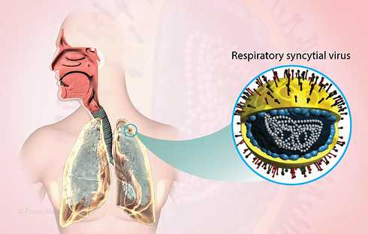
RSV
Respiratory syncytial virus.
Viral pathogen - respiratory infections, can trigger pneumonia or bronchiolitis, characterised by inflammation in the airways.
Very common - globally, infects up to 90% of children within the first 2 years of life and frequently reinfects older children and adults.
More common during winter, especially in temperate countries like the UK.
Roughly 33 million cases, 3.6 million hospital admissions, and 100,000 deaths globally each year in children under 5 years old.
Second largest infectious cause of death in children under one year of age, after malaria.
Notes:
Plain slide with subhead and bullets

Slide 54
Pilot
Notes:
Plain slide with subhead and bullets

Slide 55
RSV vaccine
Every year in our region hundreds of babies get ill and go to hospital ​with RSV and some sadly die​.
JCVI recommendation - maternal vaccination programme.
RSV vaccine cannot routinely be given at the same time as pertussis, so it’s going to be vital to keep motivation for vaccination high, so that we can save babies lives​.
As with pertussis, RSV vaccine needs to be offered for each pregnancy that an individual has – “every baby needs the protection, so every pregnancy needs the vaccine!”
Notes:
Plain slide with subhead and bullets

Slide 56
Premature babies
Any infant born before 37 completed weeks gestation.
It is important that premature infants have their immunisations at the appropriate chronological age, according to the schedule.
Advice on the use of prophylactic paracetamol should be followed as recommended for term infants.
As the benefit of vaccination is high in this group of infants, vaccination should not be withheld or delayed.
Notes:
Plain slide with subhead and bullets

Slide 57
Use of Paracetamol (Calpol)
Fever can be expected after any vaccination, but more common after MenB (offered at 8 & 16 weeks and 1 year).
Give paracetamol soon after MenB vaccination, not before and not waiting for the fever to develop.
Paracetamol is only for use from 2 months of age onwards (and if over 4kg).
Paracetamol should not be given routinely for any other immunisations as its use has not been shown to prevent febrile convulsions but may lower the antibody response to a vaccine.
Notes:
Plain slide with subhead and bullets

Slide 58
Gillick competency
Gillick competency is used to help assess whether a child has the maturity to make their own decisions.
Healthcare professionals need to consider Gillick competency if a young person under 16 wishes to receive treatment without having their parent’s consent, or in some cases, knowledge.
Encourage a child to tell their parents about the decisions they are making. If they don't want to do this, you should explore why and discuss ways you could help them inform their parents or carers.
Notes:
Plain slide with subhead and bullets

Slide 59
Using Gillick competency
Professionals need to consider several things when assessing a child's capacity to consent, including:
the child's age, maturity and mental capacity
their understanding of the issue and what it involves - including advantages, disadvantages and potential long-term impact
their understanding of the risks, implications and consequences that may arise from their decision
how well they understand any information they have been given
their understanding of any alternative options, if available
their ability to explain a rationale around their reasoning and decision making.
Gillick competence and Fraser guidelines | NSPCC Learning
Notes:
Plain slide with subhead and bullets

Slide 60
Let’s check our knowledge…
Notes:
Plain slide with subhead and bullets

Slide 61
Putting into practice
What new information have you learnt today?
Do you feel more confident in your knowledge around immunisations i.e., who to refer to, discussing with parents, etc.?
How can you use what you have learnt in your practice?
Notes:
Plain slide with subhead and bullets

Slide 62
Questions…
Questions in the chat
Any other questions?
Notes:
Plain slide with subhead and bullets

Slide 63
Feedback

Slide 64
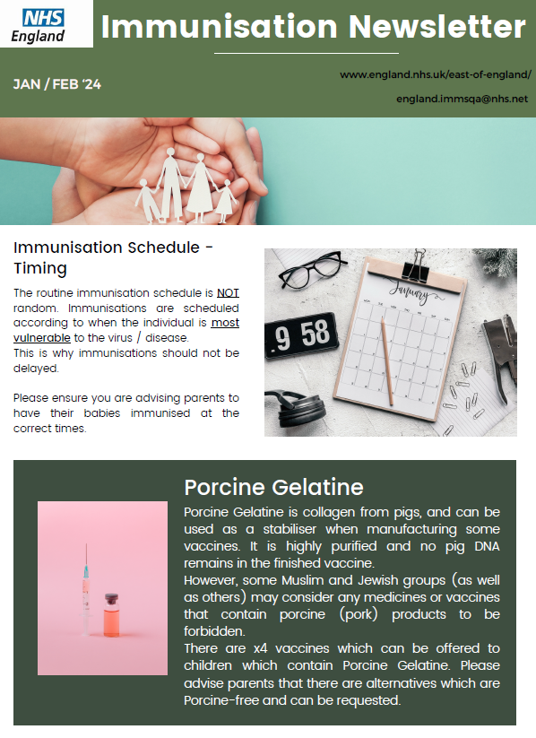
Newsletter
Notes:
Plain slide with subhead and bullets

Slide 65
End slide
E-mail: england.immsqa@nhs.net
Website: NHS England — East of England

Slide 66
Key Documents
Cochrane Review confirms effectiveness of MMR vaccines | Cochrane UK
MMR Vaccine (Measles, Mumps and Rubella Vaccine) | Vaccine Knowledge Project (ox.ac.uk)
Immunisation against infectious disease - GOV.UK (www.gov.uk)
Vaccination of individuals with uncertain or incomplete immunisation status (publishing.service.gov.uk)
Home | Vaccine Knowledge Project (ox.ac.uk)
Pregnancy: how to help protect you and your baby - GOV.UK (www.gov.uk)
Notes:
Plain slide with subhead and bullets

Slide 67
Key Documents
Guidance on the hepatitis B antenatal screening and selective neonatal immunisation pathway - GOV.UK (www.gov.uk)
Vaccine update: issue 344, November 2023, pregnancy special - GOV.UK (www.gov.uk)
Videos about vaccines | British Society for Immunology
Latest measles statistics published - GOV.UK (www.gov.uk)
Quarterly vaccination coverage statistics for children aged up to 5 years in the UK (COVER programme): July to September 2023 - GOV.UK (www.gov.uk)
Notes:
Plain slide with subhead and bullets

Slide 68
Key Documents
What to do if you think your child has measles and when to keep them off school – The Education Hub (blog.gov.uk)
JCVI statement on a childhood varicella (chickenpox) vaccination programme - GOV.UK (www.gov.uk)
Campaign Resource Centre (dhsc.gov.uk)
How to talk about vaccines (who.int)
Vaccination against pertussis (whooping cough) for pregnant women - GOV.UK (www.gov.uk)
Respiratory syncytial virus (RSV) vaccination programme - GOV.UK (www.gov.uk)
Notes:
Plain slide with subhead and bullets

