Slide 1
HWE and BLMK annual flu update
2025/2026
This presentation also contains slides collated from the UKHSA flu slide set found here: Annual flu programme - GOV.UK (www.gov.uk)
Notes:
Standard title slide

Slide 2
Overview of the session
Background and overview of the programme
Cold chain
Updates for this season
Vaccines for 2025/2026 season
Coadministration with other vaccines
FAQs

Slide 3
Immform now open!
Open for ordering from today (4th September), for all vaccines in the childhood programme

Slide 4
Key messages
flu immunisation is one of the most effective interventions we can provide to reduce harm from flu and pressures on health and social care services during the winter
it is important to increase flu vaccine uptake in clinical risk groups because of increased risk of death and serious illness if people in these groups catch flu
flu during pregnancy may be associated with perinatal mortality, prematurity, smaller neonatal size, lower birth weight and increased risk of complications for the mother
vaccination of health and social care workers protects them and reduces the risk of them spreading flu to their patients, service users, colleagues and family members
by preventing flu infection through vaccination, secondary bacterial infections such as pneumonia are prevented. This reduces the need for antibiotics and helps prevent antibiotic resistance
for a number of years, only around half of patients aged 6 months to under 65 years in clinical risk groups have been vaccinated
the childhood flu programme should reduce the impact of seasonal flu on children and reduce transmission of flu within the community
by reducing transmission of flu, it should also avert many cases of severe flu and flu-related deaths in older adults and people in clinical risk groups
Notes:
Morbidity and mortality attributed to flu is a key factor in NHS winter pressures and a major cause of harm to individuals, especially vulnerable people. The annual flu immunisation programme helps to reduce GP consultations, unplanned hospital admissions and pressure on A&E and is therefore a critical element of the system-wide approach for delivering robust and resilient health and care services during the winter.

Slide 5
Evolution of UK flu vaccination programme
Late 1960s: annual flu immunisation recommended to directly protect those in clinical risk groups who are at a higher risk of influenza associated morbidity and mortality
2000: flu vaccine policy extended to include all people aged 65 years or over
2010: pregnancy added as a clinical risk category for routine flu immunisation
2013: phased introduction of an annual childhood flu vaccination programme for all children aged 2 to 16y began with vaccine offered to all children aged 2 and 3 years and 7 geographical pilots in primary school aged children
2014: phased introduction of childhood flu vaccination programme continued with vaccine offered to all children aged 2, 3 and 4 years and geographical pilots in primary and secondary school aged children
2015: in addition to vaccinating 2, 3, and 4 year olds in primary care, the programme began nationally in primary schools in a phased roll-out starting with the youngest school-aged children first
Between 2016 and 2019: phased introduction of childhood flu vaccination programme continued with a year on year addition of the next school year
2020: offer to all children aged 2 to school year 7 and extended to those aged 50 to 64 years
  2021 and 2022: programme extended to offer to all those aged 50 to 64 years and to all children from age 2 up school year 11 (in 2021) and age 2 up to school year 9 (in 2022) because of concerns over co-circulation of flu and COVID-19
  2023, 2024 and 2025: flu vaccine programme to offer to clinical risk groups, all aged 65 years and over, and all children aged 2 to 15 years old (up to school year 11)
Notes:
Following a recommendation in 2012 by the Joint Committee on Vaccination and Immunisation (JCVI) that the routine annual flu vaccination programme should be extended to include children, a phased introduction of this extension began in 2013. In 2013, flu vaccine was offered to all 2 and 3 year old children, and to 4 to 10 year olds (up to and including pupils in school year 6) in 7 different geographical pilot areas.
For the 2014 to 2015 flu season, flu vaccine was offered to all 4 year old children as well as to all 2 and 3 year old children. The geographical pilots of primary school aged children started in 2013 to 2014 continued and there were also several different geographical pilots in secondary school aged children in Years 7 and 8.
In 2015 to 2016, flu vaccine was offered to all 2, 3 and 4-year-olds, to children of school year 1 and 2 age and to all primary school-aged children in areas that participated in previous primary school pilots.
In 2016 to 2017, flu vaccine was offered to all 2, 3 and 4-year-olds, to children of school year 1, 2 and 3 age and to all primary school-aged children in areas that participated in previous primary school pilots.
In 2017 to 2018, flu vaccine was offered to all 2, 3 and 4-year-olds, to children of school year 1, 2 , 3 and 4 age and to all primary school-aged children in areas that participated in previous primary school pilots. This was the first flu season that Reception Year children (aged 4 to 5 years) were offered flu vaccination in their reception class, rather than through general practice
In the 2018 to 2019 flu season, flu vaccine was offered to all children aged 2 to 9 years old (but not 10 years or older) on 31 August 2018 and to all primary school-aged children in former primary school pilot areas.
In the 2019 to 2020 flu season, flu vaccine was offered to all children aged 2 to 10 years (but not 11 years or older) on 31 August 2019. It was also offered to children from 6 months of age in clinical risk groups.
During the 2020 to 2021 season, the national programme was extended to include children of Year 7 (aged 11 rising to 12 years old)
In the 2021 to 2022 flu season, in addition to 2 and 3 year olds and primary school aged children, children in School Year 7 to 11 in secondary school were also offered the vaccine.
For the 2022 to 2023 flu season, flu vaccine was offered to all children aged 2 or 3 years on 31 August 2022, to all primary school aged children (from Reception to Year 6) then to secondary school-aged children up to and including Year 9. If there was remaining vaccine Year 10 and 11 were vaccinated. Vaccine was also offered to those aged 50 to 64 years old not in clinical risk groups (including those who turn 50 by 31 March 2023).
For the 2023/24, 2024/25 and 2025/26 flu seasons, flu vaccine offer for those in clinical risk groups, all aged 65 years and over, and all children aged 2 to 15 years old (up to school year 11)

Slide 6
Changes to the flu vaccines from quadrivalent to trivalent for the 2025 to 2026 vaccination programme
flu vaccines used to be trivalent and contain 2 type A and 1 type B influenza virus strains
in 2013, in order to extend protection against flu, both B strains were included in flu vaccines and these quadrivalent vaccines were then offered up until the last flu season (with the exception of LAIV which became a trivalent vaccine for the 2024 to 2025 flu season)
in 2023, the WHO recommended that the B/Yamagata lineage antigen should be excluded from future flu vaccines as there have been no confirmed naturally occurring B/Yamagata lineage virus detections after March 2020
as the B/Yamagata lineages are no longer circulating and are unlikely to cause future epidemics, the inclusion of a B/Yamagata antigen as a component of flu vaccines is no longer necessary
WHO stated that every effort should be made to exclude this B strain as soon as possible, across all vaccine types, so for the 2025 to 2026 flu vaccination programme, all flu vaccines will be trivalent vaccines once again
the trivalent vaccines will offer the same level of protection against the 2 A and 1 B flu virus strains in them as the quadrivalent vaccine
Notes:
Originally, most influenza vaccines were trivalent, containing 2 subtypes of influenza A and one B virus but then quadrivalent vaccines with an additional B virus were developed and used in recent years to improve the match of the vaccine and offer wider protection against circulating influenza B viruses. The first authorised quadrivalent flu vaccine was made available for use in the UK in 2013. From then, up until this forthcoming flu season (2025 to 2026), all the flu vaccines recommended for use in the UK were quadrivalent vaccines.
Every year JCVI reviews the latest evidence on flu vaccines and advises the type of vaccine to be offered to different age groups. Their advice for 2025 to 2026 noted that the World Health Organization (WHO) has concluded that B/Yamagata lineages are no longer circulating and are unlikely to cause future epidemics, and that inclusion of a B/Yamagata antigen as a component of flu vaccines is no longer warranted. WHO stated that every effort should be made to exclude this as soon as possible, across all vaccine types. Therefore, for the 2025 to 2026 flu vaccination programme, all flu vaccines will be trivalent vaccines again.

Slide 7
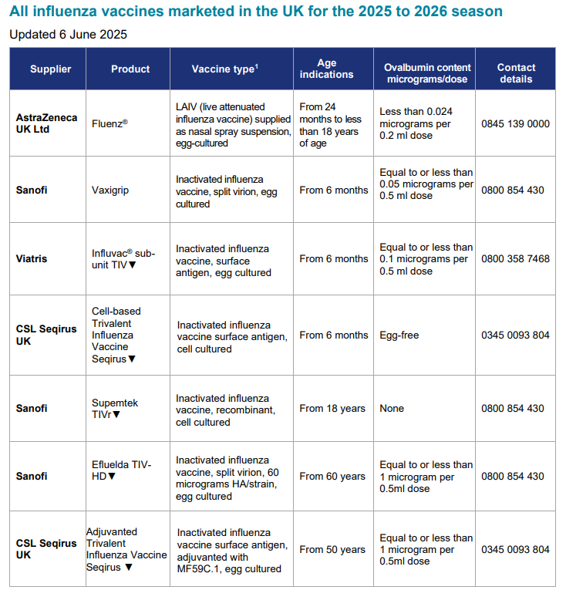
Influenza vaccines available for 2025 to 2026
Several different flu vaccines are available for the 2025 to 2026 flu season
A poster detailing the age indication and the ovalbumin content of these is available from the GOV.UK website:
www.gov.uk/government/publications/influenza-vaccines-marketed-in-the-uk
Notes:
There are a number of different flu vaccines available each year and it is important to be aware of the age indications for each of them and the ovalbumin content for those where the flu viruses are grown on hens eggs.

Slide 8
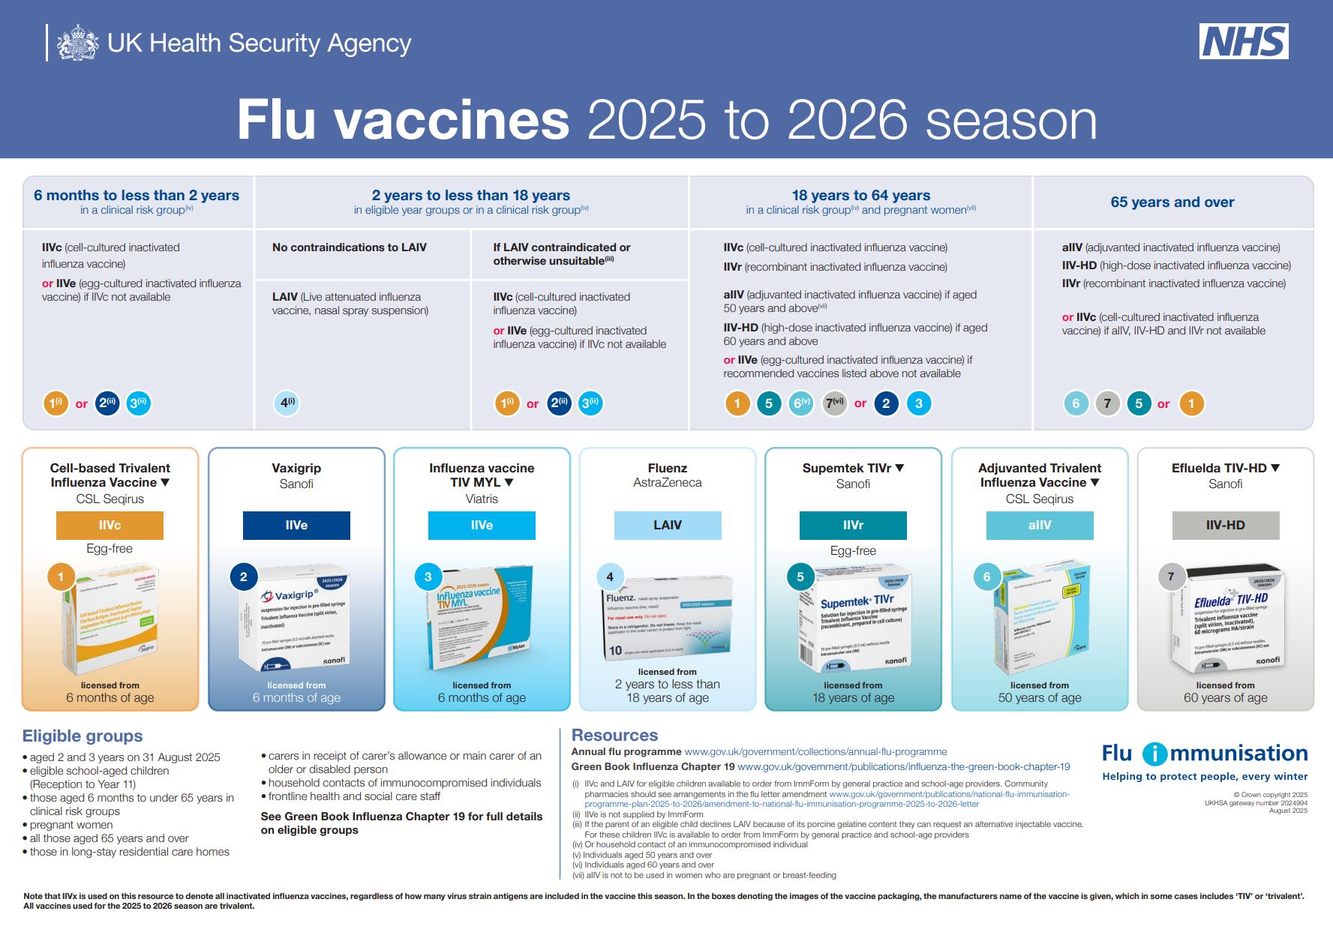
Flu vaccines 2025 to 2026 season A3 landscape poster

Slide 9
Flu vaccine eligibility: 2025 to 2026 flu season
From 1 September 2025:
pregnant women
all children aged 2 or 3 years on 31 August 2025
primary school aged children (from Reception to Year 6)
secondary school aged children (from Year 7 to Year 11)
all children in clinical risk groups aged from 6 months to less than 18 years
From October 2025:
those aged 65 years and over
those aged 18 years to under 65 years in clinical risk groups (as defined in Green Book, Influenza Chapter 19)
those in long-stay residential care homes
carers in receipt of carer’s allowance, or those who are the main carer of an elderly or disabled person
close contacts of immunocompromised individuals
frontline workers in a social care setting without an employer led occupational health scheme
Notes:
“Carers” are those who are eligible for a carer’s allowance, or those who are the sole or primary carer of an elderly or disabled person whose welfare may be at risk if the carer falls ill
Vaccination should also be offered to close contacts of immunocompromised individuals, specifically individuals who expect to share living accommodation on most days over the winter and, therefore, for whom continuing close contact is unavoidable. Child contacts of very severely immunocompromised individuals should be given inactivated vaccine rather than the live vaccine that would normally be recommended for children under 18 years.
Organisations should vaccinate all frontline health care workers and social care workers, in order to meet their responsibility to protect their staff and patients and ensure the overall safe running of services. There are limited circumstances where social care workers without access to an employer led occupational health scheme can access the vaccine on the NHS.
Frontline workers in a social care setting without employer led occupational health schemes including those working for:
a registered residential care or nursing home
registered domiciliary care providers
voluntary managed hospice providers
those that are employed by those who receive direct payments (personal budgets) or Personal Health Budgets, such as Personal Assistants
The list on the slide above is not exhaustive, and the healthcare practitioner should ensure they are aware of all eligible groups listed in the flu programme letter and apply clinical judgement to take into account the risk of flu exacerbating any underlying disease that a patient may have, as well as the risk of serious illness from flu itself. Flu vaccine should be offered in such cases even if the individual is not in the clinical risk groups specified above

Slide 10
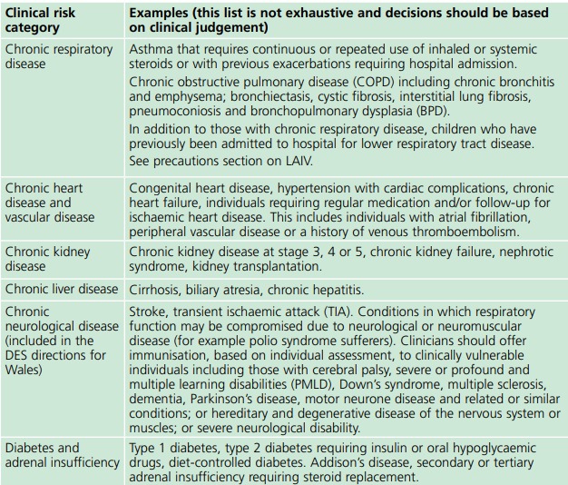
Clinical risk groups who should receive flu vaccine (1)
Notes:
Flu vaccine should be offered to the eligible groups set out in the table.
[Note to trainers: Although difficult to read the detail on this slide in a lecture theatre/classroom situation, this table is presented here in order to show immunisers that under each risk group category, individual conditions are listed and detailed. Healthcare practitioners should refer to the latest Green Book influenza chapter for further detail about clinical risk groups included in the national flu immunisation programme. This chapter is regularly updated, sometimes during the flu season, and can be found at: www.gov.uk/government/collections/immunisation-against-infectious-disease-the-green-book]

Slide 11
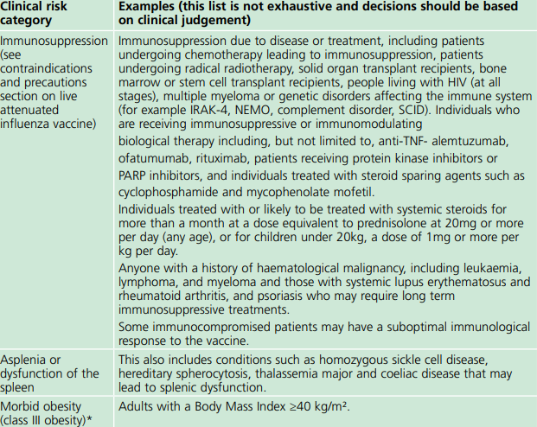
Clinical risk groups who should receive flu vaccine (2)

Slide 12
Co-administration of flu vaccine with other vaccines
flu vaccine can be given at the same time as, or at any interval from the COVID-19, shingles, pneumococcal, pertussis-containing Tdap vaccine and other live and inactivated vaccines
NB: flu vaccine should not routinely be scheduled to be given on the same day as the RSV vaccine to older adults as it may reduce the immune response made to both vaccines (although can be given if it is thought that the individual is unlikely to return for a 2nd appointment or immediate protection is necessary)
however, flu vaccine can be given at the same time as the RSV vaccine to pregnant women
if not given on the same day, no specific interval is required between administering the RSV and flu vaccines
Notes:
For older adults: Influenza vaccine and RSV vaccines
There is some data which shows that in older adults, administering the RSV vaccine, Abrysvo, at the same time as seasonal influenza vaccine may reduce the immune response to the RSV vaccine. There is also data that suggests that the response to the influenza A(H3N2) component of seasonal influenza vaccine (the influenza subtype which most severely affects older adults) may be diminished when RSV and seasonal influenza vaccine are co-administered to older adults.
The clinical significance of any reduced response is unknown, but influenza immune response is known to correlate with protection against infection, and there is emerging data that RSV immune response also correlates with clinical protection. It is therefore recommended that these vaccines should not routinely be scheduled to be given at the same appointment or on the same day. No specific interval is required between administering the vaccines.
If it is thought that the individual is unlikely to return for a second appointment or immediate protection is necessary, Abrysvo can be administered at the same time as the influenza vaccine.
For pregnant women: Influenza vaccine and RSV vaccines
The RSV vaccine, Abrysvo, can be given at the same time as the inactivated influenza vaccine to pregnant women. Similarly, there are no safety or effectiveness concerns around giving Abrysvo to pregnant teenagers who are due to have or who have recently had a live attenuated influenza vaccine nasal spray.

Slide 13

Flu – back to basics
Flu is an acute viral infection of the respiratory tract (nose, mouth, throat, bronchial tubes and lungs)
Highly infectious illness which spreads rapidly in closed communities
Even people with mild or no symptoms can infect others
Most cases in the UK occur during an 8-10 week period during the winter

Slide 14
Possible complications of flu
Common:
  bronchitis
  otitis media (children), sinusitis
  secondary bacterial pneumonia
Less common:
  meningitis, encephalitis, meningoencephalitis
  primary influenza pneumonia
Risk of most serious illness is higher in:
      children under 6 months
      older people
      those with underlying health conditions such as respiratory disease, cardiac disease, long-term neurological conditions or immunosuppression
      pregnant women (flu during pregnancy may be associated with perinatal mortality, prematurity, smaller neonatal size and lower birth weight)
Notes:
The risk of serious illness from flu is higher among children under 6 months of age, older people and those with underlying health conditions such as respiratory disease, cardiac disease or immunosuppression, as well as pregnant women. These groups are at greater risk of complications from flu such as bronchitis or pneumonia.

Slide 15
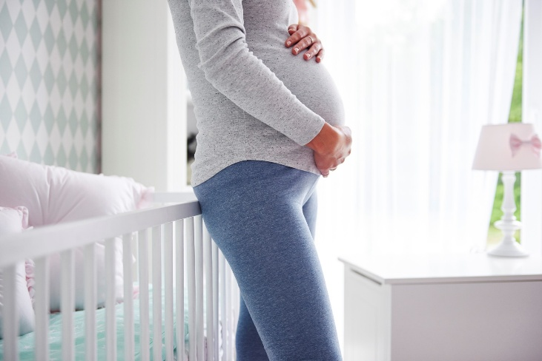
Flu risks for pregnant women
Maternal intensive care admission
Pre-term labour
Low birth weight
1 in 11 maternal deaths in 2009-2012, caused by influenza
Flu vaccine required in each pregnancy
If pregnancy is across two flu seasons, vaccines can be given in both seasons.
Vaccine protects mum and infant

Slide 16
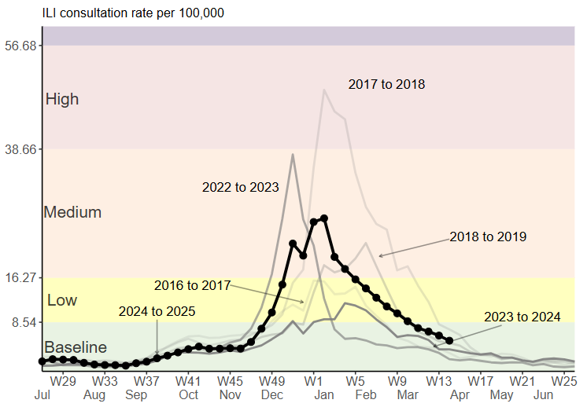
Flu epidemiology
Weekly GP influenza-like illness consultation rates per 100,000 from the RCGP RSC network, England, by season
most flu activity usually occurs between mid-November and March
during the 2024 to 2025 season, flu circulated above baseline levels from December 2024 to early March 2025, peaking at new year
influenza activity was higher in the 2024 to 2025 season than in the 2023 to 2024 season
hospital flu admissions and intensive care and high-dependency unit admissions were higher than in the previous flu season
modelling of influenza-attributable mortality in England estimated approximately 7,800 deaths due to flu in 2024 to 2025 flu season, compared to approx 3,600 in the previous season
Notes:
The impact of flu on the population varies from year to year and is influenced by changes in the virus that, in turn, influence the proportion of the population that may be susceptible to infection and the severity of the illness.
The main messages from the 2024 to 2025 season are:
the season started in the second half of November 2024 with rising influenza A(H1N1)pdm09 activity that peaked just before the start of the new year (2025) and declined after; influenza B activity started in January, leading to a slow decline of overall influenza activity
overall activity was higher than in the 2023 to 2024 season. Compared to the 2022 to 2023 season the peak was similar in both intensity as well as timing, but the 2024 to 2025 season had a slower overall decline due to the late influenza B activity
despite overall activity being higher, mortality estimates in the 2024 to 2025 season were lower than in the 2022 to 2023 season
further modelling estimated that, in England, the vaccination programme averted between 96,000 and 120,200 hospital admissions due to influenza
Influenza in the UK, annual epidemiological report: winter 2024 to 2025 - GOV.UK

Slide 17
Flu vaccine uptake in England (%)
Target group | 2024/25 | 2023/24 | 2022/23 | 2021/22 | 2020/21 | 2019/20 | 2018/19
Patients aged 65 years and over | 74.9 | 77.8 | 79.9 | 82.3 | 80.9 | 72.4 | 72
Patients aged 6 months to under 65 years in risk groups | 40.0 | 41.4 | 49.1 | 52.9 | 53 | 44.9 | 48
Pregnant women in a clinical risk group* | 44.9 | 41.4 | 33.2 | 51.8 | 57.7 | 65.9 | 60.2
Pregnant women not in a clinical risk group | 33.6 | 30.1 | 47.8 | 36 | 41.5 | 42.1 | 43.7
All pregnant women | 35.0 | 32.1 | 35.0 | 37.9 | 43.6 | 43.7 | 45.2
Frontline healthcare workers | 37.8 | 42.8 | 49.9 | 60.5** | 76.8 | 74.3 | 70.3

Slide 18
Flu vaccine uptake by individual clinical risk group in 2024 to 2025 (%) GP registered patients aged 6 months to under 65 years
Risk group | 6 months to under 2 years | 2 years to under 5 years | 5 years to under 16 years | 16 years to under 65 | Total under 65 years
Patients with Diabetes | 10.6 | 44.3 | 51.1 | 49.7 | 49.7
Patients with Chronic Kidney Disease | 14.8 | 40.1 | 44.3 | 48.1 | 48.0
Patients with immunosuppression | 9.8 | 38.3 | 46.1 | 47.4 | 47.2
Patients with Chronic Neurological Disease (including Stroke/TIA, Cerebral Palsy or MS) | 12.6 | 41.2 | 47.8 | 44.5 | 44.6
Patients with Chronic Respiratory Disease | 16.0 | 49.4 | 54.1 | 43.4 | 44.6
Patients with Chronic Heart Disease | 11.2 | 40.8 | 49.8 | 41.1 | 41.4
Patients with Chronic Liver Disease | 16.1 | 41.1 | 42.0 | 33.7 | 33.8
Patients with Asplenia or dysfunction of the spleen | 16.9 | 48.5 | 54.2 | 42.8 | 43.9
Patients with morbid obesity (BMI>=40) (no other risk factor) | - | - | - | 34.2 | 34.2
vaccine uptake for those with an underlying clinical risk factor varies widely between the individual risk groups and by age category
uptake for all those in clinical risk groups needs to improve since, despite continued efforts, only around half of those in most of the clinical risk groups are being immunised
uptake in the youngest risk groups (6 months to 2 years) is around 10-15%

Slide 19
When to vaccinate older people and risk groups
based on the evidence that the effectiveness of flu vaccine can wane over time in adults, in 2024, the JCVI advised moving the start of the flu vaccination programme for most adults to the beginning of October
this is on the understanding that the majority of the vaccinations will be completed by the end of November, closer to the time that the flu season commonly starts
it is preferable to vaccinate individuals closer to the time when the flu virus is likely to circulate (which typically peaks in December or January), as this will provide optimal protection during the highest risk period
the exceptions to this are children, pregnant women and people who are about to become immunosuppressed (see next slides)

Slide 20
When to vaccinate pregnant women
pregnant women are an exception to the advice on a later start date
vaccination of pregnant women should begin from 1 September 2025 in order to protect the baby in the first few months of life
pregnant women are not expected to lose protection as rapidly as the elderly population
therefore starting vaccination (particularly in those women who are in the later stages of pregnancy) earlier than for those in other clinical risk groups, will still offer protection to women themselves in the peak season
commencing vaccination early will ensure that as many newborn babies as possible are protected during the flu season and help to optimise uptake

Slide 21
Health and social care workers
vaccination of health and social care workers protects them and reduces the risk of spreading flu to their patients, service users, colleagues and family members
evidence that vaccination of health and social care workers significantly lowers rates of flu-like illness, hospitalisation and mortality in the elderly in long-term healthcare settings
reduces transmission of flu to vulnerable patients, some of whom may have impaired immunity and may not respond well to their own immunisation
frontline health and social care workers have a duty of care to protect their patients and service users from infection
vaccination of frontline workers also helps reduce sickness absences and contributes to keeping the NHS and care services running through winter pressures
NHS and social care bodies have a responsibility to ensure, as far as is reasonably practicable, that health and social care workers are free of, and are protected from exposure to infections that can be caught at work (Health and Social Care Act 2008, Code of Practice on the prevention and control of infections)
Notes:
Frontline health and social care workers have a duty of care to protect their patients and service users from infection. This includes getting vaccinated against flu.
Flu outbreaks can occur in health and social care settings with both staff and their patients/service users being affected when flu is circulating in the community. It is important that health and social care workers protect themselves by having the flu vaccine, and, in doing so, they reduce the risk of spreading flu to their patients, service users, colleagues and family members.
Vaccination of healthcare workers against flu has been shown to significantly lower rates of flu-like illness, hospitalisation and mortality in the elderly in long-term healthcare settings. Vaccination of staff in acute care settings may provide similar benefits. Flu immunisation of frontline health and social staff care staff may reduce the transmission of infection to vulnerable patients, some of whom may have impaired immunity, increasing their risks of flu and who may not respond well to immunisation.
Vaccination of health and social care workers also helps reduce the level of sickness absenteeism that can jeopardise the NHS and care services. This is essential in the winter when pressures on these services increase and will contribute to keeping the NHS and care services running. This is particularly important when responding to winter pressures.
Immunisation should be provided to healthcare and social care workers in direct contact with patients/clients to protect them and to reduce the transmission of flu within health and social care premises, to contribute to the protection of individuals who may have a suboptimal response to their own immunisations, and to avoid disruption to services that provide their care.
All frontline health and social care workers with direct patient/service user contact should be provided with flu vaccination by their employer. This includes staff in all NHS trusts, general practices, care homes, and domiciliary care.
Employers are encouraged to commission a service which makes access to the vaccine easy for all staff, encourage staff to get vaccinated and to monitor the delivery of their programme.
The definition of healthcare workers from the Green Book chapter 12 should be used to identify those eligible as part of the frontline and social care workers programme.

Slide 22
Vaccine uptake for frontline healthcare workers
in the 2024 to 2025 season, 37.8% of frontline HCWs were vaccinated
  51.5% of frontline HCWs in GP practices received a vaccine
  37.5% of frontline HCWs in NHS trusts received a vaccine
this is the fourth consecutive season to show a decrease in the vaccination of frontline HCWs and the lowest uptake since the 2010 to 2011 flu season
all frontline health and social care workers should be offered a flu vaccine as part of the organisations’ policy
employers have a responsibility to help protect their staff and patients or clients and ensure the overall safe running of services
employers should commission or implement a service which makes access to the vaccine easy for all frontline staff, encourages staff to get vaccinated, and monitors the delivery of their programme
in some circumstances, frontline staff, employed by specific social care providers without access to employer led occupational health schemes, can access the vaccine through the NHS free of charge

Slide 23


Slide 24
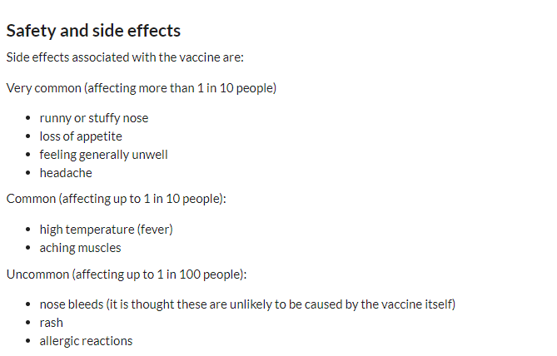
LAIV side effects
Cannot be given to anyone with a severely weakened immune system
Children who are close contacts of people with severely weakened immune systems (e.g. bone marrow transplant people requiring isolation) should be vaccinated, but given the inactivate (injectable) vaccine

Slide 25
Porcine Gelatine
LAIV contains a highly purified form of gelatine derived from pigs
Gelatine is used in LAIV as a stabiliser - it protects the live viruses from the effects of temperature
Gelatine is commonly used in a range of pharmaceutical products, including many capsules and some vaccines
There is no other live attenuated flu vaccine available that does not contain porcine gelatine.
Eligible children whose parents refuse LAIV due to the porcine gelatine content, injectable cell-based Quadrivalent Influenza Vaccine (QIVc) will be centrally supplied and should be ordered from ImmForm

Slide 26
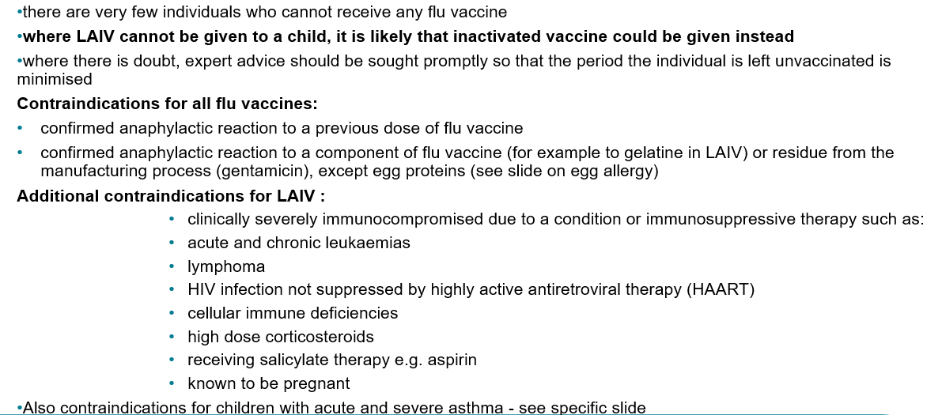
Contraindication to flu vaccine

Slide 27
Precautions to flu vaccination
Acutely unwell/severe febrile illness:
  Defer until recovered
Heavy nasal congestion:
  Defer live intranasal vaccine until resolved or, if the child is in a risk group, consider inactivated flu vaccine to provide protection without delay
Use with antiviral agents against flu:
  LAIV should not be administered at the same time or within 48 hours of cessation of treatment with flu antiviral agents
  administration of flu antiviral agents within 2 weeks of administration of LAIV may adversely affect the effectiveness of the vaccine

Slide 28
Egg allergy
CHILDREN
children with an egg allergy (including those with previous anaphylaxis to egg) can be safely vaccinated with LAIV in any setting (including primary care and schools)
children who have required admission to intensive care for a previous severe anaphylaxis to egg should be given LAIV in the hospital setting
children with both egg allergy and a clinical risk factor that contraindicates LAIV (for example immunosuppression) should be offered an egg-free inactivated flu vaccine with no or very low ovalbumin.
children aged 6 months to under 9 years in a clinical risk group who have not been previously vaccinated against influenza will require a second dose (of either LAIV (over 2 years) or inactivated vaccine as appropriate)

Slide 29

Ovalbumin content
The ovalbumin content of the flu vaccines available for 2025 to 2026 is given in the table available on the GOV.UK website www.gov.uk/government/publications/influenza-vaccines-marketed-in-the-uk.
It is also stated in the individual vaccine’s SmPC

Slide 30
Acute and Severe Asthma
Children with asthma on inhaled corticosteroids may safely be given LAIV irrespective of the dose prescribed
LAIV is not recommended for children and adolescents currently experiencing an acute exacerbation of symptoms including
  - those who have had increased wheezing and/or
  - needed additional bronchodilator treatment in the previous 72 hours
Such children should be offered a suitable inactivated influenza vaccine to avoid a delay in protection
Children who require regular oral steroids for maintenance of asthma control, or have previously required intensive care for asthma exacerbation should only be given LAIV on the advice of their specialist
These children may be at higher risk from influenza infection, those who cannot receive LAIV should receive a suitable inactivated influenza vaccine
Children with significant asthma and aged under 9 years who have not been previously vaccinated against influenza will require a second dose (of either LAIV or inactivated vaccine as appropriate)

Slide 31
When to vaccinate children (1)
as flu circulation in children normally precedes that in adults, the JCVI recommends that the children’s programme should continue to start in September as early as delivery and supply allows
protection from the vaccine lasts much longer in children, therefore the priority is to start vaccinating all children (including those in clinical risk groups) from 1 September, or as soon as vaccine becomes available
this should both provide early protection to children and reduce transmission to the wider population as the public health impact of vaccination is greater in younger children
where possible, school-aged immunisation providers are encouraged to schedule vaccination of primary school children early in the season
for school-aged cohorts, vaccination should be completed by the second Friday in December (12 December 2025)

Slide 32
When to vaccinate children (2)
parents of any child at risk from flu because of an underlying medical condition can choose to receive flu vaccination in general practice, especially if
  the parent would prefer this
  the child missed the session at school
  they do not want their child to have to wait for the school vaccination session
GP practices should invite these children for vaccination, making it clear to their parents that they have the option to have their child vaccinated in general practice (and that if they receive it there, they will not then require a dose in school)
some special educational needs (SEN) schools cater for individuals up to 25 years of age. Any young person over 17 years of age in a clinical risk group and in a SEN school can be
vaccinated with their peers, using LAIV or IIVc as appropriate

Slide 33
At risk Children Reminder
At risk 6 months – 2 years are usually very small groups per practice
Do a search and ensure all these children are invited in
Parents may not be aware they are eligible for vaccination
Check coding – why are they eligible? Is it something that has resolved

Slide 34
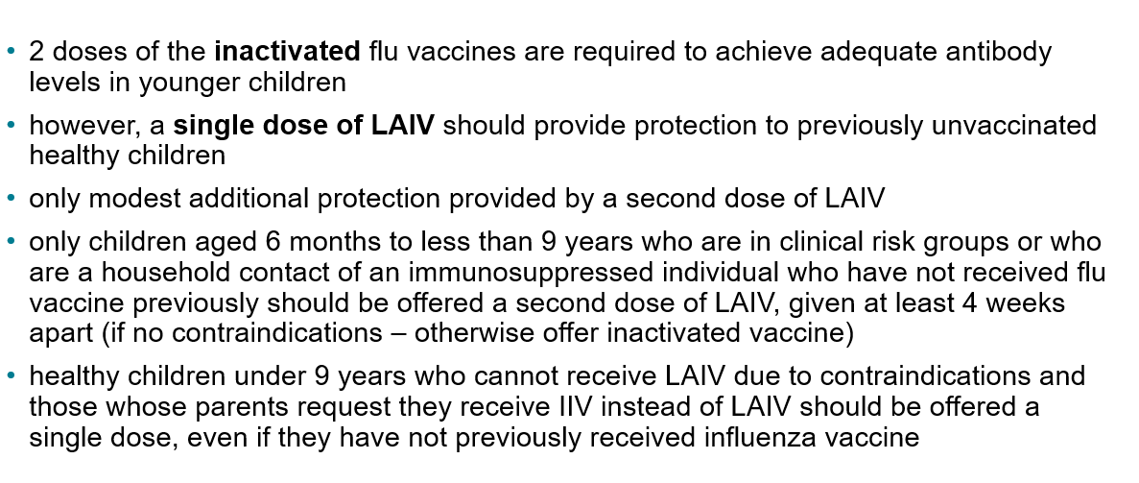
Number of doses - children

Slide 35
Rollout of the childhood flu vaccination programme in England
Extension of the seasonal flu vaccination programme to children aims to lower the public health impact of flu by:
providing direct protection by preventing cases of flu infection in children
providing indirect protection by lowering flu transmission from children to other children, adults and to those in the clinical risk groups of any age
Reducing flu transmission in the community averts many cases of severe flu and flu-related deaths in older adults and people with clinical risk factors
Studies have shown that administration of flu vaccine to children has reduced GP consultations for influenza-like illness, swab positivity in primary care, laboratory confirmed hospitalisations and percentage of respiratory emergency department attendances
the flu vaccination programme for all children has been phased in over a number of years beginning in 2013 with additional age groups being added each year
    in the 2025 to 2026 flu season, all children aged 2 to 3 years on 31 August 2025, and school aged children from Reception to Year 11 are eligible for vaccination
    children aged 6 months to 2 years in a clinical risk group are eligible due to their underlying medical condition or treatment
Notes:
In July 2012, the JCVI recommended extending the annual flu programme to include healthy children aged 2 to their seventeenth birthday in order both to lower the potentially serious impact of flu in vaccinated children and also to have a more profound effect on flu transmission. Children are the main source of transmission in the population, and extending the flu programme to include healthy children should therefore reduce the spread of infection from children to other children, to adults and to those in clinical risk groups of any age. JCVI recognised that implementation of this programme would be challenging and due to the scale of the programme it was phased in.
The children’s programme began in 2013/14 with all 2 and 3-year-olds being offered vaccination through general practice and geographic pilots in primary school-aged children. In 2014/15 this offer was extended to 4-year-olds through general practice, with pilots in primary and secondary school-aged children (in years 7 and 8). In 2015/16 the programme was extended to include children of appropriate age in school years 1 and 2 and in 2016/17, the offer of flu vaccine to extended to children in school year 3. In 2017/18, children in reception class and school years 1 to 4 were offered flu vaccine in school and pre-school age children (2y and 3y) were offered flu vaccine in primary care. In 2018/19, children in reception class and school years 1 to 5 were offered flu vaccine in school and pre-school age children (2y and 3y) continued to be offered the vaccine in primary care. In 2019/20, children in school year 6 were offered the vaccine. In the past 3 flu seasons, the childhood flu vaccination programme was extended to include more children in secondary schools. During the 2020 to 2021 flu season, children in year 7 were eligible, in the 2021 to 2022 flu season children in year 7 to year 11 were eligible, and in the 2022 to 2023 flu season, children in year 7 to year 9 were eligible.
For the 2025 to 2026 flu season, flu vaccine will be offered to all children aged 2 or 3 years on 31 August 2025, and all primary and secondary school aged children (from reception to year 11).
An analysis of data comparing the level of flu-related demand on NHS services in 2014/15 primary school pilot areas with non-pilot areas indicates that immunisation of children does have a significant impact. Results were obtained from a range of surveillance indicators including GP consultations for influenza-like illness, swab positivity in primary care, laboratory confirmed hospitalisations and percentage of respiratory emergency department attendances. The key findings were:
• the GP consultation rate for ‘influenza-like illness’ among primary school aged children was 94% lower compared to non-pilot areas
• A&E respiratory attendances by primary school aged children were 74% lower
• hospital admissions of primary school aged children caused by confirmed influenza were 93% lower
• a positive impact could also be measured among the adult population. The GP consultation rate for ‘influenza-like illness’ among adults was 59% lower compared to non-pilot areas
Children of school age that are in a clinical risk group can also access the vaccine in primary care.

Slide 36

Increasing flu immunisation uptake among children
Best practice guidance for general practice
The UKHSA have produced a summary of key strategies to help to increase flu vaccine uptake in pre-school children (from 2 years) which consider the following areas:
staff responsibilities
practice goals
identifying eligible children
inviting/contacting parents
ordering vaccines and clinics and appointments
promoting the vaccine offer to parents
ideas to sustain and promote uptake during flu season
recommendations for end of flu season review
Notes:
Note to trainers:
The content of the Best Practice Guidance for Increasing flu immunisation uptake among pre-school children is set out on the next 7 slides for those trainers who wish/are able to spend time discussing strategies for maximising uptake. Many of the ideas can also be used or adapted for older adult/clinical risk patient flu clinics
Available at Increasing influenza immunisation uptake among pre-school children - Best practice guidance for general practice (publishing.service.gov.uk)

Slide 37
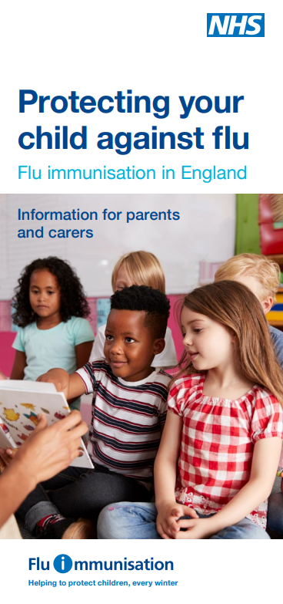
Increasing flu immunisation uptake among children
Best practice guidance for general practice
Staff responsibilities
every practice should have a lead member of staff with responsibility for running the flu immunisation campaign and all staff should know who the lead person is
all staff should understand the reason for the programme, have up to date training and access to UKHSA flu resources
every member of the practice should know their role and responsibilities
get all staff involved in promoting the vaccine message to parents
hold regular meetings so that all staff know the practice plan and progress
include health visitors, midwives, pharmacists and other healthcare professionals linked to your practice in your planning

Slide 38
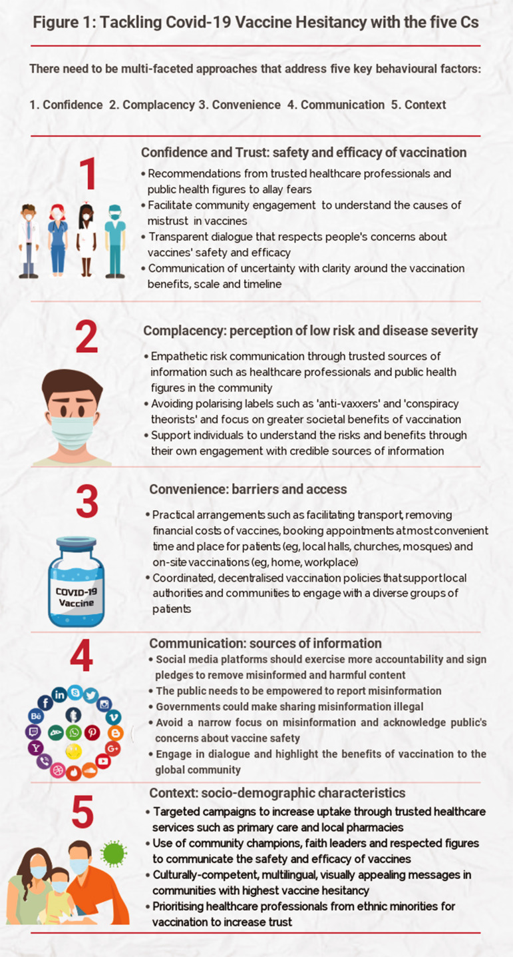
Vaccine Hesitancy
Convenience
Complacency
Confidence
Communication
Context
Notes:
Helpful graphic on vaccine hesitancy, designed for covid programme but useful for vaccine programmes in general.

Slide 39
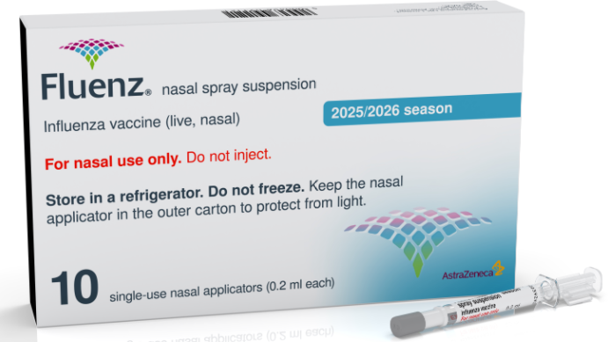
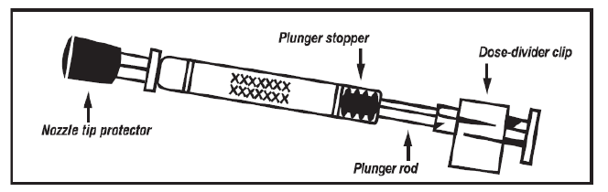
The LAIV used in the UK is Fluenz
  licensed from 2 years to less than 18 years of age
  nasal spray (suspension) in a prefilled nasal applicator
  the suspension is colourless to pale yellow, clear to opalescent and small white particles may be present
  supplied in a pack containing 10 doses (single use prefilled nasal applicators)
  ready to use (no reconstitution or dilution required)
  each applicator contains 0.2ml (administered as 0.1ml per nostril)
  the applicator has a divider clip to enable one application in each nostril.The dose divider clip should not be removed until the first half dose has been administered

Slide 40
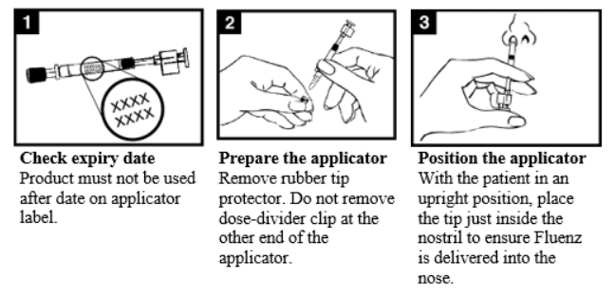
Administration of LAIV (1)

Slide 41
Administration of LAIV (2)

Slide 42

Additional messages for at-risk children
Aim to have children vaccinated early in the season (September)
GP surgery should be proactively calling in all at risk children, including school aged
Children with certain health conditions such as diabetes and issues affecting lungs, heart, kidneys, liver or immune system, are at higher risk of severe complications if they get flu. It is especially important that these children are vaccinated

Slide 43


Slide 44
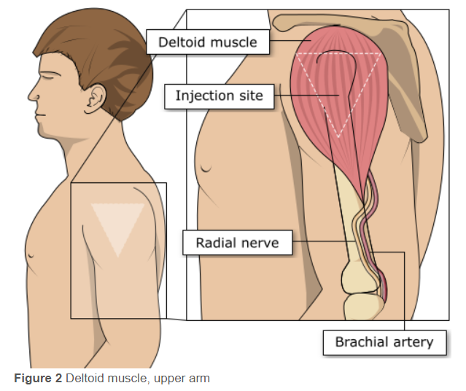
Injection site for IIV
For older infants and adults:
deltoid area of upper arm generally preferred
the vaccinator should place their index finger on the vaccine recipient’s acromion process (the highest point on the shoulder) and their thumb on the vaccine recipient’s deltoid tuberosity (the lower deltoid attachment point)
the injection site is midway between these 2 anatomical landmarks
the vaccine should be injected into the densest and thickest part of the muscle, which is usually in line with the axilla (level with armpit)
anterolateral aspect of thigh can also be used if deltoid not available or insufficient muscle mass

Slide 45
Consequences of incorrect injection technique
it is essential that the correct site and injection technique are used to administer vaccines
injecting too high into the upper arm could result in the vaccine being deposited in the shoulder capsule rather than the deltoid muscle
if this happens, inflammation can occur, leading to a shoulder injury or a frozen shoulder
  this leads to pain, weakness and a limited range of motion that can last for months
injecting too far to the side of the arm or too low on the arm risks injecting into the axillary nerve or the radial nerve
  this can cause a burning or shooting pain during the procedure and can lead to nerve damage (neuropathy/paralysis)
to avoid shoulder injury or nerve damage, always assess the limb before administering the vaccine to identify the correct site for injection

Slide 46
Commonly reported adverse reactions
Following inactivated flu vaccine:
commonly reported symptoms are: pain, swelling or redness at the injection site, low grade fever, malaise, shivering, fatigue, headache, myalgia and arthralgia
these symptoms usually disappear within 1 to 2 days without treatment
due to the MF59 adjuvant, a higher incidence of mild post-immunisation reactions has been reported with aIIV, compared to non-adjuvanted influenza vaccines
in clinical trials, some side effects were reported slightly more frequently after vaccination with IIV-HD than after standard-dose inactivated flu vaccines
Following live attenuated flu vaccine:
commonly reported symptoms include nasal congestion/rhinorrhoea, reduced appetite, feeling generally unwell, myalgia and headache
Rarely, after live or inactivated vaccine, immediate reactions such as urticaria, angio-oedema, bronchospasm and anaphylaxis can occur

Slide 47
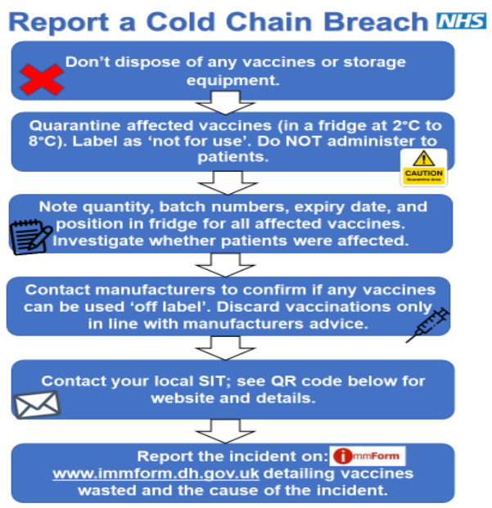
Incident Management

Slide 48
Cold Chain
For vaccines to be safe and effective they must be stored and administered correctly.
Vaccines are sensitive to heat, cold and light.
Limit quantity of stock to that needed for 2 weeks, in case of fridge failure.
Have a nominated cold chain lead.
All practice staff trained and updated on the cold chain and their role – e.g. reception staff receiving vaccines.
All staff know what to do in case of a cold chain breach.
Ideally all practices will have data loggers, which are very useful in the event of a breach
Notes:
Brief reminder of good cold chain management

Slide 49
Excursion / Cold chain breach
An “excursion” or cold chain breach, is when vaccines have been out of the cold chain for more than 20 minutes.
Visit: NHS England — East of England » Vaccine and cold chain incident management.

Slide 50
Vaccine Wastage
Do NOT discard any vaccine until after discussion with manufacturers and they have confirmed the vaccines cannot be used.
Any vaccine that must be discarded (instructed by manufacturer) must be reported on ImmForm.
Vaccine wastage cost £5.7 million of NHS funds in 2022.
The vaccine is referred to as being used ‘off-label’ if it has been stored in a way other than that described in its licence.
The decision to allow the vaccine to be used ‘off-label’ will only be taken if the vaccine is still considered to be safe and effective.
The PGD’s cover off-label vaccine use.

Slide 51
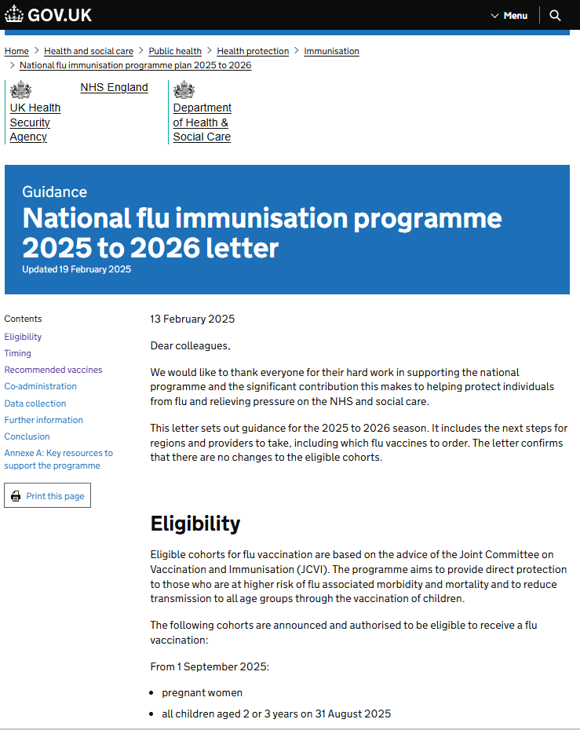
Essential further reading
please ensure that you read the national flu immunisation programme 2025 to 2026 letter (published 13 February 2025) and amendment letter (published 28 July 2025)
this letter provides key information about this year’s flu programme
it is recommended that you regularly check the UKHSA ‘Annual flu programme’ webpage during the flu vaccination period as any further information that becomes available about the programme will be published there
also read the latest Green Book Influenza chapter

Slide 52
Resources
Letters detailing 2025 to 2026 flu programme
Available at: www.gov.uk/government/publications/national-flu-immunisation-programme-plan-2025-to-2026
Green Book Influenza chapter Available at: www.gov.uk/government/publications/influenza-the-green-book-chapter-19
Leaflets, posters, information materials and other resources to support the annual flu programme Available at: www.gov.uk/government/collections/annual-flu-programme
A flu elearning programme is freely available to access https://www.e-lfh.org.uk/programmes/flu-immunisation/
PGD templates for flu vaccines www.gov.uk/government/collections/immunisation-patient-group-direction-pgd
A video for health professionals on how to administer the LAIV vaccine produced by NHS Education for Scotland is available at https://learn.nes.nhs.scot/14743/immunisation/seasonal-flu#video
Summaries of Product Characteristics (SmPC) for flu vaccines are available at www.medicines.org.uk/emc/
Leaflets and posters prepared specifically for the flu programme. Available at: www.gov.uk/government/collections/annual-flu-programme and www.healthpublications.gov.uk/Home.html

Slide 53

Resources (continued)
Flu vaccination guidance and resources for schools www.gov.uk/government/publications/flu-vaccination-in-schools
Flu immunisation: toolkit for programme extension to children www.gov.uk/government/publications/flu-immunisation-toolkit-for-programme-extension-to-children
Increasing flu immunisation uptake among children: Best Practice Guidance for General Practice
www.gov.uk/government/publications/flu-vaccine-best-practice-guide-for-gps
The national flu immunisation programme 2025 to 2026

Slide 54
Vaccine update flu special
Vaccine update: issue 362, August 2025, flu special - GOV.UK

