Slide 1
Cervical screening quarterly update session
Screening and Immunisation Teams -
East of England
East Anglia (Norfolk and Waveney, Suffolk, Cambridgeshire and Peterborough), Essex,
Hertfordshire, Bedfordshire, Luton and Milton Keynes Screening & Immunisation Team
Presented by: The Screening and Immunisation Team
Notes:
Standard title slide

Slide 2


Reminders!
Support sessions for sample takers and cervical screening administrators
East of England (EofE) only
Most of EofE samples are sent to Norfolk and Norwich lab.
A few practices in Essex send to Cervical Screening London (CSL) lab.
A few practices in HBLMK send to Berkshire and Surrey lab.
Questions and comments can be added to the
comment box through the meeting.
Please remain muted throughout the meeting.
A reminder that this is not sample taker training, or part of your 3 yearly update training/CPD.
Notes:
Plain slide with subhead and bullets

Slide 3

Our Screening and Immunisation Team
We are one team; however, we do cover different areas
Screening and Immunisation Team - Norfolk and Waveney, Cambridgeshire and Peterborough
Jamie Scott- all East Anglia
Leanne Mann - Norfolk and Waveney
Melanie Vincent - Cambridgeshire and Peterborough
Screening and Immunisation Team – Essex and Suffolk
Hayley McCarthy - all Essex and Suffolk
Claire Wright - Suffolk and Northeast Essex
Caroline Armon-Jones – Essex and Suffolk
Screening and Immunisation Team - Hertfordshire, Bedfordshire, Luton and Milton Keynes Screening & Immunisation Team
Samar Pankanti – HBLMK and West Essex
Olivia Morgans - HBLMK and West Essex
Afa Ahua- HBLMK West Essex

Slide 4
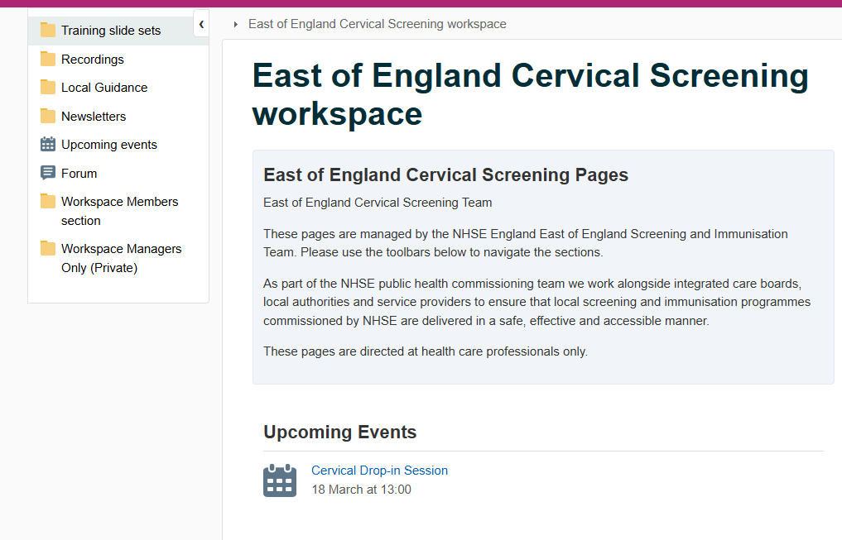
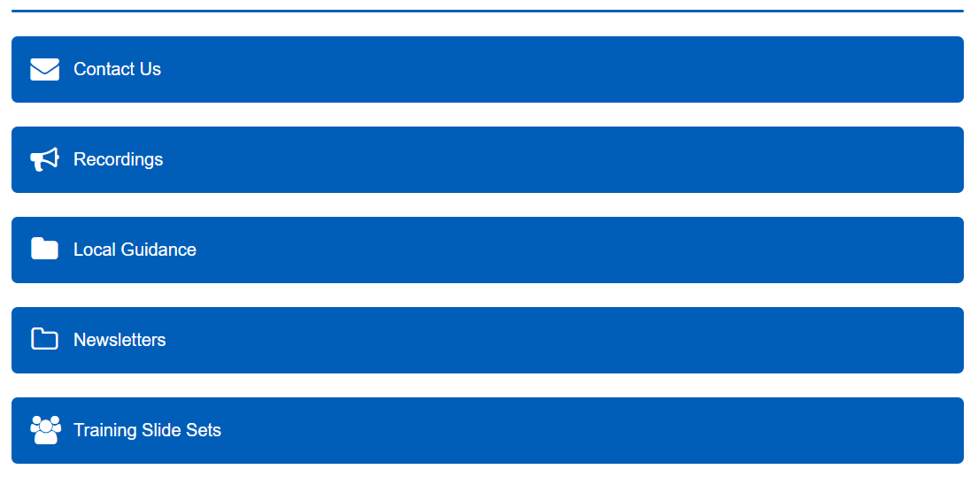
NHS Futures East of England Cervical Screening workspace - Futures

Slide 5
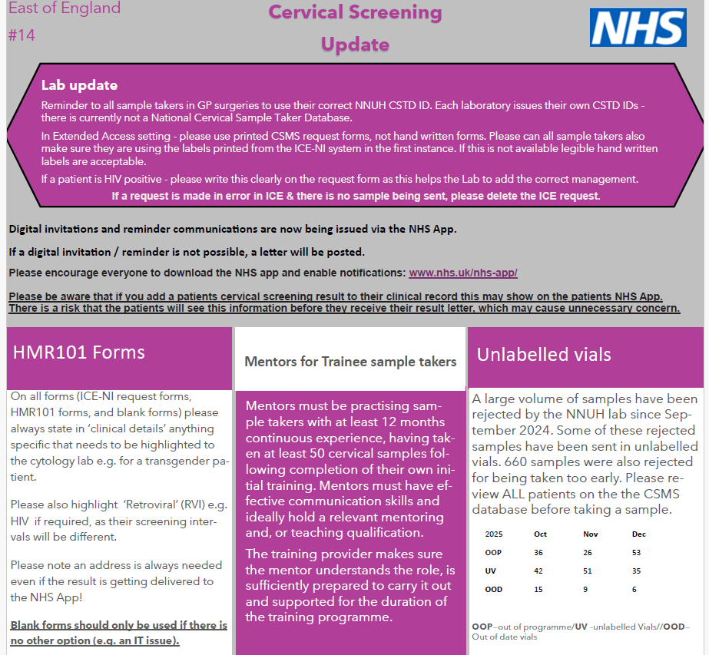
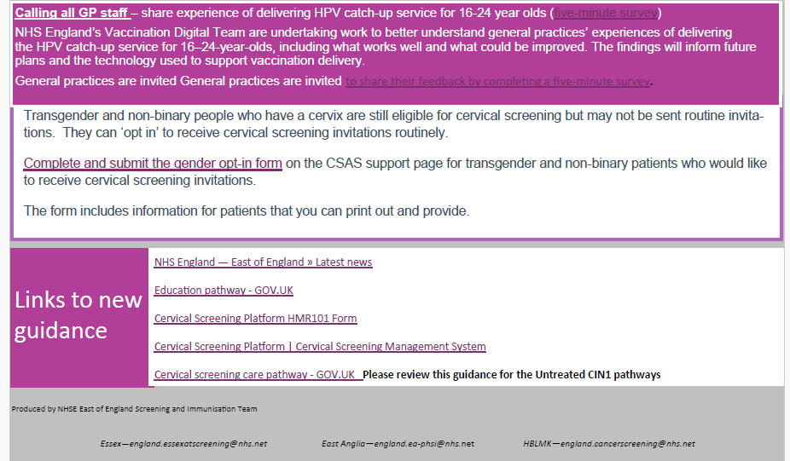
EoE Newsletter – January 2026

Slide 6
Welcome!
Today’s discussion points
Updates to the cervical screening programme
Updates
Self testing
NHS App
Ceasing patients
Non-responders List
Other tabs on CSMS
Searching for a patient on CSMS and request forms

Slide 7
Updates to the cervical screening programme

Slide 8

Updates
Reminder- 24.5- 49 years olds are now screened every 5 years, first invitation is still sent at 25 years old and if sample is negative will be invited again in 5 years time.
Screening intervals have not changed retrospectively. Participants aged 24.5 – 49 years who test negative on a routine primary HPV test, collected on or after 1st July 2025, have moved to a 5-yearly interval.
Remember your local IT systems (SytmOne/EMIS) will not be updated with these changes, this is why all patients should be checked on the CSMS to make sure they are due for screening before taking a sample (as well as checking patients current address and history).

Slide 9
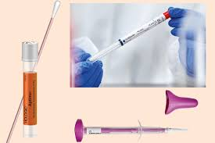
Self testing
We are preparing for HPV self-testing, there is no confirmed start date.

Slide 10

NHS App- invitations and results
All Invitation and reminders are now sent via the NHS App.
Those who have a negative test result will be notified of this by an NHS App message and notification.
In the near future (no confirm date) abnormal results will also be sent via the NHS App. We will inform you of this when this goes live.
If the NHS App message isn’t read within 72 hours, a letter will be sent as a failsafe.
Please encourage all patients to download the NHS App

Slide 11

Ceasing- CSAS- Cervical Screening Administrative Service (CSAS) have asked that all practice check a patient's status (to see if already ceased) before submitting ceasing documents, there has been an increase of ceasing letters for patients who have already been correctly ceased. Remember you can either cease a patient via PNLs - No cervix (make sure patient has had a total hysterectomy) - Age (although this should happen automatically if last 3 tests where normal) - Radiotherapy of the cervix You can't cease via PNLs for the following: - Informed consent for withdrawal from the cervical screening programme - Mental Capacity Act This is because paperwork is required for this. This was discussed at the previous drop-in session, and the presentation is on our website. There is also CSMS training you can access- Help using CSMS - NHS England Digital

Slide 12
Non-Responder List (NRL) Patients who have not responded

Slide 13
Any invited patient who does not have a test taken and the result recorded on CSMS, within 32 weeks of their first invitation, is classified as a non-responder.
Patients will appear on this list when they have not responded to 2 invitations (1 first invite and 1 reminder) to be screened.
GP practices are required to follow up and directly invite these patients.
After 8 weeks of appearing on this list, if there is no record of test being taken, these patients will be removed from the list and invited again on a date that is based on their recall status.
Please note these patients do not need to wait for their next invite, they can attend at any point.

Slide 14
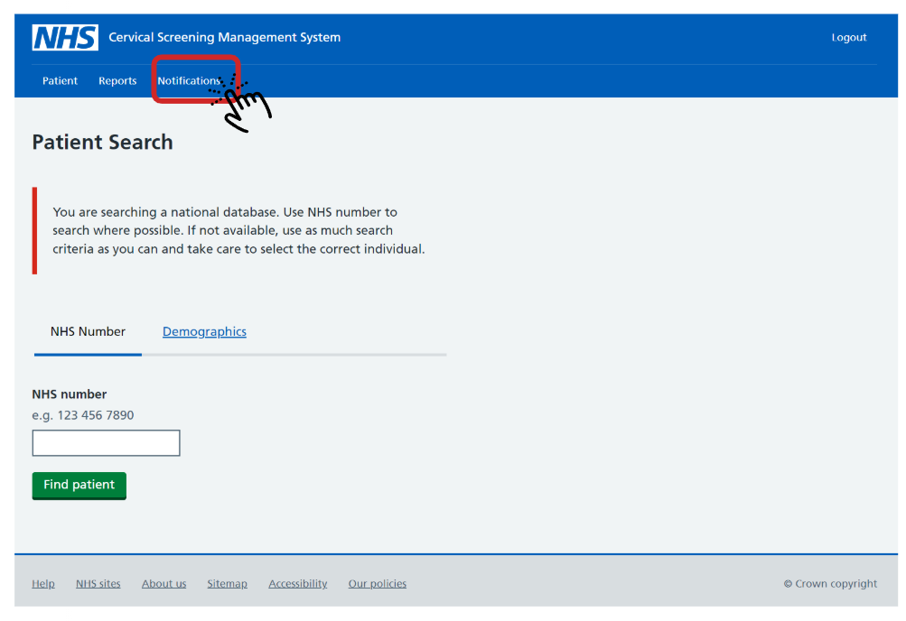
Accessing your non-responder notifications
PNLs and non-responder notifications can be found here on CSMS

Slide 15
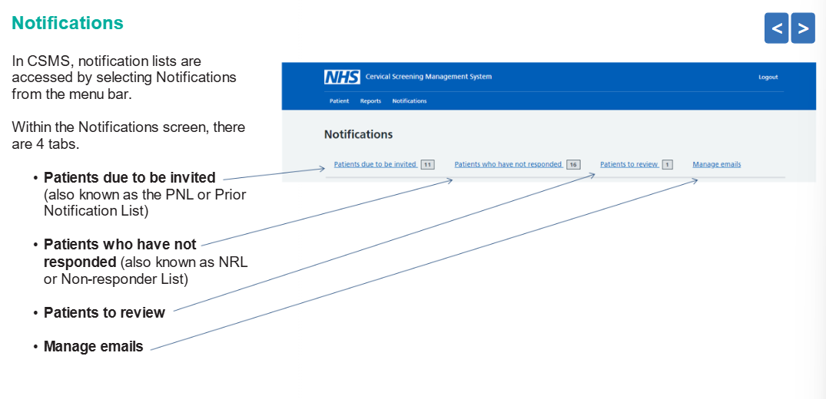

Slide 16
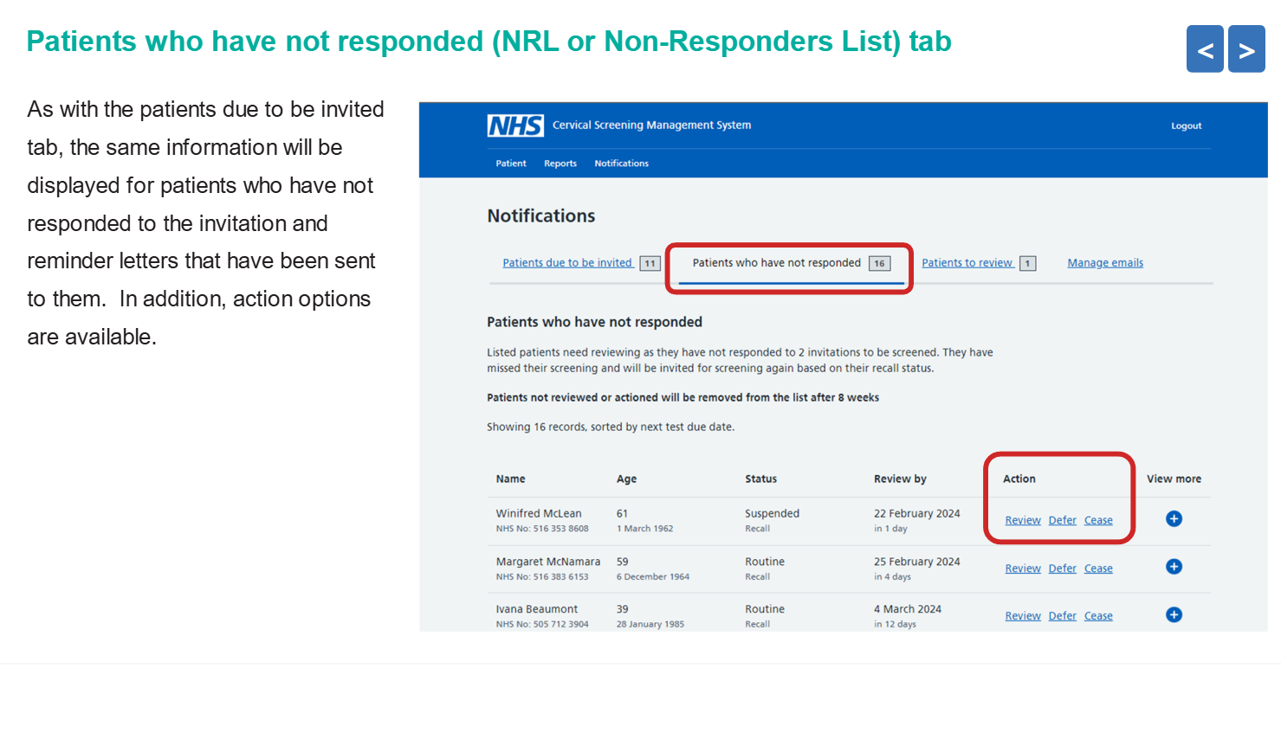

Slide 17
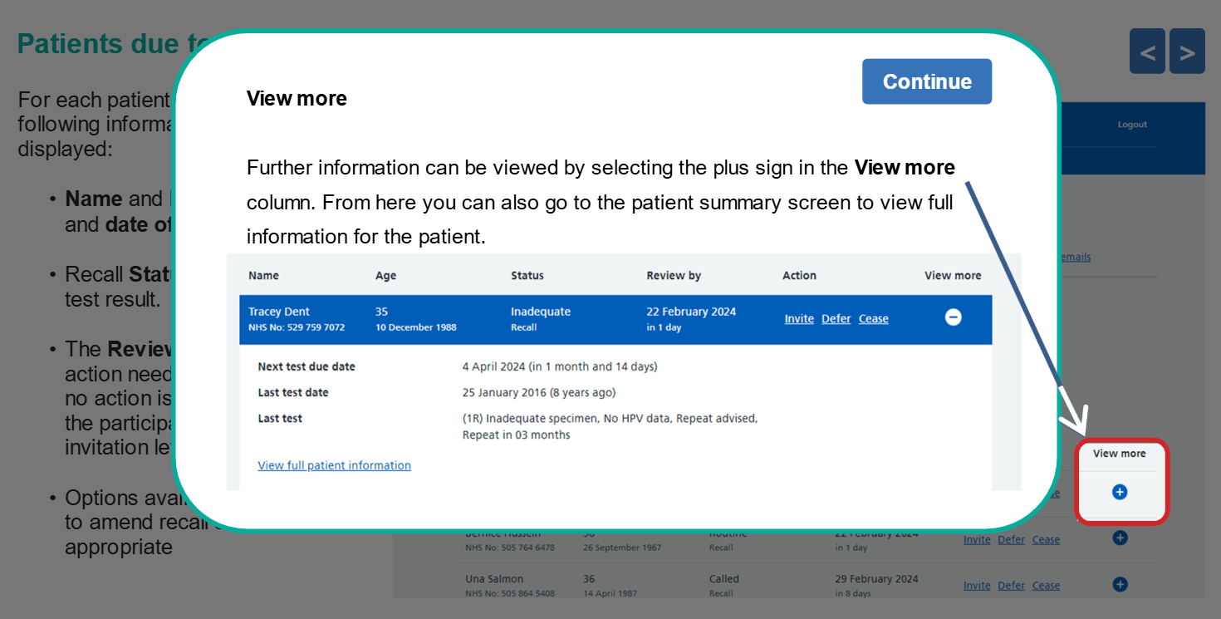

Slide 18
Before you submit the non-responder notification, review the patients notes on EMIS or SystmOne - is there a reason why they haven’t attended?
Defer if there is a reason-
Is the patient pregnant? If so, note down patients expected due date
Is the patient still under the care of colposcopy? This could be from their last cervical screening test. If this is the case, please check where their next cervical screening is due, with the GP practice or colposcopy, this should be very clear in the letter from the hospital. If they should be seen in colposcopy, please use this reason to delay the patient so they are not confused about where to attend. The patient would have also been informed that they need to attend colposcopy for their follow up cervical screening.
Under treatment relevant to screening? if stated in patient notes.
Cease if there is a reason-
No cervix (make sure patient has had a total hysterectomy)

Slide 19
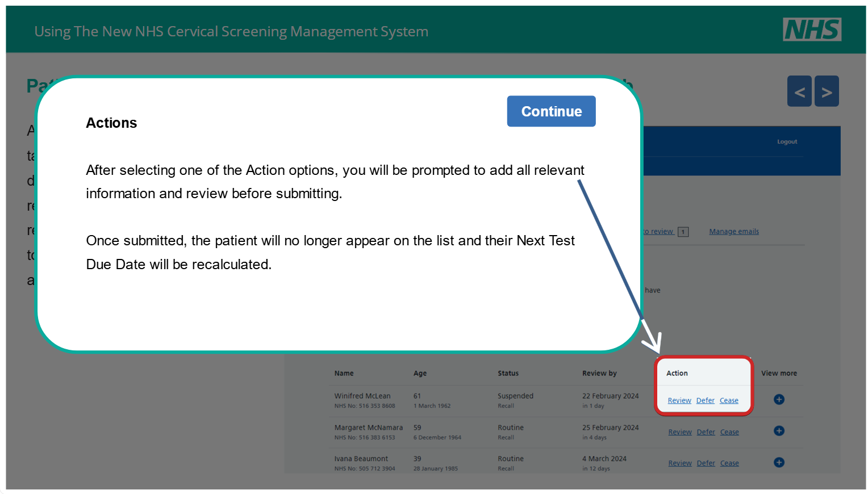

Slide 20
Third invitation for non responders-
If there is no known reason why they have not attended, then it's now the GPs responsibility to send the patient another reminder.
Please note this is part of QOF and when the patient is sent a third communication this should be clearly documented.
The non-responder patient needs to be contacted, this can be done via letter, text message or phone call.
If sending a letter, it is good practice for these to come from the sample taker (more personal approach)
if one of your non-responder’s last test was abnormal, we would encourage to contact this patient as soon as possible, potentially offering a conversation on why they haven’t attended and the importance of screening.

Slide 21
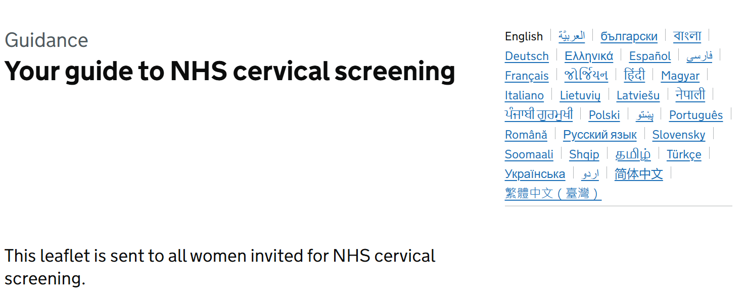
It is good practice to look in your patients notes to see why they may have not responded e.g. English is not their first language, if this is the case we would suggest sending comms in the correct language.
NHS England have recently made available ‘Your guide to NHS Cervical screening leaflet’ in multiply different languages-Your guide to NHS cervical screening - GOV.UK
This is also available Audio transcript: Your guide to NHS cervical screening podcast
And British Sign Language (BSL) signed content: Taking part in NHS cervical screening

Slide 22
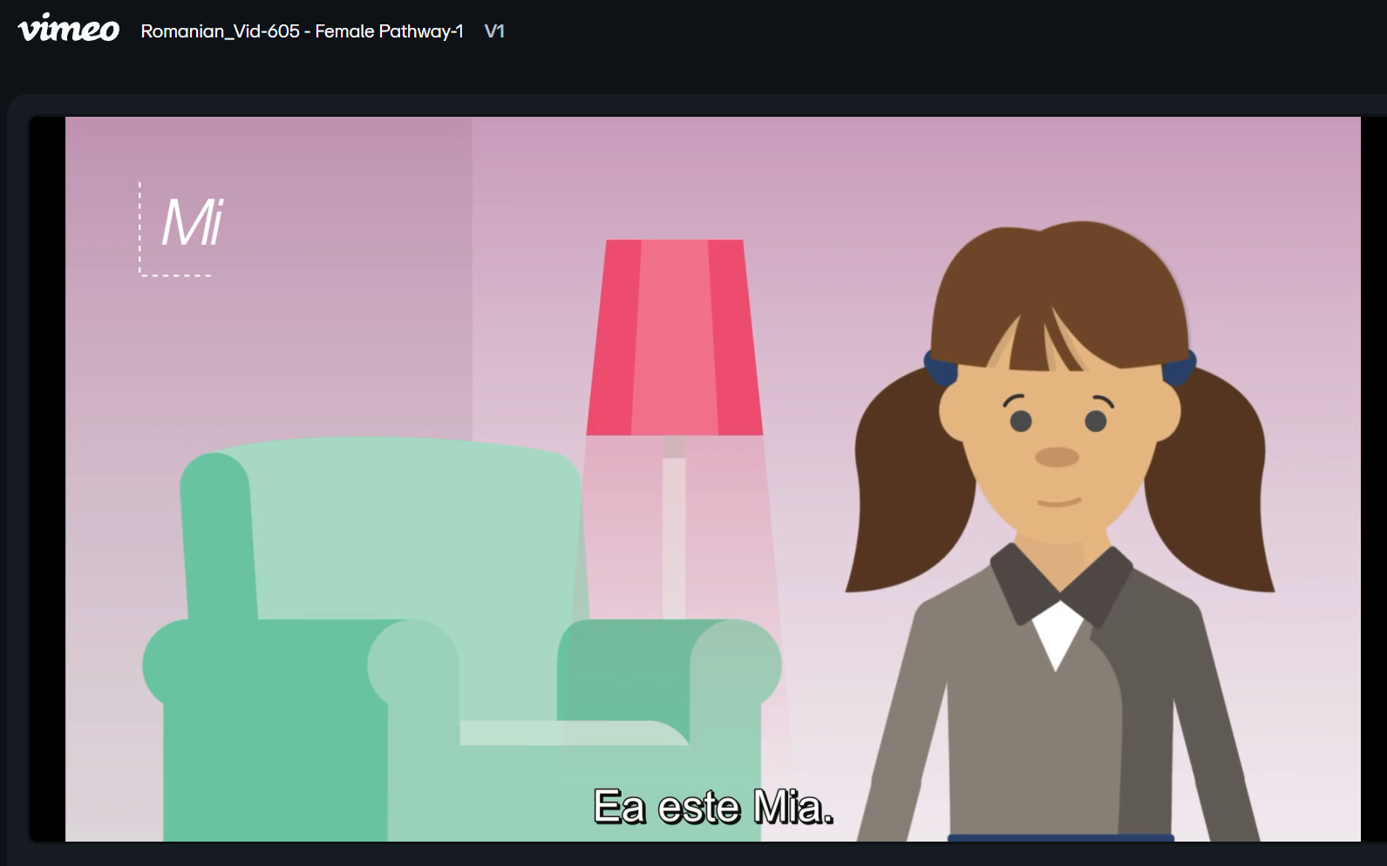
Animation
There are also animation available called ‘Lifetime screening animations’ which is available in 10 different languages which goes through all the screening pathways (both male and female) Vimeo

Slide 23
Links to existing screening assets
national/regional | NHS England — London » Cervical screening resources
 | Your guide to NHS cervical screening - GOV.UK
 | https://campaignresources.dhsc.gov.uk/search/?q=&TOPIC=SCREENING&LANGUAGE=&sort=
local
 | Cervical Screening | CPICS Website- - at the bottom there are translated FAQs.
Information for specific groups
Hearing impaired | British Sign Language (BSL) signed content: Taking part in NHS cervical screening - GOV.UK
Learning disability | Cervical screening: an easy guide - GOV.UK
 | Free stories & resources — Beyond Words
Language or targeted to particular ethnic groups | Bengali-speaking video: Cervical screening: Protecting your health (Bangla community)
 | Cervical screening: Quick, private and life-saving (Punjabi)
 | Cervical screening: A message for Pakistani women
 | Cervical screening matters: A message for Black women
 | https://www.gypsy-traveller.org/resource/cervical-cancer-screening-resource-for-gypsies-and-travellers/
 | https://www.youtube.com/watch?v=RA0kDC-9IBU

Slide 24
Other tabs Patients to review tab New patients whose last test was abnormal New patients registered at your practice who are ceased from screening Existing patients recently ceased from screening Manage email tab

Slide 25
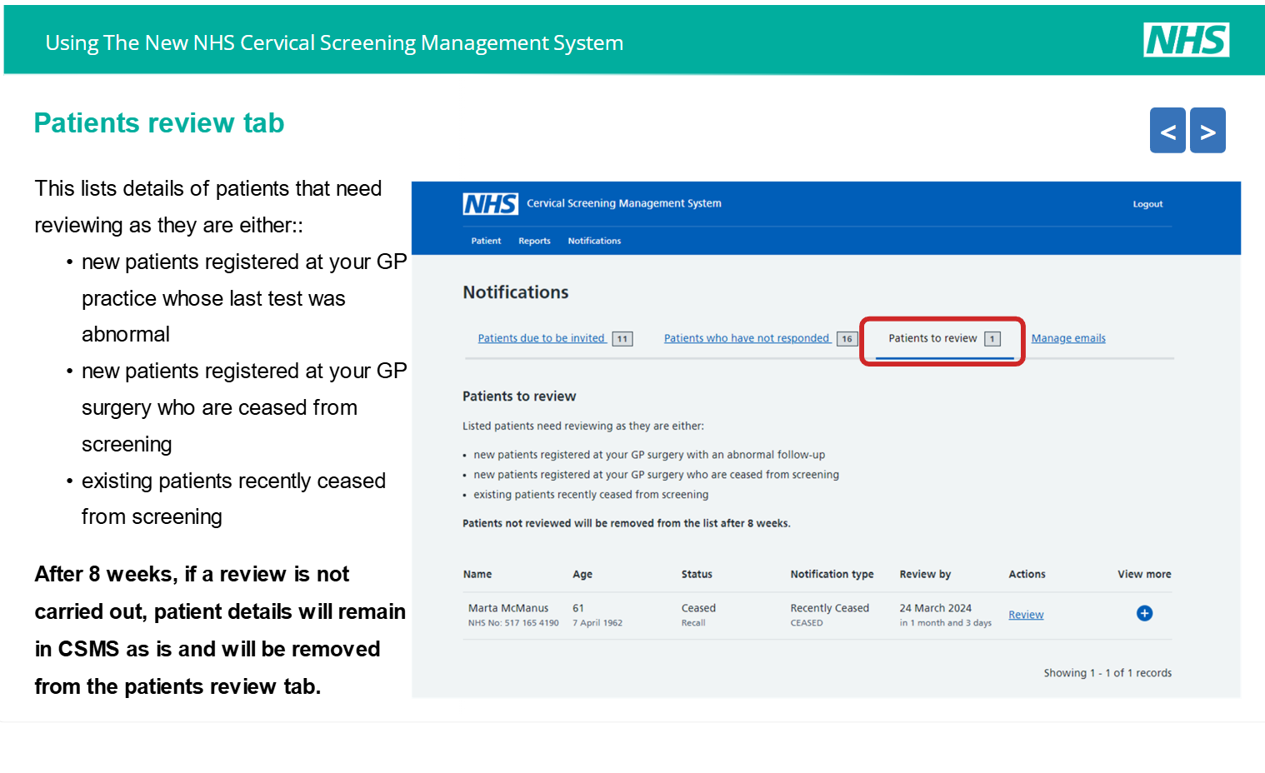

Slide 26
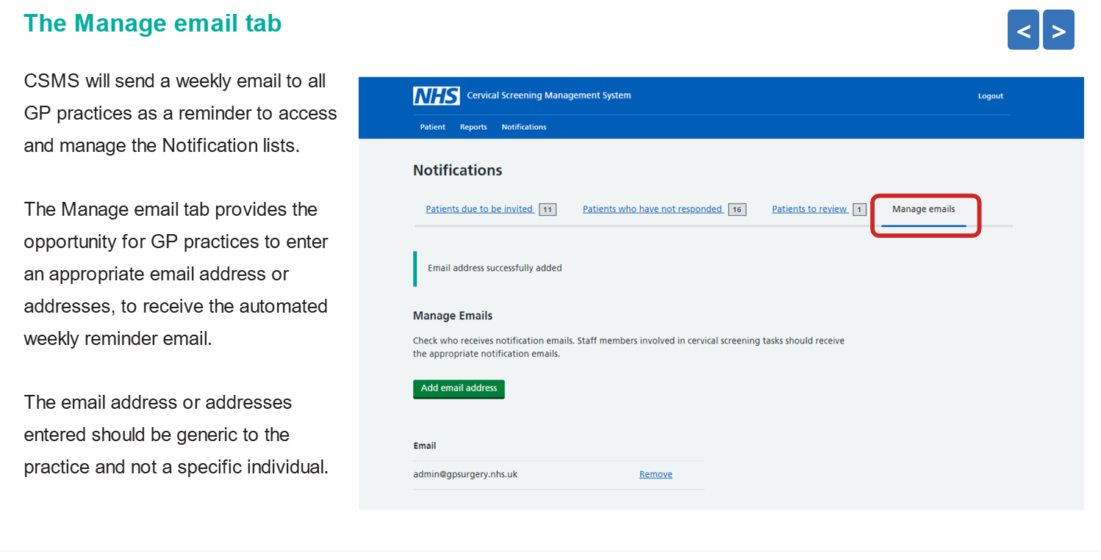

Slide 27
Searching for a patient on CSMS and request forms

Slide 28
Background
To be automatically invited for cervical screening you need to be registered with a GP.
You can search on CSMS, using a patient's name and DOB. Please note this will give you everyone in the country with the same name and date of birth - make sure you have the correct patient!
Training on use of CSMS Guidance for system users - NHS England Digital- there is also a demo system on here for training. Catalogue we strongly recommend anyone involved in cervical screening should do this training.

Slide 29
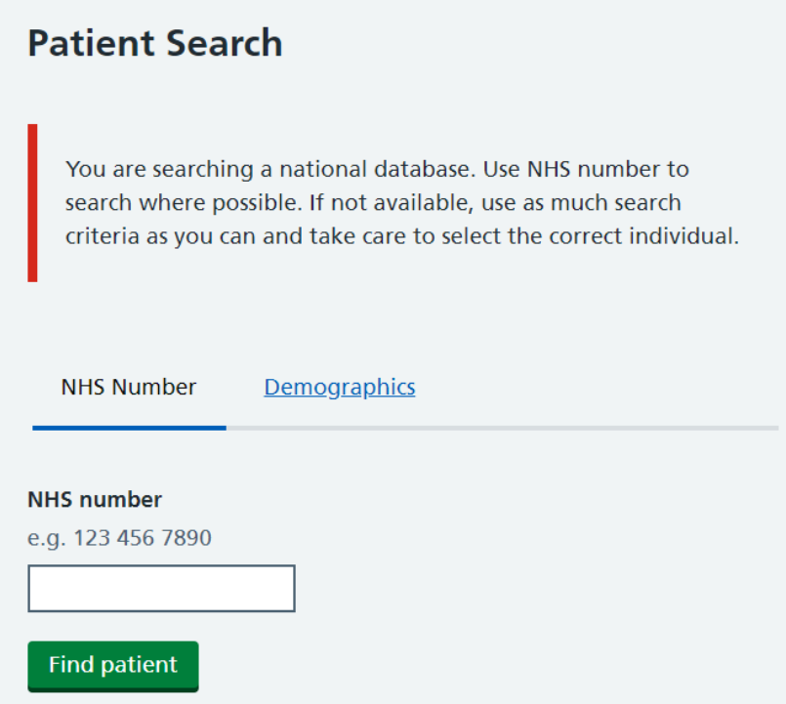
CSMS searching for a patient
You can search and view ALL patients, both active* and inactive** records
Once logged onto CSMS the first screen displayed is ‘Patient Search’.
There are two tabs on the Patient Search screen:
NHS Number
Demographics
If you have access to the patients NHS number, it is always best to use this. Once you have entered the NHS number, check the patients name and date of birth are correct.
*Active- These are live patients registered with a GP; these patients will be routinely invited to attend cervical screening.
**Inactive- These are inactive patients and are no longer invited for screening routinely. Some users may know this as ‘deducted’. This could be for patients who are no longer registered at a GP practice, moved aboard or are deceased.

Slide 30
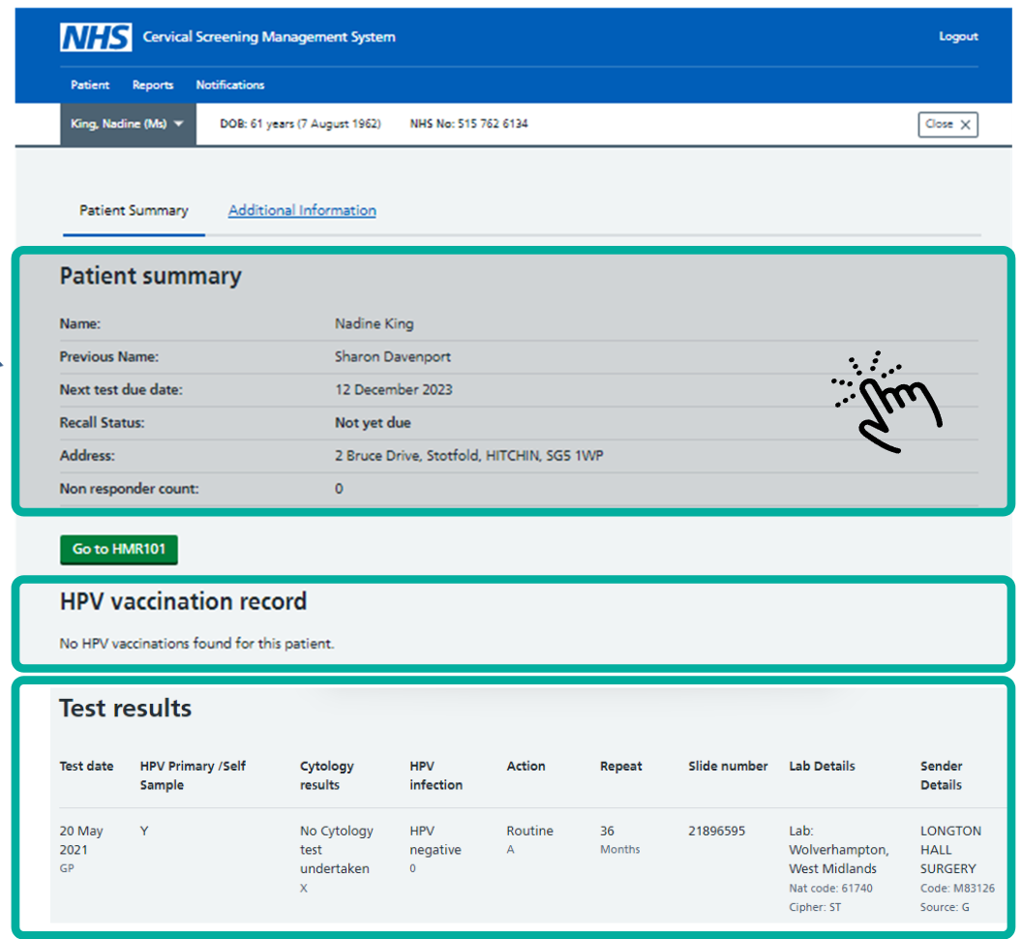
Once you have found the correct person, you will be able to access the patient's history, HPV vaccination record and cervical screening test results.
Click on Patient Summary to get the following information:
Patients full name
Next test due date
Recall status (not yet due, invited, reminded and overdue)
Patient registered address
The number of times they have been a non-responder
To access the HMR101 form (all practices should be using ICE/ICE-NI request forms)
Please only use HMR101 forms if working in extended access/sexual health or
ICE/ICE-NI is down.
Click on test results to view full information on the patient’s screening history.
Please note this is a dummy patient

Slide 31
Adding users CSMS
To access the Cervical Screening Management System (CSMS) portal, you must have an NHS smartcard or Microsoft Authenticator app, with specific ‘cervical screening’ workgroup permissions assigned to your Care Identity profile.
To Access the CSMS is via https://cervicalscreening.nhs.uk If permissions are missing, contact your local Registration Authority (RA)
If you do not know who your RA contact is please contact us.

Slide 32
ICE-NI/ICE request forms
ICE- NI/ICE is the requesting system produced by NNUH lab.
There is step by step guidance on how to use ICE-NI/ICE
All sample takers still need to check CSMS to check the patient is correctly due for screening. Once this has been checked please use the ICE-NI/ICE request forms.
ICE/ICE-NI will be pre- populated with the patients ID as this is linked to your clinic system. You will then be asked a series of questions relating to the patient which will require accessing/checking CSMS.
Some of these areas can be left blank if you do not know.
If you are unable to use ICE-NI/ICE system, please create a HMR101 form on CSMS (where you find the patient details) as previously explained.
Please note that if you are taking samples in extended access/sexual health, you will only be able to use HRM101 forms, please make sure these are correctly prepopulated and you have marked clearly on the form ‘extended access’ or ‘sexual health’

Slide 33
Request forms
If you need access to a blank request form (HMR101 form) these can be accessed from CSAS Cervical Screening Platform | HMR101
Blank forms should only be used if there is no other options (e.g. an IT issue)
If used please make sure you hand write clearly on the form, especially your Cervical Sample taker code, make sure all information is completed.
Please also state the reason why you are sending a handwritten form under clinical details e.g. 'IT issue’
On all forms (ICE-NI request forms, HMR101 (digital or paper) please always state in ‘clinical details’ anything specific that needs to be highlighted to the cytology lab e.g. for a transgender patient.

Slide 34
Please also highlight ‘Retroviral’ (RVI) e.g. HIV if required, as their screening intervals will be different.
Please note an address is always needed even if the result is getting delivered to the NHS App!
Please try to avoid using the Arden request forms (these are the forms created using SytmOne/Emis). This form does not include all the information that the lab require.
Please use your Sample Taker Code on all request forms (this is issued when you register on the CSTD) this is not the same as your NMC PIN.

Slide 35
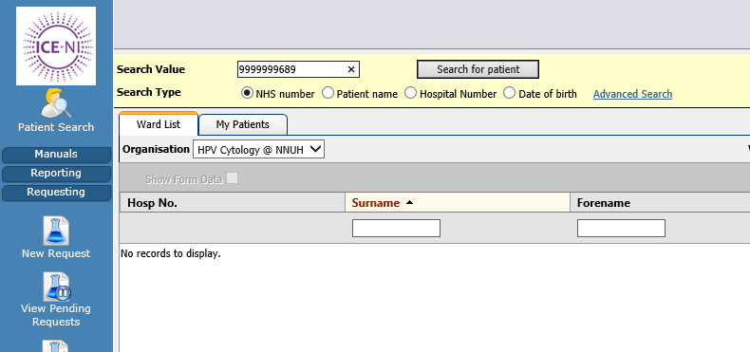
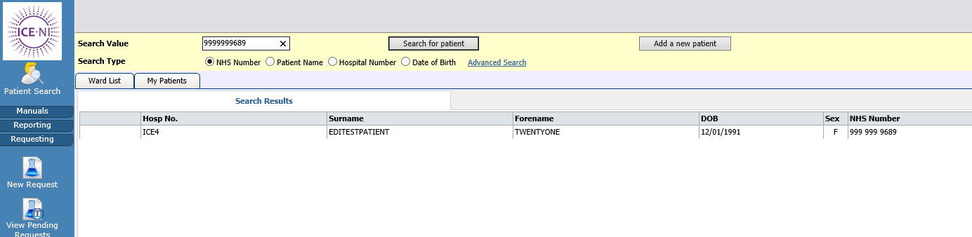
If you don’t take the sample, please remember…
Go into ICE/ICE-NI and delete request as the lab are expecting it.
Search for the request using the patients NHS number:
Check you have the correct patient & left click on the patient:

Slide 36
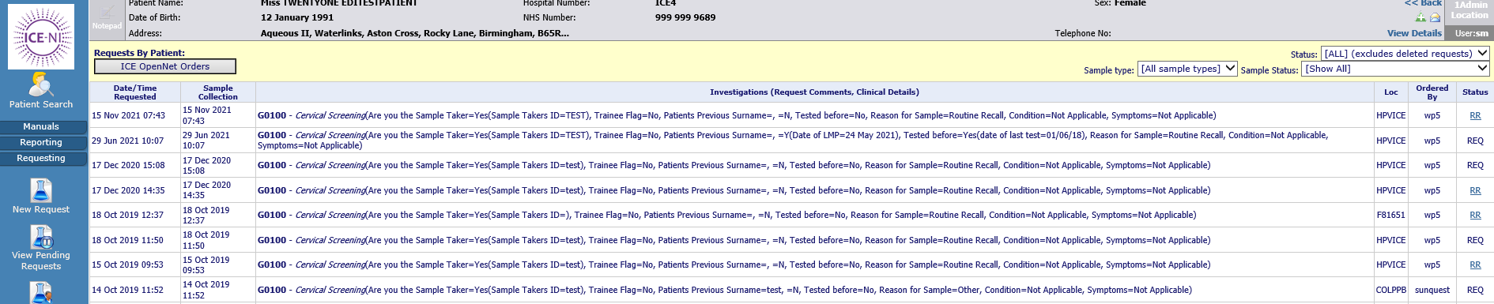
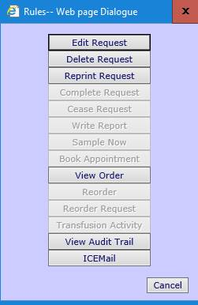
All the previous requests on that patient will then be shown, from most recent at the top, to oldest request at the bottom of the list. Select the one you wish to delete:
This list will pop up, select Delete Request:

Slide 37
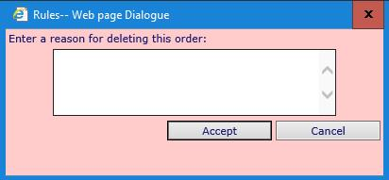
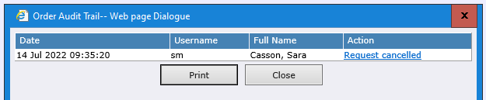
This box will pop up, enter a reason for deleting the request, e.g. – patient unable to tolerate test, patient not due for screening, unable to locate cervix etc:
This is then recorded in the patient’s record within the View Audit Trail option:
If you have produced a form for a patient that is not screened, please make sure this is discarded immediately to prevent mislabelling.

Slide 38
Changing contacts details on CSAS website
If a submission is made to CSAS (for example ceasing documentation) by a person at a practice not listed with CSAS as a contact at the organisation, CSAS are not able to reply to them. An email will be sent instead to the main contact held for the organisation in relation to the query raised. The person making the submission would need to check with them to see if the query has been answered.
It is best for the person to request to be set up as a contact with CSAS via our website using the following link Main contacts and new starters – NHS Cervical Screening Administration Service
If a person at the organisation leaves, they should notify CSAS via the link above so they can be removed from the system.

Slide 39
Cervical Screening Management System
Training on how to use the new NHS Cervical Screening Management System (CSMS) is available on the NHS Learning Hub.
Training is delivered in 2 parts and takes approximately 2 hours to complete. It does not need to be completed in one go.
You can also access the training and guidance here Guidance for system users - NHS England Digital
Please note all practices should be actioning their prior notification lists (PNLs) regularly as well as reviewing non-responder lists and sending further communication to the relevant patients. These should be actioned weekly.

Slide 40

Please remember…
All sample takers need to:
Access Cervical Screening Management System (CSMS)
Use Cervical Sample Taker Database (CSTD)
Use ICE-NI/ICE for request forms. If ICE-NI/ICE is not available, then please use request forms on CSMS.
If taking samples in extended access/sexual health, please see CSMS forms.
Use their Sample Taker Code on all request forms (this is issued when you register on the CSTD) rather than your NMC PIN.
Check dates on vials!

Slide 41
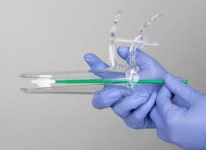
Please remember…
Use ICE-NI/ICE request forms- when a patient is attending their cervical screening appointments make sure that CSMS has been checked for patients correct address and patients' history. Best practice is to complete ICE-NI/ICE when the patient is in the room.
Remind younger eligible patients that just because they may have had the HPV vaccine, they should still attend their cervical screening appointment when they are due.
When checking to see if a patient is due for screening, don’t just reply on the practice clinical system, check CSMS, this will especially be the case with patients who have had their NTDD changes due to extended intervals.

Slide 42
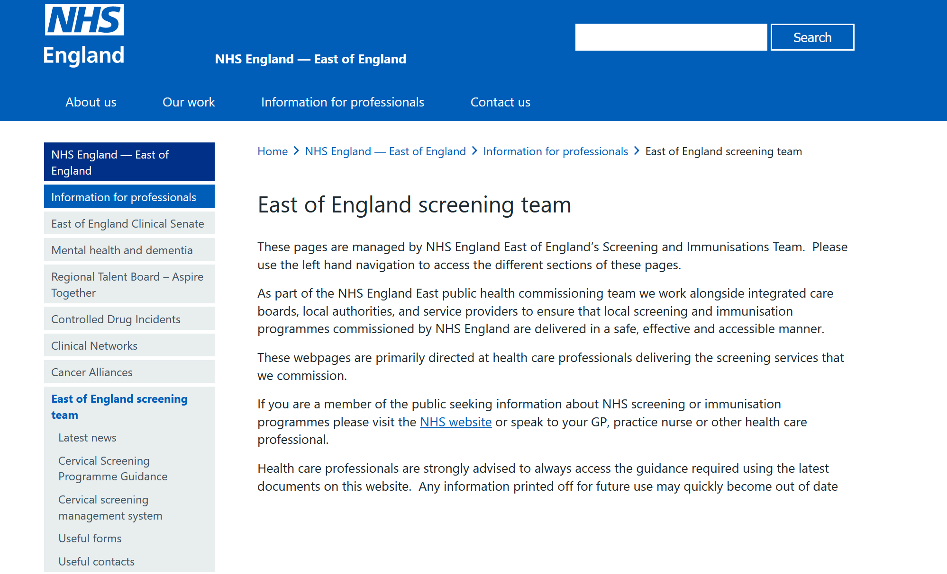
Updates
We have developed a series EoE Screening web pages where you can access Guidance/Forms/contacts/latest news. Please check regularly for updates

Slide 43
Date of next drop in session
Wednesday 24th June 2026

Slide 44
Screening and Immunisation contact details
East Anglia
Screening: england.ea-phsi@nhs.net Immunisations: england.eaimms@nhs.net
Essex
Screening: england.essexscreening@nhs.net Immunisations: england.essexatimms@nhs.net
HBLMK Cancer screening: england.cancerscreening@nhs.net
Screening: england.screening1@nhs.net Immunisations: england.immsqa@nhs.net
Website: https://www.england.nhs.uk/east-of-england/information-for-professionals/east-of-england-screening-team/
Notes:
Standard title slide

