Slide 1
Cervical screening quarterly update session
Screening and Immunisation Teams -
East of England
East Anglia (Norfolk and Waveney, Suffolk, Cambridgeshire and Peterborough), Essex,
Hertfordshire, Bedfordshire, Luton and Milton Keynes Screening & Immunisation Team
Presented by:
The Screening and Immunisation Team
Notes:
Standard title slide

Slide 2


Reminders!
Support sessions for sample takers and cervical screening administrators
East of England (EofE) only
  Most of EofE samples are sent to Norfolk and Norwich lab.
  A few practices in Essex send to Cervical Screening London (CSL) lab.
  A few practices in HBLMK send to Berkshire and Surrey lab.
Questions and comments can be added to the
comment box through the meeting.
Please remain muted throughout the meeting.
A reminder that this is not sample taker training, or part of your 3 yearly update training/CPD.
Relevant slides/Q&A document and certificates of attendance will be available on our Cervical Screening web pages
We will NOT be emailing out any slides. This will be available on 10th October at the latest.
Notes:
Plain slide with subhead and bullets

Slide 3

Our Screening and Immunisation Team
We are one team, however we do cover different areas
Screening and Immunisation Team - Norfolk and Waveney, Cambridgeshire and Peterborough
Jamie Scott- all East Anglia
Leanne Mann - Norfolk and Waveney
Melanie Vincent - Suffolk and Northeast Essex
Claire Wright - Cambridgeshire and Peterborough (Maternity leave)
Screening and Immunisation Team – Essex (and Suffolk)
Hayley McCarthy - all Essex and Suffolk
Tom Davis - Mid and South Essex
Caroline Armon-Jones – Essex and Suffolk
Screening and Immunisation Team - Hertfordshire, Bedfordshire, Luton and Milton Keynes Screening & Immunisation Team
Olivia Morgans - HBLMK and West Essex

Slide 4
Welcome!
Today’s discussion points
Changes in the cervical screening programme
    Extended intervals
    Self sampling
    NHS App
Part 1 Cervical screening admin
    Ceasing patients
    Prior notifications
Reminder of the website
  NHS England — East of England » Information for professionals
  Part 2 in January

Slide 5
Extended Intervals
Notes:
Standard title slide

Slide 6

Extended Intervals for cervical screening
Routine cervical screening intervals
After 1st July 2025
25- 49 years old- every 5 years
50- 64 years old- every 5 years
Before 1st July 2025
25- 49 years old- every 3 years
50- 64 years old- every 5 years

Slide 7
Background
HPV primary screening has been fully implemented in England since December 2019. This is a more sensitive and accurate test than the previous ‘smear’ test, which only looked for cervical cell changes.
HPV testing is the best way to find out at an early stage who is at higher risk of developing the cervical cell changes that over time could potentially lead to cervical cancer, if left untreated. This enables us to offer a more personalised approach to cervical cancer prevention based on an individual’s risk.
Studies have shown that if a person tests negative for high-risk human papillomavirus (hrHPV), they are extremely unlikely to go on to develop cervical cancer within the next 10 years.
A study in England, published by King’s College London, showed that 5-year screening intervals are as safe as 3-year intervals. The same number of cancers will be prevented, and less frequent cervical screening tests are needed.

Slide 8
Screening intervals will not be changed retrospectively. Participants aged 24.5 – 49 years who test negative on a routine primary HPV test, collected on or after 1st July 2025, will move to a 5-yearly interval.
This move brings England into line with Scotland and Wales who introduced this change some years ago, and with women aged 50 – 64 who are already invited every 5 years.

Slide 9

What is changing?
For cervical screening participants aged 24.5 – 49 years who have a routine screening sample taken on or after 1st July 2025:
Patients who test negative for hrHPV will be recalled in 5 years.
Patients who test negative for hrHPV but had a positive hrHPV result within the last 5 years, that has not already been followed by a negative test, will be recalled for screening in 3 years.
This is because those with recent evidence of an hrHPV positive result have a higher chance of this happening again and so will not move to a 5-year interval straight away.

Slide 10

What is not changing?
Cervical screening pathway for patients who test positive for hrHPV
Cervical screening pathway for patients aged 50 – 64 years. Patients will continue to be invited every 5 years.
HIV positive individuals will continue to be screened annually.
Cervical screening pathway for patients aged 24.5 – 49 years and who have never had an HPV test. Patients will continue to be invited every 5 years.

Slide 11
FAQs- extended intervals
Why are cervical screening intervals changing?
The Human Papillomavirus (HPV) causes nearly all cervical cancers. We now use a test which is more sensitive and accurate than the previous method (smear test) to look for HPV in your sample. This helps us offer a more personalised approach by finding out who is at higher risk of developing the cervical cell changes that over time, if left untreated, could lead to cervical cancer. This change from 3 to 5 yearly screening is backed by robust scientific evidence – studies have shown that if you test negative for HPV you are extremely unlikely to go on to develop cervical cancer within the next 10 years. So now we have this better test, you don’t need to be screened as often if you don’t have HPV.
Will everyone move onto this new 5 yearly screening pathway automatically?
No. Next test due dates will not be changed retrospectively; you will be invited at the interval in which you were advised of at the time of your last test. Only those who attend cervical screening on or after 1 July, and meet the clinical criteria, will have their next test due date set at 5 years. NHS England made this decision based on clinical advice from experts. Those aged 50 to 64 are already invited every 5 years.

Slide 12
FAQs- extended intervals
So, will everyone aged 25-49 move to a 5-year screening if they test negative after 1 July?
No, not everyone. If your test result is negative but your last test (taken within the last 5 years) showed an HPV positive result, you will still be invited for screening in 3 years time so that we can continue to monitor your HPV status. If you test negative for HPV at that next test, then you’ll move to 5-year screening.
What happens if I test positive for HPV?
It’s important to remember that having HPV does not mean that you have or will develop cervical cancer. It is a common virus that most people will have at some point in their life without knowing, which usually goes away on its own. If HPV is found in your sample and there are no cell changes, you are invited for screening again in 1 year. If cell changes are found alongside HPV, you are referred directly to a hospital clinic for a colposcopy to check the cervix more closely. Further follow up and treatment will depend on the colposcopy findings.
I’m currently having treatment following a colposcopy, will I be put on 5- yearly screening?
Not immediately. You will be followed up according to the reason for your treatment. Once this is completed successfully you will move to 5 yearly screening.

Slide 13
FAQs- extended intervals
I’ve had cervical cancer in the past, will I be put on 5-yearly screening
Most people diagnosed with cervical cancer receive follow-up care and monitoring by their hospital cancer team instead of returning to regular screening. Those people who are diagnosed with very early cervical cancer and remain in the Cervical Screening Programme will go onto 5-year routine recall once their 10 year follow up is successfully completed.
I’ve never been for cervical screening, even though I am eligible. Will I now move onto a 5-year recall if I do decide to come for a test?
Yes, if you come for screening and test negative for HPV you will be invited again in 5 years time.
I’m 25 and have been invited for my first ever screening. Will I automatically go straight onto a 5-year recall if I test negative?
Yes, if you test negative for HPV at your first ever test aged 25, your next test date will be in 5 years time.
06062025 NHS CSP - ESI master toolkit FAQ FINAL.pdf

Slide 14

Further information
Detailed information is available on the FutureNHS platform:
NHS Cervical Screening Programme Extended Screening Intervals System Letter
NHS Cervical Screening Programme Extended Screening Intervals Toolkit and FAQs
Clinical Pathway Protocol - following the implementation of a 5-year screening interval for people aged 24.5 to 49 years
Updated NHS Cervical Screening Programme Service Specifications
Notes:
Plain slide with subhead and bullets

Slide 15
Self- Sampling
Notes:
Standard title slide

Slide 16

Self- Sampling
‘Under screened’ patients to be offered convenient HPV self-sampling kits under new 10 Year Health Plan Home testing kits for lifesaving checks against cervical cancer - GOV.UK
Home kits to be offered to those who have missed their invite, making care more convenient and supporting our shift from treatment to prevention
New initiative builds on NHS personalised approach to cervical screening
Patients who have rarely or have never attended their cervical screening will be offered a self-sample kit to complete at home. They are then sent out in discreet packaging and returned via pre-paid mail in the local post box.
Anyone testing positive for HPV through self-sampling will be encouraged to attend a clinician-taken follow-up cervical screening test to check for cervical cell changes.
Notes:
Pollical release, not normal nhs england . Being planned now, thought it may start in early 2026

Slide 17
Q&As
Self sampling
When will HPV self-sampling kits be available? NHS England will roll out HPV self-sampling from early 2026.
Who can access the HPV self-sampling kits? HPV self-sampling will only be offered to those who rarely attend or who have never attended cervical screening. We will set out specific eligibility criteria in due course as the offer is developed.
Why is it restricted to this group only? This is because there is uncertainty about whether self-sampling is as good as clinician taken sampling for those who already regularly attend screening. For those who do not attend their appointments, any test is better than no test.
Is HPV self-sampling as good as a clinician taken cervical screening? A clinician-led test is the best option and has been shown to routinely detect HPV and prevent cancer. For those already attending routine cervical screening, a shift to self sampling might result in a programme that is not yet proven to be of equal efficacy. Further studies to consider whether self-sampling could be used across the whole population are being organised.
How does the HPV self-sampling kit work? A sample of cells will be self-collected from the vagina, which is a different method to a clinician-taken sample from the cervix. The self-sampling method tests for the presence of HPV only. People who test positive for HPV will still need to go for a clinician taken sample to get cytology (an examination of the cells of their cervix).

Slide 18
Q&As
Self Sampling
20250624 HPV self-sampling QA Final.pdf
6. How will HPV self-sampling be offered to under-screened individuals? Those eligible will initially be contacted via the NHS App. They will be able to request an HPV self-sampling kit and receive it through the post. If the person does not have the NHS App, the invitation will be sent using another form of communication, to ensure no one is excluded. We encourage people to download the NHS App and ensure notifications are switched on. As part of the future roll out, we are also exploring offering kits in other ways including:
• an opportunistic offer from a healthcare professional – where eligible individuals are offered a self-sampling kit when they attend a primary care setting
• a direct mail-out – where eligible individuals are sent a kit directly to their home
• a combination of both approaches
The Cervical Screening Programme is currently in the design phase of this initiative and it’s subject to change. Further details about the new HPV self-sampling offer will be made available in due course.

Slide 19
Digital Invites
Notes:
Standard title slide

Slide 20
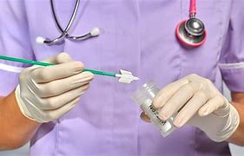

Invites
All first invitations are now sent via the NHS App. Reminder letters are still sent for patients who have not attended
Results
From September, the NHS started sending digital results from the NHS Cervical Screening Programme, utilising the NHS App.
Those who have a negative test result will be notified of this by an NHS App message and notification.
If the NHS App message isn’t read within 72 hours, a letter will be sent as a failsafe.
Abnormal result letters will continue, for the time being, to be sent by post.
This change follows the successful rollout of digital invitations and reminders in June 2025.
Since the launch, 9 out of every 10 invitations are being sent digitally, with the remainder being sent by post.

Slide 21

Important actions and notes for providers
For immediate effect - please can sample takers inform patients attending cervical screening that from September their results may be delivered via the NHS App.
We would be grateful for sample takers continued support in encouraging your patients to download the NHS App and turn on notifications.
www.nhs.uk/nhs-app/
Please be aware that if you add a patients cervical screening result to their clinical record this may show on the patients NHS App. There is a risk that the patients will see this information before they receive their result letter, which may cause unnecessary concern.

Slide 22
Admin in the cervical screening programme
Notes:
Standard title slide

Slide 23
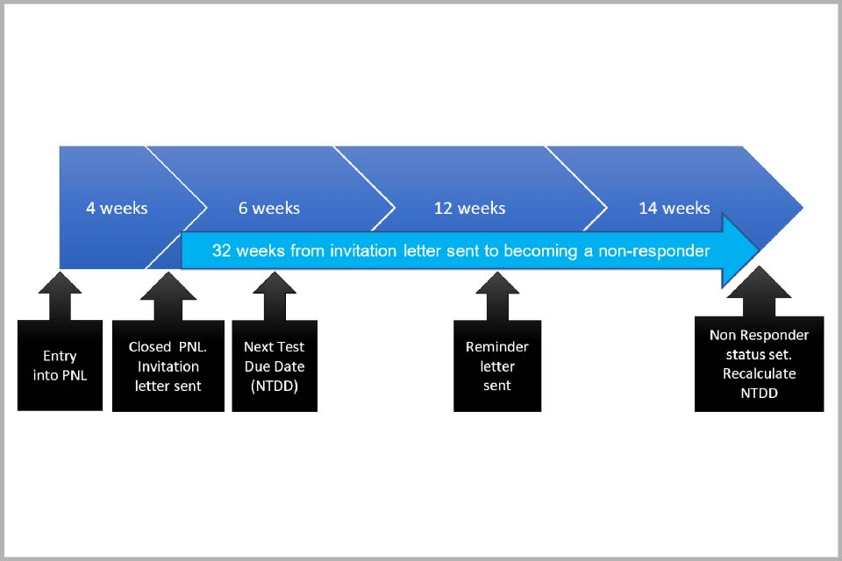
Invitation timeline
Text message sent 2.5 weeks after first invite is sent

Slide 24
The national call/recall service is run by Cervical Screening Administration Service (CSAS)
CSAS supports the national Cervical Screening Programme by:
Sending out invitation and reminder communications to patients eligible for cervical screening tests
Manually processing laboratory test results that the system was unable to automatically match to a patient
Notifying patients of test results once we receive these from laboratories
Updating a patient’s Next Test Due Date (NTDD) from colposcopy discharge lists
Website
NHS Cervical Screening Administration Service – Providing screening to reduce the number of people developing cervical cancer
Contact us page – useful resource for sample takers
Contact us – NHS Cervical Screening Administration Service

Slide 25
Prior Notification List (PNL)
Patients due to be invited

Slide 26

Background ​
A prior notification list (PNL) is sent to every GP practice. This is a list of patients that the national cervical screening programme is going to invite. ​
​
Practices have 4 weeks to action the PNLs. ​
​
A weekly email will be sent from CSMS to each GP practice as a reminder to review their lists and to action as appropriate. ​
​
GP practices have a responsibility to ensure that the right individuals registered in their practice are invited for cervical screening at the right time. ​

Slide 27
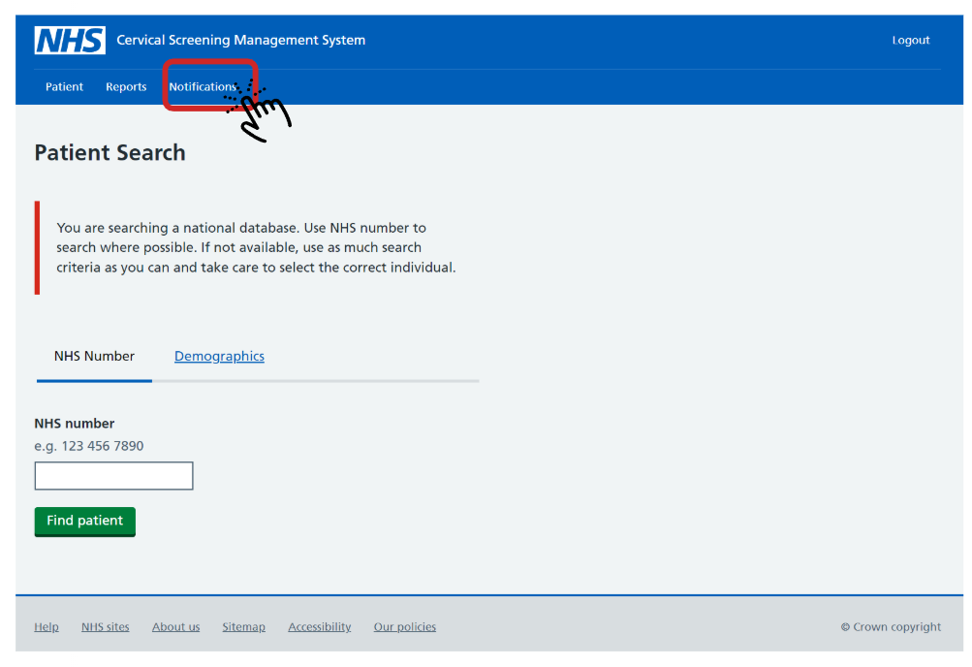
Patients who are within 10 weeks of their next test due date (NTDD) will be included in the PNL for the GP practice they are registered with.
If no action is taken to defer or cease a patient from the PNL, it is assumed the invitation should be sent.
PNLs and non responder notifications can be found here on CSMS

Slide 28
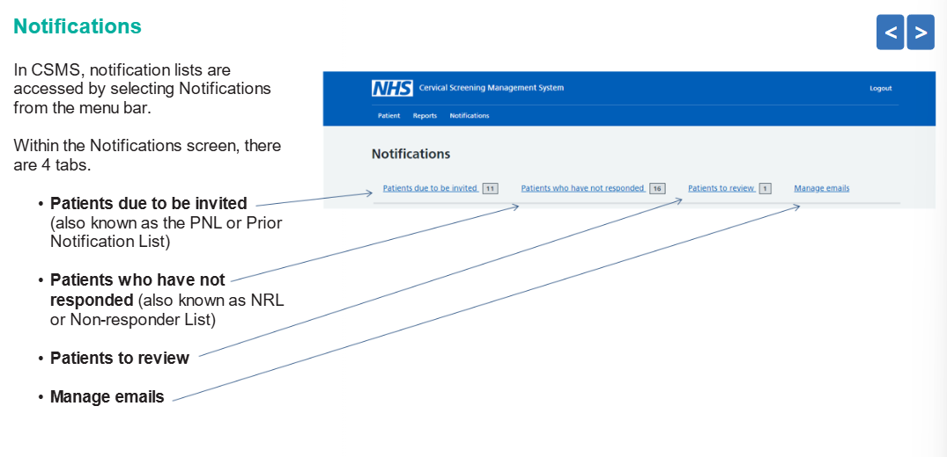

Slide 29
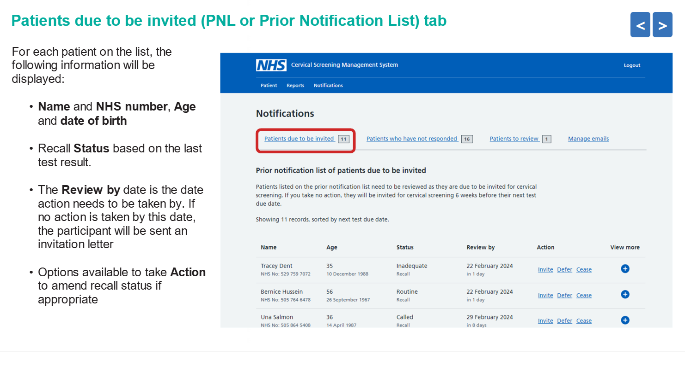

Slide 30
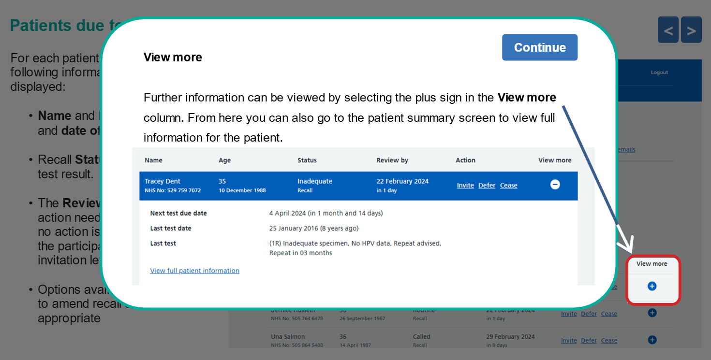

Slide 31
This is the point when you would check your GP system (EMIS or SystmOne) to see if there is any reason why the patient should have their screening delayed.
Check for the following:
Is the patient pregnant? If so, note down patients expected due date
Has the patient had a recent cervical screening test? (sometimes this does happen)
Is the patient still under the care of colposcopy? This could be from their last cervical screening test. If this is the case, please check where their next cervical screening is due, with the GP practice or colposcopy, this should be very clear in the letter from the hospital. If they should be seen in colposcopy, please use this reason to delay the patient so they are not confused about where to attend. The patient would have also been informed that they need to attend colposcopy for their follow up cervical screening.
Under treatment relevant to screening? if stated in patient notes.
If there is no delay required, please press the ‘invite’ button.

Slide 32
You can also cease a patient from the cervical screening programme this way.
You can cease for the following reasons on PNLs:
  No cervix (make sure patient has had a total hysterectomy)
  Age (although this should happen automatically if last 3 tests where normal)
  Radiotherapy of the cervix
You can't cease via PNLs for the following:
  Informed consent for withdrawal from the cervical screening programme
  Mental Capacity Act
This is because paperwork is required for this.

Slide 33
Ceasing

Slide 34
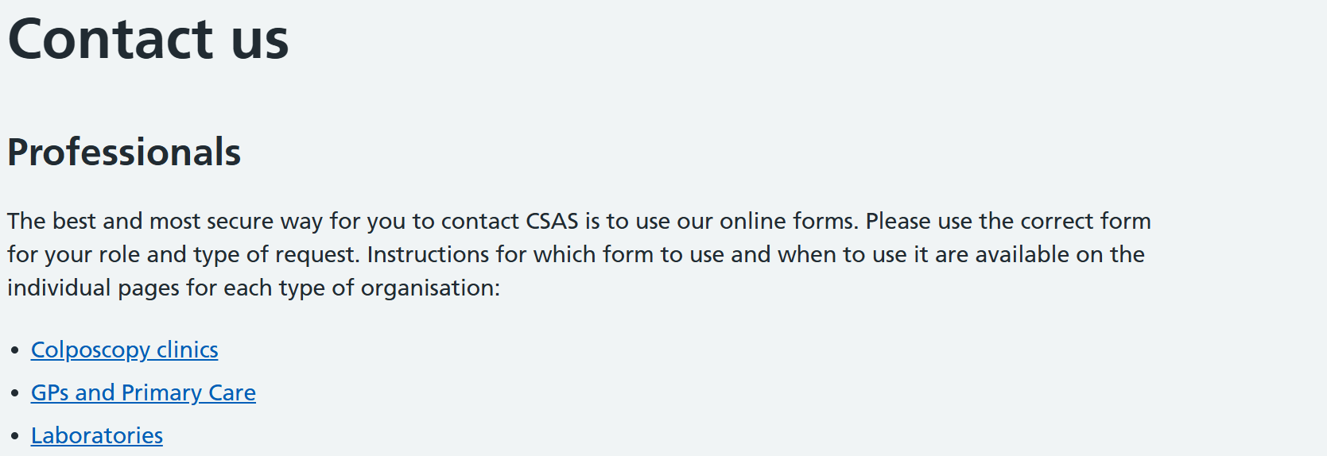

All PNLs, non responder notifications and ceasing requests are sent to CSAS to process.
Practices will need to contact CSAS to cease patients for Patients informed choice and Mental Capacity Act.
Contact us – NHS Cervical Screening Administration Service

Slide 35
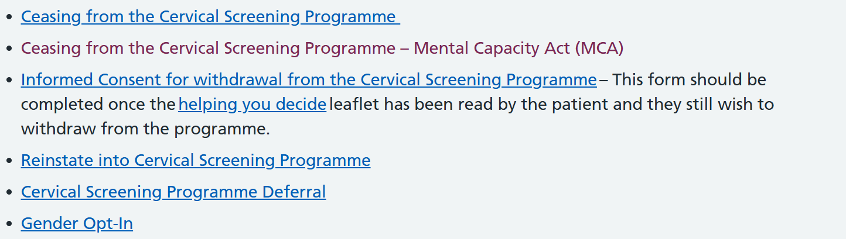
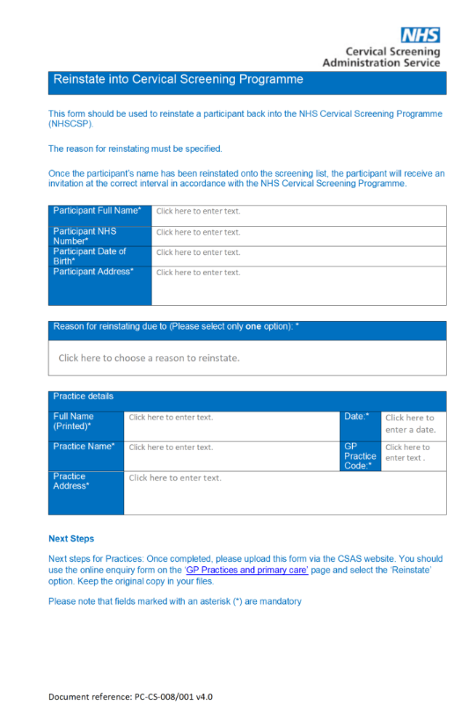
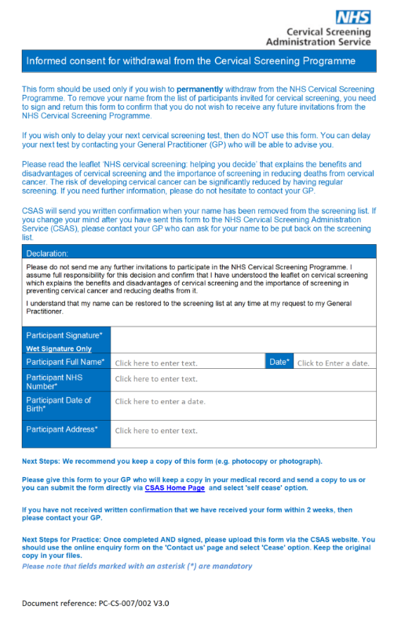
The following documents can be found on this website:

Slide 36
Informed consent for withdrawal from the cervical screening programme
For patients who do not want to be part of the national cervical screening programme
This form should only be completed once the ‘helping you decide’ leaflet has been read by the patient.
Please make sure the patient knows they can come back into the programme at any time as long as they are still eligible.
This should not be used for patients who want to delay their screening.
Patient should also keep a copy of this, and a copy should be included in the patient's medical record.

Slide 37
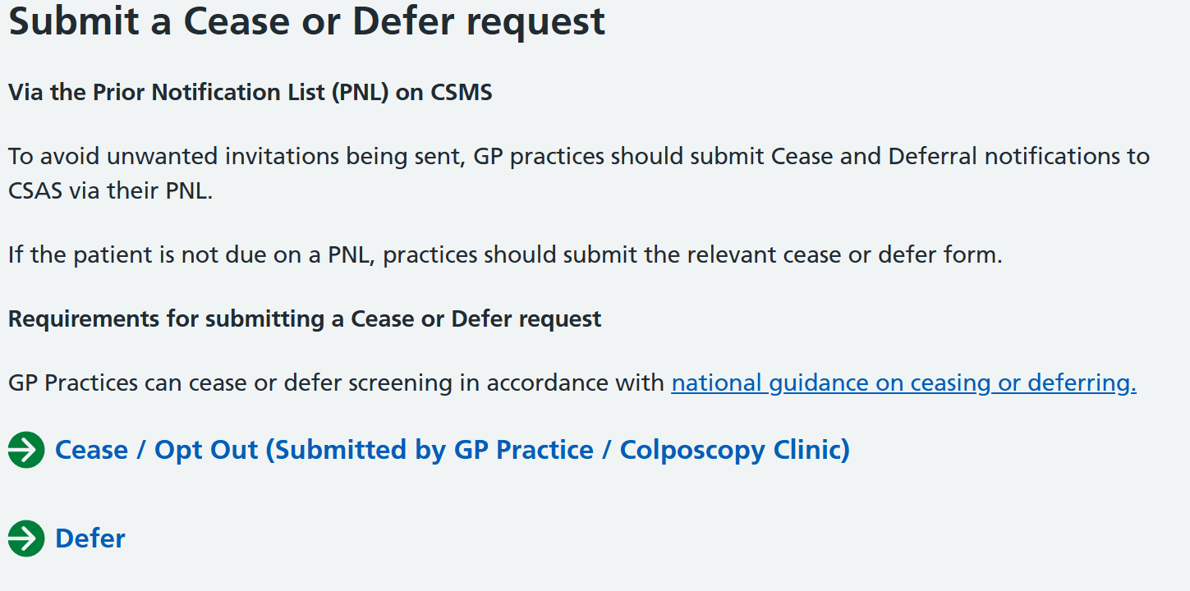
The GP practice should submit this form via the CSAS website
GP practices and primary care – NHS Cervical Screening Administration Service
Follow the steps and then upload the correct ceasing form.

Slide 38
Mental Capacity Act (MCA)- best interest
There are different physical and mental health conditions and learning disabilities which can affect an individual’s mental capacity. It is important to ensure that all people who are eligible for cervical screening have equality of access to the service.
People with learning disabilities can often understand and consent to screening with adequate support and preparation. Learning disability alone is not a valid reason for ceasing.
Individuals must always be presumed to have capacity to make their own decisions unless it is proved otherwise.
If a ceasing decision has to be made on behalf of a person who lacks capacity, the person who makes the decision is known as the decision-maker. This will usually be a healthcare professional such as the person’s GP.
The decision-maker may only act if the person cannot make their own decision.
There is a lot more information on this in the ceasing guidance, under section 2.3.

Slide 39
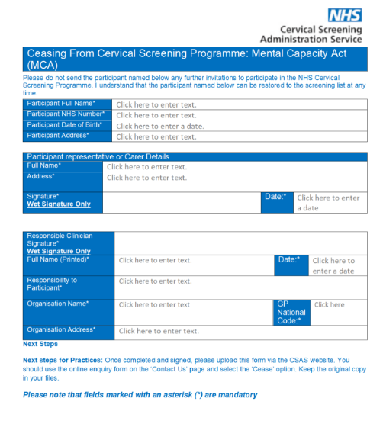
Ceasing from cervical screening recall in a person’s best interests is likely to be appropriate only where the individual would never be suitable for screening, or for further investigations and/or treatment in the event of a positive screening result.
The GP practice should submit this form via the CSAS website
GP practices and primary care – NHS Cervical Screening Administration Service
Follow the steps and then upload the correct ceasing form.

Slide 40
Other ceasing forms on CSAS website
General ceasing forms
Reinstate into cervical screening programme
Cervical screening programme deferral
Gender opt-in
GP practices and primary care – NHS Cervical Screening Administration Service
You can also contact CSAS via this page regarding the following:
Contact update
General enquiry
Complaints
Subject access requests
Test results form

Slide 41

You don’t need to wait for a patient to appear on PNLs to cease them.
We recommend you do this as soon as the practice is made aware the patient is not eligible for cervical screening.
Ceasing and deferring women from the NHS Cervical Screening Programme - GOV.UK
This webpage offers helpful guidance, goes into a lot more detail, for example, how to manage individual circumstances, such as terminally ill patients.

Slide 42
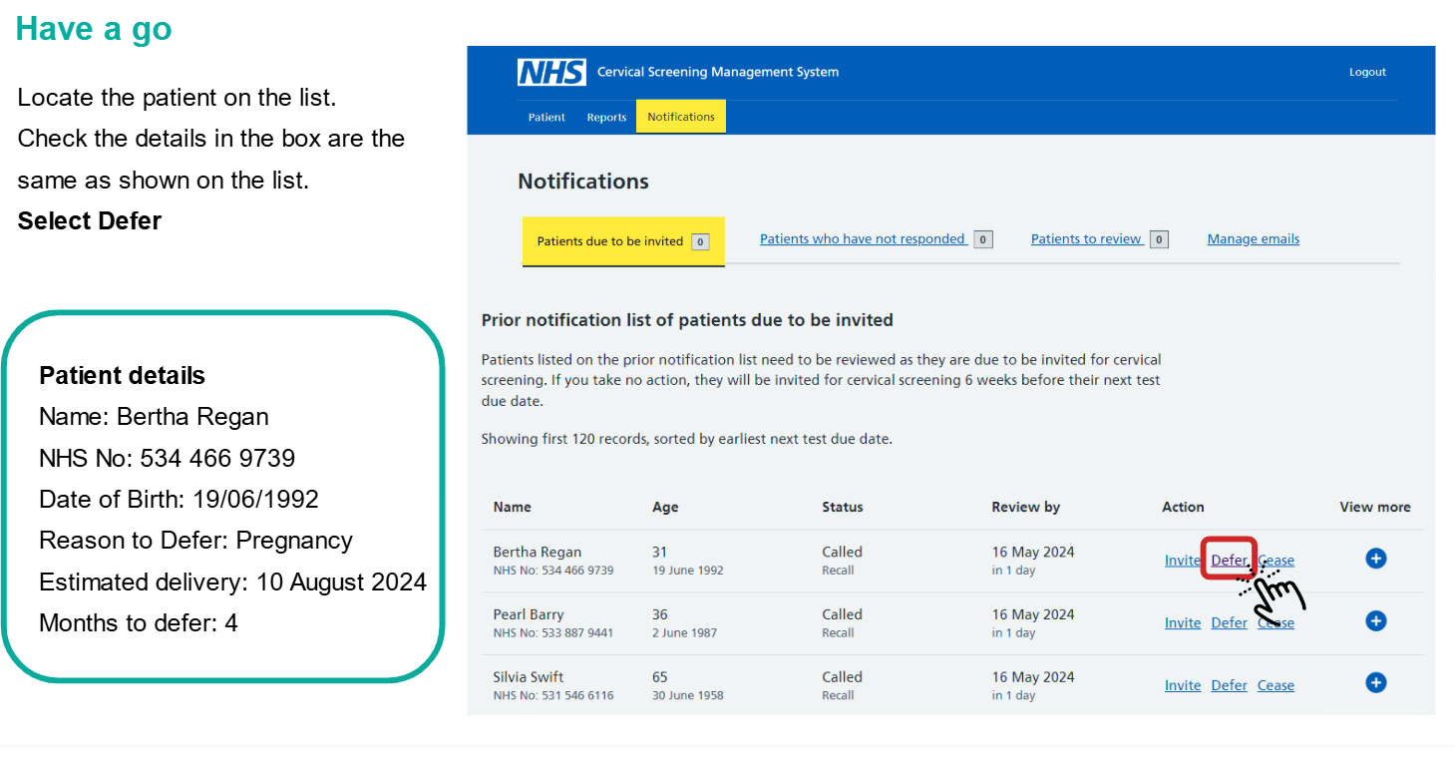
Example of how to submit a PNL

Slide 43
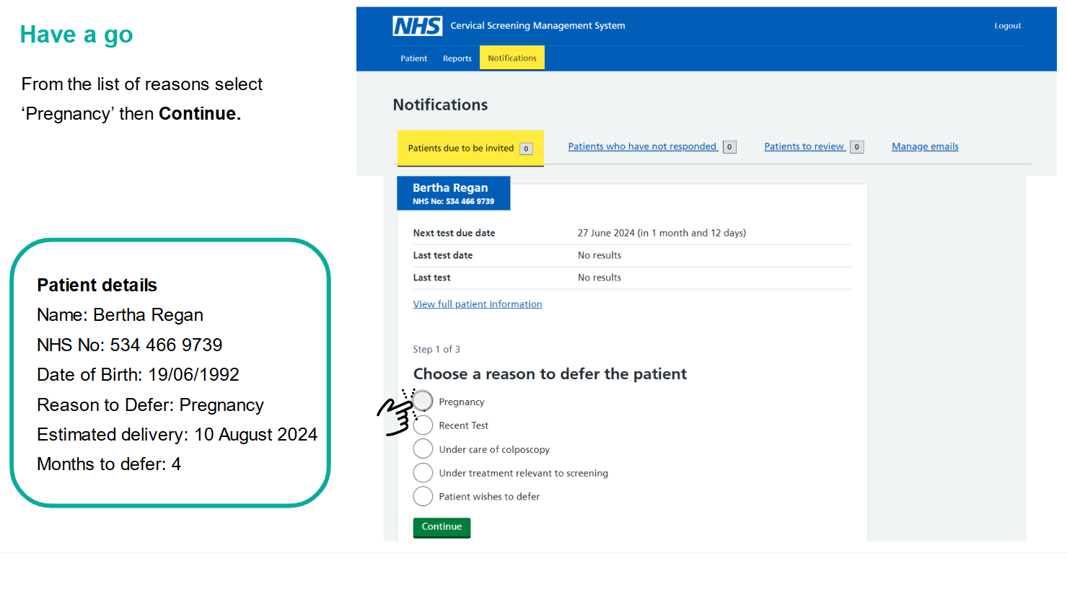

Slide 44

Reason for delays
Pregnancy- 12 months
Recent test – max of 3 months
Under care of colposcopy- max of 12 months
Under treatment relevant to screening- max of 12 months
Patient wishes to defer- max of 18 months

Slide 45
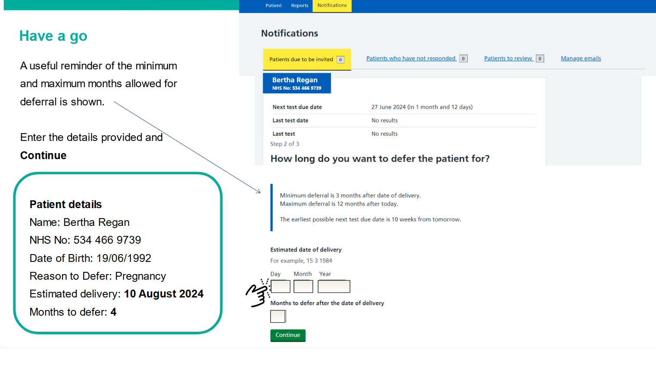

Slide 46
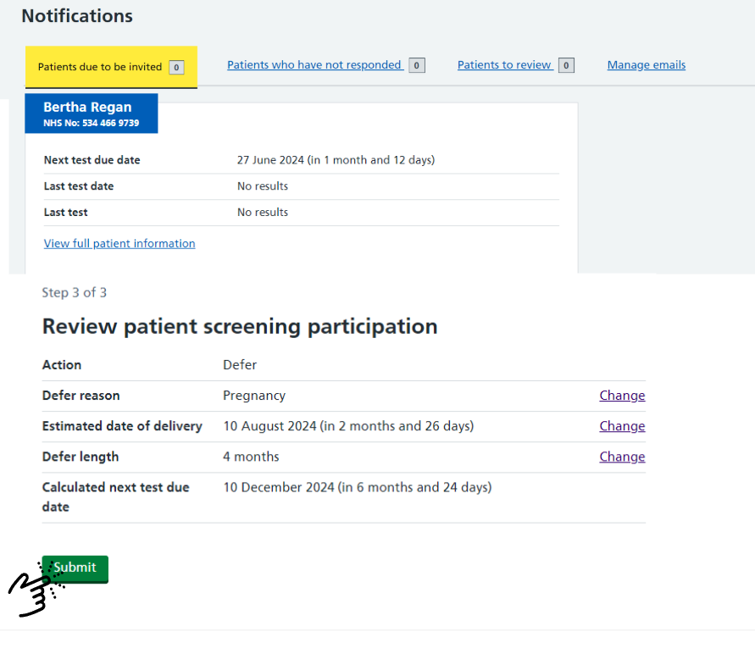
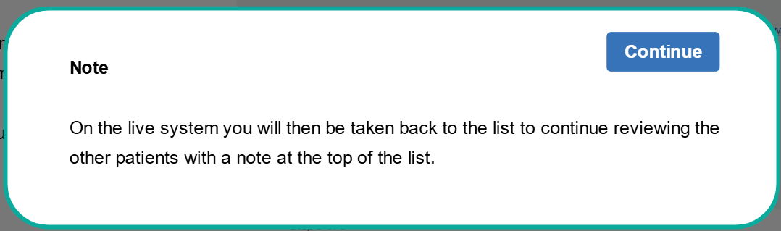

Slide 47
Cervical Screening Management System
Training on how to use the new NHS Cervical Screening Management System (CSMS) is available on the NHS Learning Hub.
Training is delivered in 2 parts and takes approximately 2 hours to complete. It does not need to be completed in one go.
You can also access the training and guidance here Guidance for system users - NHS England Digital
Please note all practices should be actioning their prior notification lists (PNLs) regularly as well as reviewing non-responder lists and sending further communication to the relevant patients. These should be actioned weekly.

Slide 48

Please remember…
All sample takers need to:
Access Cervical Screening Management System (CSMS)
Use Cervical Sample Taker Database (CSTD)
Use ICE-NI/ICE for request forms. If ICE-NI/ICE is not available, then please use request forms on CSMS.
  If taking samples in extended access, please see CSMS forms.
Use their Sample Taker Code on all request forms (this is issued when you register on the CSTD) rather than your NMC PIN.
Check dates on vials!

Slide 49
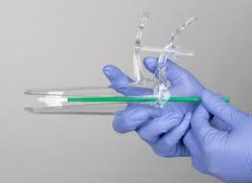
Please remember…
Use ICE-NI/ICE request forms- when a patient is attending their cervical screening appointments make sure that CSMS has been checked for patients correct address and patients' history. Best practice is to complete ICE-NI/ICE when the patient is in the room.
Remind younger eligible patients that just because they may have had the HPV vaccine, they should still attend their cervical screening appointment when they are due.
When checking to see if a patient is due for screening, don’t just reply on the practice clinical system, check CSMS, this will especially be the case with patients who have had their NTDD changes due to extended intervals.

Slide 50
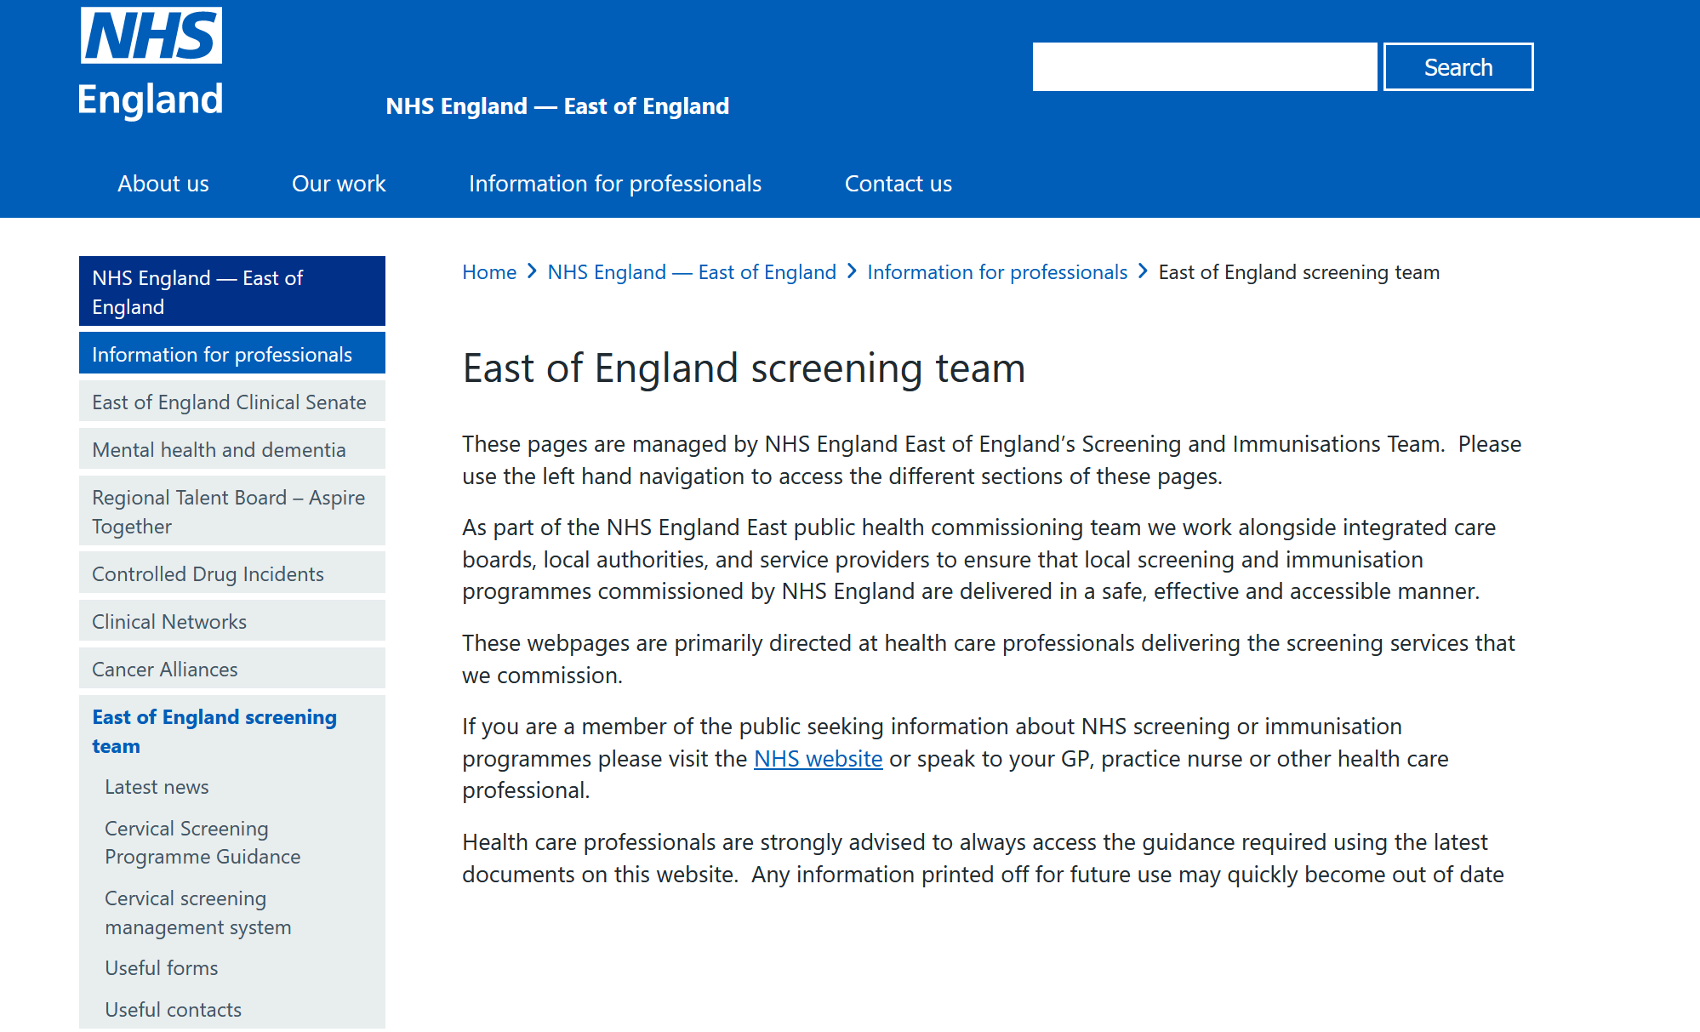
Updates
We have developed a series EoE Screening web pages where you can access Guidance/Forms/contacts/latest news. Please check regularly for updates

Slide 51
Date of next drop in session
Wednesday 14th January 2026
Part 2 of admin for cervical screening
Non responder notifications
How to search for a patient on CSMS
ICE-NI requesting

Slide 52
Screening and Immunisation contact details
East Anglia
Screening: england.ea-phsi@nhs.net
Immunisations: england.eaimms@nhs.net
Essex
Screening: england.essexscreening@nhs.net
Immunisations: england.essexatimms@nhs.net
HBLMK
Cancer screening: england.cancerscreening@nhs.net
Screening: england.screening1@nhs.net
Immunisations: england.immsqa@nhs.net
Website: https://www.england.nhs.uk/east-of-england/information-for-professionals/east-of-england-screening-team/
Notes:
Standard title slide

