Slide 1
Expo 2017 Overview Sharing Pack
Inspiring patient-centred innovation and transformation across health and social care

Slide 2
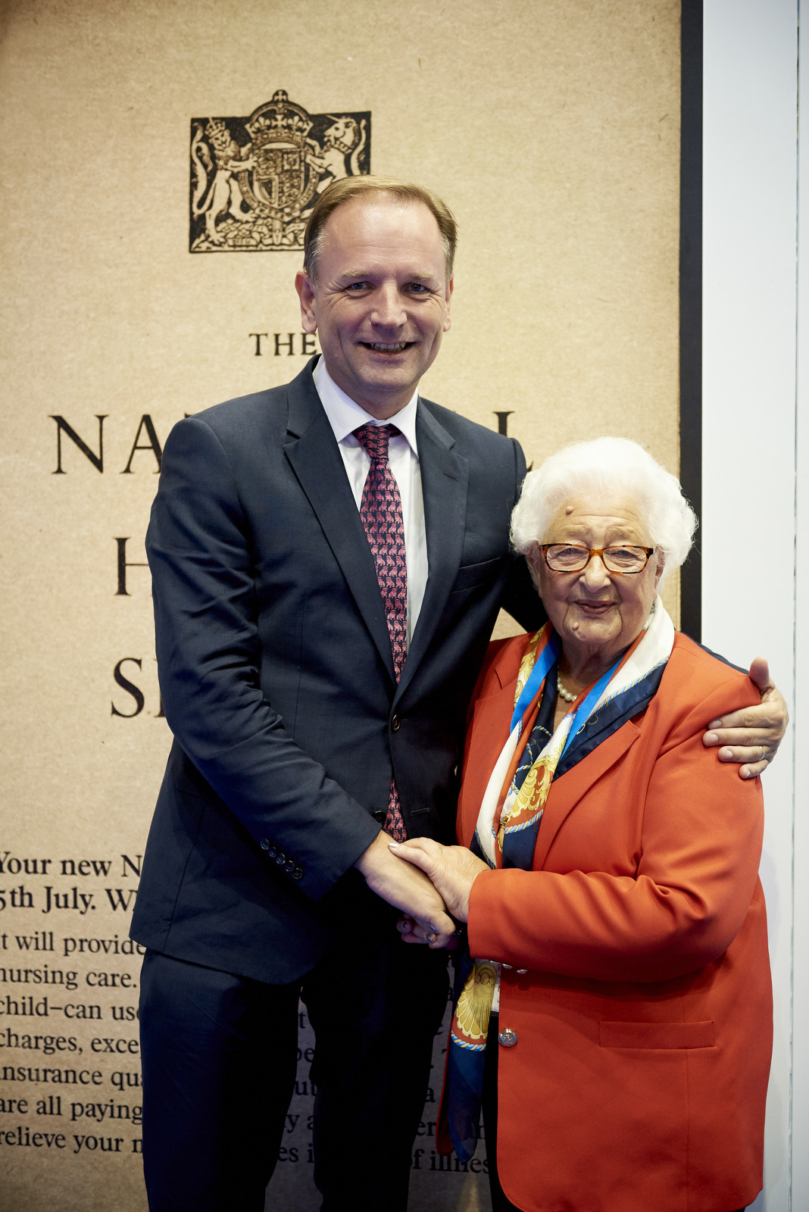
Headlines
Greater Manchester Mayor praises “heroic” NHS staff
Ethel Armstrong (87) at the #NHS70 Hub
New technology helps tackle frailty in older people
NHS Digital Academy Launch
Practical guides to support disabled patients to access GP services online
Ambulance services begin using new response times
App to help children and young people with their health
Launch of 70/70 campaign for volunteering
Notes:
Greater Manchester Mayor praises “heroic” NHS staff
Professor Sir Malcolm Grant, chairman of NHS England was joined by Manchester Mayor Andy Burnham to open the Heath and Care Innovation Expo.
The Mayor started with a tribute to the “heroic efforts” of NHS staff for their care of the victims of the Manchester bombing. Speaking just a mile from the arena where 22 innocent people died in a nail bomb blast at the end of an Ariana Grande concert in May, the Mayor said: “In the aftermath of the attack I felt the strength in our National Health Service in Manchester and saw a service that today is so much more than the sum of its parts. We are blessed with great people leading the NHS.”
He also reflected the major themes of the conference by setting out the city’s ambitions for integrating NHS and social care.
Ethel Armstrong (87) at the #NHS70 Hub
Ethel Armstrong, 87, was at the NHS on its first ever day and spoke to delegates about her 42-year career as an NHS cadet, nurse and radiographer.
Ethel described what it was like in the early days of the NHS telling the audience how patients had to bring their own sandwiches, but even then she said she knew: “it was to be a big wide world that I wanted to be a part of.”
New technology helps tackle frailty in older people
NHS England revealed that the NHS is trialling new wearable sensors, based on technology used by NASA and the CGI film industry, to help identify older patients at risk of falls as part of a new drive to tackle frailty.
NHS Digital Academy Launch
The NHS Digital Academy was officially launched at Expo. The Academy, which is led by Imperial College London’s Institute of Global Health Innovation in partnership with Harvard Medical School and The University of Edinburgh, will see three of the world’s top universities provide virtual masterclasses in leadership and digital as part of a comprehensive programme to provide NHS staff with the right skills to drive digital innovation.
Practical guides to support disabled patients to access GP services online
NHS England published guides aimed at supporting people with sight loss, hearing loss, autism or learning disabilities to use GP services online – for things like booking appointments, ordering repeat prescriptions and viewing their medical records.
Ambulance services begin new response times
Four of England’s ambulance services have begun the roll out of new response times announced earlier this year.
Professor Jonathan Benger, NHS England’s National Clinical Director for Urgent Care, and NHS England’s lead paramedic, Richard Webber, told delegates that a further four ambulance trusts would be switching to the new target times before the winter begins.
App to help children and young people with their health
An app, designed with, and for, children and young people, is helping them understand more about their health.
At a special National Quality Board, which was co-chaired by representatives from the NHS Youth Forum, NHS Go was showcased to the audience.
Launch of 70/70 campaign for volunteering
Professor Sir Bruce Keogh has called for 70 NHS Trusts to sign up to plans to encourage more young people to volunteer in their local NHS as part of its 70th birthday year.
This comes after Sir Bruce made a personal pledge to HRH, The Prince of Wales to support the Step Up To Serve #iwill initiative.
Step Up To Serve of which The Prince of Wales is Patron, seeks to increase the number of 10 to 20 year olds participating in social action, to recognize the contribution young people make to their local communities.
At Expo 2017, Sir Bruce and Ruth May, Executive Director of Nursing NHS Improvement, called on the NHS to commit to the #iwill pledge to help young people act as health champions, supporting their peers and communities to live healthier lifestyles in health and care settings, or their wider communities.

Slide 3
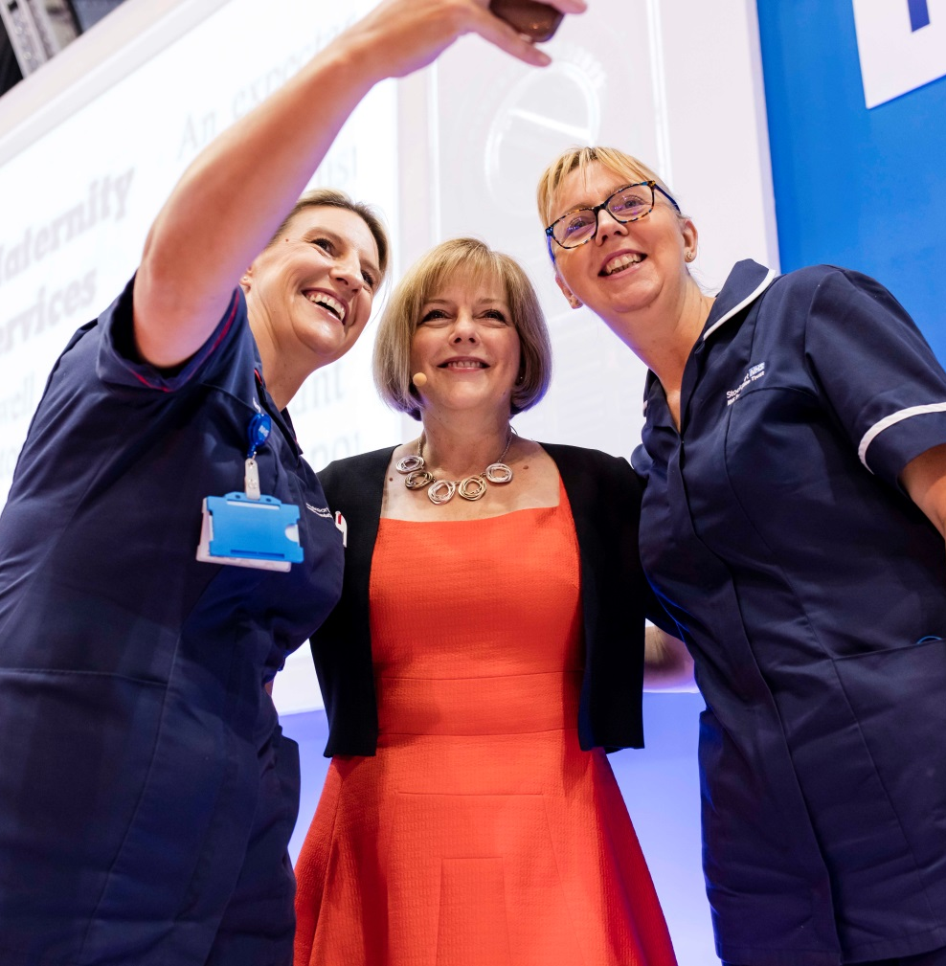
Headlines
The Kate Granger Compassionate Care Awards
Including a special award for London and Manchester teams involved in response to terror attacks and the Grenfell Tower fire
NHS to routinely offer cutting-edge treatments
Jeremy Hunt unveils plans for digital-led NHS treatment by 2018
New quality of life measure for recovering cancer patients
New drive to save thousands of people from heart attacks and strokes
Leading support for people with mental health issues and learning disabilities
Notes:
Kate Granger Compassionate Care Awards
Heroic frontline NHS staff who treated victims of the recent Manchester and London terror attacks and the Grenfell fire were given special recognition at the Kate Granger Compassionate Care Awards.
Staff including nurses, doctors and paramedics received a standing ovation as the Special Recognition honour was announced by Professor Jane Cummings, Chief Nursing Officer, NHS England. Jane said: “Compassion has never been more in the spotlight than over the last few months of this year. We’ve had appalling horror – terrorism in London and Manchester, and the Grenfell fire. These tragedies have affected so many people across the country, including NHS staff. They highlighted the resilience and the compassion of the NHS staff who time after time responded to victims, who had suffered unimaginable injuries – putting the needs of those people first”.
See the full list of winners on the NHS website: https://www.england.nhs.uk/expo/2017/09/12/special-award-for-manchester-and-london-nhs-terror-attack-heroes/
NHS to transform patient care by routinely offering cutting edge treatments
Simon Stevens, Chief Executive of NHS England, unveiled new plans to free up funds for the latest world class treatments by slashing hundreds of millions from the nation’s drugs bill and announced that new and cutting edge treatments will be routinely available for the first time.
This will include revolutionary new treatment for Hepatitis C, new measures to slash up to another £300 million from the nation’s medicines bill, trailblazing new treatment to restore sight, routine commissioning of the latest technology to help deaf children hear and an expansion of the Test Bed programme that is testing the treatments and care models of tomorrow.
Jeremy Hunt unveils plans for digital-led NHS treatment by 2018
The Rt Hon Jeremy Hunt MP, Secretary of State for Health, pledged every patient should be able to access their medical records and book appointments with their GP via an app by 2018.
The app has been piloted in south-east London, where patients can already book appointments with their GPs, access NHS 111, receive online consultations with their GPs and order repeat prescriptions using their smartphones.
New quality of life measure for recovering cancer patients
NHS England announced five areas where a new quality of life metric will be piloted, as part of an ambitious plan to radically improve care and support for people once treatment ends.
The ground-breaking new approach is set to drive improvements in after care which includes personalised plans for people with cancer outlining not only their physical needs, but also other support they may need, such as help at home or financial advice.
The new metric, which is the first of its kind, will use questionnaires to measure how effective this support is and the data will be made available on My NHS – helping patients, the public, clinicians and health service providers see how well their local after cancer care support is doing.
New drive to save thousands of people from heart attacks and strokes
The NHS, working with Public Health England (PHE), announced a new drive to prevent heart attacks and strokes saving thousands of lives by taking a more integrated approach to cardiovascular care.
Sir Bruce Keogh, the National Medical Director of NHS England, urged the new sustainability and transformation partnerships (STPs) to take coordinated action to improve prevention, diagnosis and treatment of these life-threatening conditions.
Leading support for people with mental health issues and learning disabilities
In her keynote speech, Professor Jane Cummings, Chief Nursing Officer, NHS England, urged nurses to lead the way in improving the lives of millions of people living with a mental health condition or learning disability
Professor Jane Cummings, Chief Nursing Officer at NHS England, has urged nurses to lead the way in improving the lives of millions of people living with a mental health condition or learning disability. She cited examples such as
Leading Change Adding Value: Smoking in Mental Health - Mental Health nurses are leading work to ensure improvements are made in understanding the inequalities and biases people with mental health conditions face if they want to give up smoking, and assess where good practice is taking place to learn from each other. Eight mental health trusts are also working together on a number of improvement initiatives to improve their compliance with the NICE Guidance on smoking cessation.
STOMP (stop the over- medication of people with a learning disability or autism) - one year into the campaign, over 100 social care organisations have signed up to STOMP, supporting more than 40,000 people, all pledging to transform care for people with a learning disability, autism or both.

Slide 4
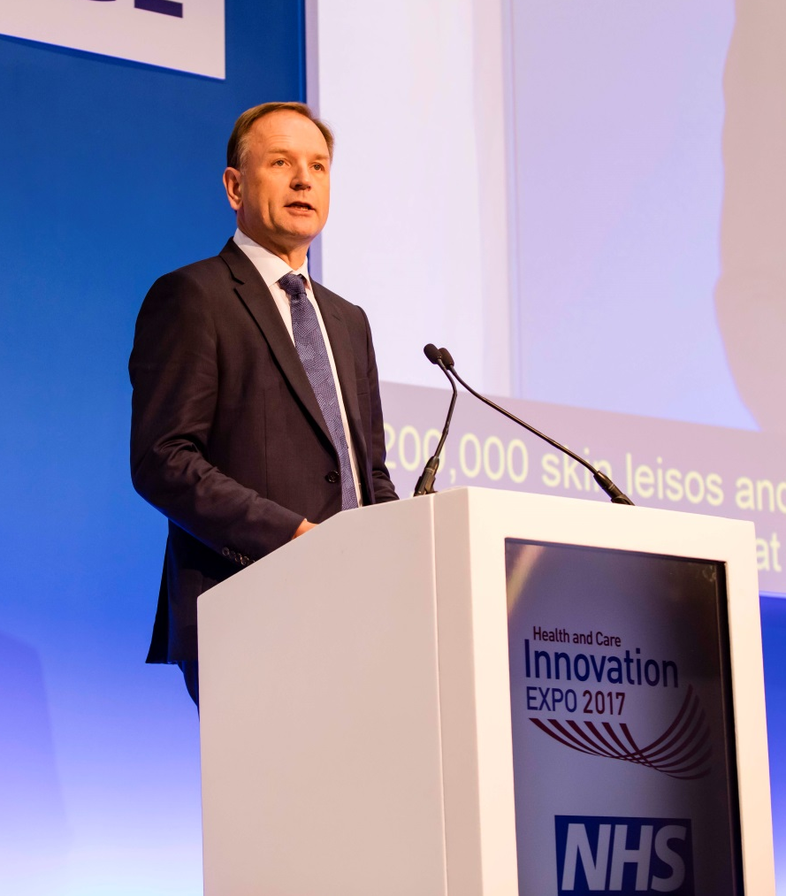
Simon Stevens, Chief Executive, NHS England
The NHS: a hotbed of innovation
Medicine
Continue to negotiate best deals with pharmaceutical industry
Data
Life Sciences: Industrial Strategy
Artificial Intelligence
Make the case for more investment
Med tech
Extend Innovation and Technology Tariff to cover primary care
Notes:
In his keynote speech at Expo Simon Stevens, as well as calling out Winter preparations as the major focus for the new few weeks and months and celebrating some of the achievements of the last year, identified four areas NHS England is focusing on to progress innovation in the NHS.
Medicine
Need to continue the progress that has been made in negotiating good deals with the pharmaceutical sector. For example, the approach taken across the country on the new Hepatitis C treatments has allowed:
20,000 patients treated
Death rate cut by more than 10%
More than 50% reduction in need for transplants
Prices cut by more than 25%; saving the NHS millions
There is also a need to exploit the opportunities from the new biological medicines, such as biosimilars. NHS England is setting the aim:
90% of new patients will get the best value biological medicine within three months of the launch of a biosimilar
80% of existing patients, where it is clinically appropriate, will make that transition within 12 months
This could save the NHS up to £300 million over the next several years, if this is achieved.
Data
John Bell’s report, Life Science: Industrial Strategy, sets out a compelling case to advance the use of anonymised clinical data. NHS England and NHS Digital, as well as partners, back John Bell’s recommendations and, by the end of the calendar year, will identify three to five locations that will go live as digital innovation hubs.
Artificial Intelligence
There are great opportunities to use artificial intelligence, and machine learning, to improve the quality of clinical care. There is the potential to automate great swathes of what is happening in radiology and to some extent, pathology and dermatology. Advancements are already being made in pulmonary embolisms and CT scans, as well as retinal scan analysis.
Over the next 12 months NHS England will make the case for public investment and NHS investment in more artificial intelligence and machine learning projects that will benefit health and care.
Med tech
NHS England is extending the funding of NHS Test Beds for a further two years as they have already proven themselves to be a strong and investable proposition. So far this year the Test Beds have delivered:
40 innovations
Eight evaluation teams
Five voluntary sector partners
4,000 patients enrolled across those test bed sites

Slide 5
Rt Hon Jeremy Hunt MP, Secretary of State for Health
Digital-led NHS treatment by 2018 – enabling all the following to be done online
Access NHS 111
Access your patient records
Book GP appointments
Order repeat prescriptions
Set and change data sharing preferences
Register for organ donation
Record end of life care preferences
Receive medical consultations
Notes:
As well as thanking the NHS staff who responded to the attack at Manchester Arena and celebrating the progress in cancer survival rates and safety improvements, Jeremy Hunt, the Secretary of State for Health also took time to celebrate the Global Digital Exemplars programme and identifying the next set of fast followers. He then outlined eight digital challenges for the NHS
1) To make sure that there is a fully functioning version of 111, available through apps or on line to all NHS patients by the end of next year.
That could mean you have a smart Q&A service which would mean much more accurate diagnosis, and much quicker diagnosis and a much better service for patients. Also of course a cheaper service for the NHS. So 111 on line for all NHS patients.
2) Challenge number two, we made huge progress in giving people access to their GP record on line. Initially those interactions will obviously only be your GP interactions but we want to move towards everyone being able to look at all their interactions, as simply as you can look at your entire order history on amazon for example. That's something that will have enormous patient safety benefits.
3) Challenge number three is to make sure that we really make it easy for people to book GP appointments on line. At the moment we book about one million GP appointments a month on line. We want to double next year the number of on line appointment slots for GPs.
The next one is to really ramp up the booking of repeat prescriptions on line, we have about two million of those every month. And we want to increase that dramatically. This of course has huge patient safety benefits, but also huge convenience benefits for people with long term conditions and will tie into a big new campaign that we are putting together in the next few months to reduce medication error.
We want to transform the data sharing debate for NHS patients by saying whatever your preferences are, can you go on line at any time, access your medical record and through an app change that preference, in one direction or another.
And this also gives us an opportunity to do is transform the debate on organ donation, where there is also a big debate about opt out and opt in. We think it should be as easy as loading up an app on your smartphone to change your organ donation preferences.
And then this is going to take us a bit longer to get absolutely right, but this gives us also the chance for people to express their end of life preferences on line. And in particular that crucial piece of information which is whether people would prefer to die at home or in a hospital setting.
And finally and perhaps the thing that will make the biggest practical difference is for people with on going conditions who are the biggest users of NHS services. We are building a suite of apps not built by the NHS but checked and approved by the NHS to be looking at a whole range of conditions from diabetes to COPD or whatever. What we want to do is allow apps to quiz people's medical records, so that for example if you have diabetes and you are put on an exercise programme by your GP, if you give your consent then information from your Fitbit can find its way through the app on to the medical record so you can have a discussion with a doctor and maybe a more honest discussion you would like about how much exercise you are actually doing.

Slide 6
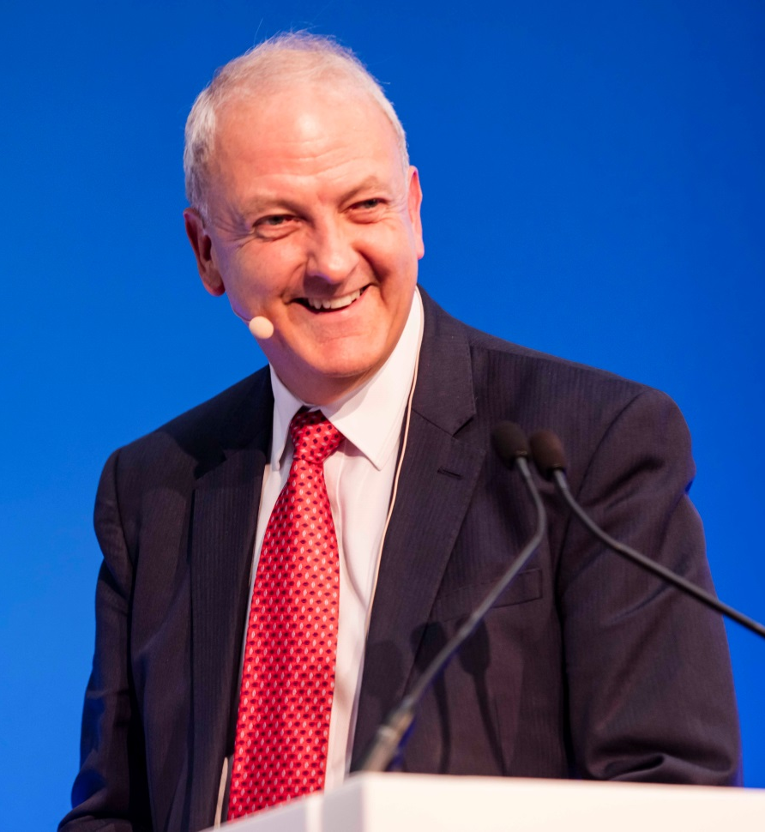
Prof Sir Bruce Keogh, National Medical Director, NHS England
Drive to save thousands from heart attacks and strokes
Co-ordinated action to improve cardiovascular care through:
Prevention
Diagnosis
Treatment
Over the next three years this could stop:
At least 14,000 strokes
More than 9,000 heart attacks
Notes:
After sharing his childhood experiences of healthcare and his assessment of the role of innovation in the NHS, in probably his last major speech as National Medical Director, Professor Sir Bruce Keogh announced a new drive to prevent heart attacks and strokes, saving thousands of lives over the next three years.
Sir Bruce urged the sustainability and transformation partnerships (STPs) to take coordinated action to improve prevention diagnosis and treatment. With better detection and management of high blood pressure, high cholesterol and atrial fibrillation this could prevent:
At least 14,000 strokes
More than 9,000 heart attacks
The former heart surgeon emphasised how cardiovascular disease kills more people nationwide than anything else. The NHS knows how to treat the resulting heart attacks and strokes but prevention is the best cure, and he called on everyone, including businesses, schools, the food and tobacco industries, local authorities and the NHS, to help.

Slide 7
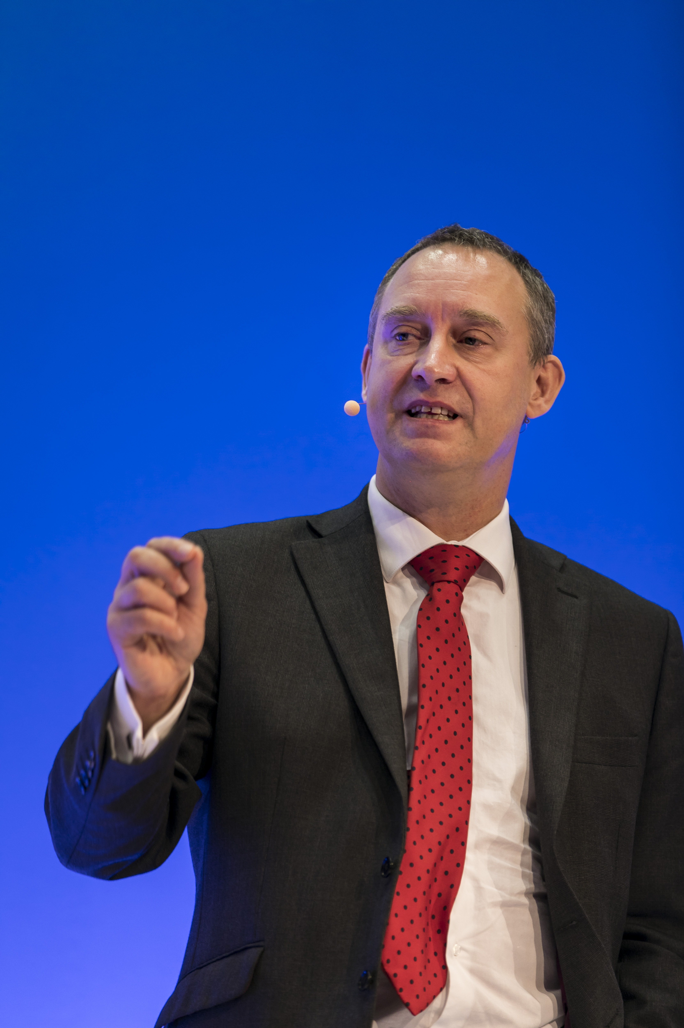
Matthew Swindells, National Director Operations and Information, NHS England
Let's come together and redesign the system
Work across NHS and care organisations in STPs
Shift the system so patients go to the right place, first time
Use opportunity of longer planning round to take long-term view
Use technology to improve care and efficiency
Financial situation will keep getting tougher: we can’t afford not to act
Notes:
Matthew Swindells made the case for Sustainability and Transformation Partnerships, explaining the work done nationally and regionally to give local leaders the freedom and support they needed to transform care in their areas.
He highlighted the extraordinary success of the NHS in comparison to other systems in the developed world in ensuring high-quality healthcare for all, but made clear there were still areas we are not getting right.
He urged leaders to:
Take every opportunity to improve: we should have been able to recover A&E performance to 95% in summer, but didn’t achieve that
Work together to further reduce delayed transfers of care
Use Right Care and Getting It Right First Time (GIRFT) to adopt best practice
Have conversations about whole systems, not individual departments or treatments
Take the decisions now that will have benefits in a year or more, using the knowledge available through the longer planning rounds
Technology will support a sea change: interoperability is key
Data will support innovation and transformation. It shouldn’t be locked away
STPs are making progress
Shared decision-making with patients dramatically reduces unnecessary surgery
We know we can do it because we are already delivering the best value highest quality health service in the world, the question is, do we want to participate in losing that and drive on from there.

Slide 8
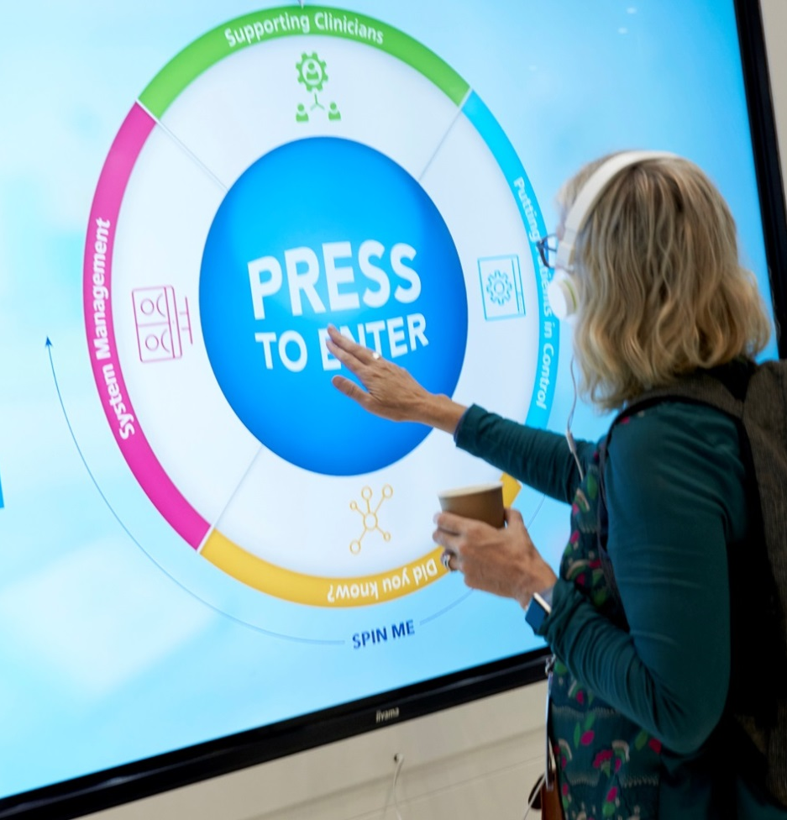
Digital Health Zone
Led by NHS England and NHS Digital, with sponsorship from Teva
How technology and information is modernising and future-proofing the NHS
ProReal – computer game technology helping people make their feelings known
Basic Charity – hi-tech vest assisting people with neurological disorders and brain injuries
#datasaveslives – campaign for the safe re-use of health data
Notes:
The Digital Health Zone showcased some of the latest innovations in technology and demonstrated the crucial role it, and information, is playing in modernising and future-proofing the NHS. This included:
ProReal – Computer gaming technology that can help people who may struggle to make their feelings known. ProReal uses 3D models, similar to those in a computer game, and transforms difficult thoughts and feelings into scenarios by creating a virtual world. People can then project themselves into this world as an avatar, which enables them to see their experiences from a different perspective. ProReal’s developers are currently working with the National Institute for Health Research as it is hoped it can be used in health and care settings.
BASIC – The Brain and Spinal Injury Charity (BASIC) demonstrated their hi-tech vest which enables people to play games and navigate a virtual world through their body movements. This helps people with neurological disorders and brain injuries to improve their cognitive skills, physical stamina and their confidence by practising real-life situations in a safe and controlled environment.
Delegates also had an opportunity to hear how managing long term conditions can be made easier with digital innovations. It explained how they are not only providing new ways of delivering care to patients, but they are also supporting clinicians by giving them better access to clinical information, reduce inefficiencies and promoting safety.
Delegates also heard from clinicians who have turned digital innovators and they had a chance to take selfies to show their support for the #datasaveslives campaign for the safe re-use of health data.

Slide 9
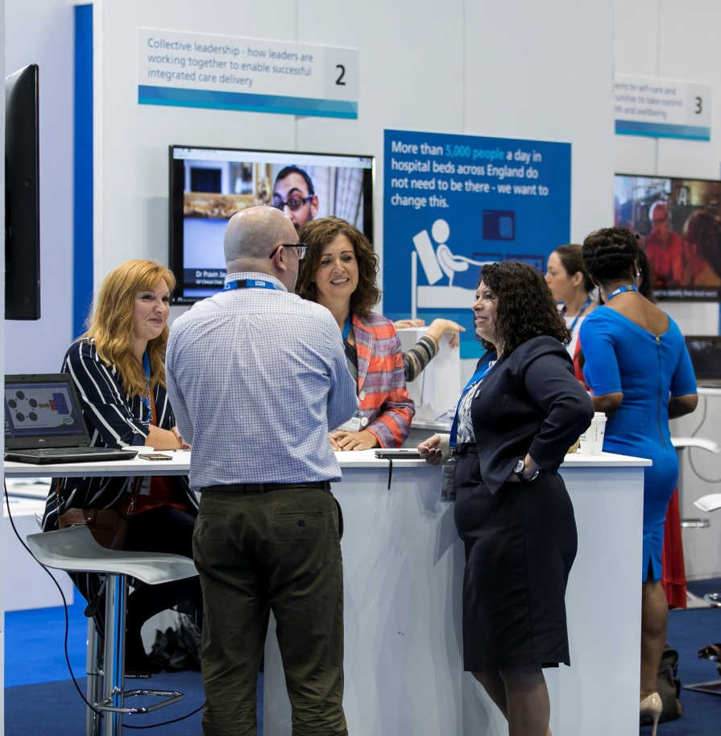
Transformation of Care Zone
Led by NHS England in partnership with local NHS and local government leaders. With sponsorship from MSD
The changing face of care
New Care Models – adopting change across the health and care system
Sustainability and transformation partnerships (STPs) – successes and challenges implementing change locally
Accountable Care Systems (ACSs) – how shared place-based responsibility is leading to new ways of treating and caring for patients
Notes:
The Transformation of Care Zone explored the changing face of care and how organisations are working together to improve the health and wellbeing of their local areas.
Delegates heard from representatives from the New Care Models vanguards and Sustainability and Transformation Partnerships (STPs) as well as other partners, including Allied Health Professionals and Healthwatch England.
The vanguards shared their learning on reshaping the New Care Models and how they are being adopted across the health and care system. STPs, including West Yorkshire and Harrogate, spoke about the challenges they have faced so far and their successes in implementing changes to improve patients’ lives locally.

Slide 10
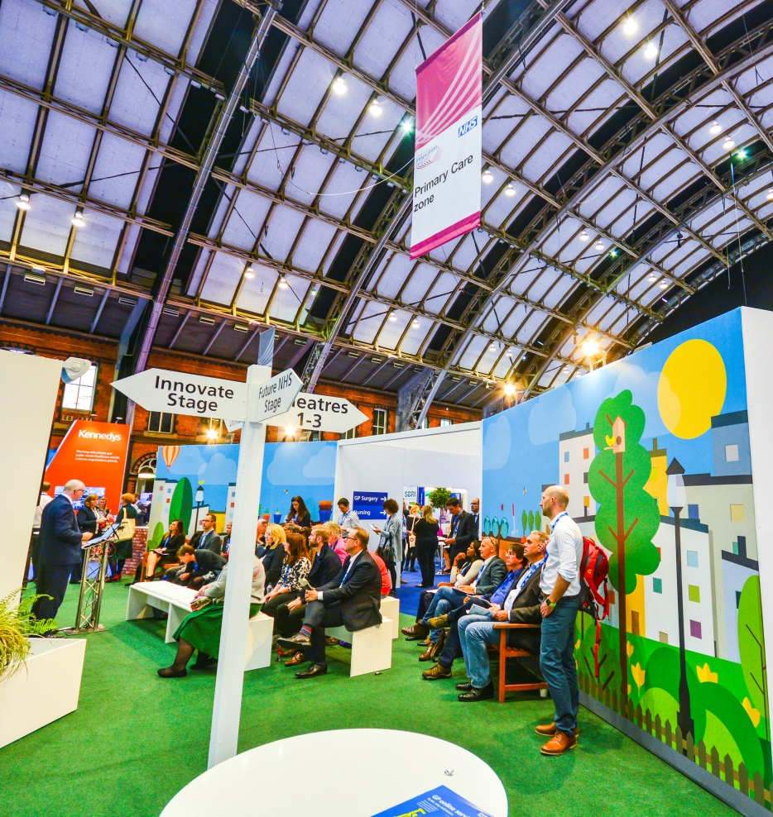
Primary Care Zone
Led by NHS England
The latest innovations and developments in primary care
Dental: integrating oral health into other primary care services
General practice: progress in achieving the General Practice Forward View
Pharmacy: Pharmacy Integration Fund
Great sessions on social prescribing, patient-centred care, getting to know your patients, and self-care.
Notes:
The Primary Care Zone focused on the latest innovations driving dental, general practice and pharmacy and gave a chance for delegates to meet and hear from leaders and patients from across the country.
Dental: Sara Hurley, Chief Dental Officer, spoke on oral health integration and early years prevention and how sustainability and transformation partnerships and local dental networks can work together.
General practice: Representatives from across general practice focused on demonstrating how the General Practice Forward View is being implemented. Delegates heard from GPs, CCGs and NHS England on a variety of subjects including patient-centred care, placing communities at the heart of primary care transformation and developing general practice nurses’ confidence and capability.
Pharmacy: delegates met Dr Keith Ridge, Chief Pharmaceutical Officer, and heard expert advice on the Pharmacy Integration Fund and how pharmacists are increasingly taking on clinical roles as of the primary care team.

Slide 11
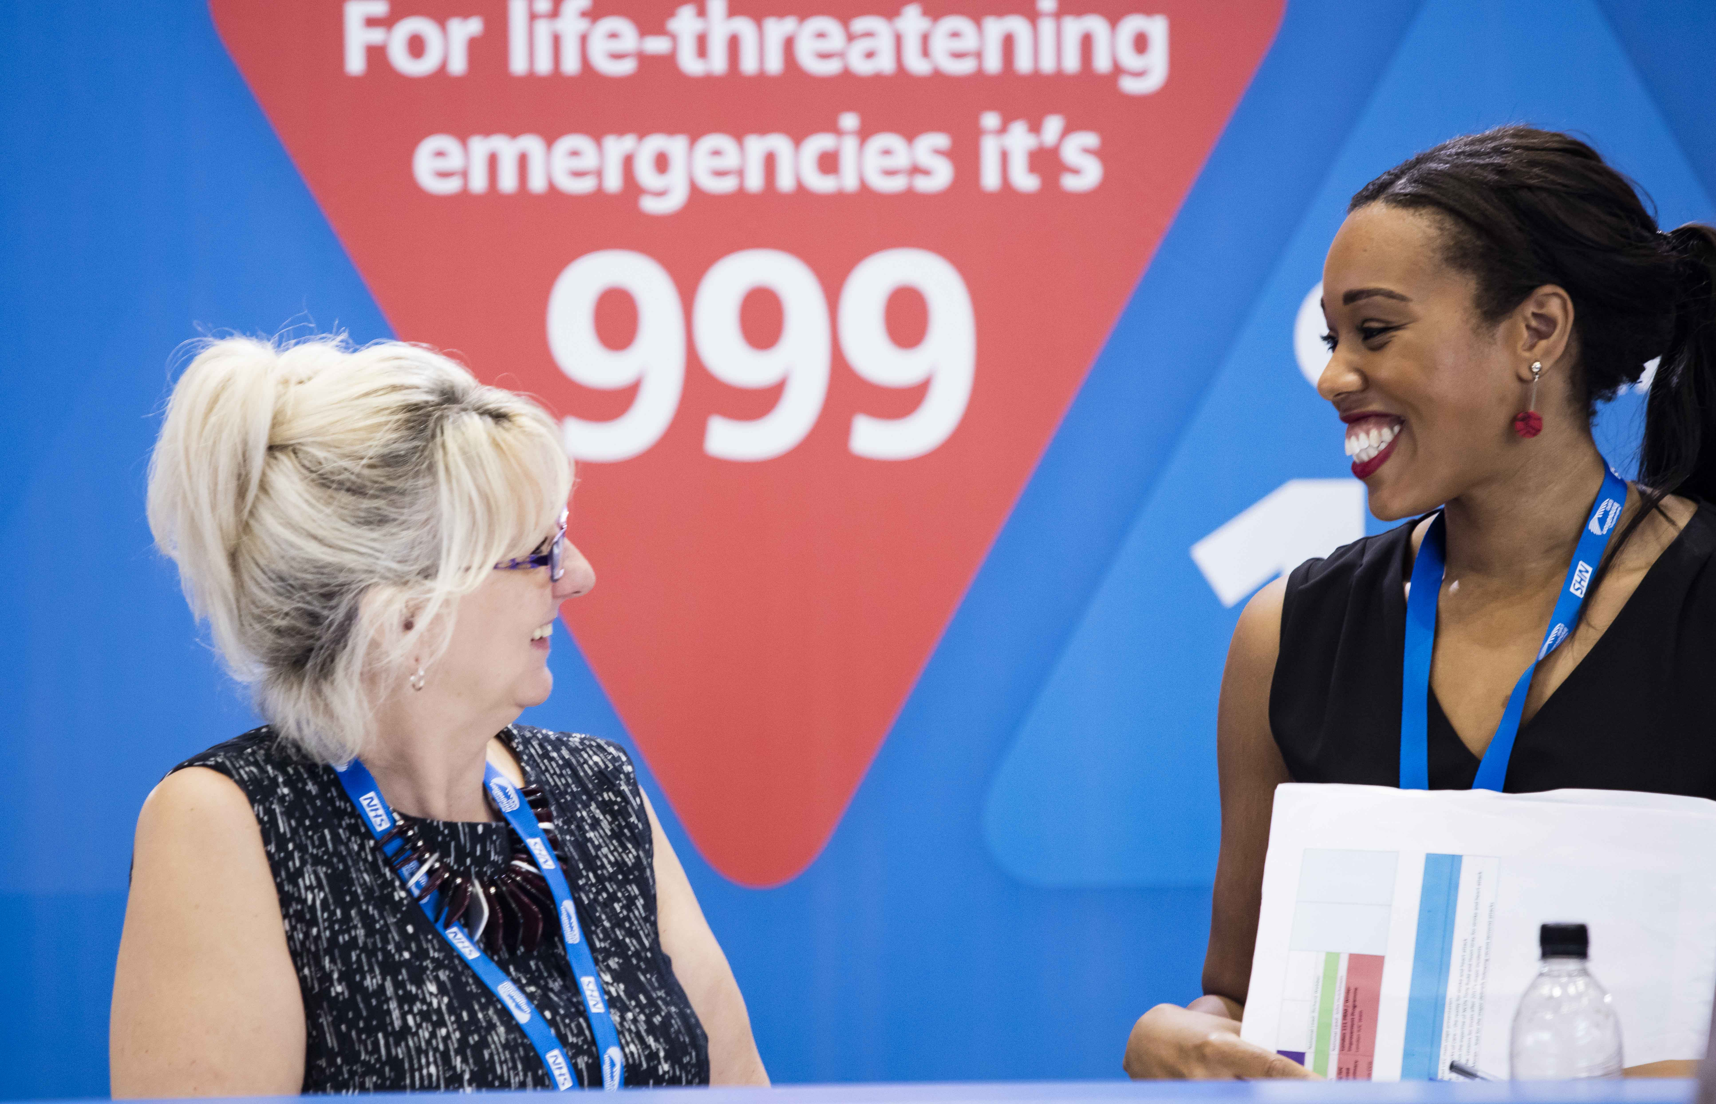
Urgent and Emergency Care Zone
Led by NHS England in partnership with NHS Improvement
Transformation on a local and national level
NHS 111: enhancements to telephone and online format
Ambulance Response Programme: changing role of ambulance services
Flight Deck: software helping hospitals to manage emergency care
Improving mental health care in emergency settings
Notes:
The Urgent and Emergency Care Zone demonstrated how urgent and emergency care is being transformed locally and nationally.
The zone heard from representative from NHS England and NHS Improvement. They detailed the latest developments in NHS 111, such as pilots to manage safer and more effective care for children and the expansion of its online services.
Experts also spoke on the Ambulance Response Programme and discussed the changing role of ambulance services, including a pilot scheme being run by the North East Ambulance Service which has introduced a triage tool that enables paramedics to recognise symptoms rather than make a definitive diagnosis.
Delegates were given a demonstration of Flight Deck; software which has been tested in the north east to help hospitals manage emergency care. It displays the current status of emergency care across a region and also predicts the likely scenario for four and 12 hours ahead. The software can reduce handover times at accident and emergency departments, reduce delays in patient care and allow better use of hospital resources. It is hoped Flight Deck will be rolled out across the north of England to help alleviate pressure this winter.

Slide 12
#NHS70 Hub
Sharing ideas and plans for celebrating the NHS’s 70th anniversary on 5 July 2018
Exploring health technology to imagine how the NHS will look in a further 70 years, in 2088
Revisiting the first day of the NHS with retired nurse and radiographer Ethel Armstrong (87) who was at work on 5 July 1948
Charting the history of world-firsts achieved in the NHS
Notes:
As the NHS is turning 70 next year the #NHS70 Hub took a look back at its history featuring talks on the NHS’s early days from the likes of Ethel Armstrong. Ethel started working for the NHS on its first day and she described how patients had to bring their own sandwiches but she knew even then what a momentous institution it was going to become.
The hub also looked to the future and predicted what a GP Practice would be like in 70 years time. Sir Sam Everington, a Tower Hamlets GP and national advisor on new care models, predicted technological advances but explained how doctors and nurses will need to remember what the NHS was founded on and ensure community is at the heart of the practice. Professor Tony Young, NHS England’s Clinical Director for Innovation, discussed how medical technology could change the way hospital services are delivered.
The hub also gave tips on how people can join the celebrations next year, such as open days, exhibitions, staff awards, photo competitions, fundraising and lots more.

Slide 13
What to do now
Use this presentation to help tell your colleagues and networks about what you learned at Expo 2017
Download all available speaker presentations from Glisser via the Expo App and on the Expo website too.
Look out for video clips, main stage speaker videos, and our official Expo highlights video as they become available in the next few weeks
Follow us @ExpoNHS for the latest updates and more follow-up information from key Expo topics
Subscribe to Informed (https://www.england.nhs.uk/email-bulletins/informed-bulletin/)
Save the date for Expo 2018! We return to Manchester Central on 5-6 September 2018

