Slide 1
Section 7a Infant Hepatitis B Immunisation Protocol 17/18
Maternity Unit
Babies born to Hep B positive mothers before September 2017 should be immunized at birth following the 0,1,2 and 12 month accelerated schedule +/- HBIG
Hep B positive mother identified and Hep B notification L1 sent to appropriate CHIS and GP
At Birth
1st dose Hep B immunization
Notification of high risk Hep B positive mothers from Colindale to CHIS Hubs
Hep B notification L2 to CHIS & GP. NBR to CHIS
CHIS Failsafe
SIT
General Practice
Health visitor help
Checks baby is registered with practice and monitors when 1st dose is given
Check 1st dose was given and Book 2nd dose appointment
4 weeks old
2nd dose neonatal Hep B immunization
Checks vaccine appointments are scheduled and that GP practices are sending proactive reminders to parent
8, 12 & 16 weeks old
3 doses of 6-in-1 (Hep B containing) vaccine
Checks progression of schedule on a weekly basis. Alerts SIT if dose missed.
Book appointment for final dose of infant Hep B vaccine & test
Requests GP practice to confirm course completion. Informs SIT.
Order DBS kits in advance from england.dbskits-london@nhs.net.
12 months old
Final dose Hep B immunization
Dried Blood Spot (DBS) or serology test
Report vaccine incident if dose/DBS is missed to england.londonscreening-incidents@nhs.net
Incomplete immunization: For any baby, infant or child with missed/ incomplete Hep B immunization please refer to Public Health England management algorithms overleaf

Slide 2
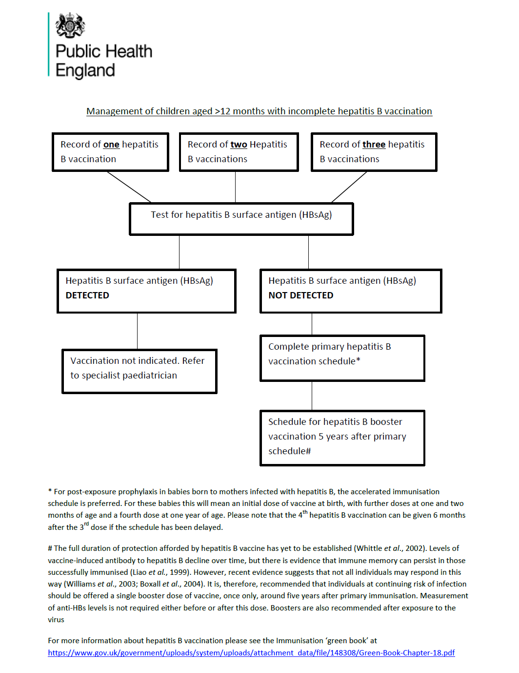

Slide 3
