Slide 1
End of Life Care event
Patient / Carer Perspective
Sue Pascoe
Notes:
Introduce myself
For the next 15 minutes let’s look at the word through a different lens – that of a patient /carer
The people that I have recent experience of caring for in the last phase of their lives can’t be in this room with us today – so let me share a bit about them
Here they are

Slide 2
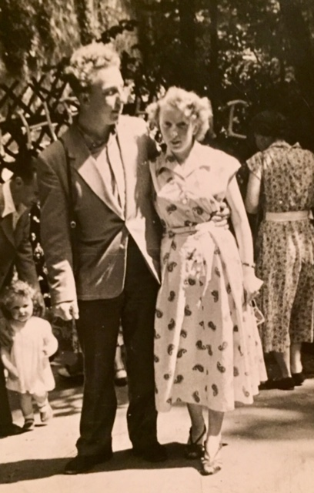
Notes:
Shortly after they met

Slide 3
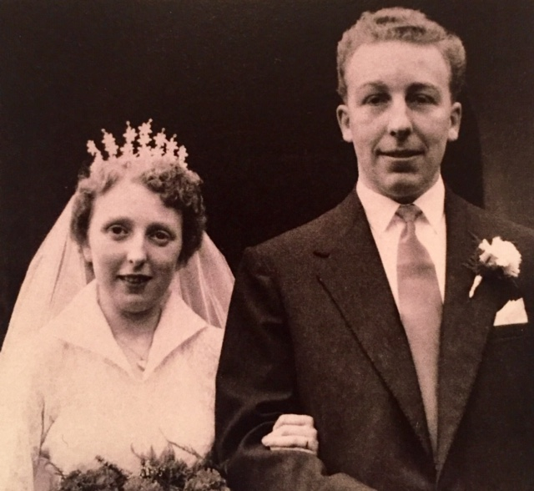
Notes:
Their wedding day

Slide 4
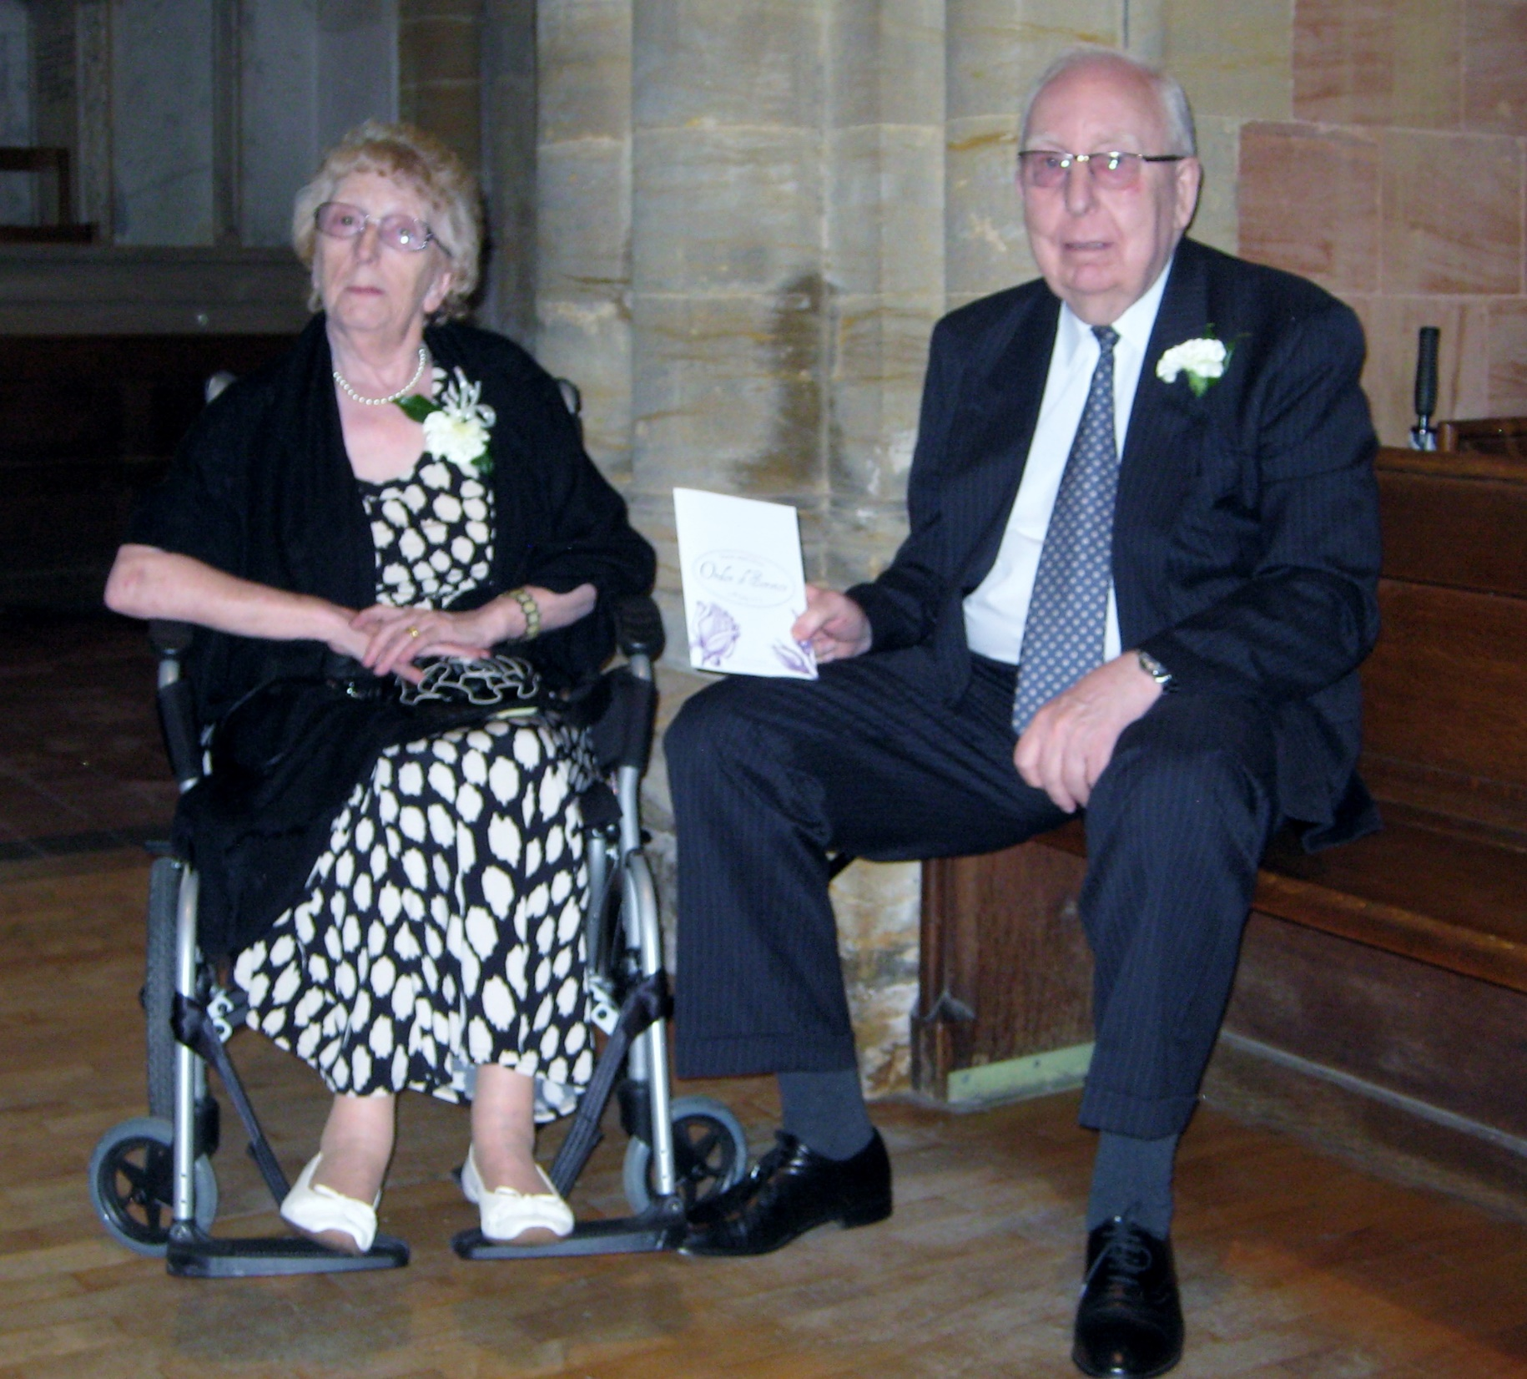
Notes:
Beginning to age - at the wedding of their eldest grandchild

Slide 5
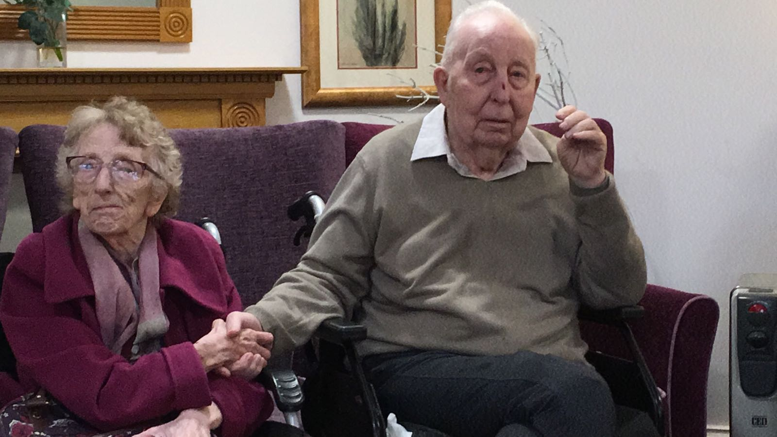
Notes:
At the care home where they spent the last 9- 12 months of their lives

Slide 6
Introducing - Mum and Dad
A couple of EastEnders
They met at the wedding of a friend The bridesmaid who went on to become a bride
Akin to others of their generation Dad worked, successful career
Mum cared for us and once we had left home their parents
Went on to own their own home 1st in their families to do this
Had 3 children grandparents and great grandparents
Notes:
Read slide
I know that this story is not unique to me
This helped me
Our parents die before we do
My guess is that I am not the only carer in this room today
Let’s check
Number of people caring for someone in the last phase of their life?
Number of people in the room caring for someone that is living with dementia?
Number of people in the room caring for someone whose living in a care home home?

Slide 7
Last phase of their lives, 5 - 7 years
Long term conditions Dementia and Progressive Cerebellar Syndrome Slow deterioration
Their wish to stay at home, together, where they felt safe
Increased support Homecare, Respite, Crossroads, Day Care, 24 hour care
Continuity of care
Increasing conveyances to hospital
Concerns - what would happen to Dad if something happened to Mum
How do others navigate the system?
Notes:
So …………………….. the focus of this event today is the End of Life but let me focus for a minute or two on the last phase of Mum and Dad’s lives which spanned around 5 years which helps to provide context
Both had long term conditions 5 / 7 years – slow deterioration
We talked, whilst they were still able, about what they wanted / how best to manage this.
Put all of the necessary paperwork in place DNAR / LPAs
As they began to deteriorate
Sought help – homecare / respite - not easy to find support / waiting lists when you do find it
Increasing conveyances to hospital – of which there would have been more without my intervention
Catheter management
Falls
Mum could cope but Dad really could not
Disorientation increased post admissions
Increased care until eventually we were looking for a 24 hr carer 7 days a week – continuity a real issue
Living with risk – a high level of risk, exhausting for everyone!

Slide 8
Last year of their lives
Managed to keep them at home, together, for longer than most
Increasing levels of need
Search for a care home Very little support available around this
Admission to a care home
Plan in place for them to live and die there
Both of them ended up dying in hospital - Mum in A&E
Last year of their lives difficult for all
Notes:
We did manage to keep them at home as long as possible
Search for a care home – dual registered.
Dad admitted following a hospital admission – not the way we wanted it to be
By this stage totally unable to express his own needs
By this I mean say that he was uncomfortable / needed a drink / needed the toilet
Not the dignified man I knew
Mum followed – just could not manage at home without him
Worried about him constantly
We found somewhere – somewhere for them to live and then die
They were safe but did not get to spend as much time together as Mum in particular would have liked
Mum very unhappy - sad
Avoidable conveyances to hospital did not stop and I was willing to live with a much higher level of risk than most
They both ended up dying in hospital Dad on a medical ward following a Bank Holiday Admission and Mum in A&E

Slide 9
What could the system do differently?
Support self funders voluntary services / day care / homecare / residential care
Conveyances to hospital Risk adverse Avoidable
Primary care – continuity skills and competencies
Medications management
Treat care homes as part of the system Significantly more care home beds than hospital beds Part of the solution not the problem Workforce
Think about how we provide care for couples
Notes:
I have been asked to think about what the system could do differently
I have tried to extrapolate form my experience the things that would make the most difference for the most number of people
I am a commissioner that commission care for a population – not in general for individuals
I struggled to navigate the system – what is it like for others?
How we minimize conveyances to hospital
Risk adverse / many avoidable / long waits – how do we give staff (care home / GPs /out of ours LAS) time and skills to mange this?
Primary care – continuity of care (Dr Small)
Medications management – could and should have been reviewed. Anticoagulants in particular.
Treat care homes as part of the system
Support the workforce
Commission care for couples

Slide 10
What helped?
Long and happy lives
Talking to those in a similar position
Sharing the responsibility with others
Individuals – regardless of sector The kindness of others Developing meaningful relationships Communication / reinforced messages Delivering on promises
Notes:
Let’s finish on a positive note
There are some things that helped – both Mum and Dad had a good 80 years / lots of happy times. Managing the final stage of life is not easy / often messy.
Talking to those in a similar position – colleagues / other relatives
The kindness of others – words / gestures
Sharing the responsibility with others – my husband and brother
Developing meaningful relationships – with key people GP / care home staff not always those you expect. The person that sorted the laundry often had more time to talk to Mum that those providing her care
These people made me feel ssafe
Communication / reinforced messages
Delivering on promises

Slide 11
THANK YOU FOR LISTENING
Notes:
Introduce myself
For the next 15 minutes let’s look at the word through a different lens – that of a patient /carer
The people that I have recent experience of caring for in the last phase of their lives can’t be in this room with us today – so let me share a bit about them
Here they are

