Slide 1
NHS London Violence Reduction Clinical and Professional Network
15th October 2019
9am - 11am
Agenda item | Lead | Slide number
Welcome and introductions | Martin Griffiths
Background to the programme | Martin Griffiths | 2
Draft Terms of Reference, Governance and ways of working | Martin Griffiths / Sinead Dervin | 3 – 5
High level programme plan | Martin Griffiths | 6
Integrated physical and physiological trauma model | Sinead Dervin | 7
Violence Reduction Academy | Martin Griffiths | 8
System data and intelligence | Emily Treder | 9
AOB | Martin Griffiths

Slide 2

1. NHSL Violence Reduction Programme: Background
The number of violent incidents in London is unacceptably high and has significant impact on individuals, families, communities and our health service.
The Mayor of London has established a Violence Reduction Unit to address this by taking a long-term public health approach with key partners such as health, social care, education, housing
Violence reduction has also been reflected in the recently published Health and Care Vision and is one of London’s ten priority areas.
The NHS is a key player within the VRU but as a health service we recognise the need for an independent, coherent health response, looking at opportunities the health system can take to support violence reduction across the capital.
To support this a Clinical Director for Violence Reduction has been appointed (Martin Griffiths, Trauma Surgeon at Barts NHS Trust ) as well as NHS London Executive SRO and support from an internal team of NHS and PHE leads and programme management expertise.
Establishing a Violence Reduction Clinical and Professional Network is a key part of the programme to provide system leadership and help drive forward the programme deliverables. Draft Terms of Reference for the network are outlined on the following slide.

Slide 3
2. London’s Violence Reduction Clinical & Professional Network Terms of Reference and Governance
DRAFT
Description
Membership
The role of the Violence Reduction Clinical & Professional Network is to provide a forum for clinicians and professionals to meet and share their specialist expertise, clinical expertise and strategic knowledge.
The network will act as a clinical and professional expert arm of the NHS London Violence Reduction programme and exists to provide collective knowledge and strategic leadership. The network is responsible for:
Providing clinical and professional advice and leadership of system-wide transformation across the violence reduction pathway;
To provide support and advice to local systems on the development of pathways / services in regards to the NHS’ contribution to violence reduction and lead the way in sharing good practice across the capital and nationally;
Give expert advice on best-practice pathways which cross organisational and sector boundaries;
Acting as advocates for London’s violence reduction programme across London’s health and care system and supporting stakeholder engagement;
Leading the development, and providing endorsement, on the deliverables produced by the programme.
NHS London Violence Reduction Clinical Director (chair)
Clinical representation from London’s Trauma Networks
Clinical representation from London’s A&Es
Clinical representation from London’s Mental Health Trusts
Clinical representation from primary care
Representation from the London Ambulance Service
Representation from social and community care
Representation from public health
Representation from the third sector
Frequency - The network will meet on a quarterly basis for 2-3 hours. It is expected that members will commit the time necessary to understand the issues considered by the network, participate and respectfully in debate and genuinely commit to identifying sustainable strategic decisions on behalf of Londoners. Members are expected to attend most meetings during the year.
Additional meetings - Additional Task and Finish groups will be established with network representatives to guide specific programme deliverables outside of the formal meeting structure.
Review - The network will review its purpose, function, performance and terms of reference on an annual basis.
Quorum - A quorum for meetings will be 50%, including the Chair. As members attend as individuals in their own right, the use of nominated deputies is discouraged.
*Appendix 1 shows full membership

Slide 4
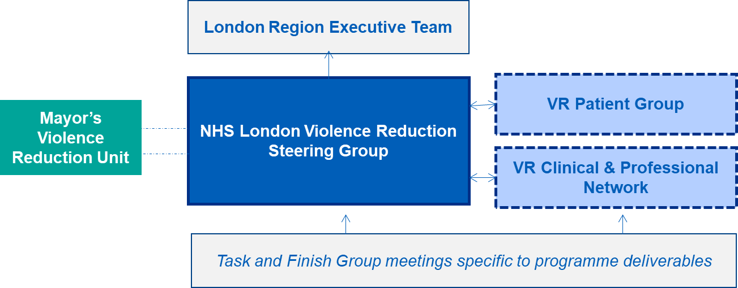
2. London Violence Reduction Clinical & Professional Network Terms of Reference and Governance
Ultimately the programme is accountable to the London Region Executive Team, chaired by Sir David Sloman via the programme’s Senior Responsible Officer (Mark Turner) and Clinical Director.
The London Violence Reduction Clinical and Professional Network serves as a leadership committee that reports and is accountable to the NHS London Violence Reduction Steering Group.
A dedicated Violence Reduction Patient Group is also being established with patients (victims and perpetrators) that have experience and knowledge of health pathways. The patient group will be pivotal in shaping, developing and leading on programme deliverables alongside the network.
Do representatives on the Clinical and Professional Network agree with the draft Terms of Reference?
Are there additional points and/or responsibilities that need to be outlined?
*Note - Meeting dates for the next 12 months are being scheduled

Slide 5
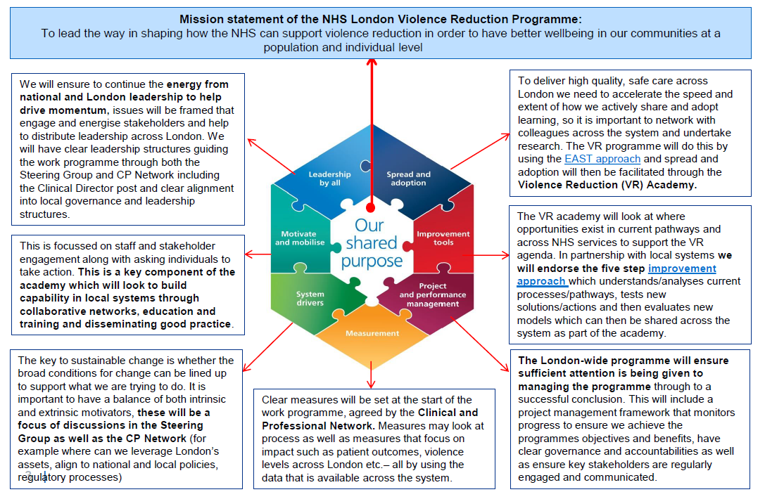
3. London’s Violence Reduction Programme: Adopting the NHS Leading Large Scale Change model

Slide 6
4. London’s Violence Reduction Programme: High Level
Mission statement of the NHS London Violence Reduction Programme:
To lead the way in shaping how the NHS can support violence reduction in order to have better wellbeing in our communities at a population and individual level
Emerging work streams to achieve the programme’s mission:
1. Violence Reduction Clinical and Professional Network and seeking pan-London opportunities
Establishing a VR clinical and professional network that plays a leading role in motivating and mobilising local systems, acting as advocates for system-wide transformation at all levels, supporting co-production with users and enhancing current service offers of pan-London NHS services.
4. User engagement
Users supporting and guiding the programme deliverables and helping identify further opportunities
2. Establishing a Violence Reduction academy
Early intervention
Supporting emotional wellbeing
Tertiary prevention
Data &
intelligence
Knowledge & evaluation
Capability building
Mapping of best practice to provide a central repository of evidence based models. Supporting pilots of new pathways/models across London and communicating success. Supporting how to define key metrics and evaluations across the system and knowledge spread of what works and lessons learnt. Facilitating online communities of practice
Identification of local champions to facilitate learning locally. Development of educational programmes which support staff. Links with HEE to incorporate VR into curriculum Building collaborative networks - events for professionals across the system to work collaboratively, problem solve, learn from each other, provide peer support and challenge.
Data hub that provides intelligence to inform local interventions and support across different health areas (scope to initially focus on areas in blue boxes above)
3. System data capture and intelligence
Improving data collection, analysis and sharing mechanisms, ensuring we have a comprehensive dataset across partners looking at the prevalence of injury, risk and protective factors to inform regional, sub-regional and local policy
5. Communications across the health system

Slide 7
4a. Violence Reduction Academy
2. Establishing a Violence Reduction academy
Early intervention
Supporting emotional wellbeing
Tertiary prevention
Data &
intelligence
Knowledge & evaluation
Capability building
Mapping of best practice to provide a central repository of evidence based models. Supporting pilots of new pathways/models across London and communicating success. Supporting how to define key metrics and evaluations across the system and knowledge spread of what works and lessons learnt. Facilitating online communities of practice
Identification of local champions to facilitate learning locally. Development of educational programmes which support staff. Links with HEE to incorporate VR into curriculum Building collaborative networks - events for professionals across the system to work collaboratively, problem solve, learn from each other, provide peer support and challenge.
Data hub that provides intelligence to inform local interventions and support across different health areas (scope to initially focus on areas in blue boxes above)
In the first instance, the academy will be a virtual space where information and data can be stored and an online community can be built;
The first phase of establishing the academy will involve a thorough mapping exercise across the system looking at what is happening and sourcing good practice to build the central repository. This phase will also look at opportunities where the NHS can play a greater role in responding to violence reduction and developing material to support local systems in doing so;
The first phase will also include making links with HEE and the Royal Colleges to see what opportunities exist in current curriculum to build capability;
It is envisioned that the academy will be more formally launched through a sharing good practice event.
Representatives on the network to provide comments and feedback on:
The scope of the academy and the three focus areas;
How we progress establishing the academy and in particular phase one, e.g. sourcing best practice and evidence across the system and particular individuals / organisations the programme should tap into;
Particular representatives on the network that want to be more involved in this work stream.

Slide 8
4b. System data capture and intelligence
Data that collects intelligence on violence, vulnerability and other risk factors is variably collected across different parts of the NHS. Largely it is inconsistent and not collated and analysed in a systematic way to inform service improvements.
The objectives of the ‘System Data and Intelligence’ work stream involves:
Identifying data currently collected across the NHS that informs the prevalence of injury from violent acts, and the risk and protective factors associated with violence,
Assessing the quality of data currently collected, including its robustness, completeness and comparability across settings and providers, and
Developing recommendations on opportunities to strengthen and expand the data collected across the NHS, ensuring that any additional ask of system partners is proportionate and practical to implement.
Initial discovery phase – Develop a greater understanding of the problem to be solved and what the system wants to change or make happen. This will include engagement with members of both the Violence Reduction Steering Group and Clinical and Professional Network
Stocktake of existing data sources, including an assessment of quality - This will cover the range of NHS health settings, including the trauma network and A&Es, LAS, elective care, walk-in centres, GP practices, dentists & liaison and diversion services. This will also include existing data collected in London as part of the Information Sharing to Tackle Violence (ISTV) programme and it is proposed school nurses are also included in scope. This phase will involve explore data systems on hand as well as conducting a range of interviews with representatives across different NHS settings.
Approach
Developing recommendations on the possibilities to strengthen existing data capture and/or expand the data collected – This phase will build on the data quality assessment and consider what is reasonable and practical to revise or collect from a system partner perspective. This would also explore any possible hurdles to recommendations, such as information sharing rules and legislation, contracts, technology, or existing processes and systems. This phase will also specifically look at the ISTV programme both locally and nationally and where opportunities lie to improve this.
Representatives on the network to provide comments and feedback on:
The scope of the data work stream and required outputs;
Any existing work both regionally and nationally to align with;
Particular representatives on the network that want to be more involved.

Slide 9
Appendix 1: Representatives on London’s Violence Reduction Clinical and Professional Network
Mental Health | Idit Albert | Consultant Clinical Psychologist & PTSD Lead / Clinical Lead for pan-London outreach and screen service | SLAM
 | Nigel Blackwood | Reader in Forensic Psychiatry, Kings College & Consultant Forensic Psychiatrist, HMP Wandsworth | King’s College
 | Tara Weeramanthri | Consultant Child & Adolescent Psychiatrist | SLAM
 | Richard Latham | Consultant Forensic Psychiatrist | SLAM
 | Andy Cruickshank | Director Of Nursing | ELFT
Voluntary / Charity Sector | Sherry Peck | Chief Executive | Safer London
 | Evan Jones | Head of CCE Development | St Giles
 | John Poyton | Chief Executive | Redthread
 | Philip Brading / Jo Begent | Chief Executive / Clinical Lead | UCLH Charity
 | Natalie Seymour | Clinical Lead / Clinical Psychologist | MAC-UK
 | Lucy Gore / Hannah Stringer | Clinical Psychologists and Project Leads | Project Future
Acute and Major Trauma Centres | Fenella Wrigley | Medical Director | LAS
 | Trisha Bain | Director of Quality | LAS
 | Tricia Fitzgerald | Director of Nursing | King's College
 | Emer Sutherland | Clinical Director for Emergency Medicine | King's College
 | Victoria Golden | Senior Sister, Emergency Department | Whittington
 | Martin Griffiths (Chair) | Clinical Director for Violence Reduction | Bart’s Trust
 | Gayle Hann | Consultant in Emergency Medicine (Paeds) | North Middlesex
 | Adam Woodgate | Consultant in Emergency Medicine | Bart’s Trust
 | Michael Carver | Lead Nurse for Violence Reduction | Bart’s Trust
 | Karim Brohi | Clinical Lead, London Major Trauma Network | Bart’s Trust
 | Fiona Wisniacki | Consultant in Emergency Medicine | Hillingdon Hospital
 | Asif Rahman | Consultant in Adult and Paediatric Emergency Medicine | Imperial
Local authority / Public Health | Florence Kroll | Director for Children’s Services | Royal Borough of Greenwich
 | Dagmar Zeuner | Director of Public Health | Merton Council
 | Ann Graham | Director for Children’s Services | Haringey Council
 | Geeta Subramaniam | Director of Public Protection and Safety | Lewisham Council
 | Simone Thorn Heathcock | Health & Justice Public Health Specialist | PHE
Primary Care | Raj Kumar | GP Principal and Clinical Lead for Mental Health & Dementia | BHR CCGs
 | Emma Ryan | Clinical Director of Bromley Connect & GP Senior Partner at Southview Partnership | Bromley CCG
 | Arundeep Hansi | GP Partner | Enfield CCG

