Slide 1
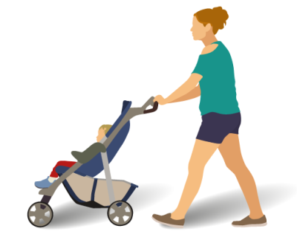
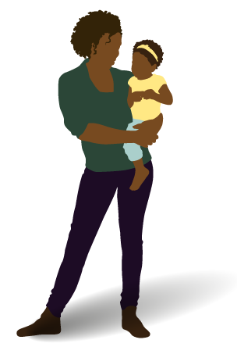
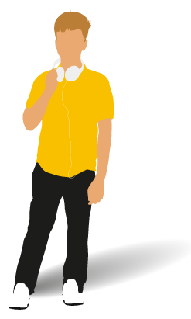
Regional Priorities: Transformation for Babies Children and Young People’s Health
System Leadership
Interdependencies
To provide system leadership to enable strategically aligned focus and co-ordination to improve the physical, mental health and well-being of CYP across partners.
CYP Mental Health
Primary Care
Urgent and Emergency care
Keeping children well
Transition
Complex needs
To improve the health and wellbeing outcomes for CYP in London through integration, collaboration and a culture of continuous improvement.
Integration
To uplift the voices and experiences of children and young people in London and embed these into the NHS.
Voice
To work collaboratively with whole system across the capital to support CYP and families to achieve healthy weight.
Obesity
To prevent deaths, reduce the number of admissions and improve the quality of
life for CYP and asthma.
Asthma
Post Covid & Elective Recovery
To reduce backlogs and increase paediatric activity volumes for elective recovery.
To improve the quality of care and outcomes for children with diabetes and epilepsy.
Diabetes & Epilepsy
To support and work collaboratively with partners to implement the national service specification requirements and improve cancer care for CYP who receive care in London.
Cancer
Neonatal
To support and provide oversight of the implementation of the Neonatal Critical Care Review recommendations in London which aim to improve neonatal outcomes and the experience of care.
To work collaboratively with whole system across the capital to support improvements in CYPMH. This work is led by Healthy London Partnership.
Mental health, LD & Autism
Childhood mortality
To work in partnership to reduce infant and childhood mortality in London.
Partnership working
System wide enablers
Supporting workforce & training
Uplifting patient voice and engagement
Data & Digital
Addressing health inequalities
Notes:
**will need to update these as aims change in the individual work programmes
Questions:
Should this only include those with individual work plans?
i.e. MH, PC, Transition, UEC, keeping children well, SPOT

