Slide 1
Making hospitals safe for people with diabetes

Slide 2
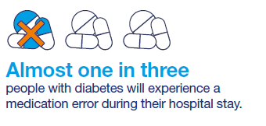
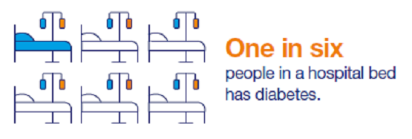
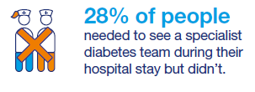
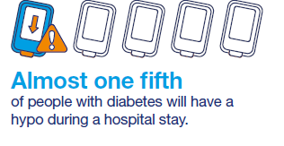
“Healthcare professionals are generally very ignorant on the subject of Type 1 diabetes. I always have a spare secret supply of meds and food when I’m in hospital. I’ve had so many awful incidents with doctors and nurses over the years – from stand up rows to nearly dying under general anesthetic from a hypo.”
Notes:
These figures come from the 2017 National Diabetes Inpatient Audit. (They can access the audit through our inpatient page on the shared practice library)
Some key things to notes
1 in 25 people experiencing DKA means people with diabetes are more likely to suffer from DKA whilst in hospital than they are out
Medication errors can lead to long lasting harm and death.
Currently one in six hospital beds is occupied by people with diabetes, this is predicted to rise to 1 in 4 by 2030 according to the NaDIA data

Slide 4
What are the barriers that can prevent a person with diabetes having a positive inpatient experience?
C → the barriers you have some control over
I → those you can influence
X → those you have no control or influence over

Slide 6
Understanding the challenges
Notes:
For our inpatient programme we wanted to understand the challenges facing the inpatient community.
We visited over 20 hospitals to generate a picture of the state of inpatient care
We asked teams what was going well, what they wanted to change and what they thought needed to happen

Slide 7
Understanding the challenges
Ward nurses
Junior doctors
People with diabetes
Other charities
Hospital managers
Diabetes inpatient teams
Diabetes inpatient groups
Notes:
We spoke to a wide range of stakeholders to make sure we had a complete picture of the challenges hospitals are facing in delivering safe inpatient care. Diabetes inpatient teams have a different perspective to say hospital managers so it was important we spoke to all the groups involved in delivering inpatient care.
Through this process we gathered rich insights which helped us to understand what constitutes a good diabetes inpatient service.

Slide 8
Notes:
We reached 39 million people through press showing how emotive this topic is. Here are some headlines.

Slide 9
For people with diabetes to be safe in hospital we need:
Multidisciplinary diabetes inpatient teams in all hospitals.
Strong clinical leadership from diabetes inpatient teams.
Knowledgeable healthcare professionals who understand diabetes.
Notes:
The report is summarised into 6 themes. For people in hospital to be safe we need the following:
Multi-disciplinary diabetes inpatient teams in all hospitals – diabetes is complex and we know people with diabetes want to see people who understand their condition
Strong clinical leadership from inpatient teams – we know good leadership leads to good care. Hospitals that have outstanding services have leaders who are visible and champion diabetes care
Knowledgeable healthcare professionals who understand diabetes – we heard from a lot of teams that they were worried about diabetes knowledges among staff on the wards. Frontline staff can’t access training and we know there is a limited amount of training on diabetes for undergraduate nurses and medics.

Slide 10
Better support in hospitals for people to take ownership of their diabetes.
Better access to systems and technology.
More support to help hospitals learn from mistakes.
Notes:
Better support in hospitals for people to take ownership of their diabetes – people with diabetes want to be able to self-manage their diabetes in hospital where appropriate, they are scared they will have their insulin taken away from them and will be treated by staff who don’t understand their individual needs. They are worried that the food provided won’t allow them to manage their diabetes and that they won’t be able to access it at the time they need
Better access to systems and technology – we know things like electronic prescribing and electronic patient records lead to safer care. We also know when teams use remote glucose monitoring they are able to prioritise their workload and see those people most at risk
More support to help hospitals learn from mistakes – the NaDIA is a fantastic audit but it is just a snapshot audit that occurs annually. For teams to make real improvements we need them to be continuously auditing care and identifying where improvements need to be made

Slide 11
Notes:
The report has 25 recommendations that align with the 6 goals we have set out.
The checklist is to help teams identify what their priorities should be. This checklist is aspirational but we know possible as every recommendation is based on a model we know exists in a trust across the country.
We want teams to work on this checklist over a 5-10 year period, we know it won’t be easy but it is possible
We’ve also given ownership to the different recommendations as this can’t all fall onto the diabetes inpatient team. Diabetes is the whole hospitals challenge

Slide 12
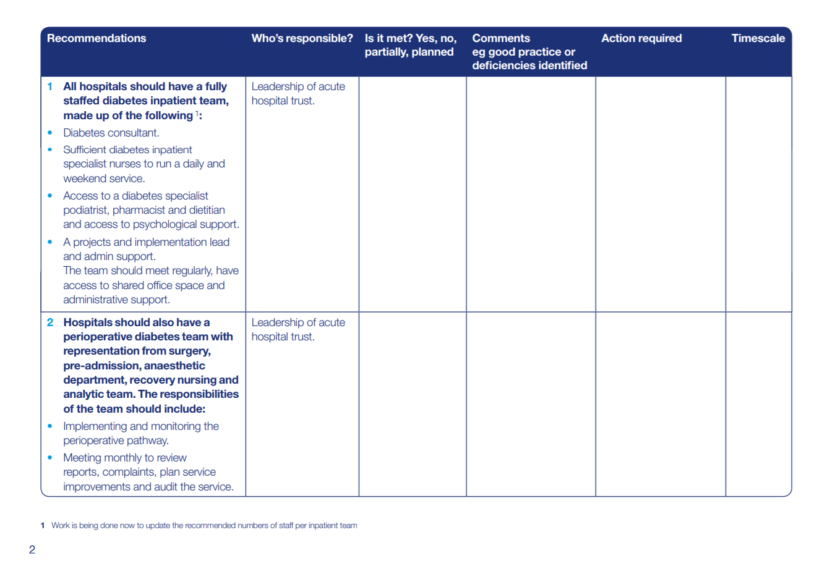

Slide 13
Notes:
We’ve already seen areas starting to take action on the report
The Clinical Networks are using it to take stock and to see if there is a particular area of care hospitals in their patch are struggling with. The London Clinical Network have asked all hospitals to fill out the checklist and will be taking a pan-London approach, they’ve already identified self-management as something they want to tackle
We are working with NHS Digital to see how the annual national diabetes inpatient audit can reflect our recommendations
We met with the CQC who will be using the checklist to inform future inspections
Individual hospitals are using the checklist to take stock and decide on next steps
People have got in touch to discuss the best practice laid out in the report. In Kingston they have a ward champions programme which is a version of a link nurse programme where non-specialists come to training and take ownership for diabetes care on their ward. This takes away the responsibility for people with diabetes sitting solely with the inpatient team

Slide 14
Some good practice

Slide 15
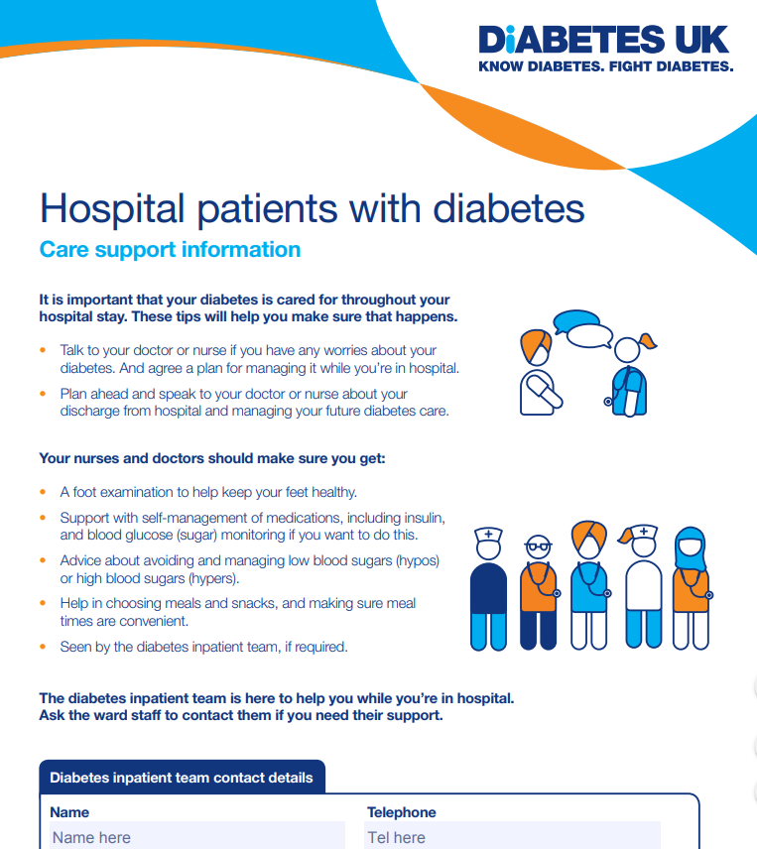
Better support in hospitals for people to take ownership of their diabetes.

Slide 16
Information Prescriptions

Slide 17
Knowledgeable healthcare professionals who understand diabetes
Notes:
These are some examples of staff training that we have seen:
The 10 point training programme was developed by one of our Clinical Champions. It covers the essentials about diabetes that everyone must know, it recognises that not everyone can be experts in diabetes but staff must know the basics. This has been rolled out across a number of trusts now and is a quick way of delivering training on the wards
There is a training tool app called Microguide for ward staff that can be downloaded. One of our Clinical Champions was involved in setting this up and we can put you in contact or the e-mail address is in our report.
Teams have thought of fun and engaging ways to involve staff such as an insulin safety advent calendar
Another training tool we’ve seen is a swatch which people can attached to lanyards.
We can send people these tools and there are more examples on our shared practice library,

Slide 19
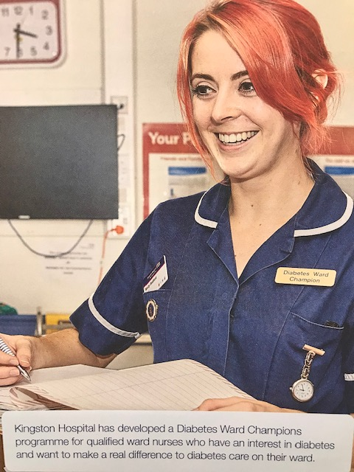

Slide 21
Developing leadership skills – Clinical Champions
Develop clinicians into leaders
Support Champions to implement improvement projects in their local areas
Multi-disciplinary
Two year appointment
Leadership training at the world-renowned Ashridge Business School
Our goal
www.diabetes.org.uk/clinical-champions-networks
Notes:
What else can we do to support hospitals?

Slide 22
Leadership course – Tomorrow’s leaders
Three day free leadership course for diabetes specialist nurses (DSNs) and dieticians
Delivered in partnership with Leicester Diabetes Centre and TREND-UK
Programme to support participants to develop and deliver an action plan to improve diabetes care.
Our goal
www.diabetes.org.uk/tomorrows-leaders

Slide 23
Patient stories

Slide 24
The national picture
Our goal
Notes:
Finally we want to share the good news that loads is happening nationally to support improvements in diabetes inpatient care
GIRFT – Your hospital will have or will be getting a visit from Dr Partha Karr or Professor Gerry Rayman, both diabetes consultants, to talk to you about your hospital data and what you can do based on national evidence to improve care. This should be a positive learning experience and is not an inspection
The Joint British Diabetes Society have guidelines for diabetes inpatient care that can be downloaded on our website
I’m sure your diabetes team will be taking part in insulin safety week and hypo awareness week. NHS England has committed to transformation funding for DiSNs

Slide 25
Questions
inpatientcare@diabetes.org.uk
020 7424 1896

