Slide 1
Tools to support development of interventions Soili Larkin & Mohammed Vaqar Public Health England West Midlands

Slide 2
Objectives
Demonstrate the CVD ROI tool
Estimate the potential benefits to an STP area for:
Improving detection or management of pre-diabetes and diabetes
Improving the usage of key interventions
Demonstrate the SHAPE CVD tool
Notes:
The tool allows the interaction of multiple risk factors in a single individual, multiple interventions acting on a risk factor and cross-cutting interventions integrated into the tool

Slide 3
Aim of ROI tool
To develop an integrated, single platform, local and national ROI tool for CVD prevention in high risk individuals, based on an up-to-date evidence review of interventions for detection or management of high risk conditions
Allows the user to explore CVD prevention strategies in patients with one or more of 6 key CVD risk factors, without existing CVD
Key exclusions:
Primary prevention in the general population, or prevention of subsequent events in people with pre-existing CVD not included in the scope of the tool
Notes:
The tool considers changes in a single risk factor by modelling the impact on a cohort of patients and considering the proportion with other risk factors that could progress to future health events (or complications). The tool then models and accrues associated costs and potential benefits from treatment of all these risk factors. For example, increasing detection of people with previously undiagnosed hypertension will also find with a proportion of these to have undiagnosed diabetes. These ‘incidentally’ diagnosed people with diabetes will then require additional treatments for diabetes as well as hypertension and some may go on to develop complications such as amputations and blindness.
How this tool can help decision makers
The tool can be used to estimate the effect of strategic changes (e.g. increasing opportunities to diagnose atrial fibrillation across a population), taking account of multiple risk factors and associated changes in service provision (e.g. increasing provision of smoking cessation interventions resulting from incidental identification of smokers). The ability to take account of multiple diagnoses from one programme (and their subsequent effect on treatment costs and benefits) distinguishes this tool from other approaches that just consider individual risk factors individually.
The tool can also be used to assess the relative benefits of strategies addressing individual risk factors (and combinations of risk factors) to identify interventions of greatest value.
The tool can also be used to consider the impact of the modelled changes on some inequalities (e.g. deprivation and gender).
Limitations
The tool is not suited for evaluating single interventions for single risk factors without considering wider impacts.
In considering ‘incidentally’ diagnosed risk factors the tool estimates a wider range of costs and potentially benefits, but is restricted by the available evidence for considering benefits that can be attributed to the intervention or strategy.
’Incidental’ diagnoses of risk factors and increases in management of one risk factor leading to increased uptake of all associated NICE interventions, the scale of the savings demonstrated from the tool are perhaps smaller that intuitively expected. For example, Improving management of hypertension leads to an increase in the number of people having smoking cessation interventions, but not all benefits from this are modelled such as reduction in lung cancer.

Slide 4
CVD ROI population of interest
Six key CVD risk factors included in the ROI population of interest are:
High blood pressure;
Atrial fibrillation (AF);
High cholesterol/high CVD risk; and familial hypercholesterolemia (FH);
Diabetes (Type 2 and Type 1);
Non-diabetic hyperglycaemia;
Chronic kidney disease (CKD
Notes:
Based on the RightCare pathway, these conditions are identified as undiagnosed and/or insufficiently managed
The tool allows the interaction of multiple risk factors in a single individual, multiple interventions acting on a risk factor and cross-cutting interventions integrated into the tool

Slide 5
CVD ROI tool - overview
The underlying model is a microsimulation model
The model simulates the population (16 years+), based initially on the Health Survey for England.
Baseline characteristics and risks coupled with diagnosis and treatment provide probability of CVD events, diabetes complications, as well as other conditions
Population cohort is aged over 20 years. Health trajectories of baseline populations defined by Whitehall II cohort
Interventions are applied to individuals that alter risk factors. CVD risk is measured using modified risk scores (QRISK and QStroke).
Notes:
Tool is based on an adaptation of the School for Public Health Research (SPHR) Diabetes Prevention Model
NHS management/treatment of risks, as well as expected detection are estimated using administrative data and estimates from a structured evidence review

Slide 6
Model progression
Over 20 years
Population
Risk factor progression
Update age and metabolic risk status of each individual
Detection
Detection and diagnosis of high risk individuals
Patients & cost
Management
Management of high risk individuals
Patients & cost
Disease outcome
Progression to disease and mortality events
Patients & cost
Notes:
The baseline population is aged 20 years
Note: management of each high risk condition is defined through optimisation of the subset list of interventions that relate to the management of specific high risk individuals, so if users choose to improve management of a condition, this will impact on the proportion of individuals using certain interventions

Slide 7
User intervention
Each model run by the user simulates the whole population twice
firstly under the assumption of current care and;
secondly under the assumption of target care (inputted by the tool user)
The difference between these simulations then calculated to produce incremental results

Slide 8
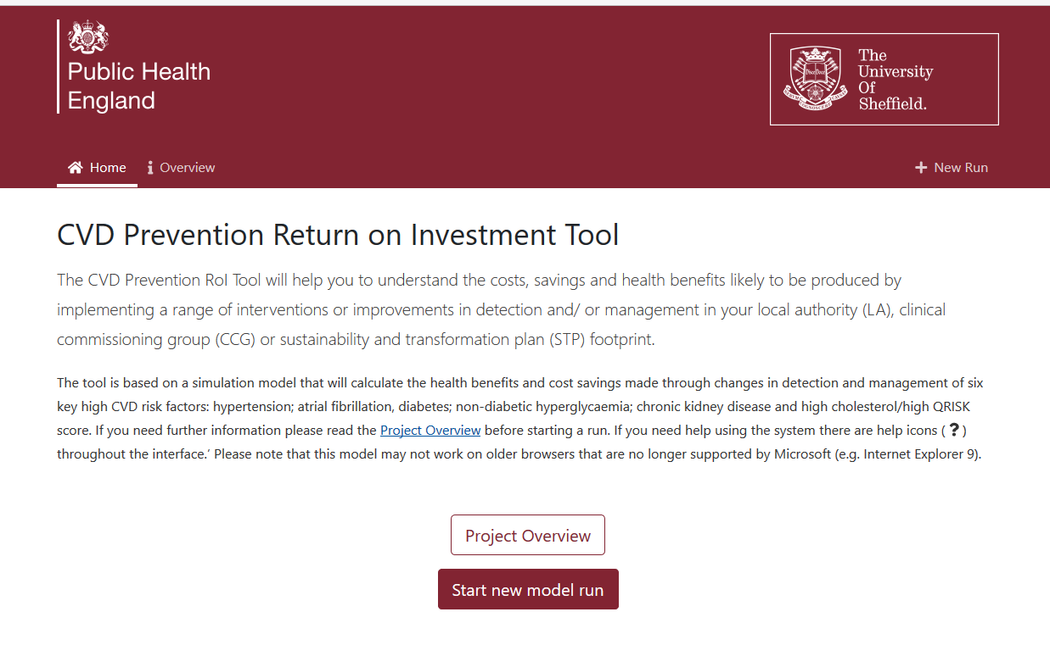
https://cvd-prevention.shef.ac.uk/

Slide 9
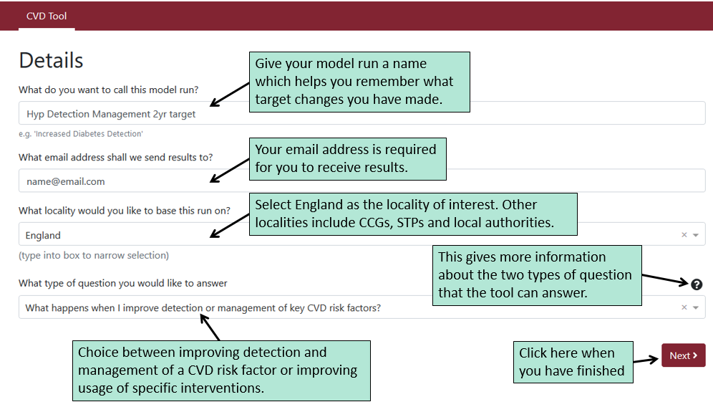
Setting up a model run

Slide 10
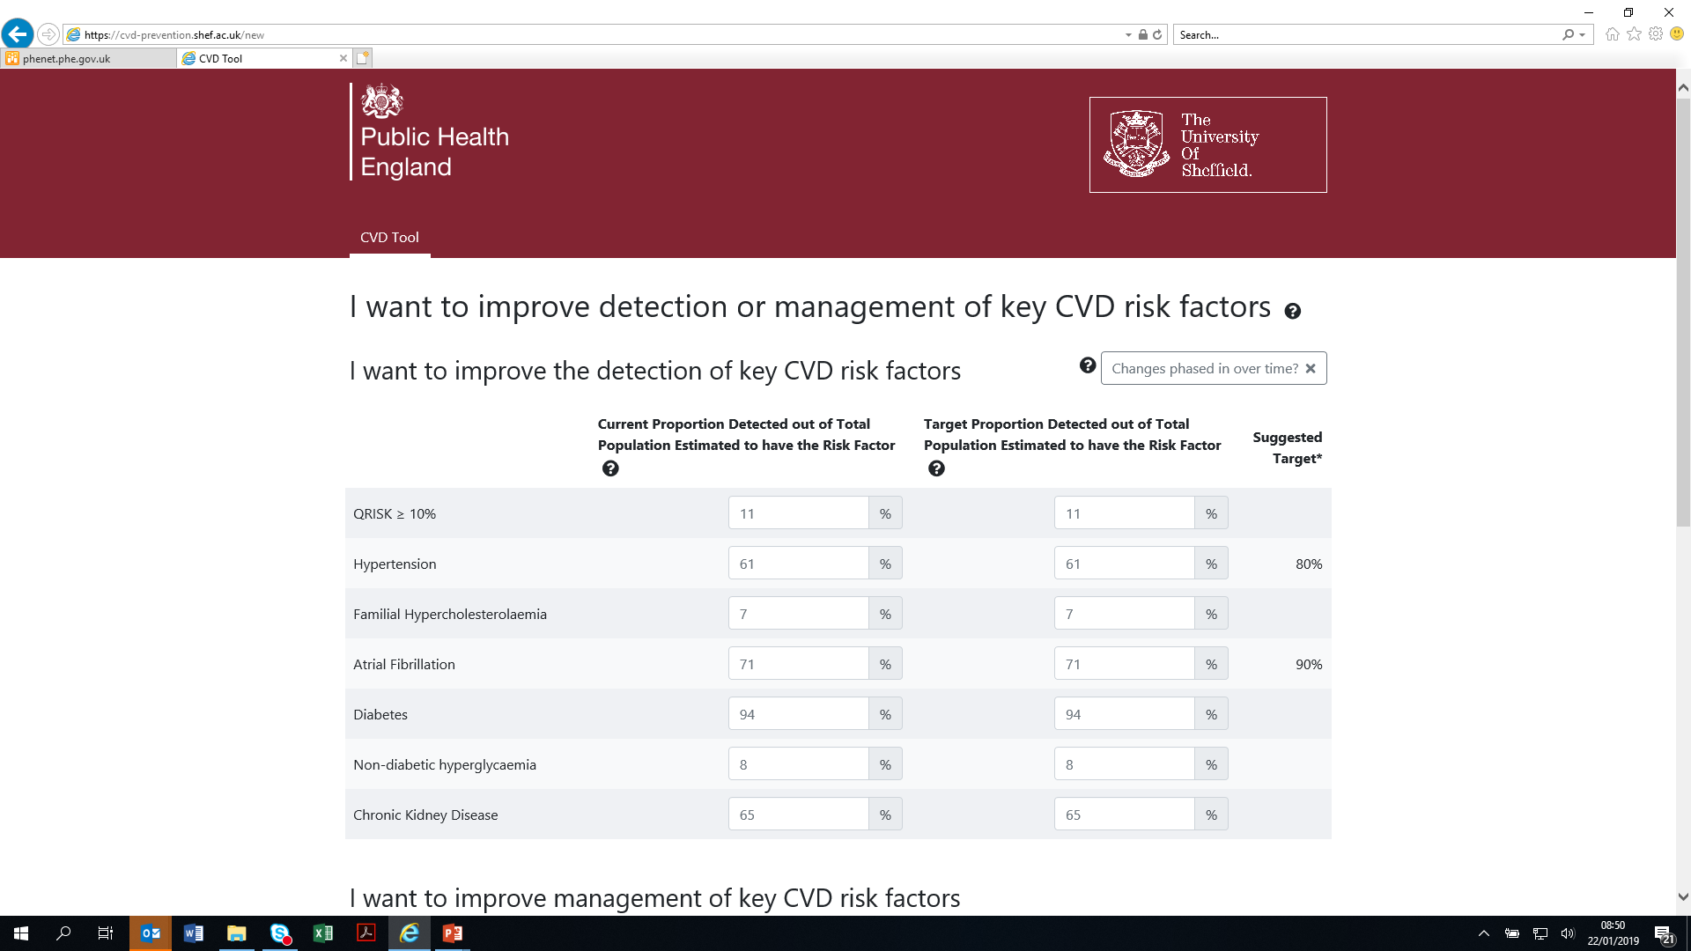

Slide 11
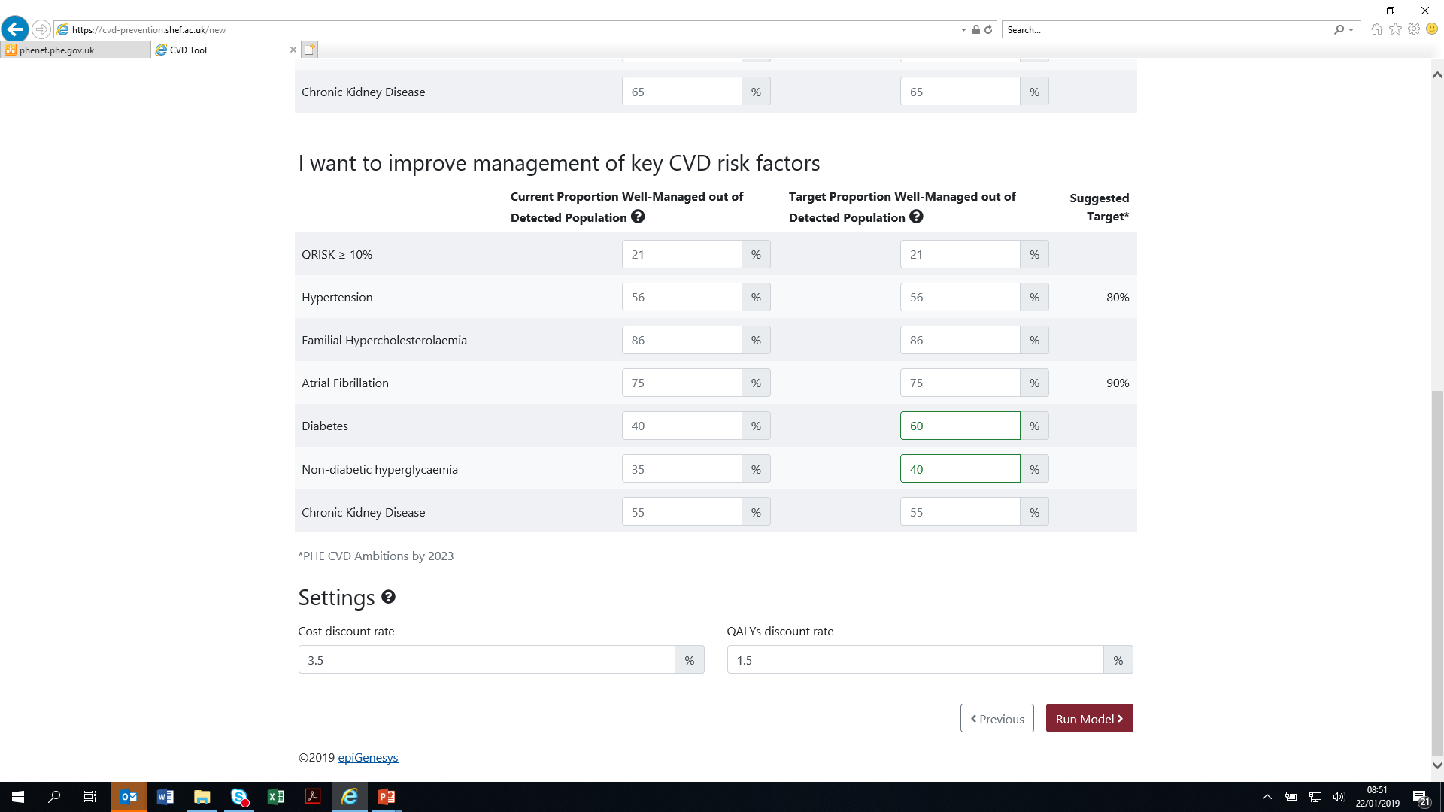

Slide 12
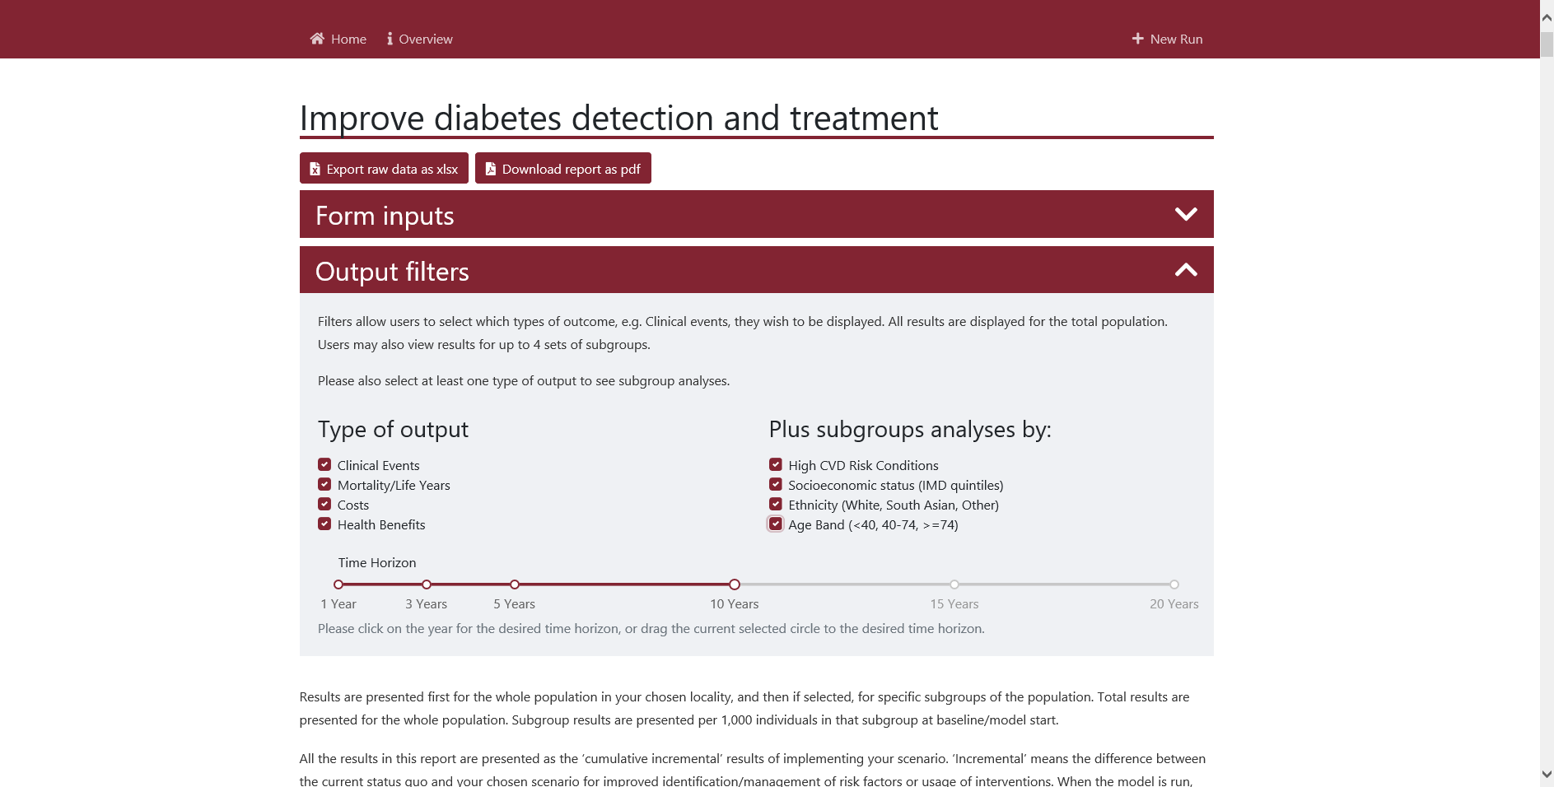

Slide 13
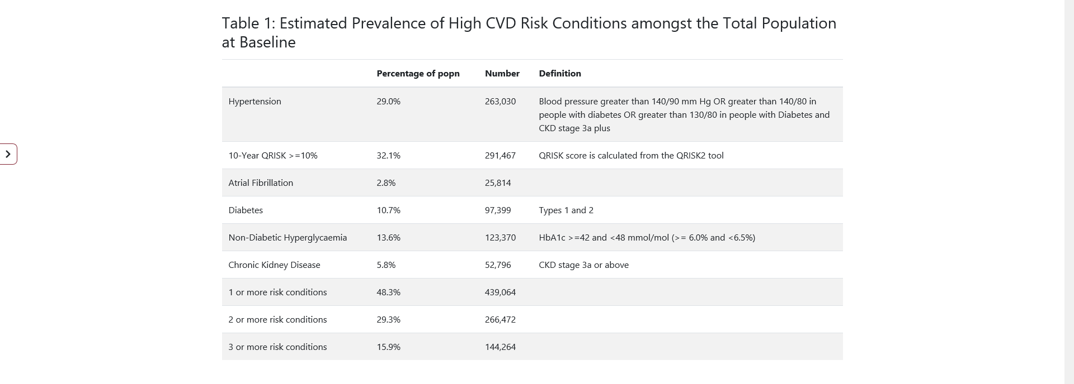
Prevalence estimates

Slide 14
Key results

Slide 15
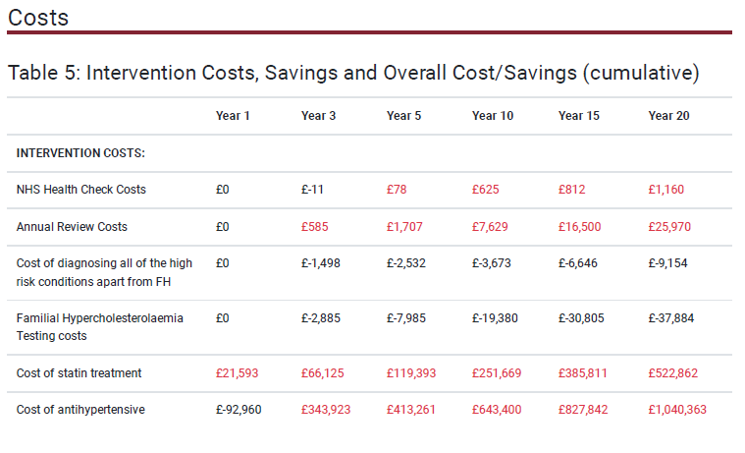
Key results - Costs

Slide 16
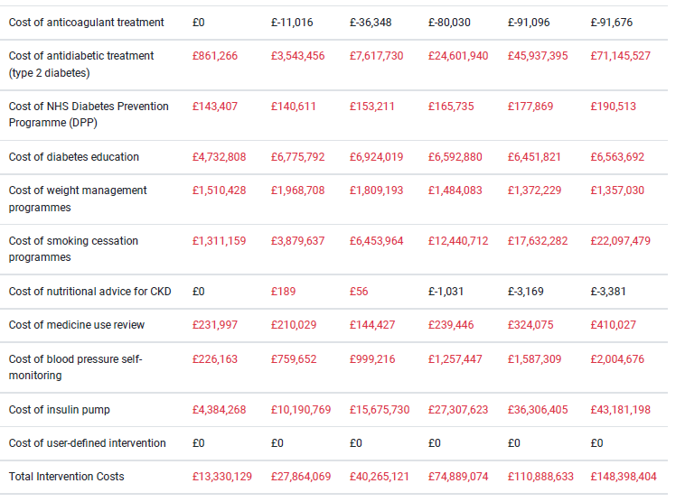
Key results - Costs

Slide 17
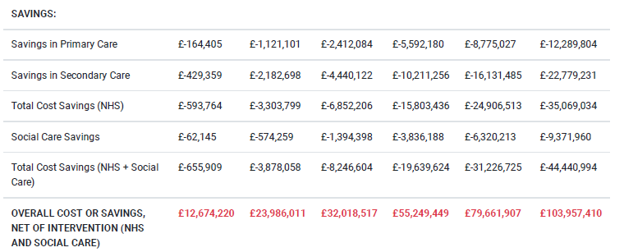
Key results - Savings

Slide 18
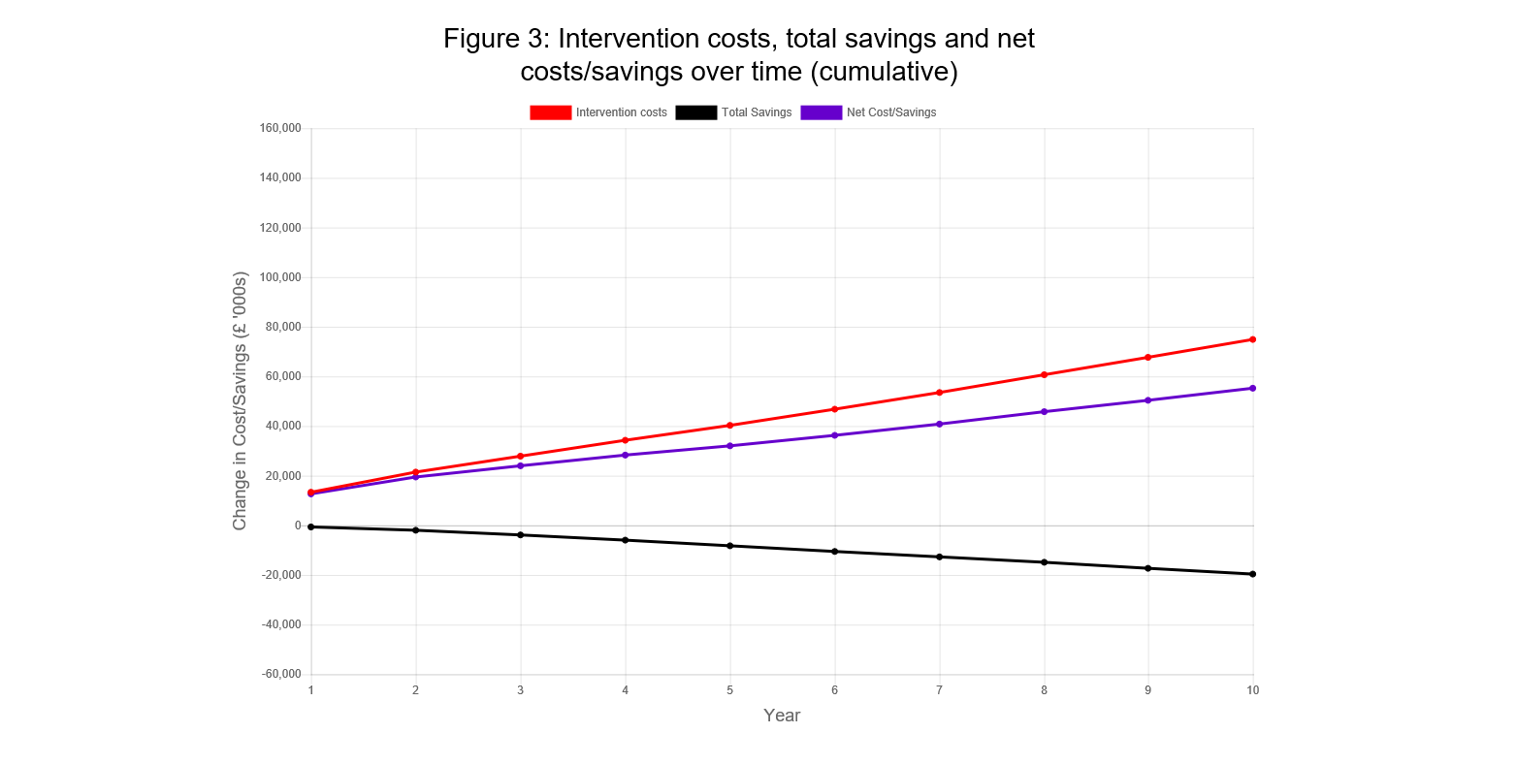

Slide 20
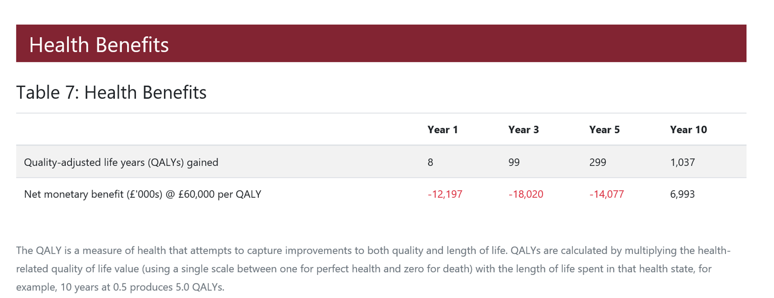
Benefits

Slide 21
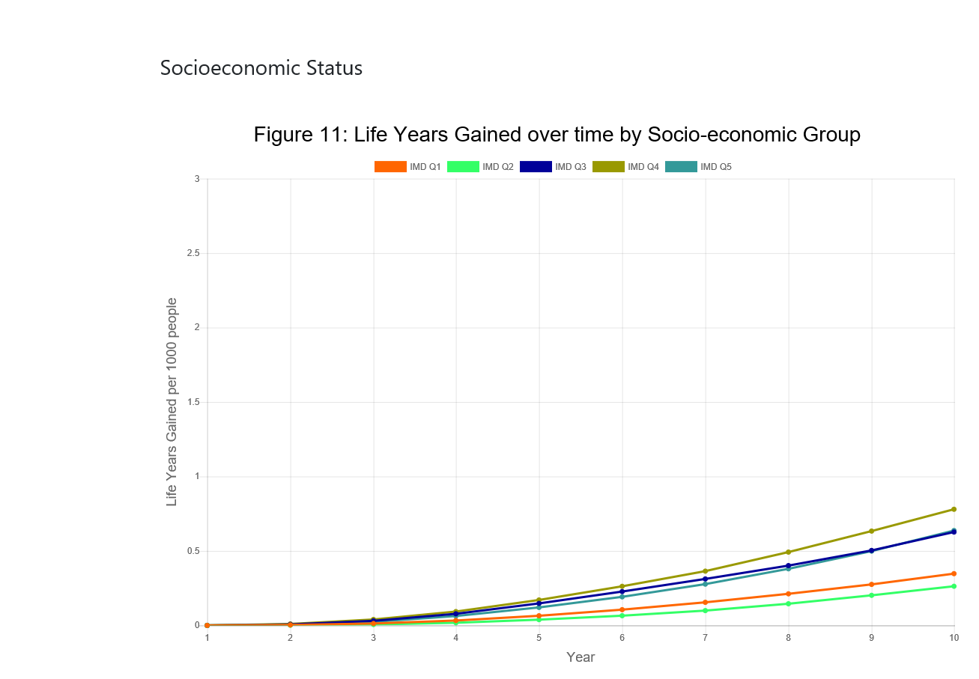

Slide 22
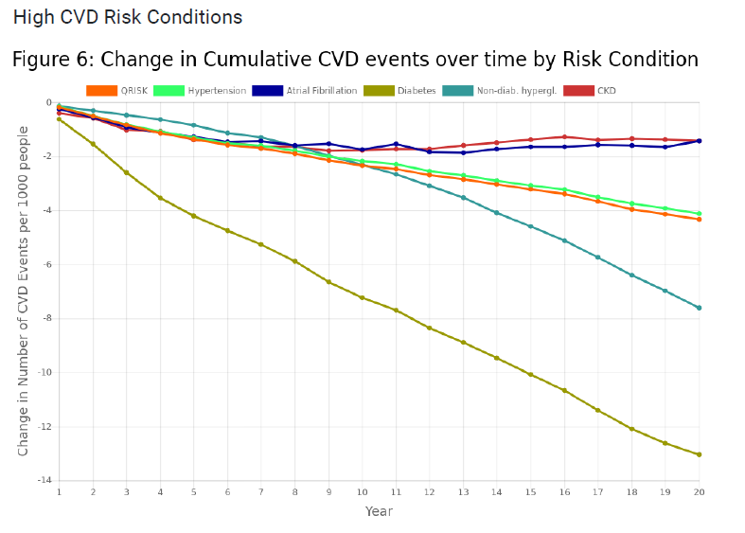

Slide 23
Shape tool CVD https://shapeatlas.net/CVD/

Slide 24
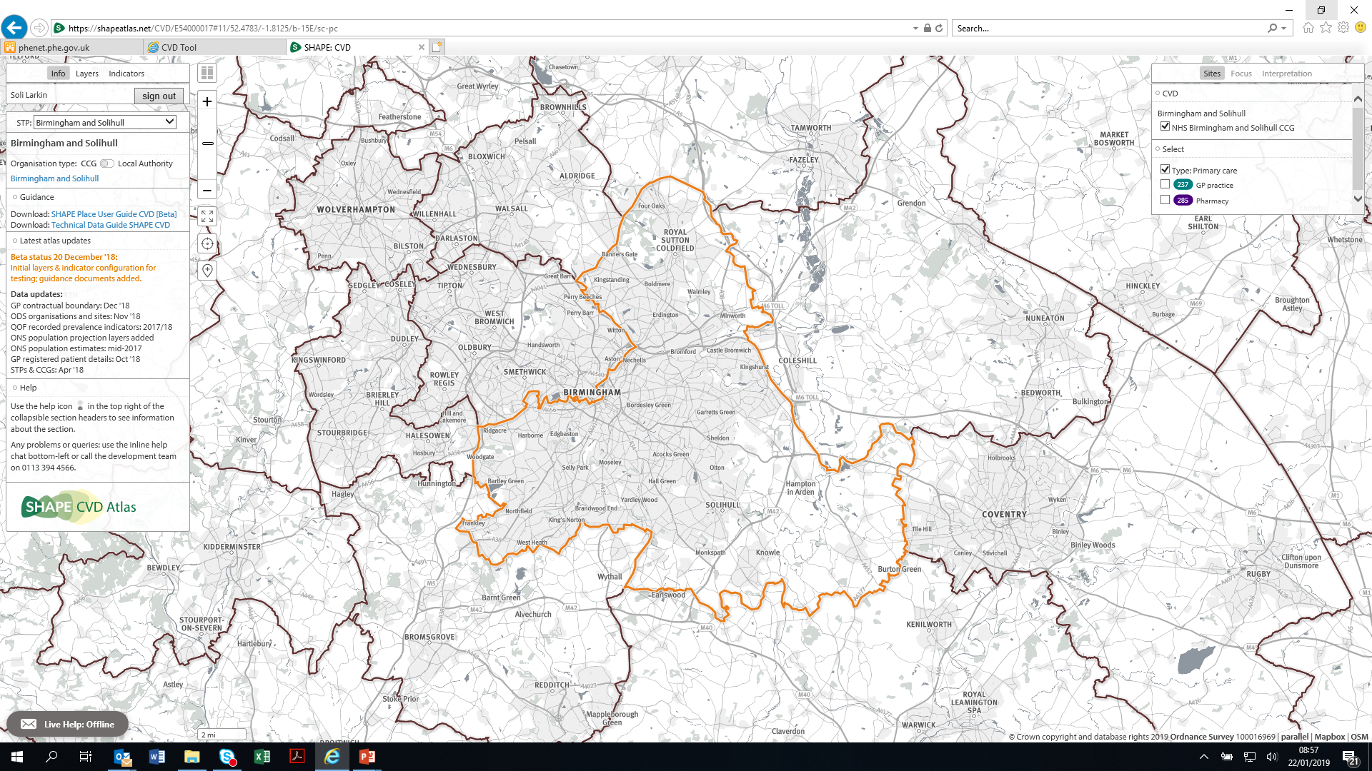

Slide 25
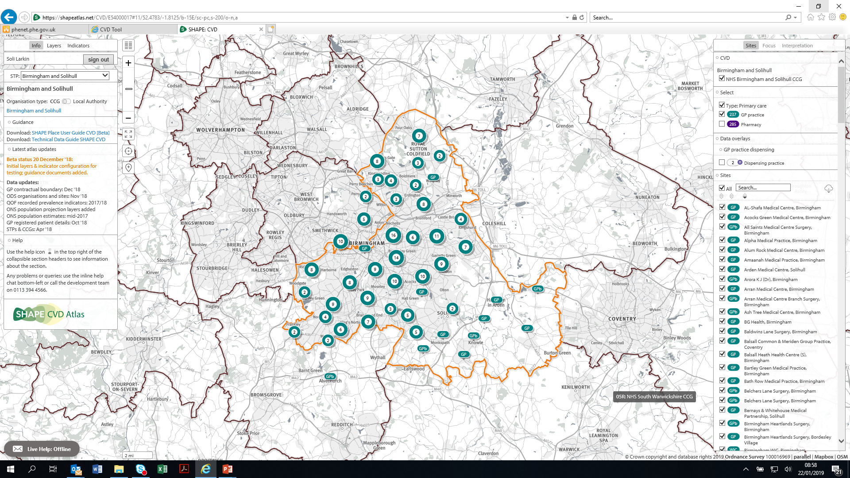

Slide 26
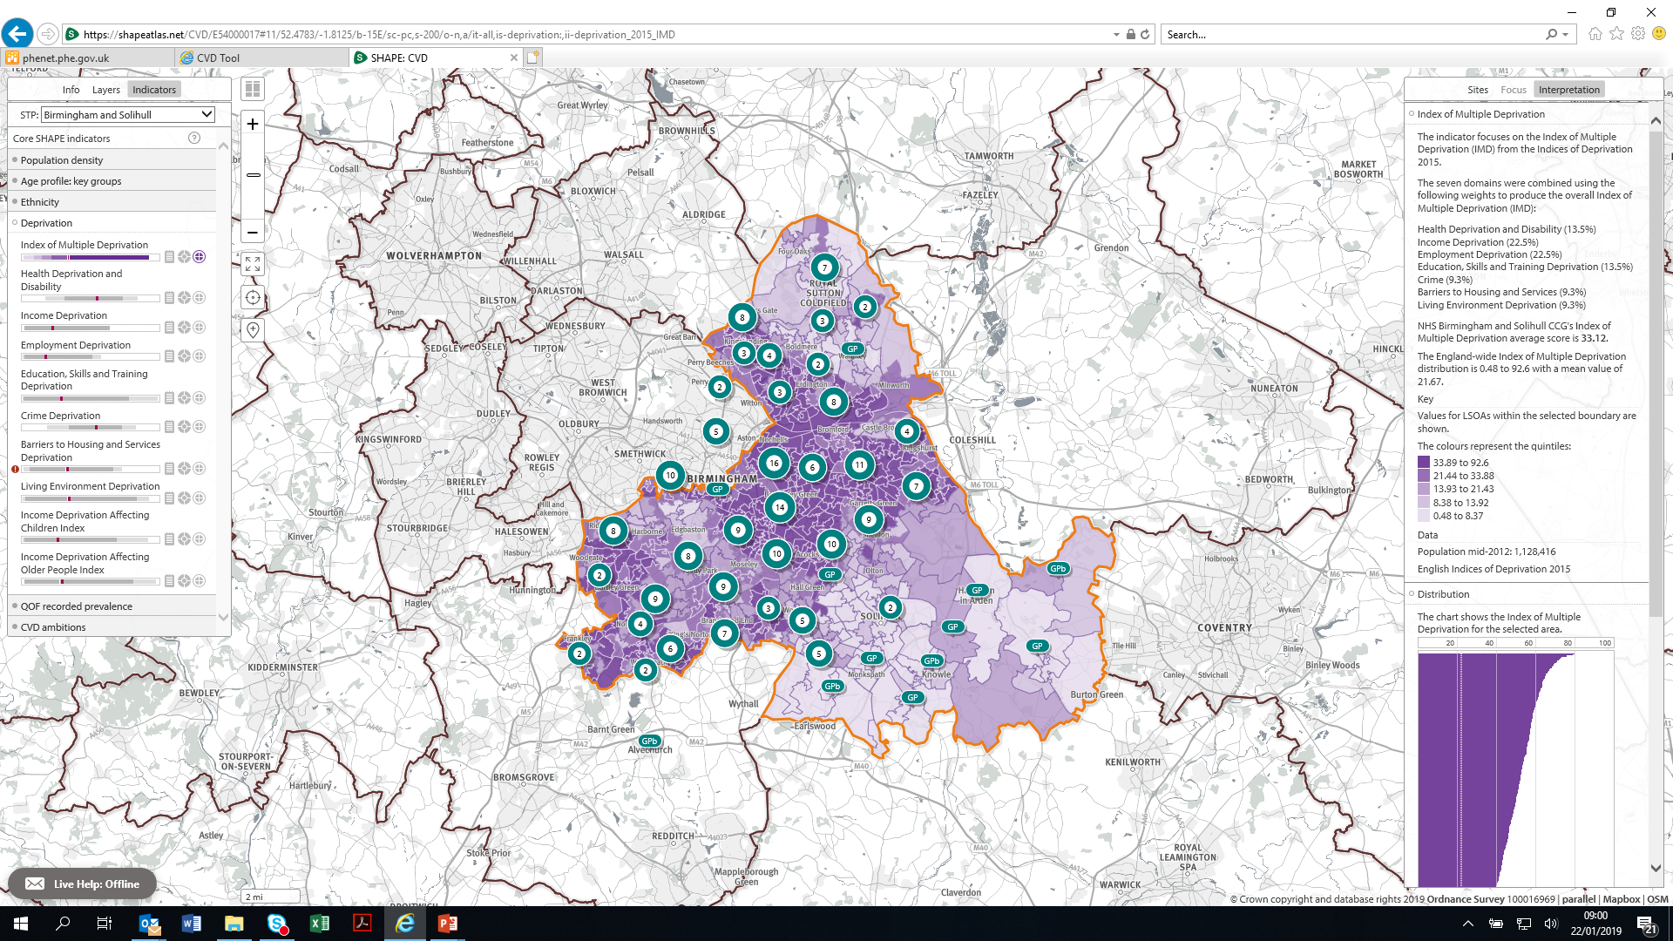

Slide 27
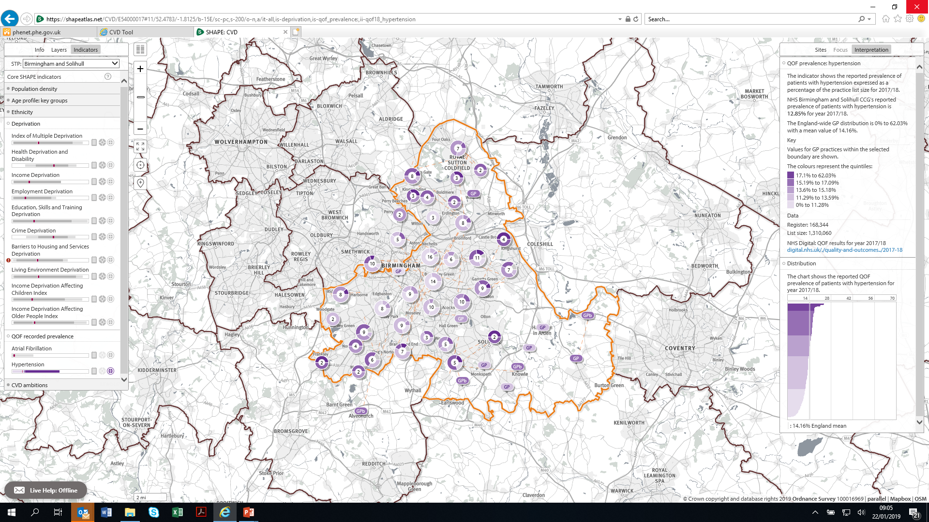

Slide 28
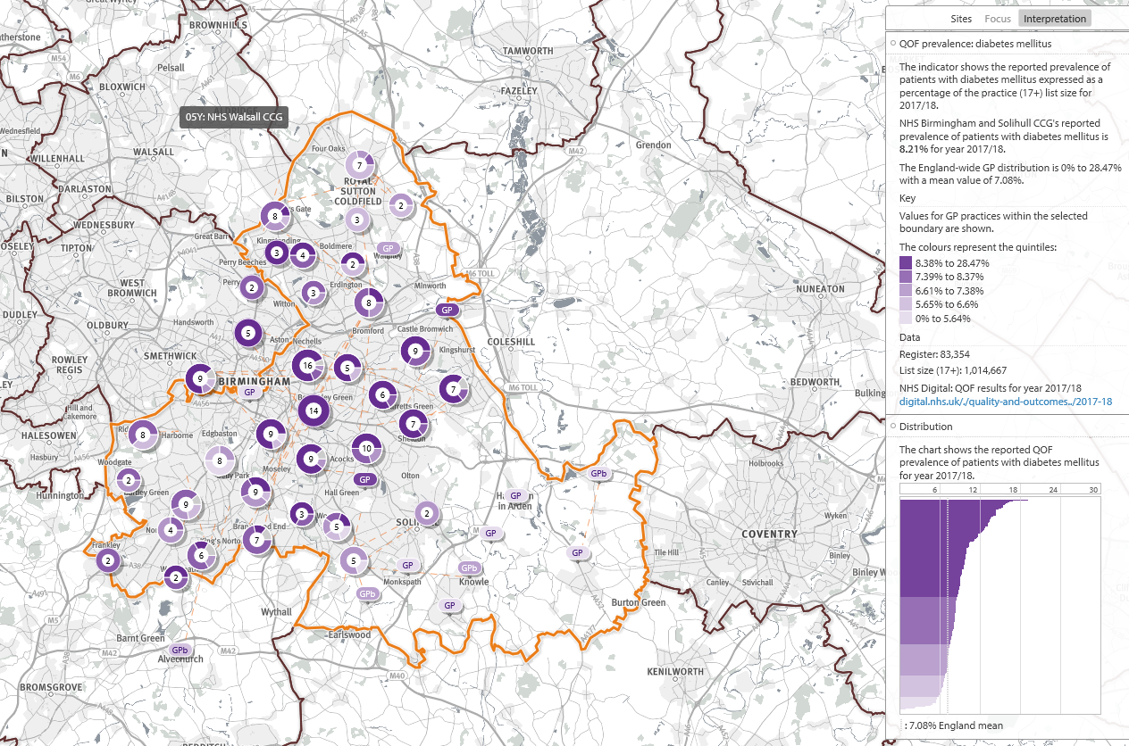
Diabetes Prevalence QOF: 2017/18

