Slide 1
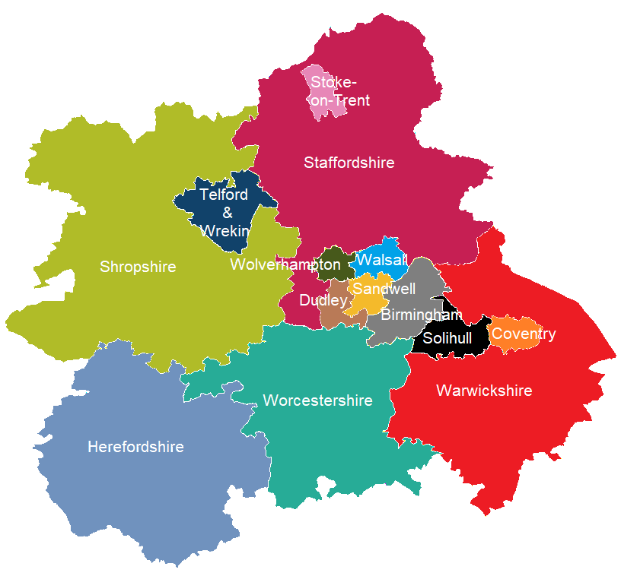
West Midlands Diabetes Priorities
Prof Vinod Patel
Clinical Lead for Diabetes
West Midlands CVD Clinical Network
Notes:
What the NDA tells us about diabetes in the West Mids
Treatment and Care, progress
Diabetes prevention programme, progress
Diabetes EAG, priorities and successes

Slide 2
NHS England Diabetes Population 2017/18 Quality and Outcomes Framework Data (1)
NHS sub-region | Number of patients on the Diabetes register (ages 17+) |  |  |  |  |  |  |  | %
 | 2010-11 | 2011-12 | 2012-13 | 2013-14 | 2014-15 | 2015-16 | 2016-17* | 2017-18
England | 2,455,937 | 2,566,436 | 2,703,044 | 2,814,004 | 2,913,538 | 3,033,529 | 3,116,399 | 3,196,124 | 30.1%
NHS England West Midlands | 209,480 | 219,899 | 234,012 | 248,765 | 257,043 | 267,178 | 256,990 | 280,912 | 34.0%

Slide 3
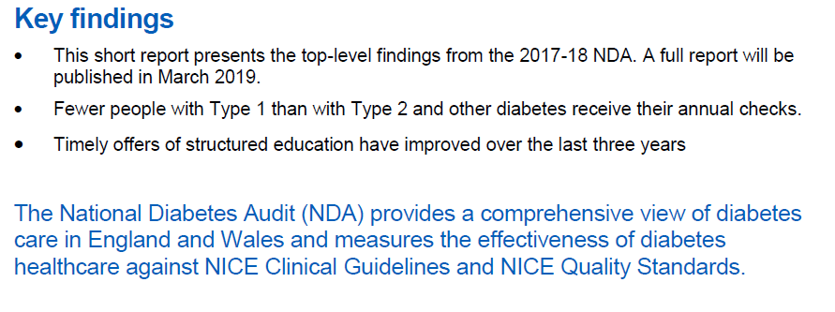

Slide 4
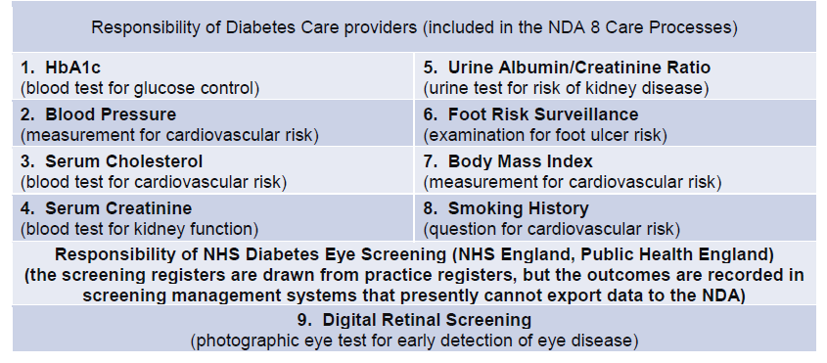

Slide 5
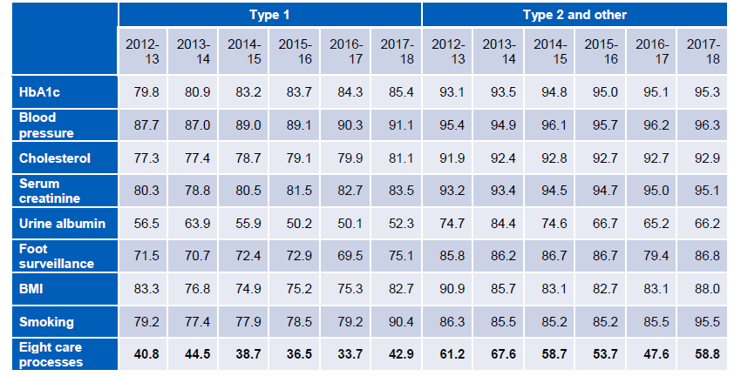

Slide 7
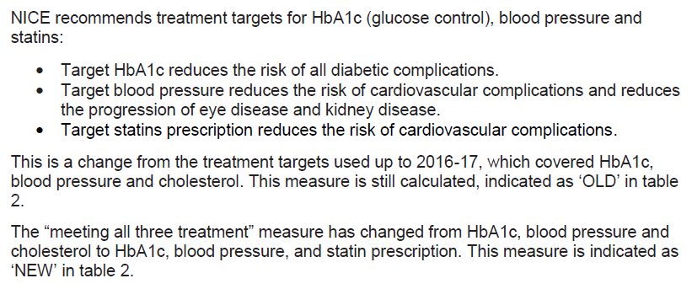

Slide 8
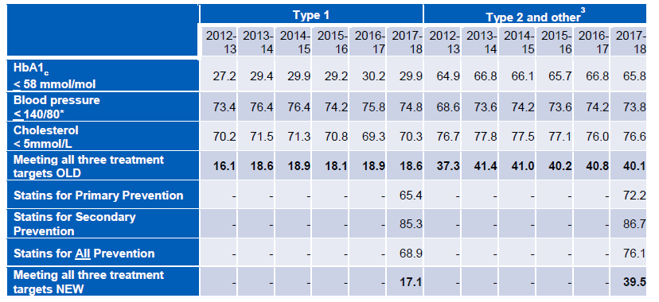
Area | 2016/17 | 2017/18
West Midlands | 42.5 | 41.2
England | 41.1 | 40.1

Slide 9
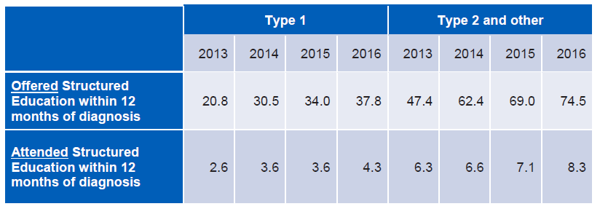

Slide 10
NDA 17/18 – Care processes
National picture - Care processes
Fewer people with Type 1 than with Type 2 and other diabetes receive their annual checks.
Urine albumin and foot surveillance are most often missed out.
A change to the smoking care process calculation method and potentially the way BMI data were collected may account for the increase in percentages for these checks, and for the eight care processes.
West Midlands
Mirrors national picture
% completion of all eight NICE care process in West Mids = 57.3%

Slide 11
NDA 17/18 - Treatment Targets
Meeting the three treatment targets
Area | 2016/17 | 2017/18
West Midlands | 42.5 | 41.2
England | 41.1 | 40.1
Treatment targets
NICE recommends treatment targets for HbA1c (glucose control), blood pressure and statins:
Target HbA1c reduces the risk of all diabetic complications.
Target blood pressure reduces the risk of cardiovascular complications and reduces the progression of eye disease and kidney disease.
Target statins prescription reduces the risk of cardiovascular complications.
This is a change from the treatment targets used up to 2016-17, which covered HbA1c, blood pressure and cholesterol. This measure is still calculated.
The “meeting all three treatment” measure has changed from HbA1c, blood pressure and cholesterol to HbA1c, blood pressure, and statin prescription. This measure is indicated as ‘NEW’ in table 2.
Nationally, 17.1% of people with Type 1 diabetes achieving the treatment targets using ‘NEW’ criteria
Nationally, 39.5% of people with Type 2 diabetes achieving the treatment targets using ‘NEW’ criteria

Slide 12
NDA 17/18 – Structured Education
Structured Education
Timely offers of structured education have improved over the last three years.
Nationally, 74.5% of people with Type 2 diabetes offered within 12 months of diagnosis, 8.3% attended.
The apparently low rates of attendance may be due to incomplete recording of attendance data in GP electronic records.
Area | Offered within 12 months of diagnosis (%) | Attended within 12 months of diagnosis (%)
West Midlands | 74.7 | 4.4
England | 75.1 | 8.7

Slide 13
West Midlands Diabetes Priorities
NDA data feeds into the CCG Diabetes Assessment 2017/18
Outstanding | Good | Requires Improvement | Inadequate
Dudley North Staffordshire Stoke on Trent | South Warwickshire Wyre Forest | Birmingham CrossCity Birmingham South & Central Cannock Chase Coventry & Rugby East Staffordshire Herefordshire Redditch & Bromsgrove Sandwell & West Birmingham Shropshire Solihull South East Staffs & Seisdon Peninsula South Worcestershire Stafford & Surrounds Walsall Warwickshire North Wolverhampton | Telford & Wrekin
Notes:
Still got work to do, great that we have outstanding CCGs in our patch, is lots of variation.
These ratings relate to time period before the transformation funding has taken full effect

Slide 14
Diabetes transformation fund – treatment and care – 17/18-18/19
£2.2 million for Structured Education
17 CCGs
£2.1million for
Treatment Targets
10 CCGs
20 out of 22 CCGs in West Mids benefiting from project funding
Almost £1.6m to improve Diabetes Footcare
3 projects
£915k for
Diabetes Inpatient Specialist Nurses
3 projects
Notes:
1. Improving uptake of structured education
2. Improving achievement of the NICE recommended treatment targets (HbA1c, cholesterol and blood pressure) and reducing variation
3. Reducing amputations by increasing availability of multidisciplinary foot care teams
4. Reducing lengths of stay for inpatients with diabetes by increasing availability of diabetes inpatient specialist nurses
Good evidence to suggest that these priorities will:
Have the most clinical impact
Are most likely to offer the highest return on investment and be sustainable
Will lead to improved outcomes for patients
Total investment in West Midlands for 17/18 and 18/19 is £6.7 million.
Projects vary in size and scale, from £20k to almost £600k.
Some on single CCG footprints, others on whole STP footprints.
Hear about your successes later on this afternoon in the West Mids Newsround session

Slide 15
Healthier You: NHS Diabetes Prevention Programme
Rolled out across all 6 STPs in the West Midlands
29,184 referrals made and 10,090 initial assessments have taken place (end November 2018)
Priorities for West Midlands; promotion of the programme to primary care to encourage take up of the programme
Diabetes prevention week 1-7 April

Slide 16
“The programme has been a great way for me to implement small changes which lead to a healthier lifestyle”
Notes:
Example from Worcestershire CCG’s

Slide 17
Pharmacy LPN
With Satyan Kotecha
Pharmacy LPN Chair WM

Slide 18
ADEPT Training Programme
Achieving Diabetes Care Excellence through Pharmacy Teams
The Alphabet Strategy Diabetes Care
IMPACT Diabetes Integrated Multi-source Resource for Patient and Clinician Teaching
Multisource educational resource compiled by George Eliot Hospital NHS Trust Diabetes Care Team
and Diabetes Teaching Team (CPD), Warwick Medical School.

Slide 19
ADEPT Training Programme
Achieving Diabetes Care Excellence through Pharmacy Teams
Session 1
Diabetes Care Essentials:
Opportunities for making a difference
Objectives
Understand the burden of diabetes at the patient and societal level
To be appraised of the essential clinical processes and targets in diabetes care
To understand the evidence-base for the Alphabet Strategy approach to care
To learn to implement Care plans and enhance consultation skills

Slide 20
ADEPT Training Programme
Achieving Diabetes Care Excellence through Pharmacy Teams
Session 2
Setting up your Community Pharmacy-based Diabetes Care initiative:
Medicines optimisation and patient empowerment
Objectives
Understand the rational for the use of pharmacological interventions in diabetes care
Learn and discuss NICE guidelines for Advice on lifestyle, Blood pressure control, Cholesterol and Diabetes Control
To teach a reflection framework to enhance delivery of high quality impactful interventions in diabetes care

Slide 21
ADEPT Training Programme
Achieving Diabetes Care Excellence through Pharmacy Teams
Session 3
Diabetes Complications:
Objectives
Learn about diabetes complications and emergencies
Learn Foot Examination and record findings
Learn about the local pathway for referring patients for further footcare
Learn about local Diabetic Retinopathy Screening Programmes and patterns of referral
Translate learning into clinical practice through case discussion

Slide 22
ADEPT Training Programme
Achieving Diabetes Care Excellence through Pharmacy Teams
Session 4
Diabetes Care moving forward:
managing challenges and bringing it all together
Objectives
Learn about diabetes care in special circumstances: pregnancy, Ramadan, driving and occupation
Review of local practice
Discuss your cases for personal and shared learning
Prepare for clinical audit, case reflection and final accreditation

Slide 23
Next Steps
First site agreed – Arden STP footprint- completed
Work with local leads across WM – 6 events booked
Accreditation of programme- on line with Coventry Uni
Agree outcome measures
Roll out across WM (c955 Community Pharmacies)

Slide 24
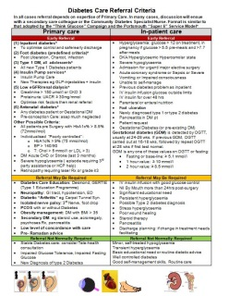
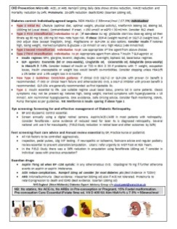
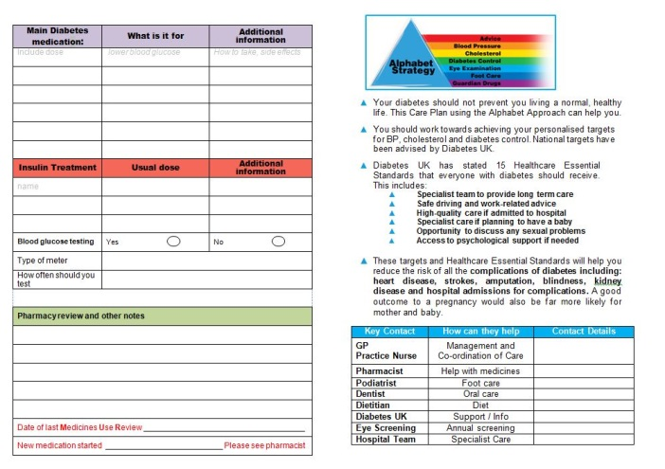
Diabetes EAG
Expert Advisory Group, steer our work in the West Midlands, share learning, agree priorities
Care plan and One Page Guidelines
ADEPT training programme for Community Pharmacists and GPs
Diabetes Improvement &
Assurance Framework

Slide 25
Into 2019…
Continue to support CCGs/STPs to improve diabetes care and reduce unwarranted variation, continue implementation of ambitions laid out in the long term plan
Shared resources: website
Accreditation of HCPs in Diabetes Care
Promotion of Patient Education and Care Plans
Implement cost efficiencies: meters, medications
Diabetes remission clinics: pilots

Slide 26
National Diabetes Audit
Collects information from general practices and specialist diabetes out-patient services to look at whether people with diabetes are
receiving their annual care checks
achieving their treatment targets
looks at their health outcomes, along with
whether they have been offered and attended structured education

