Slide 1
Covid-19 Response - BAME Staff Support and Risk Assessment Guidance for Dental Practices
June 2020

Slide 2
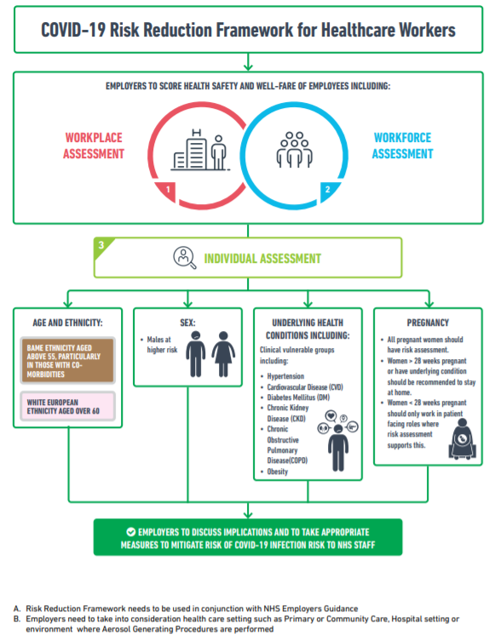
Faculty of Medicine
Source: https://www.fom.ac.uk/wp-content/uploads/Risk-Reduction-Framework-for-NHS-staff-at-risk-of-COVID-19-infection-12-05-20.pdf

Slide 3
NHS Employers Guidance - risk assessments
Communicate to all workers, whatever their professional background or work area, describing the approach being taken to risk assessment, reassuring them as to the nature of the assessment being undertaken and the support available to them.
Share the agreed local risk assessment tool or guidance with all team members to help them identify whether they are in an at-risk group
Explain the need for staff to discuss with their manager/employer any concerns as a result of the risk assessment guide or any concern or anxiety they might have (and offer them alternative routes of support prior to these discussions)
Agree alternative routes through which individuals might raise concerns or flag the need for a risk assessment discussion
Provide guidance to those managing services regarding the follow-up conversations about risk with their team members, including the potential responses to protect or support staff
Review and repeat risk assessments as necessary in line with individual circumstances, emerging evidence, and/or national guidance

Slide 4
NHS Employers Guidance – Outputs and actions
Organisations should gather the relevant information through one-to-one conversations with their teams. Those managing services should listen carefully to concerns and provide support and consider adjustments or redeployment for any staff who are identified as being at greater risk.
Adjustments may include:
1. Limiting duration of close interaction with the patient (for example, preparing everything in advance away from them).
2. If possible, maintaining a two-metre distance from the patient.
3. Avoiding public transport/rush hour through adjustments to work hours.
4. Asking patients to wear a mask for staff member interaction.
5. Asking that only the patient is in attendance for home visits/outreach where possible.
6. Providing surgical mask for staff members for all interactions with patients or specimens.
7. Redeploying staff to a lower risk area.
8. Encouraging remote working where possible.
9. Varying working patterns.

Slide 5
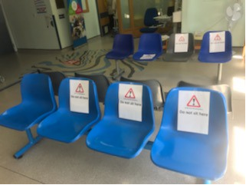
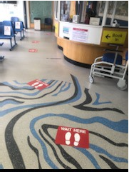
Maintaining social distancing in a practice setting
Work area
You should think about how you can organise your work area so that you can keep people 2 m apart, where possible:
physically arrange work areas to keep people 2 m apart;
mark areas using floor paint or tape to help people keep a 2 m distance;
provide signage to remind people to keep a 2 m distance;
avoid people working face-to-face, for example working side-by-side.
Where you cannot keep a 2 m physical distance, you should think about:
assigning one person per work area;
reducing the number of people in the work area;
assigning and keeping people to shift teams (sometimes known as a cohort), that is people on the same shift working in the same teams, to limit social interaction;
keeping the number of people working less than 2 m apart to a minimum;
using screens to create a physical barrier between people.
You need to think about how to keep the work area clean and prevent transmission by touching contaminated surfaces. You should consider the following:
decide on how frequently you need to clean the work area, equipment and vehicles, for example cleaning at the end of each use if equipment is shared between people or between shift changeovers;
identify objects and surfaces that are touched regularly and decide how frequently you clean them;
provide hand sanitiser for people getting in and out of vehicles or handling deliveries, if they are unable to wash their hands.

Slide 6
NHS Employers Guidance – Ongoing Actions
Practices should keep their workplace and workforce risk assessments updated and ensure managers engage and communicate regularly with workers identified as being at higher risk. Risk assessments should be repeated where new information becomes available or where an individual requests a review. Practices should also continue to consider any updates to national or local guidance regarding the testing of staff.
The following steps can also be taken to ensure ongoing review of the deployment of staff from higher risk groups:
Ongoing engagement with relevant staff networks to ensure that there is an ongoing awareness of any concerns, questions and advice.
Advice from a freedom to speak up guardian to ensure that colleagues from higher-risk groups can candidly raise any concerns about the application of the risk assessment process.
Assessment of data about the local incidence of COVID-19, particularly as more information becomes available through greater access to testing.

Slide 7
Advice on conducting conversations
Risk assessment should be carried out for all BAME staff as a priority so that a personalised risk mitigation plan can be put in place for each member of staff.
This requires an open collaborative conversation between the staff member and line manager, aided by the Health and Safety Lead or Occupational Health as required.
An open-ended question like “What can I do to help, how can we help you?” is a good starting point.
The risk assessment tool is intended to aid a structured conversation, in a safe space, exploring all potential risks.
No template can fully capture the sensitivity of the discussion and it must avoid becoming rigid, reductionist or a tick-box exercise.
Regular review, which acknowledges concerns as understandable, validating and respecting staff is likely to promote consensus.
Source: https://www.rcpsych.ac.uk/docs/default-source/about-us/covid-19/impact-of-covid19-on-bame-staff-in-mental-healthcare-settings_assessment-and-management-of-risk_13052020v2.pdf?sfvrsn=1068965_2

Slide 8
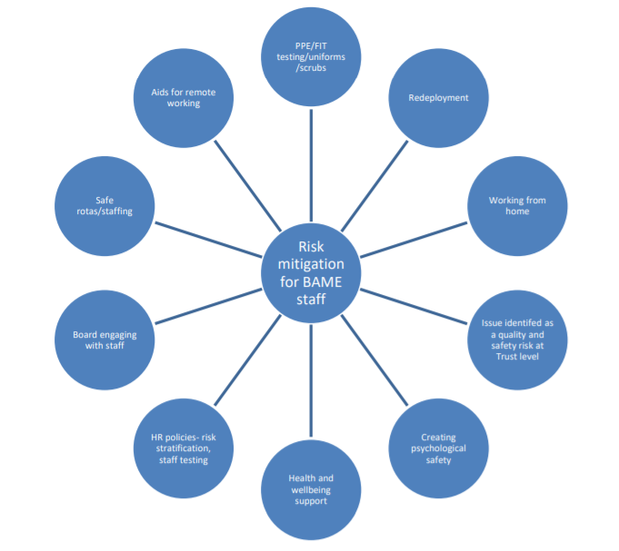
Examples of mitigation
Some immediate steps that can be taken by organisations to mitigate risks for all staff, including BAME, older male and pregnant staff.
Source: https://www.rcpsych.ac.uk/docs/default-source/about-us/covid-19/impact-of-covid19-on-bame-staff-in-mental-healthcare-settings_assessment-and-management-of-risk_13052020v2.pdf?sfvrsn=1068965_2

Slide 9
Guidance on how to reduce risk
PPE:
Appropriate PPE should be made available as a priority for all staff in all clinical settings, in keeping with national guidance with clear requirements for each.
Clear instructions are needed about the correct PPE garments and how to don and doff them.
Sensitive conversations about cultural factors and PPE are required.
Staff testing:
Should be offered to all staff with consideration given to prioritising BAME staff and their families, as a means of identifying those who are infected and to rule out infections, to enable healthy staff to attend work.
Aids for remote working
It is advised that organisations provide resources for remote working (audio and video consultations and assessments) for all staff as a priority.
Redeployment
Older male, BAME staff should be considered for redeployment to lower risk areas.
A proactive offer by the manager as part of an ongoing review, keeping staffing needs in mind, will engender confidence that the staff member’s needs are being taken seriously.
Source: https://www.rcpsych.ac.uk/docs/default-source/about-us/covid-19/impact-of-covid19-on-bame-staff-in-mental-healthcare-settings_assessment-and-management-of-risk_13052020v2.pdf?sfvrsn=1068965_2

Slide 10
Support for BAME healthcare workers to manage additional impact of COVID
Vitamin D supplements: Although there is no evidence to suggest that Vitamin D confers specific protection towards COVID -19 or prevents respiratory complications of COVID-19, low levels of Vitamin D may predispose to severe infections.
Psychological Safety
Reminders of avenues available to speak out, e.g. about poor access to equipment, bullying, and links between the Freedom to Speak Up Guardian (FTSU) and BAME staff to reduce fear of raising concerns, should be shared with staff.
Healthy Organisational Responses to COVID and inequalities
Inclusive leadership
PPE and IPC Champions
Quality Improvement
Support for line managers
Data
Source: https://www.rcpsych.ac.uk/docs/default-source/about-us/covid-19/impact-of-covid19-on-bame-staff-in-mental-healthcare-settings_assessment-and-management-of-risk_13052020v2.pdf?sfvrsn=1068965_2

Slide 11
Examples of Best Practice
Any issues raised by staff need to be addressed with a bilateral discussion on what solutions are available to address the concerns raised with a documented plan with time line and review date to implement any solutions.
The employee should be offered the opportunity to have an assessment done by someone other than their manager if they do not want to disclose certain issues to them. LDCs may be able to provide support by linking practices to provide access to an independent person
Staff should be made aware that concerns about their safety or lack of mitigation can be escalated to the freedom to speak up champion or to the local commissioner
Any residual risk identified by the manager and staff member, particularly where a staff member is identified as at risk, should be documented including where a staff member has been offered mitigation (redeployment) but wishes to remain on the point of care
Staff need reassurance about the risk assessment process and that anything noted on the assessment will not have an adverse impact or detrimental on their current or future working conditions

Slide 12
Support available to practices in managing impact
If risk assessments and adjustments for staff are likely to have a significant impact on the ability of the service to provide care to patients then action will need to be taken:
Consider your practice business continuity plan and ensure you have undertaken a prioritisation of activities and are implementing a phased approach to resuming services
Consider “buddying” arrangements or mutual aid from other local practices - you may have staff who can undertake remote triage and they may have surplus staff unable to work due to social distancing restrictions and reduced throughput in the practice
Seek support or advice from your professional body or local dental committee
Notify the local commissioning team so that support can be provided to ensure ongoing care to your patients – Urgent Dental Centres will remain in place but special arrangements may need to be put in place if non AGP is restricted due to staffing difficulties

Slide 13
Caring for yourself while you care for others: A toolkit for nursing ambassadors to look after their own health

Slide 14
Suggested Health and Wellbeing Offer
NHS England and NHS Improvement is also providing NHS employees with free access to psychological and practical support:
Support Helpline - A free wellbeing support helpline 0300 131 7000 available from 7am to 11pm seven days a week, providing confidential listening from trained professionals
Wellbeing apps - NHS staff have been given free access to a number of wellbeing apps from now until the end of December 2020 to support their mental health and wellbeing. Apps include SilverCloud, Sleepio, Daylight, Unmind and Headspace
#LookingAfterYouToo - Individual coaching support for primary care staff - Register at https://people.nhs.uk/lookingafteryoutoo/ and book individual coaching in a way and at a time of day that suits them.
Any other local arrangements in place
Source: https://people.nhs.uk/help/

