Slide 1
Resumption of NHS Dentistry
COVID-19 response
Jasmine Murphy, Consultant in Dental Public Health
Christine Utting, Local Dental Network Chair
Catriona Peterson, Associate Medical Director
Developed in the Midlands Region

Slide 2
Coronavirus
COVID-19 disease is caused by SARS-CoV-2 which is from the family of coronaviruses. As it is a novel virus evidence is still emerging
The current national approach is to ensure that social distancing measures are observed to reduce social interaction between people in order to reduce the transmission of coronavirus (COVID-19)
Stringent social distancing measures are required for the following population groups:

Slide 3
Categories of clinically vulnerable people
aged 70 or older (regardless of medical conditions)
under 70 with an underlying health condition listed below (that is, anyone instructed to get a flu jab each year on medical grounds):
chronic (long-term) mild to moderate respiratory diseases, such as asthma, chronic obstructive pulmonary disease (COPD), emphysema or bronchitis
chronic heart disease, such as heart failure
chronic kidney disease
chronic liver disease, such as hepatitis
chronic neurological conditions, such as Parkinson’s disease, motor neurone disease, multiple sclerosis (MS), or cerebral palsy
diabetes
a weakened immune system as the result of certain conditions, treatments like chemotherapy, or medicines such as steroid tablets
being seriously overweight (a body mass index (BMI) of 40 or above)
pregnant women

Slide 4
Categories of shielded people (extremely vulnerable)
Solid organ transplant recipients
People with specific cancers:
people with cancer who are undergoing active chemotherapy
people with lung cancer who are undergoing radical radiotherapy
people with cancers of the blood or bone marrow such as leukaemia, lymphoma or myeloma who are at any stage of treatment
people having immunotherapy or other continuing antibody treatments for cancer
people having other targeted cancer treatments which can affect the immune system, such as protein kinase inhibitors or PARP inhibitors
people who have had bone marrow or stem cell transplants in the last 6 months, or who are still taking immunosuppression drugs
People with severe respiratory conditions including all cystic fibrosis, severe asthma and severe chronic obstructive pulmonary (COPD)
People with rare diseases that significantly increase the risk of infections (such as severe combined immunodeficiency (SCID), homozygous sickle cell)
People on immunosuppression therapies sufficient to significantly increase risk of infection
Women who are pregnant with significant heart disease (congenital or acquired)

Slide 5
Transmission and protection
1
2
3
The transmission of COVID-19 is thought to occur mainly through: respiratory droplets generated by coughing and sneezing, and through contact with contaminated surfaces.
The predominant modes of transmission are assumed to be:
droplet and contact
During Aerosol Generating Procedures (AGPs), there is an increased risk of aerosol spread of infectious agents and additional precautions must be implemented when performing AGPs
Non-AGP involves compliance with standard infection control procedures which ensure no contact or droplet transmission of COVID-19 with AGPs requiring additional transmission based precautions

Slide 6
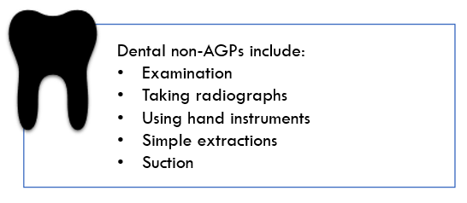
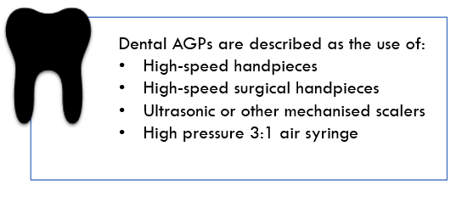
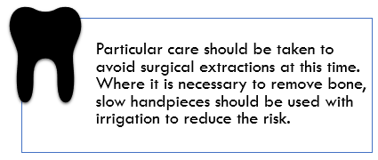
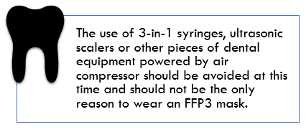
AGPs and non-AGPs
AGPs can increase the risk of transmission of infection to healthcare workers and therefore
should be avoided where possible

Slide 7
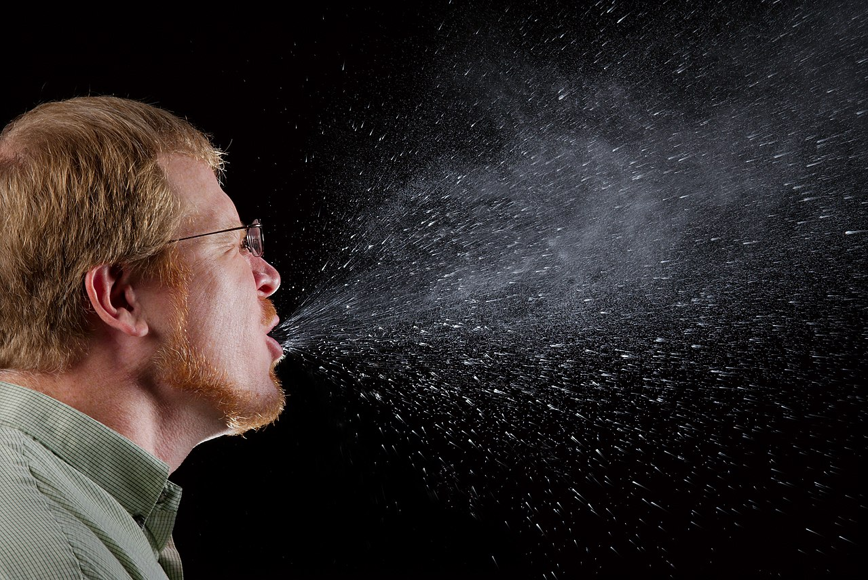
Respiratory hygiene
Respiratory and cough hygiene should be observed by staff and patients/carers
Disposable tissues should be available and used to cover the nose and mouth when sneezing, coughing or wiping and blowing the nose
Dispose of tissues directly into bin
Perform hand hygiene for at least 20 seconds

Slide 8
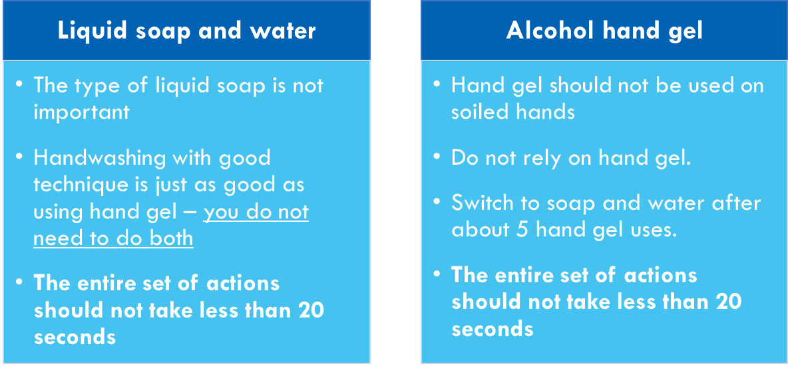
Hand hygiene
Hand hygiene must be performed immediately:
This includes putting on and removing PPE, equipment decontamination and waste handling

Slide 9
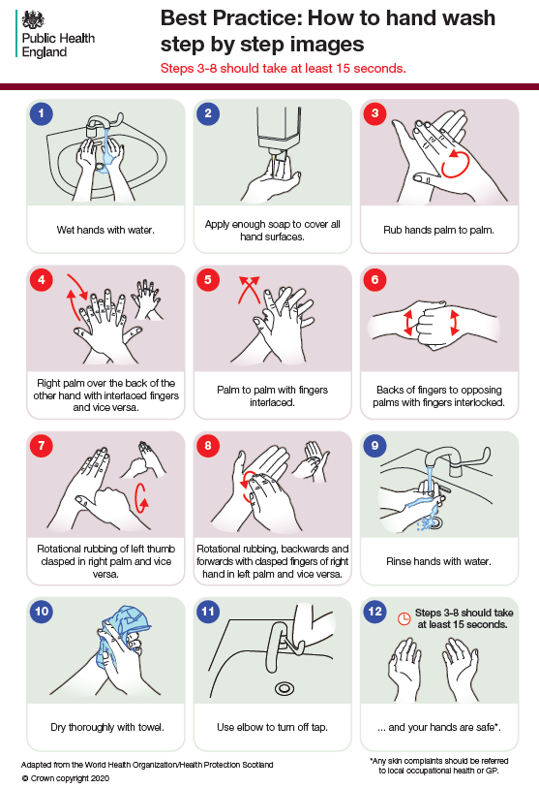
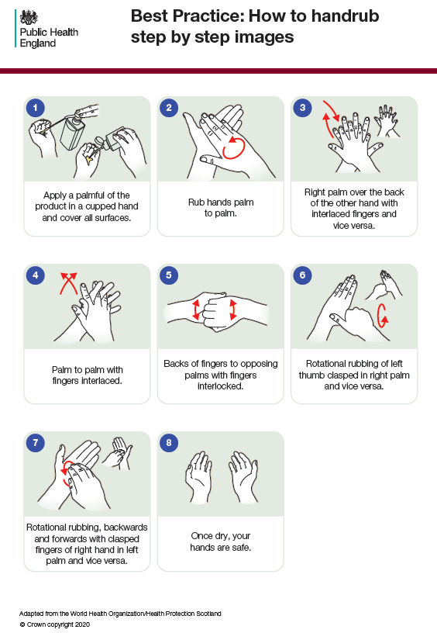

Slide 10
COVID-19 symptoms
a loss of, or change in, normal sense of taste or smell (anosmia)
new continuous cough
high temperature
Cough, Fever and Smelling by Gan Khoon Lay from the Noun Project

Slide 11
Self-isolation
For 7 days
from when
symptoms
started
Those with
COVID-19
symptoms
Need to
stay at home
Infographics from the Noun Project

Slide 12
Household contacts
All household members who remain well must stay at home for 14 days
The 14-day period starts from the day when the first person in the house became ill
Infographics from the Noun Project

Slide 13
Contacts notified by NHS Test and Trace
People who have been in contact with a person who has had a
positive test result for COVID-19 need to self-isolate for 14 days
The 14-day period starts from the day when the first person had last contact with the case
Icontact by Binpodo from the Noun Project

Slide 14
Care Home residents
If symptomatic, isolation period is for 14 days (not 7 days) from onset of symptoms
Residents who have been in close contact should also isolate for 14 days since contact
elderly care by Gan Khoon Lay and home support by Mohammed Salim from the Noun Project

Slide 15
Smoking and COVID-19
There have been some media reports that smoking is protective against COVID-19. The quality of these studies is low and there are problems with confounding errors
For now, there is NO evidence that smoking is protective
It is still the case that smokers have more severe symptoms
Smokers should still be encouraged to quit smoking

Slide 16
Essential guidance documents

Slide 17
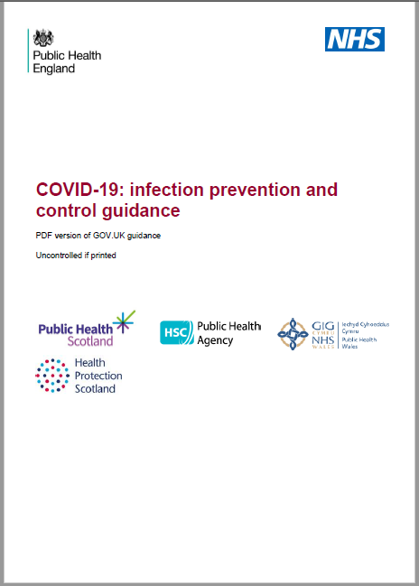
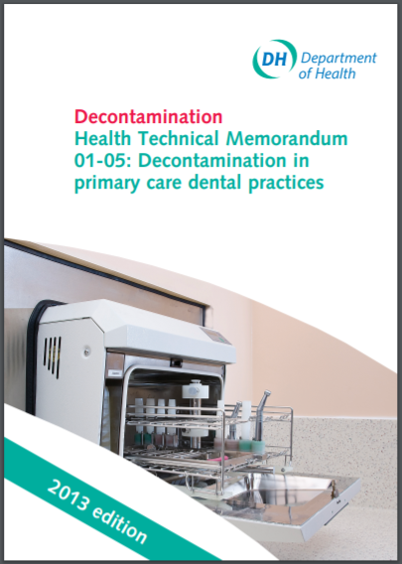

Slide 18
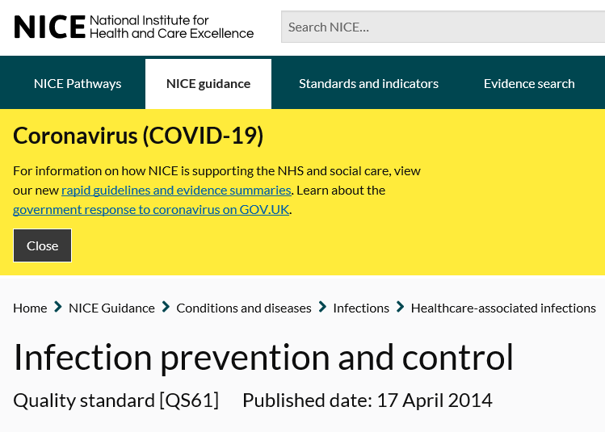
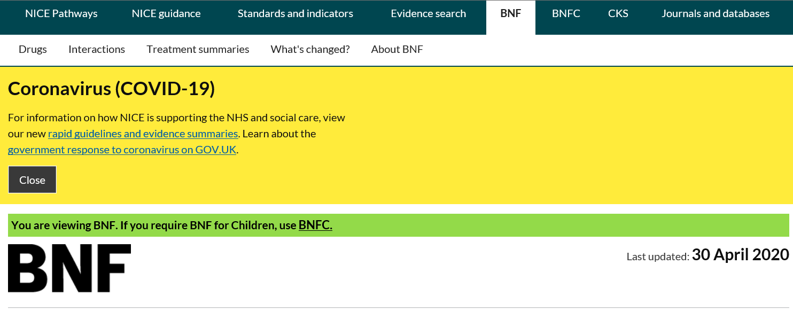
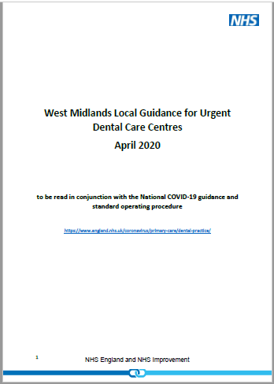

Slide 19
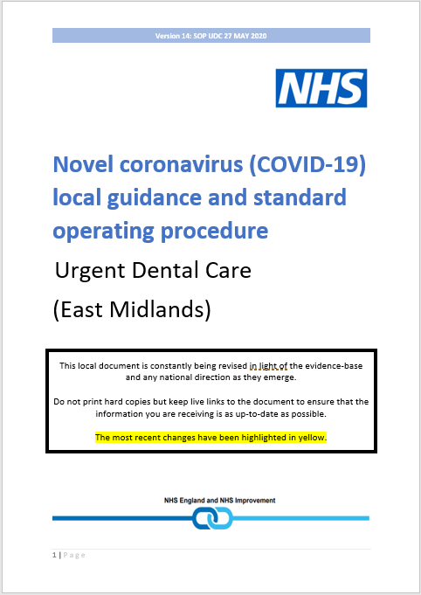
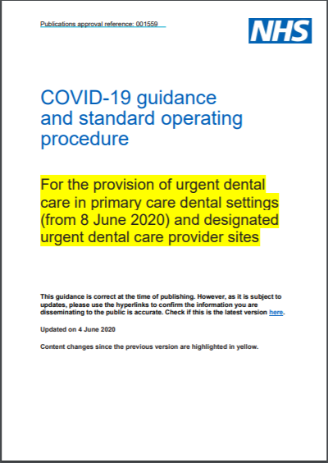
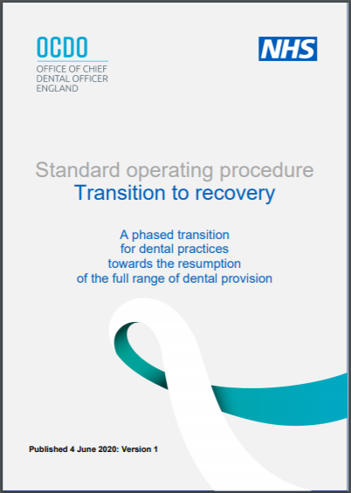

Slide 20
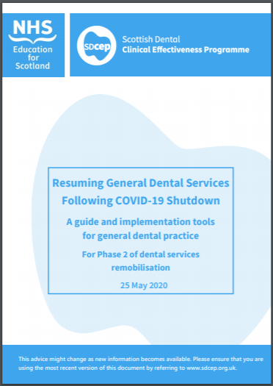
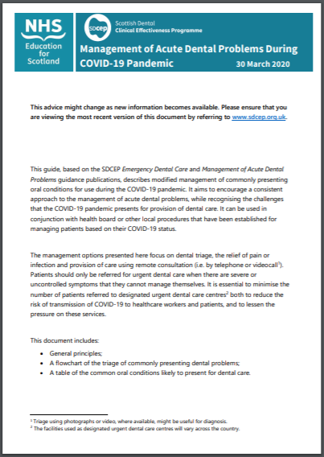
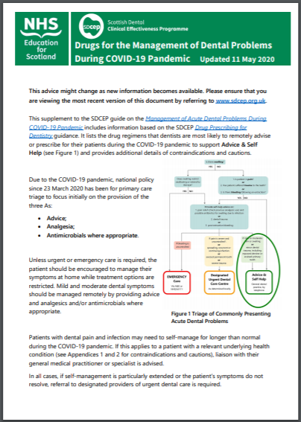

Slide 21
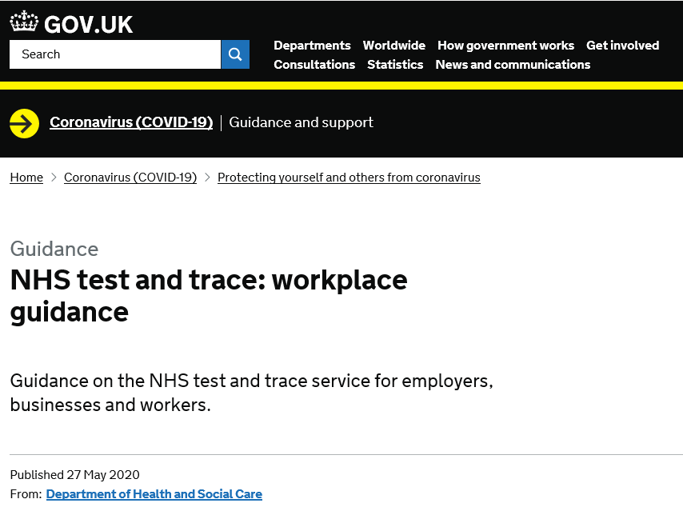
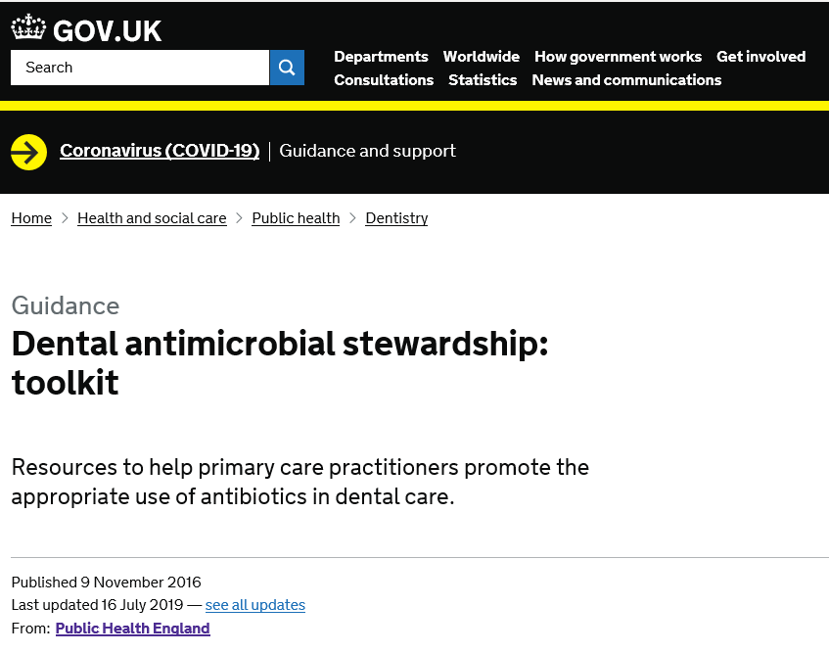
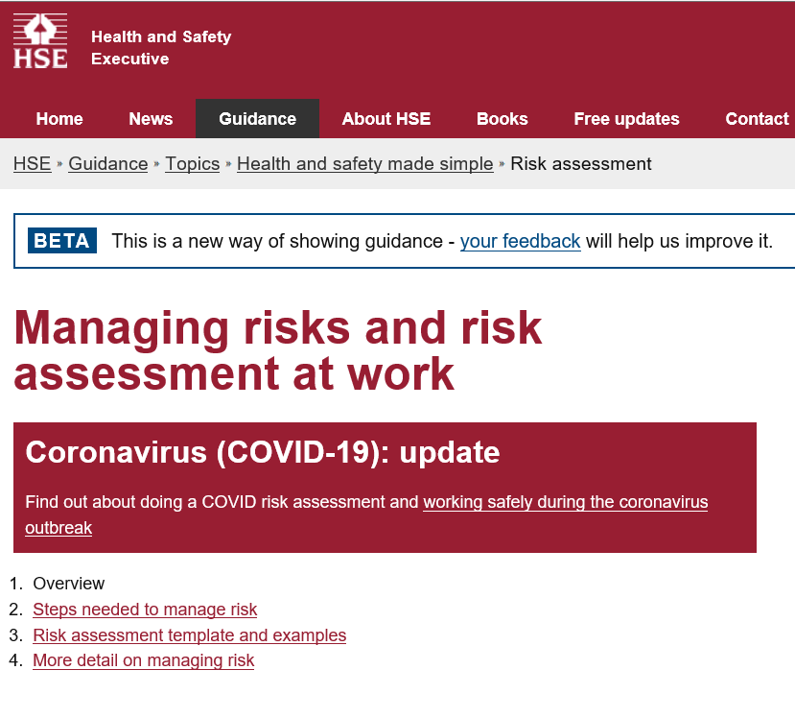

Slide 22
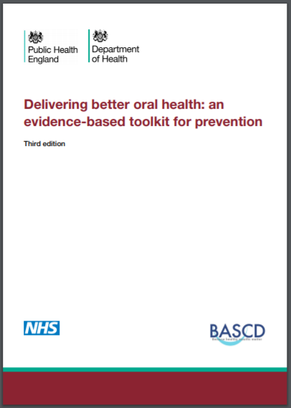
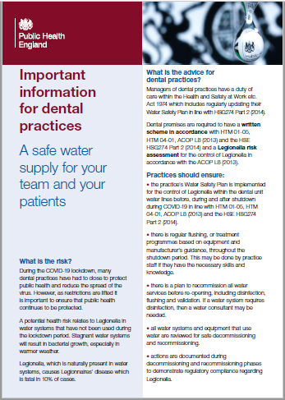

Slide 23
Five steps for preparation considerations
Practice
Principles
Patients
Staff
PPE

Slide 24
Surgery
Phased approach to full resumption based on risk management
Continue to provide remote consultations
for all patients
Provide advice, analgesia and antimicrobials (where appropriate)
in the first instance
Observe social distancing measures
at all times
Principles
Minimise all
face to face patient contact
Clear safety standards for Personal Protective Equipment and Infection Prevention and Control
Appropriate sequencing and scheduling of patients
Refer all possible/confirmed patients to Urgent Dental Care sites until phased resumption is complete
Patients
Promote self-care and prevention for all appropriate conditions
Staff
PPE

Slide 25
Practice
Principles
Patients
Staff
PPE

Slide 26
Surgery
Considerations
Instruct all members of staff to regularly assess and report any COVID-19 symptoms (personal and household contacts)
Undertake risk assessment of the following staff and make appropriate arrangements:
Clinically vulnerable
Shielded
BAME
All staff to observe
social distancing (2 metres) wherever possible
Plan staff rota carefully to ensure resilience of arrangements
Staff
Principles
Patients
Provide staff training:
New ways of working: processes, policies and protocols
Personal Protective Equipment (PPE)
Infection Prevention and Control, including hand and respiratory hygiene
PPE

Slide 27
Surgery
1
Reduce staff mixing and consider staggered start, break and finish times
2
Staff
Do not rotate staff across different sites
Considerations for planning
staff rota
3
Ensure appropriate arrangements in place for staff following risk assessment (to include those living with clinically vulnerable and shielded)
Principles
4
Ensure adequate supervision of staff in place, especially for those in training
5
Staff who provide care for possible or confirmed cases should not provide care for other patients
Staff
PPE

Slide 28
Surgery
Supporting information
Staff with COVID-19 symptoms should not come to work for 7 days since onset of symptoms
Staff living in a household where someone has symptoms should not come to work for 14 days since onset of household contact’s symptoms.
However, if the member of staff becomes symptomatic during the 14 days isolation, they should isolate for 7 days since the onset of their symptoms
Staff
Principles
Patients
Staff who inadvertently come
into contact with a confirmed or suspected
COVID-19 patient should undergo a risk assessment to determine if they can remain at work. The factors include: severity of patient symptoms, length of exposure, proximity to patient, activities undertaken and whether
eyes, nose or mouth were exposed
All members of staff who are self-isolating should be offered the opportunity for coronavirus testing.
Book at test at self referral portal
PPE

Slide 31
Surgery
Supporting information
Consider the impact that the current unprecedented circumstances could have on the wellbeing of everyone who works in the practice and ensure appropriate support is in place
Staff
#LookingAfterYouToo
Principles
Provides individual coaching support for primary care staff and can be accessed by video link or telephone with highly trained, experienced coaches
This support is available to all dental staff and provides opportunities to process experiences, develop coping skills, deal with difficult conversations and develop strategies for self-management in difficult circumstances
Dental staff can register and book individual coaching in a way and at a time of day that suits them
Patients
PPE

Slide 32
Practice
Principles
Patients
Staff
PPE

Slide 33
Considerations
Go through
NHS England and Improvement (Midlands) checklist on
Preparation for reopening
Update practice website, answerphone, policies, processes and clinical protocols
Ensure visibility of
zero-tolerance policy
to protect staff
Develop plan for sequencing
and
scheduling
of patients
Practice
Patients
Principles
Plan patient flow through practice
Set up Interpretation Services
Do not allow patient escort for translation/
interpretation
Enhance decontamination processes
Ensure indemnity and employers liability arrangements in place
Staff
PPE

Slide 34
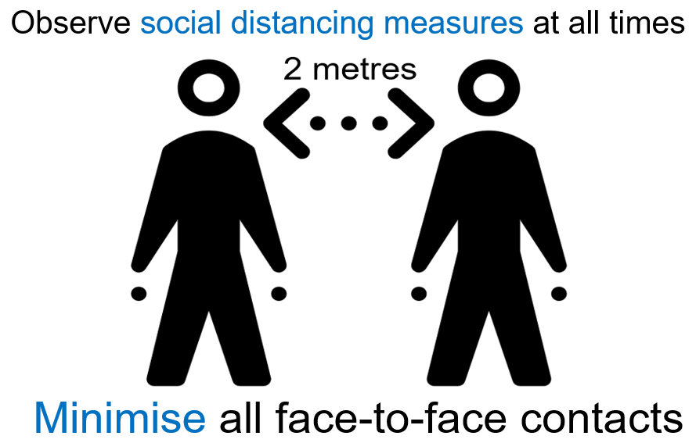
Environment considerations
Conform with social distancing measures where possible
Consider screens for reception
Consider using one-way system for patient flow if entrances/exits allow
Rearrange waiting room; keep clean and clutter free
Mark zoning on chairs, flooring and practice pavement
Remove all non essential items from surgery work surfaces and waiting room
Practice
Patients
Principles
Remove fans that recirculate the air
Ensure good ventilation, particularly in surgery
Determine how many patients can safely be seen over what time period and in which surgeries
Staff
PPE

Slide 35
Supporting information
Air-conditioning
Practice
For the current outbreak, there is currently insufficient evidence to indicate transmission of viable virus through
air vent and air conditioning systems
Patients
Principles
They could therefore potentially be used
after undertaking a risk assessment
Staff
PPE

Slide 36
Decontamination considerations
Practice
Patients
Principles
Staff
PPE

Slide 37
Cleaning and decontamination considerations
Frequency of cleaning and decontamination needs to be increased
Cleaning and decontamination should only be performed by staff trained in the use of the appropriate PPE. In some instances, this may need to be trained clinical staff rather than domestic staff, in which case, clinical staff may require additional training on
standards and order of cleaning
Decontamination of equipment and the care environment must be performed using either:
OR
Products must be prepared and used according to the manufacturers’ instructions and recommended product ‘contact times’ must be followed
Practice
Patients
Principles
A combined detergent/disinfectant solution at a dilution of 1,000ppm available chlorine
A general purpose neutral detergent in a solution of warm water followed by a disinfectant solution of 1,000ppm available chlorine
Staff
PPE

Slide 38
Decontamination considerations
Clean and disinfect all reusable equipment systematically from the top or the furthest away point e.g. dental light before dental chair
Practice
Use dedicated or disposable equipment (such as mop heads, cloths)
Patients
Principles
Pay greater attention to frequent touch points e.g. door handles, light switches
Decontaminate reusable cleaning equipment (such as mop handles, buckets) after use
with a chlorine-based disinfectant
Always perform hand hygiene for at least 20 seconds after doffing
Staff
PPE

Slide 39
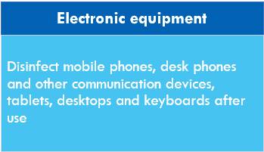
Decontamination considerations
When an AGP has been used, it is recommended that the room is left vacant with the door closed for 20 minutes in a negative pressure isolation room or one hour for a neutral pressure room before performing a terminal clean. Windows to the outside in neutral pressure rooms can be opened
Practice
Patients
Principles
Disposal of waste
Discard all waste from asymptomatic patients as healthcare (clinical waste)
Waste from possible or confirmed patients must be disposed of as Category B waste
Hand hygiene must always be performed after waste disposal
Staff
PPE

Slide 40
Supporting information
Freshly laundered uniform/clothing should be worn each day
Change into and out of uniform at work, where possible
If own clothes are worn at work, consider getting
T-shirts and trousers
that are only used for work and can be washed at high temperature
Transport home in a
disposable plastic bag
or a closable fabric bag
which can be washed alongside the uniform at the same time and temperature.
If a disposable plastic bag is used, discard into the household waste stream
Practice
Patients
Principles
Wash uniform/clothing separately from other household linen, in a load not more than half the machine capacity.
Wash at the maximum temperature the fabric can tolerate, then iron or tumble-dry
Detergents
(washing powder/liquid) and agitation
release any soiling from the clothes, which is then removed by sheer volume of water during rinsing
Do not take any personal items into clinical area e.g. phones.
If personal items have to be taken into the clinical area, disinfect them before leaving work
Staff
PPE

Slide 41
Practice
Principles
Patients
Staff
PPE

Slide 42
Surgery
Considerations
Check PPE availability
Update PPE requirements
Ensure PPE availability
for patients
(FRSM, tissues and hand gel)
Identify where PPE should be kept close to the area of use:
on a trolley or
in a specific cupboard
Reduce the risk of inadvertent self-contamination by ensuring all staff observe specific PPE doffing sequence
PPE
Patients
Principles
Identify areas that are safe to remove PPE (doffing areas):
Ensure they are large enough
Ensure that the bin is large and easy to use and not over-flowing
Laminate and display PHE donning and doffing quick guide posters
The area should be near a sink with liquid soap or have alcohol gel available nearby
Staff

Slide 43
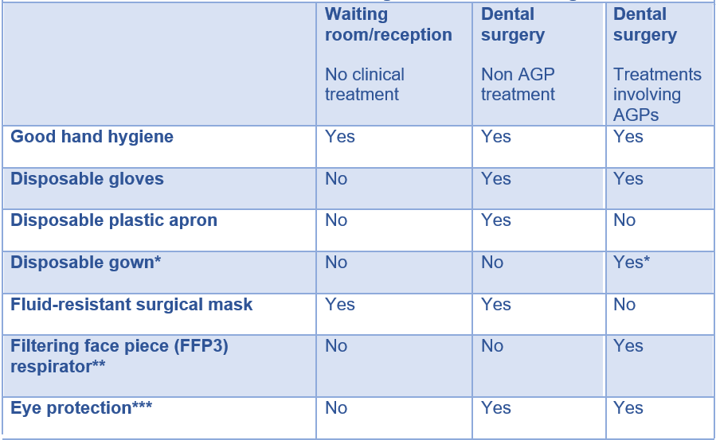
Surgery
Supporting information
PPE
Patients
Principles
* Fluid-repellent gowns/ coveralls (or long-sleeved waterproof apron) must be worn during aerosol generating procedures (AGPs). If non-fluid-resistant gowns are used, a disposable plastic apron should be worn underneath.
**If wearing an FFP3 that is not fluid-resistant, a full-face shield/visor must be worn. Operators who are unable to wear FFP3 e.g. due to facial hair, religious head coverings should wear alternatives such as hoods.
***Eye protection ideally should be disposable. Re-usable eye and face protection (such as polycarbonate safety glasses/goggles) is acceptable if decontaminated between single or single sessional use, according to the manufacturer’s instructions or local infection control policy. Regular prescription glasses are not considered adequate eye protection
Staff

Slide 44
Surgery
Supporting information
Provide FRSM to all possible/confirmed patients (including asymptomatic household contacts) while being escorted into and out of practice
PPE
Risk assess provision of FRSM or requirements for face coverings for all other patients
Be aware that some patients are unable to use alcohol based hand gel and will therefore require access to handwashing facilities
Rooms/areas where PPE is removed must be decontaminated, ideally timed to coincide with periods immediately after PPE removal
Patients
Principles
The sequence for putting on (donning) and taking off (doffing) PPE should be observed in order to reduce the risk of inadvertent self contamination
Staff

Slide 45
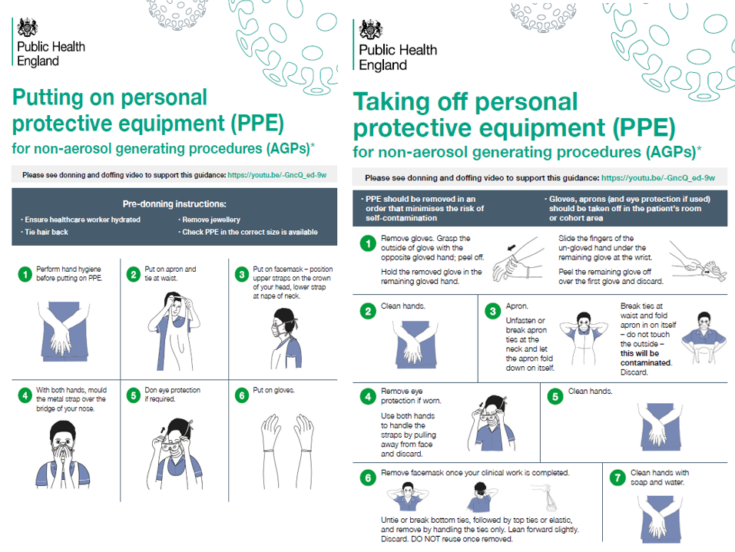

Slide 46
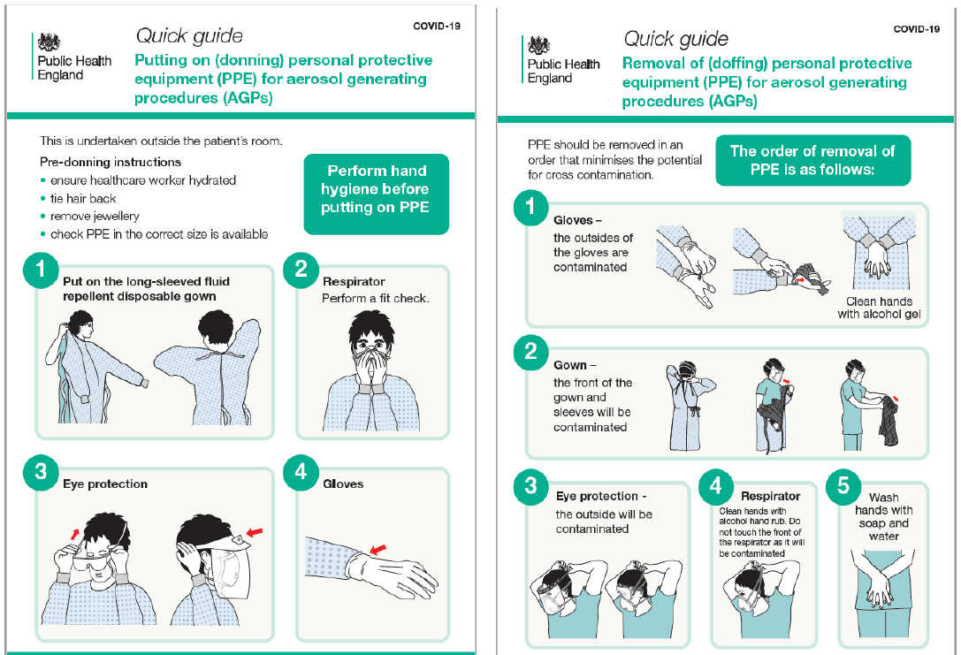

Slide 47
Surgery
Supporting information
All respirators should:
be well fitted, covering both nose and mouth
PPE
be fit-tested on all staff undertaking AGPs to ensure an adequate seal/fit according to the manufacturers’ guidance
be fit-checked (according to the manufacturers’ guidance) by staff every time a respirator is donned to ensure an adequate seal has been achieved
not be allowed to dangle around the neck of the wearer after or between each use
not be touched once put on
Patients
Principles
be compatible with other facial protection used such as protective eyewear so that this does not interfere with the seal of the respiratory protection
be disposed of and replaced if breathing becomes difficult, the respirator is damaged or distorted, the respirator becomes obviously contaminated by respiratory secretions or other body fluids, or if a proper face fit cannot be maintained
be removed outside the dental surgery where AGPs have been generated in line with doffing protocol
be shrouded with a full-face visor if a valved non-fluid resistant FFP3 is used
cleaned accorded manufacturer’s instructions if re-usable
all surgery staff should be specifically fit-tested and fit-checked for the specific make and model of the FFP3 respirators if AGPs are undertaken. If the model of the FFP3 respirators change, fit-testing and fit-checking must be undertaken in accordance with that manufacturer’s guidance.
Staff

Slide 48
Surgery
Supporting information
Operators who are
unable to wear respirators
e.g. due to facial hair, religious head coverings should wear alternatives such as hoods
PPE
Patients
Principles
Other respirators (apart from FFP3) can be used if they comply with
HSE recommendations
Staff

Slide 49
Surgery
Supporting information
Sessional use refers to using PPE for a period of time
PPE
During this period you may be looking after more than one patient
The items that can be used sessionally are the ones that protect the health worker from that patient (mask and eye protection)
Patients
Principles
Items that protect both the patient and the health care worker cannot be used in this way (gloves and apron) and must be changed between patients
Advantages of single sessional use of PPE:
Theoretically reduces risk of self contamination by reducing face touching when doffing
Can reduce the number of masks and eye protection used
Facilitates delivery of efficient clinical care
Staff

Slide 50
Surgery
Supporting information
Single sessional use should always be risk assessed
Usual dental practice involves the disposal of FRSM after each patient
Under the current circumstances, single sessional use instead of single patient use should be risk assessed
FFP3/FFP2/N95 respirators have a large capacity for the filtration and retention of airborne contaminants
Sessional use can be used in dental practice
A full-face visor changed between patients will protect the respirator from droplet/splatter contamination if this is to be used for a session
PPE
Patients
Principles
Staff

Slide 51
Practice
Principles
Patients
Staff
PPE

Slide 52
Surgery
Considerations
All patients to be provided with remote triage
Consider video consultations
Undertake COVID-19
risk assessments for all patients
All patients to receive advice, analgesia and antimicrobials (where appropriate)
Refer those requiring Emergency Care
Patients
Principles
Ensure appropriate scheduling arrangements
Prepare for patient arrival
Patient management process
Patient discharge and referral
Staff
PPE

Slide 53
COVID-19 risk-assessment: STEP 1
Q1:
Q2:
Q3:
Q4:
Q5:
Have you tested positive for COVID-19 in the last 7 days?
Are you waiting for a COVID-19 test
or
the results?
Do you have any of the following symptoms:
New, continuous cough*;
High temperature or fever;
Loss of, or change in, sense of smell or taste?
Do you live with someone who has either tested positive for COVID-19
or
had symptoms of COVID-19 in the last 14 days?
Have you been notified by
NHS Test and Trace
in the last 14 days
that you are a contact of a person who has tested positive for COVID-19 and you do not live with that person?
* A new, continuous cough means coughing for longer than an hour, or three or more coughing episodes in 24 hours. If the patient usually has a cough, it may be worse than usual
Note: A patient who has recovered from COVID-19 or who has completed a period of self isolation, can be regarded as ASYMPTOMATIC. Even though the coronavirus infection has cleared, a cough may persist for several weeks in some people and the loss of, or change in, sense of smell or taste may also linger. As long as they have completed the period of self-isolation of 7 days, they can be regarded as ASYMPTOMATIC.

Slide 54
COVID-19 risk assessment: STEP 2
Identify
If the patient is within
the following groups:
Shielded
Clinically vulnerable
Care Home resident
People who are clinically extremely vulnerable (shielded) should have received a letter advising them to shield of have been told by their GP or hospital clinician
Isolation period for Care Home residents is 14 days (not 7 days) for those who are symptomatic and regarded as contacts
Significant efforts should be made to ensure that shielded patients are separated from other patient groups, if they need to be seen

Slide 55
Surgery
Considerations for prescribing
In line with social distancing measures and minimising face to face contact, remote prescribing should be adopted. This does not mean the active prescription of antibiotics is always required
Patients
Refer to the BNF for comprehensive information on contraindications, cautions, drug interactions and side effects. Be aware that prescribing for some patient groups might differ. Examples include the elderly, patients who are immunocompromised or with hepatic or renal problems, patients who are pregnant and nursing mothers
During the COVID-19 pandemic, it is advisable to liaise with local pharmacy colleagues to ensure that the drugs being prescribed are available
Principles
Antibiotics should only be considered if a bacterial infection is causing the symptom
Irreversible pulpitis is not caused by a bacterial infection and antibiotics are inappropriate
Advise patients to recontact the practice if symptoms persist or worsen
Any child who requires antimicrobials for a swelling should be considered for an assessment and placed on the appropriate pathway of care
Staff
PPE

Slide 56
Surgery
Considerations for patients requiring Emergency Care
If the patient is in acute distress and time is of the essence, call 999
For potentially life-threatening cases i.e. those with increasing swelling affecting swallowing and mouth opening/uncontrollable haemorrhage:
Patients
Ascertain COVID19 status of the patient
Ring the switchboard of the appropriate hospital
Ask for them to bleep the OMFS team
Discuss the case with the designated person
Receive advice on where the patient should attend
01
02
03
04
05
Principles
Staff
PPE

Slide 57
Contact OMFS prior to referring patient to ED to reduce the risk of patient being turned away
Possible or confirmed
COVID-19 patients
(including asymptomatic contacts)
Asymptomatic patients
In Hours – OMFS on call
In Hours – OMFS department
Out of Hours – COVID ED
Out of Hours - OMFS on call
It is important to inform them if the patient has a long-term condition as alternative arrangements will need to be made

Slide 58
Surgery
Considerations for scheduling patients
Schedule patients for appointments ensuring separation in time and place as follows:
Once phased resumption is complete, all possible or confirmed cases of COVID-19 should be:
Provided with FRSM (where tolerated) whilst being escorted
Taken straight to surgery and must not wait in communal areas
Placed at the end of the list where feasible
Significant efforts should be made to ensure that shielded patients are separated from other patient groups. They could be seen in any of the following ways:
It is recommended that patients in Categories 2, 3 and 4 beneath are referred to Urgent Dental Care sites until phased resumption is complete. Staff treating these patients should not
also treat asymptomatic patients.
Patients
Principles
in the morning only (allowing maximum time for air clearance/ventilation overnight)
in a surgery which minimises the number of people passing
provided with a domiciliary visit by a dedicated dental team
Staff
PPE

Slide 59
Surgery
Preparations for patient arrival
Patients
Principles
Staff
PPE

Slide 60
Surgery
1
Identify need for interpreter (including British Sign Language) and/or disabled access
2
Patients
Undertake COVID-19 assessment to ensure appropriate scheduling of patient
Checklist prior to patient arrival
3
Inform no escort allowed unless parent/carer (undertake COVID-19 assessment on them and they need to be from same household). Escort not allowed for translating
Principles
4
Discuss payment options preferably over the phone/contactless or bring exemption evidence
5
Prepare patient for PPE appearance and advise to call the practice on arrival and wait to be invited into the practice
Staff
PPE

Slide 61
Surgery
Checklist on patient arrival
Patient to call practice and wait in car until invited, if possible
Patients
Ensure virtual access to interpreter, if required
Ensure no changes to COVID-19 assessment before patient enters practice
Principles
Patient to perform hand hygiene for at least 20 seconds
on arrival in practice
Risk assess the provision of FRSM while escorted to surgery
Advise patient not to touch any surfaces and maintain 2m social distance, where possible
Staff
PPE

Slide 62
Surgery
1
Manage patients’ condition with as little intervention as possible to minimise exposure risk
2
Patients
Where possible, AGPs should be avoided and should only be used when absolutely necessary
Considerations for
patient management
3
Carry out any procedure with patient and only staff who are needed; with the doors shut
Principles
4
Reduce risk of droplet contamination by using high speed suction and rubber dam
5
Complete dental treatment in one visit, wherever possible
Staff
PPE

Slide 63
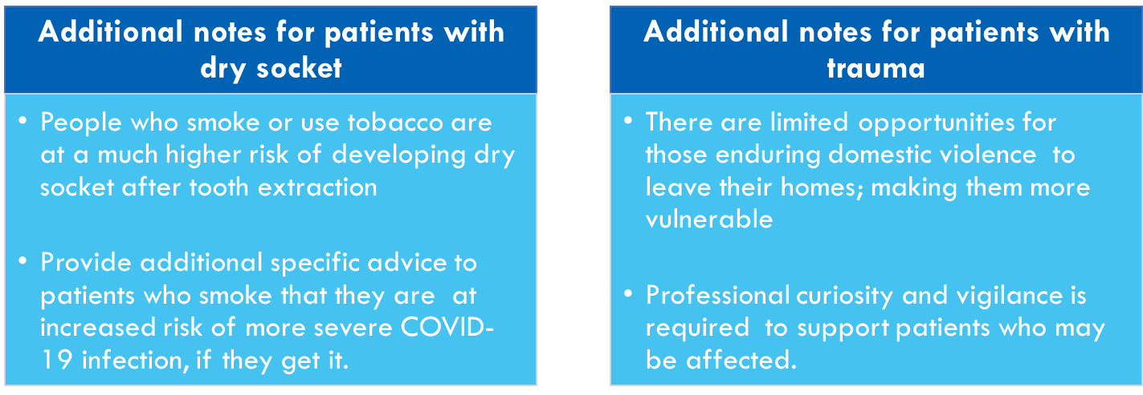
Surgery
Considerations for patient management
Patients
Principles
Staff
PPE

Slide 64
Surgery
Checklist and considerations on patient discharge
Patient to perform hand hygiene for at least 20 seconds before leaving dental practice
Patients
Symptomatic and confirmed patients to be provided with FRSM (if tolerated)
while escorted out of dental practice
Provide usual post-operative instructions to all patients who have had a tooth extracted, with additional specific advice to smokers about the increased risk of more severe COVID-19 infection, if they get it. Signpost patients to:
Principles
NHS SmokeFree
QuitforCovid
Reduce the risk of patient requiring another episode of urgent dental care and prescribe fluoride mouth rinses or high concentration fluoride toothpaste, as appropriate for those giving concern as well as dietary and self-care advice
Staff
PPE

Slide 65
Use local referral systems for
Potentially life-threatening cases i.e. those with increasing swelling affecting swallowing and mouth opening/uncontrollable haemorrhage to the local Emergency Department
Possible/confirmed patients to Urgent Dental Care Centres while phasing in full resumption of NHS dental services
All non-traumatic lesions that have been present for over three weeks via the two-week-wait pathway
Patients
Patients
Principles
Staff
PPE

Slide 66
Surgery
Cardio Pulmonary Resuscitation
Patients
Chest compressions and defibrillation (as part of resuscitation) are not considered AGPs; first responders (in any setting) can commence chest compressions and defibrillation without the need for AGP PPE while awaiting the arrival of other clinicians to undertake airway manoeuvres
Principles
Dental practices may choose to advise their clinical staff to wear FFP3 respirators, gowns, eye protection and gloves when performing chest compressions but it is strongly advised that there is no potential delay in delivering this life saving intervention
Staff
PPE

Slide 67
Get in touch
Contact
NHS England and NHS Improvement Primary Care Commissioning team
via the generic email addresses below clearly identifying the name of the dental practice
at the start of the subject narrative:
East Midlands: england.em-pcdental@nhs.net
West Midlands: ENGLAND.dentalcontractswm@nhs.net

Slide 68
STAY ALERT CONTROL THE VIRUS
SAVE LIVES
THANK YOU

