Slide 1
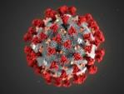



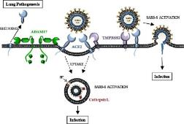

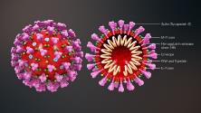
Diabetes Care in Primary and Secondary Care in the time of COVID- 19
Professor Vinod Patel
FHEA FRCP MD MRCGP DRCOG PSc
Professor, Diabetes and Clinical Skills
Hon Consultant in Endocrinology and Diabetes
Warwick Medical School, George Eliot Hospital NHS Trust, Nuneaton
CD Diabetes NHS England and NHS Improvement (West Midlands)

Slide 2
Declaration of Interests
I have worked with most of the large pharmaceutical industry groups over the years with the majority of the work being in education of Healthcare Professionals in Diabetes Care
This includes Novo Nordisk, Eli Lily, MSD, BI, Sanofi, Napp, , Internis,Takeda and AZ. I have been part of Advisory Board work on occasions.
From these companies I would have received Conference Arrangements and Lectures Fees.
I am a trustee of the SAHF Charity (South Asian Health Foundation).

Slide 3

Diabetes Care in the time of COVID- 19
National Diabetes Audit (NDA) : main priorities for diabetes care
COVID-19 and the Diabetes Patient: risks for death
Role of SGLT-2- inhibitors: brief review of outcomes for patients
Who to Prioritise in GP Care: Traffic-lights approach
Care Planning: GP Systems and Care
Final Remarks and Conclusions: Questions and Comments
Educational Objectives- to facilitate you to
Be Informed of key statistics in relation to COVID-19
Learn of COVID-19 risk factors for death
Be informed of outcomes that can accrue from SGLT2-I Rx
Become convinced of care planning in Diabetes Care
Ask awkward questions
Reflect on how you can change practice…..?

Slide 4
Diabetes Care in the time of COVID- 19
National Diabetes Audit (NDA) and BSOL: main priorities for diabetes care
COVID-19 and the Diabetes Patient: risks for death
Role of SGLT-2- inhibitors: brief review of outcomes for patients
Who to Prioritise in GP Care: Traffic-lights approach
Care Planning: GP Systems and Care
Final Remarks and Conclusions: Questions and Comments
Educational Objectives- to facilitate you to
Be Informed of key statistics in relation to the local NDA
Learn of COVID-19 risk factors for death
Be informed of outcomes that can accrue from SGLT2-I Rx
Become convinced of care planning in Diabetes Care
Ask awkward questions
Reflect on how you can change practice…..?

Slide 5

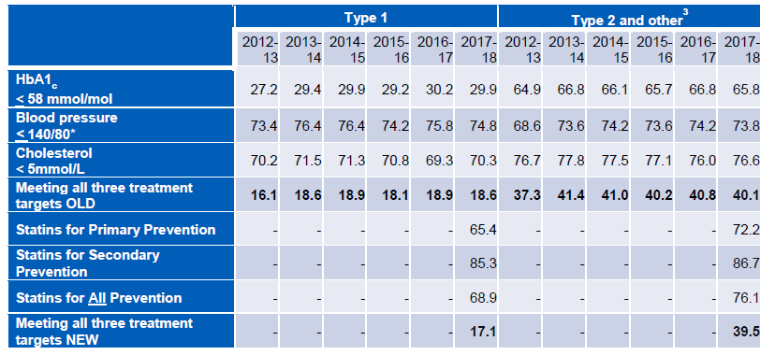
* All Three Treatment Targets NEW – HbA1c, Blood Pressure and Statins for Combined Prevention of CVD

Slide 6
Risk Factor Control. Mortality and CVD Outcomes in Patients with Type 2 Diabetes
% increased risk
399 | 288 | 210 | 39
5 Risk factors:
  A: Current Smoker
  B: BP ≥ 140/80
  C: LDL ≥ 2.5 mmol/l
  CKD: Albuminuria (Micro or Macro)
  D: HbA1c > 53 mmol/mol (7%)
Similar Trends for:
Excess MI
Excess Stroke
Excess Heart Failure
Rawshani A et a. NEJM 2018;379:633-644.

Slide 7
Urine ACR tests for diabetes patients are being completed at low rates compared with other kidney function tests
UK testing rates for serum creatinine, eGFR and urine albumin
38% of T2DM
patients in England and
haven’t had
a urine albumin
check within the last
12 – 15 months^{1,2}
*
Percentage of T2DM patients tested in the previous
15 months (2018)²
Percentage of T2DM patients tested (Jan – Dec 2019)¹
Percentage of diabetes patients* tested annually (2016)³
Although reported testing rates vary, these figures show urine albumin testing in the UK is poor
*Diabetes type not specified. ACR: albumin/creatinine ratio; eGFR: estimated glomerular filtration rate; CKD: chronic kidney disease.
NHS Digital. National Diabetes Audit. Report: Care Processes and Treatment Targets, January to December 2019. [Accessed August 2020]. https://digital.nhs.uk/data-and-information/publications/statistical/national-diabetes-audit/national-diabetes-audit-quarterly-report-january-to-december-2019
NHS Scotland. Scottish Diabetes Survey 2018. June 2019. [Accessed August 2020]. https://www.diabetesinscotland.org.uk/wp-content/uploads/2019/12/Scottish-Diabetes-Survey-2018.pdf
Nitsch D, et al, on behalf of the National CKD Audit and Quality Improvement Programme in Primary Care, First National CKD Audit Report 2017. [Accessed August 2020]. www.hqip.org.uk/resource/national-chronic-kidney-disease-audit-national-report-part-1/#.Xtzgipp7nOQ

Slide 8
Diabetes Care in the time of COVID- 19
National Diabetes Audit (NDA) and BSOL: main priorities for diabetes care
COVID-19 and the Diabetes Patient: risks for death
Role of SGLT-2- inhibitors: brief review of outcomes for patients
Who to Prioritise in GP Care: Traffic-lights approach
Care Planning: GP Systems and Care
Final Remarks and Conclusions: Questions and Comments
Educational Objectives- to facilitate you to
Be Informed of key statistics in relation to the local NDA
Learn of COVID-19 risk factors for death
Be informed of outcomes that can accrue from SGLT2-I Rx
Become convinced of care planning in Diabetes Care
Ask awkward questions
Reflect on how you can change practice…..?

Slide 9
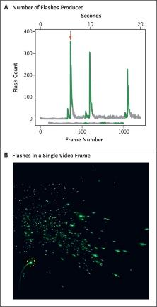
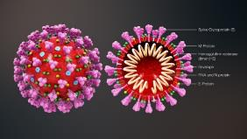
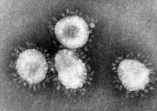
Introduction to the Virus
COVID-19 Pandemic: One of the most serious new health threats in the modern history of humanity. Its propensity for rapid transmission has lead to 33 million diagnosed cases and as of yesterday over a Million- 1 000 000 deaths globally within a few months
COVID-19 is caused by SARS-CoV-2, a Beta-coronavirus closely related to the SARS virus. Approx. 0.100 µm diameter
Transmission: Respiratory, Naso-pharyngeal and Speech droplets by direct inoculation via touching of fomites or breathing in such droplets. Asymptomatic carriage.
Infectious dose ? Hundreds to thousands ? Chinese study 50000 particles. One mustard seed, 1 mm across, 524 Billion virus capacity. 20 µm droplet: 4,189,000 minus dilution, 500 µm droplet: 65,400,000,000
Speech Droplets
“Stay Healthy”
Visualizing Speech-Generated Oral Fluid Droplets with Laser Light Scattering : Anfinrud P et al, NEJM 2020

Slide 10
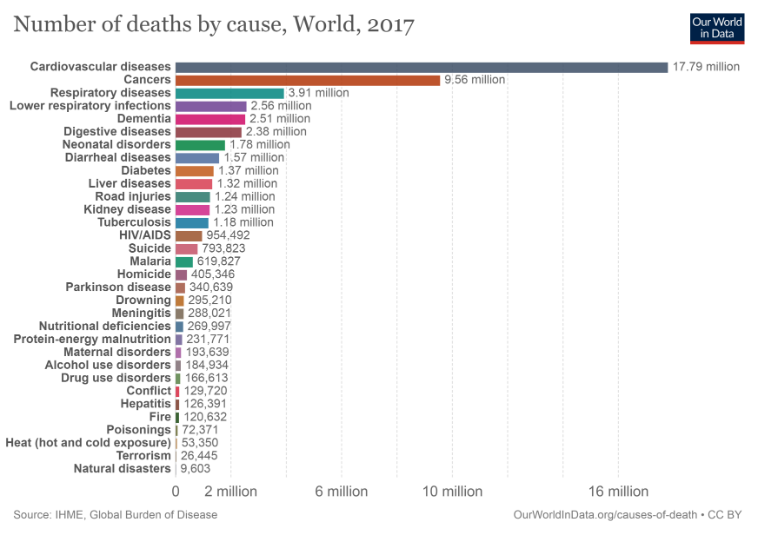
Global Causes of Death
Global: 9th Rank
Coronavirus Deaths*
November 20th 2020
1 361 000 people
9 Months
*CNA Infographic 2020

Slide 11
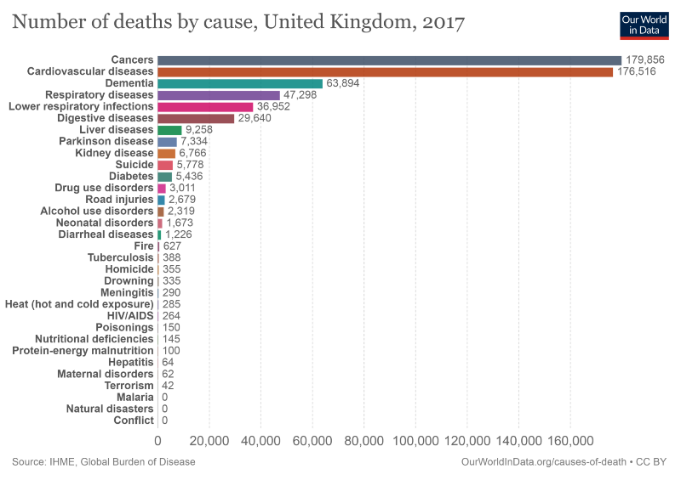
Global Causes of Death
UK: 4th Rank
Coronavirus Deaths
November 20th 2020
53 775 people
9 Months

Slide 12
Total Deaths: 27706
Age and COVID-19 Mortality Matrix
9th June 2020 NHS Data
Comparative Risks
Age Band |  | % Total Deaths
0-19 | 18 | 0.06%
20-39 | 196 | 0.7%
40-59 | 2173 | 7.8%
60-79 | 10556 | 38.1%
80+ | 14763 | 53.3%
 | 0-19 | 20-39 | 40-59 | 60-79 | 80+
0-19 | 1.0 | 10.8 | 120.7 | 586.4 | 820.2
20-39 | 0.1 | 1.0 | 11.1 | 53.9 | 75.3
40-59 | 0.01 | 0.09 | 1.0 | 4.86 | 6.79
60-79 | 0.002 | 0.02 | 0.21 | 1.0 | 1.40
80+ | 0.001 | 0.013 | 0.147 | 0.715 | 1.0

Slide 13
Type 1 and Type 2 Diabetes and COVID-19 related mortality in England: a whole population study
No Diabetes 94.84%
Type 1 DM 0.43%
Type 2 DM 4.66%
Other DM 0.07%
People with Diabetes in England- 5.16%
Emma Barron , Chiraj Bakhai, Partha Kar, Andy Weaver, Dominique Bradley, Hassan Ismail, Peter Knighton, Naomi Holman, Kamlesh Khunti, Naveed Sattar, Nick Wareham, Bob Young, Jonathan Valabhji
NHS England Website accessed 20/5/2020

Slide 14
Type 1 and Type 2 Diabetes and COVID-19 related mortality in England: a whole population study
People with Diabetes in England- 5.16%
No Diabetes 66.8%
Type 1 DM 1.5%
Type 2 DM 31.4%
Other DM 0.3%
One Third of COVID-19 Deaths in Hospital in
People with Diabetes- 33.2%
Emma Barron , Chiraj Bakhai, Partha Kar, Andy Weaver, Dominique Bradley, Hassan Ismail, Peter Knighton, Naomi Holman, Kamlesh Khunti, Naveed Sattar, Nick Wareham, Bob Young, Jonathan Valabhji
NHS England Website accessed 20/5/2020

Slide 15

What practical advice should we give to the majority of people
with type 2 diabetes (who are well)?
People with diabetes should be reminded that diabetes increases risk of many infections, and that may include COVID-19
Maintaining good glucose control, a healthy diet and regular exercise are important for all
Current UK advice is to continue usual glucose lowering drugs, and aim to optimise glucose control
Antihypertensives (including ACEi’s and ARBs) and lipid lowering drugs should also be continued
https: / /www .diabetesonthenet .com /journals /issue /607 /article-details /glance-factsheet-covid-19-and-diabetes-dpc

Slide 16

Patient Information on the Diabetes and COVID-19 Studies
Type 1 Diabetes and Type 2 Diabetes: People with both types of diabetes are more likely to have the serious outcomes from coronavirus infection
NHS England Diabetes and Coronavirus Studies: In May 2020, two studies were published which showed that people with diabetes with coronavirus were at higher risk of dying. This result only applies to those people with diabetes with such severe coronavirus disease that admission to hospital was essential.
Highest Risks for death: This was in the elderly, often with other conditions such as heart disease, stroke or kidney disease. There were very few deaths under the age of 40.
Type 1 and Type 2 Diabetes and COVID-19 related mortality in England: a whole population study
Emma Barron , Chiraj Bakhai, Partha Kar, Andy Weaver, Dominique Bradley, Hassan Ismail, Peter Knighton, Naomi Holman, Kamlesh Khunti, Naveed Sattar, Nick Wareham, Bob Young, Jonathan Valabhji .
NHS England Website accessed 20/5/2020
Type 1 and Type 2 Diabetes and COVID-19 related mortality in England: a cohort study in people with diabetes. Naomi Holman, Peter Knighton, Partha Kar, Jackie O’Keefe, Matt Curley, Andy Weaver, Emma Barron , Chiraj Bakhai, Kamlesh Khunti, Nick Wareham, Naveed Sattar, Bob Young, Jonathan Valabhji : NHS England Website Accessed May 2020

Slide 17

Patient Information on the Diabetes and COVID-19 Studies
Community Coronavirus Infections: Current evidence suggests that people with diabetes are no more likely to catch coronavirus infection than those without diabetes. However, if there is coronavirus infection requiring hospital admission then the outcome is more likely to be serious than in people without diabetes.
Mild and Moderate coronavirus infection: It is clear that many hundreds of people with diabetes have had the infection the community and made a good recovery from there mild to moderate illness.
Risk Stratification: could help identify diabetes patients, within a clinical service, that need most urgent intervention where services are stretched and working in different ways due to the COVID-19 Pandemic
You and your Healthcare Professionals could use the information from the studies to help identify any risk factors that you have may have that could lead an increased chance of a more serious outcome from coronavirus infection. Some of these could be improved to your potential benefit- such as an improvement in glycaemic control

Slide 18
How these studies can help manage your diabetes
The findings from the studies could be integrated into a Care Plan for you using the following main points:
  Good diabetes control is important with a HbA1c target that is individualised to you. This would take into account not just the current coronavirus pandemic with prevention of other complications.
  Weight control: very high BMI and lower BMI were associated with the most serious outcomes of coronavirus infection. A personal, achievable target can be discussed if you want. Physical activity and a healthy diet remain important in this regard.
  Cardiovascular disease prevention and management: Heart attacks, strokes and Heart Failure were all associated with poorer outcomes with coronavirus infection. Management and prevention of these conditions through lifestyle measures (especially not smoking), Blood Pressure Control, cholesterol-lowering, foot care are all essential.
The following tables could be used to inform a discussion on the risk factors for a more serious outcome associated with coronavirus infection specific to your type of diabetes and other factors such as age, ethnicity, HbA1c, weight and duration of diabetes.

Slide 19
NHS England: COVID-19 Mortality Studies Type 2 Diabetes
HCP to consider using tick marks, to individualise to patient*
Type 2 Diabetes | Lower Risk | Higher Risk |  |  |  |  |  | Your Lower Risks* | Your Higher Risks*
Gender | Female, 1.0 | Male 1.59
Ethnicity | White, 1.0 | Black 1.63 |  | Asian 1.09* |  | Mixed 1.3
Age yrs | 60-69, 1.0 | 70-79, 1.92 |  | 80+, 4.39
Duration | 3-4, 1.0 | 15-19, 1.14 |  | 20+, 1.17
IMD* | IMD 5, 1.0 | 3, 1.07 |  | 2, 1.27 |  | 1, 1.45
Previous Stroke | No Stroke, 1.0 | 1.95
Previous HF | No HF, 1.0 | 2.05
HbAc | 49-58 1.0 | 54-58 1.05 | 59-74 1.23 |  | 75-85 1.37 |  | 86+ 1.62
BMI 1 | 25-29.9 1.0 | 30-34.9 1.04 |  | 35-39.9 1.16 |  | 40+ 1.64
BMI 2 | 25-29.9 1.0 | 20-24.9 1.31 |  | <20 2.26
eGFR | 60 1.0 | 45-59 1.37 | 30-44 1.75 |  | 15-29 2.24 |  | <15 4.83
Only statistically significant data is colour coded. Amber less than 50% increase in HR, Red > 50% increase in HR, Current Smoking was protective- reasons not clear.
Based on Data from Holman N et al 2020 NHS England

Slide 20
NHS England: COVID-19 Mortality Studies Type 1 Diabetes
HCP to consider using tick marks, to individualise to patient*
Type 1 Diabetes | Lower Risk | Higher Risk |  |  |  |  |  | Your Lower Risks* | Your Higher Risks*
Gender | Female, 1.0 | Male 1.64
Ethnicity | White, 1.0 | Black 1.79 |  | Asian 1.68 |  | Other 2.0
Age yrs | 60-69, 1.0 | 70-79, 1.84 |  | 80+, 4.63
IMD* | IMD 5, 1.0 | 3, 1.79 |  | 2, 1.53 |  | 1, 1.79
Previous Stroke | No Stroke, 1.0 | 2.14
Previous HF | No HF, 1.0 | 1.82
HbAc | 49-58, 1.0 | 86+, 2.19
BMI 1 | 25-29.9 1.0 | 30-34.9 1.5 |  | 35-39.9 1.70 |  | 40+ 2.15
BMI 2 | 25-29.9 1.0 | 20-24.9 1.38 |  | <20 2.11
eGFR | 60+, 1.0 | 45-59 1.92 | 30-44 2.16 |  | 15-29 2.98 |  | <15 6.85
Only statistically significant data is colour coded. Amber less than 50% increase in HR, Red > 50% increase in HR
Entirely Based on Data from Holman N et al 2020 NHS England

Slide 21
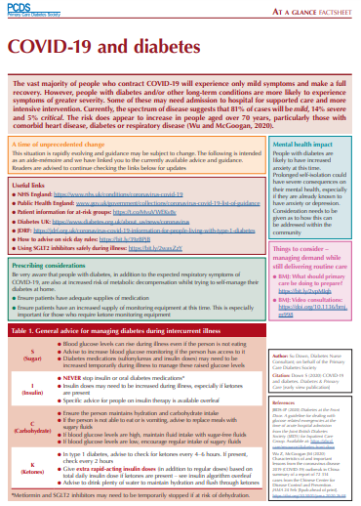
Specific considerations for primary care management of people with COVID-19 and suspected COVID-19 infection
Most people (80%) will have mild disease and can be managed at home.
Usual sick day rules apply – stop SGLT2i and metformin if unwell and not eating or drinking normally, other medication (eg SUs) may need adjustment
Never stop insulin
Monitor glucose frequently (every 2-4 hours) – ketone testing needed for type 1 diabetes
Please consult individual product SmPCs for full product information
https://www.diabetesonthenet.com/journals/issue/607/article-details/glance-factsheet-covid-19-and-diabetes-dpc

Slide 22






Diabetes Control:
UKPDS: 1% ( ~ 10mmol/mol) decrease in HbA_{1c} is associated with a reduction in complications by….
43%
Amputation or fatal peripheral blood vessel disease*
37%
Microvascular complications e.g. kidney disease and blindness *
HbA_{1C}
1%
21%
Deaths related to diabetes*
14%
Heart attack*
* p<0.0001
** p=0.035
12%
Stroke**
Stratton IM, et al. BMJ 2000; 321: 405–12.
Notes:
Reducing HbA_{1c} is a key to addressing other potential complications.
CORE SLIDE
Observational data based on the UKPDS has demonstrated the association of good blood glucose control with a reduced burden of microvascular and macrovascular complications.¹
Link to next slide:
How are we doing currently?
Reference
Stratton IM et al. BMJ 2000; 321: 405–412.

Slide 23
Type 1 and Type 2 Diabetes and COVID-19 related mortality in England:
a cohort study in people with diabetes
Adjusted Hazard Ratios: HbA1c and COVID-Death
 |  | Type 1 Diabetes | COVID-19 Deaths | Type 2 Diabetes | COVID-19 Deaths
HbA1c Mmol/mol | <48 | 18010 6.8% | 1.22 | 726600 25.1% | 1.11
 | 49-53** | 21610 8.2% | 1.0 | 594270 20.6% | 1.0
 | 54-58 | 25250 9.5% | 0.73 | 367365 12.7% | 1.05
 | 59-74 | 77550 29.3% | 1.15 | 553840 19.2% | 1.23
 | 75-85 | 30235 11.4% | 1.31 | 157685 5.5% | 1.37
 | 86+ | 31380 11.8% | 2.19 | 175640 6.1% | 1.62
 | Missing | 61055 23.0% | 1.6 | 313815 10.9% | 1.57
Data are adjusted HRs for diabetes type specific Cox’s proportional hazards multivariate survival model
Only statistically significant data is colour coded. Amber up to 50% increase in HR, Red > 50% increase in HR, Blue lower risk. ** indicate data compared to as reference:

Slide 24
Diabetes Care in the time of COVID- 19
National Diabetes Audit (NDA) and BSOL: main priorities for diabetes care
COVID-19 and the Diabetes Patient: risks for death
Role of SGLT-2- inhibitors: brief review of outcomes for patients
Who to Prioritise in GP Care: Traffic-lights approach
Care Planning: GP Systems and Care
Final Remarks and Conclusions: Questions and Comments
Educational Objectives- to facilitate you to
Be Informed of key statistics in relation to the local NDA
Learn of COVID-19 risk factors for death
Be informed of outcomes that can accrue from SGLT2-I Rx
Become convinced of care planning in Diabetes Care
Ask awkward questions
Reflect on how you can change practice…..?

Slide 25
ABCD Recovery Guidance (June 2020)
 | Red | Amber | Green
Recommended Review Date | Review all “Red” patients within 3 months | Review all “Amber” patients by 31.12.2020 | Inform patients in this category that they are unlikely to be seen before early 2021. Provide clear advice on where and how to contact the team for emergency support if things change
Metabolic Control Alternative Measures BP (mm of Hg) | Hba1c 86 mmol/mol (10%) <30% time in range BP>160/100 | 69-86 mmol/mol (8.5- 10%) 30-50% time in range BP 140-160 /100 on suboptimal medication | <64 mmol/mol (8.0%) >50% time in range BP <140/80
Hypoglycaemia Risk | Complete loss of awareness (e.g. Gold score 6-7) Severe Hypos needing 3rd Party assistance in last 12 months | Impaired awareness of hypoglycaemia (e.g. Gold score 4- 5) HbA1c <48 mmol/l on insulin or sulfonylureas. With known frailty, cognitive impairment or eGFR <30ml/min >20% time below 4mmol/l | Normal awareness of hypoglycaemia

Slide 26
ABCD Recovery Guidance (June 2020)
 | Red | Amber | Green
Renal Function | Known CKD level 4 or more (eGFR <30ml/min) Known to diabetes renal service (optimise care and avoid duplication) Rapidly declining renal function (eGFR reduction >15 ml/min/year) | Known CKD 3b (eGFR <45ml/min) or Progressive albuminuria ACR >30 mg/mol
Risk of admission | Admission in the last 12 months with Unstable glucose (DKA/HHS or hypoglycaemia) Cardiovascular ds Cerebrovascular ds Admission with unrelated condition where hypoglycaemia was a major factor | Those with frailty/cognitive impairment needing additional support from their diabetes teams.

Slide 27
ABCD Recovery Guidance (June 2020)
 | Red | Amber | Green
Diabetes Foot status | Known active diabetes foot disease | Known high risk foot disease not known to podiatry services. | No known diabetes foot disease
Other factors | Planning pregnancy in next 6 months | Young patient (age <40yrs) with T1D or T2D with known early complications
Wales recommendations for Triage of people with diabetes post COVID Aug 2020 includes above and additional points:
Red:
Eating disorders, serious mental health issues, Newly diagnosed T1 and T2 diagnosis, Vulnerable groups such as the homeless and those needing glucose optimisation pre –surgery
Amber:
Patients 16-25yrs, Patients with no diabetes review in last 18months, People with a body mass index greater than 30kg/m2 and People in BAME groups.

Slide 28
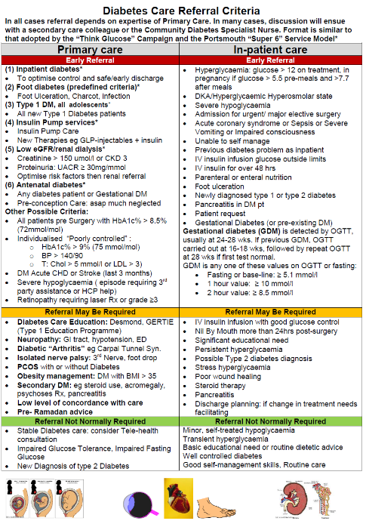

Diabetes Care
Referral Criteria
A Safety “Checklist”, Patient-Centred, Multi-Professional, Evidence-based Approach
Primary Care Referral: All dependent of level of resources and expertise
  Early Referral
  Referred may not be required
  Referral normally not needed
Secondary Care Referral: All dependent on diabetes care expertise
  Early Referral
  Referred may not be required
  Referral normally not needed

Slide 29
C+V Guidance for Primary Care Diabetes Prioritisation and Remote Reviews
Dr Sarah Davies May 2020
Patient Groups
Needs Review
Remote Video or Telephone Consultation Checklist
Check available results:
Current or previous HBA1c / home glucose readings
Weight changes and BP
U&Es and ACR
Review symptoms and lifestyle:
Alert flags: thirst, lethargy, recurrent infections, foot issues, vision, neuropathic symptoms
Signpost lifestyle resources / Ref Dieticians (virtual consults/education)
Remember mental health
Medication review:
Compliance
Side effects
Awareness of sick day rules
Complications:
Feet: Home Foot assessment – Diabetes UK Touch your toes test, if concerns convert to video consult. Referral to podiatry if appropriate
Eyes: review last retinopathy screening, signpost if any new issues
Signpost or provide written resources via email or post (links below):
Sick day rules for patients
Diabetes UK Website
Diabetes UK Information Prescriptions
Pocket Medic Videos
Starting injectables videos
Plan next review date and safety net
Needs Review - options
Patients where benefit of a F2F visit outweighs risk
Consider single visit to surgery for practical assessments: HBA1c, U+Es, ACR, BP, weight, foot check
Remote consultation with results
Requires Face2Face (F2F) Review
Suspected new Type 1 diabetes
Unwell patient with diabetes, possible ketosis
Patients where benefit of a F2F visit outweighs risk
Consider single visit to surgery for practical assessments: HBA1c, U+Es, ACR, BP, weight, foot check
Follow Up by remote consultation with results
Needs Review
New diagnosis Type 2 diabetes
New/worsening foot issue
HBa1c over personal target (now or at previous check), prioritise those >64mmol/mol
Recent therapy change
Declining renal function
Needs to commence injectable therapy
Patients where F2F visit can be avoided - remote review
Consider using a pre assessment questionnaire to gather information first (example available)
Inform the patient of the details of their planned remote review.
Ask them to prepare by undertaking home assessments if possible for:
Blood glucose monitoring (if suitable)
BP checks
Weight recording
Self foot assessment
Drop in/send in urine sample for ACR
Safe to Defer Review for 6 months
Well controlled, HBA1c to target in the last year
Engaged with treatment
Referrals
For a response within 48hrs email the Community Team (GPwSIs, DSNs)
Alternatively contact your Community Diabetes Consultant Team
Podiatry: Walk-In Clinic CRI Tues/Fri 9-11 or Hot Tel. for urgent advice XXXXXXXXXX

Slide 30

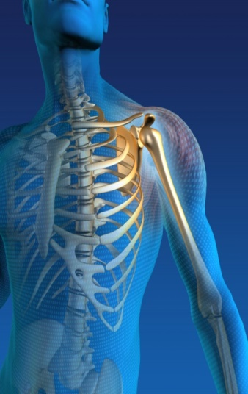
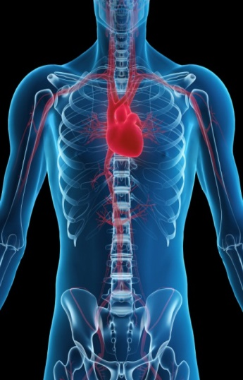
Morbidity of hypoglycaemia in diabetes
Brain
Musculoskeletal
Blackouts, Seizures, Coma, Death
Cognitive dysfunction
Psychological effects
Falls, Accidents
eg driving
fractures, dislocations
Cardiovascular
Myocardial ischaemia (angina and infarction)
Cardiac arrhythmia
Abnormal prolonged QTc
Sudden death
ABC of Diabetes. Holt and Kumar 2015. BMJ Books

Slide 31
Dexamethasone in COVID-19:
Clear Benefit in Hospitalised Patients on Oxygen Therapies
PICO Analysis of the Dexamethasone Study
Patients: Hospitalised, clinically suspected or laboratory confirmed SARS-CoV-2 infection. 2104 patients were randomised to dexamethasone vs 4321 usual care.
Intervention: Dexamethasone 6mg od. Either oral or IV- single dose. For 10 Days or until discharge if sooner.
Comparison: Usual current Standard of Care in UK Hospital setting
Outcomes: June, recruitment to the Dex. Halted, results clear evidence of clinical benefits. Overall, with usual care alone, 28-day mortality highest in ventilation (41%), intermediate in oxygen only (25%), and lowest in no respiratory intervention (13%).
Patients treated with Dexamethasone:
Overall Dexamethasone reduced deaths by 17%: From 24.6% to 21.6%
In ventilated patients: Deaths reduced by 35%, Rate Ratio-RR- 0.65 [95% CI 0.48-0.88, p <0.001)
Oxygen Therapy no Ventilation: Deaths reduced by 20%, RR 0.80 [95% CI 0.67-0.96, =0.0021)
No benefit in “did not require respiratory support” RR 1.22 [95% CI 0.86-1.75]; p=0.14).
Number Needed to Treat (NNT): Based on these results, 1 death would be prevented by treatment of around 8 ventilated patients or around 25 patients requiring oxygen alone.

Slide 32
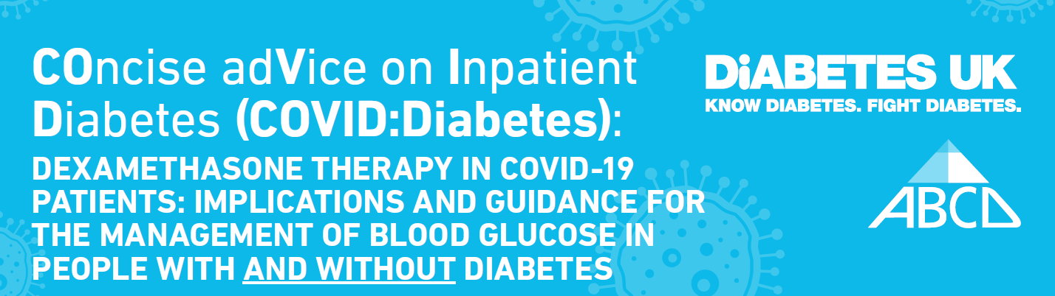
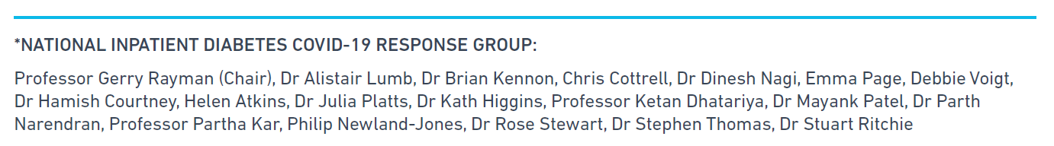
COVID: Diabetes
Dexamethasone in COVID-19 Patients:
Implications and Guidance for the Management of Blood Glucose in People with and without Diabetes
All Slides cut from Original PDF Document

Slide 33
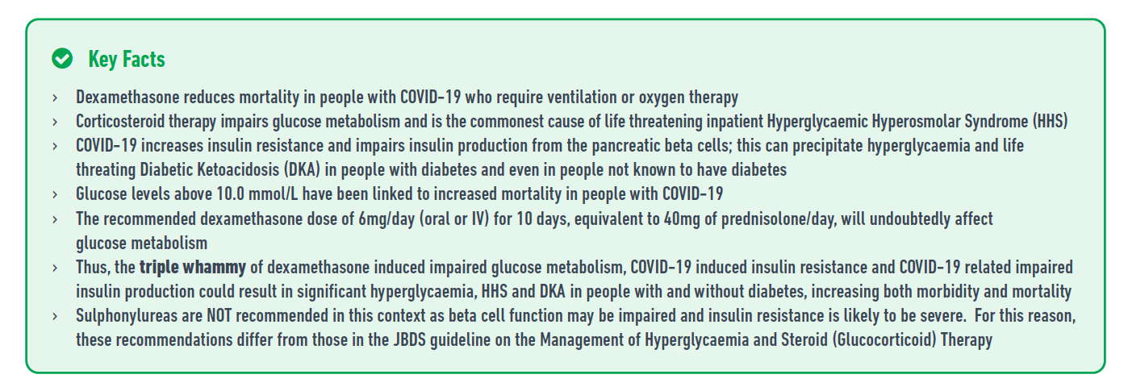
COVID: Diabetes
Dexamethasone in COVID-19 Patients:
Implications and Guidance for the Management of Blood Glucose in People with and without Diabetes

Slide 34
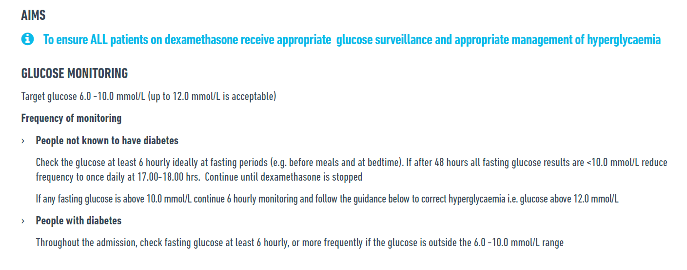
COVID: Diabetes
Dexamethasone in COVID-19 Patients:
Implications and Guidance for the Management of Blood Glucose in People with and without Diabetes

Slide 35
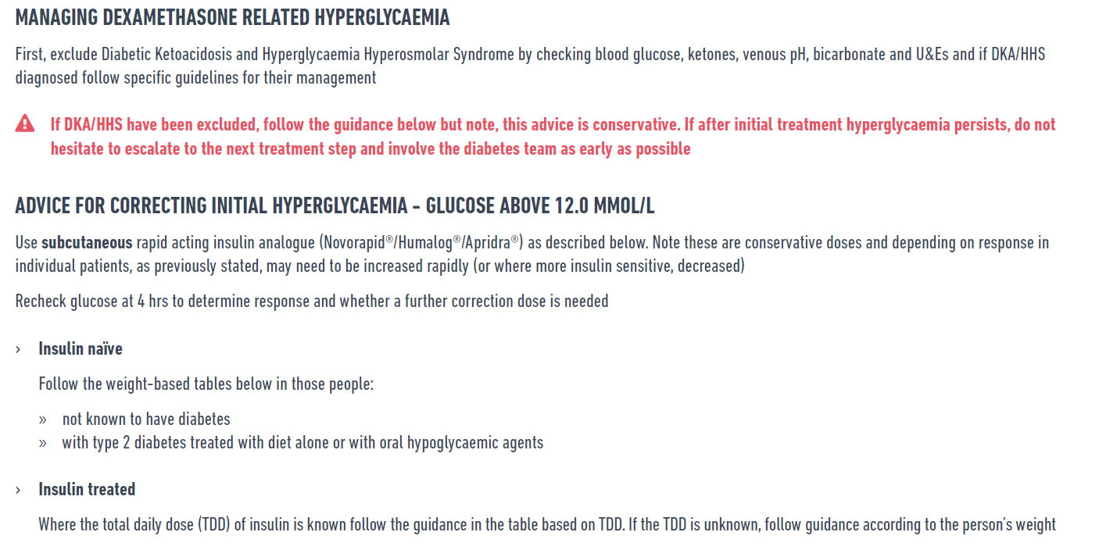
COVID: Diabetes
Dexamethasone in COVID-19 Patients:
Implications and Guidance for the Management of Blood Glucose in People with and without Diabetes

Slide 36
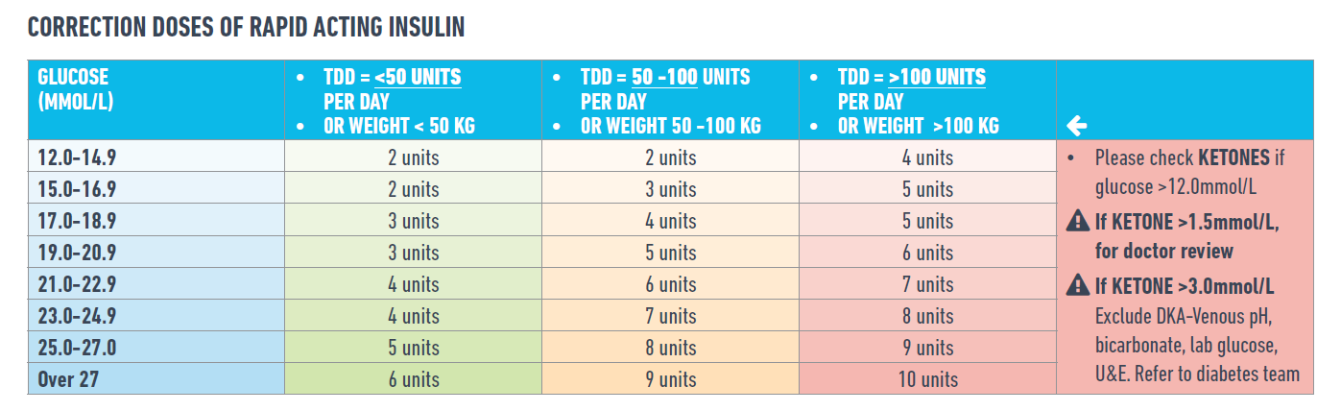
COVID: Diabetes
Dexamethasone in COVID-19 Patients:
Implications and Guidance for the Management of Blood Glucose in People with and without Diabetes

Slide 37
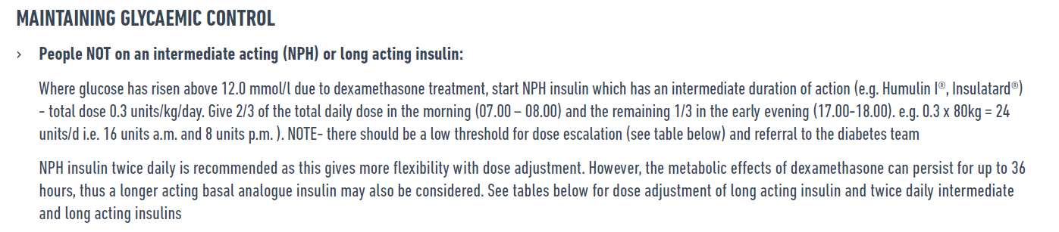
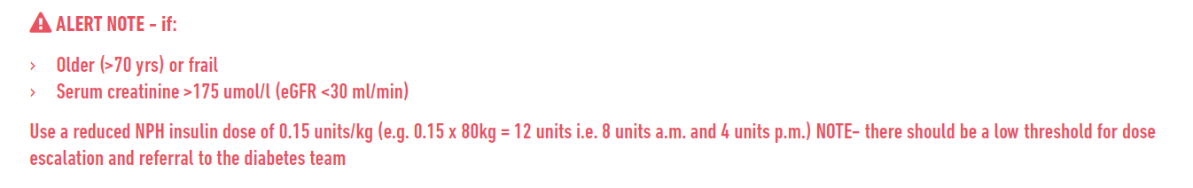
COVID: Diabetes
Dexamethasone in COVID-19 Patients:
Implications and Guidance for the Management of Blood Glucose in People with and without Diabetes

Slide 38
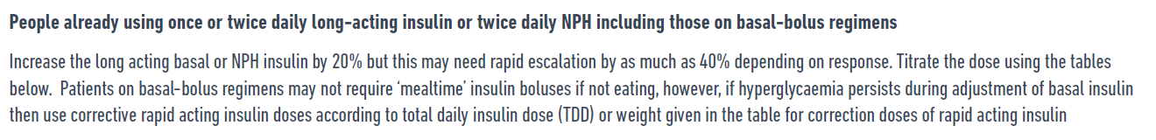
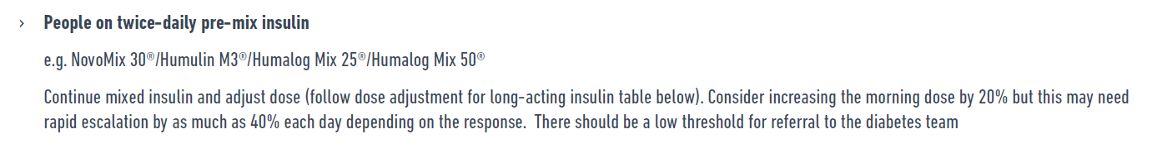
COVID: Diabetes
Dexamethasone in COVID-19 Patients:
Implications and Guidance for the Management of Blood Glucose in People with and without Diabetes

Slide 39
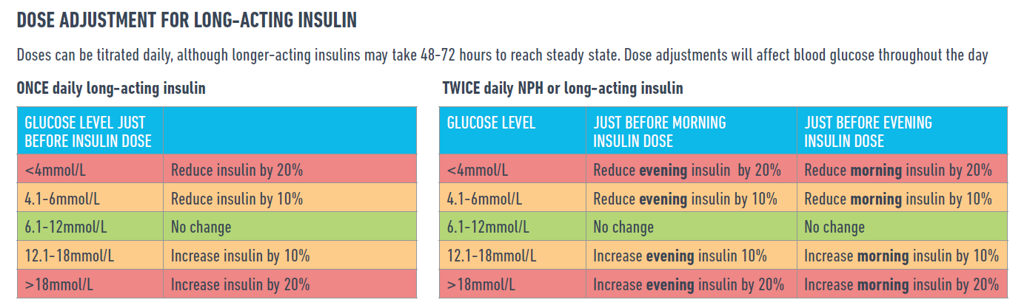
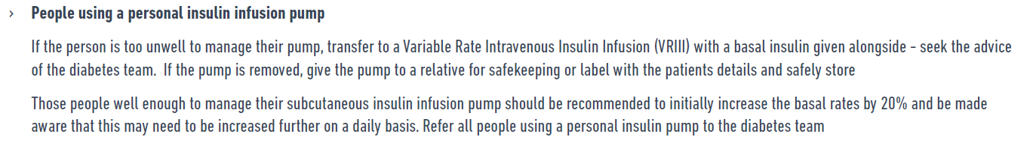
COVID: Diabetes
Dexamethasone in COVID-19 Patients:
Implications and Guidance for the Management of Blood Glucose in People with and without Diabetes

Slide 40
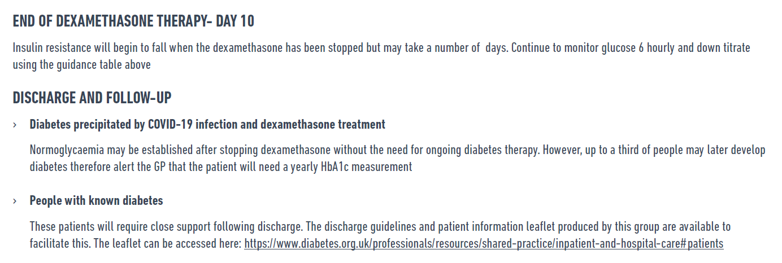
COVID: Diabetes
Dexamethasone in COVID-19 Patients:
Implications and Guidance for the Management of Blood Glucose in People with and without Diabetes

Slide 41
Diabetes Care in the time of COVID- 19
National Diabetes Audit (NDA) and BSOL: main priorities for diabetes care
COVID-19 and the Diabetes Patient: risks for death
Role of SGLT-2- inhibitors: brief review of outcomes for patients
Who to Prioritise in GP Care: Traffic-lights approach
Care Planning: GP Systems and Care
Final Remarks and Conclusions: Questions and Comments
Educational Objectives- to facilitate you to
Be Informed of key statistics in relation to the local NDA
Learn of COVID-19 risk factors for death
Be informed of outcomes that can accrue from SGLT2-I Rx
Become convinced of care planning in Diabetes Care
Ask awkward questions
Reflect on how you can change practice…..?

Slide 42
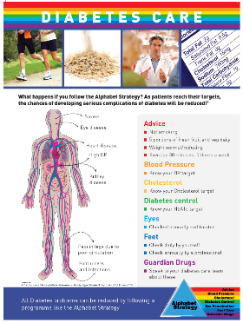

Your Current Local Strategy can be adapted in the Time of COVID-19!
Alphabet Strategy for Diabetes Care: “Checklist”
A Safety “Checklist”, Patient-Centred, Multi-Professional, Evidence-based Approach
Advice:
  Diet and weight control, Physical activity, not smoking, Good Infection Control Measures, Appropriate PPE, COVID-19 Symptoms,
Blood Pressure:
  aim ≤ 140/85,
  CVD or CKD ≤ 130/85
Cholesterol & CKD Prevention
  Most Atorvastatin 20mg or 80mg, TC ≈ 4 mmol/l
  UACR yearly and treat
Diabetes Control:
  HbA1c < 59 (7.5%) usual target, ideal < 48 (6.5%)
  Outcome based Rx: ? SGLT2-i, ? GLP antagonists
  Safer insulins where needed
Eyes:
  check yearly at least
Feet:
  daily self-care, HCP check yearly at least
Guardian Drugs:
  ?Aspirin 75mg (CVD atheroma), ?ACE-i, ARBs (esp CKD, HF, CVD), appropriate SGLT-i
Healthcare Progessional Advice:
  DVLA Advice and Occupation
  Hospital Admission Care
  Contraception Advice where needed
Targets Based on NICE Guidelines, EASD/ADA
Wong ND et al 2014: Am J Cardiol
JD Lee & V Patel 2015: World D J

Slide 43
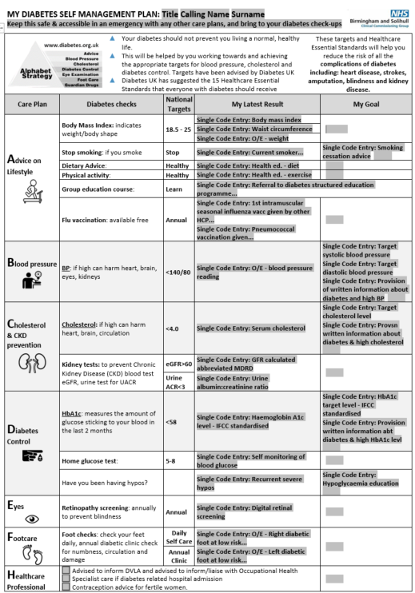


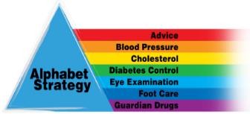
Birmingham and Solihull CCG
My Diabetes Self Management Plan
Works through GP Systems and printable to give or post to patients
Notes:
BSol CCG – My Diabetes Self Management Plan
All delegates will have this in there delegate packs as this slide will not be easily read on the screen
Explain where they can find this on the system and how to use it etc.
Any questions regarding this ?

Slide 44
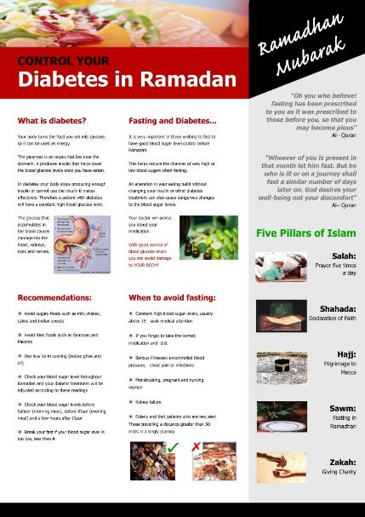
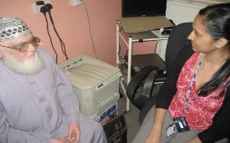
Individualised to the Patient
Ramadan
Cultural Aspects
Specific Care Plans

Slide 45
Ramadan Care Plan
Based on Design by
Alia Gilani
adapted by
Raj Gill
Care plans provide direction for individualized care of the patient.
A care plan flows from each patient's unique list of diagnoses and should be organized by the individual's specific needs. The care plan is a means of communicating and organizing the actions of a Healthcare Team to the patient and their carers.
RCN adapted

Slide 46
Ramadan Care Plan
Based on Design by
Alia Gilani
adapted by
Raj Gill
Care plans provide direction for individualized care of the patient.
A care plan flows from each patient's unique list of diagnoses and should be organized by the individual's specific needs. The care plan is a means of communicating and organizing the actions of a Healthcare Team to the patient and their carers.
RCN adapted

Slide 47

MDT Clinic advice during Ramadan
Kabir Ali
64-year-old, diabetes 16 years, Taxi Driver
Putting on weight- BMI 32.5
Taking:
  Simvastatin 40mg
  Ramipril 10mg od
  Indapamide 2.5 mg od
  Gliclazide 160mg bd
  Metformin 850mg tds
Clinical Data: 146/84, T-Chol 5.2 mmol/l, HbA1c 68mmol/mol = 8.4%, Creatinine 98 umol/l,
eGFR 60ml/min
 | Current Treatment | During Ramadan
Suhoor | Gliclazide 160mg Metformin 850mg Ramipril 10mg od Indapamide 2.5 mg od | Gliclazide 80mg Metformin 850mg
Lunch | Metformin 850mg
Iftar | Gliclazide 160mg Metformin 850mg Simvastatin 40mg | Gliclazide 160mg Metformin 850mg -1000mg Ramipril 10mg od Indapamide 2.5 mg od Simvastatin 40mg ? Stop Gliclazide and start a DPP-4i?
suhoor
iftar
Notes:
47
Patients will need careful follow up during the month of Ramadan but are often reluctant to attend clinic visits as appropriate advice is not given.
Ramadan is an important month in the Islamic calendar and the majority of diabetic Muslims will aim to fast for the full month. Our job is to ensure we can help them achieve their task by providing support and advice so that they may fast safely with few, if any complications

Slide 48
Diabetes Care in the time of COVID- 19
National Diabetes Audit (NDA) and BSOL: main priorities for diabetes care
COVID-19 and the Diabetes Patient: risks for death
Role of SGLT-2- inhibitors: brief review of outcomes for patients
Who to Prioritise in GP Care: Traffic-lights approach
Care Planning: GP Systems and Care
Final Remarks and Conclusions: Questions and Comments
Educational Objectives- to facilitate you to
Be Informed of key statistics in relation to the local NDA
Learn of COVID-19 risk factors for death
Be informed of outcomes that can accrue from SGLT2-I Rx
Become convinced of care planning in Diabetes Care
Ask awkward questions
Reflect on how you can change practice…..?

Slide 49

Sick day rules for avoiding or recognising DKA^{1,2}
There are several classes of drug that should be stopped if the patient is at risk of dehydration due to acute illness:
Signs and symptoms of DKA
Excessive thirst
Polyuria
Dehydration
Shortness of breath and laboured breathing
Abdominal pain
Leg cramps
Nausea and vomiting
Mental confusion and drowsiness
Ketones can be detected on the person’s breath (pear-drop smell) or in the blood or urine
S | SGLT-2 inhibitors | Increased risk of euglycaemic DKA
A | ACE inhibitors | Increased risk of AKI due to reduced renal efferent vasoconstriction
D | Diuretics | Increased risk of AKI
M | Metformin | Increased risk of lactic acidosis
A | ARBs | Increased risk of AKI
N | NSAIDs | Increased risk of AKI due to reduced renal efferent vasoconstriction
ACE, angiotensin converting enzyme; AKI, acute kidney injury; ARB, angiotensin receptor blocker; DKA, diabetic ketoacidosis; NSAID, nonsteroidal anti-inflammatory drug;
SGLT2, sodium-glucose co-transporter 2
How to advise on sick day rules. Available online at https://www.diabetesonthenet.com/journals/issue/457/article-details/how-advise-sick-day-rules. Accessed March 2020
Down S, et al. Diabetes and Primary Care, 2018, 20 (1 ), p 15-16

Slide 50
Vitamin D supplementation to prevent acute respiratory tract infections: systematic review and meta-analysis of individual participant data
Vitamin D supplements
Reduced risk of acute respiratory tract infection approx 12%: adj. OR 0.88, 95% CI 0.81-0.96)
Protective effects were stronger with baseline Vit D levels <25 nmol Approx. 42%: Adj. OR 0.58, 0.40 to 0.82,
Number Needed to Treat, NNT=8, 5 to 21). Not statistically significant effect in > 25nmol/L (adj. OR 0.89)
Conclusions Vit D Supplementation was safe and protected against Acute Respiratory Tract Infection overall. Patients who were very vitamin D deficient experienced the most benefit.
Vitamin D supplementation to prevent acute respiratory tract infections: systematic review and meta-analysis of individual participant data
BMJ 2017; 356 doi: https://doi.org/10.1136/bmj.i6583

Slide 51

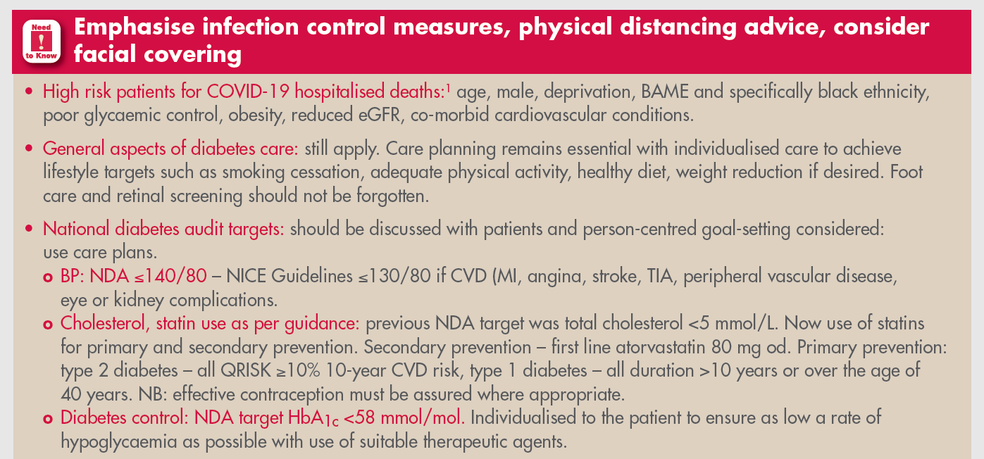

Slide 52
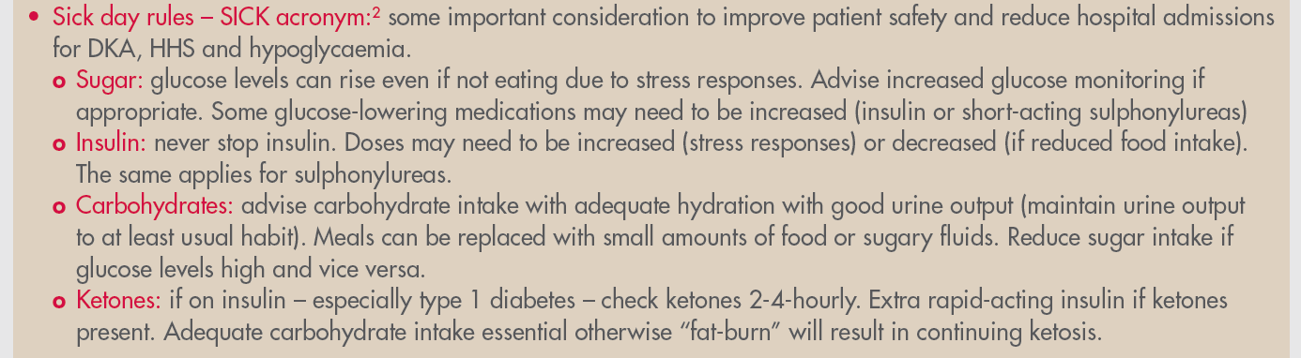
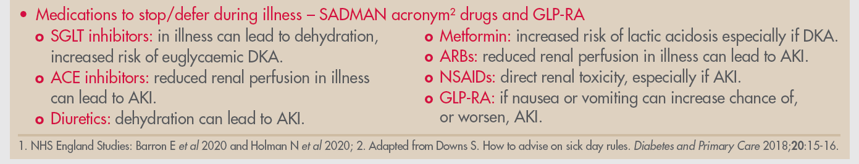

Slide 53
How to undertake a Remote Diabetes Review- A PCDS Quick Guide
Jane Diggle and Pam Brown 2020
Prioritise who to review based on
CVD and COVID-19 risks
Risk Stratification to re-establish Diabetes Care
Searches allow segmentation into manageable-sized cohorts benefitting from early review
High CD Risk: eg not meeting BP, Lipid, HbA1c NDA or, QoF targets, those not on statins
Risk factors for COVID-19 serious morbidity and mortality: Increasing age, BAME, hyperglycaemia, obese
Previous non-attenders or review overdue
On drugs increasing risk: insulins, Sulphonylureas, SGLT2-i
Recently diagnosed
Consider referring those with Type 1 diabetes… with poor control to local specialist
Videos and advice on (Diabetes UK mainly)
Patient Foot Self-examination
Weight. Waist Circumference
Self-monitoring blood glucose
Home BP Monitoring
Healthcare Professionals
Remote Consultations
NHS Guidance
NICE Guidelines
https://youtu.be/kauYqodCx6w
Diggle J, Brown P (2020)
How to undertake a remote diabetes review.
Diabetes & Primary Care 22: 43-5

Slide 54
Diabetes UK: Ipswich Touch Test
Designed by Professor Gerry Rayman and the team at Ipswich Hospital

Slide 55
Guidelines

Slide 56
Factors Associated with COVID-19 Transmission and Mortality

Slide 57
Guidelines

Slide 58
COVID-19 Guidelines
Bengali, Urdu, Gujarati,
Hindi, Punjabi

Slide 59
Diabetes Care in the Time of COVID-19
Key Messages
Diabetes and COVID-19 mortality: distinct increase in mortality. Adjusted for age, sex, deprivation, ethnicity and region: Type 1 DM x 3.50, Type 2 DM x 2.03.
Glycaemic control and COVID-19 mortality: Adjusted Hazard ratio of HbA1c > 86 mmol/mol vs HbA1c 48-53 mmol/mol was 2.19 for T1 DM, 1.62 for T2 DM. T2 DM significant increase > 58 mmol/mol
“Clinical Phenotype” your Patient: to the appropriate glycaemic control agents that fits, for the outcome desired by the patient, advised by the HCP
Beyond age and male gender:
  Ethnicity & COVID-19 mortality: T1 DM: Black 1.79, Asian 1.68, T2 DM: Black 1.63, Asian* 1.09
  Deprivation: T1 DM: IMD 1,2,3 T2 DM: IMD 1,2,3
  Duration of Diabetes: Only T2 DM: greater than 15 years
  eGFR: Less than 60 for both T1 DM and T2 DM
  BMI: T1 DM ≥ 30, T2 DM ≥ 35
Risk Stratification: could help identify diabetes patients, within a clinical service, that need most urgent intervention where services are stretched and working in different ways due to the COVID-19 Pandemic.
NDA targets would be a good starting point.
*esp. Bangladeshi popn. PHE Disparities Report 2020

