Slide 1

Implementing the
GIRFT Recommendations at Your Trust
Diabetes
GIRFT Programme National Specialty Report
by Professors Gerry Rayman and Partha Kar
a resource via the
West Midlands Diabetes Expert Advisory Group (EAG) from
Professor Vinod Patel:
Clinical Director for Diabetes NHS England and NHS Improvement (West Midlands)

Slide 2
Diabetes
GIRFT Programme National Specialty Report by Professors Gerry Rayman and Partha Kar
Diabetes: GIRFT Programme National Specialty Report November 2020
Professor Gerry Rayman and Professor Paths Kar.

Slide 3
Diabetes: GIRFT Programme National Specialty Report
Implementing the GIRFT Recommendations
at Your Trust
Contents
Forward
Background
Main Findings and Evidence for the recommendation
Recommendations with Templates for creating an implementation Plan
Conclusion
Professor Vinod Patel:
Clinical Director for Diabetes NHS England and NHS Improvement (West Midlands)
Diabetes: GIRFT Programme National Specialty Report November 2020
Professor Gerry Rayman and Professor Paths Kar.

Slide 4


Implementing the GIRFT Recommendations in the West Midlands
Forward
The GIRFT Report on Diabetes (2020) has highlighted many areas of good practice in many trusts but clear areas of improvement remain in most trusts. Implementation of the recommendations will serve to improve clinical outcomes, improve clinical efficiency (eg in terms of length of stay as in-patients) and medicines optimisation. The 3 main areas of concern “which offer the most significant opportunities for improvement” were in relation to:
  Type 1 Diabetes
  In-patient Care
  Diabetic Footcare
Especially, in these times of COVID-19, it is imperative that we optimised diabetes care for our patients. One-third (33.2%) of all hospitalised deaths due to COVID-19 were in patients with diabetes. Older age, socio-economic deprivation, male gender, poor glycaemic control, obesity, reduced eGFR, BAME ethnicity and concurrent other co-morbidities were all identified as increased risks for COVID-19 mortality.
I acknowledge the incredible work undertaken and completed by Professor Gerry Rayman and Professor Partha Kar. I have liberally copied the report throughout as pasted PDFs with some retyping, and created templates to facilitate the Diabetes Care Team to start an implementation plan in their own trust. Please do read and digest the full report.
It is very likely that CQC will gather evidence on the implementation of the GIRFT reports within a trust. Not a threat- but an opportunity to shine and improve Diabetes Care!
We can now all try to deliver on the recommendations within the report.
Professor Vinod Patel: Clinical Director for Diabetes NHS England and NHS Improvement (West Midlands)
Diabetes: GIRFT Programme National Specialty Report November 2020
Professor Gerry Rayman and Professor Paths Kar.
Type 1 and Type 2 Diabetes and COVID-19 related mortality in England: a cohort study in people with diabetes.
Holman N et al. Lancet Diabetes Endocrinol 2020; 8: 823–33

Slide 5
Implementing the GIRFT Recommendations in the West Midlands
How to Use this resource – any way you wish! This is just a suggestion/starting point
1. Circulate the Report and Slides to the Diabetes Care Team. This would includes clinicians including some ward staff, managers and patient’s representatives where in place.
2. Consider dividing the team into the 3 main areas of concern:
  Type 1 Diabetes
  In-patient Care
  Diabetic Footcare
3. Convene a meeting- face to face or virtual to discuss the report and an implementation strategy
4. Consider using the format on the next slide- or similar- to have an open discussion about the service specifically in relation to the main three areas of diabetes care stated above. Participants should have read the report ideally.
5. Read through the background information.
6. In the recommendations section, there are templates to collate ideas on implementation. This will help put together ideas from individuals members of the Diabetes Care Team and then allow a formal paper or business plan to be created by management via the responsible manager.
It is very likely that CQC will gather evidence on the implementation of the GIRFT reports within a trust. Not a threat- but an opportunity to shine and improve Diabetes Care!

Slide 6








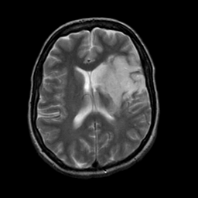
Implementing the GIRFT Recommendations
  Type 1 Diabetes, In-patient Care,
  Diabetic Footcare
Strengths | Weaknesses
1 | 1
2 | 2
3 | 3
4 | 4
5 | 5
6 | 6
7 | 7
Plans/Ideas | Overcoming Barriers
1 | 1
2 | 2
3 | 3
4 | 4
5 | 5
6 | 6
7 | 7

Slide 7
Implementing the GIRFT Recommendations
Background
‘Patient safety must be at forefront of post-COVID care’ says GIRFT diabetes national report
Specialist inpatient teams recommended for every trust to help prevent errors and protect patients
Every hospital should have a specialist team dedicated to caring for inpatients with diabetes to help ensure their safety, according to a new national report.

Slide 8
Implementing the GIRFT Recommendations
Up to 20% of all hospital beds are occupied by patients with diabetes, with the vast majority (92%) admitted for non-diabetes related reasons
The Diabetes Getting It Right First Time (GIRFT) report, published on the eve of World Diabetes Day (14 November 2020) states how uncoordinated inpatient diabetes care and insufficient specialist staffing result in complications for some patients, which leads to increased LoS and risks higher mortality.
The COVID-19 pandemic has further highlighted the need for better inpatient services to ensure patient are safe.
Coordinated inpatient diabetes care is essential to manage treatment in hospital during the pandemic and it is essential for all trusts to consider the safety of these patients in their future plans
In line with the NHS Long Term Plan, Professors Gerry Rayman and Partha Kar outline a series of recommendations to help improve outcomes for patients with diabetes receiving hospital care.

Slide 9
Implementing the GIRFT Recommendations
These include:
Establishing specialist multi-disciplinary diabetes inpatient teams (MDiTs) in every trust, to ensure patients with diabetes are monitored and managed throughout their stay in hospital. 30% currently do not have a MDiT. The aim is to provide a seven-day service for patients.
Training for every healthcare professional who dispenses, prescribes or administers insulin, to help reduce insulin errors in hospital.
An electronic system in every hospital to identify people with diabetes on admission. This will ensure all staff in all hospital departments – from emergency department to operating theatre – are aware of a patient’s diabetes and can treat them accordingly.

Slide 10
Implementing the GIRFT Recommendations
Professor Rayman, who is also co-author of Diabetes UK’s report Making Hospitals Safe for People with Diabetes, said:
“People who come to hospital for reasons other than their diabetes can suffer because their diabetes is not identified, or not effectively monitored or managed through the stages of their care. This can lead to miscommunication, insulin errors and hypoglycaemic events.
“This could be avoided if we work in a more effective way to reduce unwarranted variations and close current gaps in provision.”

Slide 11
Implementing the GIRFT Recommendations
Report also emphasises the need for lifelong support for patients with diabetes and calls for virtual clinics and online reviews to be adopted more widely and permanently.
The COVID-19 pandemic has reinforced the benefits of using technology to help people better manage their diabetes – adopting them in the long term will help the NHS recover services and keep patients safer.
More than 4.0 million people have diabetes in the UK (3.2m in England) and the number of diagnoses has doubled in the past 20 years. If not managed well, diabetes can lead to complications such as amputation, sight loss, kidney failure, stroke, heart disease and death.
The overall spend on diabetes in the NHS is around £11 billion. £2.5bn is spent every year on caring for diabetes inpatients.
Professors Rayman and Kar visited more than 100 trusts as part of their national review, examining data, sharing good practice and noting unwarranted variation.
Professor Kar, who is also the National Specialty Adviser for Diabetes with NHS England, said: “We were encouraged by the openness of colleagues to engage with the process and listen to what the data tells us about variations and areas for improvement.”

Slide 12
Implementing the GIRFT Recommendations
Inpatient safety is emphasised.
15 recommendations also include measures to improve services and psychological support for people living with type 1 diabetes (8% of diabetes patients), including better transition services for young adults to help manage the spike in 19-25-year-olds being admitted to hospital as a result of diabetic ketoacidosis (DKA), and creating equitable access to technology such as insulin pumps, flash glucose monitors and continuous glucose monitors which help keep blood glucose levels stable. There is also a need for both staff and patients to be educated and trained in the use of such technology.
Professor Kar added: “While teams across the country are working exceptionally hard, we found that some services for people living with type 1 diabetes are falling short of what we should expect. Often, type 1 patients do not have the right support to manage their condition throughout their lives, especially during the transition from childhood to adulthood. This means some patients become disengaged with their diabetes which in turn leads to many avoidable harms.
“Thankfully, there are some great examples of good care going on across the country – many of them highlighted in the report – and our focus now is on helping trusts to emulate such good practice.”

Slide 13
Implementing the GIRFT Recommendations
Another theme in the report looks at footcare services.
Diabetes-related ulcers and consequent amputation costs the NHS around £1bn a year and there are 140 foot and toe amputations every week. The GIRFT report recommends every provider should have a multi-disciplinary footcare service (MDFS) in hospitals, integrated with a community-based footcare protection service (FPS) to help prevent ulcers.
Alongside improving patient care, the report outlines opportunities to save up to £117m for the NHS by reducing length of stay, admissions and readmissions.

Slide 14
Implementing the GIRFT Recommendations
The GIRFT diabetes report is welcomed by the charity Diabetes UK. Chief executive Chris Askew said:
“As we continue to navigate the challenges of the pandemic, and while vital services remain under immense pressure, we must not forget that serious conditions – like diabetes – cannot be put on hold. This report, and the recommendations it makes for vital improvements in key areas of diabetes care, speak directly to the concerns of many people living with diabetes.
“The COVID-19 pandemic has disproportionately affected people with diabetes, and has shone a light on the potential impact on care when they are unable to access fully staffed multidisciplinary diabetes inpatient teams, foot protection services, and diabetes specialist nurses. Without action, people with diabetes will – unnecessarily – continue to be at increased risk of serious and life-altering complications. It is vitally important that these recommendations are acted upon as soon possible to ensure that people with diabetes get the best care possible.”

Slide 15
Implementing the GIRFT Recommendations
The Association of British Clinical Diabetologists (ABCD) also supports the report. Chairman Dr Dinesh Nagi said: “The unique aspect of GIRFT is a visit by specialists to specialists enabling valuable challenge, support and dialogue backed up by a common dataset.
“We appear to be on the cusp of a more advanced era for diabetes care – the publication of the GIRFT diabetes report is therefore welcomed and timely.”
13 November 2020

Slide 16
Implementing the GIRFT Recommendations
Executive Summary

Slide 17
Implementing the GIRFT Recommendations
About the Report

Slide 18
Implementing the GIRFT Recommendations
Type 1 Diabetes

Slide 19
Implementing the GIRFT Recommendations
Transition Services for Young Adults

Slide 20
Implementing the GIRFT Recommendations
Technology, Training and Education

Slide 21
Implementing the GIRFT Recommendations
Downloadable technology

Slide 22
Implementing the GIRFT Recommendations
Structured Education

Slide 23
Implementing the GIRFT Recommendations
Inpatient Care

Slide 24
Implementing the GIRFT Recommendations
MDiTs: Multi-disciplinary inpatient teams

Slide 25

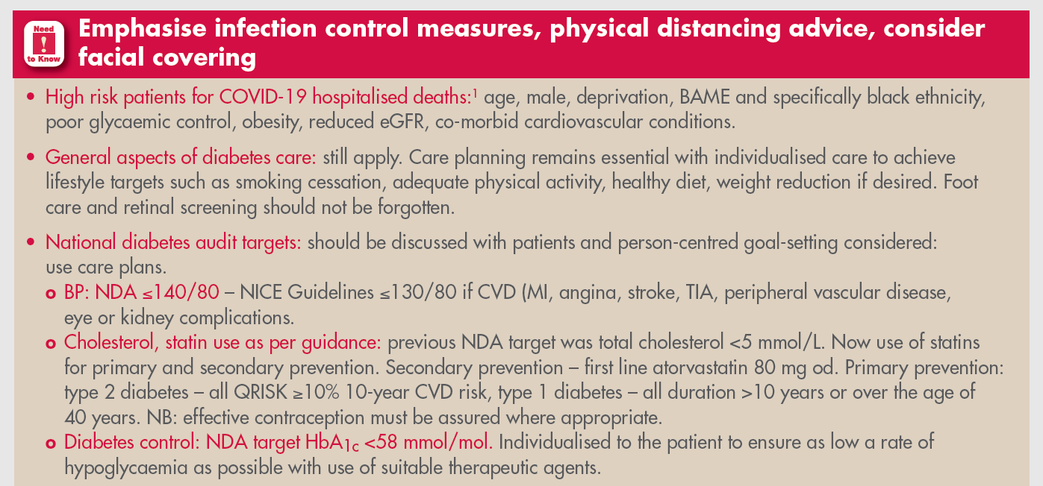

Slide 26
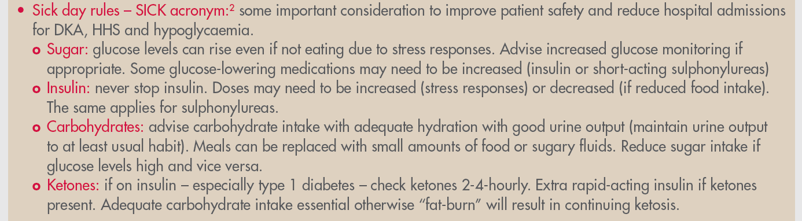
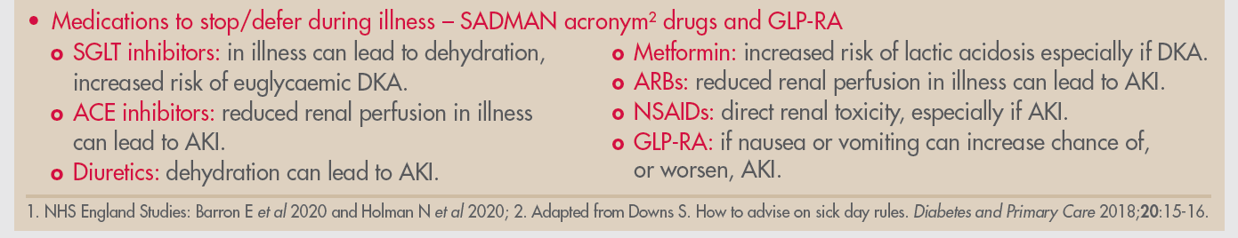

Slide 27
ABCD Recovery Guidance (June 2020)
 | Red | Amber | Green
Recommended Review Date | Review all “Red” patients within 3 months | Review all “Amber” patients by 31.12.2020 | Inform patients in this category that they are unlikely to be seen before early 2021. Provide clear advice on where and how to contact the team for emergency support if things change
Metabolic Control Alternative Measures BP (mm of Hg) | Hba1c 86 mmol/mol (10%) <30% time in range BP>160/100 | 69-86 mmol/mol (8.5- 10%) 30-50% time in range BP 140-160 /100 on suboptimal medication | <64 mmol/mol (8.0%) >50% time in range BP <140/80
Hypoglycaemia Risk | Complete loss of awareness (e.g. Gold score 6-7) Severe Hypos needing 3rd Party assistance in last 12 months | Impaired awareness of hypoglycaemia (e.g. Gold score 4- 5) HbA1c <48 mmol/l on insulin or sulfonylureas. With known frailty, cognitive impairment or eGFR <30ml/min >20% time below 4mmol/l | Normal awareness of hypoglycaemia

Slide 28
ABCD Recovery Guidance (June 2020)
 | Red | Amber | Green
Renal Function | Known CKD level 4 or more (eGFR <30ml/min) Known to diabetes renal service (optimise care and avoid duplication) Rapidly declining renal function (eGFR reduction >15 ml/min/year) | Known CKD 3b (eGFR <45ml/min) or Progressive albuminuria ACR >30 mg/mol
Risk of admission | Admission in the last 12 months with Unstable glucose (DKA/HHS or hypoglycaemia) Cardiovascular ds Cerebrovascular ds Admission with unrelated condition where hypoglycaemia was a major factor | Those with frailty/cognitive impairment needing additional support from their diabetes teams.

Slide 29
ABCD Recovery Guidance (June 2020)
 | Red | Amber | Green
Diabetes Foot status | Known active diabetes foot disease | Known high risk foot disease not known to podiatry services. | No known diabetes foot disease
Other factors | Planning pregnancy in next 6 months | Young patient (age <40yrs) with T1D or T2D with known early complications
Wales recommendations for Triage of people with diabetes post COVID Aug 2020 includes above and additional points:
Red:
Eating disorders, serious mental health issues, Newly diagnosed T1 and T2 diagnosis, Vulnerable groups such as the homeless and those needing glucose optimisation pre –surgery
Amber:
Patients 16-25yrs, Patients with no diabetes review in last 18months, People with a body mass index greater than 30kg/m2 and People in BAME groups.

Slide 30
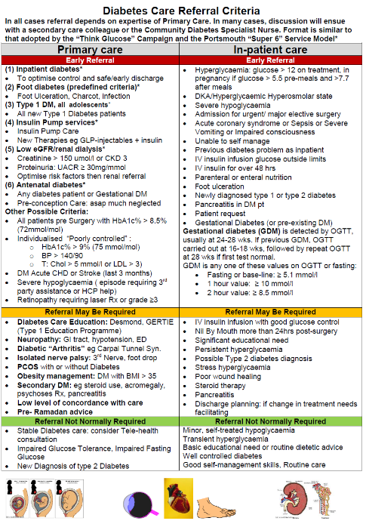

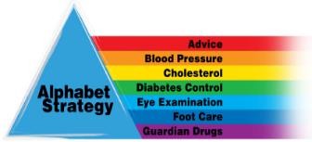
Diabetes Care
Referral Criteria
A Safety “Checklist”, Patient-Centred, Multi-Professional, Evidence-based Approach
Primary Care Referral: All dependent of level of resources and expertise
  Early Referral
  Referred may not be required
  Referral normally not needed
Secondary Care Referral: All dependent on diabetes care expertise
  Early Referral
  Referred may not be required
  Referral normally not needed
  Further version for COVID-19 Pandemic

Slide 31
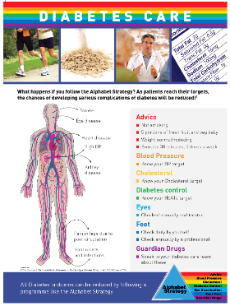

Your Current Local Strategy can be adapted in the Time of COVID-19!
Alphabet Strategy for Diabetes Care: “Checklist”
A Safety “Checklist”, Patient-Centred, Multi-Professional, Evidence-based Approach
Advice:
  Diet and weight control, Physical activity, not smoking, Good Infection Control Measures, Appropriate PPE, COVID-19 Symptoms,
Blood Pressure:
  aim ≤ 140/85,
  CVD or CKD ≤ 130/85
Cholesterol & CKD Prevention
  Most Atorvastatin 20mg or 80mg, TC ≈ 4 mmol/l
  UACR yearly and treat
Diabetes Control:
  HbA1c < 59 (7.5%) usual target, ideal < 48 (6.5%)
  Outcome based Rx: ? SGLT2-i, ? GLP antagonists
  Safer insulins where needed
Eyes:
  check yearly at least
Feet:
  daily self-care, HCP check yearly at least
Guardian Drugs:
  ?Aspirin 75mg (CVD atheroma), ?ACE-i, ARBs (esp CKD, HF, CVD), appropriate SGLT-i
Healthcare Progessional Advice:
  DVLA Advice and Occupation
  Hospital Admission Care
  Contraception Advice where needed
Targets Based on NICE Guidelines, EASD/ADA
Wong ND et al 2014: Am J Cardiol
JD Lee & V Patel 2015: World D J

Slide 32
Implementing the GIRFT Recommendations
Identifying people with diabetes on admission

Slide 33
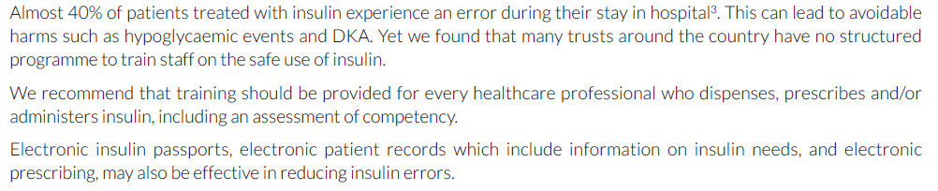
Implementing the GIRFT Recommendations
Reducing Insulin Errors

Slide 34
Implementing the GIRFT Recommendations
Peri-operative Diabetes Care

Slide 35
Implementing the GIRFT Recommendations
Self-management while in Hospital

Slide 36
Implementing the GIRFT Recommendations
Financial Opportunity

Slide 37
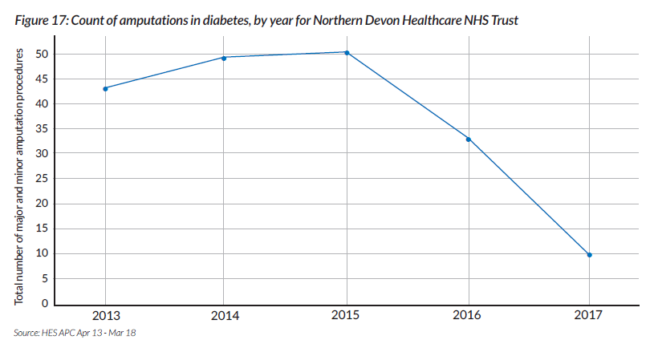
Implementing the GIRFT Recommendations
Diabetic Footcare

Slide 38
Implementing the GIRFT Recommendations
Effective Diabetic Footcare Services

Slide 39
Implementing the GIRFT Recommendations
Vascular Services

Slide 40
Implementing the GIRFT Recommendations
Data and Coding

Slide 41
Implementing the GIRFT Recommendations
Procurement and medicine Optimisation

Slide 42
Implementing the GIRFT Recommendations
Litigation

Slide 43
Implementing the GIRFT Recommendations
  Overview of your service
  Type 1 Diabetes, In-patient Care,
  Diabetic Footcare
Strengths | Weaknesses
1 | 1
2 | 2
3 | 3
4 | 4
5 | 5
6 | 6
7 | 7
Plans/Ideas | Overcoming Barriers
1 | 1
2 | 2
3 | 3
4 | 4
5 | 5
6 | 6
7 | 7

Slide 44

Implementing the GIRFT Recommendations
Type 1 Diabetes

Slide 45
Implementing the GIRFT Recommendations
Type 1 Diabetes
Strengths | Weaknesses
…. …. …. etc | …. …. …. etc
Recommendation | Current Status add narrative | Plans to Deliver add narrative | Key Performance measures | Clinical Lead and Managerial Lead
1: Transition from Paeds to Young Adult Services |  | Next 3 Months By 6 months Within 12 months | 1. 2. 3. etc | 1. 2.
2: Training and Technology
3: Structured Education
4: Systems for Data Download from glucose monitoring

Slide 46
Implementing the GIRFT Recommendations
Inpatient Care

Slide 47
NCEPOD Report
People with Diabetes
undergoing Surgery:
Highs and Lows

Slide 48
NCEPOD Report
People with Diabetes
undergoing Surgery:
Highs and Lows

Slide 49
NCEPOD Report
People with Diabetes
undergoing Surgery:
Highs and Lows

Slide 50
Implementing the GIRFT Recommendations
Inpatient Care
Strengths | Weaknesses
…. …. …. etc | …. …. …. etc
Recommendation | Current Status add narrative | Plans to Deliver add narrative | Key Performance measures | Clinical Lead and Managerial Lead
5: Dedicated In-patient MDT (MDiTs) - MDT and Weekend Cover |  | Next 3 Months By 6 months Within 12 months | 1. 2. 3. etc | 1. 2.
6: Dedicated In-patient MDT (MDiTs) - Errors and Safety Issues remit
7: Identifying diabetes and ensuring rapid referral
8: Reducing Insulin Errors
9: Improving care through peri-operative pathways
10: Supporting self-management in hospital

Slide 51
Implementing the GIRFT Recommendations
Diabetic Footcare

Slide 52
Implementing the GIRFT Recommendations
Diabetic Footcare
Strengths | Weaknesses
…. …. …. etc | …. …. …. etc
Recommendation | Current Status add narrative | Plans to Deliver add narrative | Key Performance measures | Clinical Lead and Managerial Lead
11: All trusts to have MDFS as in NICE NG 19 |  | Next 3 Months By 6 months Within 12 months | 1. 2. 3. etc | 1. 2.
6: Vascular networks: same day assessment by MDFS- including same day vascular assessment if needed, whether hub or spoke. May need transfer

Slide 53
Implementing the GIRFT Recommendations at GEH
Data and Coding

Slide 54
Implementing the GIRFT Recommendations
Inpatient Care
Strengths | Weaknesses
…. …. …. etc | …. …. …. etc
Recommendation | Current Status add narrative | Plans to Deliver add narrative | Key Performance measures | Clinical Lead and Managerial Lead
13: NDA data, ND Inpatient Audit, National Diabetes Footcare Audit |  | Next 3 Months By 6 months Within 12 months | 1. 2. 3. etc | 1. 2.

Slide 55
Implementing the GIRFT Recommendations
Procurement and Medicine Optimisation

Slide 56
Implementing the GIRFT Recommendations
Procurement and Medicine Optimisation

Slide 57
Implementing the GIRFT Recommendations
Procurement and Medicine Optimisation

Slide 58







Regional Medicines Optimisation Committee VP Presentation
Opportunities for Savings and Improved Clinical Outcomes in Diabetes Care
DPP4i Class
Deprescribing
Lowest cost DPP4i - alogliptin.
Combo Products with metformin
Generally not advocated. Local DTC/APCs will need to green light combo drugs
Metformin “free” ? Potential to save ? 10% of £90.8 million in England
DPP4i with SGLT2i- Lina-Empa, Saxa-Dapa
Empa 12.5mg with Metformin is bd, evidence of all benefits with 10mg same as with 25mg od
With Gurpreet Kaur: NHS Sandwell and West Birmingham Commissioning Group

Slide 59
Regional Medicines Optimisation Committee VP Presentation
Opportunities for Savings and Improved Clinical Outcomes in Diabetes Care
Insulins
Biosimilar Insulin: National and some Local edicts on this. Eg 80* within 12 months
Long-acting or no insulin for frail- can reduce District Nurse visits- remit from GP QoF
Safety Needles: Cost-efficient safety needles available now. Use acquisition cost, agree on top choices
Glucose Monitors
Use lowest cost ISO approved meters, also ketone meter
Check validity of testing regime
with Gurpreet Kaur: NHS Sandwell and West Birmingham Commissioning Group

Slide 60
Regional Medicines Optimisation Committee VP Presentation
Opportunities for Savings and Improved Clinical Outcomes in Diabetes Care
 | West Mids | East Mids |  | Midlands Potential
DPP4i Class | 3140k | 3140k |  | 6280K
Metformin Combos | 900k | 900k |  | 1800k
Insulins | 571k | 571k |  | 1142k
Glucose Monitors | Scenario B 777k Scenario C 1.96 m Scenario D 5.13 m | Scenario B 777k Scenario C 1.96 m Scenario D 5.13 m |  | Scenario B 1554k Scenario C 3.92 m Scenario D 10.26 m
Total- year savings | B: 5.387 m C: 6.570 m D: 9.740 m | B: 5.387 m C: 6.570 m D: 9.740 m |  | B: 10.774 m C: 13.140 m D: 19.480 m
Assumptions: Midlands is 20% of England. 10.4 million population
DPP4i: switch to best West Midland Regional
Metformin combos: 10% of metformin spend
Insulins: 80% Semglee switch
Glucose meters: Scenario B (High cost 25%, low cost 75%, Scenario C (High cost 10%, low cost 90%, Scenario D (High cost 10%, low cost 40%. Lowest cost 50%)

Slide 61
Implementing the GIRFT Recommendations
Procurement and Medicines Optimisation
Strengths | Weaknesses
…. …. …. etc | …. …. …. etc
Recommendation | Current Status add narrative | Plans to Deliver add narrative | Key Performance measures | Clinical Lead and Managerial Lead
14: GIRFT, Trust and others to address novel procurement and reduce costs where possible |  | Next 3 Months By 6 months Within 12 months | 1. 2. 3. etc | 1. 2.

Slide 62
Implementing the GIRFT Recommendations at GEH
Reducing Impact of Litigation

Slide 63
Implementing the GIRFT Recommendations
Procurement and Medicines Optimisation
Strengths | Weaknesses
…. …. …. etc | …. …. …. etc
Recommendation | Current Status add narrative | Plans to Deliver add narrative | Key Performance measures | Clinical Lead and Managerial Lead
14: Reduce litigation costs by applying the GIRFT Programmes 5 point plan- (all the recommendations) |  | Next 3 Months By 6 months Within 12 months | 1. 2. 3. etc | 1. 2.

Slide 64
Diabetes: GIRFT Programme National Specialty Report
Implementing the GIRFT Recommendations
at Your Trust
Conclusions- Final Remarks
Implementation of the recommendations will be an on-going process for at least 6 to 2 months in most cases
Clinicians should work closely with their colleagues in management to create business plans and cases to fully implement the recommendations
It will be important to maintain the high standards attained through continuing CPD and succession planning
I would be very grateful if you could share your trials and tribulations with me. I would also appreciate you sharing your reports of good practice to facilitate delivery of these recommendations in other trusts regionally and possibly nationally.
Professor Vinod Patel:
Clinical Director for Diabetes NHS England and NHS Improvement (West Midlands)
vinod.patel@warwick.ac.uk
Diabetes: GIRFT Programme National Specialty Report November 2020
Professor Gerry Rayman and Professor Paths Kar.

