Slide 1
Reducing violence against staff comms toolkit

Slide 2
What is the campaign?
The 2021 NHS Staff Survey for England found that 27.5% of NHS Staff experienced harassment, bullying or abuse from patients, service users, their relatives or other members of the public in the last 12 months.
14.3% of staff responding experienced at least one incident of physical violence, staff in the ambulance service report far higher levels of violence - 31.4% more than double the national average.
We know the damaging impact that violence, abuse and harassment can have on people’s health and wellbeing, affecting both mental and physical health.
This toolkit aims to bring together new public-facing assets which have been produced support NHS teams to reduce abuse and violence against staff featuring real NHS staff.
We recognise that many local organisations will already have, or be planning, campaigns to achieve objectives, and communications and engagement colleagues will be best placed to decide if and how to integrate these resources.
We would strongly recommend a similar ‘norming positive behaviour’ approach to these messages, as this is supported by behavioural science and staff/patient groups. This means encouraging the public to treat our staff with respect rather than emphasising “zero tolerance” messaging

Slide 3
Policy
The NHS Long Term Plan and the NHS People Promise both demonstrate a commitment to the health and wellbeing of NHS colleagues, and violence and abuse toward NHS colleagues is one of the many factors that can have a devastating and lasting impact on health and wellbeing.
The government has now legislated for the maximum prison sentence for common assault to be doubled to two years if the victim is an NHS worker, through the Police, Crime, Sentencing and Courts Bill 2021.
However, we know that we need to focus on prevention rather than prosecution so we are taking action to protect and support all staff through the NHS Violence Prevention and Reduction Standard – a risk based framework to improve staff safety, complementing action taken already by individual employers. This includes:
Investing, £8.4 million in a 3 year trial on the use of body worn video across the 11 Ambulance Services (10 Trusts plus the Isle of Wight Ambulance Service) in England
Investing a further £500K through our work with the Association of Ambulance Chief Executives to develop a central violence prevention hub to improve and better coordinate responses, training and support to staff experiencing violence and abuse across the service, including a review of de-escalation and restraint training
Developing a national NHS Preventing Violence Against Staff Network with over 300 members which aims to bring violence prevention leads together to facilitate the sharing of good practice and evidence-based practice to inform violence prevention activities
Developing a comprehensive programme of education, training and development opportunities to improve understanding and knowledge around violence prevention, advocating a public health, trauma informed approach in line with WHO guidance
Entering in to a joint agreement with His Majesty’s Prison and Probation Service (HMPPS), the National Fire Chiefs Council (NFCC), the National Police Chiefs Council (NPCC) and the Crown Prosecution Service (CPS) to ensure the more effective investigation and prosecution of cases where emergency workers are the victim of a crime
Updating the NHS England » Primary Medical Care Policy and Guidance Manual (PGM) with a new chapter on managing (non-violent) inappropriate and unacceptable patient behaviours, including protecting against discrimination, harassment or victimisation
Developing enhanced health and wellbeing support for our NHS people, including counselling, coaching, text support service, staff mental health and wellbeing hubs, wellbeing apps and more.

Slide 4
Audience and insights
The 2021 NHS Staff Survey for England found that 27.5% of NHS Staff experienced harassment, bullying or abuse from patients, service users, their relatives or other members of the public in the last 12 months.
14.3% of NHS staff responding experienced at least one incident of physical violence, with staff in the ambulance service reporting far higher levels of violence - 31.4%, more than double the national average.
46.8% of staff said that violent attacks at work contributed to them feeling unwell as a result of work-related stress in the last 12 months, with 31.1% thinking about leaving the organisation. (YouGov)
Only 49% of staff said that last time they had experienced harassment, bullying or abuse at work it was reported.
The latest reported data taken from 11 Ambulance Services in England for 2020/21 shows a total of 3,569 physical assaults were recorded, representing a 32% increase in violence over the last five years.
NHS Resolution report that between 2016/17 and 2020/21 there were 2,852 claims made in respect of personal injury to NHS staff, and the cost of claims settled to date is £43.5m.

Slide 5
Key messages (Staff facing)
Last year our staff survey showed that [insert local stat] at [NHS Organisation] had been subject to physical violence from the people they were trying to care for.
We know that you go to work each day to do the very best for your patients, their families and the community.
Being assaulted or abused is not part of your job.
Nationally, only 49% of staff who had experienced abuse last year reported it.
You deserve to work without fear.
Call to action
We encourage you to report all forms of verbal or physical abuse from patients, their families and their friends so that we may support you and so that we may act. (insert local mechanisms here)
Please report any incidents of violence, aggression, bullying or harassment to someone that you trust.
You will be believed, and we will take action.
If you need someone to talk to, we have a confidential text support service that you can access by texting FRONTLINE to 85258 for support 24/7. This service is available to all our NHS colleagues who have had a tough day, who are feeling worried or overwhelmed, or who have a lot on their mind and need to talk it through.
Victim Support operates a free and confidential 24/7 Support line and live chat service, every day of the year - offering specialist support to anyone who has been a victim of crime.
If you don’t know where to go to access NHS support, our free and confidential self-check tool can provide you with further information on the range of support offers that are available to help you identify what option is the right one for you to access. The self-check tool is now available at the following link: self-check tool.

Slide 6
Key messages (public facing)
Last year, our staff survey showed that [insert local stat] at [NHS Organisation] had been subject to physical violence from the people they were trying to care for.
We believe that no member of our staff should have to work in fear.
The NHS is here to help you. Thank you for treating us with respect.
Call to action
We are here to help you.
Thank you for treating us with staff respect.

Slide 7
Key dates
W/c 10 October, updated assets and communications toolkit live on the Campaign Resource Centre
NHS Staff Survey 2022 fieldwork (5 September – 25 November)
NHS Staff survey results (Q1 2023 tbc)

Slide 8
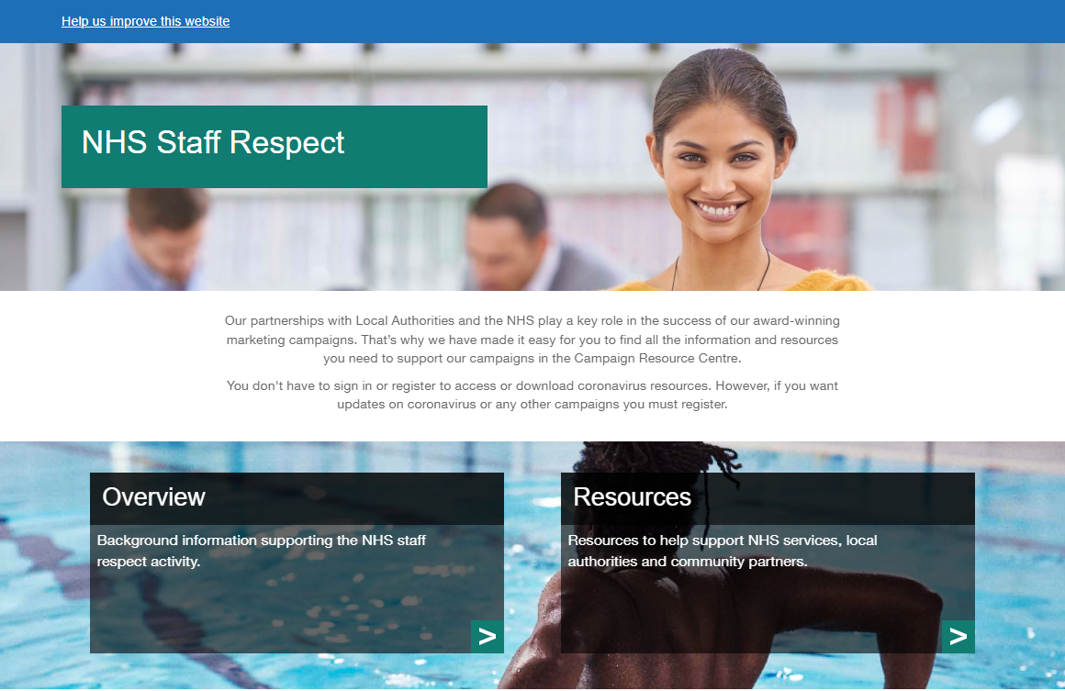
Top ways to help
What three things can communications colleagues do to help?
Share our messages across your channels, particularly on email and staff intranets or staff facing social channels.
Highlight the ways that staff can report abuse and the support available to them, both from within your organisation and from partner organisations.
Download campaign materials and share with colleagues, local communications networks and community organisations
The NHS Staff Survey is the main way to evaluate the impact of messaging around violence and abuse, as there is a standard question on this asked every year. However, you may like to talk to your local staff experience lead about additional ways to measure staff experience (i.e. the NHS People Pulse).

Slide 9
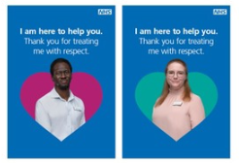
Resources to use
We have created pre-populated assets featuring NHS staff working in a range of different NHS settings:
General Practice
Pharmacy
Optometry
Secondary Care (Hospital)
Dental
They all carry the message ‘We are here to help you. Thank you for treating us with respect’. Assets available are:
Posters featuring groups of NHS staff,
Posters featuring individuals from a range of roles ‘I am here to help you. Thank you for treating me with respect’,
Social media assets featuring alternative groups of NHS staff,
Digital screen featuring groups of NHS staff for waiting room or staff room screens
A poster template is also available that allows NHS primary and secondary care organisations to feature photographs of their own staff and teams with the same messages - please ensure you have the correct consent for this.

Slide 10
Social and traditional media guidance
Your staff facing social media channels may be a good place to profile local case studies featuring staff who have come forward after experiencing abuse. Personal examples work well on these platforms, particularly where you can highlight action has been taken and changes made to your organisation.
Safeguarding considerations:
Please ensure you have the consent of your staff to tell their story and make sure they are clear where and how it will be used
Issues around assault are very sensitive and although some members of staff may feel comfortable sharing their story as part of their recovery process, they may need extra support
Where a legal issue is still under investigation there may be restrictions by law in what you can discuss in public forums
Resources
NHS England runs a confidential text support service that you can access by texting FRONTLINE to 85258 for support 24/7. This service is available to all our NHS colleagues who have had a tough day, who are feeling worried or overwhelmed, or who have a lot on their mind and need to talk it through.
Victim Support operates a free and confidential 24/7 Support line and live chat service, every day of the year - offering specialist support to anyone who has been a victim of crime.
If you don’t know where to go to access NHS support, our free and confidential self-check tool can provide you with further information on the range of support offers that are available to help you identify what option is the right one for you to access. The self-check tool is now available at the following link: self-check tool.
Editors code on reporting crime

Slide 11
Example social media posts
Depending on the make up of your social media following, you may want to use more or less staff facing messaging
Public Facing
NHS staff are here to help you. Thank you for treating us with respect
We have launched a campaign to urge people using local health and care services to treat our staff with kindness and respect. Please remember our teams are here to help you. Thank you for treating us with respect
14.5% of NHS staff in England experienced at least one incident of physical violence from the public in the last 12 months. Please remember, our staff are here to help you. Thank you for treating us with respect.
Your *Pharmacy/Optometry/Dental/NHS* team is here to help you. Thank you for treating us with respect.
Staff Facing:
You deserve to work without fear. Any abuse or violence directed at NHS staff, in whatever setting they work, is unacceptable. We are taking steps to protect you, find out more. [insert link to press release/relevant weblink].
Only XX% of our staff reported violence when it occurred. We know that it can be difficult to come forward after experiencing assault or harassment, We encourage you to report all forms of verbal or physical abuse to some one you trust, You will be believed, and we will take action, you deserve to work without fear.
We have launched a campaign to urge people using local health and care services to treat our staff with kindness and respect. Any abuse or violence directed at NHS staff, in whatever setting they work, is unacceptable. We are taking steps to protect you by [insert specific interventions] We encourage you to report all forms of verbal or physical abuse to some one you trust. You will be believed, and we will take action - you deserve to work without fear.
Image guidance
Always up-to-date image size guide for Twitter can be found here.
Always up-to-date image size guide for Instagram can be found here.
Always up-to-date image size guide for Facebook can be found here
Always up-to-date image size guide for LinkedIn can be found here

Slide 12
Quotes from staff
You may like to share messages, with permission, from your staff about the importance of reporting violence and abuse
“The first time I experienced verbal abuse at work I hadn’t been a qualified nurse very long. The transition from student nurse to qualified takes some time to get used to and to be verbally abused because you weren’t quick enough doing something can really knock your confidence. The first time it happened it made me wonder if I was good enough to be a nurse. The first time I was physically assaulted, I was punched in the face, and this made me question if being a nurse was worth it.”
Having been physically and verbally abused at work I know how much of an impact this has on our teams. Its hurtful and its personal – when someone is commenting about you, your appearance, what they don’t think you are good at or attacking you it’s incredibly personal and something that you take home and you continue to think about. It makes you feel like less of a human. When the opportunity arose to be the operational lead for staff safety at our organisation this was something that I was really keen to be involved in.”
“There are so many reasons why people don’t report incidents of violence or aggression; it’s just part of the job, no one will do anything, I don’t have the time… We need to make sure all of our staff know this isn’t part of the job and it’s not ok.”
Nicola Rose, Divisional Director of Nursing, Planned Care, Chelsea and Westminster Hospital NHS Foundation Trust

Slide 13
Example wording for staff facing message
The 2021 NHS Staff Survey for England found that 27.5% of NHS Staff experienced harassment, bullying or abuse from patients, service users, their relatives or other members of the public in the last 12 months.
We know that you go to work each day to do the very best for our patients, their families and the community.
We, the executive team of (organisation), are speaking with one voice to say that any abuse or violence directed at NHS staff, in whatever setting they work, is unacceptable. We are taking steps to protect you by [insert specific interventions here:]
We want to encourage you to report all forms of verbal or physical abuse from patients, their families and their friends so that we may support you and so that we may act. [insert information about how to report abuse locally]
Above all we want you to know that we appreciate you and thank you for continuing to care for people when they are at their most vulnerable.

Slide 14
Get in touch!
Please do let us know how this activity went!
If you have any feedback or questions about this toolkit or any of the information within it, please contact the strategic communications team at NHS England Strategic.comms@nhs.net
If people have questions or need help – Please get in touch

