Slide 1

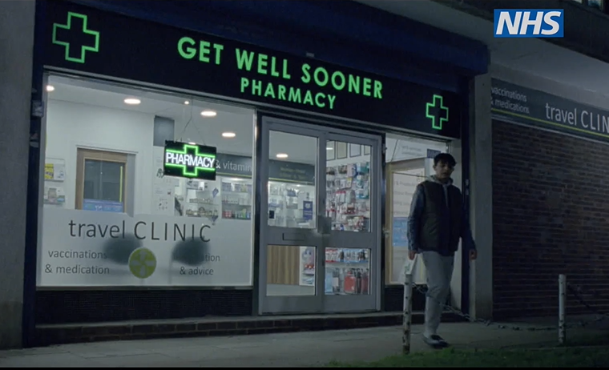
NHS England
Pharmacy First Campaign
CAMPAIGN TOOLKIT
Launch: 20th October 2025
Updated 29 October 2025

Slide 2
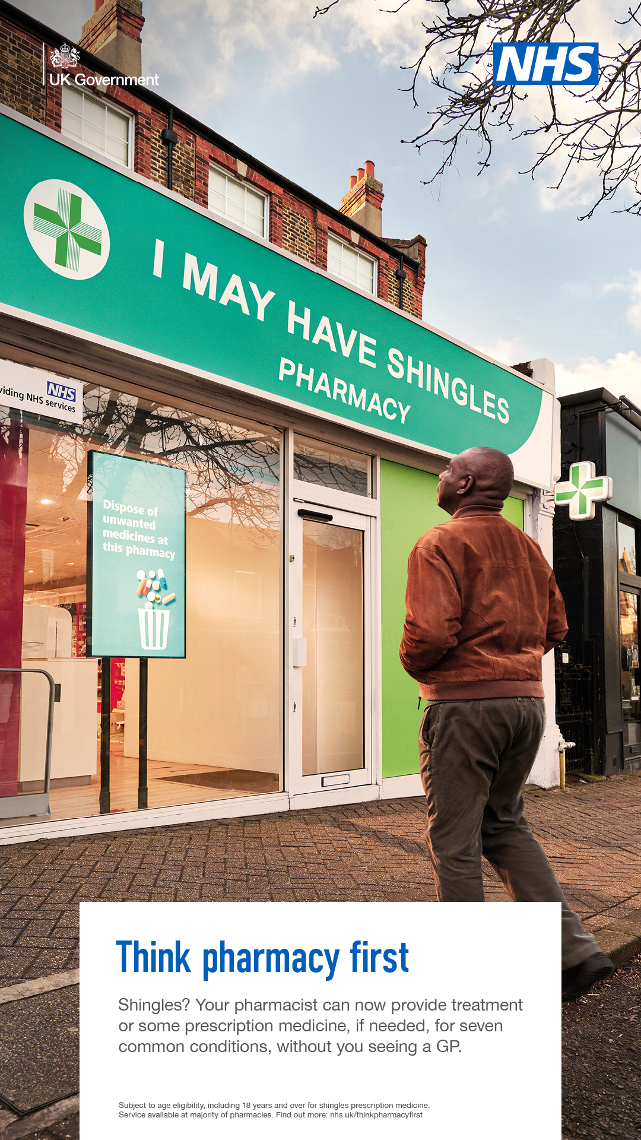
Campaign Overview
NHS England’s community pharmacy campaign will run from 20 October 2025 until 4 January 2026. This campaign ran twice in 2024.
The campaign will build awareness of the support community pharmacists can offer to patients on their doorstep and encourage people to use community pharmacy services for seven common conditions. This will include highlighting the Pharmacy First service that allows pharmacists to provide treatment or some prescription medicine, if needed, for seven common conditions, without needing to see a GP.
Conditions they can offer prescription medicine for are:
sinusitis (aged 12 years and over)
sore throat (aged 5 years and over)
earache (aged 1 to 17 years)
infected insect bites (aged 1 year and over)
impetigo (aged 1 year and over)
shingles (aged 18 years and over)
urinary tract infections (UTIs) (women aged 16 to 64 years)
The campaign will also promote:
The ability to initiate or provide the ongoing supply of oral contraception
The ability to provide the emergency contraceptive pill (morning after pill) for free. And the offer to discuss long-term contraception options with you at the same time.
The campaign will seek to demonstrate how the health service is making it more convenient for people to access care. It will primarily target working age adults (18-40) who may experience minor health conditions. It will also reach ethnic minority people, and those with disabilities, to ensure it is addressing key health inequalities.
The campaign will run for 10 weeks across England, with adverts on TV on Demand, on radio, in public spaces such as bus shelters, as well as adverts on relevant websites and search engines, online videos and paid for social media.
The advertising will be supported by PR and partnership activity until the end of March 2026. This also includes activity targeted to multicultural audiences and engagement with charities and organisations that reach disabled audiences, including people with learning disabilities. Alternative formats, including British Sign Language (BSL) and Easy Read versions of materials, will be available on the campaign resource .
Notes:
This service will enable pharmacists to supply prescription-only medicines, including antibiotics and antivirals where clinically appropriate, to treat seven common health conditions (sinusitis, sore throat, earache, infected insect bite, impetigo, shingles, and uncomplicated urinary tract infections in women) without the need to visit a GP.

Slide 3
Campaign Support
This toolkit includes campaign messages, long and short copy, and links to suggested social media posts to help you support the national campaign.
NHS Pharmacy First campaign resources can be downloaded, free of charge, from the Campaign Resource Centre from 20 October 2025.
You can support the campaign by:
1
Sharing our campaign messages on social media, websites, email, and staff intranets to reach as wide an audience as possible
2
Downloading the campaign resources and sharing these with your colleagues, including local community pharmacies, general practice, local communications networks and community organisations.
≈
3
Identify and share community pharmacy case studies in your region with the NHS England campaigns team for potential involvement in media activities and to support the campaign locally.
If you have any queries about the campaign, please contact the NHS England Campaigns Team: england.campaigns@nhs.net​

Slide 4
Key Messages
Core messaging ​(Seven common conditions)
Your pharmacist can now provide treatment or some prescription medicine, if needed, for seven common conditions, without you seeing a GP
Think pharmacy first and get seen by your local community pharmacy team.
For more information, visit nhs.uk/thinkpharmacyfirst
Core messaging ​(Contraception)
Your pharmacist can now provide you with oral contraception, without a prescription or the need to see a GP.
Your pharmacist can provide you with the emergency contraceptive pill (morning after pill) for free, without you seeing a GP. They can also discuss long-term contraception options with you at the same time.
Think pharmacy first and get seen by your local community pharmacy team.
For more information, visit nhs.uk/thinkpharmacyfirst
Wider messaging​
Conditions pharmacists can offer prescription medicine for are sinusitis (aged 12 years and over), sore throat (aged 5 years and over), earache (aged 1 to 17 years), infected insect bites (aged 1 year and over), impetigo (aged 1 year and over), shingles (aged 18 years and over) and urinary tract infections (UTIs) (women aged 16 to 64 years).
Going to your local pharmacy offers an easy and convenient way to get clinical advice on minor health concerns - you don't need an appointment and you can be seen in a private consultation room.
Community pharmacies are staffed by highly-skilled and qualified health professionals who are trusted parts of local communities:​
All pharmacists train for five years in the use of medicines before they qualify and are also trained in clinically assessing and treating minor illnesses and giving health and wellbeing advice to help people stay well.
Pharmacy technicians are part of the pharmacy team and are also registered health professionals.
Pharmacists have the right clinical training to make sure you get the help you need and can also signpost you to your general practice team, A&E or other relevant local service, where necessary.
Over 10,100 pharmacies (97%+) have opted to deliver the Pharmacy First service and 80% of people live within 20 minutes of a community pharmacy, making it a convenient and quicker way of accessing care.
Notes:
This service will enable pharmacists to supply prescription-only medicines, including antibiotics and antivirals where clinically appropriate, to treat seven common health conditions (sinusitis, sore throat, earache, infected insect bite, impetigo, shingles, and uncomplicated urinary tract infections in women) without the need to visit a GP.

Slide 5
Content (1)
Below are some examples of long and short copy that could be used when communicating with audiences about the campaign. Please use the copy for any newsletters, emails or other materials, including websites, e-bulletins.
LONG COPY
Going to your local pharmacy offers an easy and convenient way to get clinical advice on minor health concerns, and your pharmacist can provide treatment or some prescription medicine, if needed, for seven common conditions, without you seeing a GP
Highly trained pharmacists can assess, treat, and if needed, provide some prescription medicine sinusitis (aged 12 years and over), sore throat (aged 5 years and over), earache (aged 1 to 17 years), infected insect bites (aged 1 year and over), impetigo (aged 1 year and over), shingles (aged 18 years and over) and urinary tract infections (UTIs) (women aged 16 to 64 years), without needing to see a GP.
Your pharmacist can also provide you with oral contraception, without a prescription or the need to see a GP. In addition, your pharmacist can now provide you with the emergency contraceptive pill (morning after pill) for free, without you seeing a GP. They can also discuss long-term contraception options with you at the same time.
Community pharmacy teams are highly-skilled, qualified health professionals who have the right clinical training to give people the health advice they need. Patients don't need an appointment and private consultation rooms are available. Pharmacy teams can also signpost to other relevant local services where necessary.
Pharmacists have always helped patients, families and carers in their communities stay healthy and are well placed to offer treatment for health conditions. By expanding the services community pharmacies offer, the NHS is aiming to free up GP appointments and give people more choice in how and where they access care.
Think pharmacy first and get seen by your local pharmacy team.
For more information, visit nhs.uk/thinkpharmacyfirst

Slide 6
Content (2)
SHORT COPY
Your pharmacist can provide treatment or some prescription medicine, if needed, for seven common conditions, without you seeing a GP
Highly trained pharmacists can assess, treat, and if needed, provide some prescription medicine sinusitis (aged 12 years and over), sore throat (aged 5 years and over), earache (aged 1 to 17 years), infected insect bites (aged 1 year and over), impetigo (aged 1 year and over), shingles (aged 18 years and over) and urinary tract infections (UTIs) (women aged 16 to 64 years), without needing to see a GP.
Your pharmacist can also provide you with oral contraception, without a prescription or the need to see a GP. In addition, your pharmacist can now provide you with the emergency contraceptive pill (morning after pill) for free, without you seeing a GP. They can also discuss long-term contraception options with you at the same time.
Available at the heart of local communities, community pharmacy teams have the right clinical training to give people the health advice they need, with no appointment necessary and private consultations available. Community pharmacists will signpost patients to other local services where necessary.
Think pharmacy first and get seen by your local pharmacy team.
For more information, visit nhs.uk/thinkpharmacyfirst

Slide 7


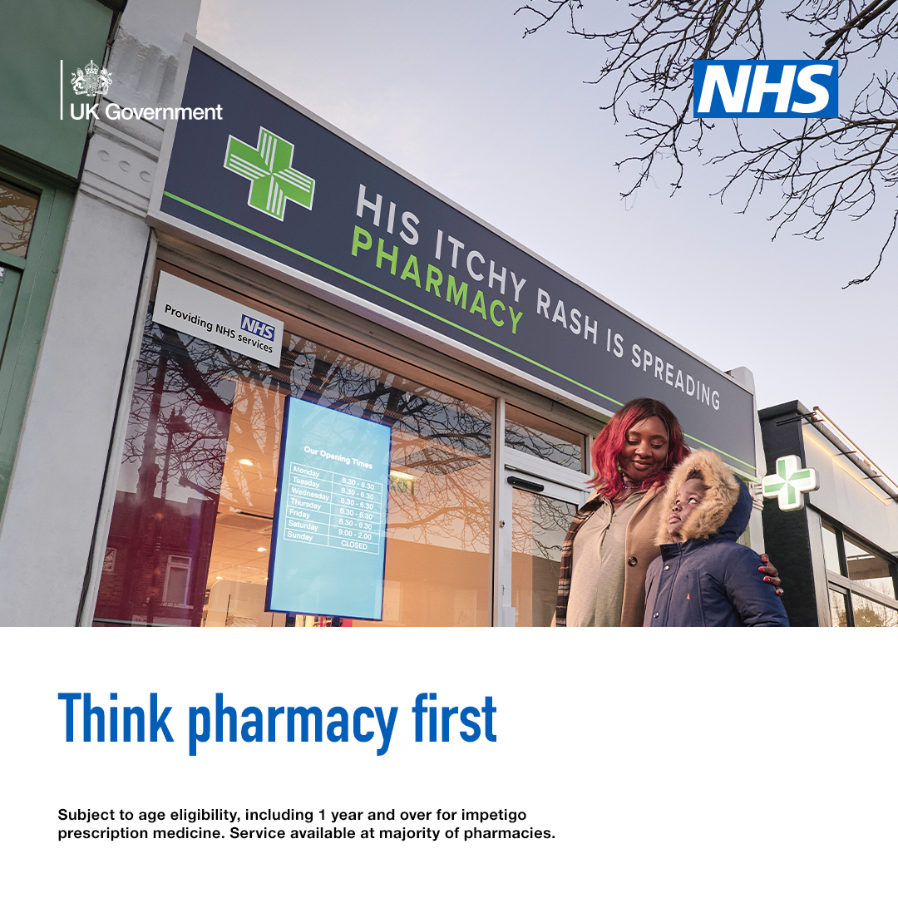
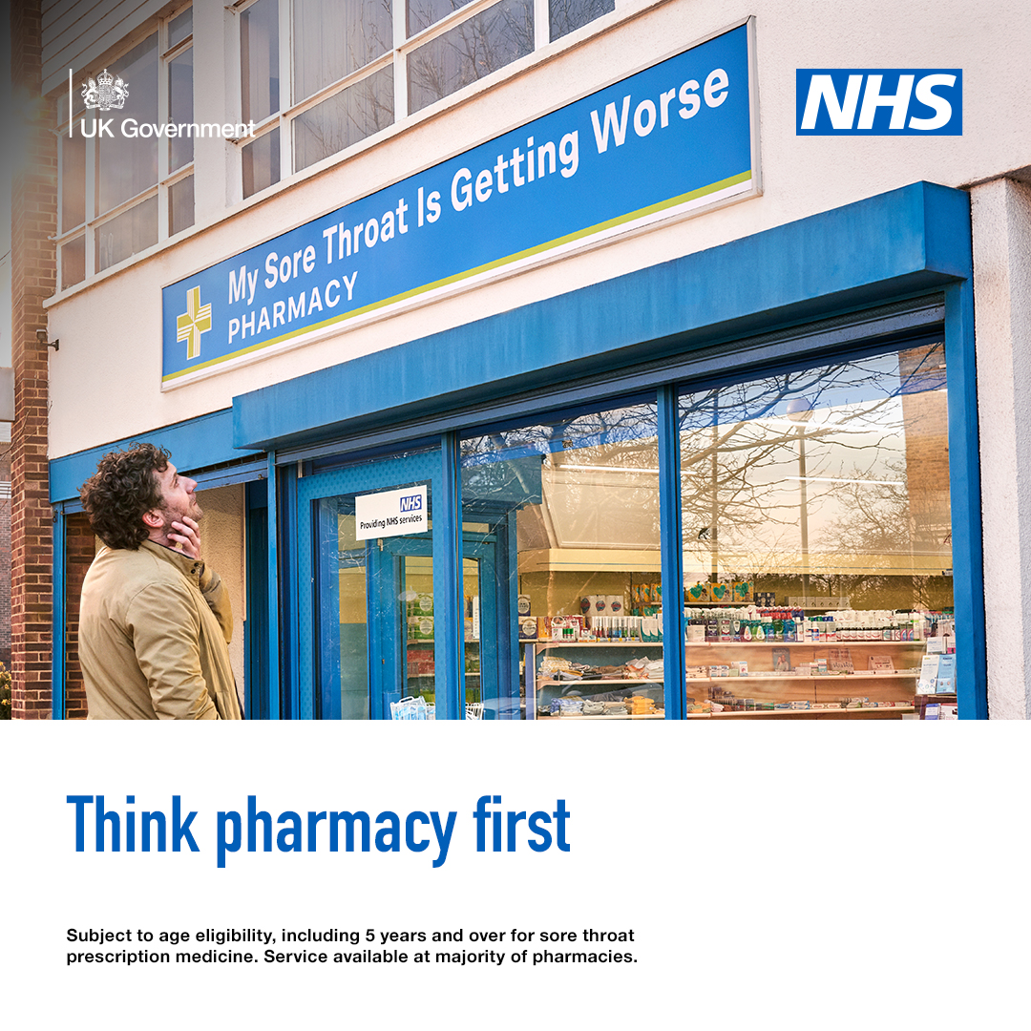
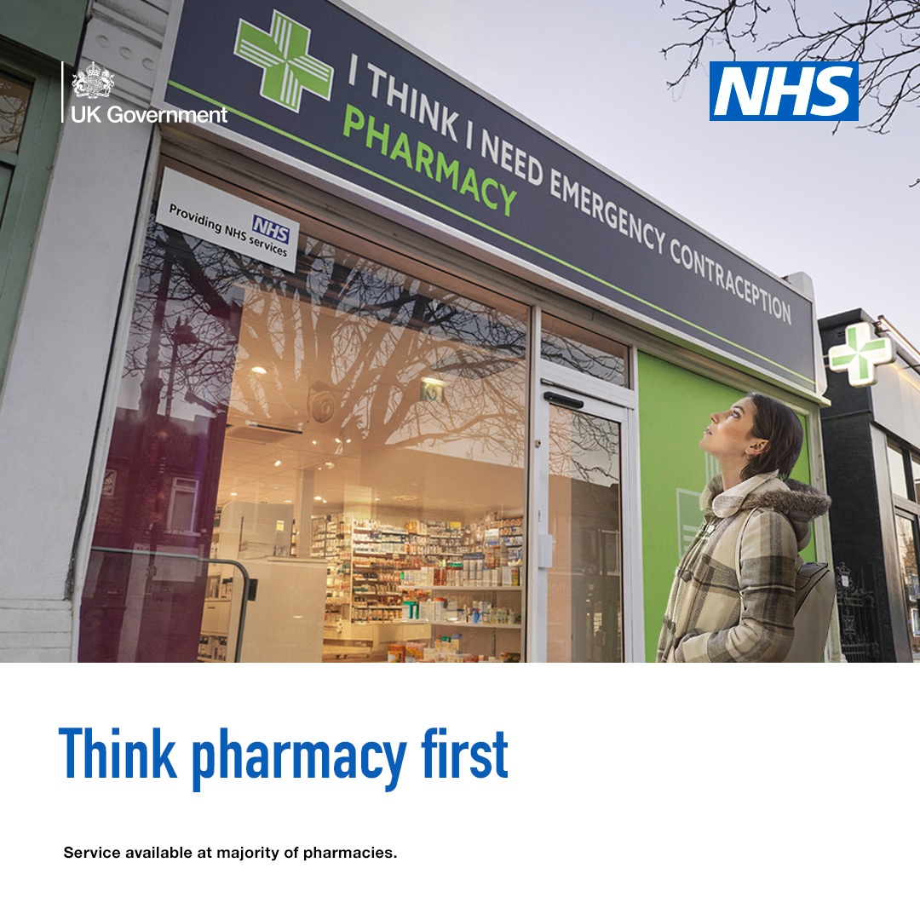

Social media
We will amplify the reach of the campaign by posting content across NHS media channels including X (formerly known as Twitter), Facebook and Instagram, Snapchat, and Reddit.
Please help us get the message out there by using your social media channels to support the campaign.
Social media assets (videos and static images, some examples below) along with recommended accompanying post copy is available on the Campaign Resource Centre [Social media | Think Pharmacy First | Campaign Resource Centre (dhsc.gov.uk)]

Slide 8
Evaluation - Measurement
NHS campaign activity is evaluated in line with the Government Communications Service (GCS) Evaluation Framework 2.0.
It is important that we monitor and evaluate all our campaign activities effectively to show how campaigns contribute towards successful policy outcomes, providing clear evidence of impact and value for money.
The GCS Evaluation Framework 2.0 provides a structure for a monitoring and evaluation plan including outputs, out-takes, outcomes and organisational impact that you can apply to your local activity.
It recommends standard evaluation measures that you can use to:
develop SMART (Specific, Measurable, Attainable, Relevant, Time-bound) communication objectives and Key Performance Indicators (KPIs)
use evaluation to improve the effectiveness of all communication and campaign activity
More information can be found via:
Monitoring and evaluating government communications activity - GCS (civilservice.gov.uk)

Slide 9
NHS England
Expansion of community pharmacy clinical services
Communications toolkit Updated 29.10.2025

Slide 10
Communications activity
This communications toolkit has been developed to help regional and local NHS communications teams promote existing and new community pharmacy services.
Please continue to support the Pharmacy First campaign (which runs from 20 October – 4 January), to help raise awareness of how patients can get treatment for seven common conditions directly from a pharmacy, without the need for a GP appointment or prescription. Communications materials can be accessed and downloaded from the Communications Resource Centre. As part of the Community Pharmacy Contractual Framework (CPCF) 2025/26, pharmacy contractors are required to take part in two national health campaigns promoting Pharmacy First to the public, and two local health campaigns agreed by ICBs and Local Pharmaceutical Committees at a local level. Colleagues can use these materials for their own promotional activity.
From 29 October, two services available from community pharmacies have been expanded. Please can teams promote and target key messages by using the communications materials provided in this toolkit to relevant public and professional audiences. The expansions are:
The emergency contraceptive pill (oral emergency contraception) being made available free of charge in pharmacies across England that are providing the NHS Pharmacy Contraception Service
Pharmacists providing the NHS New Medicine Service to offer extra support to those newly prescribed antidepressants.
If you have any questions, please contact the primary care communications team at NHS England on: pccs.communications@nhs.net

Slide 11
Background notes
NHS Pharmacy Contraception Service expanded to include the emergency contraceptive pill
The emergency contraceptive pill (oral emergency contraception) is available free of charge in pharmacies across England that are providing the NHS Pharmacy Contraception Service.
The emergency contraceptive pill was already free from most GPs and sexual health clinics, but not all pharmacies were able to offer it for free, with some women paying up to £30 for the medication. Making it available free of charge has ended variation across the country. Find out more or find a participating pharmacy: Find Pharmacy Services - NHS.
NHS New Medicine Service expanded to include medicines for depression
The NHS New Medicine Service allows community pharmacists to provide structured support to patients and carers, helping them manage newly prescribed medicines for eligible conditions, such as asthma and hypertension, and make shared decisions about their care.
The service is intended to support patients in a person-centred manner, and to complement and inform the shared decision-making process about taking a new medicine. This is of particular importance for people seen under the service for depression.
This service also provides an opportunity to promote lifestyle changes or other non-pharmacological interventions to enhance well-being.
The service is provided either in-person or over the phone, and takes place over three conversations, usually during the first several weeks after the medicine is started.
Community pharmacists providing the NHS New Medicine Service will now be able to offer extra support to adults aged 18 years and over newly prescribed most common antidepressants (citalopram, escitalopram, fluoxetine, paroxetine, sertraline, duloxetine and mirtazapine) to treat depression.

Slide 12
Key messages – emergency contraceptive pill
Bulletin copy for professionals and stakeholders (137 words):
Community pharmacies can provide the emergency contraceptive pill free of charge
Community pharmacies can provide the emergency contraceptive pill (oral emergency contraception) free of charge as part of the expanded NHS Pharmacy Contraception Service.
This means that more women can access the emergency contraceptive pill for free from community pharmacies without needing to see their GP or having to get an appointment at a sexual health clinic. This can be provided by pharmacists and pharmacy technicians, and teams should also discuss long-term contraception options with patients, as appropriate. This move helps to make healthcare more convenient and closer to people's homes, with four in five people living a 20-minute walk from their local community pharmacy.
Further information, including updated service specification and patient group directions for the expanded NHS Pharmacy Contraception Service are available on NHS England's website.

Slide 13
Key messages – emergency contraceptive pill
Bulletin copy for patients (88 words):
Emergency contraceptive pill available free of charge from your local pharmacy
Your local pharmacist can provide the emergency contraceptive pill, also known as 'the morning after pill', for free, without having to see a GP or having to get an appointment at a sexual health clinic. They can also discuss long-term contraception options with you at the same time. Find out more or find a participating pharmacy on the NHS.uk website.
This makes healthcare more accessible and convenient, with four in five people living a 20-minute walk from their local community pharmacy.

Slide 14
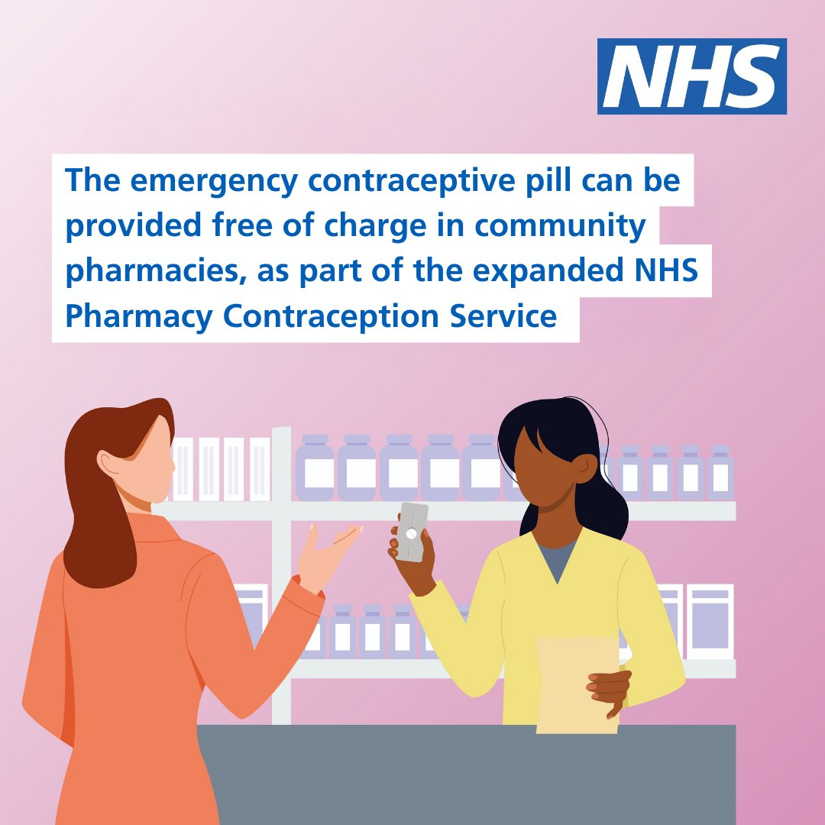
Resources – emergency contraceptive pill
Please help us get the message out there by using your social media channels to support the campaign:
Social media assets along with recommended accompanying post copy is available:
Profession-facing:
Post 1:
🏥 There's now a national service to provide the emergency contraceptive pill free of charge from community pharmacies
Making healthcare more convenient for patients and closer to people's homes
For more info: https://www.england.nhs.uk/primary-care/pharmacy/pharmacy-services/nhs-pharmacy-contraception-service/
Post 2:
The emergency contraceptive pill can be provided free of charge in community pharmacies, as part of the expanded NHS Pharmacy Contraception Service
For more information, including the updated service specification and patient group directions: https://www.england.nhs.uk/primary-care/pharmacy/pharmacy-services/nhs-pharmacy-contraception-service/
Notes:
Add Ian’s images when ready

Slide 15
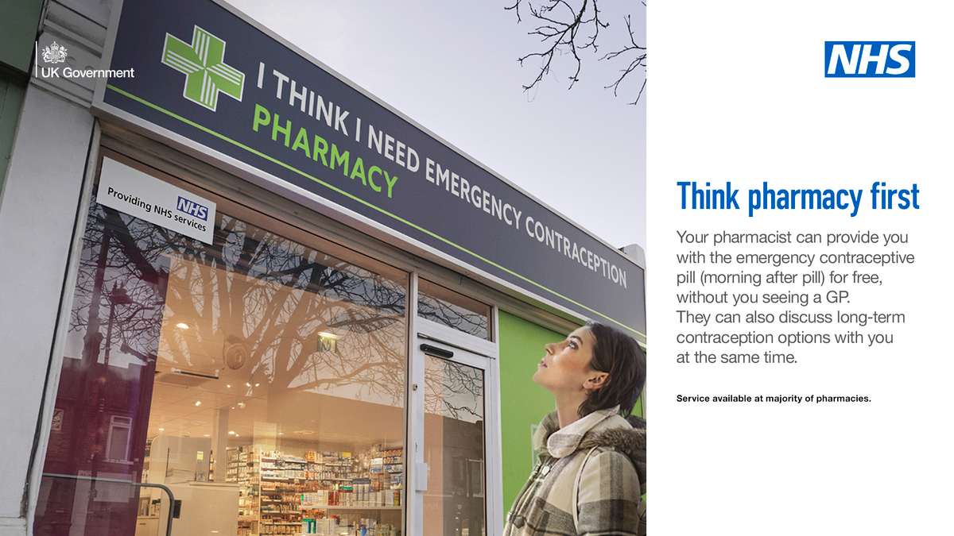
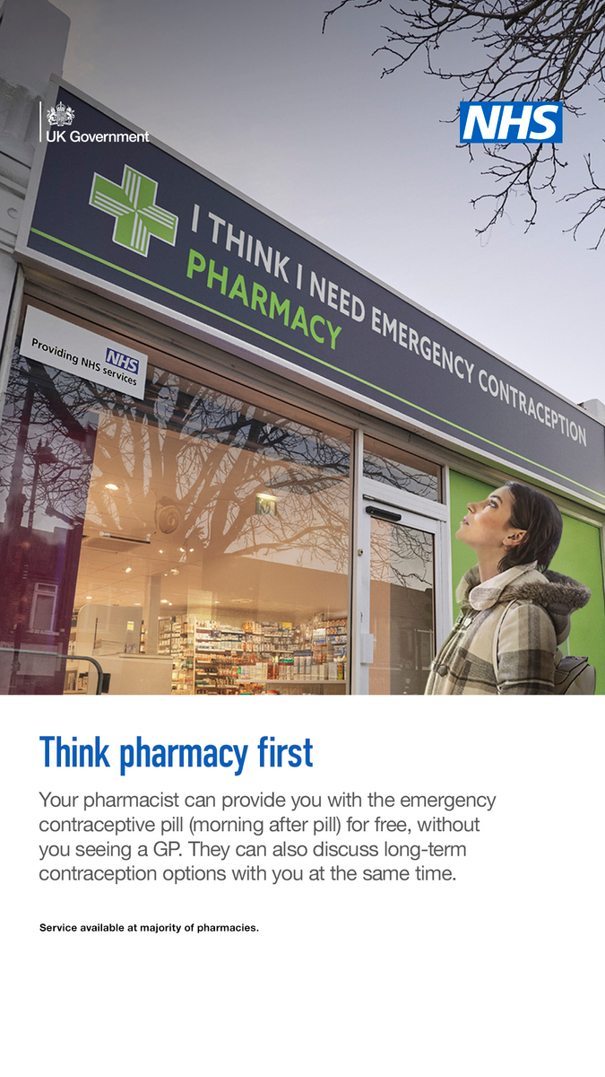
Resources – emergency contraceptive pill
Please help us get the message out there by using your social media channels to support the campaign:
Public-facing:
Post 1:
💊 If you need the emergency contraceptive pill, your local community pharmacy can provide this at no cost
They can also talk through long-term contraception options with you at the same time
Find a participating pharmacy: https://www.nhs.uk/service-search/sexual-health-services/find-emergency-contraception/
Post 2:
💊 If you think you need the emergency contraceptive pill - 'morning after pill' - you can access this from your local pharmacy free of charge
You can also discuss long-term options at the same time
Find a participating pharmacy: https://www.nhs.uk/service-search/sexual-health-services/find-emergency-contraception/
Notes:
Add Ian’s images when ready

Slide 16
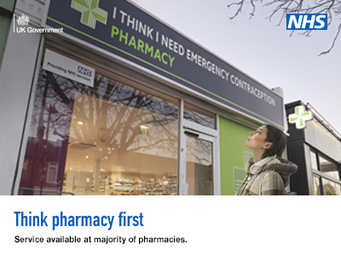
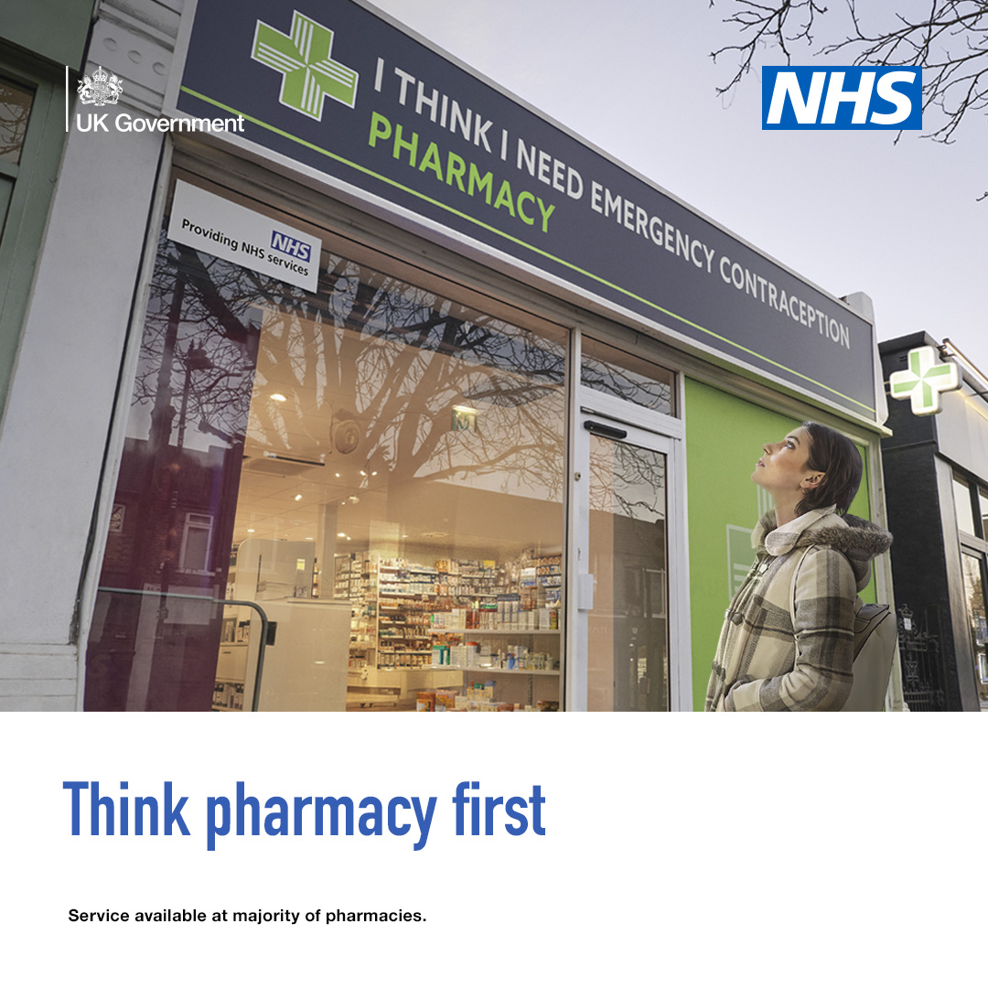
Resources – emergency contraceptive pill
Please help us get the message out there by using your social media channels to support the campaign:
Public-facing:
NHSUK Instagram (4x5) | If you need the emergency contraceptive pill, you can get it free from pharmacies across England — without needing an appointment with your GP or at a sexual health clinic. Search ‘find emergency contraception NHS’ to find your nearest participating pharmacy.
NHSUK Facebook and X (4x5 or 1x1) | If you need the emergency contraceptive pill, you can get it free from pharmacies across England — without needing an appointment with your GP or at a sexual health clinic. Pharmacists can provide advice and support. Find your nearest participating pharmacy: https://www.nhs.uk/service-search/sexual-health-services/find-emergency-contraception/
NHSUK Instagram story (9x16) | Text on link sticker: Find your nearest participating pharmacy URL: https://www.nhs.uk/service-search/sexual-health-services/find-emergency-contraception/
Notes:
Add Ian’s images when ready

Slide 17
Resources – emergency contraceptive pill
Please help us get the message out there by using your social media channels to support the campaign:
Social media assets along with recommended accompanying post copy is available:
LinkedIn – (profession-facing):
Community pharmacies can provide the emergency contraceptive pill free of charge
Community pharmacies can offer the emergency contraceptive pill (oral emergency contraception) can be provided free of charge as part of the expanded NHS Pharmacy Contraception Service.
This means that women can access the emergency contraceptive pill for free from community pharmacies without needing to see their GP or having to get an appointment at a sexual health clinic. This can be provided by pharmacists and pharmacy technicians, and teams should also discuss long-term contraception options with patients, as appropriate.
Further information can be found on NHS England's website including updated service specification and patient group directions.

Slide 18
Key messages – NHS New Medicine Service
Bulletin copy for professionals and stakeholders (209 words):
NHS New Medicine Service expanded to support patients newly prescribed medication for depression
The NHS New Medicine Service (NMS) provided by community pharmacists has been expanded to include medicines for depression.
This means that adults who are newly prescribed the most common antidepressants will be able to seek additional advice and support about their medicine, healthy lifestyle changes, and help to understand their treatment options, from their local pharmacist.
This support can be provided either in-person or over the phone, and takes place over three conversations, usually during the first several weeks after the medicine is started.
Pharmacists are reminded that the service should be used to identify instances where continuing with the prescribed medicine is not tolerated, desired, and/or clinically appropriate and refer patients back to the prescriber. This includes cases where, in their professional judgement, a change to the prescribed medicine may be required including discontinuation.
The NMS Eligible Drug List and NMS service specification have been updated. A range of learning resources are also available to support effective service delivery, and the CPPE online training module 'consulting with people with mental health problems' has been included as a requirement in the 2025/26 Pharmacy Quality Scheme. More information is available on the NHS England and NHS.uk websites.

Slide 19
Key messages – NHS New Medicine Service
Bulletin copy for patients (171 words):
If you have been newly prescribed antidepressants, your local pharmacist can offer additional advice and support
If you have been newly prescribed antidepressants and want more information about them, or if you're worried about how they're working, you can discuss this with your local community pharmacist.
You can do this when collecting your medicine or arrange a dedicated conversation, so you don't have to wait until your next GP appointment to discuss your medication concerns. If needed, the pharmacist can refer you back to your GP practice.
Local pharmacists can provide adults aged 18 and over with additional advice and support about their medicine and healthy lifestyle changes. Further information about this service can be found on the NHS.uk website. The additional flexibility of pharmacy opening times means you’ll be able to fit your visit round your life or arrange a convenient time to speak over the phone.
By making this available at local pharmacies, it will be easier for people to get the advice and information they need closer to home.

Slide 20
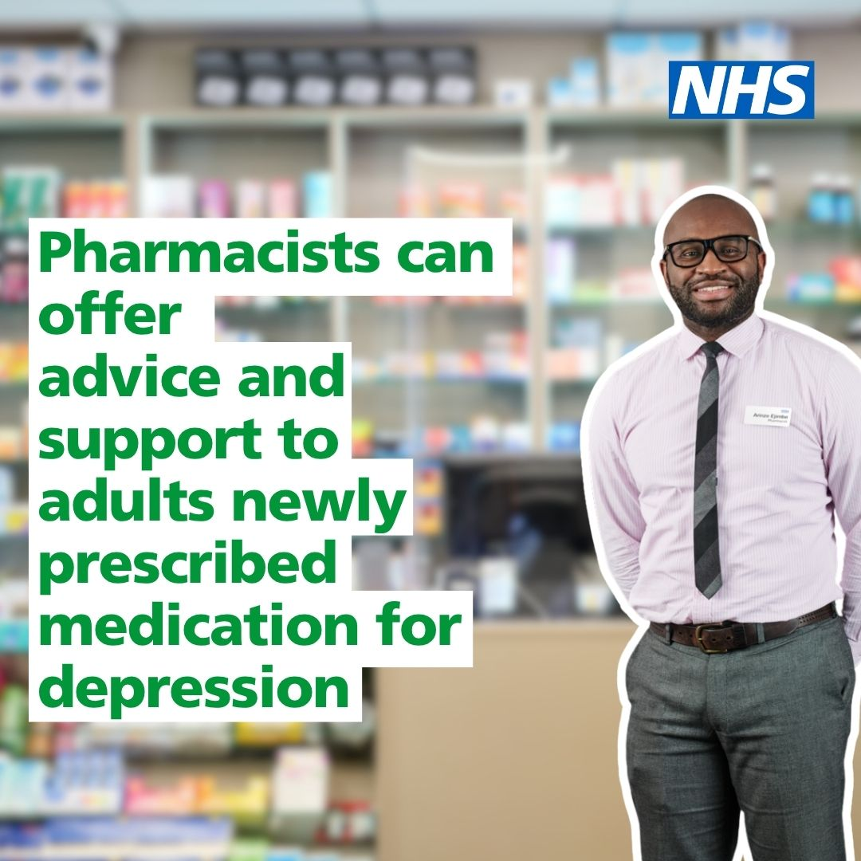
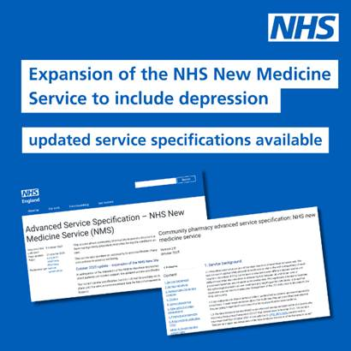
Resources – NHS New Medicines Service
Please help us get the message out there by using your social media channels to support the campaign:
Social media assets (videos and static images, some examples below) along with recommended accompanying post copy is available for X:
Profession-facing
Post 1:
The NHS New Medicine Service has been expanded to include medicines for depression
Adults who have been newly prescribed the most common antidepressants can seek additional advice about their medicine from their local pharmacist
Find out more: https://www.england.nhs.uk/primary-care/pharmacy/pharmacy-services/nhs-new-medicine-service/
Post 2:
The NHS New Medicine Service has been expanded to include medicines for depression
Community pharmacy teams delivering this should read the updated service specification:
https://www.england.nhs.uk/publication/advanced-service-specification-nhs-new-medicine-service-nms/
Notes:
Profession facing:
The New Medicine Service has been expanded to include depression medication
Community pharmacists can now provide additional guidance and follow-up support when you start antidepressant treatment.
#NewMedicineService #CommunityPharmacy

Slide 21
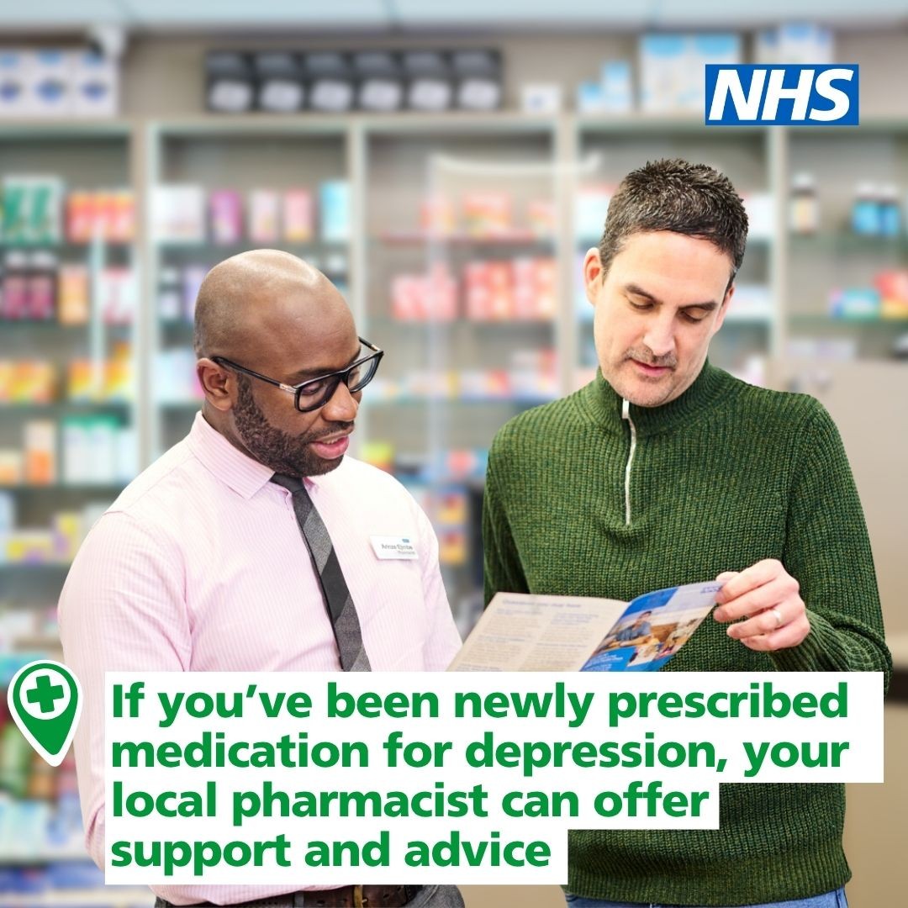
Resources – NHS New Medicine Service
Patient-facing:
Post 1:
If you've been newly prescribed antidepressants, your local pharmacist can offer additional advice and support about your medicine
Available in-person or over the phone, so you can access support in a convenient way
For more information: https://www.nhs.uk/nhs-services/pharmacies/get-help-with-newly-prescribed-medicines/
Post 2:
Your local pharmacist is here to help you with your newly prescribed antidepressant medicine🤝
They can offer information and advice on your medicine, and any concerns you might have, in-person or on the phone
For more information: https://www.nhs.uk/nhs-services/pharmacies/get-help-with-newly-prescribed-medicines/
Notes:
Profession facing:
The New Medicine Service has been expanded to include depression medication
Community pharmacists can now provide additional guidance and follow-up support when you start antidepressant treatment.
#NewMedicineService #CommunityPharmacy

Slide 22
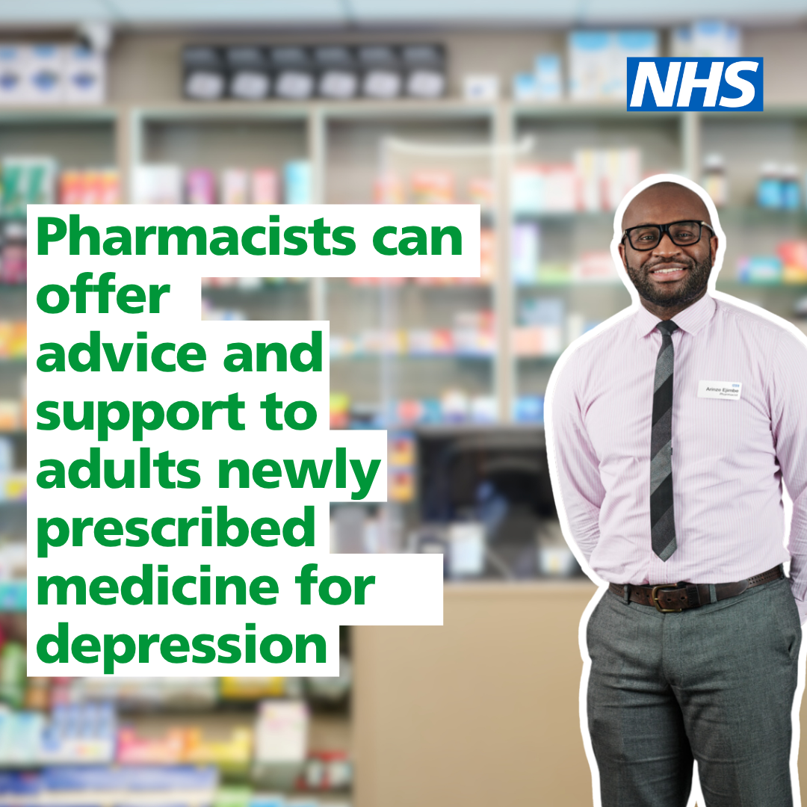
Resources
Please help us get the message out there by using your social media channels to support the campaign:
LinkedIn (profession-facing):
NHS New Medicine Service expanded to support patients starting medication for depression
The NHS New Medicine Service (NMS) provided by community pharmacists has been expanded to include medicines for depression.
This means that adults aged 18 and over who are newly prescribed the most common antidepressants will be able to seek additional advice and support about their medicine, healthy lifestyle changes, and help to understand their treatment options, from their local pharmacist.
This support can be provided either in-person or over the phone, and takes place over three conversations, usually during the first several weeks after the medicine has started.
Pharmacists are reminded that the service should be used to identify instances where continuing with the prescribed medicine is not tolerated, desired, and/or clinically appropriate and refer patients back to the prescriber. This includes cases where, in their professional judgement, a change to the prescribed medicine may be required including discontinuation.
More information is available on the NHS England and NHS.uk websites.

Slide 23
Key messages – combining
Bulletin copy for professionals and stakeholders (222 words):
Community pharmacy services expanded to include the emergency contraceptive pill and medicines for depression
Community pharmacies can offer the emergency contraceptive pill (oral emergency contraception) free of charge as part of the expanded NHS Pharmacy Contraception Service.
This means that women can access the emergency contraceptive pill for free from community pharmacies without needing to see their GP or having to get an appointment at a sexual health clinic. This can be provided by pharmacists and pharmacy technicians, and teams should also discuss long-term contraception options with patients, as appropriate. Further information, and updated service specification and patient group directions for the expanded NHS Pharmacy Contraception Service are available on NHS England's website.
In addition, the NHS New Medicine Service (NMS) provided by community pharmacists has been expanded to include medicines for depression.
This means that adults who are newly prescribed the most common antidepressants will be able to seek additional advice and support about their medicine, healthy lifestyle changes, and help to understand their treatment options, from their local pharmacist. The NMS Eligible Drug List and NMS service specification have been updated. More information is available on the NHS England and NHS.uk websites.
These moves helps to make healthcare more convenient and closer to people's homes, with four in five people living a 20-minute walk from their local community pharmacy.

Slide 24
Key messages – combining
Bulletin copy for patients (104 words):
Expanded health services now available at your local pharmacy
Your local pharmacy can provide the emergency contraceptive pill, also known as 'the morning after pill', for free, without you having to see a GP or having to get an appointment at a sexual health clinic. They can also discuss long-term contraception options at the same time. You can find further information, or a participating pharmacy on the NHS.uk website.
If you have been newly prescribed antidepressants and want more information about them, or if you're worried about how they're working, you can discuss this with your local community pharmacist. You can do this when collecting your medicine or arrange a dedicated conversation. More information including eligibility can be found on the NHS.uk website.
Four in five people live a 20-minute walk from their local community pharmacy. These services make healthcare more accessible and convenient for patients, bringing support closer to home.

Slide 25
Case studies
Where possible, please identify examples of pharmacies delivering these services well and showcase them across your channels.
Examples of how case studies for the contraception service have been used:
NHS England » Case study: Pharmacy contraception service – growing people’s confidence in local NHS care
NHS England » Case study: Community pharmacy contraception service – involve your whole team for success
A new service offering oral contraception through pharmacies has already saved over 1,000 hours of GP time » Joined Up Care Derbyshire
NHS England — Midlands » Over 17,000 women visit local pharmacy for oral contraception in the East Midlands as service marks its first anniversary
NHS Derby and Derbyshire 💙 on X
NHS England — North East and Yorkshire » Blog : 12 months of the NHS Pharmacy Contraception Service – from emergency to long-term supply

Slide 26
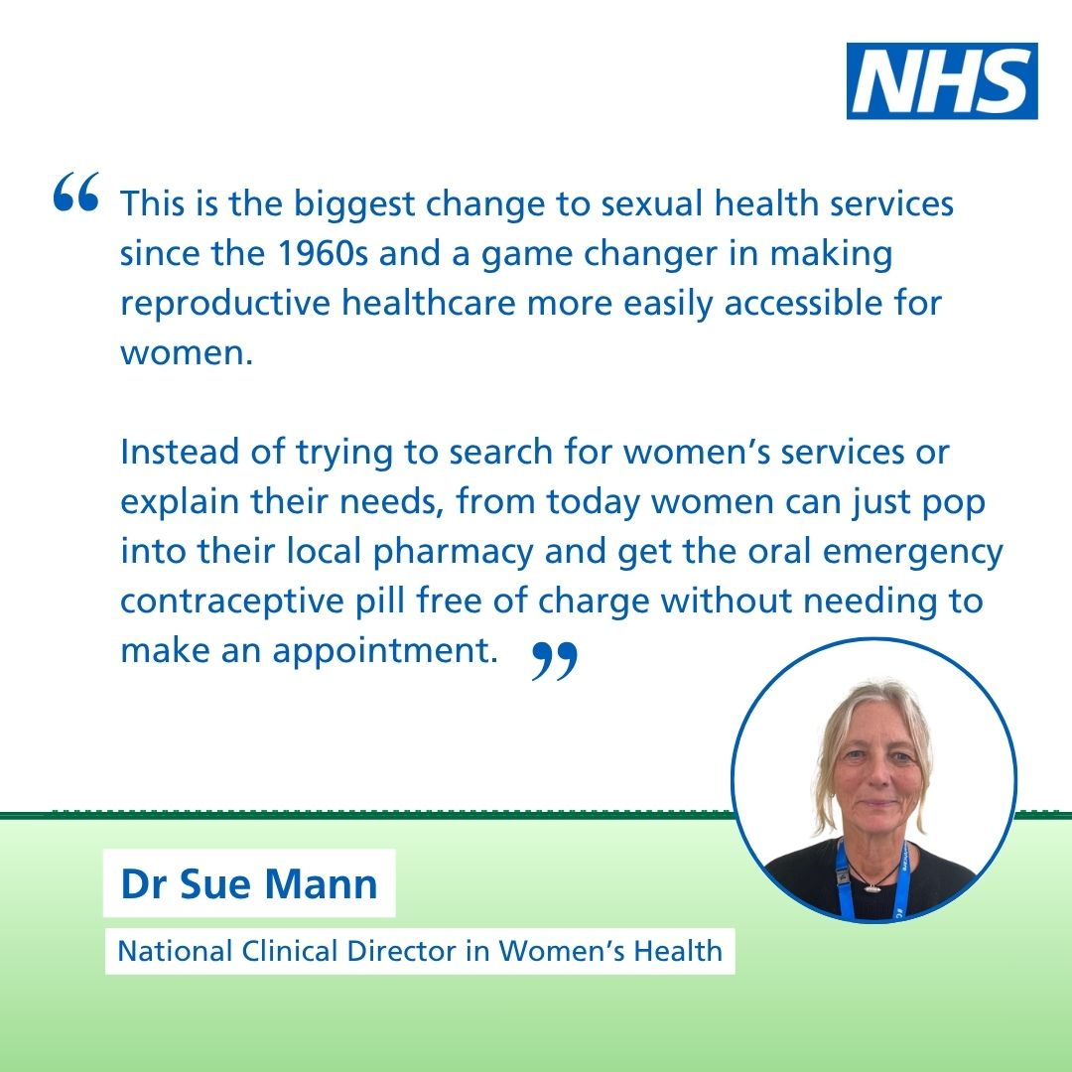
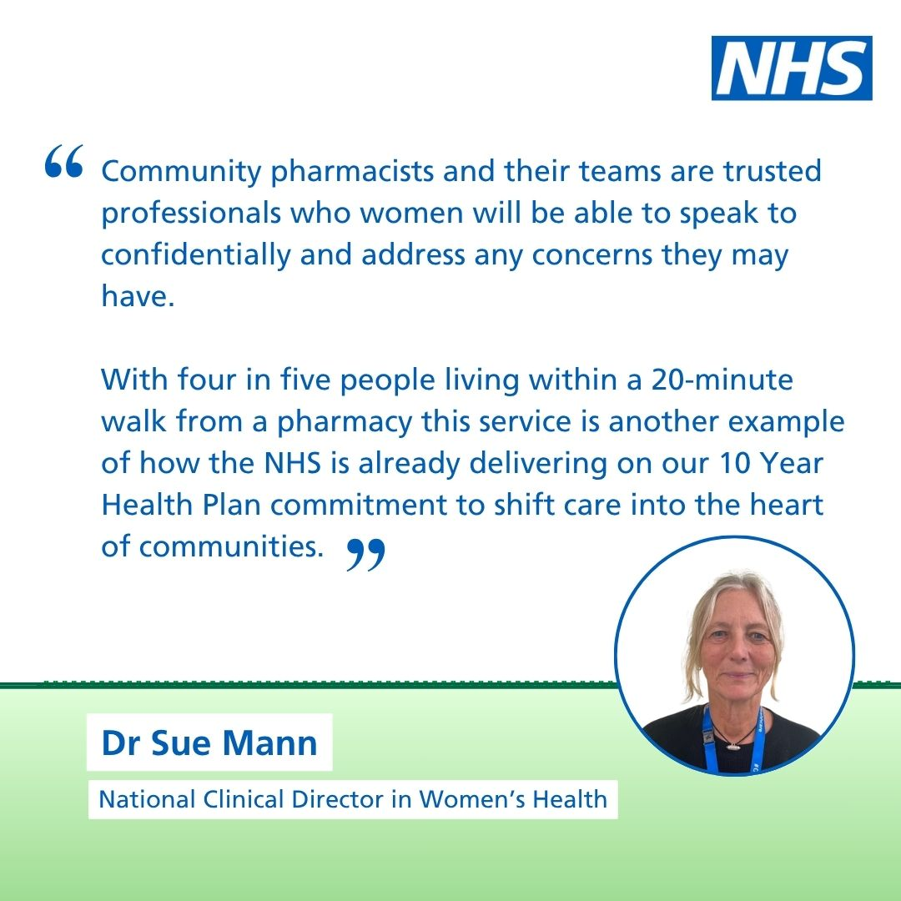
Resources
The press notice is available on NHS England's website: NHS England » Free ‘morning after pill’ for women at high street pharmacies thanks to NHS expansion
Social media cards are available to help further promote the press notice and key leader quotes:

