Slide 1

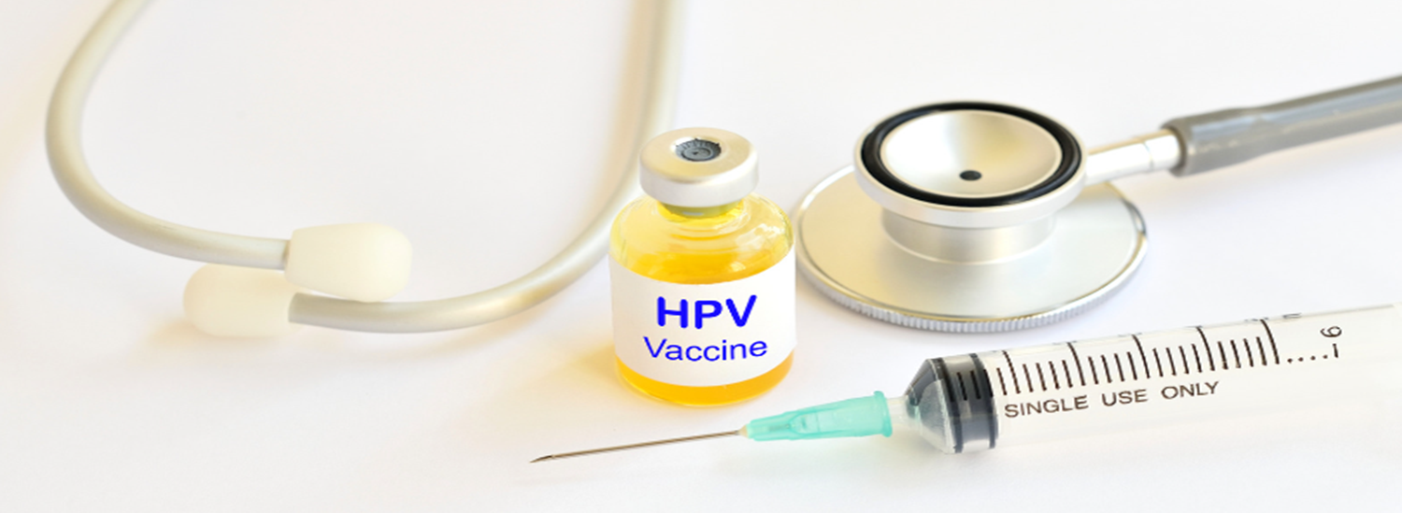
Improving human papillomavirus (HPV) vaccine uptake:
A toolkit of information and resources for general practice
Published March 2025 Version 2.0 Review date March 2026
With thanks to Surrey and Sussex Cancer Alliance who developed the toolkit

Slide 2



Contents
This toolkit aims to provide health professionals in general practice with information and resources on HPV vaccination that can be used to improve local uptake and help prevent HPV-related cancers and diseases.
Introduction to the HPV vaccine
Benefits of HPV vaccination
Who is eligible for HPV vaccination?
Cohort 1: Children aged 12-13 (school year 8)
Cohort 2: Girls under 25 and boys born after 1 September 2006 who missed their vaccine at school
Cohort 3: GBMSM and other at-risk individuals (up to 46th birthday)
How can general practice help?
Ardens and HPV
Resources for healthcare professionals
Patient facing resources

Slide 3

Human papillomavirus (HPV) is a common sexually transmitted infection that can lead to various cancers and other diseases.
The human papillomavirus (HPV) is usually a symptom-free virus.
There are more than 100 types of HPV. Some can cause warts and verrucae, but “high-risk” types of HPV can cause changes to DNA, increasing the risk of certain cancers.
HPV vaccines became part of the routine vaccination schedule in 2008 for school-age girls and the programme was extended to include boys in 2019. A programme for gay, bisexual and other men who have sex with men (GBMSM) was introduced in 2018.
The HPV vaccine used in the NHS vaccination programme is called Gardasil 9 and targets nine types of HPV, which protect against oral, throat, cervical, vulval, vaginal, penile and anal cancers and genital warts.
For most individuals, only one dose of HPV vaccine is now needed to offer protection.

Slide 4
Benefits of HPV vaccination
Vaccination against HPV has proven effective in reducing the rates of cervical cancer (UK Health Security Agency). A 2021 study found that cervical cancer rates were reduced by almost 90% in women in their 20s in England, who were offered the vaccine aged 12-13 (Falcaro et al. 2021).
Additionally, it is one of the key pillars alongside cervical screening and pre-cancer treatment to help achieve the NHS ambition to eliminate cervical cancer by 2040.
Other benefits include
Prevention of HPV-related cancers (anal, penile, oropharyngeal, vulval, and vaginal)
Reduction in genital warts
Herd immunity (reducing overall circulation rates of HPV in the community)
Prevention of transmission
Protection against recurrent respiratory papillomatosis
Cost-effectiveness (reducing the burden of HPV-related diseases)

Slide 5
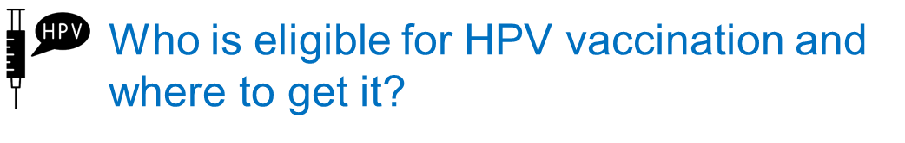
 | Eligible population | Where to get the vaccine
Cohort 1 | Children aged 12 to 13 (school year 8) | Secondary school (or community clinics for those not in school)
Cohort 2 | Girls aged 14 up to their 25th birthday and boys born after 1 September 2006 up to their 25th birthday who missed having the vaccine at school | Via the school vaccination team or GP surgery
Cohort 3 | Gay, bisexual and other men who have sex with men (GBMSM) and other at-risk individuals (up to 46th birthday) not previously vaccinated | Sexual health clinic or HIV clinic

Slide 6





Cohort 1: Children aged 12-13 (school year 8)
Children aged 12 to 13 years
The HPV vaccine is routinely recommended for children in school year 8, for children aged 12 to 13 years old, see Immunisation schedule for further guidance).
This cohort normally receive their vaccination as part of the school-age immunisations programme delivered by school-age immunisation services in the East Midlands which also offer catch-up opportunities in school and via community clinics.
EM SCHOOL AGED IMMUNISATION SERVICE (SAIS)
LINCOLNSHIRE | lhnt.sais@nhs.net Tel: 01522 572950
LEICESTERSHIRE | lpt.sais@nhs.net Tel: 0300 3000 007
NORTHAMPTONSHIRE | Imms.nhft@nhs.net Tel : 0800 170 7055 (option 5)
DERBY AND DERBYSHIRE | immunisations.derbyshire@intrahealth.co.uk Tel: 03333583397 Option 5
NOTTS AND NOTTINGHAMSHIRE | immunisations.nottinghamshire@intrahealth.co.uk Tel: 03333583397 Option 4
Education and resources
Ctrl+Click on the images below for further information and promotional materials.

Slide 7
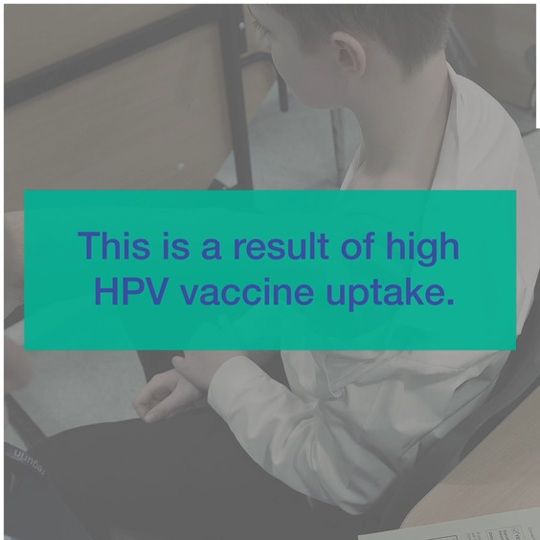
Cohort 2: Girls aged 14 up to their 25th birthday and boys born after 1 September 2006 up to their 25th birthday who missed having the vaccine at school
Girls aged 14-24 and boys born after 1 September 2006 who missed having the vaccine at school
If the routine HPV vaccine delivered through the school's programme is missed:
Girls remain eligible to receive the HPV vaccine up to their 25th birthday
Boys who were born on/after 1 September 2006 are eligible up until their 25th birthday
For individuals who started but did not complete their vaccination before reaching the age of 25 years, the vaccination course should be completed where possible as per the vaccination schedule
HPV vaccine should also be offered to eligible individuals coming into the UK if they have not been offered vaccination in their country of origin
For individuals who are immunosuppressed see Green Book chapter 18a
This cohort can receive their HPV vaccination via the school vaccination team or GP surgery.
Education and resources
Ctrl+Click on the images below for further information and promotional materials.

Slide 8
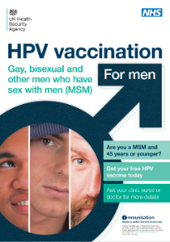

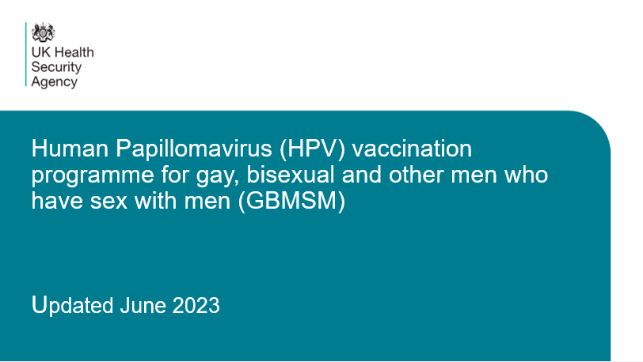
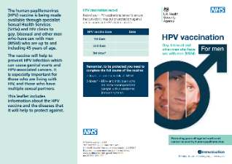
Cohort 3: GBMSM and other at-risk individuals (up to 46th birthday)
GBMSM and other at-risk individuals (up to 46th birthday)
Gay, bisexual and other men who have sex with men (GBMSM), up to and including 45 years old, who attend specialist sexual health services, are eligible for HPV vaccination if they have not previously been vaccinated.
Other eligible at-risk individuals include some transgender individuals, sex workers, and men and women living with HIV infection (See Green Book chapter 18a).
Under 25s in this cohort should be offered a single dose of HPV vaccine*
GBMSM who have already received at least one dose before their 25th birthday are considered to have completed their vaccination course and do not require further doses
GBMSM aged 25 years and older (up to and including 45 years) should continue on the 2 dose HPV vaccination schedule*
* unless immunosuppressed or known to be living with HIV – 3 doses are required
This cohort can receive their HPV vaccination at a sexual health clinic or HIV clinic.
Education and resources
Ctrl+Click on the images below for further information and promotional materials.

Slide 9
How can general practice help?
The national uptake ambition for the school-age HPV vaccination programme is 90% but the national uptake is less than pre-pandemic levels and there is a way to go to meet this target – see figures below for your local area.
2023/24 HPV vaccination uptake by ICB
ICB | Girls (dose 1 ) | Boys (dose 1)
Derby and Derbyshire | 72.1% | 65.3%
Leicester, Leicestershire and Rutland | 69.9% | 64.8%
Lincolnshire | 71.3% | 65.1%
Northamptonshire | 75.6% | 74.2%
Nottingham and Nottinghamshire | 68.4% | 61.7%
England | 72.9% | 67.7%
Reference: UK Health Security Agency - HPV vaccine coverage 23/24 Human papillomavirus (HPV) vaccine coverage estimates in England: 2023 to 2024 - GOV.UK
You can help by offering opportunistic* catch-up HPV vaccination to 14 to 24-year-olds who have missed their school-age vaccine.
*opportunistic vaccinations can be triggered by:
Patient request (following a review that they are eligible)
Identification of gaps in a patient’s vaccination record upon presentation of an unrelated issue or other key points e.g. new patient registration.
If a patient is missing HPV, there is opportunity to check if they are missing other eligible vaccinations (e.g. MenACWY, Td/IPV, MMR) and administration would attract the relevant fee
For each eligible HPV vaccination dose delivered, a £10.06 item of service fee is payable under the General Medical Service Contract. For more information click here.

Slide 10
How can general practice help? Incomplete Immunisation Lists
Practices will receive a list of young people aged 16-18 years registered at your practice who have no record on the Child Health Information System (CHIS) as having received their HPV vaccination. The data will also include any other vaccines they are missing to enable you to 'Make Every Contact Count'. The list will be sent out via the East Midlands Primary Care Team to your practice generic email account.
Practices already receive Incomplete Immunisation lists from CHIS as per below
List of all children 0-5 missing immunisations (Appears Monthly)
List of all children 5-19 missing immunisations (Appears Every Other Month)
Please see below guidance on how to action the Incomplete Immunisation lists
EMIS guidance SYSTMONE guidance
If you are not receiving these lists, please contact scwcsu.chis.datawarehouse@nhs.net

Slide 11
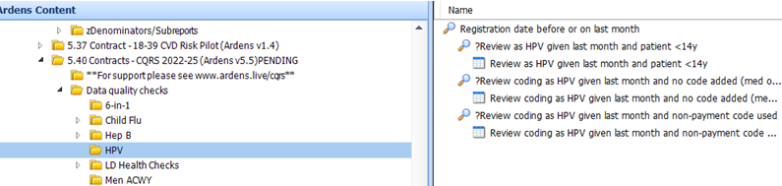
Ardens and HPV searches
Ardens searches
To support data quality of HPV, Ardens have included 5.40 CQRS Searches : Ardens EMIS Web as part of their CQRS search suite.
New “Smart” Childhood Immunisations Template
Ardens have deployed a new version of the Childhood Immunisations Template (v18.45 or above), which includes the following:
a new “smart” front page advising clinicians of which vaccines a child has had based on their age and vaccination history
any catch-up vaccines the child is eligible for
if a vaccine is contraindicated or has previously been declined.
To find out more, please read the Smart Childhood Immunisations Template support article.

Slide 12
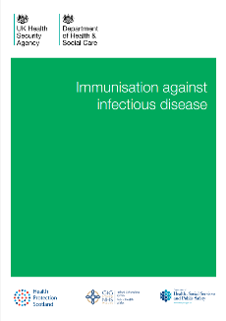
Resources for healthcare professionals
HPV vaccination schedule
The vaccine schedule has been updated several times since its introduction.
Complete routine immunisation schedule - GOV.UK
The Green Book, HPV chapter 18a provides Human papillomavirus (HPV) immunisation information for public health professionals, including updates – link via thumbnail
Opportunistic vaccination
NICE: Identifying people eligible for vaccination and opportunistic vaccination
Ardens Searches
Supplementary resources
JCVI statement on a one-dose schedule for the routine HPV immunisation programme
HPV vaccination programme: changes from September 2023 letter
HPV vaccination guidance for healthcare practitioners (UKHSA)
Information on the HPV vaccination from September 2023
HPV Vaccines and Cervical Cancer Factsheet for Health Professionals
HPV universal vaccination: leaflet (UKHSA)
NHS England » NHS vaccination strategy
The HPV vaccine | Cancer Research UK

Slide 13
Patient facing resources
Practical tools
The Green Book, chapter 2, Consent
Detailed information and guidance for healthcare professionals
Vaccine coverage data collection
Vaccination records and data capture
Patient facing resources
HPV and cervical cancer factsheet
Universal HPV leaflet (available in 33 languages and easy read)
A British Sign Language (BSL) video of this leaflet is available to download, watch or signpost to
HPV universal vaccination: record card
HPV universal vaccination: poster
MSD resources
Training and resources | GARDASIL®9 (Human Papillomavirus 9 valent Vaccine) | MSD Connect

Slide 14
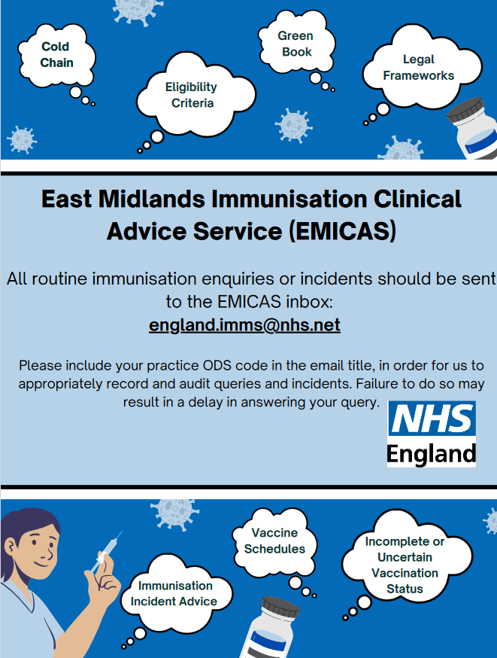
Please contact england.imms@nhs.net if you have any vaccination queries
Thank you for your ongoing support with all vaccination programmes

