Slide 1



June 2026
Clinical Non-Executive Director or Associate Non-Executive Director
Candidate pack

Slide 2
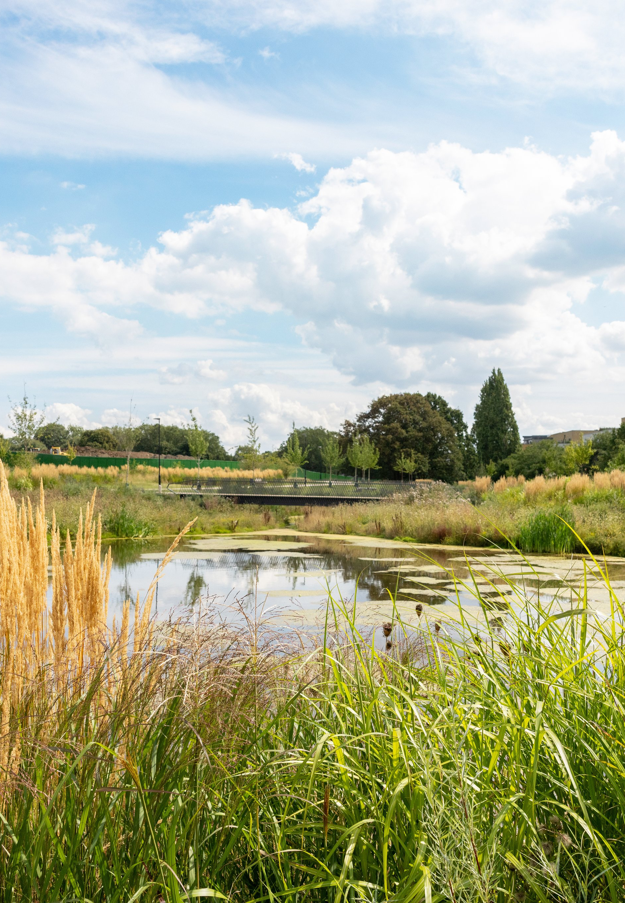
Contents
Welcome from the Chair
About us
About this role
Recruitment timetable and how to apply
Springfield Park, our new 32-acre public park on our Springfield University Hospital ground

Slide 3
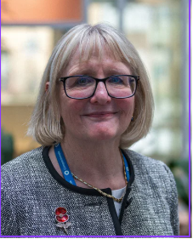
Welcome from the Chair
Thank you for your interest in becoming an Non-Executive Director at South West London and St George’s Mental Health NHS Trust.
We are a 2,900-strong team providing high quality mental health care, treatment and recovery support to about 20,000 people from South West London and beyond at any given moment. We are proud to be one of the most diverse organisations in the NHS and we are working together to create an organisation in which we all belong, and one which celebrates our diversity, promotes equity, and is actively working towards being anti-racist.
As a leading provider of mental health services and a beacon of excellence for many national mental health services, the Trust has a long history of inclusion and innovation that has helped to redefine the mental health landscape in the UK, Making Life Better Together for our local communities.
We’re looking for a clinical Non-Executive Director to join our Board, with a background in psychiatry or psychology, or as an allied health professional. This role could be a developmental Associate Non-Executive Director position, and we would strongly encourage candidates with different backgrounds and lived experience to apply.
If you have a passion to make a difference in mental health service and can see yourself in our values, we want to hear from you
Ann Beasley
Trust Chair

Slide 4

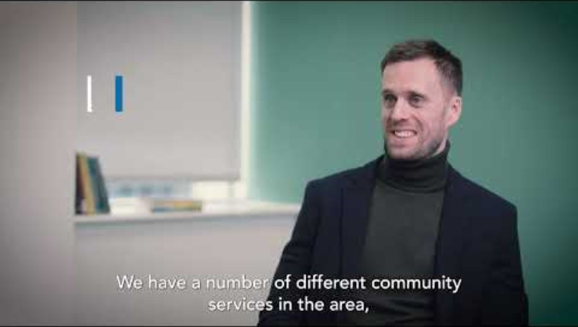
About us
South West London and St George’s
We are Proud to Belong
at South West London and
St George’s Mental Health
NHS Trust (SWLSTG).
We have expert services, a
rich history, and a clear
commitment to providing
the best quality care for
those with mental ill-health. The Care Quality Commission already rates our services as ‘good’ - we aspire to be ‘outstanding’.
This is a great time to join us. We are transforming the way we care for our communities to support our mission of Making Life Better Together. Quality improvement, co production and race equity and inclusion is central to our delivery.
We have built two brand new mental health facilities at Springfield University Hospital, which are amongst the best in the world. More development and transformation are planned across sites in Tolworth, Barnes, and Richmond, and across our services in adult community and urgent care.
We are inclusive and diverse, and we strive to be actively anti-racist. We want to attract people from all backgrounds and experiences to enrich the work we do together.
We put patients and their carers at the heart of all that we do, working to hear their voices through engagement, involvement, and co-production. We are proud to be an ‘anchor’ in our local community and we are working to be an excellent local employer and neighbour.

Slide 5
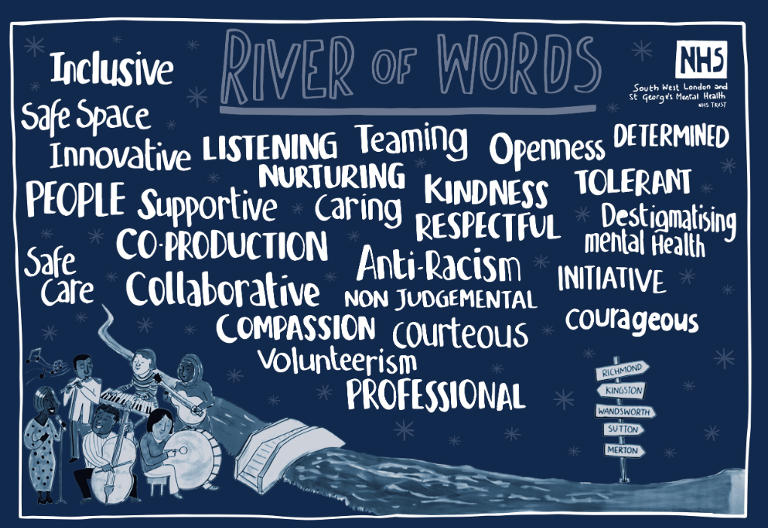
About us
South West London and St George’s
We are the main provider
of mental health services to
the 1.2 million people living
in the boroughs of Kingston,
Merton, Richmond, Sutton
and Wandsworth.
We provide acute and
community care across a
number of sites: including
inpatient facilities at Springfield University Hospital (Tooting) and Tolworth Hospital (Kingston) and community clinics, hospitals, surgeries, community locations, and in people’s homes.
We are a teaching Trust and provide education, training and research in partnership with a number of universities.
We are digitally advanced: we understand the positive impact digital can have on patient choice, care and treatment, as well as staff experience.
We believe that a great staff experience leads to a good patient experience. We therefore provide agile working opportunities, career development, feedback mechanisms and benefits.
Collaboration and partnership are crucial to how we work. Together with South London and Maudsley NHS Foundation Trust and Oxleas NHS Foundation Trust, we are part of the South London Partnership. We also play a leading role in the South West London Integrated Care System and work at borough levels with many local community organisations.
Come and join our inclusive teams and help our
patients on their recovery journey.

Slide 6
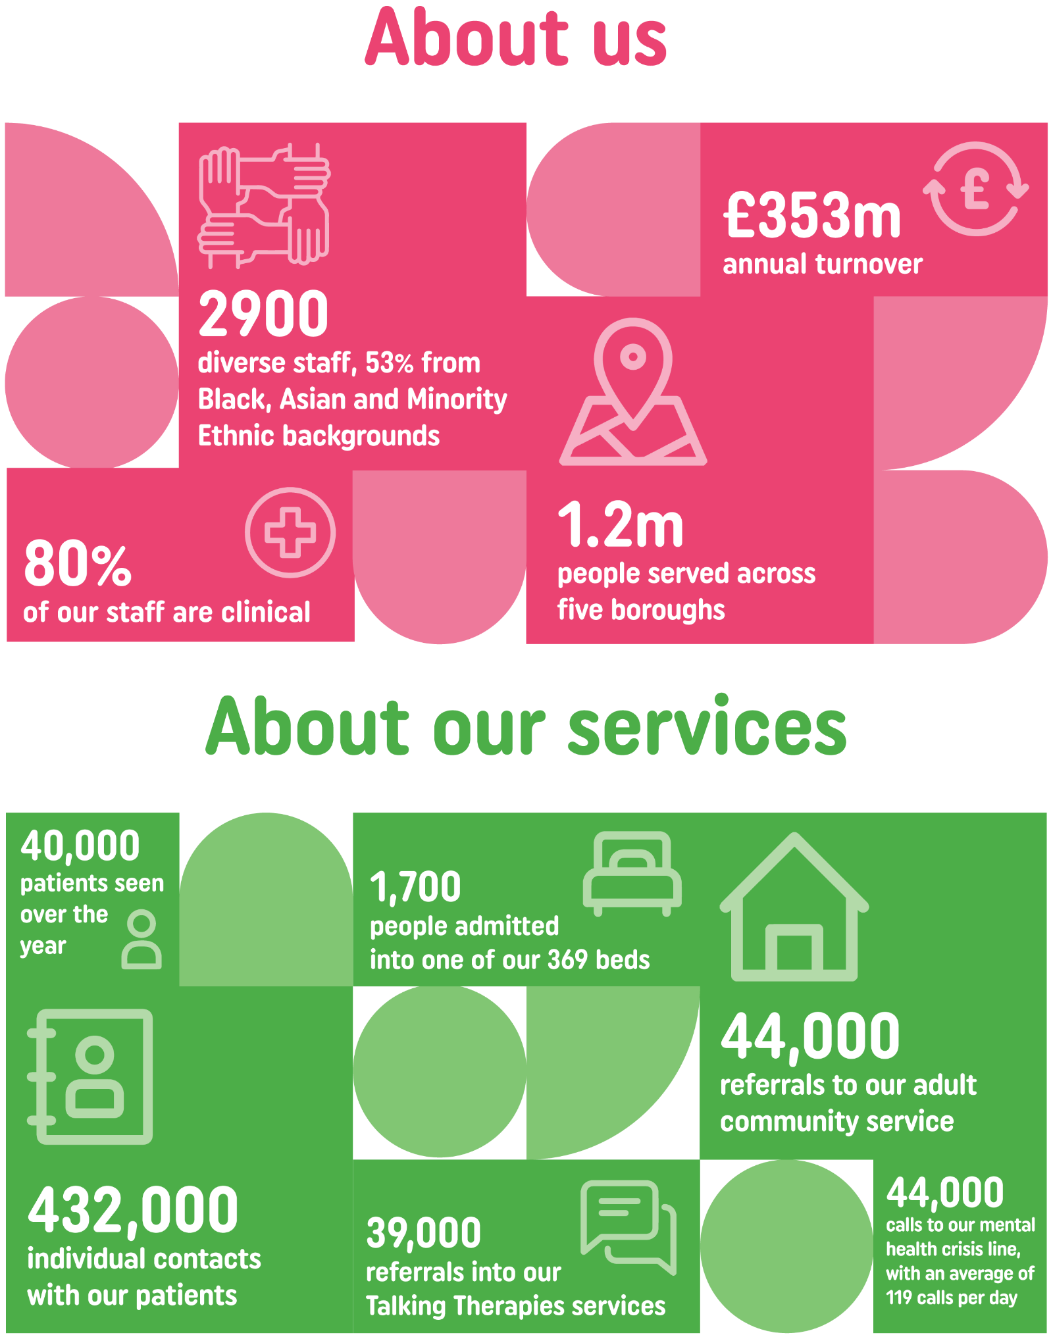
About us
Our Trust in numbers

Slide 7
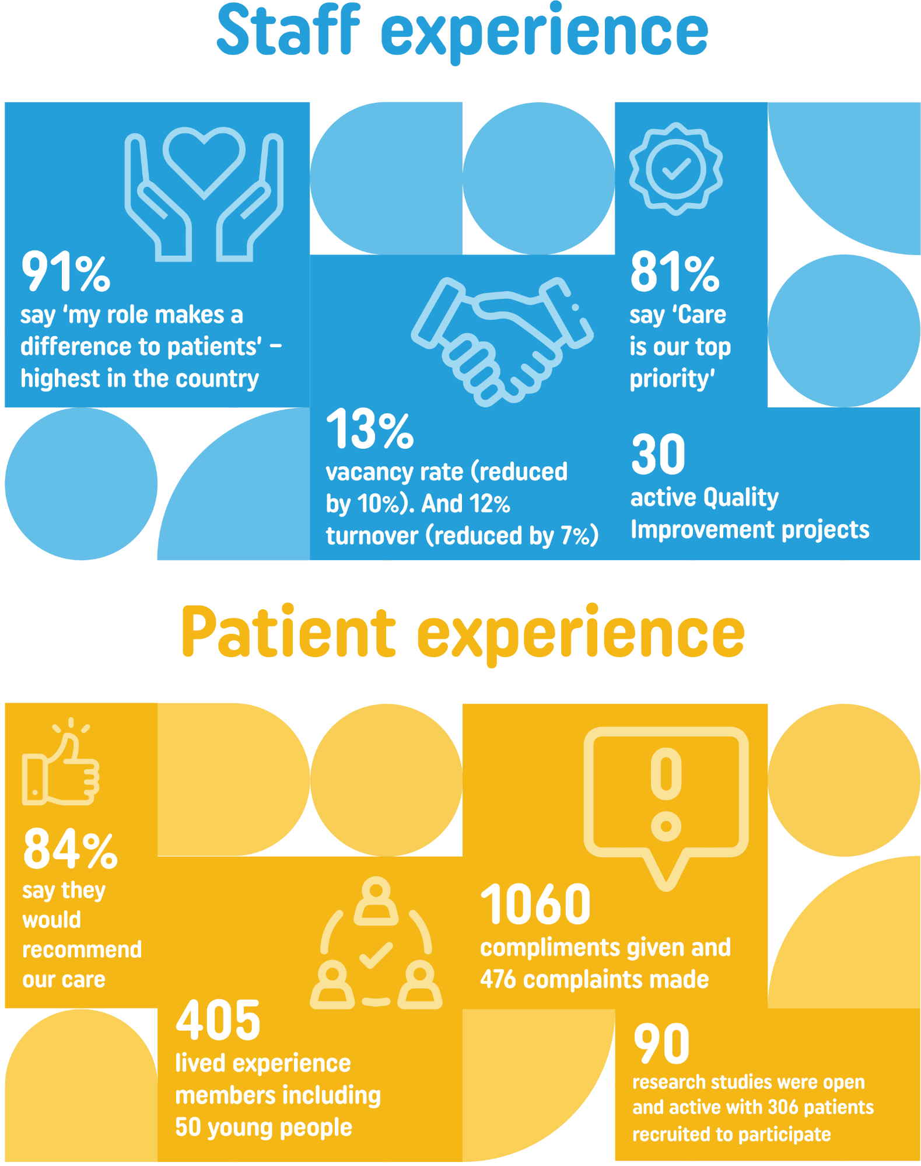
About us
Our Trust in numbers

Slide 8

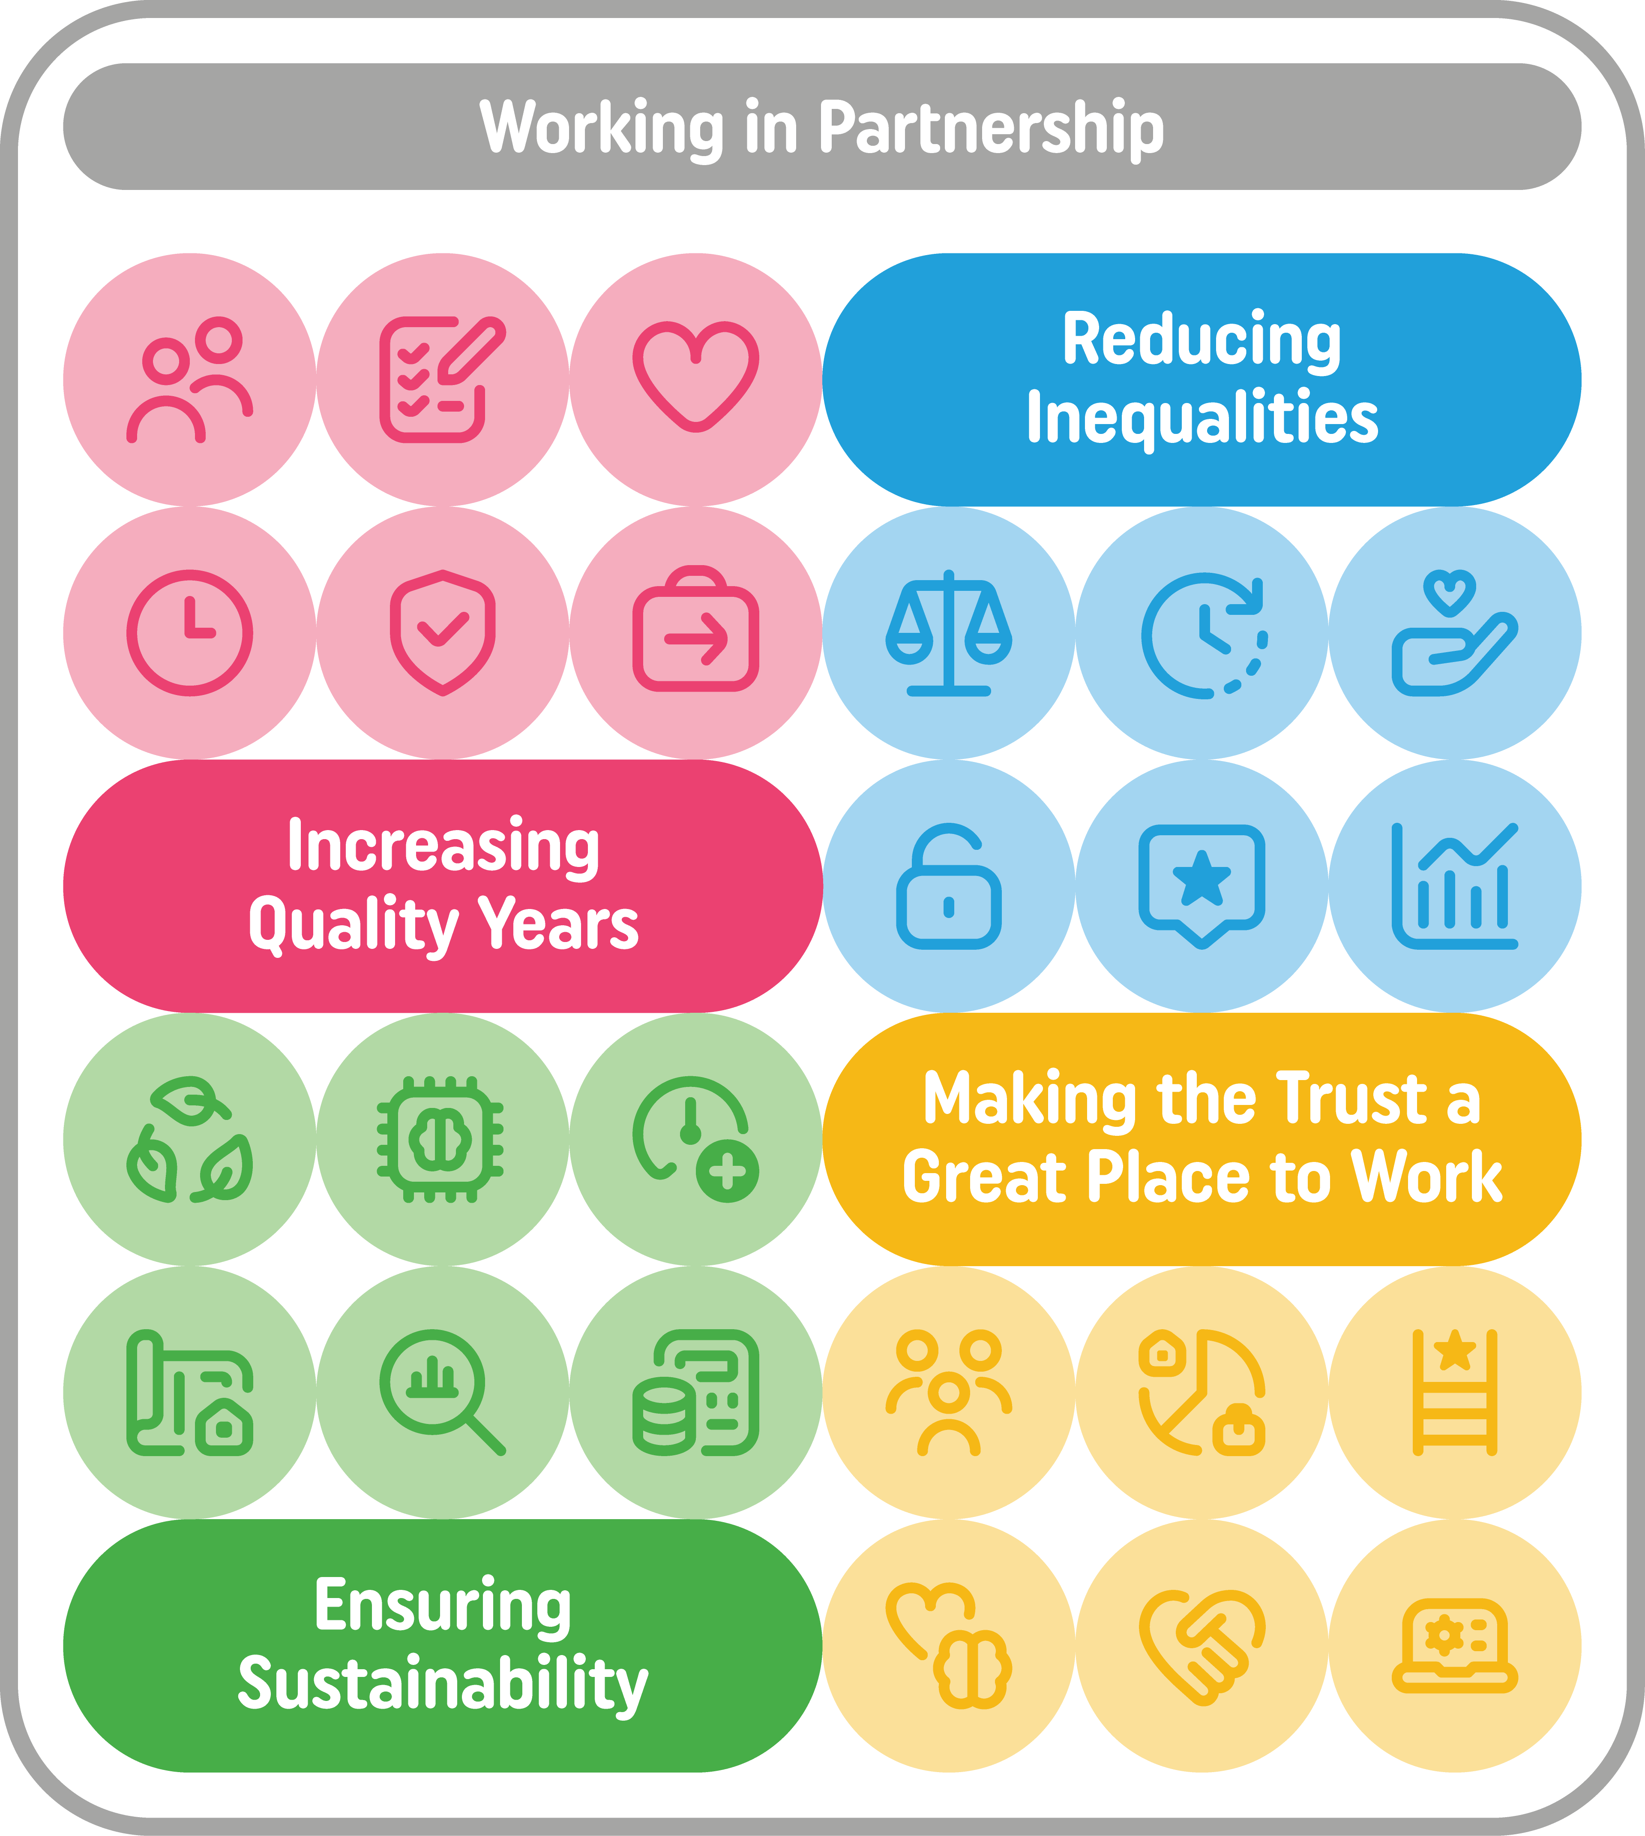
About us
Our strategy: mission, ambition and values
Patients are at the heart of all our delivery. Working in partnership, by 2031, we want everyone who uses our services to have excellent, timely, personalised and recovery focused mental health support.
Our vision:
Our mission:
Our ambitions:
We are:
actively anti-racist and inclusive
ambitious for mental health
patient‑centred, clinically-led and expertly-managed
digital first and accessible 24/7
evidence‑based and consistent
rooted in our communities
continuously improving and building confidence across the system
Our values and principles guide everything we do

Slide 9
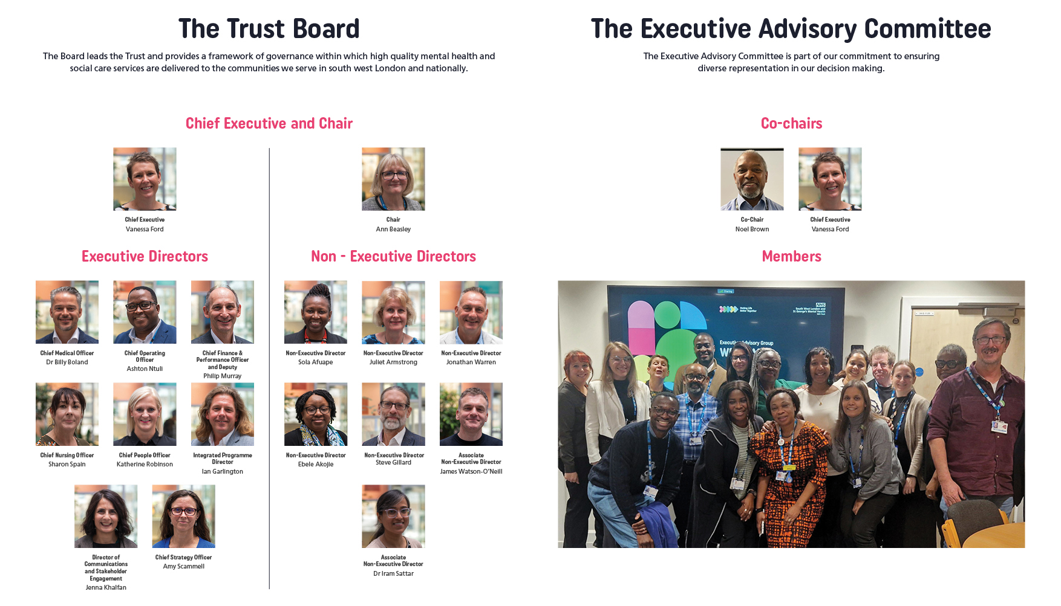
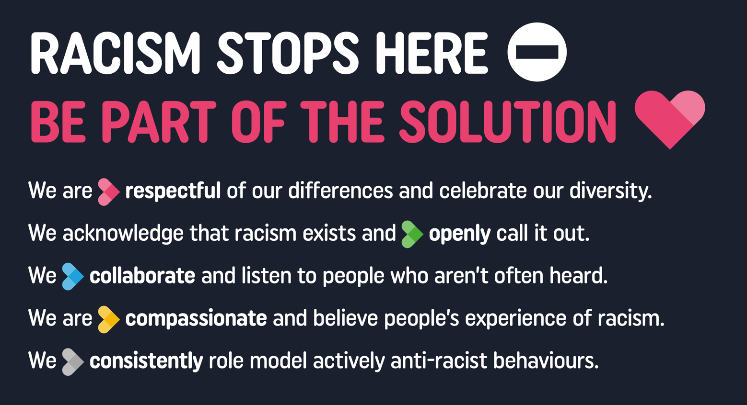
About us
Our Board and Executive Advisory Group
Our values into actions

Slide 10
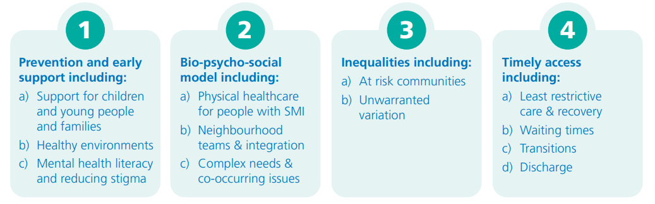
About us
Our Integrated Care System
We are an active parter in the South West London Integrated Care System (ICS), which serves over 1.5 million residents across six boroughs. Bringing together NHS organisations, local authorities and community partners, it works collaboratively to:
Understand local needs and inequalities
Develop long-term population health strategy
Commission services and allocate resources
Monitor performance and improve outcomes
The Integrated Care Board (ICB) leads the planning and commissioning of NHS services across the system. In 2025, South West London and South East London ICBs established a formal cluster arrangement, sharing senior leadership while remaining separate statutory organisations. This partnership strengthens strategic commissioning across south London.
The NHS in South West London has developed a Mental Health Strategy setting out the ways it will improve and support the mental health of everyone who lives, work or studies in Croydon, Kingston, Merton, Richmond, Sutton and Wandsworth over the next five years.
Our vision is to make South West London the best place to live for emotional wellbeing, with everyone having access to high quality, accessible wellbeing and mental health services. We will do this through:

Slide 11
About this role
The Trust is looking to recruit a clinical Non-Executive Director or Associate Non-Executive Director to join the Board.
Working collaboratively as part of a unitary board, you will contribute to the development of strategy, support long-term sustainability and help ensure the Trust continues to provide safe, effective and compassionate care. You will also work closely with executive colleagues and partners across the wider health and care system to support system-wide thinking and collaborative leadership in partnership.
The successful candidate will demonstrate sound judgement, strategic thinking and the ability to provide constructive challenge while building positive and collaborative working relationships. Our successful candidate will be passionate about tackling health inequalities.
We particularly want to encourage candidates from groups currently under represented in NHS Board roles.
All Non-Executive Directors must champion the standards of public life – by upholding the highest standards of conduct and displaying the principles of selflessness, integrity, objectivity, accountability, openness, honesty, and leadership.
As a future NHS leader, the successful candidate will be able to demonstrate the range of behaviours required to contribute effectively in this board level role. All Board roles are subject to NHS England’s Leadership Competency Framework.
For this role, it would be preferable that applicants should live in or have strong connections with the area served by the Trust.
On average this role will require the equivalent to 2 to 3 days a month, however the time commitment may vary and a flexible approach should be taken. The remuneration payable for this role is £13,000 per annum for a 3 year term.
Given the significant public profile and responsibility members of NHS Boards hold, it is vital that those appointed inspire confidence of the public, patients and NHS staff at all times. NHS England makes a number of specific background checks to ensure that those we appoint are “fit and proper” people to hold these important roles. More information can be found on the NHS England website.

Slide 12
Person Specification
Non-Executive Director – Clinical
As a Non-Executive Director, you will come from a strong senior clinical background in psychiatry or psychology or as an allied health professional. You will enhance oversight of Trust quality, safety, and patient experience, ensuring its effective operation and alignment with Board priorities.
You will offer robust scrutiny and assurance on quality, patient safety, clinical effectiveness and patient experience, as well as supporting a culture of openness, learning and continuous improvement across the Trust.
We are looking for a senior leader with substantial experience operating at Board or senior leadership level within a complex organisation, ideally within the NHS, wider public sector or a similarly regulated environment. We would welcome applications from those who have not worked at board level before but bring a range of lived experience, and the role could be a developmental Associate Non-Executive Director role for the right candidate.
Strong understanding of governance, audit, risk and assurance
The ability to interpret complex information and support robust decision-making
Experience of leading within complex and changing environments
Commitment to equality, inclusion and compassionate leadership
An understanding of partnership working across organisational boundaries
Excellent interpersonal and communication skills

Slide 13
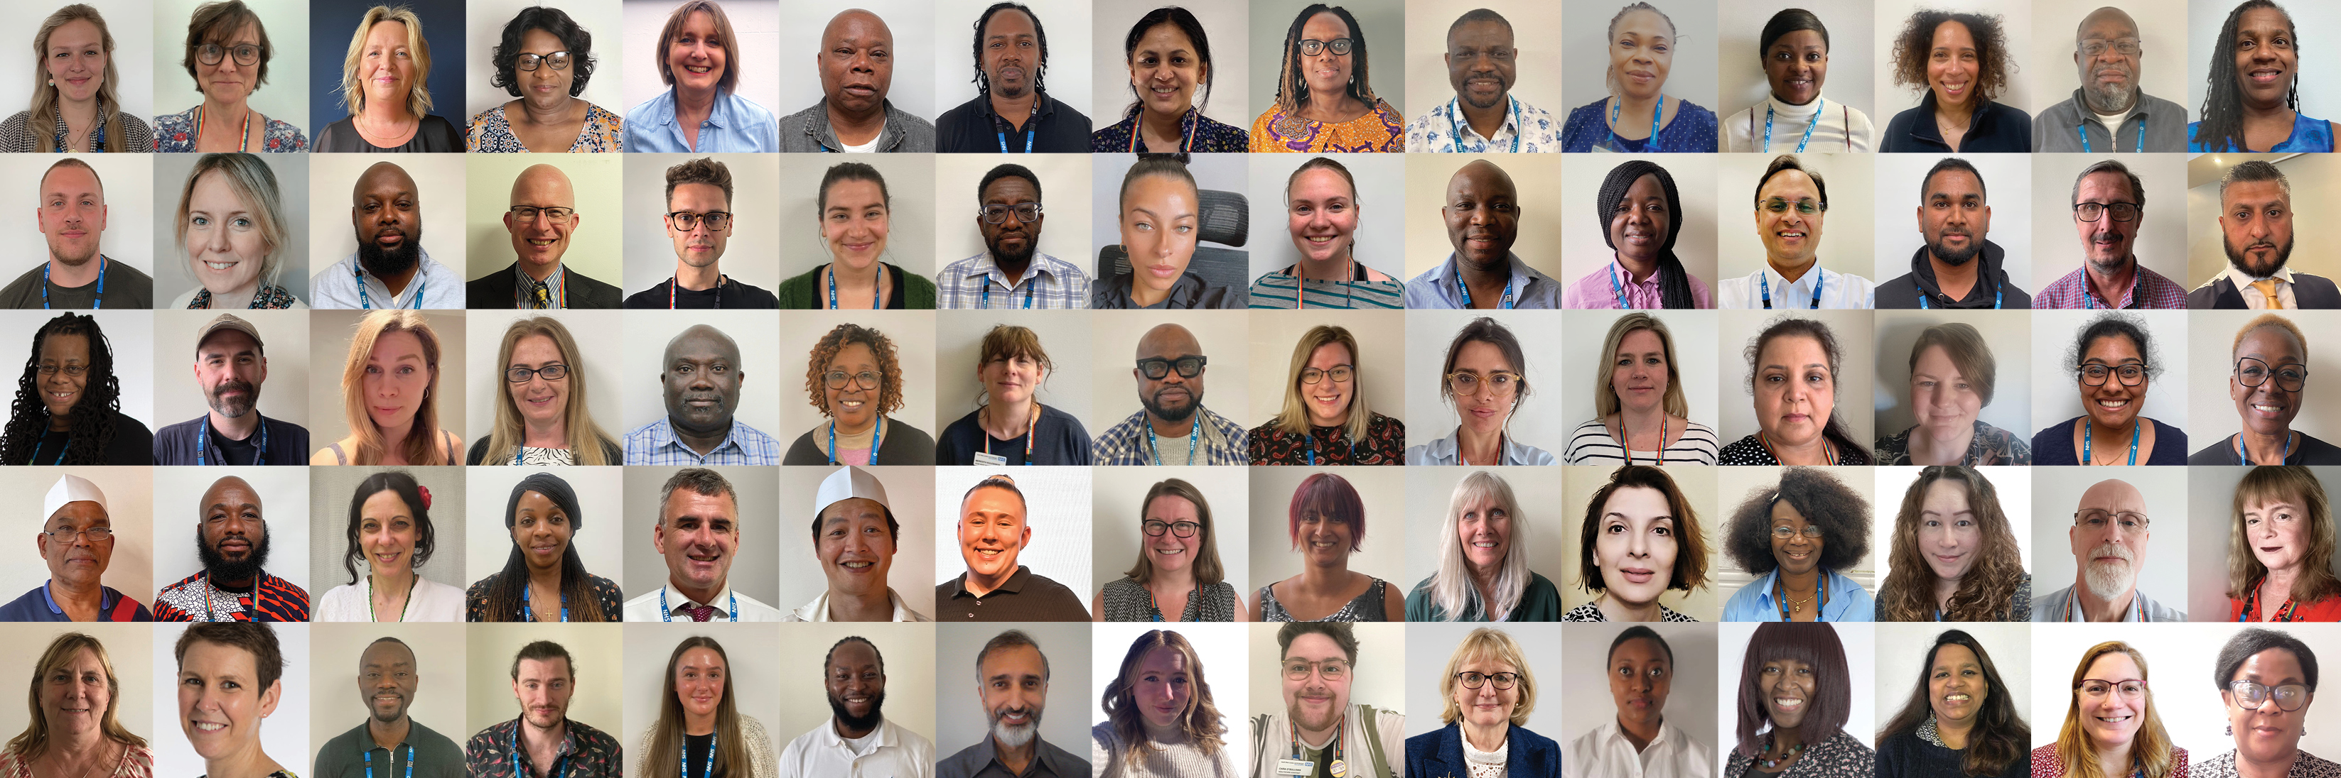

About you
Recruitment timetable and how to apply
Apply for the role via the GatenbySanderson website here: www.gatenbysanderson.com . The closing date for applications is Monday 5th October.
Applications should include:
An up to date copy of your CV, along with a Supporting Statement that addresses the criteria set out in the person specification, using examples to demonstrate how you meet the essential requirements.
A completed Fit and Proper Person Form - the template can be downloaded from the same place as the job description.
Detail any employment or education gaps.
The names, positions, organisations and contact details for two referees, one of whom should be your current or most recent position. Please note, should you be appointed, you will be required to provide references covering your last 6 years of employment. Where there have been gaps in employment, this six-year period will be extended accordingly. We would not approach these referees before the shortlist stage, and only with your permission.
Let us know any difficulty with the indicative timetable.
Once you have submitted your application, you will receive an automated email to confirm that you have applied. If you do not receive this email, please make contact with GatenbySanderson.
For a confidential discussion, contact our executive search partners at GatenbySanderson:
X
Melanie Shearer - melanie.shearer@gatenbysanderson.com
Jim Canning - jim.canning@gatenbysanderson.com
Closing date for applications: 5th October 2026
Final panel interviews: w/c 2nd November

Slide 14


Thank you
Website: www.swlstg.nhs.uk
Join us on social

