Slide 1
A Guide to Allyship As part of Anti-racism toolkit
Version 2 – 3rd November 2020
Prepared by:
Naveed Sharif; Equality, Diversity and Inclusion Manager; NHS England and NHS Improvement, North West Region

Slide 2
Why are we creating this Guide?
There are many guides in the public domain and address specific challenges around Racism, Transphobia, Gender discrimination, Religion and Belief etc;
This guide is part of a suite of tools around anti-racism, however this guide covers wider protected characteristics under the Equality Act 2010;
There are very many reasons to why colleagues would become an Ally;
Saying you’re an ally is much easier than actually being an ally. Saying you’re an ally looks good on paper, especially if you’re never questioned about your inaction (Amelie Lamont, 2020);
This guide is designed as many others to support colleagues looking into allyship to be best placed around the challenges of being an ally, a look at what it takes to become an ally and challenge the orthodoxies presented in the national WRES data, the recent publication of the Lawrence Report (2020), and of course the publication of Snowy White Peaks (Kline, 2014).

Slide 3
To be an ally is to...
Take on the struggle as your own;
Transfer the benefits of your privilege to those who lack it;
Amplify voices of the oppressed before your own;
Acknowledge that even though you feel pain, the conversation is not about you;
Stand up, even when you feel scared;
Own your mistakes and decenter yourself;
Understand that your education is up to you and no one else.

Slide 4
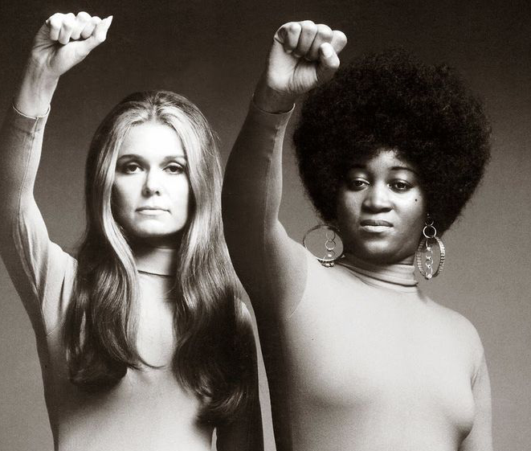
What is an Ally and why are they necessary?
Being an ally doesn’t necessarily mean you fully understand what it feels like to be oppressed. It means you’re taking on the struggle as your own.
A individual from an underinvested community cannot easily cast away the weight of their identity (or identities) shaped through oppression on a whim. They carry that weight every single day, for better or for worse. An ally understands that this is a weight that they, too, must be willing to carry and never put down.
Anyone has the potential to be an ally. Allies recognize that though they’re not a member of the underinvested and oppressed communities they support, they make a concerted effort to better understand the struggle, every single day.
Because an ally might have more privilege and recognizes said privilege, they are powerful voices alongside oppressed ones.

Slide 5
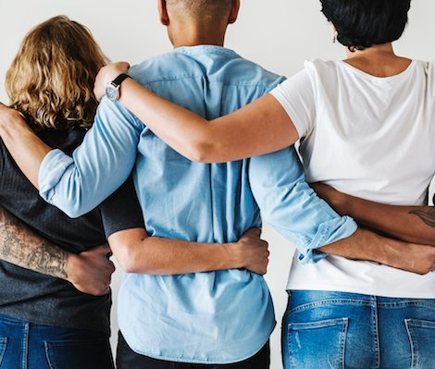
The necessity of Allies
Anyone has the potential to be an ally. Allies recognize that though they’re not a member of the underinvested and oppressed communities they support, they make a concerted effort to better understand the struggle, every single day.
Because an ally might have more privilege and recognizes said privilege, they are powerful voices alongside oppressed ones

Slide 6
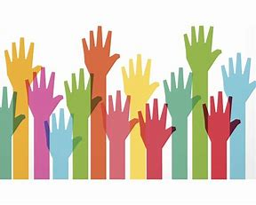
What is involved in being an Ally?
There is no doubt, being an ally is not plain sailing;
Many would-be allies fear making mistakes that could have them labeled as “-ist” or “-ic” (racist, sexist, transphobic, homophobic, etc);
This means that as an ally, there is much to unlearn and learn—mistakes are expected. You need to own this as fact and should be willing to embrace the daily work of doing better.

Slide 7
The Ally Continuum https://eskalera.com/

Slide 8
The Do:
Do
Do be open to listening
Do
Do be aware of your implicit biases
Do
Do your research to learn more about the history of the struggle in which you are participating
Do
Do the inner work to figure out a way to acknowledge how you participate in oppressive systems
Do
Do the outer work and figure out how to change the oppressive systems
Do
Do use your privilege to amplify (digitally and in-person) historically suppressed voices
Do
Do learn how to listen and accept criticism with grace, even if it’s uncomfortable
Do
Do the work every day to learn how to be a better ally

Slide 9
The Don’t:
Do not
Do not expect to be taught or shown. Take it upon yourself to use the tools around you to learn and answer your questions;
Do not
Do not participate for the gold medal in the “Oppression Olympics” (you don’t need to compare how your struggle is “just as bad as” a marginalized person’s);
Do not
Do not behave as though you know best;
Do not take credit for the labour of those who are marginalized and did the work before you stepped into the picture;
Do not
Do not assume that every member of an underinvested community feels oppressed.
Do not

Slide 10
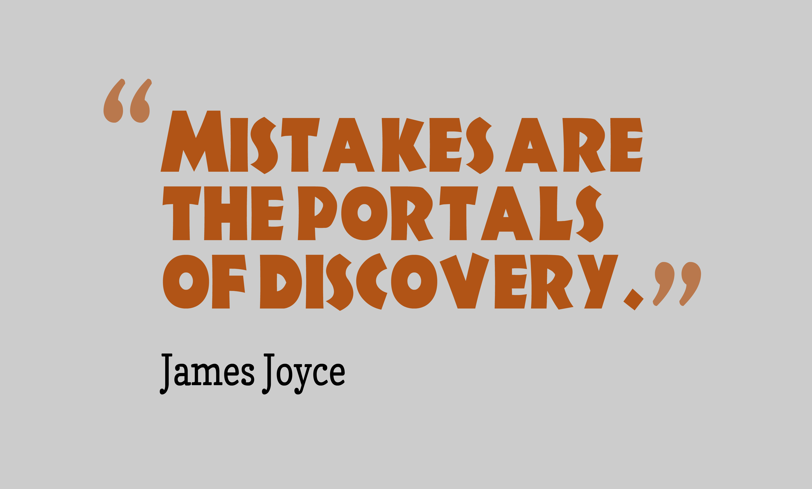
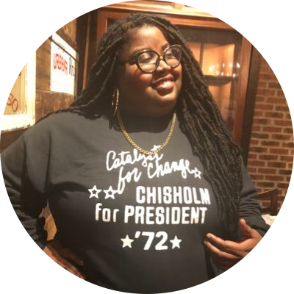
Kayla Reed’s (@iKaylaReed): How to Handle Mistakes?
While mistakes are to be expected, what’s the best way to go about resolving them?
“Reacting in a fair and helpful way isn’t about learning arbitrary rules or being a doormat. When we take the politics out of it, it’s just the reasonable thing to do. Still, it’s hard to remember in the moment, because these issues are so charged in our society. As such, it may be helpful to reframe the situation so that you don’t feel defensive.
You may have noticed it’s easier to handle being corrected about something you didn’t know if you’re grateful for and even open to the opportunity to learn rather than embarrassed to have been wrong. Being able to let go of your ego is an incredibly important skill to develop.
Try starting with “Thanks for letting me know” to put yourself in a better frame of mind. If after you say that, you need to take some time to think about the situation, that’s fine, too. Just remember that this isn’t about changing the other person’s frame of mind. They’re allowed to be upset about being oppressed”. (Kayla Reed, 2020 and Amielie Lamont 2020).

Slide 11
Becoming an Ally for Diversity (M. Walker) (11/09/2015).

Slide 12
Credits
This guide has been utilised through:
https://guidetoallyship.com/ via Amielie Lamont and M. Walker 2015

