Slide 1
Introduction to the Clinical Practice Summary
Guidance on consensus approaches to managing palliative care symptoms
Martin Davidson
Consultant Palliative Medicine
Blackpool Victoria Hospital & Trinity Hospice

Slide 2
What is it ??

Slide 3
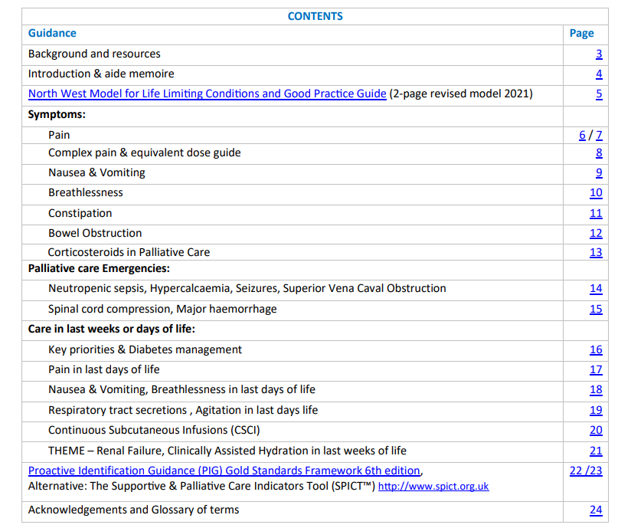
What's it for??

Slide 4
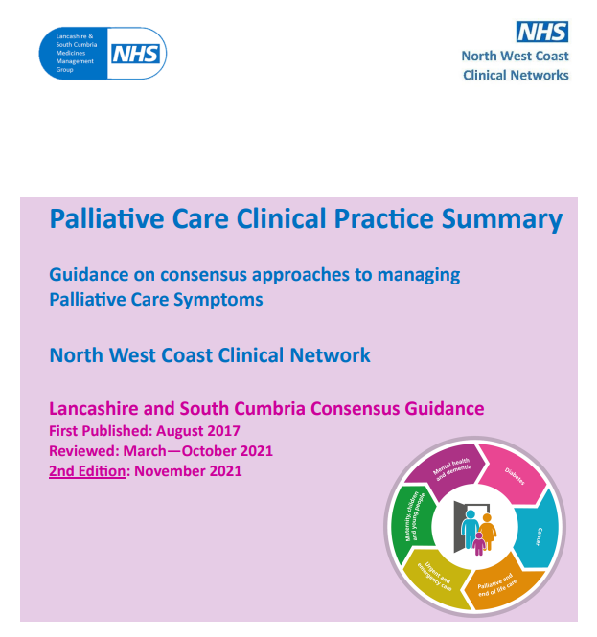
Where can I access it?
www.england.nhs.uk/north-west/north-west-coast-strategic-clinical-networks/our-networks/palliative-and-end-of-life-care/end-of-life-resources/clinical-practice-summary/
www.fyldecoastccgs.nhs.uk/document/nwc-scn01-clinical-practice-summary-palliative-care-final-version-pdf/

Slide 5
Evolution of existing guidance. The 1st Edition was published in 2017
Should be very familiar but doses and dosing intervals may be different

Slide 6
What I cover today …
Anticipatory prescribing in final days of life
- Pain
- Breathlessness
- Agitation
- Secretions
Diabetes care in final days of life
Haemostatics
Opioid Conversion Table

Slide 7
Anticipatory Prescribing

