Slide 1
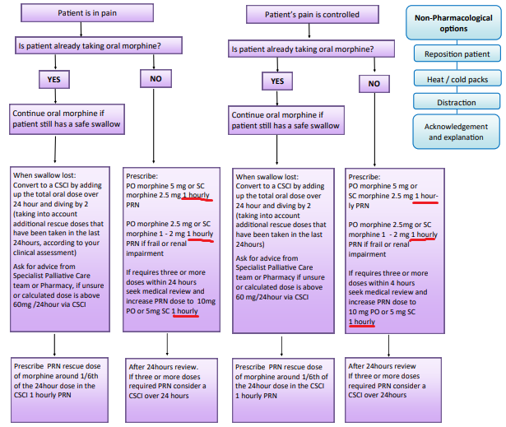

Pain in last days of life

Slide 2
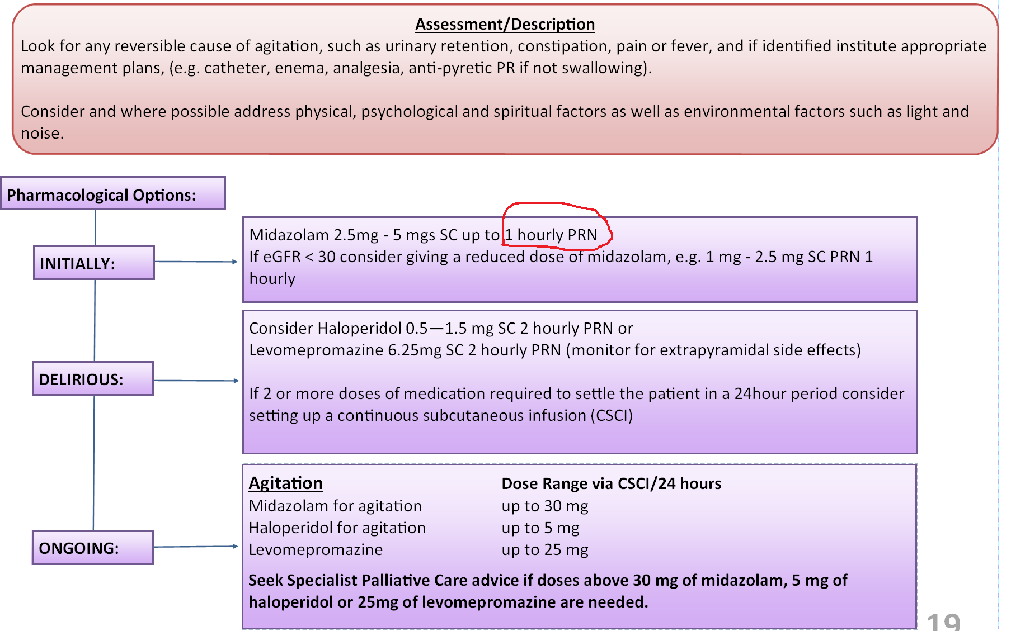

Agitation in last days of life

