Slide 1
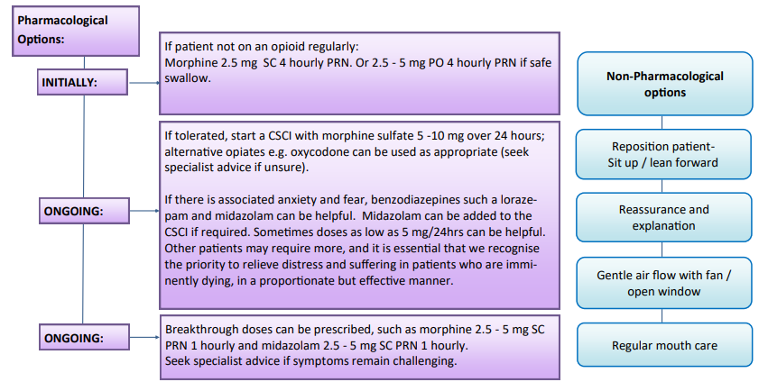

Breathlessness in last days of life

Slide 2
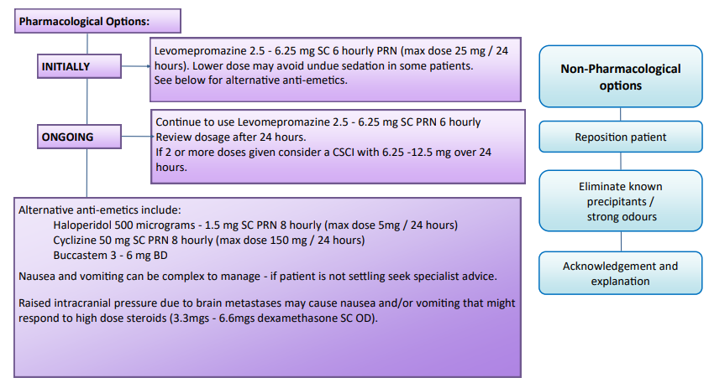

Nausea & Vomiting in last days of life

Slide 3
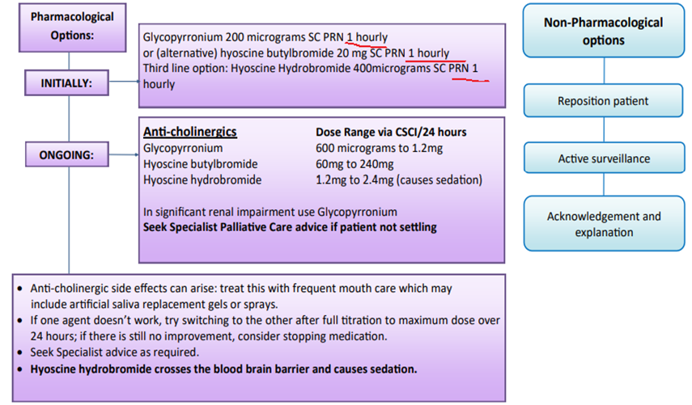

Secretions in last days of life

