Slide 1
Opioid Conversion Table

Slide 2
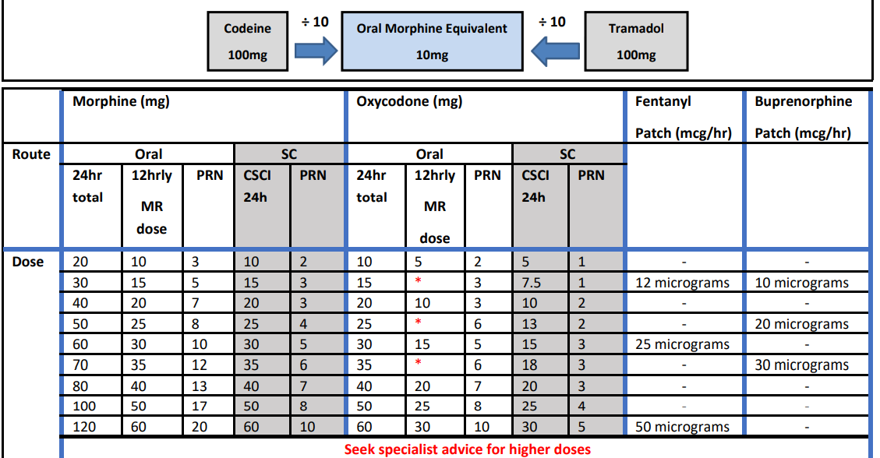
Opioid Conversion Table

Slide 3
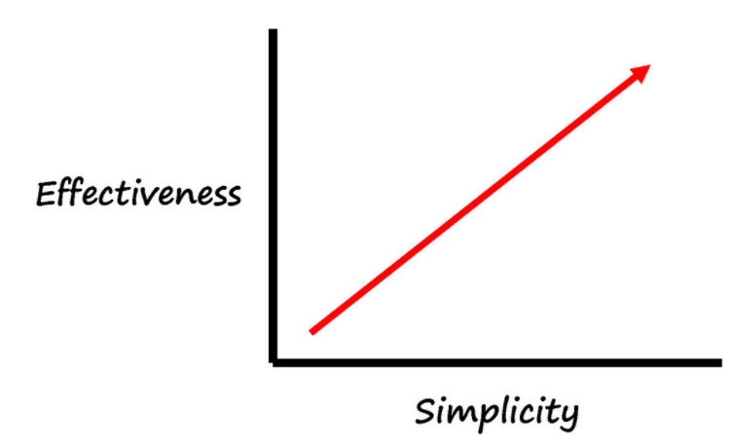
Opioid Conversion Table – Main Changes
Conversion Ratios
Whole number PRN doses
PRN dose for 20mg 24 hour dose of MR Morphine is 3mg not 3.3mg
PRN dose for 10mg syringe driver morphine is 2mg not 1.66mg
There are other opioid conversion
tables available
Teams may wish to adopt alternatives suitable for local circumstances

Slide 4
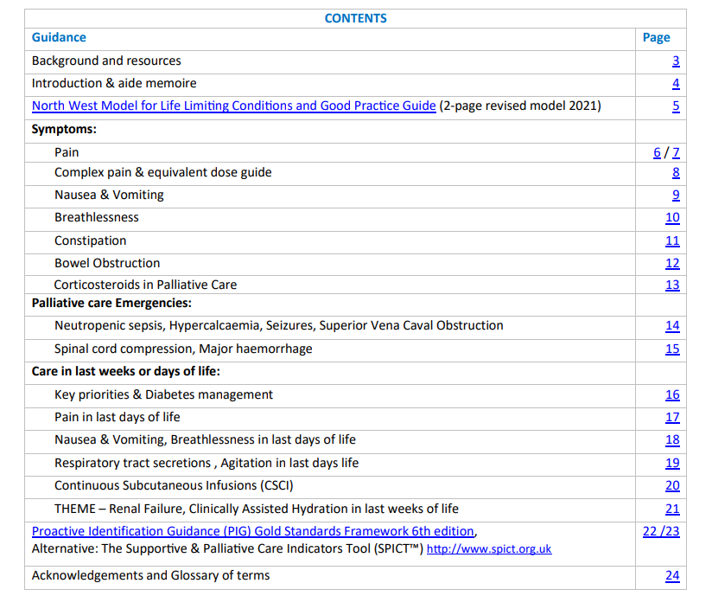
But there's lots more…..
Guidance on patches…..
Guidance on syringe drivers…..
Guide to recognising emergencies…..
Bowel Obstruction……
Steroids……
Prescribing in renal and liver impairment….
Probably most importantly
Extensive guidance on symptom management at earlier stages in disease

Slide 5
Thank you for listening
Have a read!
Happy to respond to any queries: Martin.davidson@nhs.net

