Slide 1
The Great Escape: The Nitrous Oxide Mitigation Project For East Lancashire
Presented by Baillal Shahid & Rajit Khosla (ST5 Anaesthetics)
Sustainability Lead: Dr Jason Lie (ELHT)

Slide 2
Environmental Impact
Huge environmental burden
Present in atmosphere for 150 years
Global warming potential 310x CO2
Contributes to significant NHS CO2 footprint
Other NHS trusts estimating NO contributes 80% of total anaesthetic gas footprint

Slide 3
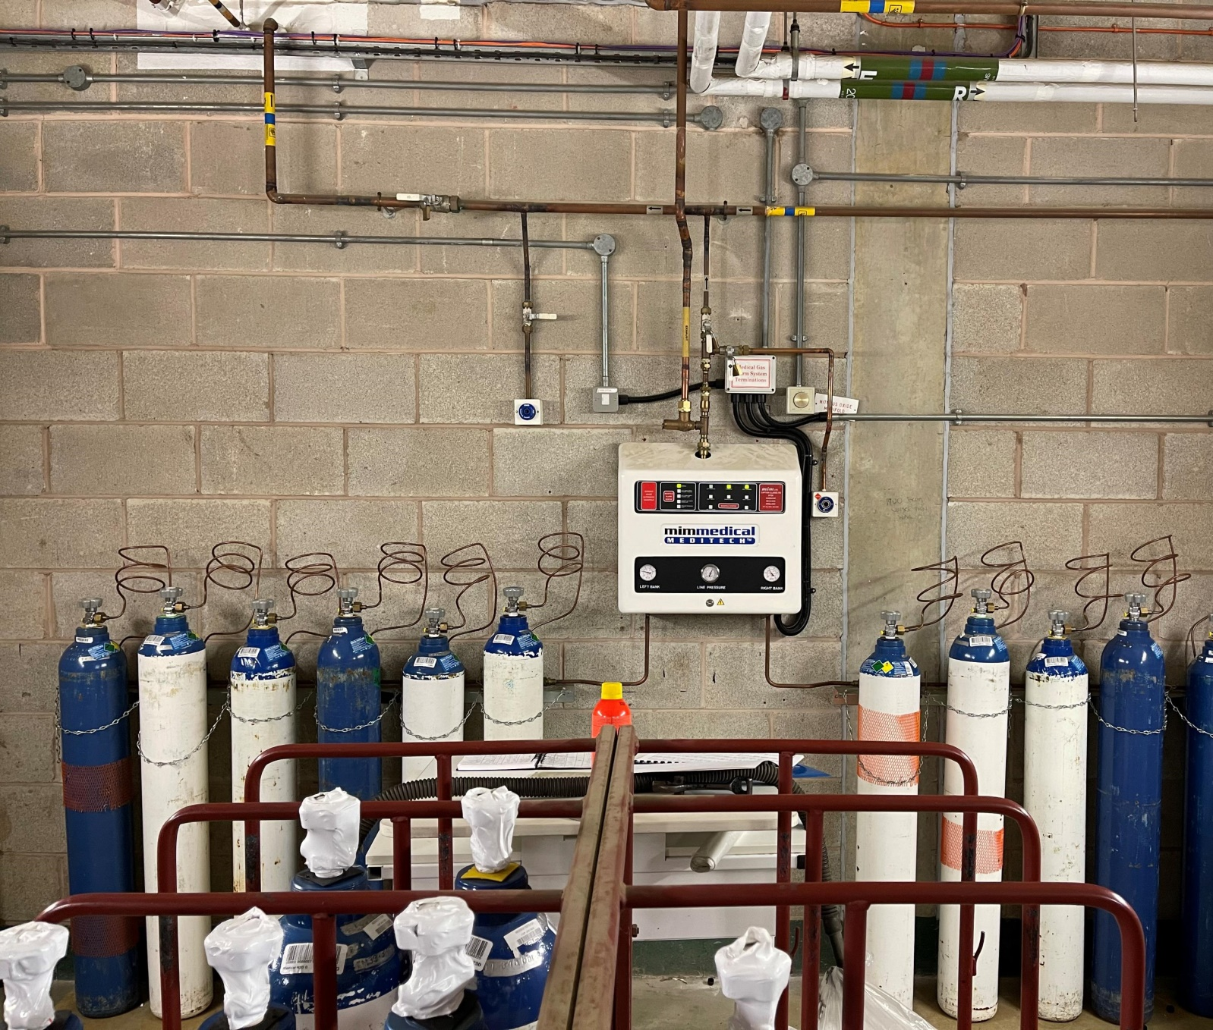
How Is Nitrous Oxide Stored in ELHT
Nitrous oxide stored in a cylinder manifold and piped around the hospital
Typically, G cylinders used in Manifold, which expire every 5 Years
At Blackburn:
2x banks
6 size G cylinders per bank
Size G = 9,000L
Total NO per bank = 54,000L
2x emergency cylinders
Burnley has 2 similar Manifolds and an Entonox Manifold

Slide 4
What We Did
ELHT investigated in a 3 staged approach
Stage 1: Review nitrous oxide manifolds at ELHT including physical inspection, pipeline connections and logbook review tracking cylinder changes
Stage 2: Review nitrous oxide clinical use by pulling gas usage data from the anaesthetic machines in two typical ‘snapshot weeks’ and extrapolating monthly/yearly usage
Stage 3: Survey of anaesthetists evaluating nitrous oxide usage habits

Slide 5
What We Found
Huge difference between manifold consumption and clinical use
Estimated manifold consumption approximately 4,000,000 litres annually
Extrapolated clinical usage approximately 10,800 litres annually
Annual cost: £12,800
Annual ‘clinical use’ cost: £55
Environmental burden: CO2e >2500 tonnes/year
Main issues at Blackburn site

Slide 6
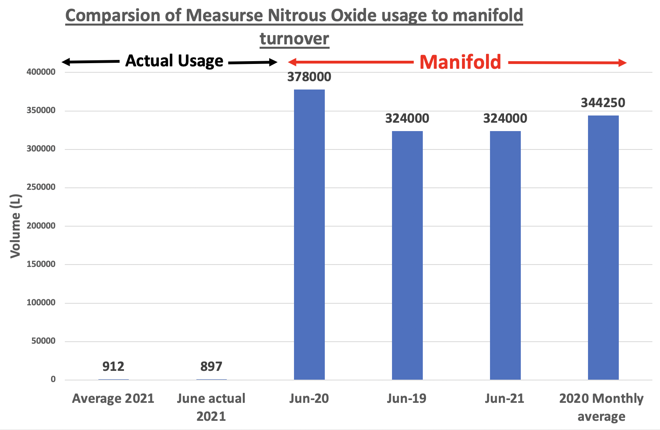

Slide 7
CO2e comparison between Blackburn and Burnley (Similar case-mix)

Slide 8
Environmental Impact
Yearly consumption at Blackburn alone CO2 Equivalent to:
Running 1L flow via sevoflurane vaporiser for 215 Years
Equivalent to the emissions of 450 households for a year
Driving to the moon almost 26 times over!
Notes:
6,200,000 miles
Equator- 240x

Slide 9
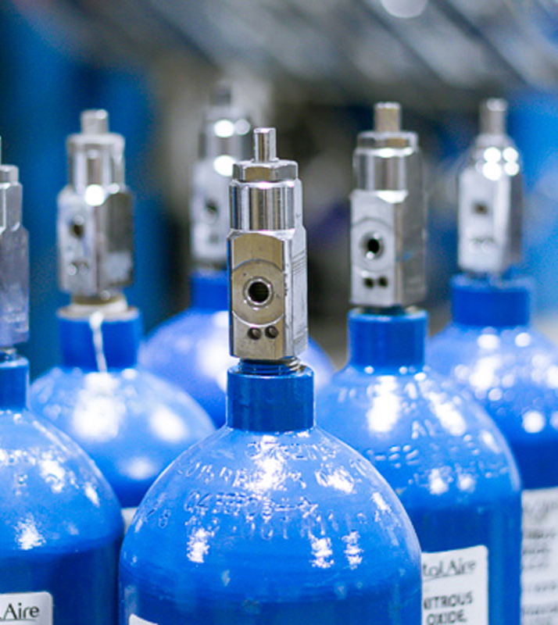
Outcomes
Findings raised urgently to medical gases/estates
Major leak found in main theatre complex requiring extensive, costly and disruptive repair
Departmental and trust level decision that pipeline repair NOT justifiable given falling clinical use
Nitrous oxide pipeline isolated and capped off
Nitrous oxide supply remains available for use at ELHT via compact cylinders attached directly to the back of anaesthetic machines
Cylinder use has stayed at consistently low levels since isolating the main pipeline

Slide 10
Cost and Environmental Savings
Annual cost savings of £12,500
Annual environmental saving of 2515 tonnes CO2e
Extrapolated 10 year savings are £125,000 and 25,000 tonnes of CO2
Small environmental savings today translate to huge savings in the future!

Slide 11
Further Work
Re-evaluation of other manifolds within EHLT
Monitoring of staff exposure to anaesthetic agents
Consideration of N2O capture devices in maternity
Appointment of sustainability fellow

Slide 12
Hazardous Gases Monitoring
Annual hazardous gases monitoring
Are we compliant with COSHH guidelines?
Staff exposure of N2O should be <100ppm
1 room on Central Birth Suite identified to have higher than recommended N2O levels
Further investigation found blockage of room ventilation flow which has now been rectified

Slide 13
Thank you For Listening
ELHT Anaesthetic Sustainability Lead: Dr Jason Lie (Jason.Lie@elht.nhs.uk)
Project contributors:
Dr Rajit Khosla (Rajitkhosla@nhs.net)
Dr Baillal Shahid (Baillal@doctors.org.uk)
Dr Jemma Barnes (jkb189@doctors.org.uk)
Special thanks to Alifia Chakera, National Nitrous Oxide Mitigation Project Lead, Clinical Pharmacist, NHS Lothian, Scotland

