Slide 1
Cheshire & Merseyside I-CARE & Share Personalised Care Planning Support Package
Dr Peter Chamberlain

Slide 2
Position statement
Personalised Care Planning is a priority for Cheshire & Merseyside Health & Care Partnership.
It gives agency to patients by framing crucial conversations patient and empowers urgent care providers. It helps prevent crises and unnecessary attendance to hospital
Many areas have made good progress already. Learning from one another about the challenges, successes and innovations is a key opportunity that we are seeking to capitalise on.
We will work with Place-based leadership to support Primary Care Networks in advancing Personalised Care Planning from the current baseline to an agreed minimum standard across all nine places.
Standardised coding needs to be agreed in line with EPaCCs standards to ensure communication is pulled through in Share2Care and data sharing arrangements.

Slide 3
PCN DES: NHSe moved ACP oversight from NHSe > ICBs
“Updates to the PCN service specifications September 2022
8. Update the anticipatory care requirements to better reflect system-level work on anticipatory care. Replace the current specification with:
a. 8.9.1. ICSs have responsibility to design and plan anticipatory care for their system, of which the following PCN requirements form a part. 11
b. 8.9.2. PCNs must contribute to ICS-led conversations on the local development and implementation of anticipatory care working with other providers with whom anticipatory care will be delivered jointly.”⁹

Slide 4
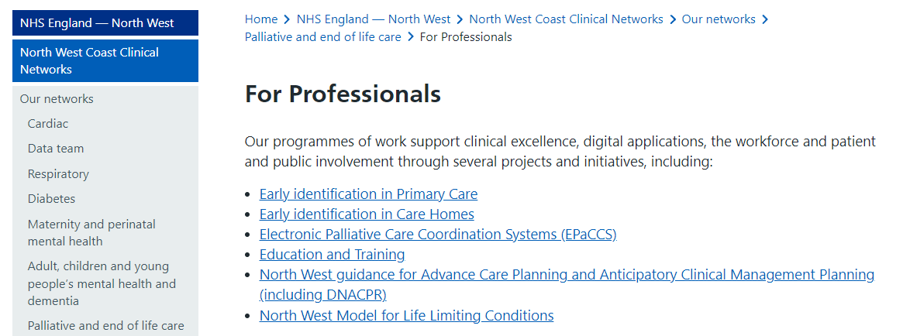
Ambitions for Palliative and End of Life Care:
A national framework for local action 2021-2026

Slide 5
Identify
Communicate
Anticipatory care plan
Resuscitation decision
Escalation plan
&
Share
C&M
Personalised Care Planning Process
EOL & Personalised Care Planning EMIS template
C&M Personalised Care Plan
North West uDNAR
GSF Tracker

Slide 6
Measures of success:
0.6% GP population on EoL register
100% DNA CPR problem coded
60% patients on EOL register have PCP
90% of PCP shared with urgent care

Slide 7
Priority Patients
End of life patients
Patients receiving palliative care
Care Home patients (PCN DES)
May also be used for
Patients with complex needs
Patients with severe long-term conditions

Slide 8
Principles for Places
Each Place to have ONE agreed PCP that meets EPaCCs standards
Key stakeholders: EOL leads / PCNs / GPs
A C&M ICB-approved EMIS/Systm1 template and PCP is available to all areas
This has been extensively tested and being used
Train non-GPs (nurses, pharmacists, etc)
Incentivise through local contract

Slide 9
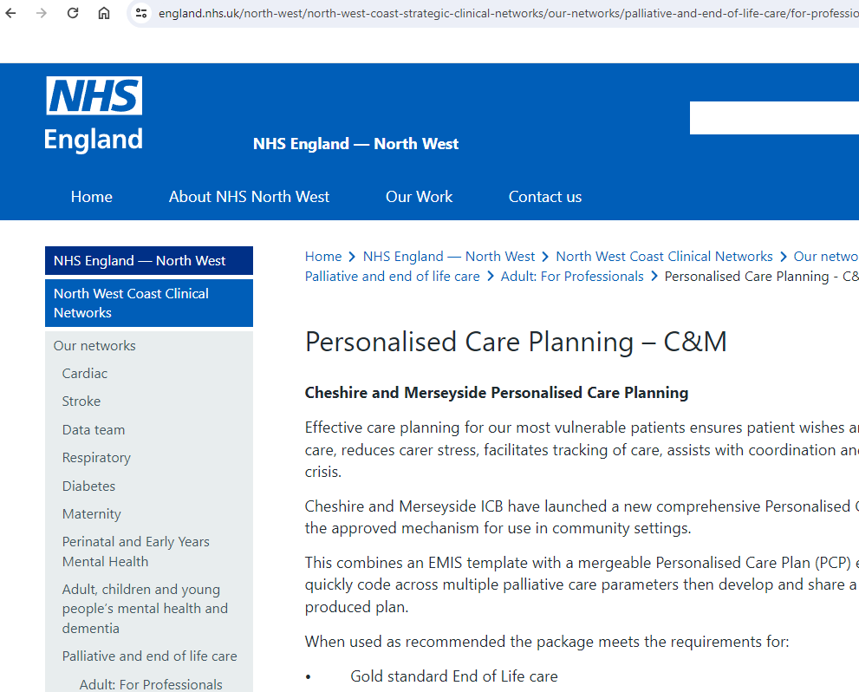

Slide 10
Internal GP IT Process for PCP: End of Life
Patient in last months of life
Put on EOL register
Complete EMIS EOL template
PCP – Merged EMIS document
Register NWAS/OOH
Patient given copy
Coding feeds to BI
Identify
Register
Core coding
Collate
Share

Slide 11
Internal GP IT Process for PCP: Care Home
Patient in last months of life
Put on EOL register
Complete EMIS EOL template
PCP – Merged EMIS document
Register NWAS/OOH
Patient given copy
Coding feeds to BI
Identify
Register
Core coding
Collate
Share

Slide 12
Internal GP IT Process for PCP: Other
Patient in last months of life
Put on EOL register
Complete EMIS EOL template
PCP – Merged EMIS document
Register NWAS/OOH
Patient given copy
Coding feeds to BI
Identify
Register
Core coding
Collate
Share

Slide 13
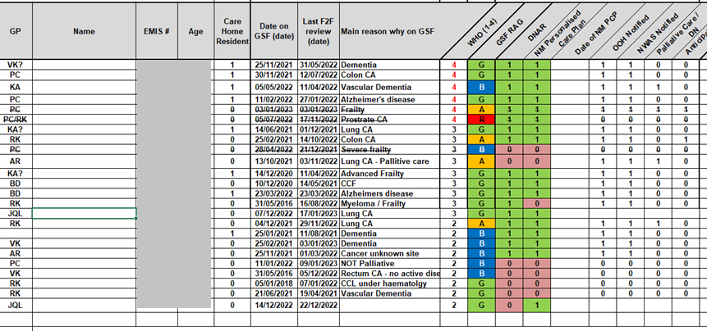
Implement a GSF tracker mechanism e.g.

Slide 14
Consultation Process
Ideally discuss face to face with patient and carers
The value is in the conversation - Use a PCP example to guide

Slide 15
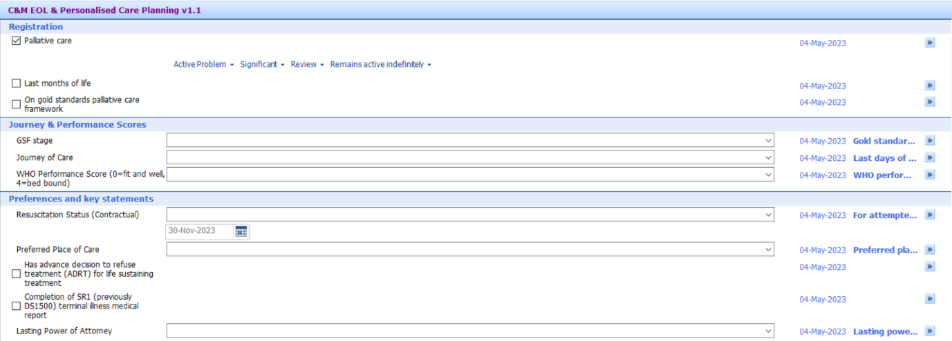
C&M EOL & Personalised Care Planning v1.1 (EMIS template)

Slide 16
Complete PCP
Save the consultation
Re-open the consultation
Via ‘Documents’ find:
C&M Personalised Supportive Care Plan v1.1
Merged codes will be populated automatically
Complete other key patient specific variables
Save
Notify administration to share with patient & urgent care providers

Slide 17
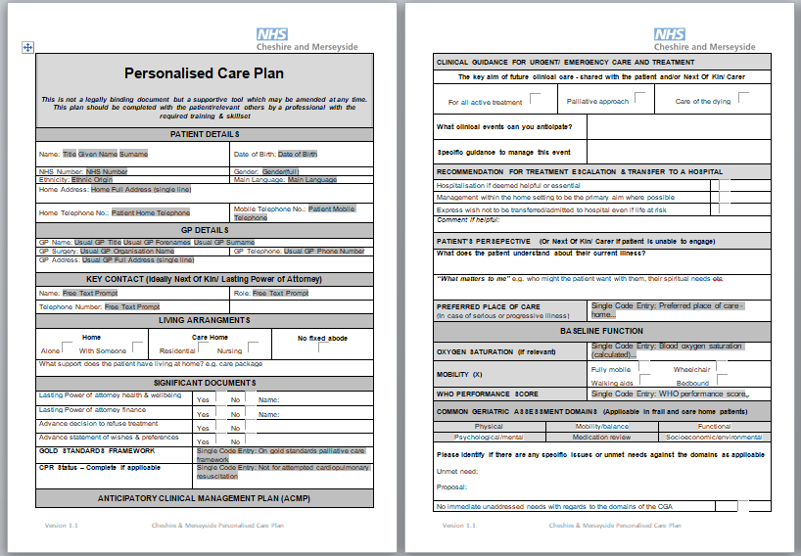
Personalised Care Plan

Slide 18
Next steps
Check out https://www.england.nhs.uk/north-west/north-west-coast-strategic-clinical-networks/our-networks/palliative-and-end-of-life-care/for-professionals/personalised-supportive-care-planning/
Install the EOL template(.xml) on GP EMIS systems
Install the PCP (.ewdt) document on on GP EMIS systems
Local EOL lead: Test template and document on local GP system
Presentation to practice leads & PCN
Practices: Test template and document
Practices: Integrate into internal GSF processes
PCNs: Integrate into Care Home processes (DES)

Slide 19
References
Macmillan Advance Care Planning
https://www.macmillan.org.uk/coronavirus/healthcare-professionals/advance-care-planning
Anticipatory Care EOI - HEE
https://www.hee.nhs.uk/sites/default/files/Anticipatory%20Care%20EOI%20Form.docx
Anticipatory Care Planning Intervention for Older Adults at Risk of Functional Decline: A Primary Care Feasibility Study (Host Organisation – QUB)
https://research.hscni.net/chitin/trial/anticipatory-care-planning-acp
What is Advance Care Planning?
https://www.england.nhs.uk/north-west/north-west-coast-strategic-clinical-networks/our-networks/palliative-and-end-of-life-care/for-professionals/advance-care-planning/
EARLY Toolkit for Primary Care
https://www.england.nhs.uk/north-west/north-west-coast-strategic-clinical-networks/our-networks/palliative-and-end-of-life-care/for-professionals/early-toolkit-for-primary-care/
Electronic Palliative Care Coordinating Systems (EPaCCS)
https://www.england.nhs.uk/north-west/north-west-coast-strategic-clinical-networks/our-networks/palliative-and-end-of-life-care/for-professionals/electronic-palliative-care-coordinating-systems-epaccs/
Ambitions for Palliative and End of Life Care: A national framework for local action 2021-2026
https://acpopc.csp.org.uk/system/files/documents/2021-05/FINAL_Ambitions-for-Palliative-and-End-of-Life-Care_2nd_edition.pdf
Network Contract Direct Enhanced Service Draft Outline Service Specifications (pages 22-28)
https://www.engage.england.nhs.uk/survey/primary-care-networks-service-specifications/supporting_documents/Draft%20PCN%20Service%20Specifications%20December%202019.pdf
Supporting general practice, primary care networks and their teams through winter and beyond
https://www.england.nhs.uk/wp-content/uploads/2022/09/B1998-supporting-general-practice-pcn-and-teams-through-winter-and-beyond-sept-22.pdf

