Slide 1

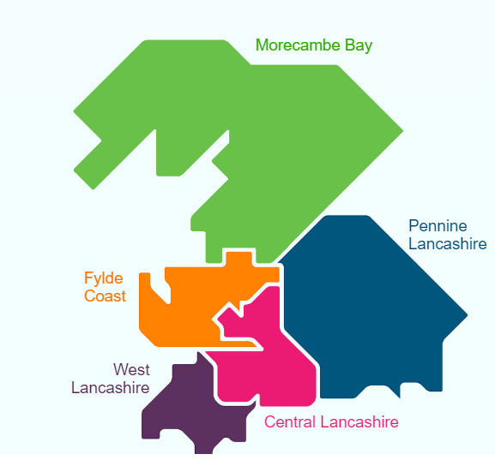


Lancashire &
South Cumbria
Cardiac Network
Heart Failure Pathway
December 2022

Slide 2
Contents
Foreword |  | 3
Introduction |  | 4
Prevention of Heart Failure |  | 6
The Pathway |  | 7
Key Areas for Improvement |  | 8
Stage 1: Case Finding and Early Diagnosis |  | 11
Stage 2: Management of Heart Failure (Acute / Chronic) |  | 14
Stage 3: Advanced Therapies |  | 22
Stage 4: Lifetime Management and End of Life |  | 24
Glossary |  | 29
Abbreviations |  | 30

Slide 3


Foreword
Lancashire & South Cumbria
Cardiac Clinical Network
Improving heart failure services for people
The Lancashire & South Cumbria Cardiac Network provides clinical expertise, high quality
clinical leadership and advice to improve cardiac population health and care services to the population of our region.
Cardiac Networks have been formed to work with local integrated health and social care systems to ensure when patients require treatment for heart conditions, they have easy and quick access to the most efficient and effective pathways, delivering the best outcomes for patients and families.
The Network includes the Placed based
locations* of:
Blackpool
South Cumbria
Lancashire
Blackburn with Darwen
* The Lancashire and South Cumbria ICB has reviewed the geographical make-up of its Place Based Partnerships to align to Local Authority boundaries.
We work and collaborate with all stakeholders - patients, carers, health and social care partners, GP and community based professions providers, members of the VCFSE, universities and individual local community networks and teams - to bring real improvements in health and wellbeing outcomes and equity of access to all cardiac services in our area.
Over the last few years we have made great progress in improving the way our services work together and how we work as a partnership across Lancashire and South Cumbria. We continuously strive to support the transformation of health outcomes, the provision of equitable access to all cardiac services in our area with an aim of patients and the public experiencing:
Reduced mortality due to cardiovascular disease
More preventative and proactive care,
so people remain healthier longer and
avoid unnecessary admissions to
hospital
Better quality and safety of care across
the cardiac pathways leading to better outcomes
Reduced waits for diagnostics,
specialist assessment and care
as services are restored post-COVID
Better experience of care
More equitable access to care across
different groups and different geographies
More sustainable costs of care.
We would particularly like to thank the members of the Cardiac Network Heart Failure Clinical Advisory Group and to those organisations and individuals who attended the Heart Failure Pathway Workshop on 27 September 2022, in the production of this document, their contribution was vital.
Dr R More Dr S Chadaide
Consultant Cardiologist Consultant Cardiologist
Chair Cardiac Clinical Network Clinical Advisory Group Heart Failure Lead
Lancashire and South Cumbria Lancashire and South Cumbria
Clinical Networks Clinical Networks
Including how the document has been produced
Including how the document has been produced
Including how the document has been produced
Dr Ranjit More and Dr SC
every ones details here

Slide 4
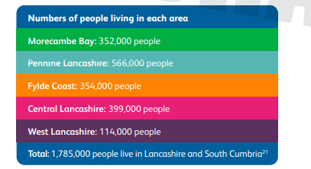
Introduction
Heart Failure in Lancashire and South Cumbria
Our Population
There are nearly 1.8 million people living in Lancashire and South Cumbria across a large geographical area. Statistics from the British Heart Foundation™ show that one in four people in England die from Cardio-vascular disease (CVD)
We understand from data and conversations with local people that our residents have very different needs, opportunities, assets, views and experiences. Similarly, our data tells us they have different day to day lives, different factors contributing to their health and wellbeing and even different life expectancies.
Understanding the demographics is vital to providing the best quality health and care services for the region and maintaining a strong relationship with the population we serve.
Number of people living in each
area of the region:
What is heart failure?
Heart failure is a long term condition in which the heart is unable to pump blood properly around the body. It is characterized by relapses and remissions, and in end stage disease, many people have multiple admissions to hospital and high contact across many healthcare services.
Mortality rates for heart failure are high, with 40% of newly diagnosed patients dying within a year, and 50% of patients either readmitted to hospital or dying within a year of admission to hospital. Despite these poor outcomes early diagnosis, optimal treatment and responsive management can result in significantly increased life expectancy, as well as better quality of life for heart failure patients.
Cardiovascular disease remains one of the leading causes of mortality in England, accounting for a quarter of all deaths each year and many more people living with the debilitating effects. By reducing unwarranted variation, and closing gaps in provision, there is potential to deliver improved outcomes for thousands of people each year. In making our recommendations, we do not seek to be prescriptive; rather, our aim is to create stronger systems and support to enable colleagues to do their best and level up to best practice.
Heart failure cannot be cured, but with appropriate symptom management people with heart failure can be supported for many years. The total cost of heart failure to the NHS is estimated at 2% of its annual budget. However, evidence suggests that well-developed heart failure services consume less budget overall¹. These services focus on:
The organization of multi-disciplinary care
Interventions that support transitional care
Ongoing follow-up
Co-ordination across primary and secondary care

Slide 5
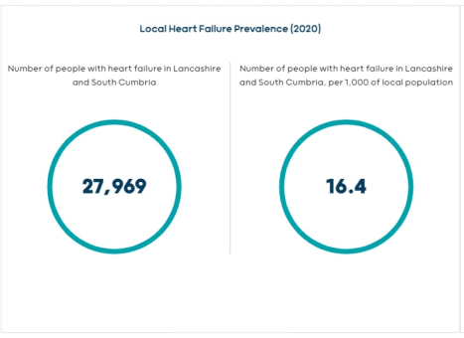
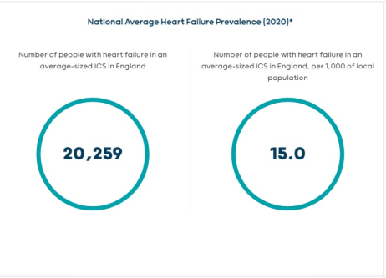
Introduction
Heart failure in Lancashire and South Cumbria
Prevalence and Recording
Epidemiological studies suggest that heart failure is present in approximately 1 to 2 per cent of the population. However, the prevalence of heart failure in the population varies significantly location to location (see heatmaps of HF prevalence on next two pages).
In the Lancashire & South Cumbria ICB footprint – according to “Cardiovascular Disease Jan 2018 Lancashire County Council” – 18,674 had a confirmed diagnoses of heart failure, accounting for 1.07% of the population. This gives the area a significantly higher prevalence than the England average of 0.79%.
When this is reviewed at a CCG level (pre ICB organisational structural change in 2022), all eight CCGs from across the ICB area have significantly higher levels of heart failure prevalence compared to England, with the figures ranging from 1.55% in Fylde & Wyre to 0.84% in Blackburn with Darwen.
This variability is influenced by a number of factors including:
Deprivation – nearly one third (29.1%) of the population in the ICS live in some of the most deprived areas across England – with the percentage living in fuel poverty (13.4%) is higher than the national average (10.9%)
Population demography – The percentage of the population over 65 is 19.7%, the national average for England is 17.3%. The percentage of the population in communities is 20.4%, the national average for England is 17%
Life Expectancy – is lover than the national average. There is a significant level of unwarranted variation in the number of years people can expect to live a healthy life expectancy disability free. This is predicted to be 68 years for children born today. In some neighbourhoods, healthy life expectancy is just 46.5 years.
Heath and Wellbeing – Around a fifth of adults are not meeting the recommended levels of physical activity.
Smoking – 18.5% of adults smoke, the national average for England is 17.2%
Approximately 40% of ill-health is due to smoking, physical inactivity, obesity and substance misuse.
Public Health England figures for 2020/21 also show heart failure admissions rates across L & SC are higher than the national average of 146/100,000, with rates varying between different parts of the region (eg Blackburn & Darwen 219, Greater Preston 188, Blackpool 170, Morecambe Bay 101). In addition in L&SC the length of stay (LoS) following a non-elective admission for heart failure stands at 10.3 days, which is slightly higher than the England average. Furthermore 12% of all heart failure admissions are readmissions within 30 days following a non-elective heart failure admission.
Commissioning effective services for people living with heart failure, such as cardiac rehabilitation for example, can deliver a 25% relative risk reduction in unplanned admissions. We are hoping will enhance close collaboration between Integrated Care System partners to co-design and commission effective heart failure services supporting the improvement of outcomes for all heart failure patients.

Slide 6
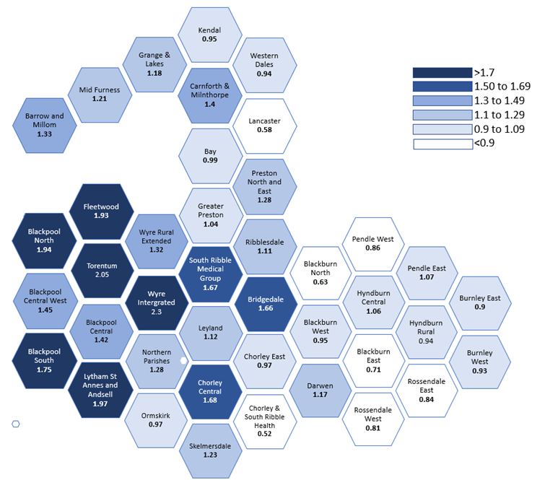
Lancashire & South Cumbria:
Heart Failure QOF Prevalence (2021-2022) ¹ by Primary Care Network
Prevalence Ranges (%)
https://digital.nhs.uk/data-and-information/publications/statistical/quality-and-outcomes-framework-achievement-prevalence-and-exceptions-data/2021-22 accessed Feb 2023
Date of Preparation: February 2023

Slide 7
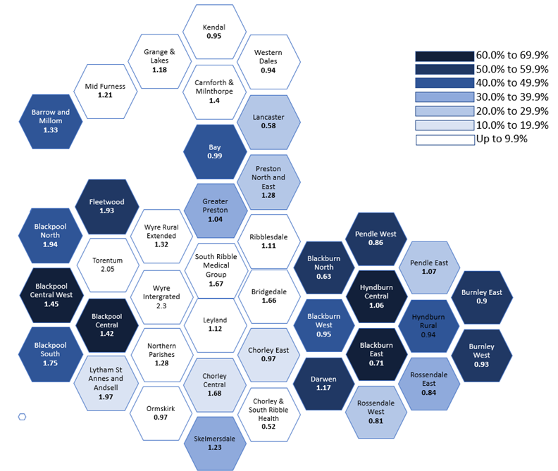
Lancashire & South Cumbria : Heart Failure QOF Prevalence¹ and the Percentage of Hospital Patients with Heart Failure in the 1st Quintile of IMD (20% most disadvantaged) by Primary Care Network (2021 – 2022) ²
% in 1st Quintile of IMD (20% most disadvantaged)
https://digital.nhs.uk/data-and-information/publications/statistical/quality-and-outcomes-framework-achievement-prevalence-and-exceptions-data/2021-22 accessed Feb 2023
IMD: Index of Multiple Deprivation (based on the Lower Super Output Area of the patient's address) for patients identified with an ICD-10 code for heart failure in the period April 2016 to March 2020 and with any admission or outpatient appointment in the period April 2019 to March 2020. Data taken from AstraZeneca asset ID GB-34068. Methodology of data analysis described in AstraZeneca asset ID GB-34068.
Copyright 2023, HES data re-used with the permission of NHS Digital. All Rights Reserved. Analysis performed by AstraZeneca UK Ltd. AstraZeneca are not responsible for the accuracy of the source data.
Date of Preparation: February 2023

Slide 8
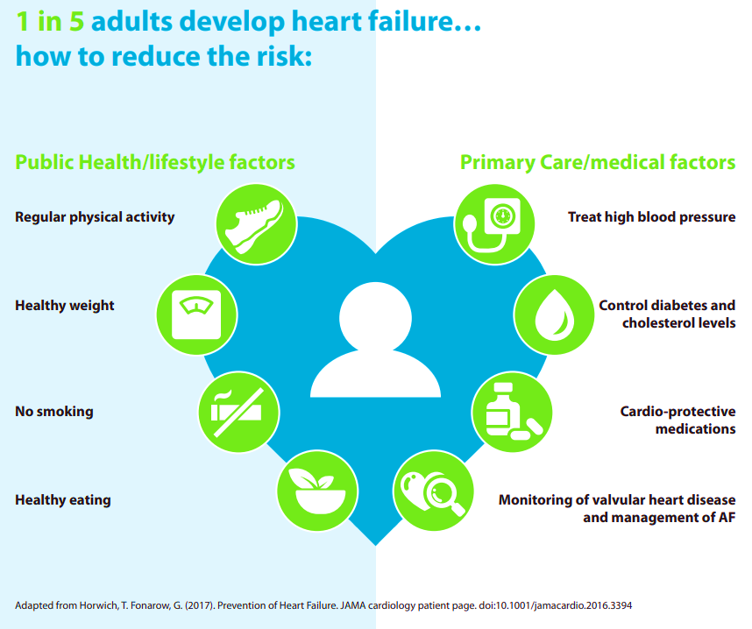

Prevention of heart failure
Improving cardiovascular health
Poor cardiovascular health can cause heart attacks, strokes, heart failure, chronic kidney disease, peripheral arterial disease and the onset of vascular dementia. Furthermore, it disproportionately affects people from the poorest communities.
Falling mortality rates from heart disease were the biggest cause of increases in life expectancy between 2001 and 2016 in England, according to the Health Profile for England. Published by Public Health England (PHE)
To complement the publication of the NHS Long Term Plan, the National CVD Prevention System Leadership Forum (CVDSLF) agreed specific ambitions for the detection and management of the high risk conditions – atrial fibrillation, elevated blood pressure, cholesterol – because although CVD mortality rates have almost halved over recent decades, there is no room for complacency in the efforts required to address the major challenges that CVD continues to play in individual lives, communities and society as a whole.
The establishment of Integrated Care Systems (ICSs) and the opportunities the integration of services, providers and pathways brings, along with the associated place based partnership structure, provide an ideal opportunity for all health and social care partners to co-produce local initiatives and services to improve the way we educate and support our communities health and wellbeing, thereby reducing their risk of cardiovascular disease.
Population health is one of the core strategic aims for ICSs and the adoption of Population Health Management (PHM) is a way of working to help frontline teams understand current health and care needs and predict what local people will need in the future. Local health and care services, and other local public and voluntary services can then design new proactive models of care which will improve health and wellbeing today as well as in future years time.

Slide 9
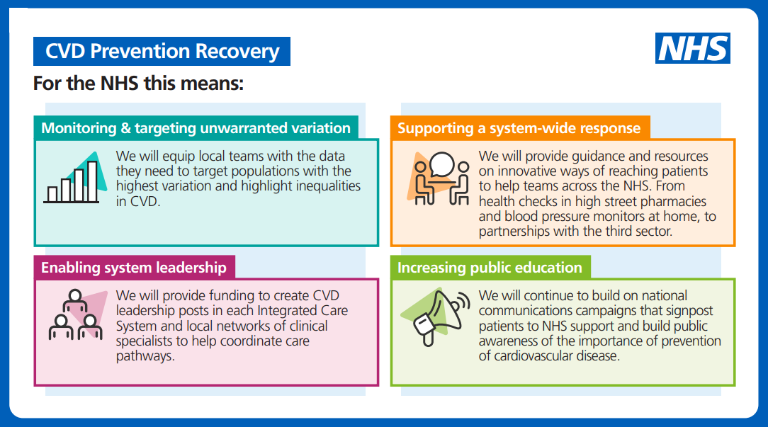
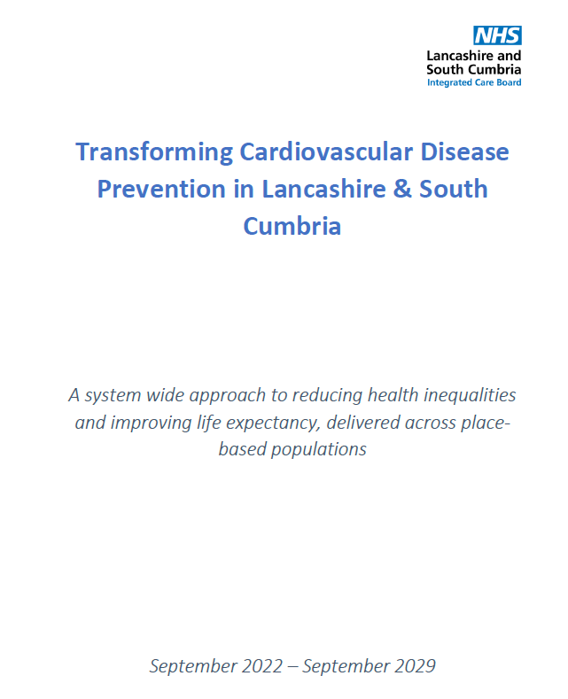
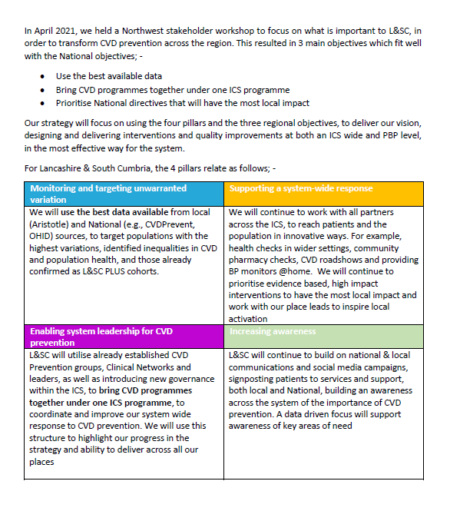
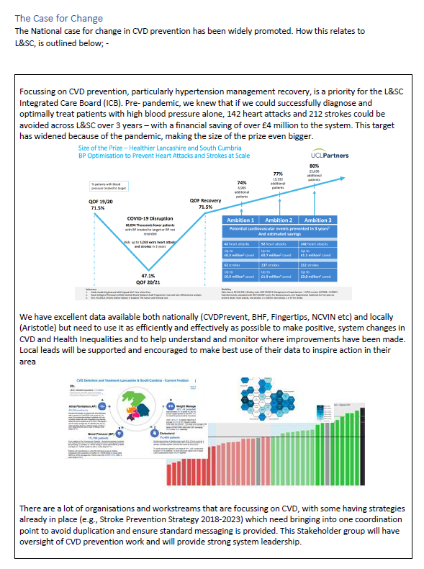

Prevention of heart failure
In Lancashire & South Cumbria, a programme of work around CVD Prevention, Detection and Management is underway. Governed within the Integrated Care Board (ICB) the workstream is a cross organisation programme, collaboratively working with partner organisations to not only improve the cardiovascular health of our population, but the overall health outcomes of our communities by using population health models.
The programme focuses on improving the prevention, detection and management of the ABC(D) conditions;
Atrial Fibrillation
Hypertension/High Blood Pressure
High Cholesterol/Lipids (including Familial Hypercholesterolemia)
Weight Management (with diabetes links).
The ICB have endorsed the Transforming Cardiovascular Disease Prevention in Lancashire & South Cumbria Strategy, which has been devised around National and Local priorities. It outlines the direction of travel for the region, as well as the desired outcomes for the population. The document is a collaborative piece written across the Integrated Care System (ICS), to ensure that the requirement of CVD prevention (and detection and management) is outlined, understood and addressed as a whole system.
Following on from the strategy, an ambitious work plan has been produced, focusing on where and how the whole system can have an impact on improving cardiovascular health. This includes a number of projects that compliment the strategy, including, but not limited to;
Raising Public awareness through campaigns and Healthy Heart & Brain website
Improving access to Blood Pressure checks within primary care and the community
Ensuring sufficient services/clinics are available for lipids and FH patients
Informing the system on support and tools available to treat patients more effectively
Optimising Care
Effective secondary preventative measures in IHD patients and VHD patients will be addressed in detail by the Cardiac Network IHD & VHD Working Groups respectively.
Optimisation of rhythm and rate control in patients with significant arrhythmias will be addressed in detail by the Cardiac Network HRM Working Group.
Improving cardiovascular health

Slide 10
Heart failure care pathway management stages
End to end care pathway
4 clinical management stages
Stage 1
Stage 2
Stage 3
Stage 4
Case finding and Early diagnosis
Surveillance and Escalation
Lifetime Management
& End of Life
Management
Heart Failure
of Chronic

Slide 11
Key Areas for Improvement
10 key areas for improvement and focus
Improving heart failure services for people
1 | Improved Prevention of Heart Failure | Heart failure is not inevitable and there are a number of opportunities to reduce the severity and even prevent the onset of heart failure. It is important that patients are given timely lifestyle advice on regular physical activity, maintaining a healthy weight and diet and avoiding smoking, alcohol or drug abuse. For those with predisposing health conditions such as a previous heart attack, high blood pressure or diabetes (this is not a comprehensive list) optimising medical treatments and lifestyle interventions alongside advising that patients continue to take prescribed medication regularly will protect heart muscle function. For anyone identified with heart failure, secondary prevention in the form of cardiac rehabilitation is extremely important and all patients should be referred.
2 | Early and rapid diagnosis | The possibility of a heart failure syndrome should always be considered in the early assessment of the breathless patient. The simple and accessible blood test, NT-ProBNP (or BNP), provides high sensitivity for a diagnosis of heart failure and will be a first-line investigation in any breathlessness diagnostic pathway (which will have echocardiography and specialist assessment as an integral part). This approach (which could be done in CDC, community or secondary care setting) will enable rapid recognition of patients with heart failure, allowing timely access to ongoing HF specialist care and heart failure treatments, which improve heart failure symptoms whilst significantly reducing morbidity and mortality. BNP is B type Natriuretic Peptide. It has a high negative predictive value in the diagnosis of heart failure. It is released in response to ventricular stretch. It is raised by heart failure, as well as left ventricular hypertrophy, atrial fibrillation, sepsis, chronic hypoxia, respiratory causes such as PE and pulmonary hypertension, and renal failure, liver cirrhosis and digoxin. It can be reduced by ACE inhibitors, ARBs, MRAs, diuretics and treating obesity.
3 | Optimisation of evidence based medical therapy | In HFrEF patients to ensure patients on ACEI/ARBs or ARNI, beta blockers, MRAs, SGLT2I and dose optimisation carried out. In HFpEF patients to ensure on adequate antihypertensive therapy, myocardial ischaemia controlled, AF rate controlled and SGLT2I considered in appropriate patients.
4 | Coordinated Patient Care to decrease mortality/ morbidity | In-patients should be reviewed by hospital Heart Failure Specialist Team prior to discharge for education and optimization of management. Post discharge care should also include the involvement of the community HFSN team, patient self monitoring, and possible remote monitoring (including device monitoring ). All HF teams should have a single point of contact hub available 24 hours a day (minimum dedicated answer machine facility). Best practice Patients should also have the ability to self care/manage and to contact named HF nurse/team from 24/7 single access hubs or other similar platforms – mobile devices, text/email/WhatsApp and allow for every accessibility need. All health and care professionals should have access 24/7 to advice about their patients. Care pathway changes should ensure they consider interoperability of care records (shared care patient record) and link into any system wide work in this area. Robust communication lines should be in place between patients, primary care, community and secondary care HF specialty services. When patients or carers should to call for advice Any change in heart failure symptoms e.g. oedema, orthopnoea, weight gain, dizziness & palpitations Symptoms as a result of medication changes 999 if syncope, acute SOB at rest, sustained symptomatic tachycardia/bradycardia When GPs or other clinical colleagues should be called for advice Non-heart failure related symptoms Simple titration of heart failure medication as recommended by HF team Once fully discharged from heart failure follow up, routine six-monthly medication and blood result review

Slide 12
Key Areas for Improvement
10 key areas for improvement and focus
Improving heart failure services for people
5 | Enhance managing Co-morbidities and end of life care | Heart failure symptoms or clinical signs are often non-specific and exclusion of other causes or exacerbations of existing medical conditions is recommended. Symptoms and signs may present differently and may be more difficult to identify or interpret in e.g. obese patients, elderly or young. When considering a move towards a palliative care focus, pre-existing conditions should be taken into account and a multidisciplinary approach should be applied. It is advised that the multidisciplinary team negotiate involvement depending on presenting symptoms; specialist palliative care services should be considered.
6 | Minimise inappropriate cessation of HF therapy | To note the following guidance when managing renal function in heart failure patients: During initiation and titration of RAAS inhibitors, testing renal function is mandatory; a decline in renal function of UP TO 30% can be acceptable. During intercurrent illness, there is no evidence that stopping RAAS inhibitor is beneficial, but if patient is hypotensive, potassium rises above 6.0 mmol/L, or creatinine rises more than 30%, RAAS inhibitors should be reduced in dose or temporarily withheld. The HF specialist team should be consulted or informed of this decision as soon as practicable. The Renal Association & Resuscitation Council recommendation for reassessment of patients with hyperkalaemia is for serum potassium levels > 5.5 and treatment being required if they have hyperkalaemia associated ECG changes or if levels are > 6.0. https://renal.org/sites/renal.org/files/ RENAL ASSOCIATION HYPERKALAEMIA GUIDELINE 2020.pdf – algorithms on pages 156–158 provide a summary. In patients with fluid retention, high doses of diuretic are needed and a decline in renal function is not an indication to reduce diuretic dose: if the patient remains congested, more diuretics are required. If the patient is hypovolaemic or hypotensive, diuretics should be stopped should be reviewed to ensure the minimum dose required to maintain euvolaemia is prescribed. A trial and error approach is appropriate providing adequate surveillance is in place. The only way to tell if a patient has fluid retention, is just right, or is hypovolaemic is to examine them clinically. Towards end-of-life, consider stopping RAAS inhibitors. RAAS inhibition has no known prognostic benefit in heart failure with preserved ejection fraction unless used to control hypertension to readings consistently <130/80 Efforts should be made to initiate, titrate and maintain patients with HFrEF on RAAS inhibitor treatment, whether during intercurrent illness or worsening heart failure. Clark AL, Kalra PR, Petrie MC, et al - Change in renal function associated with drug treatment in heart failure: national guidance. Heart 2019;105:904-910
7 | Enhance Cardiac Rehabilitation uptake | All patients with heart failure symptoms and a confirmed diagnosis of either HFrEF or HFpEF should be offered cardiac rehabilitation (CR). For patients with HFrEF, attending and completing a course of exercise-based CR has been shown to dramatically reduce unplanned hospital admissions (any cause and HF-related) and improve quality of life. For patients with HFpEF, CR results in improved exercise capacity and quality of life. CR should commence as soon as possible once the diagnosis has been confirmed and if/when acute hospital care is not required.
8 | Improve access to advanced therapy | Consider HF patients for a. CRT-P /CRT-D /ICD/SICD in appropriate patients. b. AF ablation may be a consideration in patients with HF symptoms and poor control of heart rate c. Revascularisation in those with ischaemic symptoms d. Surgical/transcatheter intervention in those with significant valvular heart disease e. Early referral to transplant centre for appropriate patients
6

Slide 13
Key Areas for Improvement
10 key areas for improvement and focus
Improving heart failure services for people
9 | Improve Acute/ Decompensated Heart Failure Outcomes | Acutely Decompensated Heart Failure is the rapid worsening of symptoms and/or signs of HF—as a de novo presentation or in a known HF patient—that warrant immediate medical intervention. Early intervention in the community in those with known heart failure (up-titration of therapy including iv diuretics). Effective treatment of any precipitating factors e.g. infection, fast AF, myocardial ischaemia/infarction, significant valvular heart disease. Specialist HF review whilst inpatient. Minimise readmissions – early reassessment and treatment up-titration in the community/primary care by HF team.
10 | Enhance patient self care: Minimise patient visits | Encourage patient self care and patient digital monitoring and early interaction with HF service (daily weight, patient passport/EPR, HF at home etc) Early community interventions (increase diuretics, referral to ambulatory iv diuretic clinic etc.) Enhanced patient self-care by supportive monitoring of patients eg. Heart Failure @ Home or virtual wards (where available) Support GP/community HCP monitoring of patients through utilization of heart failure advice and guidance platforms Improve communications between patient, primary care, community and secondary care.

Slide 14
Stage 1: Case Finding and Early Diagnosis
Diagnosed “Heart Failure” in Lancashire & South Cumbria*
Heart Failure
18,674 patients from across the Lancashire & South Cumbria ICS footprint have a confirmed diagnoses of heart failure, accounting for 1.07% of the population. This gives the area a significantly higher prevalence than the England average of 0.79%. At a place-based partnership level, all 4 locations across the ICS have significantly higher levels of heart failure prevalence compared to England, with the figures ranging from 1.55% in Fylde & Wyre to 0.84% in Blackburn with Darwen. " –
*Cardiovascular Disease Jan 2018 Lancashire County Council
Diagnostics
BNP/NT-proBNP is released in response to ventricular stretch and is raised in heart failure and proved to be an invaluable biomarker in the diagnosis of heart failure. It has very high negative predictive value hence if it is very low presence of symptomatic or decompensated heart failure is very low probability.
It is to be emphasised that its level can be increased in variety of other non-HF clinical entities such as left ventricular hypertrophy, atrial fibrillation, sepsis, chronic hypoxia, respiratory causes such as PE and pulmonary hypertension, and renal failure, liver cirrhosis and digoxin. We would like to emphasise BNP/pro-BNP measurement is to aid diagnosis of new onset HF in patients presenting with signs and/or symptoms suggestive of cardiac failure. It is important to acknowledge that in patients who already have a pre-existing diagnosis of HF, random measurement of BNP/pro-BNP is of very low clinical value and is not encouraged in this document.
Echocardiography
NICE (NG106) recommend transthoracic echocardiography to exclude important valve disease, assess the systolic (and diastolic) function of the (left) ventricle, and detect intracardiac shunts. Transthoracic echocardiography should be performed on high-resolution equipment by experienced operators trained to the relevant professional standards. Need and demand for these studies should not compromise quality and those that report echocardiography are experienced in doing so.
Current typical echocardiogram reports will classify left ventricular systolic function. Quantification of left ventricular ejection fraction whenever applicable and aids classification of HF syndrome based on ejection fraction. This will have significant impact on evidence-based medical therapy selection. Request are expected to contain relevant information (history of MI, pre-existing atrial fibrillation, relevant ECG findings, relevant co-morbidities etc.) and the clinical question to be answered. the type of heart failure.
Heart failure can be classified based on measured left ventricular ejection fraction (LVEF): heart failure with reduced ejection fraction (HFrEF), heart failure with mildly reduced (HFmrEF) and preserved ejection fraction (HFpEF).
Heart failure with preserved and mildly reduced ejection fraction are defined as the presence of signs and symptoms of HF with a normal or only mildly reduced ejection fraction. There should be evidence of other relevant structural heart disease (left atrial enlargement, left ventricular hypertrophy) or raised natriuretic peptides or evidence of left ventricular diastolic dysfunction. This has been previously known as diastolic dysfunction heart failure or diastolic heart failure.
Identification of new and existing patients in Primary Care
Heart failure admissions in the UK are high and usually prolonged with consequent burden on the NHS workforce and resources, as well as significant morbidity and mortality for heart failure patients. Early identification of patients would provide opportunity for early therapeutic interventions thus reducing unplanned hospital admissions, improving prognosis, morbidity and mortality.
Atypical presentations (young age, no clinical signs of overload etc.) to be considered as potential new onset HF patients in Primary Care to facilitate early diagnosis (many patients treated for asthma, chest infection etc. prior to HF being considered).
Furthermore, many patients who have already been treated for heart failure, at least partially, fail to be captured on NHS IT systems or to be seen by a heart failure specialist; these patients remain at high risk of morbidity and mortality without the correct therapies.
Identification of new and existing patients in primary care requires:
Detection of asymptomatic patients who are at high risk of
developing heart failure symptoms, including:
Patients with high risk co- morbidities i.e.
coronary artery disease
atrial fibrillation
valvular heart disease
diabetes mellitus
hypertension
hyper lipidaemia
pre-existing cardiomyopathy

Slide 15

Stage 1: Case Finding and Early Diagnosis
Breathlessness
Primary care disease registers & IT systems can be utilised to case-find these high-risk patients, as well as commercial tools that can be provided. Examples include GRASP-HF and Attend2. You may also want to consider any data and tools that may be in development within your ICS and/or local stakeholders.
In order to rapidly diagnose possible symptomatic heart failure patients, there needs to be an awareness of the signs and symptoms of HF, coupled with fast access to diagnostic tests and specialist assessment. The signs and symptoms of heart failure, however, can be very similar to those of other conditions, such as respiratory disease. With breathlessness and fatigue, it can be common for this to be attributed to natural ageing or a lack of physical fitness, which can delay diagnosis and treatment.
Education and awareness raising of signs, symptoms and possible causes of heart failure, are essential in ensuring prompt referral for assessment. Providing clear access routes into the heart failure from other condition pathways, will also be vital to provide a swift diagnosis.
Having an integrated breathlessness pathway (pending development in collaboration of respiratory specialists) will mean that heart failure is always a consideration in patients with new onset dyspnoea.
The breathlessness pathway outlined here, suggests early use of NT-proBNP combined with ECG, spirometry, chest X-ray and other blood tests, as these are generally easily accessible to primary care. Community Diagnostic Breathlessness Hubs are under development. This level of diagnostic investigations would provide a clearly outlined pathway exit point and as speedy entry point directly onto the Heart Failure pathway at the point of specialist investigation and assessment. This example pathway will need to be localized to fit the availability of diagnostics and local expertise, but it has the advantage of being able to be delivered by primary or integrated community services, truly supporting early-diagnosis of heart failure.
Breathlessness
Consider NT-proBNP and ECG / Spirometry/ CXR
Other investigations depending on clinical indication e.g. FBC, TFT, iron studies etc
NICE clearly advocate using NT pro-BNP due to its sensitivity and specificity but
please note – where only BNP available, BNP levels of <100 are considered normal and those >400 are suggestive of heart failure
NT-proBNP 400-2000ng/l
and/or
Abnormal ECG
BNP
<100 = normal
>400 = suggests HF
NT-proBNP >2000ng/l
NT-proBNP <400
and
Normal ECG
Abnormal spirometry
Or
CXR suggesting
pulmonary disease
Echo plus HF
Specialist review
<6 weeks
Echo plus HF
Specialist review
<2 weeks
Unlikely to be heart failure, consider alternative diagnosis
Consider respiratory cause and specialist assessment
See also – BSH position statement on NTproBNP cut offs in Emergency Departments - https://static1.squarespace.com/static/62416ca389785537abb9dea3/t/67d450c97553a23f056d03ba/1741967561492/240412%2BBSH%2BPosition%2BStatement%2B-%2BNT-proBNP%2Bcut-offs%2Bfor%2Buse%2Bin%2BAcute%2BHeart%2BFailure+%281%29.pdf

Slide 16
Stage 1: Case Finding and Early Diagnosis
Suspected heart failure:
Seek diagnosis
Possible Heart Failure – case finding in primary care
Consider tools such as Attend 2/GRASP HF / Oberoi or any developed or developing platforms available locally
Based on NICE guideline (NG106)
Undertake:
History
Clinical examination
NT-proBNP *see notes
ECG
Echocardiography
Chest X-ray
Blood and other tests:
Renal function (inc. eGFR)
Thyroid function profile
Liver function profile
Lipid profile
Glycosylated haemoglobin (HbA1c)
Full blood count
Urinalysis (inc. ACR)
Peak flow or spirometry (if considering other diagnosis)
Check the existing heart failure LVSD register for accuracy of diagnosis and code appropriately *see notes
Patients with the following comorbidities who present with symptoms raising suspicion of HF: AF, stroke, MI, IHD, hypertension, valvular disease, high cholesterol, COPD, recurrent chest infections, CKD, diabetes, asthma, CMP
Has there been a previous test in the past 12 months –
ECG, echo, NT-proBNP, chest x-ray?
No
Yes / positive
Yes / negative
Consider heart failure diagnosis now or review in the future
Add to heart failure register and assess accuracy of diagnosis and code
Medication review and reconsider heart failure in the future
Measure NT pro-BNP
NT-proBNP <400 ng/l
(47 pmol/l)
Heart Failure not confirmed
Consider other causes of symptoms with specialist heart failure team input if concern persists
NT-proBNP 400-2,000ng/l
(47-236 mml)
Refer urgently to be seen within 6 weeks
Heart Failure confirmed
Assess severity/establish
NICE clearly advocate NT-proBNP due to its sensitivity and specificity but please note where this test is not available:
BNP levels <100 are considered normal
BNP levels >400 are suggestive of heart failure
Specialist Clinical assessment including transthoracic electrocardiography
Assess severity, aetiology, precipitating factors, type of cardiac dysfunction and correctable forces Refer to Stage 3
Consider cognitive assessment screening.
NT-proBNP >2,000 ng/l
(236 pmol/l)
Refer urgently to be seen within 2 weeks

Slide 17
Stage 2: Management of Heart Failure (Chronic & Acute)
The Heart Failure Multidisciplinary Team
Heart failure management requires a holistic approach. Close co-operation of various members of the multi-disciplinary team and patients are heavily rely on effective communication amongst the members of the team. In order to deliver high-quality care for these patients commitment to a coordinated and continuous healthcare delivery with an understanding of the workforce roles and responsibilities, supported by clear channels of communication, which then facilitate opportunities for shared learning and education. Advancements in current digital technology are expected to result in more and more digital technology emerging in contemporary heart failure management practice in the upcoming years.
The heart failure multidisciplinary team with headline responsibilities: patient/their carers, HF specialist nurse, HF cardiologist, pharmacist, primary care, cardiac rehabilitation, cardiac psychologist, palliative care team
Heart Failure Specialist
The core specialist heart failure multidisciplinary team includes:
A lead physician with subspecialty training in heart failure (usually a Consultant Cardiologist) who is responsible for making the clinical diagnosis
A Specialist Heart Failure Nurse
A healthcare professional with expertise in specialist prescribing for heart failure (Adapted from NICE’s Guideline on chronic heart failure in Adults rec 1.1.1)
Offering in both hospital and community locations.
Diagnosis of heart failure syndrome and stage, including end of life
Acute Care
Development of long-term management plan including patient and carer / family education.
Reassessment of decompensating heart failure
Specialist only interventions i.e. sacubitril valsartan, cardiac devices. Advising on complex problems with difficult decision making
Routine monitoring of patients with severe heart failure syndromes
Consider the use of technology for remote monitoring of heart failure
Utilize remote monitoring via cardiac device or via self monitoring platform
Primary Care
(GP, Practice nurse, HCA, physician assistant, pharmacist)
Early symptom recognition and investigation, referral for diagnosis, and identification of end of life stage
Ensuring coordinated care 6–12-month review for all heart failure patients including optimization of comorbidities
Lifestyle counselling and interventions
Escalation of complex or worsening heart failure
SGLT2 prescription
Community services (District Nurse, Community Care Practitioner)
Care of housebound patients
Support with IV diuretics at home/ ambulatory clinic
Palliative care
Cardiac diagnostics
ECG and echo
CMR and other imaging
Expert support in interpretation
Dedicated heart failure device follow-up clinics
Cardiac Rehabilitation
A comprehensive programme accessible for all patients that provides advice and support on lifestyle and risk management, psychosocial health, education health and behaviour change and physical activity. This is offered in a variety of locations.
https://www.bacpr.org/s/BACPR-Standards-and-Core-Components-2023.pdf
Advanced Care Planning and Palliative Care services
Advanced care planning / supportive care and involvement of palliative care team when felt appropriate in terms of support with symptom management not just at end of life. ACP discussions should commence at the start of diagnosis.
Other specialists
To manage complex comorbidities e.g. nephrology and respiratory. To link to MDT for support with difficult decision making in the context of multimorbidity
Social Care
Social care provision in increasing frailty

Slide 18

Stage 2: Management of Chronic Heart Failure
Four pillars of medical therapy
Patients with chronic heart failure secondary to HF with reduced ejection fraction (HFrEF) are at high risk of HF related mortality and morbidity. Guideline directed medical therapy (GDMT) is aiming to improve prognosis, improve symptoms, quality of life and reduce risk of unplanned heart failure hospitalization.
Various group of medications have been found to reduce HF associated mortality and morbidity acting on different levels of the maladaptive activation of the neurohormonal system secondary to impaired cardiac function.
For many years these included beta blocker therapy and renin-angiotensin-aldosterone-system (RAAS) inhibition at various levels.
Since the novel discovery of positive impact of SGLT2 inhibitors on HFrEF, contemporary guideline directed medical therapy is now considered using four different groups of drugs often referred as the “four pillars” of HFrEF pharmacotherapy.
The “four pillars” are:
ACEI/AR/ARNI (sacubitril/valsartan)
Beta blocker therapy (bisoprolol, carvedilol, metoprolol)
Mineralocorticoid receptor antagonists (spironolactone, eplerenone
SGLT2 inhibitors (empagliflozin and dapagliflozin)
Commencement and/or up-titration of these medications is key to achieve mortality and morbidity benefit observed in large randomized trials. However, medications like sacubitril/valsartan is recommended to be managed in specialist clinics, other medications such as SGLT2 inhibitors might be prescribed in primary practice so patients can merit its benefit while waiting for specialist input.
Additional therapies in HFrEF
As highlighted in the below flowchart, patients with persistent symptoms may benefit from additional pharmacological and cardiac device therapies. These are normally assessed in specialist clinics and they are aiming to reduce symptom burden and reduce risk of unplanned hospitalization from HF.
Heart Failure with preserved ejection fraction (HFpEF)
Evidence-based recommendations on dapagliflozin (Forxiga) for treating chronic heart failure with preserved or mildly reduced ejection fraction in adults.
Dapagliflozin is also recommended for treating chronic heart failure with reduced ejection fraction in adults (NICE technology appraisal guidance 679).

Slide 19
Stage 2: Management of Chronic Heart Failure
Chronic heart failure: 6–12 month condition and therapy review
Patients with chronic heart failure require long term holistic approach. No one fit all advice is practical regarding frequency of follow-ups and this should be individualized according to symptoms, co-morbidities, co-existence of other cardiovascular morbidities such as cardiac arrhythmia, coronary artery disease etc. During routine follow-up the below aspects are recommended to be routinely considered and assessed:
Consider patient initiated follow-up (PIFU) in selected patients who are stabilized on guideline-directed medical therapy (GDMT)
Reassessment of the stage of heart failure. This will include evaluation of the New York Heart Association (NYHA) class and ensure GDMT has been implemented to the maximum tolerated and whether re-measurement of LVEF following GDMT is necessary to guide potential cardiac device therapy decision making.
Cardiac rehabilitation has been offered;
Co-morbidities are optimized;
Lifestyle modifications have been optimized;
Consider the impact of heart failure on their employment status and other lifestyle/wellbeing considerations
Consider social care assessment, including assessment of social isolation;
Identification of end stage heart failure and consideration of need for palliative care
Consider risk of anxiety and depression and the effect of this on the ability to self manage if this was not assessed/addressed at the outset
Screen for sleep apnoea where appropriate
Consider remote monitoring (including device monitoring), and virtual wards in selected patients
Discharging a patient back to general practice
All patients with heart failure including patients with HFpEF should have access to community HF services.
The community heart failure service will discharge a patient back to primary care for routine monitoring (at least every six months) when:
The patient is fully titrated on maximum tolerated heart failure medication.
The patient is stable and/or when specialist input no longer required/appropriate
The patient has been considered for device therapy and/or sacubitril valsartan.
The patient has been assessed for iron deficiency/iron deficiency anaemia and considered for IV ferric carboxymaltose, if appropriate.
Offered cardiac rehabilitation with support for patient’s self-management and adjustment of their diuretic therapies
Primary Care Management would also be for people with HF-pEF – patients do not usually require ongoing specialist review as management is of their comorbidities and diuretic therapy.
Once optimised – discharge back to GP with 3-month open appointment (PIFU, remote monitoring (eg HF at home), A & G etc
Palliation
Cardiac diagnostics
Transthoracic echocardiography, Holter ECG, advanced echo modalities, coronary angiography (CT or invasive), cardiac MRI, nuclear imaging to ascertain ischaemic aetiology, need for revascularization etc.
Cardiac devices
Implantable cardioverter defibrillators (ICDs) are recommended on top of GDMT to reduce the risk of sudden cardiac death.
Secondary prophylaxis:
Have survived a cardiac arrest caused by either ventricular tachycardia or ventricular fibrillation.
Have history of sustained VT causing syncope or hemodynamic compromise
Primary prophylaxis:
No history of sustained VT or VF. Persistently low LVEF 35% or less in spite of GDMT.
Cardiac Resynchronization Therapy pacemaker (CRT-P) or defibrillator (CRT-D):
Cardiac resynchronization therapy with (CRT-D) or without defibrillator (CRT-P) is recommended for HFrEF to improve prognosis and symptoms who have broad QRS and LVEF 35% or less in spite of GDMT. For further information see table https.org.uk/guidance/ta314/chapter/1-Guidance

Slide 20
Stage 2: Management of Chronic Heart Failure
Cardiac Rehabilitation
The third edition (2017) of the British Associations of Cardiovascular Prevention and Rehabilitation (BACPR) Standards & Core Components represents current evidence-based practice and a pragmatic overview of the structure and function of Cardiovascular Prevention and Rehabilitation Programmes (CPRPs) in the UK.
Guidelines can be accessed here:
https://www.bacpr.com/resources/BACPR_Standards_ and_Core_Components_2017.pdf
The evidence base for cardiac rehabilitation in people living with heart failure is strong and embedded in all national and international heart failure guidelines. For individuals with a diagnosis of HFrEF, exercise-based programs of cardiac rehabilitation impact favorably on unplanned HF hospitalization, with a 25% relative risk reduction in unplanned admissions. The need for acute hospital care due specifically to heart failure related issues can be reduced by 39% (NNT 18) and overall quality of life significantly improved. When the diagnosis is HFpEF, exercise-based cardiac rehabilitation again proves to be a very effective intervention, significantly out-performing standard heart failure drug therapies in terms of benefits on exercise capacity and quality of life measures.
Referral criteria
New diagnosis of HF or recent step change in NYHA and clinically stable for exercise
Cardiac rehabilitation staff need to know if the patient has been referred for device therapy and is the patient suitable and or been referred for sacubitril/valsartan. The referral criteria
New diagnosis of HF or recent step change in NYHA and Clinically stable for exercise
Cardiac rehabilitation staff need to know if the patient has been referred for device therapy and is the patient suitable and or been referred for sacubitril valsartan
Referral
Referral systems differ across Lancashire and South Cumbria. Find out what your local provider referral system is. Initial assessment/inclusion for core heart failure cardiac rehabilitation should be as per BACPR Accreditation recommendation (currently within 33 days – England average).
Cardiac rehabilitation offer 8–12 weeks program of education and exercise sessions hosted in a variety of venues – hospital, community and home-based. Patients are also offered virtual and digital offers of support in order to ensure their individual needs are met. Input from MDT should consist of CNS, exercise physiologist and or physiotherapist, dietician, pharmacist, occupational therapist, with psychological input and maintenance program leaders.
Cardiac rehabilitation should be delivered in venues that are easily accessible with good transport links, with choice of day or time to ensure adherence to the program.
Recent evidence also supports the concept of home-based CR for patients with heart failure – a cost-effective option that may be particularly suited to older, multi-morbid heart failure patients who would otherwise have great difficulty in attending/completing conventional ‘centre-based’ programs.
MDT Management
As a minimum, the team should have a lead physician with heart failure expertise, a specialist heart failure nurse and a specialist heart failure prescriber. MDT roles may include:
Securing the diagnosis and implementing/reviewing/optimizing therapies
Providing education and sign-posting to other services such as rehabilitation and palliative care
Assessing phase of illness and liaising with other healthcare professionals

Slide 21
Stage 2: Management of Chronic Heart Failure
Chronic heart failure treatment algorithm for new diagnoses and long-term review of therapies
Specialist advice/intervention
Heart failure diagnosed by a specialist
If symptoms persist seek specialist advice to consider the following treatments
If already on ACE, replace with Sacubitril-Valsartan (ARNI) as per NICE TA
https://www.nice.org.uk/guidance/ta388
Offer diuretics to relieve congestion symptoms
Ivabradine if in SR and HR>75 bpm in severe LVSD or EF <35%
https://www.nice.org.uk/guidance/ta267
Heart failure syndrome but
NOT significant LVSD
Criteria may include:
NT-proBNP>400 (BNP>100)
Mild LVSD – EF>40% on imaging*
  Left atrial enlargement
  Left ventricular hypertrophy
  Echo parameters fir diastolic dysfunction
Heart failure syndrome
AND significant** LVSD
Evidence of moderate or
severe LVSD on imaging
NT-proBNP>400(BNP>100)
** significant LVSD implies a visual description of LV systolic function to be moderately impaired or worse, and/or a calculated ED of <40%
Consider hydralazine and nitrate plus for patients with moderate-severe LVSD especially if of African/Caribbean origin
Digoxin for worsening HF
ttps://www.nice.org.uk/guidance/ng196
CRT-P or CRT-D or ICD as per NICE TAG314
Optimize treatment of co-morbidities (HTN, diabetes)
and lifestyle, diuretics,SGLT2 inh. in T2DM and CKD
Commence ARNI (if LVEF<35%) / ACE/ARB
+BB+MRA+SGLT2 inh.
HTTPS://www.nice.org.uk/guidance/ta679
CaReMeuk.algorithm
https://www.bsh.org.uk
Optimize therapy and monitor adherence
https://www....... (need local stuff
Advanced heart failure therapies (see stage 3)
If ARB and ACEi intolerant consider hydralazine and nitrate
If iron deficiency is established – defined as either
Serum Ferritin <100mg/L or
Serum Ferritin <20%-consider specialist referral for intravenous iron therapy in accordance with locally developed guidance/pathways. ESC Guidelines for the diagnosis and treatment of acute and chronic heart failure: Eur Heart J (2016) Jul 14;37(27):2096
Cardiac rehabilitation for all heart failure patients unless unstable
* Note: patients with heart failure symptoms and any degree of LV systolic dysfunction should be considered for ACE and ACEi and BB but the evidence base for efficacy remains strongest in those patients with a defined EF of <40%
Phase of Illness – have you considered
Patients identified as deteriorating despite effective management of underlying medical condition (s)
Clear, sensitive communication with patient and those identified as important to them
Including patient on the Supportive Care Record / GP Gold Standards Framework register and their care reviewed regularly
Request consent to share information and create EPaCCS record
A holistic needs assessment and a keyworker identified (including benefits (blue badge, prescription exemption etc.) and individual needs identified that are important are explored, respected and met as far as possible)
ICD/CRT discussion if applicable
All patients should be offered the opportunity of an Advanced Care Planning discussion
Defining palliative care in people living with heart failure – use of prognostic indicators
(e.g. GSF/SPICT/MAGGIC)
Cachexia / worsening E&Es/LFTs/Frailty/No reversible cause / low blood pressure / maximum tolerated therapy / two or more hospital admissions within last 6 months / comorbidities

Slide 22
Stage 3: Surveillance and Escalation
Management of decompensated heart failure
Acutely Decompensated Heart Failure
(Rapid worsening of symptoms and/or signs of HF as a de novo presentation or in a known HF patient, that warrant immediate medical intervention)
Hemodynamically stable?
SBP >90 mmHg
(compare usual BP Sats>90%
HR-50-130)
*obtain a manual blood pressure reading for patients reading for patients with atrial fibrillation
Refer to hospital or if in-patient (to HF Team) urgently if…..
Syncope or blackout
New shortness of breath at rest
Ongoing chest pain/suspicion of acute MI
BP <90mm Hg
Sats<90
HR>130
Pulmonary oedema
Suspicion of sepsis
No
Identification of Decompensation
Symptoms:
Worsening shortness of breath, fatigue or new shortness of breath at rest
Increased pillows at night (orthopnoea) or frequent wakening due to cough or breathlessness (PND)
Increased weight of >2kgs in 3 days
Fluid accumulation in the form of ankle/leg swelling, sacral oedema or abdominal distension
Signs
Low BP, increased heart rate, low oxygen saturations (compare with previous observations if available)
Peripheral oedema, increased JVP, sacral oedema
Pulmonary Oedema
Further clinical assessment
Blood tests – FBC, UEs, LFTs, TFTs
ECG, NT-pro-BNP in undiagnosed HF
Chest x-ray
Exclude other acute illnesses (pneumonia, COPD exacerbation, sepsis
Medication review
Urine for ACR if worsening renal function
This diagram needs constructing for this document – BC to do
Refer urgently to HF Team
Need for IV diuretics (community/ambulatory HF units/in-patients)
Early access to Echo and other diagnostics – assess if HFrEF/HFpEF/HFmrEF
Evidence-based HF medication and optimization
Consider Advanced HF therapies
Multi-disciplinary input including role of palliative input if appropriate
Patient education
Follow-up with HF team (hospital/community – irrespective of ejection fraction)
Referral to cardiac rehab
Yes
DO NOT STOP HF TREATMENTS WITHOUT DISCUSSING WITH HF TEAM
Primary Care Management
If diuretic naïve start Frusimide 40 mg OD/BD
If already on diuretics increase dose 1.5/2 times to maximum of Furosemide 80 mg BD or equivalent
Consider adding in a Thiazide (Bendroflumethiazide 2.5 to 5mg) alternate days or twice a week with close monitoring of renal function
Mineralocorticoid receptor antagonists (MRA); 12.5 – 25 mg daily
Phase of illness – have you considered?
Medical review
All reversible causes of deterioration explored
Clear, sensitive communication with patient and those identified as important to them
Person and agreed others are involved in decisions about treatment and care as they want
Prioritised as appropriate Gold Standards Framework meeting
Update EPaCCS Record as and when necessary
Work closely with other services e.g. Specialist Palliative Care
Review or offer Advanced Care Plan, share information with patients consent
DNR/CPR considered, outcome documented, information shared appropriately including ambulance service
A holistic needs assessment and a keyworker identified including benefits (e.g. blue badge, prescription exemption etc.) and individual needs identified that are important are explored, reported and met as far as is possible
Continuing Health Care funding
DS1500
Anticipatory medication prescribed and available
Equipment assessment
ICD discussion and deactivation
An opportunity for an Advanced Care Planning discussion?
Agree on-going monitoring and support to avert crisis
OOH/NWAS updated including DNA/CPR status and Advanced Care Plan

Slide 23
Stage 3: Surveillance and Escalation
Management of acute heart failure
Acute Heart Failure = Medical Emergency
(Initiative treatment simultaneously while arranging tests such as ECG, CKR, BNP, other blood tests)
Phase of illness – have you considered?
Medical review
All reversible causes of deterioration explored
Clear, sensitive communication with patient and those identified as important to them
Person and agreed others are involved in decisions about treatment and care as they want
Prioritized as appropriate Gold Standards Framework meeting
Update EP aCCS Record as and when necessary
Referral to other services e.g. Specialized Palliative care
Review or offer Advanced Care Plan, share information with patients consent
DNR CPR considered, outcome documented, information shared appropriately including ambulance service
A holistic needs assessment and a keyworker identified including benefits (e.g. blue badge, prescription exemption etc.) and individual needs identified that are important are explored, respected and met as far as possible
Continuing Health Care Funding / DS1500
Anticipatory medication prescribed and available
Equipment assessment
ICD discussion and deactivated
An opportunity for an Advanced Care Planning?
Agree on-going monitoring and support to avert crisis
OOH/NWAS updated including DNA CPR status and Advanced Care Plan
Cardiac Shock
(cold features-SBP<90, pre-syncope/oliguria)
Circulatory support
Stabilize -> ICU/CCU (inotropes / vasopressors)
* In line with agreed or preferred strategy and resources available within organisations
Respiratory Failure
(Type 1 / Type 2))
Ventilatory support
Stabilise -> ICU/CCU
(oxygen, non invasive or invasive ventilation)
Treat acute causes - (MI, arrhythmias, hypertensive emergency, mechanical causes, PE)
‘WET’ patient
Signs or symptoms of fluid overload
‘DRY’ patient
Adequate Peripheral Perfusion?
Adequate Peripheral Perfusion?
Wet and cold patient
Wet and warm patient or normal BP
Dry and
cold patient
Dry and
warm patient
(compensated)
Is Systolic BP<90 mm Hg?
Hypertension >congestion
(S BP>140)?
Congestion
Consider fluid challenge
Inotrope if refractory
Adjust oral medications
Diuretic
Vasodilator
Inotrope if refractory
D/w cardiologist
Inotrope ± vasodepressor
Diuretic once perfusion improved
Mechanical support (IA BP, VAD, ECMO)
Vasodilator
Diuretic
Inotrope if refractory
Diuretic
Vasodilator
Ultrafiltration if diuretic resistance
Refer to a renal physician if concerned about acute kidney injury or if renal therapies are to be considered/explored

Slide 24

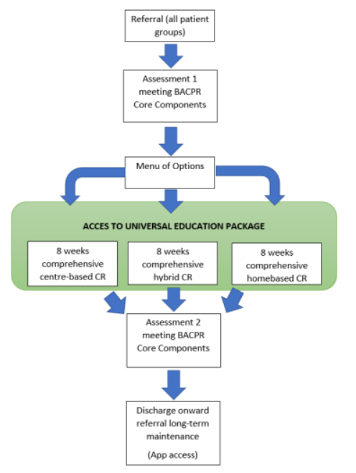
Heart Failure Services – Case Studies
Hospital at Home
National Early Adopter Pilot
Blackpool Victoria Hospital
Cardiology Heart Failure Service
The provision of digitally supported Heart Failure @ Home pathways/services is yet to be systemically introduced across the Lancashire & South Cumbria ICB, but the Cardiology team at Blackpool’s Victoria Hospital have successfully been accepted as an Early Adopter National Pilot for such a service following their successful bid earlier this year. Work will soon begin on the co-design and pilot with partner professionals and services building on successful learning of the teams to date.
What Does Hospital @ Home mean?
There are a variety of approaches across the NHS being piloted and / or implemented with the aim of the appropriate clinical team managing/supporting Heart Failure patients @ home to manage their own health and to stay well at home. Use is being made of developing remote monitoring, to support patient self-management and education. This can minimize unnecessary face-to-face appointments and reduce avoidable hospital admissions and readmissions. The @home approach can work alongside virtual wards, supporting patients who require acute care in their own homes. Experienced specialists in heart failure care will ensure any remote interactions are clinically safe and appropriate, ensuring consideration of individual needs.
Remote monitoring of Heart Failure parameters - fluid balance , patient activity (in addition to the more usual pacing / rhythm parameters measured by device) - is standard care for patients with devices locally. The Heart Failure nurses have worked on this themselves as a team across Lancashire, developing a strong network of cooperation between CPs and nurses and across Lancashire between HFN for other areas .
A patient facing app so that the patient can report on symptoms can be added to the device monitoring - and is coming on line imminently for a cohort of patients and they are beginning to roll that out using the same HFN / Clinical Professional network, in Fylde Coast first then looking at the opportunity for all through the HFN network.
The ‘HF @home’ Early Adopter Pilot will likely build on this experience by routinely enrolling all new diagnoses onto such a platform, including those without device, for additional support / surveillance. Slowly getting every HF patient on the GP register onto a single platform - analytics advantages will be significant – the potential QI approach to improvement using that data would be very exciting .
Starting in the Blackpool Place Based Partnership location this Early Adopter Pilot is an exciting opportunity.
Cardiac
Rehabilitation
Pilot
Morecambe Bay
Lancashire and South Cumbria has a population of 1.8m with one of the largest geographical areas being South Cumbria (300,000). Statistics from the British Heart Foundation show that in South Cumbria 1 in 3 people die from CVD, 27,000 live with CVD and 2,200 are diagnosed with heart failure. The BACPR Standards and core components state that comprehensive Phase III CR should be offered to priority groups (ACS, coronary revascularization and HF).
Phase III CR should meet minimum standards of delivery as outlined by the NACR 7 key performance indicators (KPI) ensuring optimal care. Currently, no L&SC trust meets all 7 NACR KPIs, further highlighting the service gaps that the L&SC Cardiac Networks mapping survey showed.
Within the pilot we are running, we will be looking to ensure that our CR Phase III services can;-
• Accept heart failure patients
• Provide face-to-face CR
• Provide Digital Home Based CR
• Provide a hybrid model of CR

Slide 25
Stage 3: Surveillance and Escalation: Advanced Therapies
Conventional criteria for heart transplantation
Impaired LV systolic function
NYHA III (eg, patient cannot climb one fight of stairs without symptoms) or IV symptoms
Receiving optimal medical treatment (including target or maximum tolerated doses of b-adrenergic antagonists, ACE inhibitors and aldosterone antagonists)
CRT device implanted (if indicated).
Evidence of a poor prognosis, for example:
  i Cardiorespiratory exercise testing (VO2 max <12 ml/kg/min if on b- blockade, <14 ml/kg/min if not on b-blockade, ensuring respiratory quotient ≥1.05)
  ii Markedly elevated BNP (or NT-proBNP) serum levels despite full GDMT
  iii Established composite prognostic scoring system, such as the HFSS or SHFM
BNP, B-type natriuretic peptide; CRT, cardiac resynchronisation therapy; HFSS, Heart Failure Survival Score; LV, left ventricular; NT-proBNP, N-terminal pro-B-type natriuretic peptide; NYHA class IV, New York Heart Association; SHFM, Seattle Heart Failure Model.
Uncommon indications for transplantation
Persistent haemodynamically compromising ventricular arrhythmias, refractory to all usual therapies (including antiarrhythmic drugs, catheter ablation, electrical device treatment, revascularisation)
Refractory angina, where there is clear objective evidence of recurrent significant (debilitating) myocardial ischaemia that is not amenable to conventional treatment (including all forms of revascularisation and full anti-anginal treatment)
Restrictive and hypertrophic cardiomyopathy with persisting NYHA III or IV symptoms refractory to conventional treatment and/or recurrent admissions with decompensated HF. Patients should have clear echocardiographic evidence of restrictive filling that can be confirmed by invasive hemodynamic studies, and the etiology should be clearly identified to ascertain the presence of a systemic disease and the risk for recurrence following transplantation
HF, heart failure; NYHA class IV, New York Heart Association.
Clinical indicators that should prompt consideration for referral
Two or more admissions for treatment of decompensated HF within the last 12 months
Persistent clinical evidence of overt heart failure after optimised medical treatment
Calculated SHFM score indicating a ≥20% 1-year mortality
Echocardiographic evidence of right ventricular dysfunction or increasing pulmonary artery pressure on optimal treatment (aim to refer before the PA systolic pressure exceeds 50 mm Hg)
Anaemia, involuntary weight loss, liver dysfunction or hyponatraemia attributable to heart failure
Deteriorating renal function attributable to heart failure or inability to tolerate diuretic dosages sufficient to clear congestion without change in renal function (aim to refer before creatinine clearance falls below 50 ml/min or the eGFR falls below 40 ml/ min/1.73m2)
Significant episodes of ventricular arrhythmia despite full drug and electrophysiology/device treatment
Increasing plasma BNP or NT-proBNP levels despite adequate HF treatment
BNP, B-type natriuretic peptide; HF, heart failure; eGFR, estimated glomerular filtration rate; NT-proBNP, N-terminal pro-Btype natriuretic peptide; PA, pulmonary artery; SHFM, Seattle Heart Failure Model.
Indications for urgent inpatient referral
Requirement of continuous inotrope infusion (or/ and intra-aortic balloon pump (IABP)) to prevent multiorgan failure
No scope for revascularisation in the setting of ongoing coronary ischaemia
Persisting circulatory shock due to a primary cardiac disorder
An absence of contraindications to transplantation
Banner, N., Bonser, R., Clarke, A et al (2011). UK guidelines for referral and assessment of adults for heart transplantation. Heart 2011;97:1520e1527. doi:10.1136/heartjnl-2011-300048
Conventional criteria for heart transplantation

Slide 26
Stage 3: Surveillance and Escalation
CONTRA-INDICATIONS MUST BE OBSERVED*
If there is a concern or question that mechanical circulatory support or transplant would be needed, then a direct conversation with the transplant fellow on call during the day, or the IVAD surgical fellow at night, should be made. They are based at Wythenshawe Hospital, part of the Manchester University Hospitals Foundation Trust.
In-patient decompensation
Stabilisation achieved
Out-Patient review
Not stabilised
No contra-indicators
Optimised medical therapy
CRT-p/d considered
Dietician/fluid management
Psychological Support
Cardiac Rehabilitation
If still symptomatic / limited
Renal evaluation/exclusion of significant intrinsic renal disease
Fluid management
Oncotic pressure management
If this fails…
Pre-renal
Declining ‘see-sawing U+E’
Low mean arterial pressure
Hepatic congestion
General signs of multiple organ failure
VBG (peripheral overestimate) Fick CO<2L/min
Refer as outpatient to Regional Transplant Assessment Centre
Start Inotropes and discuss with Tertiary centre urgently
Look at other potential causes
Update / repeat investigations
Advanced therapies
If there is any clinical uncertainty, discussion with the on-call transplant team, however there are some absolute contraindications to Ventricular Assist Device/ Transplantation as listed opposite.
Active significant substance abuse
Psychiatric illness that could jeopardise compliance (e.g. Psychosis requiring treatment)
History of non-compliance
Diabetes with microvascular complications (e.g. proliferative retinopathy, diabetic nephroplasty etc.)
Solid organ or haematological malignancy
Morbid obesity BMI 32-35.
Systemic (AL) Amyloidosis ATTRwt (Wild Type Transthyretin Amyloidosis) is not a contradiction
* http://www.jhltonline.org/pb/assets/raw/Health%20Advance/journals/healun/ISHLT_GUIDELINE.pdf

Slide 27
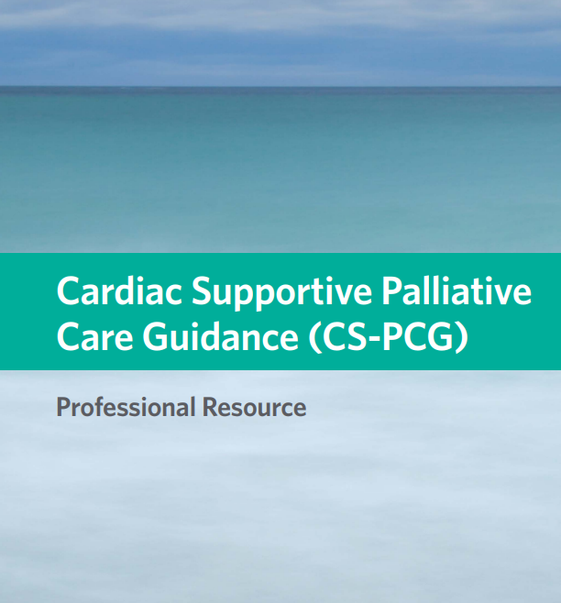
Stage 4: Lifetime Management and End of Life
End of Life and care for the dying person
When uncertain recovery is recognised - this may be through the use of prognostic indicators or by admission to hospital, reduction in renal function, or episodes of decompensated HF - thought should be given to thinking about supportive therapies such as palliative care This should lead to further discussions which may include Do Not Attempt Cardio Pulmonary Resuscitation (DNACPR) and treatment escalation options (formerly ceilings of care) and to identify if their wishes or priorities have changed.
It is vital all communication is done sensitively and if individuals indicate that they do not wish to discuss these issues then this too should be respected. The individuals person-centred holistic plan of care should be reviewed and any changes should be communicated with consent to the healthcare professionals involved with the individual from both primary and secondary care if applicable.
It is important to include and inform the patients family and friends in discussions when a plan of care is changed with the individuals consent. Including family and significant others will help to alleviate distress at what is a very difficult time for them. Families and friends input at this stage is necessary for both the individual and for the healthcare professionals to plan for end-of-life care if the individual’s condition should deteriorate.
Colleagues should give consideration to the
Cardiac Supportive Palliative Care Guidance
(CS_PCG) Professional Guidance which
are published in the resources section of BSH.
Other issues that may need to be addressed if there is recognition of increasing decline or a period of uncertain recovery may include:
Medical Emergency Team (MET) status
Consideration should be given to the Medical Emergency Team (MET) status of the individual within the secondary care setting. Parameters should be clearly documented within the medical and nursing notes and on the NEWS chart to avoid unnecessary distress and burden to the individual and their family and friends.
Implantable Cardioverter Defibrillator (ICD)
When it is recognized that there is increasing decline in the individuals condition, if applicable ICD (Implantable Cardioverter Defibrillator) therapy needs to be reviewed as defibrillation can cause physical discomfort and emotional distress to the individual, their family and friends. Healthcare professionals have a duty of care to consider withdrawal of non-contributory therapies – and the distress caused by resuscitation measures in those near the end of life with a progressive and irreversible decline in their condition.
The decision as to when to deactivate can be difficult and discussions may be appropriate through the unstable period of illness during chronic management or management of decompensated heart failure and discussions should be had, with deactivation being undertaken prior to the deteriorating phase
Deactivation should be formally documented and all relevant healthcare workers involved in the individuals care must be informed, including ambulance and out-of-hours health services. Local policy should be followed.
How to arrange deactivation
The decision to withdraw ICD therapy must be made by the health care professional (HCP) in charge of the patient care in consultation with the multidisciplinary team and having first obtained a competent patient’s consent. If the patient lacks the capacity to consent the HCP must consider whether there is a valid and applicable Advanced Decision in force and/or whether there is an attorney who has been appointed under a Lasting Power of Attorney (LPA) who can give consent to the withdrawal.
For deactivation, contact to be made in working hours with the local cardiac device follow-up team.
Out of hours, an initial attempt should be made to contact the local cardiology on-call team for further advice for advice on magnet application (this will inhibit ICD shock therapy as long as magnet is applied). For emergency deactivation there are magnets around the region – hospitals, hospices, care homes etc.

Slide 28
Stage 4: Lifetime Management and End of Life
Treatment Escalation Options
Treatment escalation options within Primary Care
If treatment to the individual is less effective, burdensome or against the individuals wishes the treatment escalation should be discussed and clearly documented and communicated to relevant healthcare professionals. It may be necessary for a collaborative approach with primary and secondary care providers to develop an individualized Anticipatory Clinical Management Plan (ACMP) which may include a hospital admission for maximization of therapy.
Treatment escalation options within Secondary Care
If treatment to the individual is felt to be futile, burdensome or against the individuals wishes the treatment escalation options should be clearly documented. It should also include if the patient is for ward only care or if they are to be considered for transfer from their ward area to Intensive Care, Acute Coronary Care or the Ventilation Inpatient Centre. Regardless of place of care communication with the wider health professionals is vital. (e.g. NWAS, care agencies, DN, out-of-hours GP etc.)
Recognizing clinical uncertainty
(e.g. AMBER Care Bundle, Secondary Care)
Clinical uncertainty should be recognized and plans put into
place that prepare for improvement or deterioration of the patient.
Recognizing clinical uncertainty is important in both primary and secondary care although tools may differ between settings.
Discharges and Transfer from secondary care
For some individuals when it is recognized that there is increasing decline or a period of uncertain recovery it may lead to discharge from the hospital environment to their chosen place of care.
It is necessary to ensure that there is co-ordination of care between both primary and secondary care settings. For those HF patients who had been recognized to be in the last twelve months of life, GP practices should be informed via the Supportive Care Template/Gold Standards Framework notification and acknowledgement made within the ‘discharge’ summary.
With the individuals’ consent, District Nurse referrals should be made for the individuals support and palliative care needs. Where the needs of the individual are complex on transfer back to the primary care setting a referral should be made to the Community Specialist Palliative Care Team or consideration of Hospice services with the individual’s consent.
Third sector referrals may be appropriate and benefit patients and their families (e.g. carers, Trust, charitable organizations etc.).
For any discharge planning at the end of life, with the individual’s consent, family and friends should be involved and be informed. Caring for an individual at the end of life can be extremely difficult both physically and mentally and where possible the challenges should be explained to the family and friends. Unfortunately, occasionally this may mean that the patients preferred place of care is not achievable due to them requiring more support than is possible in their home environment. There is a responsibility to the carers as well as the individual and open and honest discussions about fears and anxieties should be encouraged to avoid unnecessary readmissions or transfer between settings post discharge.

Slide 29
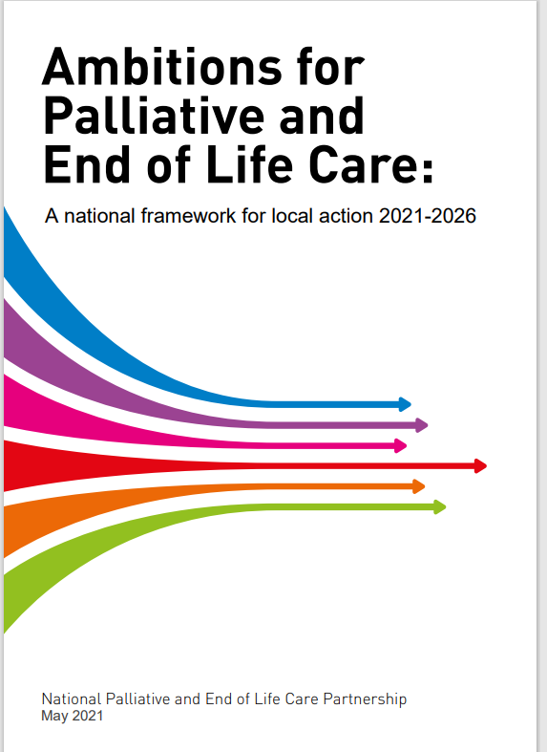
Stage 4: Lifetime Management and End of Life
Care of the dying
All approaches regarding palliative and end-of-life care should reflect Ambitions for Palliative and End of Life Care and the its 6 principles below:
It is important that you have considered the following when in communication with the person and those important to them:
Preferences and possibilities that could constitute an Advanced Care Plan
Sensitive communication about care in the last days of life and decisions about Do Not Attempt Cardiopulmonary Resuscitation (DNSCP) Orders
Ensure that if there is an ICD (Implantable Cardioverter Defibrillator) in place, it has been deactivated. Care of the dying.
Ensure that all relevant OOH services are made aware
Recognition that someone is possibly dying or likely to be dying is crucial to facilitate good symptom control this can be difficult in patients with heart failure as the disease trajectory is more uncertain.
An individual plan of care should be developed with the individual and those important to them when they are recognized as likely to be dying. Routine bloods and observations should be reviewed and the benefits and burdens considered .
Anticipatory prescribing to relieve common symptoms in the last weeks
of life should be considered in a timely manner and individualized to
avoid delay in managing distressing symptoms.
How an individual could be supported through the dying process may have been identified through an advanced care plan. As an ongoing process the dying person should be involved as much as they want to and be in decisions about:
The reason for the prescription of medications to relieve symptoms
The choice available between different medications
The route of administration for the control of symptoms
Their preference for place of care
If the dying person does not wish to be involved in these discussions or unable to, it is important that those important to the dying person are involved in their care including discussions in relation to symptom control medications used, route, hydration and nutrition.
Symptom control in the dying person requires; holistic assessment, considered interventions and a review of the effectiveness of the intervention/s made.
Each person is seen as an individual and
Receives fair access to care
We maximise comfort and wellbeing
Care is coordinated
All staff are prepared to care
Each community is prepared to help
Note: In the dying phase, you would not normally check renal function however, having knowledge of previous results is helpful to guide decision making regarding medications to use for control of symptoms. For example, if using morphine in patients where eGFR is less than 30 it may add to symptom burden rather than alleviate symptoms (e.g. hallucinations, myoclonic jerks) which would require further medication to control. Use clinic judgement with consideration of renal function and consider specialist advice within the NICE CG 140 Guidelines (referenced on page 27) and if unsure also seek specialist palliative advice when prescribing opioids in renal and hepatic impairment.

Slide 30
Stage 4: Lifetime Management and End of Life
End of Life and care for the dying person
Defining Palliative Care in people living with heart failure – use of prognostic indicators (e.g. GSF / SPICT / MAGGIC)
Cachexia
Worsening U&Es / LFTs
2 or more hospital admissions within the last 6 months
Comorbidities
Resistant symptoms
Maximum tolerated therapy
Advanced frailty
No reversible cause
Referral to:
Specialist Palliative Care
Hospice day therapy
Continue with heart failure specialist for on-going medicines management and symptom control
Ensure access to support workers
Community Specialist Palliative Care
Carers assessment for support of family and carers
Person-centred care approach shared-decision making amends
Monitoring
Iron (in line with local policies and guidelines)
Transfusions
Blood tests
Medications – stopping / reducing
ICD deactivation discussions and proceed with deactivation procedure as per implant centre
DNA CPR and Advanced Care Planning
Dying Phase
Referral to:
if in hospital
Specialist Palliative Care services
Heart failure specialist
Consider patient’s own preferred environment
if at home – care coordinated by GP
Specialist Palliative Care services
Community Heart Failure nurse specialist
District nurse / community matron
Control of symptoms
Appropriate heart failure medication – as the priority here is symptom management, medications such as diuretics(which may be subcutaneous) would be used regardless of the renal function
Prescribe anticipatory medication for the management of symptoms in those who are dying:
Individual plan of care for the dying person, including holistic assessment, review of hydration and nutrition, symptom control etc. and consideration of preferred own environment, such as home or hospice, is agreed, coordinated and delivered with compassion
Shared Decision Making:
ICD discussion and deactivation if not previously initiated
Treatment escalation plan
Risk/benefit of medications
Dying person and agreed other are involved in treatment and care as they want
Decisions made are regularly reviewed and revised accordingly
Phase of illness – you have considered?
All reversible causes of deterioration explored. MDT agree patient is in the
Last days of their life
Clear, sensitive communication with patient and those important to them
Needs of those identified as important are explored, respected and met as far as possible
Updating OOH/NWAS of plan of care
Review package of care necessary
Referral to other services e.g. specialist palliative care

Slide 31
Stage 4: Lifetime Management and End of Life
Care After Death
Administration
Care of the family
Additional Guidance
https://www.pallaborative.org.uk/clinical-standards-and-guidelines/
The dual standard bereavement specification
comprises a minimum standard that all hospitals should ensure is in place, and a gold standard of service, which should form part of the longer-term end of life strategy
In addition, the What to Expect guidance
has been developed in response to feedback and aims to support staff in acute hospitals to provide the essential information for patients and their families in a timely and proactive way.
https://www.england.nhs.uk/north-west/north-west-coast-strategic-clinical-networks/our-networks/palliative-and-end-of-life-care/for-professionals/bereavement-services-directory-lancashire-and-cumbria/bereavement-service-improvement-resources/
Example bereavement leaflet here:
https://www.england.nhs.uk/north/wp-content/uploads/sites/5/2018/06/bereavement-leaflet-recommendation.pdf
Verification / confirmation of death
Death certificate
Post-death significant event analysis if necessary
Update Supportive Care Record / Gold Standards Framework Register / EPaCCSS with date and place of death
Inform all relevant agencies – social care, allied health professionals, ambulance service, OOH, Specialist Palliative Care Team, equipment store and GP
Staff support/debrief if required
Ensure processes are in place to obtain feedback from carers
Ensure processes are in place to audit practice (e.g. mortality reviews, anticipatory medication, bereaved relatives survey etc.)
Support of family and carers
Clear sensitive communication
Funeral attendance if able and to include carer permission if appropriate or applicable
Follow up bereavement assessment to those identified
Referral of those identified as important to bereavement counselling services as required
Department for Work & Pensions 011 Booklet: What to do after a death or similar

Slide 32
Glossary
NT-ProBNP parameters
NICE clearly advocate using NT-proBNP due to its sensitivity and specificity but please note where this test is not available:
• BNP levels >100 are considered normal
• BNP levels >400 are suggestive of heart failure
Pathway implementation
The health care partnership are working on a program to support the delivery of the pathway in 2021.
Useful tools
There are a number of commercial tools that have been developed to support and assist Primary care and practitioners to deliver and support cost effective care.
Enhance HF – a service provided by Servier and developed and delivered by Oberoi Consulting which assists CCGs to implement local and national heart failure guidelines. www.oberoi-consulting.com
Attend2 HF – is a clinical platform developed by Interface Clinical Services that can be used to support the identification and management of patients with heart failure and underpinned by national and international guidelines (including SIGN 147 and NICE NG106) and is used to identify patients potentially missing from the HF register based on relevant clinical codes, medication and diagnostic indicators and clinical markers.
www.interface-cs.co.uk
GRASP-HF – is a free, easy-to-use tool that assists GP practices to interrogate their clinical data enabling them to improve the management and care of patients with heart failure (HF) with left ventricular systolic dysfunction (LVSD). The tool also assists with case-finding activity, helping practices to establish more accurate prevalence rates within the practice population.
https://www.nottingham.ac.uk/primis/tools/qi-tools/ grasp-hf.aspx
Useful links
Cardiomyopathy UK ‘Hidden in HF’ Medical Education free CPD course on the Cardiomyopathy UK website e-learning platform: https://cardiomyopathyuk.clcmoodle.org/course/view.php?id=192
The third edition (2017) of the British Associations of Cardiovascular Prevention and Rehabilitation (BACPR) Standards & Core Components http://www.bacpr.com/pages/page_box_contents. asp?PageID=791
Clark AL, Kalra PR, Petrie MC, et al Change in renal function associated with drug treatment in heart failure: national guidance. Heart 2019;105:904-910
https://www.bhf.org.uk/what-we-do/policy-and- public-affairs/transforming-healthcare/heart-failure- report
NICE impact for Cardiovascular Management report – published Feb 2021 https://www.nice.org.uk/about/what-we-do/into- practice/measuring-the-use-of-nice-guidance/impact- of-our-guidance/nice-impact-cardiovascular-disease- management
https://www.nejm.org/doi/10.1056/NEJMoa1911303
ESC. Heart failure (2021) – The impact of COVID 19 on the management of heart failure. A United Kingdom patient questionnaire study – DOI 10.1002/ehf.13209
https://pumpingmarvellous.org/impact-of-covid-19- and-heart-failure-care-in-the-uk/
Dapagliflozin for treating chronic heart failure with reduced ejection fraction – NICE Technology appraisal guidance (TA 679) Published 24th February 2021
https://www.panmerseyapc.nhs.uk/media/2431/ dapagliflozin_hf.pdf?UNLID=800322321202132172018
Health care Practitioners resource /education link https://www.forxiga.co.uk/
REACH-HF (Rehabilitation Enablement in Chronic Heart Failure) is facilitated evidence based cardiac rehabilitation (CR) and self-management program for use at home. It comprises the ‘Heart Failure Manual’, a Relaxation CD, a choice of exercise (walking program or a chair-based DVD) a ‘Progress Tracker’ for patients, and a ‘Family and Friends Resource’ for caregivers http://sites.exeter.ac.uk/reach-hf/
One Chance To Get It Right – Guidelines https://assets.publishing.service.gov.uk/government/ uploads/system/uploads/attachmentdata/ file/323188/One_chance_to_get_it_right.pdf
British Society for Heart Failure - https://www.bsh.org.uk
British Heart Foundation ‘Blueprint for change’ heart failure report
https://www.bhf.org.uk/what-we-do/policy-and-public
-affairs/transforming-healthcare/heart-failure-report
NHS Long Term Plan – cardiovascular disease https://www.longtermplan.nhs.uk/online-version/ chapter-3-further-progress-on-care-quality-and- outcomes/better-care-for-major-health-conditions/ cardiovascular-disease/
https://www.fightingfailure.co.uk/impact-in-your-area
Mayfly Education - https://eolp.co.uk/

Slide 33
Abbreviations
ACP | Advanced Care Planning
ACMP | Anticipatory Clinical Management Plan
ADRT | Advanced Decision to Refuse Treatment
AHP | Allied Health Professional
ARB | Angiotensin III Receptor Blocker
BNP | B-type Natriuretic Peptide
CMR | Cardiovascular Magnetic Resonance
CPR | Cardiopulmonary Resuscitation
CRT | Cardiac Resynchronization Treatment
CVD | Cardio-Vascular Disease
DNA /CPR | Do Not Attempt Cardiopulmonary Resuscitation
e-GFR | estimated Glomerular Filtration Rate
EJ | Ejection Fraction
EPaCCS | Electronic Palliative Care Coordination System
GDMT | Guideline-directed Medical Therapy
HaH | Hospital at Home
HF | Heart Failure
HFN | Heart Failure Nurse
HFpEF | Heart Failure with Preserved Ejection Fraction
HFrEF | Heart Failure with Reduced Ejection Fraction
HFSN | Heart Failure Specialist Nurse
HFSS | Heart Failure Survival Score
IABP | Intra-Aortic Balloon Pump
ICD | Implantable Cardioverter Defibrillator
ICS | Integrated Care System
LPA | Lasting Power of Attorney
MDT | Multidisciplinary Team
MRA | Mineralocorticoid Receptor Antagonist
NWAS | North West Ambulance Service
NE EOL | North West End-of-Life
OOH | Out-of-Hours
PCSP | Personalized Care and Support Plan
PHE | Public Health England
PHM | Population Health Management
PPC/D | Preferred Place of Care / Death
RAAS | Renin-Angiotensin-Aldosterone System
SHFM | Seattle Heart Failure Model
SOB | Shortness of Breath
SPC | Specialist Palliative Care
SPR | Specialist Register
TEP | Treatment Escalation Plans

Slide 34
Next steps
To facilitate implementation of the HF pathway a number of workshops will be set up which will look at both care elements that can be standardised across the system and elements that will require local solutions
Workshops will look at:
  Standardisation of diagnostic pathways for heart failure (including joint breathlessness pathway)
  Standardisation of medical interventions and titration
  Standardisation of strategies to maximise HF specialist input for HF inpatients
  Standardisation of referrals for complex devices & ICDs, ischaemia assessment, rhythm management & transplantation referrals
  Standardisation of followup pathways (including PIFU, A & G etc)
  Standardisation of remote monitoring interventions (HF@home, virtual wards) including device related
  Standardisation of workforce educational development and career progression
  Standardisation of end of life pathways
  Data – regional and local data on HF prevalence, HF hospital admissions & readmissions, LOS
  Local workforce baseline data, gap analysis
  Future workforce delivery models
  Annual pathway review – next review April 2024

