Slide 1

BEFAST – Expanding Stroke Recognition Beyond FAST
Linda Dunn
Stroke Nurse Consultant
MSc, ANVP, RN
East Lancashire Teaching Hospitals
Notes:
Introduce self and session

Slide 2
Housekeeping
Please keep your video on and microphone on mute unless advised otherwise.
Please enter your name and job role and place of work in the chat, tell me what your goals are for this training.
If you would like to ask a question, please use the chat function, we will review them at the end.
You will be asked to contribute to the clinical scenarios.
This session is being recorded to allow those who cannot attend today, access to this training.
Notes:
Read key points on slide

Slide 3

Who is this training for :
Everyone working in a healthcare setting
Notes:
A stroke can happen to anyone, anywhere — not just in clinical areas. Symptoms may be sudden and obvious, or subtle and easily missed. Every member of staff has a role in recognising possible stroke and escalating quickly.

Slide 4

Learning Objectives :
By the end of this session participants will be able to:
Recognise symptoms of stroke or TIA
Apply BEFAST stroke assessment tool to daily practice
Identify red flag stroke presentations
Know when and how to refer
Understand why early recognition is vital
Notes:
4 Learning Outcome By the end of this session, participants will have the knowledge and confidence to recognise the signs and symptoms of stroke and transient ischaemic attack. Participants will be able to apply the BEFAST stroke assessment tool in their day‑to‑day practice, regardless of role or clinical background, ensuring a consistent and shared approach to stroke recognition across the organisation. The session will also enable staff to identify red‑flag stroke presentations that require urgent action, helping to reduce delays in escalation and treatment. Participants will gain clarity on when and how to refer appropriately, and understand the importance of rapid communication with the stroke team. Finally, the session will reinforce why early recognition is vital, highlighting the impact timely identification and referral can have on saving lives and reducing long‑term disability.

Slide 5

Why is more training necessary?
Stroke patients commonly present to ED via ambulance in which case we get an immediate alert.
Some patients may self present themselves to ED reception, but a stroke can happen anywhere in our organisations.
Prompt recognition of stroke is essential and is proven to reduce mortality and prevent/reduce life changing disability.
Research suggest that reception staff are very good at identifying the common symptoms of stroke.
Identification of less common symptoms is more challenging
Notes:
5. Why is more training necessary?
Many stroke patients arrive in the Emergency Department by ambulance or via their GP, where an alert is raised immediately and pathways are already in place. In these situations, recognition and response are often swift.
However, not all strokes present this way. Some patients walk into the department themselves and may first speak to ED reception staff, and others may experience stroke symptoms anywhere across our organisation — in outpatient areas, corridors, waiting rooms, or communal spaces. In these moments, there may be no pre‑alert and no immediate clinical involvement.
Prompt recognition of stroke symptoms is critical. Evidence consistently shows that early identification and rapid escalation reduce mortality and can prevent or significantly limit life‑changing disability. Every minute matters.
Research suggests that reception and frontline staff are very good at recognising the common signs of stroke, such as facial weakness, slurred speech, and arm weakness. However, less common or atypical symptoms — including visual disturbance, balance issues, confusion, or sudden changes in behaviour — can be much harder to identify and are more easily missed.
Training is essential because stroke is everyone’s responsibility — not just doctors and nurses. Reception staff, porters, administrative teams, and allied professionals may be the first point of contact.
By broadening understanding beyond the classic presentations and strengthening confidence in recognising red flags, we ensure that every member of staff is equipped to act quickly and appropriately, regardless of role or location.
Stroke awareness across all staff groups creates safer systems, quicker responses, and better outcomes for patients. Regular training ensures staff are: - Confident in recognising early and atypical stroke symptoms - Familiar with BEFAST and able to apply it in real situations - Clear on red flags that require urgent action - Certain about when and how to escalate or refer

Slide 6
Why Stroke Recognition Matters
Over 100,000 people a year in UK will have a stroke
1.9 million neurons lost per minute
Stroke is one of the leading causes of death and disability
Significant financial burden to economy
Delays in treatment lead to worse outcome
Stroke burden can be reduced with immediate referral to the stroke team
Notes:
Stroke remains a major health challenge in the UK, with over 100,000 people experiencing a stroke every year. It is one of the leading causes of death and long‑term disability, affecting not only patients but families, healthcare services, and society as a whole. When a stroke occurs, time is critical. The brain loses an estimated 1.9 million neurons every minute that treatment is delayed. This rapid and irreversible damage is why stroke is often described as a brain attack — the longer it goes unrecognised, the worse the outcome. Delays in recognition and treatment significantly increase the risk of death, severe disability, and long‑term dependence on care. In addition to the personal impact, stroke places a substantial financial burden on the economy, including costs related to healthcare, rehabilitation, social care, and lost productivity. The positive message is that stroke outcomes can be improved. Prompt recognition of symptoms and immediate referral to the specialist stroke team can save lives, reduce disability, and limit long‑term consequences. Early action truly makes the difference between recovery and life‑changing impairment. This is why stroke recognition by all staff, in all settings, is so important — because every minute matters.

Slide 7
What is a Stroke?
A stroke occurs when the blood supply to parts of the brain are interrupted, usually due to a blocked or burst blood vessel.
The blood supply carries oxygen and nutrients which are essential for the brain to function normally. When oxygen and nutrients can no longer reach parts of the brain vital brain cells are damaged and may die
The onset of stroke is sudden and the effects on the body are immediate
Effects will depend on the part of the brain affected and the extent of the damage
Notes:
7. What is a Stroke? “A stroke is a sudden medical emergency that happens when the blood supply to part of the brain is interrupted or reduced. When this happens, brain tissue is deprived of oxygen and nutrients, and brain cells begin to die within minutes. There are two main types of stroke. The most common is an ischaemic stroke, which occurs when a blood vessel supplying the brain becomes blocked, usually by a clot. The second type is a haemorrhagic stroke, which happens when a blood vessel ruptures and causes bleeding into or around the brain. We also hear the term TIA, or transient ischaemic attack, sometimes called a ‘mini‑stroke’. In a TIA, symptoms resolve, but it is a serious warning sign that a full stroke may follow. The key message here is that stroke is time‑critical. The longer the brain is without blood flow, the greater the damage and the worse the effects are on the body.

Slide 8
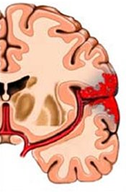
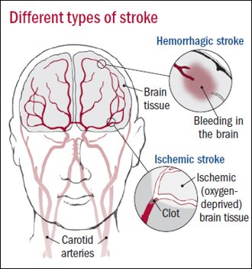
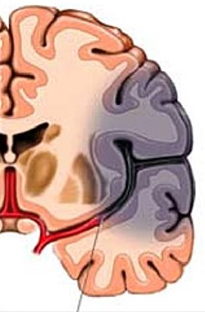
Types of Stroke
Haemorrhagic Stroke 15%
Ischaemic Stroke 85%
Notes:
8. This picture shows the two types of stroke – described what you see on the slide.

Slide 9
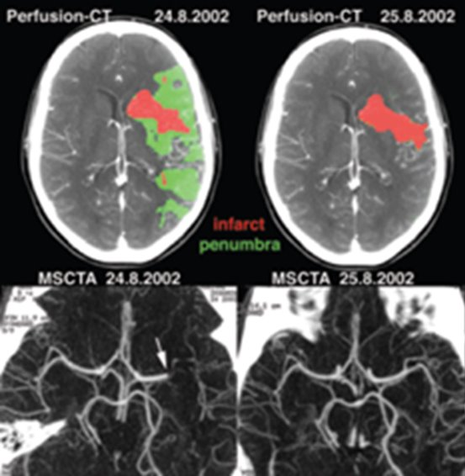
Why is early recognition so important ?
Reperfusion means restoring blood flow to the brain when a stroke is caused by a clot.
The sooner blood flow is restored, the more brain tissue can be saved.

Slide 10
Why is early recognition so important?
Thrombolysis (clot‑busting treatment)
A medication (e.g. alteplase or tenecteplase) given through a vein
Breaks down the clot causing the stroke
Most effective if given within 4.5 hours of symptom onset, can sometimes be given up to 9 hours with advanced imaging.
If stroke is not recognised early, the patient may arrive too late to receive thrombolysis.

Slide 11
Why is early recognition so important?
Thrombectomy is a treatment that physically removes a clot from the brain.
It usually involves inserting a mesh device into an artery in the groin and moving it up to the brain to pull out the clot. It only works with people where the blood clot is in a large artery (30-40% strokes LVO)
Historically only a small proportion of stroke cases were eligible for a thrombectomy, treatment needed to be given within 6 hours.
A thrombectomy can have a big impact on those people by reducing disability.
In addition to a plain CT head scan a CT angiogram is needed.

Slide 12
CT Angiogram

Slide 13
Advanced Imaging
With the aid of CT Perfusion scanning there are occasions when we can consider clot retrieval treatment up to 24 hours of stroke onset.
It is important to determine the time the symptoms first started or the time when they were last seen well.
The CT perfusion scan tells us the extent of stroke damage and whether there are enough brain cells still able to be saved to warrant this surgical intervention.

Slide 14
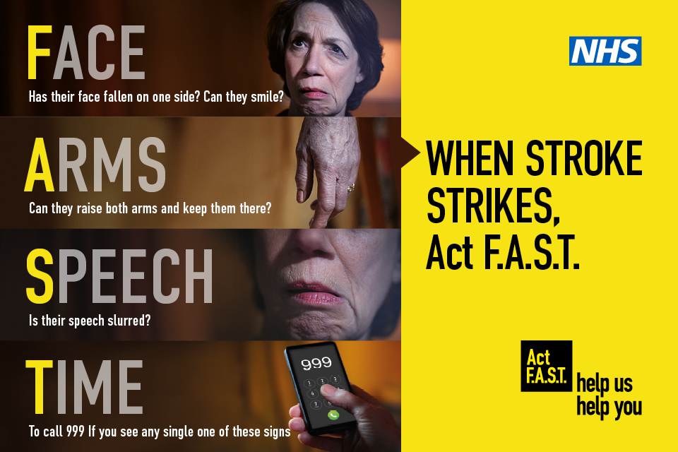

FAST
Notes:
9. FAST was introduced as a simple, memorable tool to help the public and healthcare staff quickly recognise the most common signs of stroke. It was first widely promoted in the UK through national stroke awareness campaigns in the late 2000s, led by organisations such as the Stroke Association and the NHS. The aim of FAST was clear: to make stroke recognition quick, accessible, and actionable, even for people without clinical training. By focusing on three easily observable symptoms — Face weakness, Arm weakness, and Speech disturbance — FAST helped reinforce one crucial message: Time is critical. The final letter, T for Time, emphasises the urgency of immediate action. If any FAST symptom is present, urgent referral or emergency response is required, as delays in treatment significantly worsen outcomes. FAST has been highly successful in improving awareness and increasing rapid access to stroke services. However, it focuses mainly on the most common stroke presentations and does not capture all symptoms. As understanding has developed, FAST has been expanded to BEFAST, adding Balance and Eyes, to improve recognition of posterior and less typical strokes.

Slide 15
Common Symptoms of Stroke or TIA
Sudden weakness or numbness on one side of the body, including legs, hands or feet.
Difficulty finding words or speaking in clear sentences.
Sudden blurred vision or loss of sight in one or both eyes.
Sudden memory loss or confusion.
Sudden dizziness, unsteadiness or a sudden fall.
A sudden, severe headache.
Notes:
In addition to the three symptoms highlighted in FAST — facial weakness, arm weakness and speech disturbance — there are several other common signs of stroke that we need to be alert to. These include sudden weakness or numbness on one side of the body, which may affect the leg, hand or foot as well as the arm. Patients may have difficulty finding words or speaking in clear, meaningful sentences. Sudden blurred vision or loss of sight in one or both eyes is another important warning sign. We may also see sudden memory loss or confusion, particularly when it is abrupt and unexplained. Sudden dizziness, unsteadiness, or an unexpected fall can be a key presentation, especially in posterior circulation strokes. Finally, a sudden, severe headache, often described as different from anything experienced before, should always prompt urgent assessment for stroke

Slide 16
FAST Tool: Strengths
Simple, rapid, and easy to remember.
Good sensitivity for common anterior‑circulation strokes, with sensitivity reported between 64–97% across studies.
Meta‑analysis shows a combined sensitivity of 0.77, supporting FAST as an effective first‑line screening tool.
Widely used in emergency and ambulance settings, with strong integration into care pathways.
Notes:
We have established that FAST is a simple, rapid, and easy‑to‑remember assessment, making it ideally suited for use by both clinical and non‑clinical staff. One of its greatest strengths is that it can be applied within seconds, without the need for specialist equipment or advanced training, allowing stroke recognition to begin at the very first point of contact.
FAST has been shown to have good sensitivity for common anterior‑circulation strokes, which make up a large proportion of stroke presentations. Research demonstrates sensitivity rates ranging from 64% to 97%, highlighting its reliability in identifying patients who require urgent assessment and escalation. This is further supported by large‑scale meta‑analysis data, showing a combined sensitivity of 0.77, confirming FAST as an effective first‑line screening tool for stroke recognition.
In addition, FAST is well embedded within emergency and ambulance services and is firmly integrated into established stroke pathways. Its widespread and consistent use across healthcare settings supports rapid escalation, clear communication, and timely access to specialist stroke care, helping to minimise delays in treatment.
While FAST does not capture every possible stroke presentation, its simplicity and proven effectiveness make it a cornerstone of early stroke recognition. Importantly, it provides a strong foundation on which broader tools, such as BEFAST, can build to improve detection of less typical and posterior circulation strokes.

Slide 17
Why FAST Wasn't Enough
Limitations
Low and variable specificity (13–76.9%), leading to false positives.
FAST may miss posterior circulation strokes, which often present with imbalance, vertigo, or visual symptoms not assessed by FAST.
Up to 14% of ischemic strokes may be missed, particularly non‑anterior strokes.
Does not assess key symptoms like balance or vision, prompting development of expanded tools
Notes:
11. Why FAST Wasn’t Enough While FAST is a valuable and widely used stroke recognition tool, it does have important limitations that staff need to understand. FAST has low and variable specificity, ranging from approximately 13% to 76%, which means it can generate false positives. While this may increase urgent referrals, it can also place pressure on services and highlights the need for clinical judgement alongside screening tools. More importantly, FAST is known to miss posterior circulation strokes. These strokes often present with symptoms such as imbalance, vertigo, dizziness, or visual disturbances, which are not assessed by the FAST criteria. As a result, patients with these presentations may appear well or as a non‑stroke at first contact. Research suggests that up to 14% of ischaemic strokes may be missed when using FAST alone, particularly strokes that do not affect the anterior circulation. These missed cases can lead to delays in diagnosis and treatment, with significant consequences for patient outcomes. FAST also does not assess key neurological features such as balance or vision, which are common stroke symptoms. Recognition of these gaps has led to the development of expanded assessment tools, such as BEFAST, designed to improve detection of less typical and posterior stroke presentations.

Slide 18
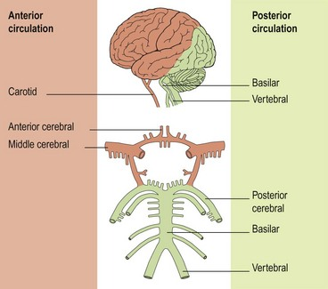
The Posterior Circulation Problem
Posterior circulation strokes often lack classic FAST signs
Symptoms commonly include dizziness, imbalance, and visual disturbance
Presentations may be vague or transient, causing false reassurance
Frequently misdiagnosed as non‑stroke conditions (e.g. vertigo, migraine)
FAST‑negative patients can still be having a stroke
BEFAST improves recognition by including Balance and Eyes
Notes:
The Posterior Circulation Problem and Stroke Recognition
Posterior circulation strokes present a particular challenge in stroke recognition. These strokes affect the brainstem, cerebellum, and occipital lobes, and their symptoms often differ significantly from the classic stroke signs most people are familiar with.
Unlike anterior circulation strokes, posterior strokes frequently do not cause obvious facial droop, arm weakness, or speech disturbance. Instead, patients may present with sudden dizziness, vertigo, imbalance, visual disturbance, nausea, vomiting, or altered consciousness. These symptoms can be vague, transient, or easily attributed to less serious causes such as inner‑ear problems, migraine, infection, or anxiety.
As a result, posterior circulation strokes are more likely to be missed or misdiagnosed, particularly at first point of contact. Patients may appear well, be able to speak clearly, and have no obvious weakness, which can create false reassurance and delay escalation.
Traditional tools such as FAST, while highly effective for anterior circulation strokes, do not assess balance or vision, meaning posterior strokes can fall outside its scope. This has been consistently highlighted in research, which shows that posterior strokes are disproportionately under‑recognised and experience longer delays to diagnosis and treatment, leading to poorer outcomes.
This recognition gap is why expanded tools like BEFAST are important. By deliberately including Balance and Eyes, BEFAST prompts staff to consider stroke when patients present with sudden unexplained dizziness, coordination problems, or visual changes — symptoms that should never be dismissed or ignored in a healthcare setting.
Improving recognition of posterior circulation strokes requires education, awareness, and confidence across all staff groups. When staff understand that stroke does not always look like FAST, they are more likely to escalate concerns early, even when presentations are atypical.
The key message is simple: a FAST‑negative patient can still be having a stroke. Recognising this is critical to reducing missed diagnoses, shortening delays to treatment, and improving patient outcomes.

Slide 19
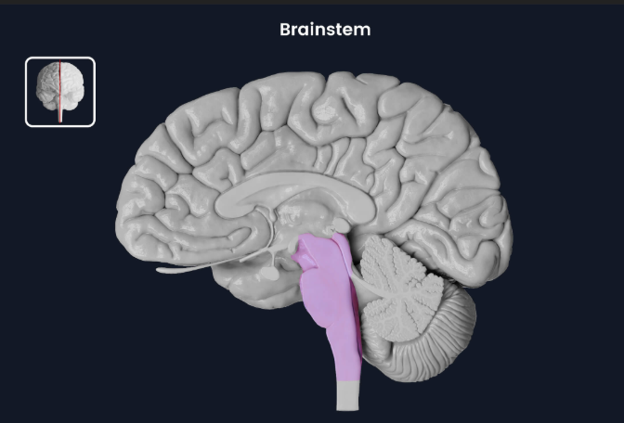
Brainstem Red Flags
Dysphagia (swallowing problems)
Dysarthria (slurred speech)
Hoarseness
Reduced consciousness
Crossed signs (ipsilateral face, contralateral limb deficit)
“Locked-in” features
Emergency:
Sudden reduced GCS + abnormal pupils
Notes:
This slide highlights key brainstem red flags that should immediately raise concern for a posterior circulation stroke. These include dysphagia, or difficulty swallowing, and dysarthria, where speech becomes slurred or unclear. Hoarseness can indicate involvement of the lower cranial nerves and should not be overlooked. Reduced level of consciousness is particularly concerning, as it suggests brainstem or reticular activating system involvement. We may also see crossed signs, such as facial weakness on one side with limb weakness on the opposite side, which are classic for brainstem pathology. In rare but devastating cases, patients may present with features of ‘locked‑in’ syndrome, where they are conscious but unable to move or speak. This is an emergency situation. Any patient with a sudden drop in GCS combined with abnormal pupils should be treated as a neurological emergency and escalated immediately.

Slide 20
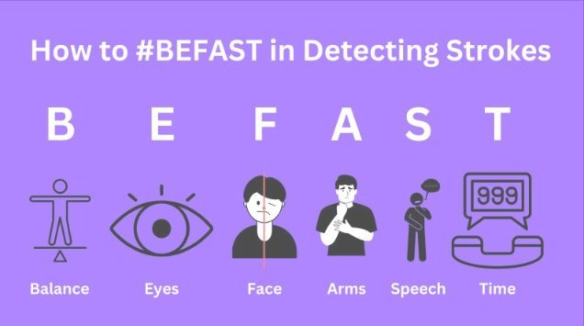
Enter BEFAST
Notes:
BEFAST builds on FAST to help us recognise a wider spectrum of stroke presentations, particularly posterior circulation strokes. B is for Balance, identifying sudden problems with balance or coordination. E is for Eyes, focusing on sudden visual changes such as loss of vision or double vision. F remains Face drooping, A is Arm weakness, and S is Speech disturbance. Finally, T reminds us that stroke is time‑critical — rapid recognition and escalation can be life‑saving.

Slide 21
BEFAST – The Evidence
Key findings from observational studies and meta-analysis (FAST v BEFAST):
BEFAST increases stroke detection sensitivity
Reduces missed posterior strokes
Slight reduction in specificity (acceptable trade-off)
Systematic reviews show posterior strokes are frequently under-recognised.
Notes:
BEFAST has several important strengths supported by research:
Improved diagnostic accuracy: The Frontiers meta‑analysis shows BEFAST has a higher AUC (0.86) and diagnostic odds ratio (2.44)—a clear performance improvement compared to FAST. [frontiersin.org], [doaj.org]
Higher specificity: BEFAST’s pooled specificity is 0.85, outperforming FAST (0.60).
Better detection of posterior strokes: One study found BEFAST identified 97.8% of posterior circulation strokes vs only 58.7% with FAST. [consensus.app]
Higher post‑test probability: When the pretest probability of stroke was set at 20%, BEFAST raised the probability to 52%, compared with 32% for FAST. [frontiersin.org], [doaj.org]
These findings underline the value of Balance and Eyes in screening.”

Slide 22
ELHT Audit
A retrospective audit of confirmed stroke, who self-presented to the Emergency Department, from January to March 2021.
No of patients: 44 over 3-month period
FAST symptoms 61%
BEFAST 84%
BEFAST would have recognised symptoms of stroke in 37% more patients
Notes:
This slide presents the findings from a retrospective audit of patients with a confirmed stroke who self‑presented to the Emergency Department at the Royal Blackburn Hospital between January and March 2021. Over this three‑month period, 44 patients met the criteria for inclusion. Using the traditional FAST assessment, only 61% of these patients had symptoms that would have been recognised as stroke. However, when the broader BEFAST criteria were applied, symptom recognition increased significantly to 84%. Importantly, BEFAST would have identified stroke symptoms in an additional 37% of patients who were not captured by FAST alone. These findings highlight the limitations of FAST in isolation and demonstrate the potential benefit of adopting BEFAST to improve early stroke recognition and timely access to care.

Slide 23
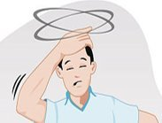
Balance (B): What Do We Want to Know
Any sudden loss of balance and coordination
“Have you suddenly become dizzy or unsteady?”
“Do you feel like the room is spinning?” (vertigo)
“Have you suddenly had difficulty walking or standing?”
“Do you feel pulled to one side or unable to stand?”
“Are you finding it hard to sit upright without support?”
“Do you feel like your body is swaying or leaning to one side?”
NOT – just are they dizzy!
Notes:
The ‘B’ in BEFAST focuses on identifying problems with balance and coordination, which are common but frequently missed signs of stroke. When assessing balance, we want to understand whether the patient has experienced a sudden change. This includes asking if they have become dizzy or unsteady, or if they feel as though the room is spinning, suggesting vertigo. We also explore whether they have had sudden difficulty walking or standing, feel pulled to one side, or are unable to maintain an upright posture. Difficulty sitting upright without support, or a sensation of swaying or leaning to one side, are key red flags. These symptoms may indicate posterior circulation stroke and highlight why including balance awareness is crucial for early recognition.
When we consider the ‘Balance’ component of BEFAST, it’s important to recognise that this is not just about asking whether the patient feels dizzy. Dizziness alone is non‑specific and common. What we are trying to identify is a sudden change in balance or coordination. This includes vertigo where the room feels like it is spinning, but also difficulty standing or walking, feeling pulled to one side, being unable to sit upright without support, or noticing the body swaying or leaning. These symptoms can indicate posterior circulation stroke and are frequently missed if we only ask, ‘Are you dizzy?

Slide 24
Balance (B): What do we want to know?
Any sudden loss of balance and coordination
“Do your arms or legs feel clumsy or uncoordinated?”
“Are you dropping things or missing your target when reaching?”
“Do your movements feel jerky or poorly controlled?”
Notes:
Building on balance, we also need to consider any sudden loss of coordination, which can be subtle but highly significant. We should ask whether the patient’s arms or legs feel clumsy or uncoordinated, or whether they are dropping things or missing their target when reaching. Movements may feel jerky, poorly controlled, or unfamiliar to the patient. These changes often represent cerebellar involvement and may occur without obvious weakness, meaning they can be easily overlooked. Recognising these coordination changes is essential, as they can be an early indicator of stroke even when strength and speech appear normal.

Slide 25
Balance (B):
Sudden balance disturbance = stroke until proven otherwise
Especially important if associated with:
Eye symptoms (E)
Nausea/vomiting
Slurred speech
New headache
Notes:
Any sudden disturbance of balance should be treated as a stroke until proven otherwise. This is particularly important because balance symptoms are often dismissed or attributed to benign causes. The level of concern should increase further when balance problems are accompanied by other neurological features. These include eye symptoms such as double vision or visual disturbance, nausea or vomiting, slurred or altered speech, or the onset of a new headache. The combination of these symptoms strongly suggests posterior circulation involvement and should prompt urgent stroke assessment

Slide 26
Eyes (E): What Do We Want to Know
What are we looking for? Sudden, new visual disturbance, including: - Loss of vision in one or both eyes - Blurred vision - Double vision (diplopia) - Visual field loss (e.g. missing half of vision, shadow, curtain effect)
Notes:
The ‘E’ in BEFAST relates to eyes and vision, and we are specifically looking for sudden, new visual disturbance. This may include loss of vision in one or both eyes, blurred vision, or double vision, also known as diplopia. We should also ask about visual field loss, where the patient may describe missing half of their vision, a shadow, or a curtain‑like effect coming across the eye. These changes are often abrupt and unfamiliar to the patient and should always be considered abnormal. Visual symptoms may be the primary presentation of stroke, particularly in posterior circulation events, and can easily be missed if we do not ask directly.

Slide 27
Eyes (E): What Do We Want to Know
Key questions to ask? “Has your vision suddenly changed?” “Can you see out of both eyes normally?” “Are you seeing double or struggling to focus?”
Notes:
The next step is to ask clear, focused questions about vision. We want to establish whether there has been a sudden change, rather than long‑standing or fluctuating problems. Asking if the patient’s vision has suddenly changed helps open the conversation, followed by checking whether they can see normally out of both eyes. We should also ask directly about double vision or difficulty focusing, as patients may not volunteer this unless prompted. These targeted questions help uncover visual symptoms that strongly support a diagnosis of stroke and ensure they are not overlooked.

Slide 28
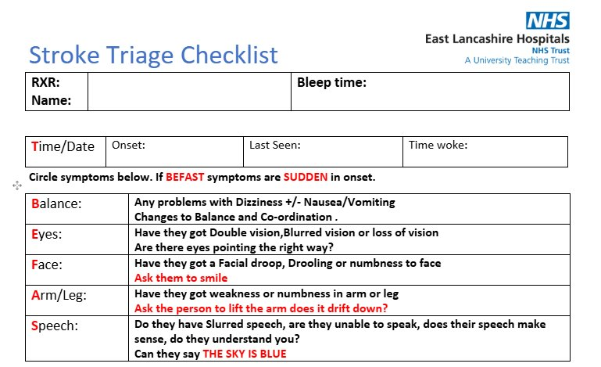
Stroke Rapid Assessment
Notes:
At ELHT, we developed a BEFAST checklist to support the launch of the approach and to act as a practical aide‑memoire for stroke practitioners. The checklist helped structure triage conversations and ensured the full range of BEFAST symptoms were consistently considered, particularly those that are more subtle or easily missed. Importantly, it played a key role in embedding BEFAST into everyday practice, increasing confidence among clinicians and supporting more timely recognition and escalation of suspected stroke.

Slide 29
Pooled Analysis
Tool | Sensitivity | Specificity | Key strength | Key limitation
FAST | ~0.83–0.86 | ~0.45–0.64 | Simple, rapid | Misses posterior strokes
BE‑FAST | ~0.68–0.78 | ~0.53–0.85 | Better posterior stroke detection | Limited evidence base
ROSIER | ~0.88–0.90 | ~0.66–0.76 | Best overall accuracy | Less suitable for lay use
LAPSS | ~0.74 | ~0.89 | High specificity | Misses cases
MASS | ~0.86 | ~0.76 | Balanced performance | Less widely used
Notes:
This chart compares common stroke recognition tools by how well they detect stroke (sensitivity) and how well they exclude non‑stroke cases (specificity). FAST is the simplest and quickest tool but can miss posterior circulation strokes. BE‑FAST improves detection of posterior strokes, although the evidence base and consistency are more limited. ROSIER shows the best overall diagnostic accuracy but requires clinical assessment, making it less suitable for lay or first‑contact use. LAPSS has high specificity, meaning fewer false positives, but at the cost of missing some strokes. MASS offers a balanced performance between sensitivity and specificity, though it is less widely embedded in routine practice.

Slide 30
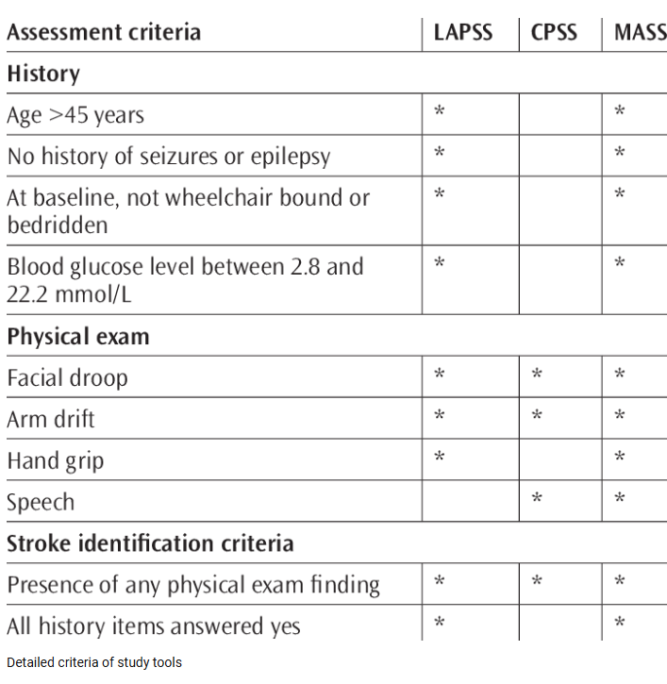
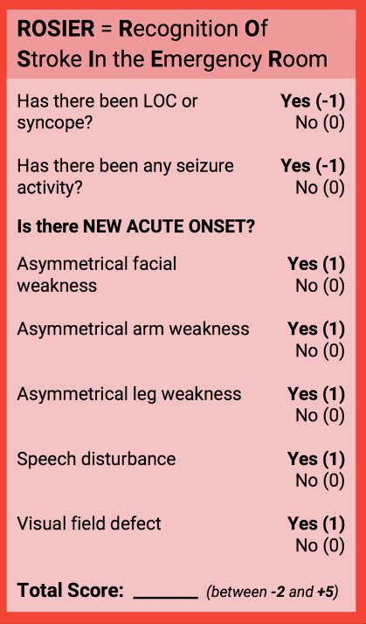
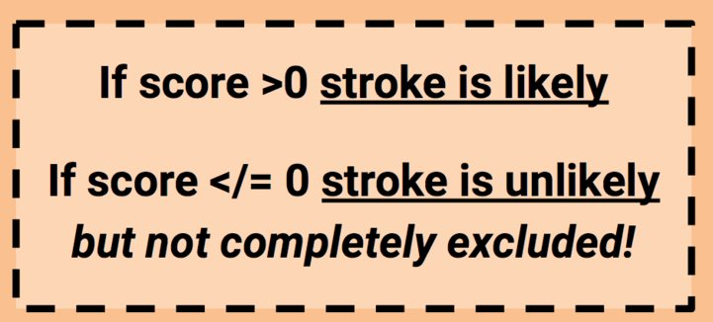
Other Tools
Notes:
The Recognition of Stroke in the Emergency Room (ROSIER) tool is a validated clinical screening instrument designed to support the early identification of acute stroke in emergency care settings. It is intended for use by trained healthcare professionals, particularly in emergency departments and prehospital services, to aid rapid clinical decision‑making rather than replace it.
A systematic review and meta‑analysis of 14 studies found that ROSIER demonstrated high sensitivity (88%), moderate specificity (66%), and strong overall diagnostic accuracy (AUC 0.88), outperforming simpler tools such as FAST and BE‑FAST when comparing these measures across studies. This indicates that ROSIER is effective at identifying true stroke cases while maintaining better discrimination between stroke and non‑stroke presentations.
ROSIER is best used in conjunction with clinical judgement, where trained staff are able to interpret neurological signs and consider alternative diagnoses. When applied by appropriately trained clinicians, the tool supports timely escalation into stroke pathways while reducing the risk of both missed strokes and unnecessary referrals.

Slide 31

Case Reviews
Open the camera on your phone
Point the camera at the QR code
Hold your phone steady – no need to take a photo
Tap the link that appears on the screen
The webpage will open automatically

Slide 32
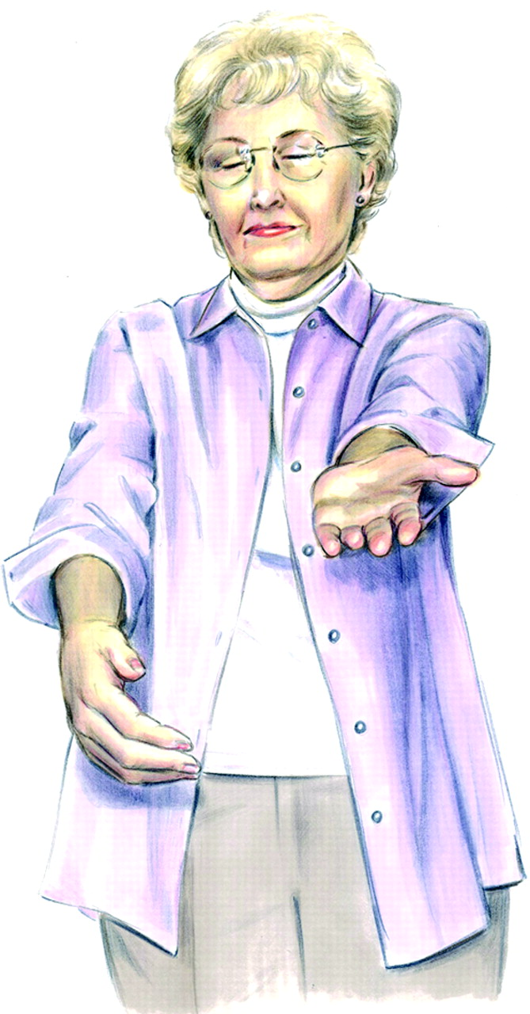
Clinical Scenario 1
A 59 year old female, witnessed sudden onset of right sided face, arm and leg weakness, expressive speech problems and slurred speech. 90 minutes prior to arrival to hospital.
Task:
1a) Apply the FAST test
1b) Apply the BEFAST test

Slide 33
Clinical Scenario 1
 |  | B | -
 |  | E | -
F | + | F | +
A | + | A | +
S | + | S | +
T | Symptoms identified – refer to stroke team | T | Symptoms identified – refer to stroke team

Slide 34
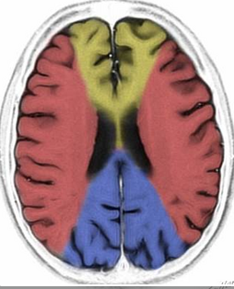
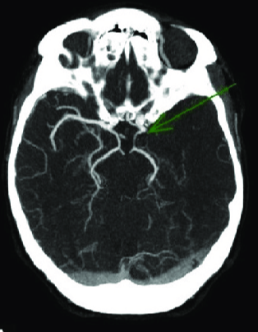
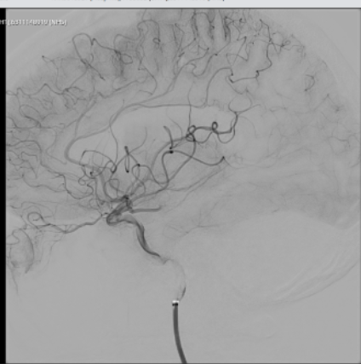
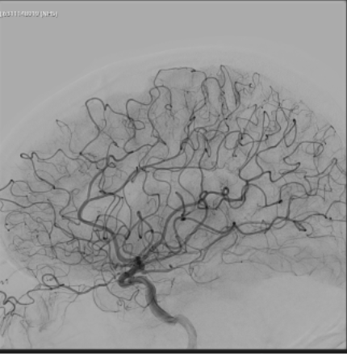

Outcome - Clinical Scenario 1
CT and CTA confirmed a stroke in the left middle cerebral artery
Thrombolysed with Tenecteplase
Transferred to Tertiary Centre for Thrombectomy
Discharged from hospital on Day 4 with a mild arm weakness to Community Therapy, post rehab - living a full and independent life – almost total recovery

Slide 35
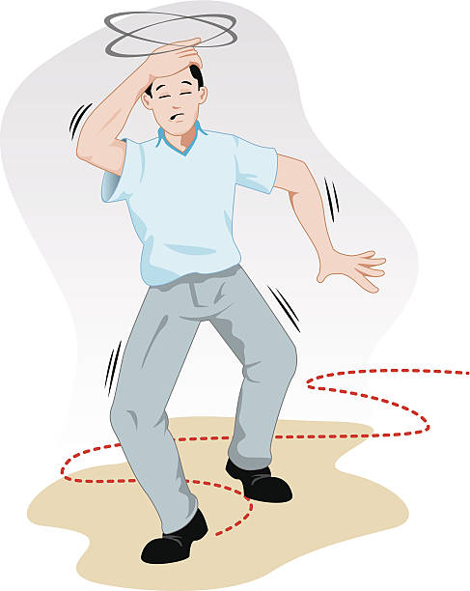
Clinical Scenario 2
A 37‑year‑old man suddenly develops double
vision, vertigo, and is unable to walk in a straight line ,
he collapses while walking out of the gym before
arrival to hospital.
Task:
2a) Apply the FAST test
2b) Apply the BEFAST test
Notes:
FAST: Negative BEFAST: Positive for Eyes + Balance
Basilar thrombus often spares motor signs early, so FAST misses it, but BEFAST catches the visual disturbance and sudden severe imbalance.
The NIHSS would not necessarily pick up on this either – nystagmus is not explicitally score , diploia or nystagmus are not scored in visual field assessment (confrontation) , diplopia would only be picked up here if the CN III, IV, VI caused a noticible gaze palsy .

Slide 36
Clinical Scenario 2
 |  | B | +
 |  | E | +
F | - | F | -
A | - | A | -
S | - | S | -
T | Symptoms identified – refer to stroke team | T | Symptoms identified – refer to stroke team
Imaging: CTA reveals a basilar artery thrombus.​
​
FAST misses approximately 40% posterior circulation strokes​
BEFAST – saves more lives
Notes:
FAST: Negative BEFAST: Positive for Eyes + Balance
Basilar thrombus often spares motor signs early, so FAST misses it, but BEFAST catches the visual disturbance and sudden severe imbalance.
The NIHSS would not necessarily pick up on this either – nystagmus is not explicitally score , diploia or nystagmus are not scored in visual field assessment (confrontation) , diplopia would only be picked up here if the CN III, IV, VI caused a noticible gaze palsy .

Slide 37

Outcome Clinical Scenario 2a
No-one noticed that this was a serious stroke, he was not referred to the stroke team for assessment.
The patient never regained consciousness and died.

Slide 38

Outcome Clinical Scenario 2b
The triage nurse applied BEFAST and alerted the stroke team immediately.
The patient was given clot busting medication and had mechanical clot retrieval
He was discharged home on Day 3 and went on to live a full and independent life.

Slide 39

Clinical Scenario 3
A 72‑year‑old female reports sudden loss of vision on the right side, symptoms started 3 days ago.
No drooping
No limb weakness
Speech intact
Task :
3a) Apply the FAST test and record your answer
3b)Apply the BEFAST test and record your answer

Slide 40
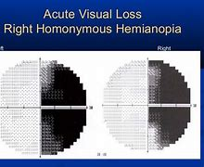
Clinical Scenario 3
 |  | B | -
 |  | E | +
F | - | F | -
A | - | A | -
S | - | S | -
T | Symptoms identified – refer to stroke team | T | Symptoms identified – refer to stroke team
BEFAST findings:​
Eyes: Right homonymous hemianopia​
Imaging: CT angiogram shows left PCA occlusion. MRI confirms Occipital Lobe Ischaemic Stroke
Notes:
Pure visual field loss is not detected by FAST, but is captured by BEFAST.

Slide 41
Outcome Clinical Scenario 3
The Emergency Department receptionist applied BEFAST and recognised the symptoms of stroke.
The stroke team was informed immediately.
The patient was not eligible for reperfusion treatment.
Rapid identification and referral = early imaging, diagnosis, treatment plan, optimisation , prevention complications, earlier access to therapy and discharge.
He was discharged on day 2, with community stroke team and referral to orthoptist .

Slide 42

Clinical Scenario 4
77 Male
While having coffee with a neighbour, suddenly vomited and developed a right facial droop, left arm weakness and slurred speech, unable to stand, complains of double vision.
Task:
4a) Apply the FAST test
4b) Apply the BEFAST test

Slide 43
Clinical Scenario 4
CT scan confirms an acute haemorrhage in the brain stem
 |  | B | +
 |  | E | +
F | + | F | +
A | + | A | +
S | + | S | +
T | Symptoms identified – refer to stroke team | T | Symptoms identified – refer to stroke team

Slide 44
Outcome - Clinical Scenario 4
The triage nurse applied BEFAST and alerted the stroke team immediately.
A CT head scan was performed which showed a brain stem haemorrhage.
They were transferred to the stroke unit.

Slide 45
Case | FAST Result | BEFAST Positive Signs | Stroke Type
1 | Face, Arm, Speech | Balance + Eyes | Left Middle Cerebral Artery Infarct
2 | Negative | Balance + Eyes | Basilar artery thrombus
3 | Negative | Eyes | Occipital (PCA)
4 | Face | Balance + Eyes | Brain Stem Haemorrhage

Slide 46
Summary
If someone suddenly seems different, confused, unsteady, or unable to see properly, trust your instincts and get help straight away.
Use the BE-FAST tool to help you recognise stroke symptoms more reliably FAST misses 40% POCS
Early recognition leads to timely treatment and better recovery.
Time wasted leads to unnecessary brain cell death
Your actions might save a life or prevent major disability
Notes:
Stroke does not always look dramatic at first. Very often, the first signs are subtle — someone may suddenly seem different, confused, unsteady on their feet, or complain that they cannot see properly. When this happens, it is important to trust your instincts. If something does not feel right, it probably isn’t, and getting help immediately can make a critical difference.
Using a structured stroke recognition tool helps turn that instinct into action. The BE‑FAST tool provides a more reliable way of recognising stroke symptoms by looking beyond speech and limb weakness alone. Standard FAST checks can miss up to 40% of posterior circulation strokes, which often present with problems such as balance disturbance or visual changes. BE‑FAST helps reduce this risk by prompting recognition of these easily overlooked symptoms.
Early recognition is not just about diagnosis — it directly affects outcomes. Stroke treatments such as thrombolysis and mechanical thrombectomy are highly time‑dependent. The earlier a stroke is recognised and escalated, the greater the chance of restoring blood flow to the brain and supporting a good recovery. Every delay reduces treatment options and worsens prognosis.
Time wasted during a stroke leads to avoidable brain cell death. With each passing minute, more brain tissue is irreversibly damaged, increasing the likelihood of long‑term disability, loss of independence, or death. This is why fast recognition and rapid escalation along stroke pathways are essential.
By acting quickly, recognising symptoms early, and using tools like BE‑FAST to guide decision‑making, your actions can save a life or prevent major disability. Early recognition is the first and most important step in effective stroke care.

Slide 47

What we need from YOU !
Identify Stroke Symptoms using BEFAST
Ask did the symptoms start SUDDENLY
Ask what TIME the symptoms started or the time they were last seen well
Refer IMMEDIATELY to the stroke team
We will take it from there!
Notes:
When identifying a possible stroke, it is essential to use the BEFAST approach.
First, identify stroke symptoms using BEFAST, paying close attention to balance problems, visual changes, facial droop, arm weakness, and speech disturbance.
It is crucial to establish whether the symptoms started suddenly, as stroke symptoms typically have an abrupt onset.
You must then ask for the exact time the symptoms began, or if this is unclear, determine the time the person was last seen well, as this information is critical for treatment decisions.
If a stroke is suspected, refer immediately to the stroke team without delay.
From that point onward, the stroke team will take over care and initiate the appropriate emergency pathway.

Slide 48
References
Chen, X., Zhao, X., Xu, F., Guo, M., Yang, Y., Zhong, L., Weng, X. and Liu, X. (2022) A systematic review and meta-analysis comparing FAST and BEFAST in acute stroke patients. Frontiers in Neurology. Available at: https://www.frontiersin.org/journals/neurology/articles/10.3389/fneur.2021.765069/full (Accessed: 29 March 2026)
British Journal of Community Nursing (2025) BE‑FAST vs FAST in prehospital stroke recognition: a systematic review. Available at: https://www.britishjournalofcommunitynursing.com/content/clinical/be-fast-vs-fast-in-prehospital-stroke-recognition-a-systematic-review (Accessed: 29 March 2026)
Godley, N.D. (2023) Neurological assessment with FAST to better detect posterior circulation stroke. Journal of Paramedic Practice. Available at: https://www.paramedicpractice.com/content/features/neurological-assessment-with-fast-to-better-detect-posterior-circulation-stroke (Accessed: 29 March 2026). [paramedicp...actice.com]
Consensus Academic Search Engine (n.d.) FAST Stroke Assessment: Effectiveness and Limitations. Available at: https://consensus.app/questions/fast-stroke-assessment/ (Accessed: 29 March 2026). [consensus.app]
El Ammar, F., Ardelt, A., Del Brutto, V.J., Loggini, A., Bulwa, Z., Martinez, R.C., McKoy, C.J., Brorson, J. and Mansour, A. (2020) BE‑FAST: A sensitive screening tool to identify in-hospital acute ischemic stroke. Journal of Stroke and Cerebrovascular Diseases. Available at: https://www.strokejournal.org/article/S1052-3057%2820%2930205-6/fulltext (Accessed: 29 March 2026). [strokejournal.org]
Lind, A., Palmgren, F. and Wibring, K. (2025) Prehospital Identification of Patients With Stroke—mNIHSS Versus FAST. Acta Neurologica Scandinavica. Available at: https://onlinelibrary.wiley.com/doi/pdf/10.1155/ane/5511498 (Accessed: 29 March 2026). [onlinelibr....wiley.com]
Stroke signs and symptoms | Stroke Association
Nor AM, Davis J, Sen B, et al. (November 2005). The Recognition of Stroke in the Emergency Room (ROSIER) Scale: Development and Validation of a Stroke Recognition Instrument. Lancet Neurology 4(11): 727-34.
Han F, Zuo C, Zheng G. A systematic review and meta‑analysis to evaluate the diagnostic accuracy of Recognition of Stroke in the Emergency Department (ROSIER) scale. BMC Neurology. 2020;20:304.. https://pmc.ncbi.nlm.nih.gov/articles/PMC7530171/
Rudd M, Buck D, Ford GA, et al. A systematic review of stroke recognition instruments in hospital and prehospital settings. Emergency Medicine Journal 2016;33:818-822. https://emj.bmj.com/content/33/11/818.short

Slide 49

Notes:
Does anyone have any questions?
I hope this session has been useful.
Many thanks for listening.

