Slide 1



Vocational Rehabilitation
Samantha Green and Elizabeth Shaw
Notes:
Hi all and welcome to our presentation that outlines the vocational rehabilitation service in Neuro and Stroke. I am Sam Green and work at RCNT covering the whole of East lancs and B with D and this is Liz Shaw who works on the Stroke team covering the same area. The reason we set up the pathway was because we were all providing slightly different reports to employers and we wanted to our services to be equitable.
To give you some data – out of the patients on Neuro OT caseload _______ % were referred for Voc Rehab
out of the patients on Stroke OT caseload _______ % were referred for Voc Rehab

Slide 2

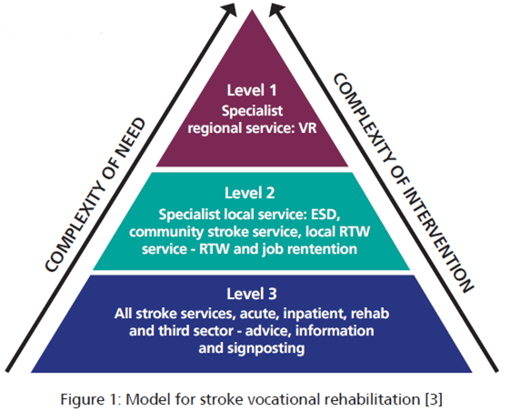

Notes:
Levels of input
Level 3 basic supports- general advice, encouragements, and information about work. Usually provided by any healthcare professional as part of routine care. Example: discussing return to work plans and signposting services
Level 2- Targeted support for straightforward issues: tailored help for people with manageable barriers to work. May include work focused therapy, workplace advice, returns work planning and liaison with employers delivered by rehabilitation teams
Level 1 - specialist vocational rehabilitation kollam intensive specialist help for complex cases. Involves multidisciplinary experts for people with significant physical cognitive or psychological difficulties affecting work. Long term support and can involve looking for alternative employment. We outsource Level 3 involvement to 3rd party agencies

Slide 3
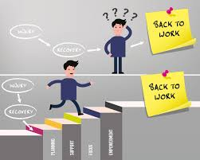
VR Pathway established: VR Pathway
Notes:
Why was t established? In 2025 pathway was ratified and live but why?- 34% of strokes on current caseload are working age, much more demand. Goal centred.
Talk about pathway content – Sam
The pathway has supported our therapist to all follow the same procedure when assessing Voc Rehab
The pathway is helping all therapist to access the links quickly
Therapists are aware of the competencies they need to work towards, several of these helped to direct PDRs this year
We have created a short informal leaflet that other members of the MDT can give out to help reassure patients.
The VR clinic enabled us to make the VR process more formal helping our less insightful patients.
We are now using the outcome WHODAS which focuses on the following clinical areas, understanding and communicating, getting around, self care, getting along with people, daily activities home and work, participation in society,
We now all complete the same paperwork which is the AHP report, this is often shared with employers via the patient and Occupational Health Physcisian (if they have one)

Slide 4
Pathway contents
Guidelines
D&C audit
Competencies – graded on Band
Workforce requirements
Links to trainings
VR Clinic
RTW Leaflet Return to Work after Stroke leaflet
Third party organisations
Job analysis sheets
AHP Report
Outcome measures - WHODAS
Notes:
Links to Cochrane reviews, BRSM VR Guidance, RCP guidelines, NICE, RCOT
Link to demand and capacity audit 2023 – Commisioned to deliver Level 2 input
Competencies
Predominantly OT led, aware there is some calls for SLT and Physio to have more input, and they do when relevant. For us; all Ots B5+ to be able to provide L3 entry level input. Staff to work through competencies and become more specialist.
Trainings: Fit Note e-lfh. ELHT not currently completing. VR Rehab toolkit. IST completed by SG. Youtube links for some additional training completed by Cheshire and Mersey – 4 modules
Initially we had VR clinic as referrals to us as VR leads, now staff becoming more confident and independently completing
That being said, staff have option to seek support/second opinions and bring into clinic. Not on set days anymore. We also have encouraged cog ax to be completed in clinic when opinions required about driving – more structured environment
Leaflet created –
Third party organisations, next slide
Job analysis sheets
What is AHP Report?
OMs

Slide 5
Third party agencies
Access to work –
https://www.gov.uk/access-to-work
Charities – Stroke association and Headway
Job Centre DEA’s
Lancashire – connect-to- work scheme
Social prescribing - BPRCVS – Home Community Solutions North West
Community Connectors
ACAS / Scope / Citizens advice
Lancashire volunteer partnership - https://lancsvp.org.uk/
Local libraires usually have groups.
Notes:
this can help support employers with funding for
equipment such as a specialist chair and desk that is height adjustable.
The employer has to pay the first £1000
What Access to Work is
Access to Work can help you get or stay in work if you have a physical or mental health condition or disability.
The support you get will depend on your needs. Through Access to Work, you can apply for:
a grant to help pay for practical support with your work
support with managing your mental health at work
money to pay for communication support at job interviews
NB – they can be waiting list depending on post code area
What Access to Work will not pay for
Access to Work will not pay for reasonable adjustments. These are the changes your employer must legally make to support you to do your job.
Access to Work will advise your employer if changes should be made as reasonable adjustments. Current wait 46 weeks? Also not providing equipment anymore.
Charities
DEAs
Social prescribing
Community connectors
ACAS Scope

Slide 6
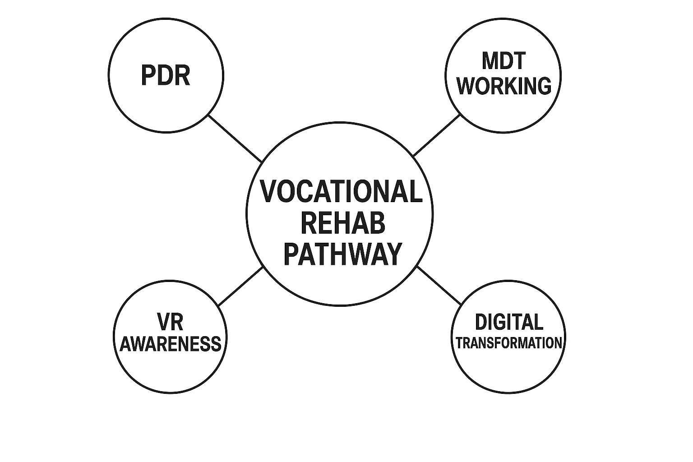

How it’s going
Increase in VR objectives during PDR
Staff working towards VR competencies
Increased awareness of potential VR issues from MDT
Success stories
Digital transformation
Notes:
More objectives set around VR during PDR.
VR competencies being working towards, increasing confidence of staff
More picking up on RTW during initial assessment, more referrals to team
New ways of working – clinic appointments – less travel, improved efficiency, using Teams and email correspondence and Accurx – real world practice. Encouraging patients to start practising e-mails at set times and getting into work practises as part of therapy. Which all supports the digital transformation model.
Increased usage of AHP report

Slide 7

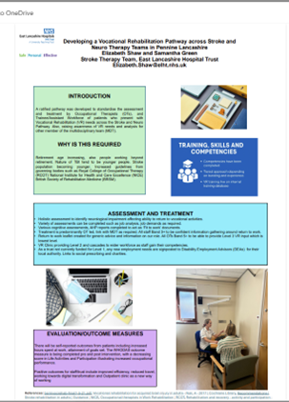
Poster presented at UKSF 2025, and ELHT OT forum:
Notes:
Presenting at UKSF in a few weeks. VR one of main topics this year.
Ongoing audits of AHP report content
Attend National VR Network 3 times per year
Attend North West VR
Ongoing work on OMs
Ongoing liaison with third party sector and signposting for L1 input and guidance which is generally when patients are looking for new roles or careers to accommodate for their Neurological impairments –
E.g. QS man. I recently visited a gentleman who was a Quantity Surveyor for a large building company. His mobility had stopped him from being able to work safely and he had resigned. He was low in mood from lack of purpose and referred by the MS nurse for Voc Rehab ( This is Level 1 which we do not get funded for) so I signed posted him to the Disability Employment Advisor at his local job centre and they had put him on a course that would use his transferrable IT and Commnication skills and he was hoping to become an advisor for the job centre.

Slide 8
Case Studies
MC – Oak furnitureland
AU – Cease contract mutual agreement
CA – Social enterprise
HD and SP – senior positions
AD – Engineer of medical equipment
AHP examples

Slide 9
Case Study
Costa Coffee Lady
Referred in Feb 2024 after 2 months inpatient rehab
Mum to a 3 year old and 12 year old – aged 40
Partner works full time
Charlie worked 60 hours plus a week over 6 days at Costa
SAH - endovascular coiling of aneurysm on 4/12/23

Slide 10
Assessment
RBANS 26.1.24
It measures five key domains—Immediate Memory, Visuospatial/Constructional, Language, Attention,
and Delayed Memory
Immediate memory 78 Borderline impaired.
Visuospatial 66 Impaired.
Language 96 Average
Attention 72 Impaired.
Delayed memory 74 Impaired

Slide 11
Rehabilitation
Not time limited service – however ensure no
decency is created and role remains formal.
Lots of education and involving partner
Slowly implemented memory strategies and ability
to walk younger son to Nursery
Had no recall if she had been to the shop however
would use coke cola bottle on the top
Very practical and liked to be busy.
Wanted to return to work and had nothing to lose. Had worked there 16 years.
No real RTW process with manager and for first 6 months she was an extra.
Formal Occupational Health referral – questioned ability to be a manager
Area manager- delayed meetings
2 years later

Slide 12
Vocational Rehab
Initially discussed roles at work
Supported with a meeting to the area manager
Then monitored via e-mail with partner CC’d to
support memory
3 x face to face visits over this period to monitor ability working
Charlie was able to function in the moment, and all drinks labels are printed out and she would see practical jobs.
At times challenging as did get fixated.
Meeting arranged without OT being informed and Charlie recorded it.
Then OT attended the next meeting
Poor RTW process has helped Charlie improve memory and process further.
Now awaiting final meeting to agree she can return as manager.

Slide 13
Case Studies
Engineer of 4D printing
Cognitive assessments RBANS Orthoptist- vision- Increased WFH during
AHP report completed suggesting RA and phased return
Notes:
more for reassurance for patient and employer, confirmed so averagescores however patient perceived pre stroke would have beenhigh average.

Slide 14
AHP report Examples
Cognitive fatigue
HCA - physical needs

