Slide 1
Appraiser Training
Welcome to day one
Facilitators:
Organiser:
Date:
Venue:
Notes:
Please adapt and use this large set of slides and resources to suit your needs, keeping the key messages
These resources are untested – please feedback to ruth.chapman@nhs.net if you would like to suggest any ideas for development
Begin with welcome and introduction of facilitators and observers if present

Slide 2

Housekeeping
Notes:
Housekeeping:
Mobile phones
Fire drills
Comfort breaks
Timings
You may need to tailor the training materials to your designated body/learners’ specific needs although, all key areas need to be covered
It is also a good time to move people around to ensure a mixture of primary/secondary/independent doctors in the group

Slide 3
Ground rules
Confidentiality
Listen
Respect
Participate
Punctuality
Have fun!
Notes:
The group may wish to add to these
It is important to check that there is a shared understanding about what confidential means in this setting and that everyone is comfortable with the idea that the learning is to be shared and used for benchmarking with other appraisers but specific anecdotes might be very private and should not be retold without explicit permission
Explain what will happen to an issue raised that cannot be dealt with immediately (have a second flip chart to “park” it on?)
This is also a good time to mention the delegate pack

Slide 4

Who are you and why are you here?
Notes:
Go around the room, asking participants to introduce themselves
You may wish to use a gentle ice breaker such as choosing a postcard from a selection and explaining why
Or ask
Why are you here?
Why do you want to become an appraiser?
Or even:
What do you bring that will make you a good appraiser?

Slide 5
Aims and objectives
To be
familiar with the principles and processes underpinning medical appraisal for revalidation
confident about your own skills in appraising and documenting medical appraisal for revalidation
Notes:
Remember to check at the end of the event that the delegates feel these aims and objectives have been reached
It is important to emphasise that these two days have a summative element. Delegates will get verbal and written feedback on their performance and facilitators will make a recommendation that they are (or are not) suitable for appointment as an appraiser at this time, based on whether they have been able to demonstrate key skills
The feedback has a formative basis: the aim is to help improve skills throughout the course and to give every opportunity to demonstrate the core competencies being assessed
“Passing” this training by demonstrating all the competencies assessed does NOT guarantee an appraisal job; in many organisations it will still be dependent on what is available and on interview

Slide 6
Definitions
Appraisal
Assessment
Formative/Summative
Performance
Review
Revalidation
Notes:
6
Generate discussion about what appraisal is and is not
Try and emphasise that although revalidation is summative, it is an easy hurdle for most doctors
Appraisal should be a positive experience for a doctor and provide support and challenge for their professional development in a formative and developmental way
Assessment can be used in a formative way to help doctors to calibrate their performance and to define what steps they need to take in order to improve

Slide 7
Appraisal and performance review – how do they differ?
Appraisal | Performance review by your employer
Appraisee led. Done by peer | Employer driven and done by line manager
Low level concerns can be discussed informally –referred to RO if needed | Discussions about underperformance may be directly linked to action such as a formal warning or suspension
PDP led by personal rather than practice goals | Development aims linked to job plan /organisation needs
Appraisee brings the information | The employer often will bring as much if not more “evidence” than the employee
The judging role in the appraisers is restricted to the 5 statements | Greater element of “judging” whether performance meets objective standards
Notes:
This slide is particularly relevant to secondary care

Slide 8
The purposes of medical appraisal
To enable doctors to discuss their practice and performance with their appraiser in order to demonstrate that they continue to meet the principles and values set out in Good Medical Practice and thus inform the responsible officer’s revalidation recommendation to the GMC.
To enable doctors to enhance the quality of their professional work by planning their professional development.
Notes:
Four purposes of medical appraisal for revalidation taken from the Medical Appraisal Guide (MAG)
Appraisal is usually about quality improvement in patient care through personal and professional development – but is also about supporting doctors in demonstrating that they are up to date and fit to practise by helping them develop an appropriate portfolio of supporting information, and helping doctors to ensure that they are fit for purpose in the context within which they work
Most doctors should have no difficulty in demonstrating that they are up to date and fit to practise and should spend almost all their time discussing:
their reflections on what they have been doing over the previous year, and
their continuing professional development and how to improve the quality of their practice by reflecting on their work, challenges, achievements and aspirations and deciding where it is most appropriate to focus their efforts in the coming year
The MAG makes it explicit that in some places appraisal is used for service development and that this is a legitimate purpose of appraisal. This is distinct from job planning as it is recommended that the two processes should be separated as far as possible because of the conflicts of interest between performance management and medical appraisal. However, it is recognised that, in some places, appraisal and job planning can take place one after the other if the process is well-managed, appropriate safeguards put in place and training given to the appraisers

Slide 9
The purposes of medical appraisal (continued)
To enable doctors to consider their own needs in planning their professional development
and may also be used:
To enable doctors to ensure that they are working productively and in line with the priorities and requirements of the organisation they practise in.

Slide 10
Key roles of appraisal
Appraisal is the key vehicle by which it is confirmed that a doctor is progressing satisfactorily towards revalidation (and any concerns are being addressed).
Appraisal is the central process for discussion and verification of the evidence submitted.

Slide 11
Key roles of appraisal (continued)
Appraisers will be judging adequacy of evidence for the purposes of revalidation, NOT making judgments about a doctor’s fitness to practice.
ROs completely depend upon a robust quality assured appraisal process to deliver revalidation.

Slide 12
What do appraisers do?
Prepare for the appraisal discussion
Manage the process of the appraisal interview using a range of communication skills
Manage the content of the appraisal interview
Assist in the planning of development needs
Record the outcomes of the appraisal interview
Handle and organise the workload and complete administrative tasks within allotted time frame
And more....
Notes:
This slide merely gives an outline of the systematic process that appraisers undertake and should be expanded on in discussion
The slide could be used to discuss the many skills used by an appraiser
The appraiser job description and doctor feedback could be referred to - both will highlight the process and the role

Slide 13
Qualities of a good appraiser
Exercise:
  What are the qualities of a good appraiser?
  Write down one quality per post-it note
  Group answers under the three headings:
      knowledge
      skills
      attributes
  Based on Bloom’s Taxonomy: Cognitive; Psychomotor; Affective
Notes:
Put the three divisions up on the wall with plenty of space between them: Knowledge, Skills and Attributes
Ask the delegates to generate as many qualities of a good appraiser as they can, one quality per post it note and then go and add them to the area they think that they most naturally come under e.g. knowledge of electronic platforms vs. communication skills vs. empathy
Multi-coloured post-its are especially good
The key teaching points are to identify that there is relatively little specific knowledge required and the skills and attributes are actually those of a good doctor, so, although they can be enhanced through training, the delegates will already have strong baseline skills and attributes to draw on
Note full reference for model - Bloom, B. S., Engelhart, M. D., Furst, E. J., Hill, W. H., & Krathwohl, D. R. (1956) Taxonomy of educational objectives: the classification of educational goals; Handbook I: Cognitive Domain New York, Longmans, Green.

Slide 14
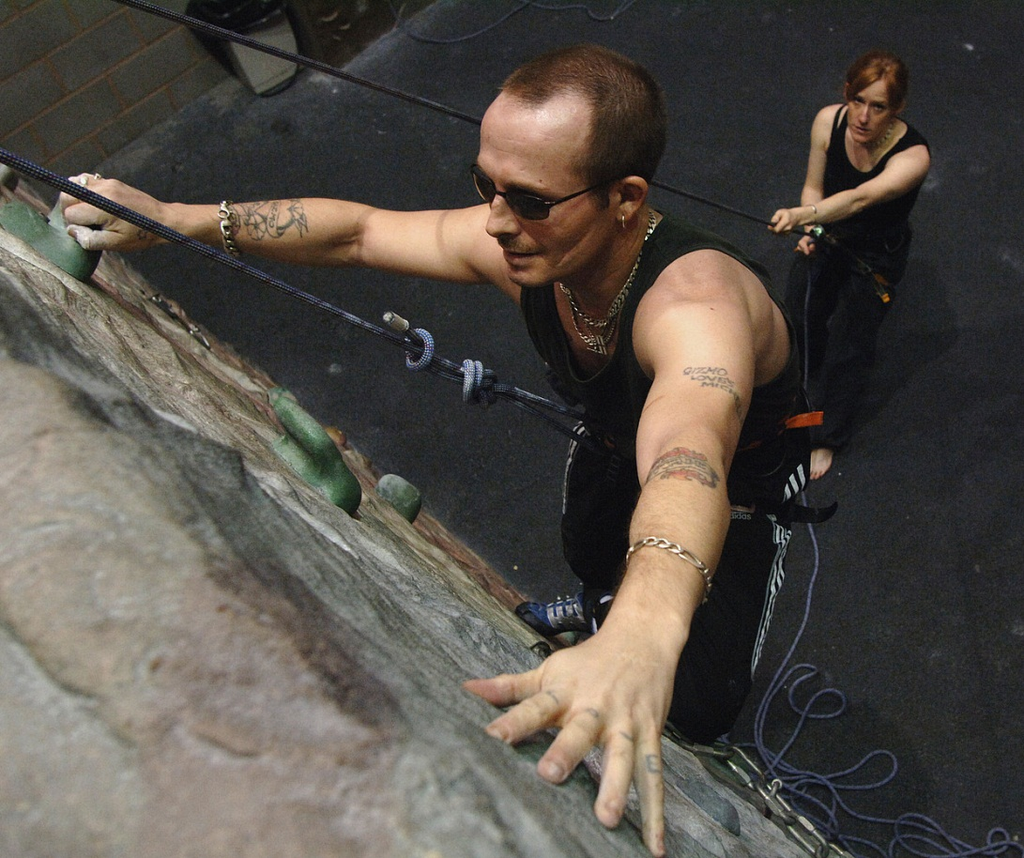
Supporting and challenging
Notes:
Being an appraiser is really all about supporting and challenging doctors, in the sense of promoting their personal and professional development and quality improvements in practice
This blind climber is being supported by his instructor and challenged by what he has set himself to do

Slide 15
‘Competency framework for medical appraisers’
Exploring the ‘Competency framework for medical appraisers’:
    Professional responsibility
    Knowledge and understanding
    Professional judgement
    Communication skills
    Organisational skills
Notes:
The delegates will hopefully have completed the self assessment for appraiser competencies prior to the course
The NHS Revalidation Support Team’s ‘Competency framework for medical appraisers’ is an appendix of Quality Assurance of Medical Appraisers (RST, 2014) and groups the core competencies that all appraisers should be able to demonstrate into the five headings here. The competency framework is in the materials provided and the delegates could be asked to complete it before they attend day 1. They could reflect on the areas that they have developed at the end of day 2 by redoing the self-assessment
Make the point that some competencies must be recruited and selected for whereas others can be enhanced through training

Slide 16
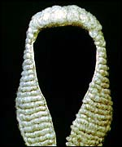
Important terms used
Professional judgement
The equivalent of the clinical judgements
that we are all used to making everyday
as clinicians (not a judicial process)
Reflection
“Good Medical Practice requires you to reflect on your practice and whether you are working to the relevant standards” (Supporting information for appraisal and revalidation, GMC, 2012)
Notes:
Appraisers need to have a shared understanding about these key terms and not exploring this can lead to misunderstandings in training
There are real anxieties in some quarters about “judging the information not the person”. Professional judgement is a decision-making process about whether there is a cause for concern or action. The ability to use this professional judgement derives from expertise in the field, self-awareness and calibration of decision making. It is about being able to deal with uncertainty and being comfortable with when to ask for help. It is not about pass/fail or guilty/not guilty. Appraisers are not judges! It is best thought of as being like the clinical judgements that doctors are used to making every day
Similarly the word ‘reflection’ can be poorly understood and some doctors may feel it is like “woolly navel-gazing” rather than a specific process of review and analysis leading to improvements in performance. Some doctors find that the use of structured reflective templates useful

Slide 17
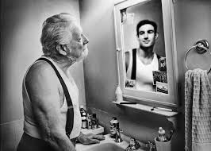
Reflection
Notes:
Of course you don’t always see things as others do…

Slide 18
Questions to prompt reflection
What went well?
What could have been done better?
How will this learning/case/experience affect me personally and my practice?
How will it improve my patient care and how can I demonstrate that objectively?
How can I share this learning with my colleagues?
Notes:
Encourage the appraisers to think about how learning might influence systems and organisations
This could be locally, regionally and nationally

Slide 19

Reflection by proxy
19
Notes:
This is when an appraiser heavily prompts the doctor’s reflection in the appraisal discussion
The reflective process is really carried out by the appraiser not the doctor
The appraiser may then write up the summary as if the doctor reflected in the conversation when really they did not

Slide 20
What might you need to develop?
Professional judgment relating to the doctor’s:
  Engagement
  Adequate CPD and other SI
  Scope of practice
  Reflection and insight
  PDP progress and new PDP
  Progress towards revalidation
  Patient safety issue or emerging concern
Notes:
It is important as a facilitator to be aware that the new appraisers will come from different backgrounds and have varied skill sets. For example, some may be educators and some may have experience in coaching and mentoring. Each appraiser will have different learning needs
The important competence of professional judgement makes explicit some decisions that appraisers have to make - about engagement, covering the whole scope of practice, the appropriateness of the supporting information and progress towards revalidation
Raising a concern will be a trigger for the responsible officer to find out more, triangulate with other sources of information and possibly take further action
The sign-off statements provide a focus for the decision-making processes
The calibration of professional judgements with other appraisers is a key skill that needs continual updating - benchmarking will take place via appraiser workshops linked in with the appraiser network

Slide 21
What may need practice?
Professional responsibility: to maintain credibility as a medical appraiser
Knowledge and understanding: of the appraiser role
Communication skills: to facilitate an effective appraisal discussion, produce good quality outputs and to deal with any issues
Organisational skills: to ensure the smooth running of the appraisal, including timely responses and sufficient computer skills
Notes:
Does this fit with the self-reported level of confidence in self assessment?

Slide 22
The purpose of revalidation
To assure patients and public, employers and other health care professionals that licensed doctors are up to date and fit to practise
Notes:
Revalidation is about being up to date and fit to practise
Demonstrating that a doctor is up to date and fit to practise is achieved by building a revalidation portfolio of supporting information over a five-year cycle. The appraiser must be trained to support the doctor in doing this
The whole of the documentation relating to the appraisal and the supporting information will all be available to the responsible officer, should they request it, and possibly to other named parties in accordance with local policy. This is important and therefore worth emphasising so that doctors and appraisers know that they must be careful not to include personally identifiable information (e.g. colleague names) in their documentation and they should write all their reflections in a professional manner
Most doctors will participate in annual appraisals without difficulty and renew their license to practice
Only those doctors who have some exceptional circumstance that prevents them from completing the annual medical appraisal process satisfactorily will automatically trigger increased scrutiny and even then it will usually be a “white flag” of something quite acceptable (maternity, long term sickness, sabbatical)
A serious cause for concern due to performance, conduct or health would be a “red flag” that would trigger immediate investigation and suspend the annual appraisal process until the outcomes of the investigation were clear
Of course, some doctors will randomly have increased scrutiny as part of a quality assurance process to ensure that positive recommendations to revalidate are benchmarked at the right level

Slide 23
What do doctors fear from revalidation?
Discuss with your neighbour and then the wider group…
Notes:
Acknowledge that there is a lot of anxiety about revalidation
Ask what feeds that fear?
Uncertainty and lack of understanding of the process
High stakes – but the standard is of being up to date and fit to practise – we all want our doctors and those looking after our families to meet those standards
Being found wanting – but the standard is not perfection and there should be a developmental approach unless not fit to practice
Being on an uncontrollable journey – however the outcome is within their control
Discuss what will happen to doctors who do not revalidate - identify early and communicate
Support – for example, remediation, clinical supervision, Occupational Health

Slide 24
Who does what in medical appraisal for revalidation?
Doctors collect portfolios of supporting information and reflection
Appraisers appraise
Responsible officers make recommendations
The GMC revalidates and issues licences to practice
24
Notes:
Doctors need guidance on what to collect in their portfolio of supporting information but it is their professional responsibility to engage with the process
Appraisers need to be trained and supported, and to calibrate their decision making processes regularly, to perform effective medical appraisals for revalidation
Responsible officers need to be trained and supported, and to calibrate their decision making processes regularly, to make appropriate quality assured revalidation recommendations to the GMC
The GMC makes the revalidation decision – and issues licenses to practise
It is important that these roles are not confused! Appraisers do not make recommendations although their input allows the RO to focus attention appropriately

Slide 25
The responsible officer recommendation
The responsible officer makes one of the following recommendations to the GMC about a doctor with whom there is a prescribed connection based on the triangulation of information from appraisal, clinical governance and any other source:
  revalidate
  defer
  notification of non-engagement
25
Notes:
The role of the responsible officer is defined by legislation
The responsible officer has only three choices when making a recommendation to the GMC:
A positive revalidation recommendation – where there are no concerns and the portfolio is complete
A recommendation to defer for a period of time (up to 12 months) – where a doctor may need additional time or support/remediation to complete a full appropriate portfolio of supporting information or for an investigation to come to a conclusion
A recommendation to the GMC that the doctor has failed to engage in the medical appraisal process and so there is insufficient information to make a revalidation recommendation but a deferral recommendation is also not appropriate. The GMC will deal with those doctors who do not engage

Slide 26
The role of the responsible officer
To make a recommendation about a doctor’s fitness to practice to the General Medical Council
To be accountable for the quality assurance of the appraisal and clinical governance systems
To be accountable for the provision of support and remediation where a need is identified
To be accountable for the pre-employment checks of fitness to practice, including identity and language checks
26
Notes:
The role of the responsible officer is defined by legislation and is more than just making revalidation recommendations. There are limits to the role – only the GMC will be able to make a revalidation decision – but it will be based on the responsible officer recommendation.
It is important that issues or concerns about a doctor are addressed as they arise and not left until the revalidation recommendation is due
Ultimately whether an issue is brought to light through the appraisal or clinical governance routes, it will be the responsibility of the responsible officer to ensure that it is dealt with promptly, appropriately and efficiently. Doctors may need specific support or remediation, but if this fails then the responsible officer will refer the issue to the GMC
If a doctor may not have adequate language skills to practice safely, the GMC may request an English language assessment – the IELTS test (international English language testing system) is used. If an appraiser has concerns about a doctor’s English language skills they should discuss this with the appraisal lead/RO

Slide 27
Identifying issues
Annual appraisal might identify doctors in difficulty at an early stage and allow positive intervention
Support can be offered (remediation, occupational health review)
No doctor should have their revalidation recommendation deferred if they have had satisfactory appraisals and no unresolved performance concerns
Doctors should be made well aware that they are not progressing satisfactorily towards revalidation and what they need to do to address this
Notes:
It is important that the appraisers and appraisal team work closely with doctors and document an agreed action plan if a deferral is made

Slide 28
Medical appraisal: the process
Appraisal covers the whole scope of the doctor’s work
Guidance and training
Scope and nature of work
Inputs
Outputs
Personal
development
plan
Quality assurance
Confidential
Supporting
information
Reflection
Summary of appraisal
Appraisal
discussion
Personal development plan review
Appraiser statements
Challenge
Achievements Challenges Aspirations
Sign-off by appraiser and doctor
28
Notes:
Introducing the structure of medical appraisal as inputs, discussion and outputs

Slide 29
Medical Appraisal Guide and MAG Model Appraisal Form
29
Notes:
The process that appraisers use for medical appraisals for revalidation is set out in the Medical Appraisal Guide (RST, 2013) and mirrored in the MAG Model Appraisal Form
Doctors can use whichever tool or format they prefer (or their designated body mandates) for their appraisal but we suggest that whatever tool is chosen it must meet the requirements of following the MAG process (asking for the six types of supporting information and reflections esp. on achievements, challenges and aspirations and the summary being written up under 4 domains and general comments and including the five post appraisal sign-off statements) in order for the doctor to be set up properly for their revalidation recommendation date
Doctors can only prepare effectively if they are fully aware of what they are preparing for

Slide 30
The MAG Model Appraisal Form
An interactive pdf; free of charge
Needs Adobe Reader 9 (also free to download) or later and Windows 2007 or later but it works on PCs and Macs (as long as Adobe Reader is the default instead of Mac Preview)
Follows the MAG appraisal process
Simple and easy to use
Supporting information can be attached
The whole form can be e-mailed to your appraiser
A new form can be generated post appraisal that pre-populates with basic information for the following year
30
Notes:
Some trainers may prefer to omit this slide or substitute one about their preferred tool

Slide 31
The 4 GMC domains - GMP
Appraisal is a supportive discussion between two peers in which performance is reviewed in all relevant Good Medical Practice areas – based on the GMC agreed supporting information
The Domains and Attributes underpin the doctor's preparation, the discussion and appraisal summary

Slide 32
Good Medical Practice:
Four domains
Knowledge, skills and performance
Safety and quality
Communication, partnership and teamwork
Maintaining trust
32
Notes:
The GMC Good Medical Practice is divided into four domains under which all doctors have to reflect on their practice across the whole of their scope of work
This is the way the appraisal has to be written up, with the addition of a general comments box
How to write up a useful and succinct summary in this structure is best learned through experience, practice and feedback. Appraiser support groups may provide useful benchmarking. The basics will be covered on Day Two of new appraiser training

Slide 33
Each domain is underpinned by attributes
Domain 1:
Develop and maintain your professional performance
Apply knowledge and experience to practice
Record your work clearly, accurately and legibly
Domain 2:
Contribute to and comply with systems to protect patients
Respond to risks to safety
Protect colleagues and patients from any risk posed by your health
Notes:
Each domain has attributes
The point of providing supporting information is to demonstrate that the doctor is working to all the attributes
The RST Pathfinder Pilots in 2010/11 showed that it was possible to map supporting information to all 12 (now more) attributes but that the exercise of doing so added a burdensome level of complexity and subjectivity and that well chosen supporting information fulfilling the GMC guidance would necessarily cover all 12 attributes over a five-year period. In order to ensure that producing the portfolio is simple and proportionate, mapping to the attributes has been removed from the Medical Appraisal Guide (RST, 2013) process for medical appraisal

Slide 34
Domains (continued)
Domain 3:
Communicate effectively
Work collaboratively with colleagues to maintain or improve patient care
Establish and maintain partnerships with patients
Additional:
Teaching, training, supporting and assessing
Continuity and coordination of care

Slide 35
Domains (continued)
Domain 4:
Show respect for patients
Treat patients and colleagues fairly and without discrimination
Act with honesty and integrity
Notes:
Might include:
Communicating information appropriately
Openness regarding legal or disciplinary proceedings
Honesty in financial dealing

Slide 36
Declarations before the appraisal discussion
Acceptance of the professional obligations placed on doctors in Good Medical Practice in relation to probity and confidentiality
Acceptance of the professional obligations placed on doctors in Good Medical Practice in relation to personal health
Personal accountability for accuracy of the supporting information and other material in the appraisal portfolio
36
Notes:
These pre-appraisal sign-off statements, taken from the Medical Appraisal Guide, give a written record that the doctor has considered the professional obligations upon them and mean that a doctor can be held to account should it subsequently be found that they have deliberately misrepresented themselves
Organisations have an obligation to assist doctors in collecting supporting information for appraisal. A doctor cannot be held responsible for genuine errors in information that has been supplied to them

Slide 37
Just before coffee – 2 key messages
First, do no harm:
The appraisal should be a positive experience for the doctor
The effort needs to be proportionate
Appraisers must not take on inappropriate
roles even if they have the skills
37
Notes:
Good doctors who are trying hard to engage should find the appraisal a reassuring and useful process. They should not be “bruised” by a process that makes them feel inadequate when there are no serious concerns. Instead they should be empowered to make positive changes for the benefit of themselves and their patients
The portfolio of supporting information must not take excessive time and effort to collect
Appraisers have a lot of skills but should not become the doctor’s GP/doctor, or ongoing mentor – the role of appraisal is to move doctors on to finding appropriate ongoing support if it is needed. Protecting appraisers is also important
A lot of counselling or mentoring skills may be used in appraisal but it is a once a year intervention and mentoring and coaching are ongoing relationships. ‘Find a mentor/coach…’ may be a very useful PDP objective!
37

Slide 38
The appraisal balance
Revalidation
Professional Development
Quality Improvement
Notes:
The balance in most appraisal discussions should be heavily weighted in favour of professional development as a way to drive quality improvements in patient care or medical practice, because most of the baseline requirements for revalidation should be easily met in the portfolio of information provided before the appraisal discussion
Doctors frequently express the desire to be challenged in the areas of personal and professional development in order to deliver quality improvement for patients – and constructive challenge is a key purpose of appraisal
This is NOT to say that patient safety and revalidation is less important, just that it will take less time in the appraisal (for most doctors) than promoting quality improvements

Slide 39
Key message 2
If in doubt – ask:
  Appraisers should have a low threshold for seeking advice (and know the appropriate contact details)
  Appraisers need access to professional support structures including the appraisal network
  The doctor being appraised is the expert
  Supporting information needs to be set in context
39
Notes:
Doctors are trained to come to quick conclusions and act on their decisions
In appraisal, particularly pre-appraisal, it is important to bear in mind that the doctor being appraised is the only person who can put all their pre-appraisal documentation into context
A professional judgement about the quality of a piece of supporting information will be informed by benchmarking with other appraisers, but there are no absolutes and the appraiser will need to understand the context for the doctor being appraised before coming to any conclusions
For revalidation, it is important that the appraisal policy makes clear that the appraiser may need to seek advice, and give the name and contact details of the appropriate person/people (usually senior appraiser/appraisal lead in first instance)
Appraisers need to be trained to have a lower threshold for seeking advice on “soft” issues so that standards are applied consistently and so that appraisers are supported in making appropriate and consistent decisions
39

Slide 40

Tea/coffee
40
Notes:
Time for a break
Remind people what time to return

Slide 41
General overview of appraisal supporting information
Personal details
Scope of work
Record of previous appraisals
PDP and its review
Supporting information
Probity and health declarations
Doctor’s appraisal statements
Notes:
Scope of work – list of all the roles undertaken and how these are reviewed. Include all clinical work (NHS and private), managerial, teaching and all other roles (private, voluntary etc.)

Slide 42
Supporting information
Exercise:
  What would you use to affirm the quality of your own practice? Write it down
  Only one type of supporting information per post-it note
Once generated…
  Post up under relevant domain of Good Medical Practice
42
Notes:
This is a chance for the participants to take ownership of supporting information before looking at what the GMC requires
Hopefully the suggestions will align but it also affords an opportunity to discuss the difference between GMC requirements (base line) and college (best practice) guidance
Most appraisers, even the very experienced, find it hard to resist the temptation to try to give a black and white answer to what supporting information is required, but actually this is an area that needs a lot of professional judgement as there are perfectly reasonable exceptions to almost every requirement (e.g. histopathologists do not see patients as such…)

Slide 43
Levels of supporting information
Personal
Aspirations
Supporting information that promotes reflection,
may be about the current working environment or areas for future growth and development
Organisational and individual information
Professional development
Mandatory requirements may be made contractually by the employing organisation
Supporting information defined by the employing organisation or specialist body
(Fitness for purpose)
GMC guidance is the essential basis for all revalidation decisions
Supporting information defined by the General Medical Council
(Fitness to practise)
Revalidation
43
Notes:
A reminder that supporting information may be defined by the GMC as essential for revalidation, or it may be required by the organisation or speciality, or it may be selected and provided by the individual because it is of particular relevance to their individual professional or personal development
Not all supporting information is defined by the GMC. What is required of an individual will depend on the year of the revalidation cycle and the context within which they are working. The detailed guidance has been delegated by the GMC to the Royal Colleges and Faculties, who, together with the employing organisation may have specific requirements for demonstrating contractual fitness for purpose as a specialist or employee. But what is provided by the individual is likely to be of most relevance in driving quality improvements in patient care
The shape could probably be represented the other way up with the GMC foundation as a small triangle and each level above getting broader: the idea is to emphasise the GMC supporting information as being a foundation, even though in some ways for most doctors it will be the smallest part

Slide 44

GMC requirements for supporting information for revalidation
44
Notes:
This document should be included in pre-course reading / e-learning modules and every appraiser needs to be thoroughly familiar with it
It underpins all professional judgements about supporting information

Slide 45
GMC supporting information principles
General information
Keeping up to date
Review of your practice
Feedback on your practice
45
Notes:
The GMC document (pre-course reading) states: “The supporting information that you will need to bring to your appraisal will fall under four broad headings…” as above
The key learning point for appraisers is that the GMC requirements are the absolute baseline for all doctors (and the ultimate indicators of fitness to practise)
College and organisational requirements can be contractually enforced (and considered as indicators of fitness for purpose)
As long as the four broad principles of supporting information (describes whole scope of work, demonstrates keeping up to date, demonstrates review of practice and feedback on practice) are covered and the six types of supporting information (next slide) are provided, it would be hard to justify a decision that a doctor could not revalidate (as a doctor) on the basis of their supporting information

Slide 46
GMC supporting information requirements
The GMC requires six types of supporting information:
Continuing professional development
Quality improvement activity
Significant events
Feedback from colleagues
Feedback from patients (where applicable)
Review of complaints and compliments
46
Notes:
The GMC document (pre-course reading) states: ”There are six types of supporting information that you will be expected to provide and discuss at your appraisal at least once in each five-year cycle. They are…” as above
The GMC also says: “The nature of the supporting information will reflect your particular specialist practice and your other professional roles. For example, an appropriate quality improvement activity will vary across different specialties and roles.”
It is important that this is understood to ensure that doctors who have particular issues e.g. locums or doctors working in isolated practice can find appropriate ways to demonstrate their competence across all 12 attributes even if they are not able to do what a more mainstream doctor could or what their Royal College or Faculty guidance says

Slide 47

What concerns might you have about evidence?
Lack of evidence or inadequate evidence (scope)
Lack of personalised evidence
Lack of reflection on evidence submitted
Evidence of poor performance
Notes:
Ask the group – ‘What issues might you come across when looking at a doctor’s appraisal evidence?’
Discuss how you might address these issues in the group

Slide 48
Whole scope of work – for every medical role you have, please consider…
How did you train and qualify for this role?
How do you keep up to date in this role?
How can you demonstrate that you are fit to practise in this role?
What feedback do you get about your performance in this role?
Do you have supervision?
48
Notes:
It is very important that the appraisal covers the whole of a doctor’s scope of work i.e. every role for which they use their medical qualification. Revalidation will be about actual roles performed now, not what was qualified for originally
Think of a doctor as a Swiss Army Knife with lots of tools at their disposal that can be used for different purposes: doctors may use their medical qualifications for lots of different functions
New appraisers should be reminded that appraisal will be a new part of their scope of work

Slide 49
Supporting information quality
As an appraiser you may comment on the quality of supporting information in the summary of the appraisal discussion
For example:
  Was it a good quality audit?
  Did the doctor re-audit?
  Did the doctor reflect on the process and findings?
  Did they change practice as a result of the QIA and show improvement in patient care?
  Did they share the findings with colleagues?

Slide 50
Good quality supporting information and documentation - small group work
How can we encourage doctors (and designated bodies) to produce good quality SI?
How do we approach scope of work and supporting information?
What quality markers are we expecting to be documented? (Relate these to the 6 types of SI)
Notes:
Small group work:
Spend 15 minutes considering these questions:
Good leadership may result in a culture of learning and development which will feed into appraisal
Consider ways designated bodies might use systems to gather SEAs/SUIs, audits, complaints, compliments, performance and prescribing data in a way that can be used by doctors in their personal appraisals
A doctor should include a statement about their full scope of work as well as CPD relating to each role within their appraisal portfolio. The PDP should also reflect their scope of work
Look at handout ‘supporting information audit’ – this could be given towards the end of the small group discussion
Feedback to the large group – if time

Slide 51
Continuing professional development (CPD)
Should cover scope of work (might not all be clinical)
Approximately 50 hours per year
Submitted with associated reflection +/- learning points
May be diverse for example, conferences, meetings, conversations, e-learning, films, books
Notes:
CPD – learning activity relevant to doctor’s scope of work

Slide 52
Continuing professional development (CPD) (continued)
The GMC states: “There should be a discussion on CPD at each appraisal meeting”
  How do you keep up to date?
  How do you identify what you need to learn?
  What have you reflected on in your learning this year?
  What are the main things you have learned this year?
52
Notes:
The quote is from: Supporting Information for appraisal and revalidation (GMC, 2012)
Useful stem questions on CPD
CPD should focus on outcomes or outputs rather than on inputs and a time-served approach. You should evaluate what you have learned and understood from your CPD activity and how it may impact on and improve your performance. (GMC Supporting information…)
It should be needs-based
It should be influenced by participation in clinical governance
Lessons learned, encouraging excellence and identifying examples of good practice can easily be introduced when considering CPD

Slide 53
Continuing professional development (CPD) (continued)
What changes have you made as a result of what you have learned?
Can you objectively show an improvement in patient care as a result?
How have you shared your learning with others?
How do you keep the recording of your CPD proportionate?
Taken from ‘Supporting information for appraisal and revalidation’ (GMC 2012)

Slide 54
‘Mandatory training’ as part of CPD
Not defined by the GMC
Refer to organisational requirements
Commonly CPR and safeguarding training, information governance, equality and diversity, health and safety

Slide 55
Last year’s PDP
Review last year’s PDP and the linked CPD that has been carried out
Were all the items on the PDP completed?
If not, why not? The explanation will need to be documented in the summary of appraisal discussion
Some uncompleted items may be carried forward to next year’s PDP or they may no longer be relevant
Your appraisal discussion may inform next year’s PDP which should be SMART

Slide 56

Think about the impact…
…of what you learn on what you do
Patients
Patients
Patients
Doctor
Patients
Service
56
Notes:
Attendance at a CPD event does not necessarily imply learning has taken place – what impact has it had?
The GMC statement on reflection emphasises that the skill to be demonstrated in the revalidation portfolio is reflection: “Good Medical Practice requires you to reflect on your practice and whether you are working to the relevant standards” (Supporting information for appraisal and revalidation, GMC, 2012)
The GMC requires a reflection on impact in terms of lessons learned and demonstration of change as a result
Impact is demonstrated through the reflective note that the doctor makes about the learning event (e.g. date, title, hours spent, what you learned, further actions, who you shared it with and what the impact was) or in the appraisal discussion

Slide 57
Quality improvement activity (QIA)
The GMC states: “Involvement in QIA is expected at least once every revalidation cycle; however, the extent and frequency will depend on the nature of the activity…you should discuss and agree the frequency of the QIA with your appraiser.”
Your Quality Improvement Activity (QIA) should be relevant to your work
57
Notes:
The quote is from: Supporting Information for appraisal and revalidation (GMC, 2012)
Discussing the QIA will involve the doctor demonstrating that they have actively participated in a QIA or clinical audit relevant to their work, evaluated and reflected on the results, taken appropriate action in response to the results and closed the loop through repeat of the activity or re-audit
While individual colleges and faculties may require a particular type of QIA, the GMC does not, and doctors in unusual situations are encouraged to find innovative ways of demonstrating that they reflect upon what they actually do in practise
The appraiser is expected to exercise professional judgement about the appropriateness of the supporting information in this area, as in all others
Encourage the appraisers to comment on the quality of supporting information e.g. relating to an audit – was it a full audit cycle with measurement of performance against formal standards [e.g. NICE guidance] with 2 sets of data collection?

Slide 58
Quality improvement activity (QIA) (continued)
  Clinical audit
  Review of clinical outcomes
  Case review or discussion – shared with a colleague(s)
  Audit and monitor the effectiveness of a teaching programme
  Evaluate the impact and effectiveness of…health policy

Slide 59
Quality improvement activity (QIA) (continued)
‘Quality improvement activities should be robust, systematic and relevant to your work. They should include an element of evaluation and action, and where possible, demonstrate an outcome or change…’
Supporting information for appraisal and revalidation (GMC, March 2011)

Slide 60
Significant events
The GMC states: “You should discuss significant events
involving you at appraisal with a particular emphasis on those that have led to a specific change in practice or demonstrate learning”.
A GMC significant event is any “unintended or unexpected event, which could or did lead to harm of one or more patients”
60
Notes:
Secondary care doctors aspire to have no SUIs. General practice SEAs are seen more like case reviews or learning events to go in section 8 not section 9 of the MAG
The quote is from: Supporting Information for appraisal and revalidation (GMC, 2012)
The GMC states that a significant event (also known as an untoward, critical or patient safety incident) is any unintended or unexpected event, which could or did lead to harm of one or more patients. This includes incidents which did not cause harm but could have done, or where the event should have been prevented
Further guidance on significant events as supporting information is available from the GMC and from the National Patient Safety Agency. Please also ensure you are familiar with your organisation's local processes and agreed thresholds for recording incidents
All significant events involving you should be discussed at appraisal or a statement made that there have been none
In primary care in particular, significant event audit has evolved as an important tool in improving practice. Where these have been undertaken and don’t meet the GMC definition above, they should be included as supporting information for quality improvement activity
Please note:
You can submit SEAs that you were not directly involved in if you personally reflect on them and show learning
You do not need to list any significant events where your only involvement was in the investigation unless that is an important part of your scope of work
It is not the appraiser's role to conduct investigations into serious events. Organisational clinical governance systems and other management processes are put in place to deal with these situations
Please ensure you are familiar with your organisation's local processes and agreed thresholds for recording significant events

Slide 61
Significant events (continued)
Please ensure you are familiar with your organisation's local processes and agreed thresholds for recording incidents. Secondary care tend to refer to SUIs – serious untoward incidents
All such significant events involving you should be discussed at appraisal - or a statement made that there have been none
Other ‘significant events’ may be quality improvement activities

Slide 62
Colleague and patient feedback
The GMC states: “ Feedback should be formally sought at least once per revalidation cycle, normally every five years.” (and will always be needed by the revalidation recommendation year)
  You should seek feedback from colleagues and patients in your whole scope of work and review and act upon that feedback where appropriate
62
Notes:
Feedback is a particularly useful tool to look at behaviours, teamwork, professionalism, communication and interpersonal skills
The quote is from: GMC Supporting Information for appraisal and revalidation (GMC, 2012)
Normally the requirement is for reflection on one formal set of colleague and patient feedback to be included in appraisal per revalidation cycle. If the results are poor, it is suggested that the feedback surveys are repeated after making an action plan and implementing changes in order to demonstrate improvement
The feedback must:
cover the current scope of work
have enough respondents to get an overview (each tool has its own numbers: 15 colleagues, 34 patients are suggested, but not mandatory, for the GMC questionnaire; professional judgment may be needed depending on the context within which the doctor works)
be externally collated and anonymised before being fed back to the doctor for their personal reflections so that respondents are assured that they can comment freely
include self-assessment (discrepancies with rater scores can be revealing – many doctors rate themselves lower than their feedback suggests they should)
include benchmark data from others doing the same questionnaire (this will become more useful as the benchmark data includes a greater variety of doctors, but beware falsely high scores because early adopters of the tools have been keen doctors in stable working environments)
Doctors must:
reflect on the outcomes and what it means for their practice and behaviour
include their reflection in the pre-appraisal documentation
discuss the feedback and their reflections on it during the appraisal discussion
Feedback that meets these requirements and has been done within the past five years will be eligible to be submitted as part of the revalidation portfolio of supporting information. Appraisers will have discretion to determine whether feedback is suitable and to make professional judgments about circumstances where variation in the guidance is called for (e.g. an unusually low number of respondents for a doctor working in unusual circumstances)

Slide 63
Colleague and patient feedback (continued)
Feedback will usually be collected using standard questionnaires that comply with GMC guidance
The questionnaire must be administered independently of the doctor and the appraiser
Discussion during the appraisal should highlight areas of good performance and identify areas for further development

Slide 64
Feedback – documentation in summary
Reflect on what tool was used and how feedback was collected (and how many were collected)
Where there any special characteristics?
Review and refer to self-assessment
Refer to benchmarking scores
Reflect on the areas the doctor scores highly
Reflect on the areas with lower scores - does the doctor agree? Does the scoring triangulate with other SI? Action to be taken?
Review free text comments
Notes:
Some doctors have difficulty collecting feedback from patients and may receive lower scores (e.g. psychiatrists)

Slide 65
Review of complaints and compliments
The GMC states: “A complaint is a formal expression of dissatisfaction or grievance…You should discuss any change in your practice that you have made as a result of any complaints or compliments you have received since your last appraisal”.
65
Notes:
The quote is from: Supporting Information for appraisal and revalidation (GMC, 2012)
The GMC is concerned about reflection on:
Awareness of the complaints procedures and any complaints about the doctor or the team
Participation in the investigation and response to complaints where appropriate
Actions taken in response to the complaint
The identification of opportunities for professional development
Those who are involved in the investigation of complaints do not need to include every complaint they have investigated, if they were not about them or their team and there was no personal learning to reflect on – but they should reflect that this is part of their scope of work and demonstrate how they keep up to date, review what they do and get feedback in this area
There may be a need to ensure that the organisation has systems to let doctors know about any complaints that may have been received about them. A doctor cannot be held accountable for information that they do not know about - but wilful ignorance is no excuse.
If there have not been any complaints then a statement to that effect will be required

Slide 66
Review of complaints and compliments (continued)
Complaints and compliments should be seen as another type of feedback
It is how you dealt with the complaint rather than the number that should be the focus of discussion in the appraisal
You will be required to make a statement that there have been no complaints about you or your team in a given appraisal period if there have not been any

Slide 67
Probity statement
Probity – being honest and trustworthy and acting with integrity
Acceptance of professional obligations outlined in Good Medical Practice
Must inform GMC if cautioned, charged with a criminal offence or another professional body found against you
If suspended or restrictions on practice you must inform all organisations you work for
Notes:
Paragraphs 56-76 GMP
Discuss what might be discussed in the appraisal conversation relevant to probity:
e.g. being honest and trustworthy, providing and publishing information about your services, writing reports and CVs, giving evidence and signing documents, research, financial and commercial dealings, conflicts of interest

Slide 68
Health statement
Declaration that you accept the professional obligations placed on you in GMP about your health
Guidance:
Registration with GP outside your family and you should not treat yourself
Immunisation
Consult a suitably qualified colleague if you have a serious condition that could pose a risk to patients

Slide 69

Patient safety
Notes:
This slide is to remind the appraiser that appraisal is in part about patient safety
The appraiser can also remind the doctor to consider the patient journey for example using case reviews, significant event analysis and complaints and compliments

Slide 70
Supporting information scenarios
Exercise:
  Look at the supporting information scenarios given
  Consider the decision point and decide on your course of action - write it down
  Review your answers with the supporting information algorithm and teaching points as an aide memoire and discuss with the person next to you
  Share your answers with the group
70
Notes:
This exercise is designed to provide an entry point into developing consistency in decision-making across all appraisers
Appraisers need to take into account the complexities of real life. They are trained to do no harm and, if in doubt, to ask
There will inevitably be exceptions to any rule and appraisers need to be able to deal appropriately with doctors from a huge variety of different contexts. This may initially be uncomfortable but it fits with the idea of doctors as professionals making expert clinical judgements where exactly the same principles apply
Appraisers should understand that their professional judgements about supporting information will need further modification and benchmarking over time within a peer support system / network of some sort
More scenarios are explored in the worked examples in the resource pack and there is an algorithm for those who like visual prompts for decision-making processes

Slide 71
Outputs of appraisal
Appraisal summary of discussion
Personal development plan (PDP)
Appraiser statements
Both parties sign off within 28 days

Slide 72
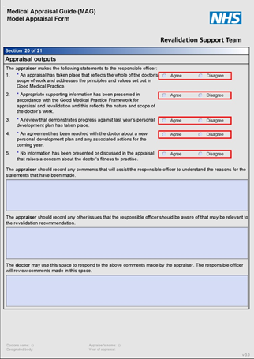
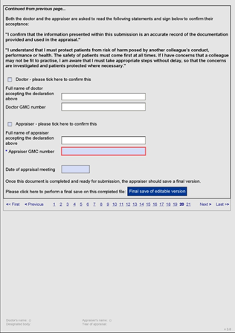
Outputs of appraisal (continued)
72
Notes:
Quick screen shot to show what the outputs of appraisal look like in the MAG MAF form
Detail comes in the next few slides

Slide 73
Outputs of appraisal: statements one and two
An appraisal has taken place that reflects the whole of a doctor’s scope of work and addresses the principles and values set out in Good Medical Practice
Agree/Disagree
2. Appropriate supporting information has been presented in accordance with the Good Medical Practice Framework for Appraisal and Revalidation and this reflects the nature and scope of the doctor’s work
Agree/Disagree
73
Notes:
Appraisers can be trained to use their professional judgement about engagement in the appraisal process and how to sign the statements agreed for the roll out of revalidation
They should discuss the issues around these three areas: the appraisal taking place, the whole scope of work being covered and the supporting information being appropriate according to the GMC guidance

Slide 74
Outputs of appraisal: statements three and four
A review that demonstrates progress against last year’s personal development plan has taken place
Agree/Disagree
An agreement has been reached with the doctor about a new personal development plan and any associated actions for the coming year
Agree/Disagree
74
Notes:
It is important to make a statement to the responsible officer about having appropriate levels of achievement against last year’s PDP. Dropping, modifying or carrying forward individual objectives may be appropriate (and some may have a time scale of over one year) but over a five year cycle there needs to be a clear demonstration of progress with the PDP objectives
There is also a separate statement about the new PDP confirming that it is derived from the appraisal discussion and the supporting information presented. It will be informed by what is needed to make a good revalidation portfolio and promote quality improvement

Slide 75
Outputs of appraisal: statement five
No information has been presented or discussed in the appraisal that raises a concern about the doctor’s fitness to practise
Agree/Disagree
75
Notes:
It is important to make a statement to the responsible officer about having no concerns about the doctor’s fitness to practise arising from the appraisal discussion and supporting information presented
This statement is to be made in the context of a declaration about understanding the obligations of Good Medical Practice

Slide 76
Outputs of appraisal: additional information for the RO
The appraiser should record any comments that will assist the responsible officer to understand the reason for the statements that have been made.
The appraiser should record any other issues that the responsible officer should be aware of that may be relevant to the revalidation recommendation.
The doctor may use this space to respond to the above comments made by the appraiser. The responsible officer
will review comments made in this space.
76
Notes:
This additional information will ensure that the responsible officer is given the contextual information that enables them to make sense of the sign-off statements
Sometimes the appraiser will “disagree” with a statement, but there may be an entirely appropriate reason for this e.g. PDP objectives not met because circumstances changed dramatically and a different PDP was created and met
While exceptional circumstances will be recorded elsewhere, it may also enable the responsible officer to see at a glance where particular circumstances apply e.g. maternity leave, sabbatical, long-term illness
Experience teaches us that it is better to leave the boxes blank when everything is going well rather than entering a null answer such as “n/a” as leaving it blank makes populating the RO dashboard easier

Slide 77
Confirmation of understanding of GMP obligations
Both the doctor and the appraiser are asked to read and sign the following statements to confirm their acceptance:
I confirm that the information presented within this submission is an accurate record of the documentation provided by the doctor and used in the appraisal.
77
Notes:
The responsibility is for the appraiser or doctor to raise the concern, it is not to make a decision about whether patients or a colleague are actually at risk
Further investigation, triangulated with other sources of supporting (or refuting) information, will be necessary for the responsible officer to make a final decision about the most appropriate course of action
This statement will need to be signed-off by the doctor and the appraiser. Having signed it, there is an imperative need to do something proactive to raise the concern if there is an issue. Doctors and appraisers must not just assume that the RO will eventually see the statements and pick up an issue.
Once these sign-offs are in place, the documentation is completed and the MAG Model appraisal form offers the appraiser (who signs second) the chance to do the “Final Save of the editable Version” and then “Lockdown and Submit”

Slide 78
Confirmation of understanding of GMP obligations (continued)
I understand I must protect patients from risk of harm posed by another colleague’s conduct, performance or health. The safety of patients must come first at all times. If I have concerns that a colleague may not be fit to practise, I am aware that I must take appropriate steps without delay, so that the concerns are investigated and patients protected where necessary.

Slide 79
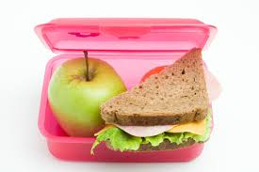
Enjoy your lunch
79
Notes:
Remember to let delegates know exactly when they need to get back after lunch
Change the image to suit your training if you wish

Slide 80
Providing a professional appraisal
  List what you consider to be important…..
  3 hours protected time – no disturbances
  Venue options and internet access
  Starting conversation: Discuss confidentiality
  Data protection
  Sign post and set boundaries – particularly timeline e.g. SI should be made available to you 2 weeks before the appraisal
  Communication (nhs.net) and timely sign off
Notes:
Reading the briefing notes on providing a professional appraisal was part of pre-course preparation
Delegates should recognise that different organisations/appraisal policies will raise different issues but key concerns may include:
Confidentiality (dealt with explicitly in the introduction to the appraisal discussion and the next exercise)
Venue being private/confidential, with freedom from interruptions and IT/resources. Appraisers need to recognise the risk if they allow an appraisal to take place in their own home even if they have a home office environment and protect themselves by getting the agreement in writing prior to the appraisal
Time taken (roughly an hour preparation, 2 hours at appraisal meeting, 2 hours write up after meeting)
Providing protected time when fresh and able to fully engage. If an appraisal is taking place out of normal working hours, again getting explicit written agreement beforehand is a wise safety net in case there are later charges of collusion/accusations.
Ensuring that there are no incomplete appraisals (i.e. not fully signed off with all paperwork complete by 4 weeks after the appraisal date)
Data protection - there should be no patient or colleague identifiable details and any electronic communication should be over secure e-mail (e.g. nhs.net)
Local policies can be explored in more detail on day two

Slide 81
Your preparation before the appraisal
  You will be allocated doctors – check that there are no COI
  Early contact with sign-posting
  Read previous appraisal – summary and PDP
  Is everything there that should be?
  Make notes
Notes:
Allocations: Discuss any potential conflict of interest with your appraisal lead
Early contact – sign-post doctor if necessary and arrange appraisal. Advise that SI needs to be made available to you at least 2 weeks before the appraisal meeting
Read previous appraisal and check that there are no concerns (conditions/GMC)
Check through SI – this is particularly important just before revalidation recommendation is due. Is there adequate reflection – you may need to ask the doctor to add more to the portfolio (or you may decide to go ahead with the appraisal and discuss and document any gaps)
Make notes – see appraisal summary preparatory template – and list questions that you might like to ask. The ASPAT tool may also guide you through the process.

Slide 82
Duties of a doctor
“You must protect patients from risk of harm posed by another colleague's conduct, performance or health. The safety of patients must come first at all times. If you have concerns that a colleague may not be fit to practise, you must take appropriate steps without delay, so that the concerns are investigated and patients protected where necessary. This means you must give an honest explanation of your concerns to an appropriate person from your employing or contracting body, and follow their procedures.”
Good Medical Practice (GMC, 2006)
82
Notes:
This is a direct quote from Good Medical Practice (GMC, 2006) section 43
It underlines the need for appraisers who are in any doubt to discuss their concerns
One aim of this section of the training is to ensure that every appraiser trained is completely clear about who the appropriate person from the employing or contracting body is and how to contact them
Having the right names and contact details/processes for the audience prior to training is essential as all appraisers need to go away with this key knowledge. It can be an action point for individual appraisers to take away from the day to find out for themselves.
If not already covered this is also a good place to explore the new reality that there are many other occasions when confidentiality will be breached to a minor degree – to allow quality assurance and collation of constraints or learning needs, to raise an issue and ask advice (highlighted by the new emphasis on asking others in order to moderate/benchmark decisions). These should be clearly understood by both parties and explicit in the appraisal policy

Slide 83

Demonstrating an introduction
83
Notes:
It is essential that appraisers make the limits of confidentiality explicit, even if it is not the first appraisal with that doctor
It is worth asking for a show of hands to see how many doctors in the room are already used to an explicit reference to confidentiality as part of the introduction to their appraisal when they have been appraised, as this will highlight how much time to spend on this area of training
If only a few hands go up, acknowledge that one learning point from this exercise is to drive appraisal policies to make the limits of confidentiality explicit and to suggest to new appraisers that they go back to their organisations looking for a standard written explanation of the limits of confidentiality that is always shared pre-appraisal. Note that people do not always read policies or even introductory letters/e-mails, so it is still worth touching on at the beginning of the appraisal when it sets the professional boundaries in place for the discussion
Acknowledge that it can feel artificial to have to actually make an introduction and say out loud what is needed to make the GMC requirements explicit
The form of words offered in the pre-course reading may help some appraisers by providing an example (See ‘Providing a professional appraisal’)
Rehearsal and observation of how another appraiser does it makes it feel more comfortable – so use role play by the facilitators– making an introduction as if we were about to start an appraisal – or ask appraisers in pairs to have a go
If new appraisers do not feel that this effort will make their own lives easier in the long run, they are unlikely to make it part of their routine – but remind them that it will be assessed in the feedback exercise and the partial appraisal during the training

Slide 84
The introduction
Introduce yourself
Thank the GP for their preparation
Mention confidentiality for example:
  ‘This is a confidential discussion, with outcomes submitted to the RO - BUT if anything emerges from the discuss that could affect patient safety then I would need to share this information’
What’s your experience of appraisal? How was the preparation?
Agenda – what would you like to discuss?
Notes:
Agenda – this may depend on the doctor’s circumstances and stage of career, difficulties with preparation or understanding of appraisal

Slide 85
The discussion
Guided by your preparation, the SI and the doctor’s agenda
Listen and you may take notes
Discuss evidence, reflection and learning
Review last year’s PDP
Identify gaps and link to this year’s PDP
Cover scope of practice
Challenge constructively
Map to domains and attributes

Slide 86
Your role with concerns
Being able to identify them
Making a judgement about seriousness
Know where to seek advice and help as an appraiser
Know where to sign post doctors for further help
Capture concerns accurately in summary and include actions in PDP
Know how to stop an appraisal

Slide 87

Suspending the appraisal
There are a very few situations where this might be necessary:
  Evidence of a previously unknown serious performance concern threatening patient safety
  Attendance at interview in a seriously depressed/distressed state or under influence of drugs/alcohol
Notes:
In most situations where a concern is raised it is more sensible to use the appraisal discussion to explore issues in more depth, rather than to stop the discussion. At the end of the appraisal you must make it clear if you feel you need to take advice from the appraisal lead or RO
It is not fair to the doctor to think everything is fine at the end of the appraisal and then to get a phone call from the RO.
At this point in the training you could ask the doctors to run a quick role play on ending an appraisal prematurely – one as the doctor and the other as the appraiser
Discuss – what would be the advantages of stopping over continuing?

Slide 88
What communication skills might you use at the appraisal?
Some examples:
  Listening
  Open questioning
  Repeating back what they have said
  Body language for example, mirroring
  Coaching (and mentoring) skills
  Motivational interviewing
  Adult – adult interaction
Notes:
Small group work – ask the group to come up with some examples
Acknowledge that there are many skills that you might use and appraisers will have different approaches
This training will not cover all these tools of communication but appraisers can read around the techniques (put on their own PDP)
Challenging appraisals are covered in day 2 and in more detail in other training sessions

Slide 89
Challenge – TrUST model
Trust
Understanding
Safe exploration
Task – setting goals/actions

Slide 90
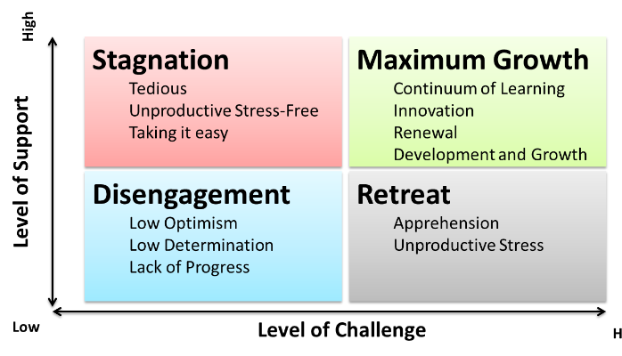
90
Notes:
References:
Stanford (1962) studied college students and developed the challenge and support model.
Sanford, N. (1962). The American college. New York: Wiley.
Sanford, N. (1966). Self and society: Social change and individual development. New York: Atherton.

Slide 91

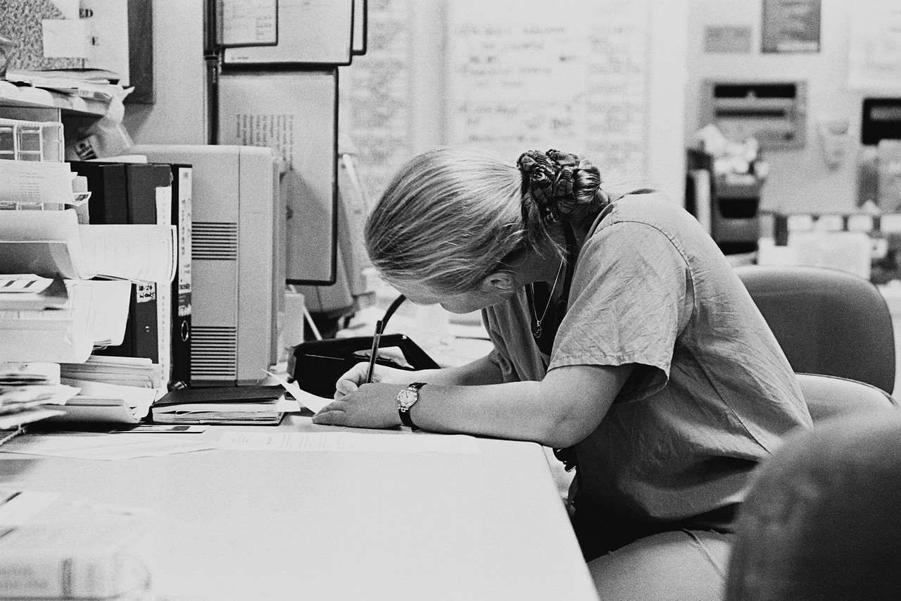
Are they listening?
91
Notes:
Take home message:
A doctor will not think you are listening if you are not displaying the behaviours associated with active listening – in particular if you are looking at the paperwork and not making eye contact.

Slide 92

Questioning skills
What?
How?
Why?
Where?
When?
92
Notes:
Ask each delegate to write down a suitable opening question on a post-it note, then share with the group.
Rudyard Kipling (1902) The Elephant’s Child
‘I keep six honest serving men,
(They taught me all I knew);
Their names are “What”? and “Why?” and “When?”,
And “How?” and “Where?” and “Who?”’
How many of the opening questions used one of these as the entry point?
“Tell me about…” is another good opener.

Slide 93
Questions, questions…
Open to funnel
  Open, probe, re-cap, close
Paired (for example, good/bad)
Real detail
  Difficult decisions
  Stressful events
Be inquisitive
No assumptions
93
Notes:
The communication skills section of the resources provides a useful introduction to questions that may be helpful in appraisal
This slide is a structure to guide question preparation
Point out the stem questions in the resources
Emphasise that there is no need to learn the stem questions and that to use them rigidly would inhibit the flow of the appraisal discussion. However, for a new appraiser it is often useful to feel that there is a prepared open question or two “in reserve” to alleviate the fear that conversation might dry up on the day.

Slide 94

Giving and receiving feedback
Where?
How?
What?
When?
94
Notes:
Ask the group for examples of good and bad experiences of giving and receiving feedback
Think about:
Where? (in private)
How? (sensitively and at the right pace for the doctor)
What? (specific examples of things that went well or could have gone better)
When? (when the doctor invites it, or opportunistically when a chance arises, or during the appraisal)
Resources on these questions are provided
Appraisal reviews and demands reflection on all areas of a doctor’s scope of work

Slide 95
Pendleton’s rules’ of feedback
Appraiser clarifies matters of fact, and prompts…
Doctor to identify what went well
Appraiser highlights observations that confirm what went well, and asks…
Doctor to discuss what did not go well and how they could improve this aspect of performance
Appraiser confirms/refutes doctor’s feelings and shares observed areas for improvement
Appraiser and doctor agree areas for improvement and formulate an action plan, ending on a positive note
95
Notes:
Ask how many of the delegates are already familiar with Pendleton’s Rules? What do they remember about them?
Signpost the resources on giving and receiving feedback in the resource folder
Explain that this is the preferred model for this course because it is simple and lends itself well to appraisal.
Doctor’s in training exposed to this repetitively can find it annoying/frustrating because it can feel formulaic but for a doctor being appraised the questions come naturally as part of the appraisal discussion and the “rules” need not be obvious to the doctor at all!
In the feedback exercise we are about to do, the appraiser spends 10 minutes ‘appraising’ the doctor on an area of their work that is a current issue that the doctor wants to discuss. They will rehearse the introduction and the appraiser will demonstrate their active listening, questioning and summarising skills. It is the observer who is giving the feedback and who has to play by Pendleton’s Rules!
Ref for Pendleton’s rules: The Consultation: An approach to learning and teaching (Pendleton, Schofield, Tate & Havelock, Oxford University Press, 2003)

Slide 96
Feedback summary
Establish empathy
Balance challenge with support
Have the evidence: specific examples
If resistance is encountered point it out and ask why
Review specific incidents in detail
Point out patterns of behaviour
Don’t duck issues: collusion causes problems
Allow time out if necessary
Negotiate if appropriate
96
Notes:
All the usual do’s and don’ts of giving feedback apply particularly when giving difficult feedback
This section is also covering challenge to a certain extend – discuss the slightly negative connotation that the word ‘challenge’ has.
Consider the idea of facilitation of positive change after reflection.

Slide 97
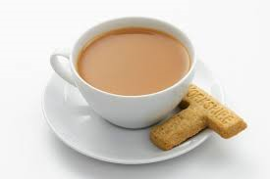
Tea/coffee

Slide 98
Rehearsing feedback skills
In your appraisal trios…
Time | Appraiser | Doctor | Observer
00.00 | A | B | C
00.15 | B | C | A
00.30 | C | A | B
98
Notes:
98
Remind the observers to be time-keepers for the appraisal pair who only have 10 mins
Highlight 10 mins for appraisal exercise, followed immediately by 5 mins for feedback led by observer in trio. The observer will often need prompting to remember to let the doctor analyse what went well first, especially in the first round of feedback. Doctors often go straight into what they wish they had done differently and need to be brought back into the feedback structure.

Slide 99
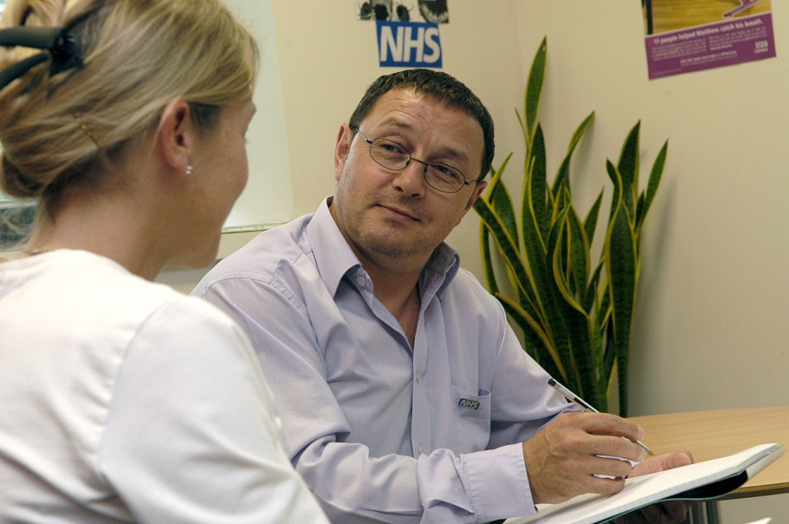
Rehearsing interview and feedback skills - plenary
99
Notes:
99
The plenary for the feedback exercise is about identifying common themes:
Time goes fast
It is sometimes possible to get into very deep areas even in a very short time
The first appraiser has the most difficult job as good techniques and top tips may be modelled by watching the others perform
What are the themes for this group?
Use the session to affirm skills that the facilitators have observed

Slide 100
Getting ready for day two
Read, reflect and review what you have learnt today
Share what you are going to prepare for your partial appraisal on day two with your “appraiser” if it has not already been shared before the training
Confirm trios
Check the preparation resources in your pack
100
Notes:
The better a delegate has prepared the more likely it is that they will be able to use what they have done for their own annual appraisal and the more they will get out of the partial appraisal exercise.
Check that everyone is clear who is going to be appraising whom in the trios
Share the pre-appraisal documentation prior to day two, so that the delegates can prepare for their turn at the appraiser role in each trio for the partial appraisal. If the two days are run consecutively, it is essential to share well in advance of day one, but, in every case, the end of the first day is a chance to check that everyone has everything that they need
Some training courses may be set up to allow a full appraisal on each other to be undertaken between the two days of the course. Even in these cases it is good to demonstrate skills in a directly observed exercise on day 2

Slide 101

Questions and answers
101
Notes:
This is the conclusion and Q&A session. It is important to have dealt with any issues that have been “parked” and to check out a shared understanding and comfort level before delegates depart

Slide 102

Have a good evening
102
Notes:
Day one is quite intense and many delegates will have commitments during the evening
Prompt them to relax in order to assimilate all that they have covered today
Remind them that the start needs to be prompt for day two

Slide 103
Appraiser training
Welcome to day two
Facilitators:
Organiser:
Date:
Venue:

Slide 104
Reflections on day one
‘Something I learned and something I enjoyed’
‘Something I still need to cover’
Notes:
Ice breaker – go round the group asking for answers to these questions
Add any new learning needs to those from the day before onto flip chart

Slide 105
Plan for the day
Appraisal preparation and organisation
The outputs: summary, PDP and statements
Conducting an appraisal – role play
Challenging appraisals

Slide 106
Preparation for the appraisal
Once you are allocated to a doctor (after checking for COI) make early contact by e-mail setting boundaries within the e-mail which should be professional and supportive.
State you will need:
  To set a date and time – 3 hours of protected time
  Venue – ideally at the doctor’s place of work
  You will need access to the SI at least 2 weeks before the meeting
Notes:
NB please mention that you can only appraise the same doctor for 3 consecutive years

Slide 107

Preparation

Slide 108
2 weeks before the appraisal meeting
Read and review the SI in the MAG form including last year’s summary and PDP
Is everything there that should be?
If just prior to recommendation, look for feedback and QIA
Is there around 50 hours of CPD covering scope of work?
Is there adequate reflection?

Slide 109
2 weeks before the appraisal meeting (continued)
If not, make contact with the doctor to request additions – but you may need to postpone the appraisal meeting
Seek advice when necessary

Slide 110
Preparatory notes
Look for areas to explore in the appraisal conversation. Consider questions to respectfully challenge the doctor
Any gaps particularly prior to revalidation recommendation?
Review the last year’s PDP progress and consider areas for consideration for this year’s PDP
These notes will contribute to the summary of appraisal discussion
Notes:
Refer to the appraisal summary preparatory notes template which can be used to make notes and prepare the summary of appraisal discussion
It is set out in the 4 Domains and prompts setting the scene and also a summary
These notes will help prompt the appraisal conversation and the appraiser may make further notes during the meeting
As in a consultation, the appraiser should avoid too much interaction with the computer rather than with the doctors

Slide 111
At the end of the appraisal meeting
It is often possible to agree the PDP there and then although sometimes the doctor requires more time
Inform the doctor that you will first write the summary of appraisal discussion as a draft. The doctor may then highlight any inaccuracies that you may change prior to the final sign off

Slide 112
At the end of the appraisal meeting (continued)
Explain that the signing off of the appraisal must be completed within 28 days. This includes the appraiser statements. If you feel unable to sign off any of the statements, you must document why in the summary and explain this to the doctor
Explain to the doctor if you feel the need to take further advice after anything that was discussed that you are unsure about
Notes:
E-mails (NHS net) – keep as an audit trail

Slide 113
Outputs
Appraisal summary of discussion
Personal development plan (PDP)
Appraiser statements
Both parties sign off

Slide 114
Why bother with a good summary of appraisal?
For the doctor
For the appraiser
For the responsible officer
Discuss:
What makes a good summary?
What do you want as a doctor?
What do you want as an appraiser?
What should the ‘service’ expect?
114
Notes:
To open this discussion, ask the delegates for their feelings and experiences first

Slide 115
Writing the appraisal summary
Best done after the appraisal meeting
Structure it in the 4 domains
Set the scene (giving scope of work) at the beginning
A summary at the end outlines progress towards revalidation and any action plans for outstanding SI prior to recommendation for revalidation (via PDP)
Explanation if you are unable to sign off any statements
See the ASPAT for guidance
Notes:
Hand out the ASPAT tool for the appraisers to examine and comment on

Slide 116
Appraiser statements
An appraisal has taken place that reflects the doctor’s scope of work and addresses the principles and values set out in Good Medical Practice
Appropriate supporting information has been presented in accordance with the Good Medical Practice Framework for appraisal and revalidation and this reflects the nature and scope of the doctor’s work

Slide 117
Appraiser statements (continued)
A review that demonstrates appropriate progress against last year’s personal development plan has taken place
An agreement has been reached with the doctor about a new personal development plan and any associated actions for the coming year
No information has been presented or discussed in the appraisal that raises a concern about the doctor’s fitness to practice

Slide 118
Appraiser statements
If you are unable to sign off statements please document why in the appraisal and discuss with the appraisal lead; make sure that the doctor is aware
Not signing off a statement does not mean ‘not revalidating’
Acts as a signpost to doctor, appraiser and appraisal team
Notes:
Acts as a signpost to doctor, appraiser and appraisal team – suggests specific tasks need completing before the next appraisal or that other action is required.
If in doubt discuss!

Slide 119
Audit tools for reviewing outputs
ASPAT
PROGRESS
EXCELLENCE
Notes:
Refer again to the ASPAT tool
It is a good idea to discuss the fact that appraisal leads will be reviewing appraisers outputs – the summary and PDP
This helps to benchmark appraisers and allows the appraisal lead to give developmental feedback which may inform the appraiser’s own PDP
PROGRESS, EXCELLENCE and ASPAT are three tools in use
Please refer to the ASPAT tool in the delegate pack

Slide 120
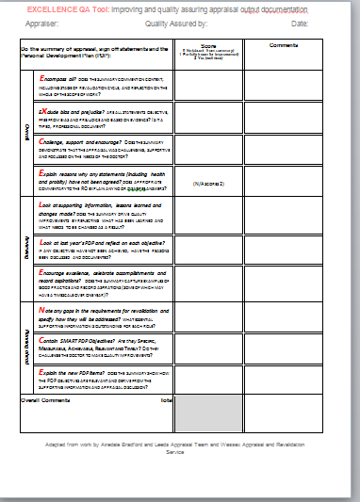
PROGRESS and EXCELLENCE QA tools
Appraiser: |  | Quality Assured by: |  |  |  | Date | 1
 |  |  |  |  |  |  | 2
 |  |  |  |  |  |  | 3
PROGRESS QA tool Quality assurance and development of appraisal documentation |  | Score (out of 20) 0-2 (absent – well done) 0-4 (absent – well done) |  |  | Comments How can the appraiser improve the appraisal documentation?
 |  | 1 | 2 | 3
Appraisal identifier (initials)
Professional (2) – is typewritten, objective, free from bias or prejudice, describes a professional appraisal: venue, time taken, good information governance, no identifiable third party info |  |  |  |  | 1
 |  |  |  |  | 2
 |  |  |  |  | 3
Reflects a good appraisal discussion (4) – demonstrates support, challenge and focus on the reflection and needs of the doctor |  |  |  |  | 1
 |  |  |  |  | 2
 |  |  |  |  | 3
Overview (2) – includes a description of the whole scope of work and context for the doctor, the appraisal and the revalidation cycle |  |  |  |  | 1
 |  |  |  |  | 2
 |  |  |  |  | 3
Gaps (2) – identifies any gaps in requirements for revalidation or scope of work and specifies how they will be addressed (or states if no gaps) |  |  |  |  | 1
 |  |  |  |  | 2
 |  |  |  |  | 3
Reviews supporting information (SI) and lessons learned (4) – reviews SI in relation to Good Medical Practice; comments on SI not supplied electronically and any information the doctor was asked to bring. Reflects on lessons learned, changes made and actions agreed. |  |  |  |  | 1
 |  |  |  |  | 2
 |  |  |  |  | 3
Encourages excellence (2) – affirms good practice, celebrates achievements and actions accomplished, gives examples of good practice and records aspirations (some of which may have a timescale over one year) |  |  |  |  | 1
 |  |  |  |  | 2
 |  |  |  |  | 3
Sign Offs & Statements (2) – ensures the input and output statements, including health and probity, have been completed, commented on and, where appropriate, explanation made to the RO |  |  |  |  | 1
 |  |  |  |  | 2
 |  |  |  |  | 3
Smart PDP (2) – PDP objectives arise from the SI and appraisal discussion and are SMART: Specific, Measurable, Achievable, Relevant and have a Timescale |  |  |  |  | 1
 |  |  |  |  | 2
 |  |  |  |  | 3
TOTAL
Overall impression:
Notes:
PROGRESS is an example of a quality assurance (QA) tool (it is widely used for the assessment of the summaries of discussion and PDPs arising from appraisals and was developed by Wessex Appraisal and Revalidation Service). EXCELLENCE v2 is another example of a QA tool, developed from Yorks and Humber and Wessex
Examples of the locally used QA tool should be substituted here, and included in the resource pack
No appraiser should have their summaries assessed without knowing in advance the criteria against which they are being assessed. The criteria chosen in these tools are designed to promote summaries that not only meet the requirements of the RO for revalidation but also encourage the appraisers to focus on capturing lessons learned and changes made and examples of good practice
Such a tool can only assess the quality of the written outputs against the chosen criteria (which necessarily leave other criteria out) and it is important to remember that a poor summary does not mean it was a poor appraisal discussion, nor does a good summary necessarily mean a good appraisal. The result is only a proxy marker and must be triangulated with other findings and QA

Slide 121
Summary of appraisal task
Look at the example summaries and PDPs provided
Quality assure the write up for Dr No Concerns first, using the QA tool provided
Now that you are familiar with the tool, QA the outputs of Dr Part Time and / or Dr Been Ill
What have you learned?
121
Notes:
In section 16 there are some examples of possible PDPs and summaries of discussion. The ASPAT tool has already been handed out
This is an exercise for individuals to review different styles of summary, work out where the gaps are and think about how they would score them using the tool
In doing so they will be challenged to start thinking about how they themselves would write up an appraisal and perhaps start to see which styles they prefer
Facilitators may like to pick one or two examples to focus on rather than covering all the resources

Slide 122
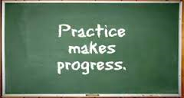
There’s no such thing as…
A perfect summary of discussion
A perfect PDP
A perfect appraisal
But…
122
Notes:
It is really important that there is not a feeling that there is a ‘correct’ way to write up an appraisal.
Every new appraiser eventually finds their own ‘voice’ and the variety is valuable.
The learning curve can be shortened by having feedback immediately after writing up the first few appraisals to ensure that bad habits don’t develop.
All new appraisers need to benchmark to improve and gain consistency and appraiser support networks are a good way of achieving this.

Slide 123
Introduction to Annex J - routine appraiser assurance
Appraisal summary and PDP audit tool (ASPAT)
Appraisal feedback from doctors (from QAMA)
Appraiser assurance review template
Appraisal summary preparatory notes template
123
Notes:
Annex J of the NHS England medical appraisal policy contains routine appraiser assurance tools
Refer to the ASPAT audit tool and ask the delegates to read through it and comment
Explain that it is not the only audit tool for reviewing appraiser outputs (i.e. the summary and PDP) and there are also PROGRESS, EXCELLENCE and others
Suggest that it may be useful for appraisers to share the ASPAT with doctors so that they have some idea of the quality of supporting information expected

Slide 124
Appraiser workshops - for calibration and benchmarking
Blueprint for appraiser workshops:
  Information sharing for example, updates, good practice
  ‘Bring and borrow’ for discussion
  Calibration/peer review for example, cases, scenarios
Notes:
All appraisers are expected to attend regular appraiser workshops in their organisation.
This allows networking, benchmarking and sharing of standards.
There is a ‘blueprint’ for these workshops – this can be loosely applied.
All appraisal leads should regularly attend the regional appraisal lead workshops.
There are also some national appraiser and appraisal lead events also.
Reference to appraiser workshop resources: http://www.england.nhs.uk/revalidation/appraisers/meetings/hee-resources/

Slide 125
Sharing of information
National Appraisal Network
(4 Regional Leads)
DB Appraisal Leads
Appraiser groups
Notes:
The national appraisal network is a network of appraisers and appraisal leads which aims to share information and standards for the purposes of benchmarking and standardisation of appraisal across the country.
These are the areas/work streams that the national appraisal network (national revalidation lead and 4 regional leads) are looking at to provide accepted ways of working:
Supporting information
Logistics
Information governance
Appraiser development and QA
Appraisees
This work has informed the revised NHS England medical appraisal policy and the medical appraisal logistics handbook

Slide 126

Information governance
You must use an nhs.net or other secure e-mail address
Shred any paper documentation after the appraisal
Delete appraisal documentation from your computer after the summary and PDP have been added to the MAG

Slide 127
Conducting an appraisal
Role play with feedback

Slide 128
Rehearsing appraiser skills in trios
In trios: doctor, appraiser and observer
Each role play will take 45 mins including giving the feedback
Swap around roles and run three times in your trios

Slide 129

Tea/coffee

Slide 130
Conducting an appraisal - part 2
Role play with feedback
Aim to stop for lunch at 12:00

Slide 131

Lunch

Slide 132
Conducting an appraisal - part 3
Role play with feedback

Slide 133

Conducting an appraisal exercise
Reflection
133
Notes:
This plenary is a chance to pull together the key experiences from the morning of appraisals
It may be necessary to reaffirm that individual stories do not get repeated without the explicit consent of the individual
Most learning can be couched in general terms

Slide 134

Looking at the personal development plan (PDP)
134
Notes:
The PDP is a PERSONAL development plan and so must be derived by the doctor being appraised, with support and challenge from the appraiser
Some doctors bring a draft new PDP to their appraisals which is often refined after the discussion
Some doctors are ready to write the PDP with their appraisers help at the end of the discussion and others need further time to reflect and formulate items
The PDP is a signpost that helps to give a sense of direction - sometimes doctors come to a crossroads and need to make choices
The importance of the PDP in revalidation is that progress against the PDP objectives is assessed each year and the new PDP objectives do have to derive from the learning needs identified and the appraisal discussion
The appraiser has to sign-off two statements about the PDP:
A review that demonstrates progress against last year’s personal development plan has taken place.
Agree/Disagree
An agreement has been reached with the doctor about a new personal development plan and any associated actions for the coming year. Agree/Disagree

Slide 135
Why bother with a good PDP?
Discuss:
What makes a good PDP?
What do you need as an doctor?
What do you need as an appraiser?
135
Notes:
A useful way into the PDP exercise is to ask the new appraisers to think through the issues
Don’t be surprised if some feel that their PDP is useless or only useful to unlock study leave etc.
The aim is to improve PDPs from where they have historically been

Slide 136

The PDP – hitting the target
136
Notes:
Doctors may be clear about where they want to go but unsure how to get there
The PDP objective can be framed to clarify the target and what will be needed to reach it

Slide 137
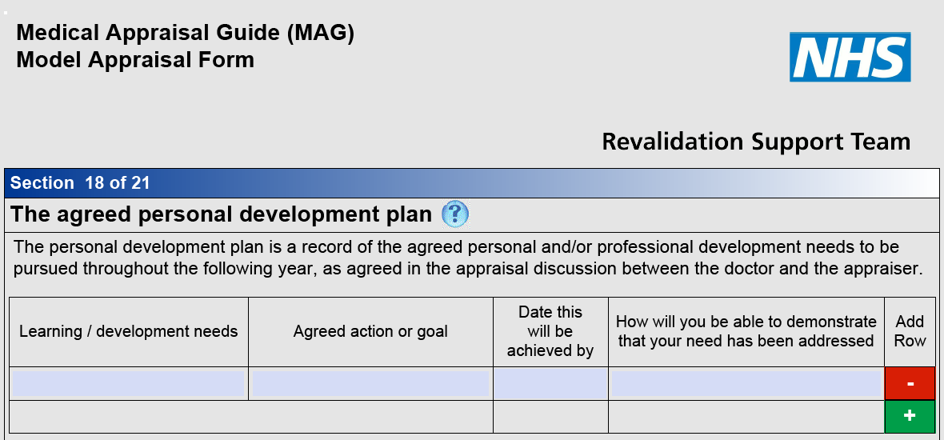
What does the PDP look like?
Notes:
A screen shot from MAG Model Appraisal Form (RST, 2012) to give a visual prompt as to the PDP headings and a reminder about how objectives will be added and new rows appear as they are needed
Even though not everyone will use the MAG Model Appraisal Form, this is a good generic visual cue and if the commissioning body wishes, they can insert a substitute slide that meets local needs better

Slide 138
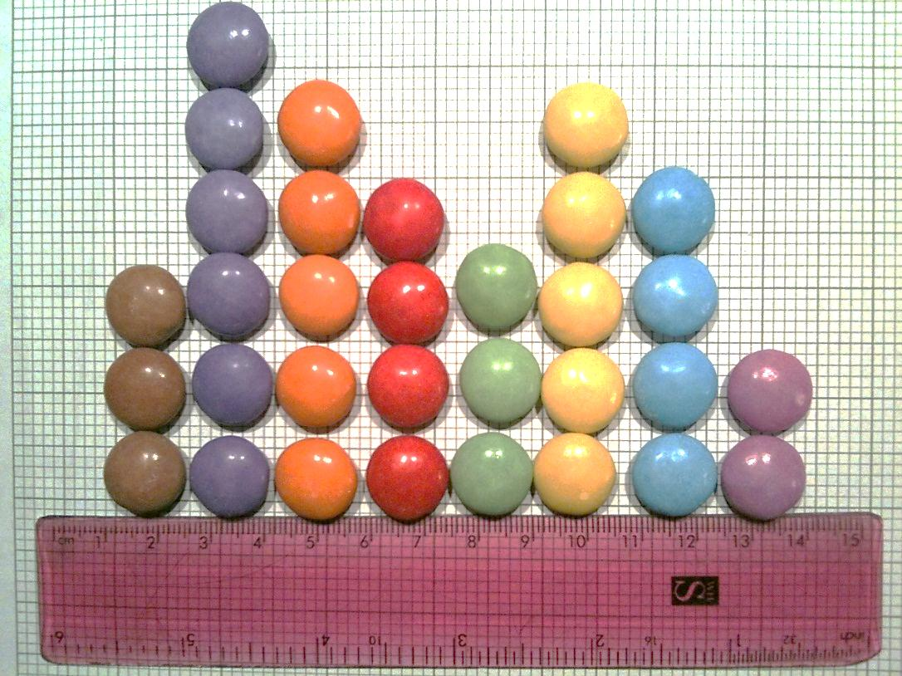
SMART(IES) objectives
S Specific
M Measurable
A Achievable
R Relevant
T Timely
I Interesting
E Economic
S Shared success
Notes:
Discuss PDP objectives – how smart are they?
Introduce the idea of SMARTIES – because unless the doctor finds the objective interesting and it is economic in terms of time and effort, it is unlikely to be achieved:
Achievable/attainable
Relevant/realistic

Slide 139
The PDP – personal development plan
Meet SMART criteria
Reflect appraisee’s approach to learning
Link to improving patient care
Needs identified through reflection on practice, SEAs, case reviews, audit etc. (links to summary)
Aspirations identified by the appraisee
Address gaps in supporting information incl. mandatory training
Outcomes – try to make objective with associated reflection (not just a certificate)
Notes:
The PDP is written in the first person and is owned by the doctor
It may change through the year if circumstances change
It is difficult to improve as it should really be written by the doctor
Outcomes are particularly difficult to write
The doctor and appraiser may be tired at the end of the meeting so it is sometimes better to write it after the 1:1, however this sometimes causes a delay in the sign off
Quality not quantity is better (3-6 items)
Not everything has to go in the summary – there may be agreed actions documented in the summary as well
Doctors need to focus on real needs, identified in a structured and objective way, rather than perceived needs
Avoid job planning/organisational PDP items – keep them personal

Slide 140
Making the PDP specific to the doctor
Activist
Experiencing
Pragmatist
Planning & applying
Reviewing
Reflector
Concluding
Theorist
Honey & Mumford, 1992
140
Notes:
40
This slide is a trigger for a discussion around different learning methods being suitable for different learning needs and different learning style preferences. As well as highlighting different preferences, the theory also suggests that a true learning cycle requires all four stages to be completed - even the least preferred!
The patient and colleague feedback may identify unknown known learning needs
Significant events and complaints are often the source of significant learning and change

Slide 141

PDP task
As an individual, derive an appropriate PDP objective for yourself – either from the discussion this morning or as a new appraiser
Remember:
PDP objectives should be
SMART(IES)
141
Notes:
The PDP is a record of the agreed personal and/or professional development needs to be pursued throughout the following year, as agreed in the appraisal discussion between the doctor and the appraiser
For the exercise ask each delegate to attempt to write a SMART(IES) PDP objective arising from their own needs from the discussion or as a new appraiser for the coming year
Remind them that this is part of the assessment and the PDP objective they create will be handed in for evaluation. (Name on sheet/keep it legible)
If there is time, ask them to swap with a partner and try to help each other make the objectives SMARTIES!

Slide 142

Tea/coffee
142
Notes:
A welcome break that can be cut short if everyone is aiming for an early finish
Remind everyone what time they need to be back

Slide 143
Preparing for difficult medical appraisals
Identify potential areas of difficulty within the appraisal process
Understand the possible causes for these difficulties
Develop strategies for dealing with difficult appraisals
143
Notes:
This slide sets out what the next section is about

Slide 144
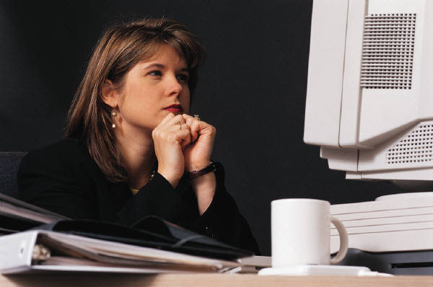
Appraiser concerns
144
Notes:
Ask:
What concerns or problems might cause you to postpone, cancel or stop an appraisal?
What would be a difficult appraisal for you?
This might be a discussion or run as a Post-it exercise or broken into pairs depending on the energy in the room

Slide 145
What doctor problems could make an appraisal difficult?
Preparation
  Too much or too little documentation, supporting information or reflection
Attitude
  Arrogant/cynical/dependent/disengaged
Special cases
  Poor performance
  Conduct issues
  Illness
  Whistleblowing
145
Notes:
Delegates need to know that they are about to discuss strategies to deal with all of these types of difficult scenarios, but ultimately they will need to find and rehearse their own strategies
The special cases are very rare and form a section of training on their own

Slide 146
Preparation: time to postpone the appraisal?
  Potential conflicts of interest (allocate a different appraiser)
  No pre-appraisal documentation/illegible documentation
  Late receipt of pre-appraisal documentation with no time to prepare
  No previous summary of appraisal or PDP from last year’s appraisal
  Inadequate supporting information
  Unsuitable venue or lack of protected time
146
Notes:
Asking for the doctor to be reallocated to a different appraiser is the only option if there is a potential conflict of interest
Other reasons for considering postponing an appraisal concern a lack of understanding of, respect for or engagement with the appraisal and revalidation process
The appraiser needs to make a professional judgment about whether it is appropriate to go ahead with the appraisal discussion or not. Many issues can be pre-empted by a timely telephone conversation or e-mail/text
The appraiser should not be afraid to postpone if the doctor has not engaged with the process. It is not the appraiser’s job to chase up the doctor – that would set up the wrong relationship from the start. Local areas should have clear policies about who contacts whom and how
Nor should the appraiser be afraid to go ahead if they feel that it will only be possible to resolve potential issues face to face – the appraisal may well be an educational opportunity for the doctor. If in doubt…ask!

Slide 147

Attitude – don’t take it personally!
147
Notes:
The key to dealing with attitudinal problems is not to take them personally
The arrogant may try to intimidate
The cynical may not engage honestly with the process
The dependent may not contribute and expect the appraiser to do all the work – but be so grateful that the appraiser gets tempted in to a rescuer role
The new appraiser needs to learn to recognise and name attitudinal issues as the first step to dealing with them effectively

Slide 148
The performance triangle
Work context
Health
Clinical knowledge and skills
Behaviour
Notes:
All issues can affect performance and may be picked up in appraisal
Issues can be personal and organisational:
Clinical knowledge and skills - out of date practice, poor CPD and development, education and training, working environment
Health, stress and psychological factors – profession - overworked, personal
Behaviours interpersonal skills, insight, poor team dynamics, culture, leadership and support, ethical issues

Slide 149
Special cases
Try as far as possible to crystallise:
    Are patients at risk?
    Should the appraisal continue?
    What action are you going to take?
How you can signpost clearly the next steps to the doctor?
Sometimes it is appropriate for the appraisal to continue but for the appraiser to take action in the way that the appraisal is written-up or the appraisal statements are signed-off
149
Notes:
Suggested stem questions for use with some stereotypical difficulties are provided as resources
Reading through them should increase the appraiser’s confidence and start the process of developing helpful strategies
Knowing exactly what next steps to signpost is very important and a real boost to confidence
There is an exercise coming up to help rehearse the necessary skills

Slide 150
Summary – reality is complex
In practice, doctors do not conform to stereotypes (unless they are choosing to play a single role)
Difficult appraisals will usually involve a mixture of some of these attitudes and behaviours
The high flying doctor may also produce too much meticulously organised paperwork and then reveal that it is all fuelled by alcohol as a stress reliever
Being an appraiser is a privilege but it is not easy and there are no perfect answers
150
Notes:
This slide is self-explanatory
Difficult appraisals usually involve more than one issue
Having looked at the possible doctor related causes for concern, we will now look at possible appraiser pitfalls

Slide 151
What potential pitfalls do you recognise for yourself as an appraiser?
The people pleaser
The elder statesman
The rescuer
The head teacher
The judge
The perfectionist
The task oriented
The diffident
The doctor
The money oriented
The over-involved/colluder
151
Notes:
Ask the group to identify which of these pitfalls they are most likely to fall into
This can also act as an aide memoire to see whether there are other pitfalls that have not been recognised?
Everyone has their own temptations – the facilitators might share whether they are a Mr Fix It or Mrs Nurturing Mother and tend to be tempted to provide solutions, thereby potentially disempowering the doctor, or whatever they feel their own temptation is
Ask how an appraiser can avoid these traps?

Slide 152
Being self-aware
Acknowledge that personal stumbling blocks exist
Do not let them get in the way of delivering an effective appraisal
Rehearse alternative strategies within an appraisal support group or network
Reflect on and discuss difficult appraisals after they have occurred (in terms of process, not specific content) to gain useful insights
152
Notes:
Self-awareness is the key to avoiding potential traps
Insight allows strategies and safety nets to be put in place

Slide 153
Before each appraisal
Be self-aware | Be doctor aware
What are my personal pitfalls to beware? | What issues of preparation or attitude might I have to challenge here? If there are no apparent issues, how can I add value to this appraisal?
153
Notes:
A quick way of thinking about how to add value for the doctor before every appraisal

Slide 154
Handling unexpected serious concerns arising during the appraisal discussion
Discussion:
The requirement to suspend an appraisal discussion because of a serious concern is not new
It is exceptionally rare for such a serious concern to arise during the appraisal discussion that the appraiser needs to take off the ‘appraiser hat’ and move into other processes
154
Notes:
Uncovering a serious concern at appraisal is a common source of anxiety but rarely happens. However, rehearsing it can reduce anxiety
An appraiser should know what the local processes and contact details are
Scenarios e.g. “You are nearing the end of an appraisal that seems to have gone fantastically well – great supporting information and a reflective and articulate doctor – so you ask, ‘How do you manage to fit it all in?’ at which point the doctor responds by saying: ‘Well, I couldn’t do it if I didn’t use amphetamines…’”
Or “Well, I couldn’t do it if I didn’t have a drink every night…”
Or, the appraisal is complete and the appraiser is just about to leave when a whistleblowing issue is raised...
Or, a doctor who is expecting to be able to sign off as satisfactory but has a clearly inadequate portfolio…

Slide 155
Handling unexpected serious concerns arising during the appraisal discussion (continued)
Exercise:
A chance to try out different ways of reacting to a doctor who reveals something for the first time during appraisal that raises serious concerns about their conduct, capability, or health

Slide 156
Local processes and specialty specific issues
Appraisal leadership and support
Appraisal policy
Occupational health and poor performance procedures
Whistle-blowing policies
What does your designated body advise?
What does your royal college or faculty advise?
Are you clear about how this links to the GMC requirements for revalidation?
Any other issues?
156
Notes:
This session is for dealing with the specific issues that are important to this group
Especially where they are all from one designated body or organisation it may also be a chance for the group to define some next steps for themselves
Capture them on a flipchart if possible and offer to get them typed up to feedback after the event
This is a good point to add specific training materials as required

Slide 157
Questions and answers
157
Notes:
157
This is the conclusion and Q&A session. It is important to have dealt with any issues that have been ‘parked’ and to check out a shared understanding and comfort level before delegates depart
Where the answer is not yet clear – admit it
Offer to follow up any outstanding queries
Avoid getting into any one-on-one discussions
Time might have overrun in other sessions and this could be a shorter session
Check that all learning needs have been addressed

Slide 158
Evaluation forms
We welcome all constructive feedback
If anything is unclear and you wish us to get back to you, please put your name and contact details on the form
Remember that you need to look again at the self-assessment of competencies and mark whether your confidence has changed as a result of the training today
Thank you for your participation
Notes:
Try to ensure that all evaluations are collected at the end of the event and shared with the organisers
Training for new medical appraisers must deliver a clear and consistent message so that new appraisers leave confident they can deliver a supportive and challenging appraisal appropriate for revalidation and professional development to a similar standard as any other appraiser
Even so, they would benefit from support for the first few appraisals from a “buddy” or a clinical appraisal lead and could be encouraged to seek out support for themselves as a ‘next step’ (if the organisation does not automatically provide it)
Encourage the participants to reflect on their learning from this session and add it to their own appraisal portfolio

Slide 159
THANK YOU
Thank you for your hard work
Notes:
It takes practice to make hard work look effortless – but it is worth the effort
Encourage appraisers to leave and start delivering medical appraisal for revalidation feeling positive about the benefits it can bring to individual doctors in promoting their continuing professional development and quality improvement
Remind them that the attitude of appraisers will be a key indicator to other doctors about how positive they should be about appraisal and revalidation. Most doctors will welcome the opportunity to discuss their professional lives with a trained colleague
159

