Slide 1
Responding to concerns
Fair, consistent & effective?
Ahead of the Curve conference
4th June 2014

Slide 2
Responding to concerns - fair, consistent and effective
The work and role of the National Clinical Assessment Service
Dr Stephanie Bown
NCAS Director

Slide 3
Our services
Advisory service – draws on in-house HR, legal and clinical expertise. Now strengthened by additional employment law expertise from NHS LA legal panel
General advice on approaches to resolving concerns about professional practice
Specific advice on issues about individual practitioners (details are subject to the usual legal rules about data protection)
Assessment services - including record review, records based assessment, action plans, behavioural assessments, occupational health assessments, assessments of communicative competence and clinical assessments. These are in addition to the standard assessment model which incorporates all of these elements
Educational provider - developing skills and knowledge to manage concerns about professional practice

Slide 4
NCAS’ Core services seek to ask you…
… What do you want to achieve to resolve this issue and how do you want to get there?

Slide 5
Immediate changes to NCAS’ work and ways of working
Greater flexibility to match the requirements of referring organisations
More signposting to interventions to help resolve concerns about practice
Assessment reports are shorter, more concise and produced in a more timely manner (although there is still more to do on this)
We offer bespoke training workshops for NHS organisations
Discussing role of NCAS in the emerging context of PSUs
Please tell us if there are other changes you would like to see ncas.education@ncas.nhs.uk

Slide 6
Where are our referrals are from
Acute trusts currently represent the larger proportion of our referrals
Mental health trusts
Area teams
Mainly deal with doctors – but we are in discussion about re-launch of dentistry
The number of referring trusts has remained reasonably constant over the past 5 years
Small health care providers tend to refer more than larger ones
All but one area teams referred at least one case in 2013
No “thresholds” for referral to NCAS for advisory services

Slide 7
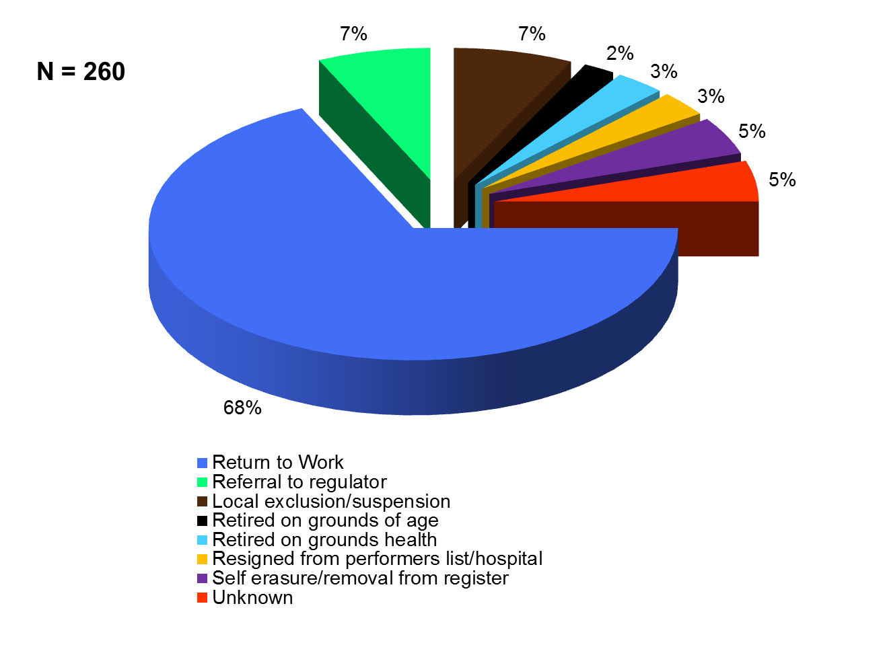
NCAS Action Plan Outcomes 2008-2013
Notes:
Data is based on cases that BoT have had involvement with in this period. 260 action plans 08-13 compared to 100 in 2013-14 financial year.

Slide 8
Relative risk of referral by specialty, doctors, 2004-2012
Data from Liam Donaldson et al, BMJ Quality & Safety, October 2013
Notes:
The long run average risk of referral for doctors is about 5 per 1000 per year – the black line. Psychiatry and O&G stand out as high

Slide 9
Three main concern areas
Behaviour / misconduct – 58%
Clinical concerns including governance/ safety 58%
30%
19%
29%
4%
5%
7%
5%
Health concerns 21%
Base - 5634 cases referred to NCAS Dec 2007 – Sept 2013
Notes:
Three of the four bits of the triangle are here - H, B, C but not W because managers don’t usually phone us and say that the work environment is a factor.
This is based on cases handled since late 2007 but we used this much earlier and the picture doesn’t change much. Lots of behavioural problems.

Slide 10
How does NCAS categorise concerns?
Top level category | Examples | 2007-2013
Clinical difficulties | Weak record-keeping, poor diagnostic and treatment decisions, serious departures from protocols | 47%
Governance/safety issues | Poor responses to complaints, serious lapses in infection control | 29%
Behaviour other than misconduct | Poor communication with colleagues and carers, erratic or aggressive behaviour towards others | 26%
Misconduct | Fraud and financial irregularities, inappropriate sexual behaviour, bullying and harassment | 38%
Health problems including substance misuse | Cognitive, sensory or physical impairment due to alcohol of drug misuse, stress and burnout, bipolar disorder | 21%
Work environment influences | Inability to cope with workload, dysfunctional team-working, unresponsive to corporate policies | 7%
Personal circumstances not ill-health | Relationship problems, family illness and bereavement, money worries | 3%
As described in Liam Donaldson et al, BMJ Quality & Safety, October 2013
Notes:
This is how we have been logging concerns since late 2007. The percentages here are as they were at 30 September 2013, 18 months more up to date than in the article
Base - 5634 cases referred to NCAS Dec 2007 – Sept 2013 as in previous slide

Slide 11
Overview of demographic differences
Source: Liam Donaldson et al, BMJ Quality & Safety, October 2013
Notes:
We monitor to check on the fairness of referral decisions
Referral rates for white and BME UK-qualified doctors are comparable
Qualification outside the UK is a statistically significant performance risk factor, with little difference between ‘other EU’ and ‘outside EU’ graduates
Place of qualification seems to explain the ethnicity variations.
We published the regression analyses behind these conclusions in 2009-2011 and are continuing to monitor referrals
The GMC came to similar conclusions after examining fitness to practise procedures (Humphrey et al, ESRC, 2009).
We also monitor the demographics of assessment cases as assurance that selection of cases for assessment is not discriminatory.
Support for IMGs needs to improve, as does support for practitioners at other career transitions.

Slide 12
Contact NCAS
England (and Scotland)
Tel: 020 7972 2999 Email: casework@ncas.nhs.uk
Address: NCAS, Area 1C, Skipton House, 80 London Road, London SE1 6LH
Northern Ireland
Tel: 028 9266 3241 Email: northernireland.team@ncas.nhs.uk
Address: NCAS Northern Ireland Office, Office Suite 3, Lisburn Square House, Haslem's Lane, Lisburn BT28 1TW
Wales
Tel: 029 2044 7540 Email: wales.team@ncas.nhs.uk
Address: NCAS Wales Office, First Floor, 2 Caspian Point, Caspian Way, Cardiff Bay, Cardiff CF10 4DQ
Out of hours emergency contact: 020 7972 2999

Slide 13
Responding to concerns
National update
Lucy Warner – Responding to concerns lead, NHS England

Slide 14
RtC RO policy
Outlines:
How NHS England will respond when a concern arises
The thresholds and triggers for action
Local processes and formal investigation
Decision making process when action is required
http://www.england.nhs.uk/revalidation/ro/resp-con/

Slide 15
CI/CM training
Circa 1200 case investigators and 600 case managers now trained through a national programme
Competencies and training requirements published
Plans for:
    Future training
    Database of trained individuals
    Networking opportunities

Slide 16
Consistent terminology
Definitions of level of concern
Categorisation framework
Glossary of terms published

Slide 17
Professional Support Unit infrastructure
A Professional Support Unit is a hub of specialist expertise, knowledge and resources which facilitates and supports healthcare organisations in developing and maintaining high professional standards, in particular in responding to concerns within their (medical) workforce. It aims to ensure consistent approaches, support, advice and learning and to reduce potential harm to patients by maintaining a safe, effective, high quality workforce.

Slide 18
Central support with local delivery
Consistency of approach
Core services to enable all designated bodies to fulfil statutory requirements
Agreed methods for assessing the most appropriate interventions and actions
Delivery and support tailored to local needs
Make the most of local resources
Providers working to an agreed quality framework

Slide 19
Benefits
Focus on early identification and prevention reducing intervention and legal costs in the longer term.
Reduced timescales for dealing with concerns
More doctors returning to safe, effective practice following the handling of a concern reducing recruitment costs
Less suspensions/exclusions reducing the need for locum cover.
Reduction in numbers of panels and costly legal challenges through the following of consistent pathways and processes.

Slide 20
NHS England as a designated body
Training members of advisory groups and panels
Review of case portfolios for consistency of decision making
Policy review for primary care contractors
Standard letters and templates for use across all area teams
Survey of remediation approach

Slide 21
National RtC stakeholder group
Provide guidance for designated bodies across England to ensure consistency and coordination in approach
To identify gaps in current plans and provision around responding to concerns and identify opportunities for shared approaches, working with stakeholders to support the implementation within designated bodies
Advise on development of national approaches, training and guidance to support implementation of responding to concerns pathways for all designated bodies

Slide 22
Consistent, fair and effective
Dr Adedeji Okubadejo
Director of Medical Appraisal & Revalidation
Heart of England NHS Foundation Trust

Slide 23
Issues for discussion
Is consistency of approach and thresholds important across England?
What role could RO networks, NCAS, ELAs play in this?
How can we learn from shared experiences and themes?
Differences in practice in acute provider organisations and the independent sector
Managing doctors who migrate across organisations
Fairness to Doctors on short term contracts?

