Slide 1
Have you got it right? How do you know? Quality assurance / Peer Review / Sharing good practice workshop
4th June 2014
Ros Crowder, Deputy Director (revalidation), south region & Joanne Smith, Revalidation Project Manager, north region

Slide 2
Agenda
Agenda item |  | Owner
1 | What would you like from the workshop?
2 | Summary of FQA (independent verification)
3 | Independent Verification from organisations perspective and what YOU can do
4 | Peer Review – North process
5 | Peer review – South process
6 | Draft specification for external quality assurance review – feedback welcome
7 | Any other questions
8
9

Slide 3
What would you like to gain from the workshop?

Slide 4
FQA - Objective
The implementation of a framework of quality assurance (FQA):
Encompassing all mechanisms by which ROs and DBs demonstrate to patients, the public, doctors and organisations that robust, consistent processes to monitor the performance of doctors are in place and are functioning effectively.
Evidence based on the Medical Profession Regulations (2010, amended 2013) and in associated guidance.
Designed to help ROs give confidence to their board (or an equivalent governance or executive group), patients, their own ROs, that the necessary functioning systems are in place and that appropriate action is being taken on the basis of the information they generate.
Notes:
4

Slide 5
FQA - key principles:
FQA must support all ROs in fulfilling their statutory duties
The model is of a single process of monitoring, culminating in the generation of an Annual Organisational Audit (AOA), which will feed a report from RO to their board (or an equivalent governance or executive group) and also the RO’s appraisal
The reporting process for ROs must be:
Streamlined
Coherent
Integrated – with other systems of quality assurance
And minimise disruption and duplication of effort
Notes:
5

Slide 6
FQA - Background
The FQA is about implementation of the RO Regulations (including Revalidation) and comprises:
A set of ‘core standards’ derived from the regulations and associated mandatory guidance;
Quarterly progress reports (appraisal rate)
An Annual Organisational Audit (AOA);
An Annual Report Template to help ROs in their reporting of progress to their DB;
A statement of compliance (signed by DB board or equivalent governance or executive group member); and
It also states that there must be mechanisms in place to help ROs achieve and demonstrate calibration and consistency of their decision-making (eg RO and appraiser networks).

Slide 7
FQA – the elements: ‘Core Standards’
The FQA team has identified every item in the RO Regulations and all the associated mandatory guidance which must be in place (and which ROs will be expected to demonstrate)
These have been compiled into a single list
Each item has been referenced to the specific point or section of the regulations or guidance
Each point of evidence or question of the reporting system for ROs is derived from the core standards
Currently shows mandatory and good practice - excellent practice standards will be gathered and shared over time
Notes:
7

Slide 8
FQA – core standards categories
The designated body and responsible officer
Appraisal
policy, leadership and governance
capacity and capability
Monitoring performance and responding to concerns
policy, leadership and governance
capacity and capability
Recruitment and engagement

Slide 9
FQA Process
RO Monitors DB Progress
Governance
Appraisals
HR
Recommendations
GMC Data
Monthly
Quarterly Report
Quarterly
ERIB
RPB
QCRC
Annual
Regional RO
Higher Level RO
AOA exercise
Independent Verification
RO Report to DB Board*
NHSE Board
DB Board* Approval
Minister
* Or Director or Executive Team as applicable
Compliance Statement
700 Reports
4 Reports
Governance Boards
1 Report
Notes:
9

Slide 10
Independent verification
to provide assurance that there are robust systems in place to underpin the statutory responsibilities of the responsible officer
minimum of once per revalidation cycle for each designated body.
undertaken by the higher level responsible officer’s team
desk top review of evidence and a visit to the responsible officer at the designated body if required
to identify and disseminate good practice
ROs may provide evidence to support independent verification through a report from an external QA review

Slide 11
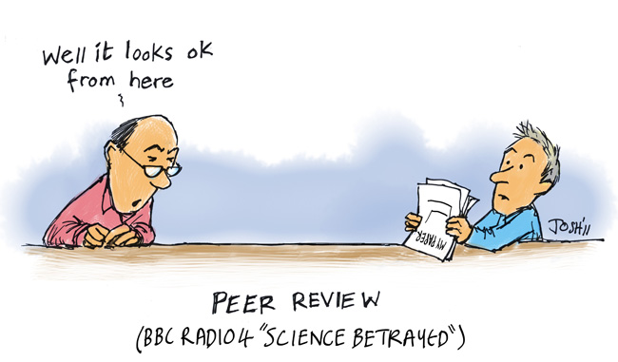
Peer review (not for the short sighted)

Slide 12
Background
An interim model of peer review to feed into a wider quality assurance process was requested by area team responsible officers (ROs) in the North region
To support area teams in being consistent as far as possible in their systems and processes
Additional support for ROs to close the gap in triangulation of the information provided in appraisal portfolios by doctors with a prescribed connection to them
Opportunity for whole teams to network and share good practice

Slide 13
Aims and objectives
Pilot observer by the All England Revalidation Operational Network (AERON) and if successful, possible national rollout
Primary aim is to provide a developmental and learning opportunity for area team ROs in the North within their new roles in NHS England
Review conducted by peers will allow sharing of best practice to close the gaps highlighted above and move towards a consistent and ‘tried and tested’ model of an overarching recommendation process

Slide 14
Guiding principles
An emphasis on being clinically led
Peer on peer review
A developmental approach initially, as the process is established, however will evolve into the quality assurance framework for revalidation when published
Consistency in the delivery of the peer review
A focus on revalidation systems contributing to the recommendation process

Slide 15
The process
Collation of pre visit data
The peer review visit, which provides the opportunity for informal feedback and sharing of information between all equivalent roles within the revalidation team
Formal structured feedback including any recommendations from the lead reviewer to the reviewee
Wider discussion on the outcome of all peer reviews in the North

Slide 16
Items to consider
Leadership – the responsible officer
Review of doctor’s appraisal and revalidation portfolio
Triangulation of information Quality assurance process
Recommendations – breakdown of figures and reasons for decisions
Risks and issues
General points

Slide 17
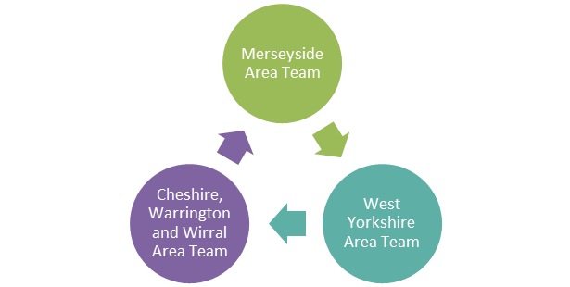
How did it work?
Final meeting hosted by the Region

Slide 18
Pre-visit information shared?
Appraiser Contract
Appraisal Output Summary Form
Sample Letters sent to doctors
Revalidation Awareness Session Flyer
Advice Sheets
Sample Appraiser Education Event Agenda
Appraiser Review Document
Sample New Appraiser Training Agenda
Excellence QA Tool
Appraisal QA Process

Slide 19
‘The day’
Appraisal and Revalidation staff all included
General discussion
1:1 meetings with person in same role, in reality split into clinical and non clinical staff
Feedback
Report submitted post visit

Slide 20
Areas of consideration
Good practice which could benefit all area teams
Areas for consideration
Areas for NHS England to address
Learning taken by [enter reviewer area team]

Slide 21
Evaluation & Recommendations
Overall feedback positive in that the process acted as an appraisal for revalidation process and systems, both formative and developmental, and provided opportunities for area teams to share best practice
External representatives will be invited to participate E.g. GMC, RCGPs and Healthwatch
Each area team will participate in a peer review, at least once every revalidation cycle
North area teams to follow recent national guidance document for deferrals as of 1st April 2014
Guidance developed for recording significant events within medical appraisal forms and providing reflective learning on audit processes

Slide 22
Peer review in the south
Desk top review of evidence
Co-ordinated by regional team
Evidence submitted by designated bodies
Evidence examined by external reviewers, including lay representatives
Groups of 5-6 designated bodies plus external reviewers and regional team
Focus on sharing good practice and finding solutions to difficulties
Summary of examples of good practice produced and shared

Slide 23
Peer review in two area teams
Visits to each area team
Involvement of Deanery
Focus on appraisal processes

Slide 24
Other examples
Use of internal audit department
External auditors
?

Slide 25
External quality assurance review
Draft guidance and sample specification available – feedback welcome
Ensure it is carried out by independent personnel
Based on core standards
Submit full report to higher level RO’s team
Share examples of good practice through RO networks
Develop an action plan to meet standards where necessary

Slide 26
Questions?

