Slide 1
Revalidation and Independent Hospitals
Professor Duncan Empey – RO for BMI Healthcare

Slide 2
Structure of Independent Sector Hospitals - BMI
Larger IS Hospital Groups have many hospitals in a wide range of geographical locations
BMI – 66 hospitals from Poole to Aberdeen
Consultants have Practising Privileges - they are not employees
Not a conventional medical management model – local Medical Advisory Committees guide Hospital Executive Directors
Group Medical Director and the Responsible Officer based in HQ
Clinical Governance Board (chaired by RO) meets monthly as do the four Regional Quality Assurance Committees
Sentinel Incident reporting and local or Group investigations
External investigations when appropriate
Regular meetings with GMC Employer Liaison Adviser

Slide 3
Connected Doctors – currently 280
IT system adopted for new task of arranging appraisals and making RO Recommendations – an issue for some!
Mainly older consultants, recently retired from the NHS
Some have not had appraisals just before leaving
Many have not understood the Annual GMC Requirements for Appraisal – “I have had a successful career for 40 years – what could possibly go wrong now?”
Some think deferral is possible to avoid engaging with the process - “I am thinking of retiring one day, so it does not matter”
“Flipping” DBs when taking on NHS locums after retiring adds confusion – BMI had 30% “churn over one 3 month period

Slide 4
In Practice
Currently we have a 60% overall appraisal rate (but is around 80% for “stable” consultants)
Some consultants have IT issues, but most manage or employ help
Increasingly better quality of input forms and PDPs
For some a thorough appraisal is a good way to obtain insight to changing circumstances, and to reduce risk
Deferral usually only when recent joiners with an early Revalidation Submission Date
Only 2 REV6 non-engagement letters needed so far

Slide 5
One size fits all ? Comparing and contrasting revalidation of Independent and Locum Doctors Dr Stuart Sanders MB ChB FRCGP RO & Medical Director

Slide 6
One size fits all ? Comparing and contrasting revalidation of Independent and Locum Doctors Demographics Appraisal Revalidation Conditions Questions

Slide 7
One size fits all ? Demographics Independent Doctors Federation Membership: 1200 Relating Doctors: 440 DRC Locums Doctors on assignment: 1000 Relating Doctors: 349

Slide 8
One size fits all ? Appraisal Independent Doctors Federation 100% compliance using modified MAG MAF DRC Locums 30% compliance using MAG MAF but . . . .

Slide 9
One size fits all ? Revalidation Independent Doctors Federation Submissions 01 April 2013 – 31 March 2014 49 Revalidation / 10 Deferred (17%) / 1Non-engagement DRC Locums 01 October 2013 – 31 March 2014 31 Revalidation / 22 Deferred (42%) / 1Non-engagement

Slide 10
One size fits all ? Conditions Independent Doctors Federation 6 doctors with sanctions 16 doctors under investigation DRC Locums 12 doctors with conditions 7 doctors under investigation

Slide 11
One size fits all ? So, is there a difference? Your questions, please.

Slide 12
One size IELTS/sharing knowledge fits all?
Dr Stephen Drotske, Medical Director
Notes:
NES has developed the most robust recruitment infrastructure we can in order to cushion the Company from fluctuations in the supply of doctors from various sources. We have our own recruitment teams based in the UK, Poland and South Africa as well as working closely with partners who supply doctors to us from all over Europe and beyond. Our doctors come from all over the globe. In the last 12 months we have seen applicants from 38 different countries.
The recruitment process typically takes 6 months or more, and this time is taken to ensure that each and every doctor is properly assessed and approved as being suitable for RMO work in the UK.

Slide 13
The Medical Profession (Responsible Officers) (Amendment) Regulations 2013
PART 3
Additional Responsibilities of Responsible Officers: England
Additional responsibilities of responsible officers: prescribed connection under regulation 10
16.—(1) Where a responsible officer has responsibilities under regulation 11 in respect of a medical practitioner who has a prescribed connection with a designated body in accordance with regulation 10, the responsible officer has the following additional responsibilities to the extent that the medical practitioner concerned is practising in England. (2) In relation to the entry by the designated body into contracts of employment or for the provision of services with medical practitioners, the responsible officers must— (a) ensure that medical practitioners have qualifications and experience appropriate to the work to be performed;
(aa) ensure that medical practitioners have sufficient knowledge of English language necessary for the work to be performed in a safe and competent manner;
(b) ensure that the appropriate references are obtained and checked;
(c) take any steps necessary to verify the identity of medical practitioners;
(d) where the designated body is the NHS Commissioning Board, manage admission to the performers list in accordance with the National Health Service (Performers Lists) Regulations 2013;
Notes:
NES has developed the most robust recruitment infrastructure we can in order to cushion the Company from fluctuations in the supply of doctors from various sources. We have our own recruitment teams based in the UK, Poland and South Africa as well as working closely with partners who supply doctors to us from all over Europe and beyond. Our doctors come from all over the globe. In the last 12 months we have seen applicants from 38 different countries.
The recruitment process typically takes 6 months or more, and this time is taken to ensure that each and every doctor is properly assessed and approved as being suitable for RMO work in the UK.

Slide 14
The Media
Lansley to announce mandatory language testing for EU doctors
04 October 2011
The plans, first announced by ministers in October 2011, are designed to tighten procedures in a bid to avoid a repeat of the Daniel Ubani case, where the German locum killed patient David Gray by administering 10 times the standard dose of diamorphine, on his first out-of-hours shift in the UK.
A Pulse investigation revealed that PCTs have so far ignored demands from the Government and the GMC to step up efforts to test EU doctors' clinical competence and language skills, with just a handful of doctors tested in the past 18 months.
DH to proceed with plans for Responsible Officers to check GP language competency
20 December 2012
Responsible Officers to be given powers to test all foreign doctors
18 April 2012
Notes:
NES has developed the most robust recruitment infrastructure we can in order to cushion the Company from fluctuations in the supply of doctors from various sources. We have our own recruitment teams based in the UK, Poland and South Africa as well as working closely with partners who supply doctors to us from all over Europe and beyond. Our doctors come from all over the globe. In the last 12 months we have seen applicants from 38 different countries.
The recruitment process typically takes 6 months or more, and this time is taken to ensure that each and every doctor is properly assessed and approved as being suitable for RMO work in the UK.

Slide 15
Readers/ Public’s comments
Anonymous, 20 December 2012 5:58pm
“Who is going to check that the Responsible Officer has reasonable English?.....bet they haven't thought that one out.”
Anonymous, 21 December 2012 9:10am
“And of course who is going to check the officer who checks the officer who checks the officer whose job it is to check the officer. I think we should be told in plain English!”
Anonymous, 21 December 2012 8:20am
“It is a subjective term. Could some body define What includes ‘Reasonable English’?”
Notes:
NES has developed the most robust recruitment infrastructure we can in order to cushion the Company from fluctuations in the supply of doctors from various sources. We have our own recruitment teams based in the UK, Poland and South Africa as well as working closely with partners who supply doctors to us from all over Europe and beyond. Our doctors come from all over the globe. In the last 12 months we have seen applicants from 38 different countries.
The recruitment process typically takes 6 months or more, and this time is taken to ensure that each and every doctor is properly assessed and approved as being suitable for RMO work in the UK.

Slide 16
The GMC
What are the new scores?
18 June 2014
A score of at least 7.0 in each of the four areas tested (speaking, listening, reading and writing)
And an overall score of at least 7.5
We only accept the academic version of the IELTS test.
How long is it valid for?
2 years
The IELTS is run in over 100 countries. You can find more information at the IELTS website at http://www.ielts.org.
Notes:
NES has developed the most robust recruitment infrastructure we can in order to cushion the Company from fluctuations in the supply of doctors from various sources. We have our own recruitment teams based in the UK, Poland and South Africa as well as working closely with partners who supply doctors to us from all over Europe and beyond. Our doctors come from all over the globe. In the last 12 months we have seen applicants from 38 different countries.
The recruitment process typically takes 6 months or more, and this time is taken to ensure that each and every doctor is properly assessed and approved as being suitable for RMO work in the UK.

Slide 17
Expired IELTS and the RO?
Submit original IELTS certificate showing that you achieved the required scores plus one of the following:
Evidence that you have successfully completed a postgraduate course of study, where all elements of the course of study, including clinical activities, were taught and examined solely in English, within the past two years.
A reference from an employer, your tutor or a lecturer on a postgraduate course of study from a country where English is the first or native language. The reference must cover at least three months’ full-time employment or study within the last two years.
Notes:
NES has developed the most robust recruitment infrastructure we can in order to cushion the Company from fluctuations in the supply of doctors from various sources. We have our own recruitment teams based in the UK, Poland and South Africa as well as working closely with partners who supply doctors to us from all over Europe and beyond. Our doctors come from all over the globe. In the last 12 months we have seen applicants from 38 different countries.
The recruitment process typically takes 6 months or more, and this time is taken to ensure that each and every doctor is properly assessed and approved as being suitable for RMO work in the UK.

Slide 18
Pilot Study 2009
Notes:
NES has developed the most robust recruitment infrastructure we can in order to cushion the Company from fluctuations in the supply of doctors from various sources. We have our own recruitment teams based in the UK, Poland and South Africa as well as working closely with partners who supply doctors to us from all over Europe and beyond. Our doctors come from all over the globe. In the last 12 months we have seen applicants from 38 different countries.
The recruitment process typically takes 6 months or more, and this time is taken to ensure that each and every doctor is properly assessed and approved as being suitable for RMO work in the UK.

Slide 19
Language Screening
Doctor applies to work with NES
Medical English Screening Test
A preliminary screening test, run from the NES website.
30 question, multiple choice test.
Pass mark of 80%.
Of 850 candidates that undertook this test in the last two years, only 150 achieved the pass mark and with evaluating skills approximately 110 were employed by NES.
Notes:
The first stage of a doctor’s application is the Medical English Screening Test. This was developed in 2011 and has been applied to all doctors for 18 months now.
The test is run from the NES website and is a 30 question, multiple choice test with a pass mark of 80%.

Slide 20
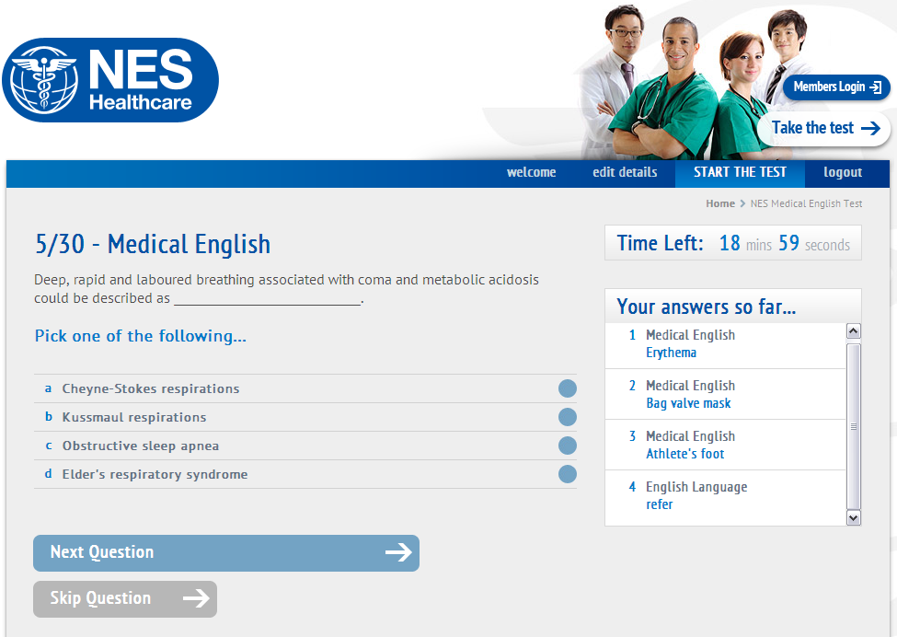
Medical English Screening Test

Slide 21
The MEST
March 2011 to September 2013

Slide 22
NES Medical English Test
45 minute test at the NES Training Centre
Two listening exams
One 200 word 10 minute writing exercise
Two reading tests over 20 minutes, including answering 16 questions
(Speaking is evaluated during RMO skills testing)
Notes:
NES has developed the most robust recruitment infrastructure we can in order to cushion the Company from fluctuations in the supply of doctors from various sources. We have our own recruitment teams based in the UK, Poland and South Africa as well as working closely with partners who supply doctors to us from all over Europe and beyond. Our doctors come from all over the globe. In the last 12 months we have seen applicants from 38 different countries.
The recruitment process typically takes 6 months or more, and this time is taken to ensure that each and every doctor is properly assessed and approved as being suitable for RMO work in the UK.

Slide 23
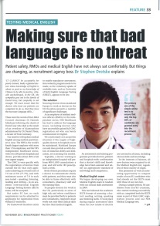
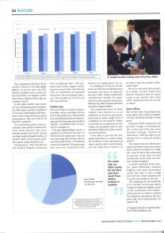
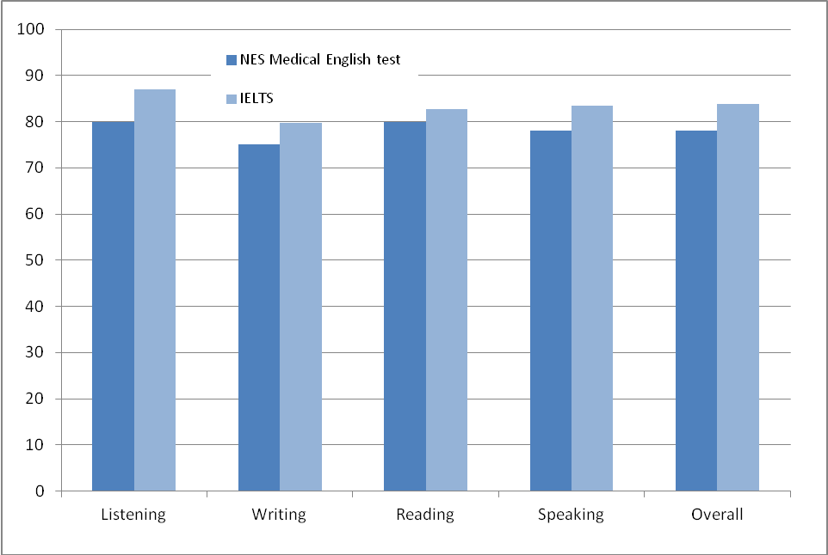
The Results
Notes:
NES has developed the most robust recruitment infrastructure we can in order to cushion the Company from fluctuations in the supply of doctors from various sources. We have our own recruitment teams based in the UK, Poland and South Africa as well as working closely with partners who supply doctors to us from all over Europe and beyond. Our doctors come from all over the globe. In the last 12 months we have seen applicants from 38 different countries.
The recruitment process typically takes 6 months or more, and this time is taken to ensure that each and every doctor is properly assessed and approved as being suitable for RMO work in the UK.

Slide 24
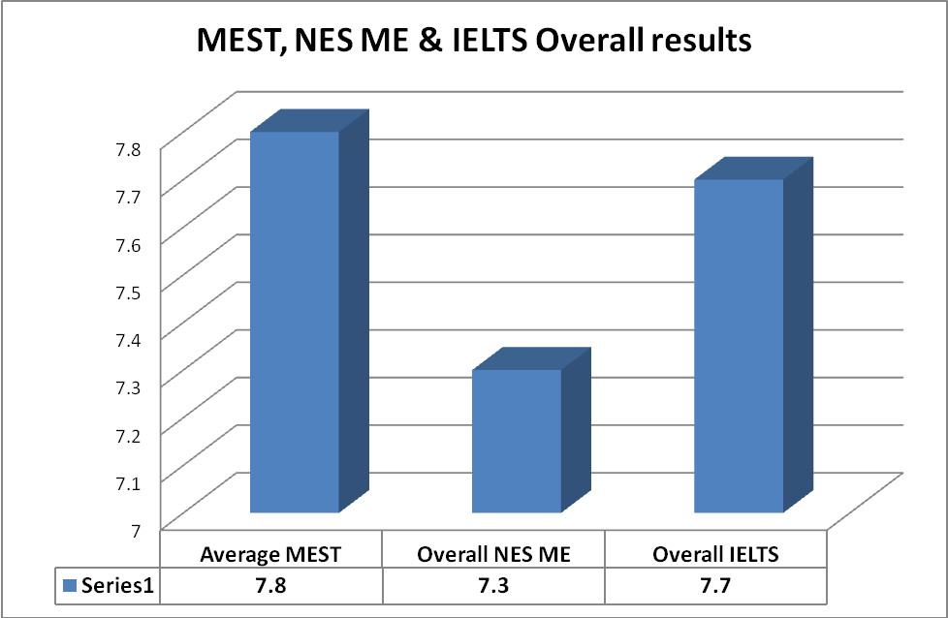
The Tests

Slide 25
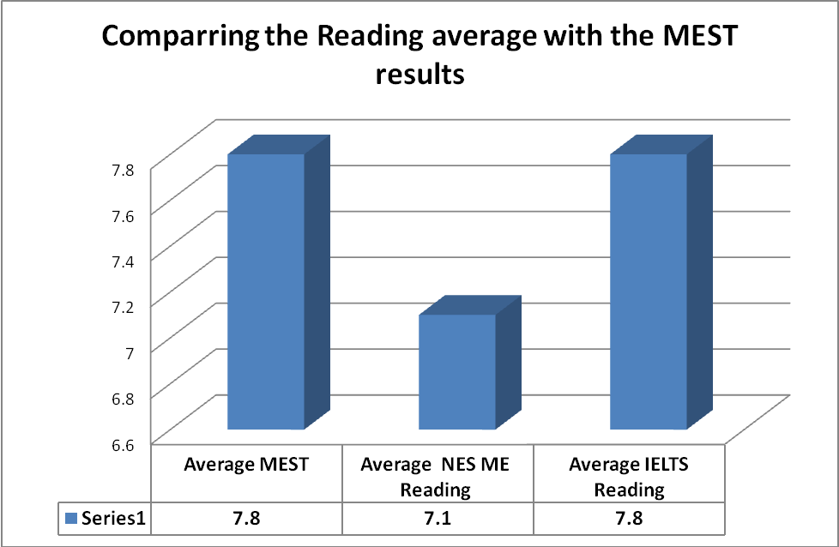
Reading

Slide 26
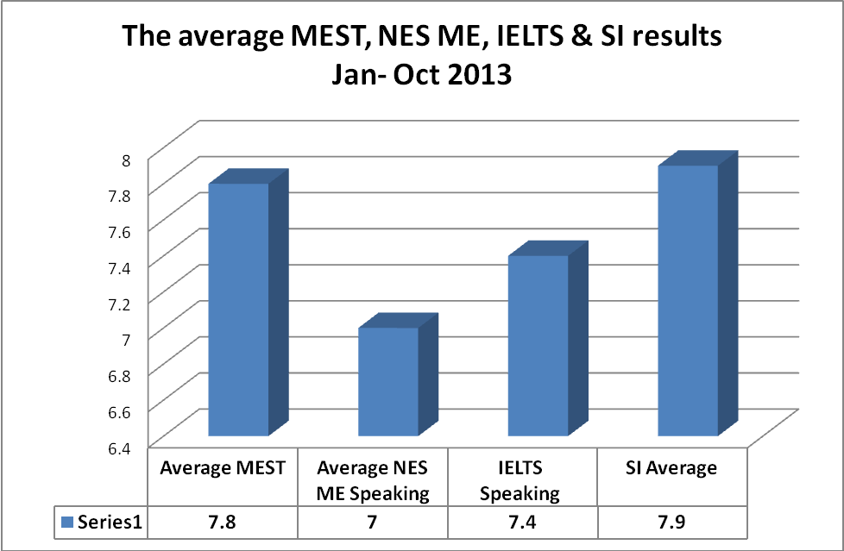
The Patient

Slide 27
The challenge...
The evidence seems to strongly suggest that although the IELTS could be used as a measure to test a doctor’s ability to provide safe patient care in the UK it is not perfectly “Fit for Purpose.”
IELTS should not be relied on as the only way of assessing a healthcare provider’s Medical English ability to gain a GMC’s Licence to Practice

Slide 28
Cape Medical Services
Revalidation: Transforming the RMO Organisation
4th JUNE 2014
Dr Stephen Agoston, Responsible Officer

Slide 29
RMO MARKET
Who are Cape Medical – our clinical methodology
Small number of RMO providers service majority of UK independent hospitals
RMO recruitment mostly from Eastern EU to do jobs that UK doctors don’t want to do
High Risk Profile - First UK job, English, Clinical Training experience, lone working, WTR, lack of supervision and cultural issues

Slide 30
RMO SECTOR CHALLENGES
Revalidation based NHS training posts (lost tribes)
Cultural Resistance - “Significant Events”
RMOs generally mistrustful of the “system”
Relationship between RMO providers and clients
Administrative issues– e.g. 360 feedback

Slide 31
TRANFORMING THE ORGANISATION
Where is the market headed?
Who are we and what are we good at?
Clinical Governance - Independent vs NHS
Recruitment and retention is key
Clinically driven

Slide 32
CLINICAL RISK, TRAINING & REVALIDATION
Clinical expertise available 24/7 - integration with Clinical Governance
What is Quality Assurance in the RMO world?
Before: Appraiser Selection: NHS experience
During Appraisal: face to face, support
Outputs: UK Centric training, client feedback
Resource implications – 35% of office time

Slide 33
OUTCOMES
Overwhelming positive response from RMOs
“Tick box” versus RMO career profiling/planning
Substantial positive impact on clinical governance
RMO protection and motivation
Reduction Clinical Risk at Client Hospitals

Slide 34
QUESTIONS

Slide 35
SUMMARY
RMO Market still dependent on foreign labour supply
Challenging regulatory/compliance/legal burden
Proper Appraisal can be used to improve Clinical Quality
Positive impact on RMO recruitment and retention

