Slide 1
Getting to grips with large numbers and complexity
Dr Ian Abbs, Medical Director, Guy’s & St Thomas’
Dr Raj Patel, Medical Director, NHS England Greater Manchester
Simone Gelinas, Revalidation Manager, Guy’s & St Thomas’
Ahead of the Curve
4 June 2014
Brighton

Slide 2
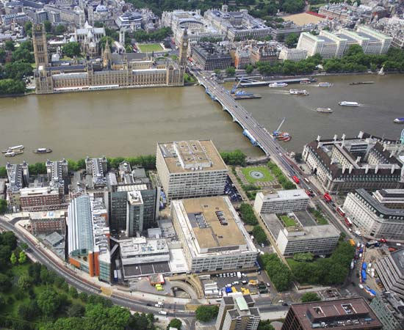

Guy’s & St Thomas’

Slide 3





King’s Health Partners AHSC

Slide 4
SE London sector

Slide 5
Doctors at GSTT
Doctors employed at GSTT – approx 1860
Total prescribed connections – 960
- 600 Consultants
- 200+ clinical academics employed by KCL with honorary contracts
- 160 Trust / SAS grade and Clinical fellows with Trust contracts
- 150+ on short term contracts
900 trainees employed by the Trust but with prescribed connection to HEE
300 further trainees for whom we are Lead Provider

Slide 6

GSTT approach to complexity
Managing complexity through standardisation:
  Policy
  Process
  Support
Sharing best practice across London network
Standardisation ongoing challenge given size of Trust

Slide 7
Revalidation to date at GSTT
Strong history of appraisal and clinical governance systems
Objectives
Meet external statutory requirements placed on the Trust, through the RO, such that the Trust ensures that it’s doctors are fit to practice
Use the processes of revalidation as a tool for personal and professional development, in line with the objectives of the Trust and the AHSC
Statistics
2013/14 – 190 recommendations with 27 deferrals
2014/15 – 420 scheduled recommendations
External benchmarking
Strong ORSA / AOA performance amongst peers
Quality assurance through external agency
Annual report to Trust Board

Slide 8
Challenges
Managing Prescribed Connections
Tenuous long standing academic and clinical relationships
- Foreign doctors
- Honorary contracts, bank staff, out of programme trainees
Quality Assurance of appraisal
- Differential requirements across specialties
- Pragmatic approach with available resource
- Engagement in a transient population
Managing risk across a wide scope of practice
- Academic tensions
- Governance arrangements in other practice environments
Employment relationships without RO link (trainees)
Standardised processes lacking across organisations

Slide 9
Case Studies
A Consultant Physician primarily employed at your Trust is involved in a series of incidents in three other organisations within their scope of practice. There are no concerns about the doctor’s practice at your Trust. The individual concerns don’t raise significant fitness to practice concerns, but in aggregate they suggest a pattern that may meet the threshold for a remediation type of programme. You are not assured of the robustness of the investigations completed at the other organisations and yet you are asked to make a recommendation about the doctor’s fitness to practice. What approach would you take then.
An employee of your partner university with an honorary contract with the Trust is on a research project abroad for three years and requires revalidation this year. His work requires him to be able to prescribe and his ongoing contract with the university and their position abroad is contingent on them continuing to hold a UK licence to practice. He will not be able engage in the appraisal or governance processes set out in your Trust’s policy. What approach would you take.

