Slide 1
Revalidation – A catalyst for quality improvement
Michael Wright, Head of Clinical Governance, NHS England
Kate Godfrey, National Lead for Quality, Improvement and Development, HQIP
4 June 2014
Revalidation Brighton Conference

Slide 2
Content
Overview of Quality Improvement
Key Quality Improvement activities
Clinical Audit
Consultant Outcome Data
Quality Accounts

Slide 3
A Framework for Quality
Bring clarity to quality
Measure quality
Publish quality
Reward & recognise quality
Leadership for quality
Innovate for quality
Safeguard quality
NICE Quality Standards
NICE Clinical Guidelines
NHS England Commissioning Guides
Indicators in NHS Outcomes Framework and CCG OIS
Clinical Audit
Indicators for Quality Improvement
Quality Accounts
NHS Choices and other sources of info for patients
Consultant Outcomes data
Care.data
NHS England Patient safety website
Tariff
CQUIN
QOF
Better Care Fund
Standard contract
Quality premium
Clinical Excellence Awards
Boards
Responsible officers
Professional bodies’ leadership Clinical Senates
National Quality Board
Health & Wellbeing Boards
NHS Leadership Academy
Academic Health Science Centres
Academic Health Science Networks
NICE technology appraisals and compliance regime
NHS Improving Quality
Strategic Clinical Networks
CQC registration, monitoring and enforcement
Quality Surveillance Groups
Professional regulation
Monitor licensing
Standard Contract
Notes:
Slide taken from one prepared for Simon Stephens introduction
Headings are from High Quality Care for All
Demonstrates the large number of tools that are available to NHS England to support quality improvement
Highlighted the areas relevant for this session

Slide 4
Why engage in Quality Improvement?
Improved outcomes
Fewer incidents
Reduced costs
Better morale
Better team working
Improved productivity
Better experience
A 2009 review found that quality improvement can make an important, if limited, contribution to the cost-efficiency of healthcare.²
The main benefits of employee involvement and empowerment are enhanced morale, more productivity, healthier co-worker relationships and creative thinking.³
Patients want to be listened to, to get good explanations from professionals, to have their questions answered, to share in decisions, and to be treated with empathy and compassion¹.
National Voices : integrated Care: what do patients , service users and carers want?
Øvretveit J. Does improving quality save money? A review of the evidence of which improvements to quality reduce costs to health service providers. London: Health Foundation, 2009
Owen E, Richardson IV, Benefits of practising employee involvement-empowerment
Notes:
As a responsible officer it is your job. A phrase you will be familiar with from the RO Training (next slide) “It’s the law”

Slide 5
Supporting the Responsible Officer to improve quality
The law puts the Responsible Officer at the heart of quality improvement by:
ensuring doctors are appraised and that the appraisal covers the entire practice; (Regulations 11 and 13)
concerns are investigated; (Regulations 11, 13, 16 and 17)
clinical governance information is reviewed; (Regulations 16 and 17)
doctors are supported to improve; (Regulations 16 and 17) and
any systemic issues are addressed. (Regulation 16)
Source: Medical Profession (Responsible Officer) Regulations 2010
Notes:
Reg 14 requires org to provide resources to enable you to carry out your duties

Slide 6
Supporting the individual to improve quality
Present information
Reflect with appraiser
Identify and agree CPD areas
Appraise
Define needs, objectives, how.
Plan development
Identify opportunities
CPD
Carry out learning plan
Collect supporting information
Begin reflection
Practise
Complete reflection
Compare with peers
Summarise what was learned
Reflect

Slide 7
Supporting the organisation to improve quality
R E V A L I D A T I O N
Quality Accounts
System regulation
Organisation
High performing workforce
Income
Standard Contracts
Complaints
Notes:
Provision of services requires licensed doctors (in most cases)
System regulators (CQC, Monitor and TDA) are all taking increased interest in how legal duties are being met and how appraisal is an indicator of quality of care.
Statements on revalidation and appraisal rates should be an important indicator as to the quality of the care delivered
Finally Commissioners want high quality services for patients

Slide 8
Appraising Clinical Audit Evidence
Kate Godfrey
National Lead for Quality, Improvement
and Development

Slide 9
Who are HQIP?
HQIP is a not-for profit, professional/patient partnership. We aim to improve health outcomes by enabling those who commission, deliver and receive healthcare to measure and improve our healthcare services.
HQIP was established in 2008 and is governed by a consortium of the Academy of Medical Royal Colleges, the Royal College of Nursing and National Voices

Slide 10
Clinical audit
Used as evidence for 3 domains
Rich source of information
Evidence of professional competence

Slide 11
Supporting Information

Slide 12
1. Knowledge Skills and Performance
Evidence of engaging in clinical governance activities
Demonstrates that learning is put into practice
Clinical record keeping audits

Slide 13
2. Safety and Quality
Meets recognised standards
One complete audit cycle
National or local audit
Individual role identifiable
Notes:
Four key criteria:
Participation
Reflection
Taking action
Closing the loop

Slide 14
2. Safety and Quality (cont’d)
Four key criteria:
Participation
Reflection
Taking action
Closing the loop

Slide 15
3. Significant Events
Audit methodology –
investigate and analyse causes of event
Identify areas for improvement / development
Implementation of change

Slide 16
4. Communication, partnership and teamwork
Multi-disciplinary team
engage, educate, execute, evaluate
Patient involvement
added perspective
patient to patient interviews

Slide 17
5. Areas for Appraiser Questions
National – awareness of the individual doctor that the audit was taking place
Local – reason for choice of topic
Patients spoken to about the audit
Data collection / entry
Discussion of Findings

Slide 18
5. Areas for Appraiser Questions (cont.)
What do the findings say about
Clinician effectiveness
Patient outcomes
Leading / active in change activity
Local / national evidence of improved practice

Slide 19
5. Areas for Appraiser Questions (cont.)
Cost benefits or justifiable reductions in spend / working with other departments
investigation referrals
prescription patterns
Clinical Audit training
attendance
provision

Slide 20
6. Selection of Material
Appraiser awareness of local and national audits carried out
Non-submission = evidence of poor practice or oversight?
Driving for improvement v going through the motions

Slide 21
Patients, Service Users, Carers and the Public

Slide 22
Clinical Audit in your organisation
On your tables discuss how you have used clinical audit to support the revalidation of your doctors.
Write your top three tips on post it notes. These will form part of the feedback from the workshop.
Time: 7 mins discussion 3 mins to write up

Slide 23
Transparency in outcomes
Source: University Hospital of South Manchester website

Slide 24
Why publish the data?
Reassure Patients
Use of NHS Choices
Supports clinicians to improve
All outliers agreed to publication
Advertise how well doing
Notes:
Bruce Keogh need to be able to describe what you do and how well you do it. Cardiac surgeons publishing for last ten years
How many have looked at their own data. What experience have you had? Have you had outliers

Slide 25
Next steps for outcome data
10 specialities in 2013
Further 3 specialities in 2014
Pilot use open data with Societies
Further specialities to follow
Notes:
Bruce Keogh need to be able to describe what you do and how well you do it. Cardiac surgeons publishing for last ten years
How many have looked at their own data. What experience have you had? Have you had outliers

Slide 26
Examples of data
What does this mean?
This shows that the 90 day mortality rate following hip surgery for this surgeon is in line with the expected rate, based on the type of patients this surgeon has seen. The national average 90 day mortality rate following primary hip replacement surgery is approximately 0.6%.

Slide 27
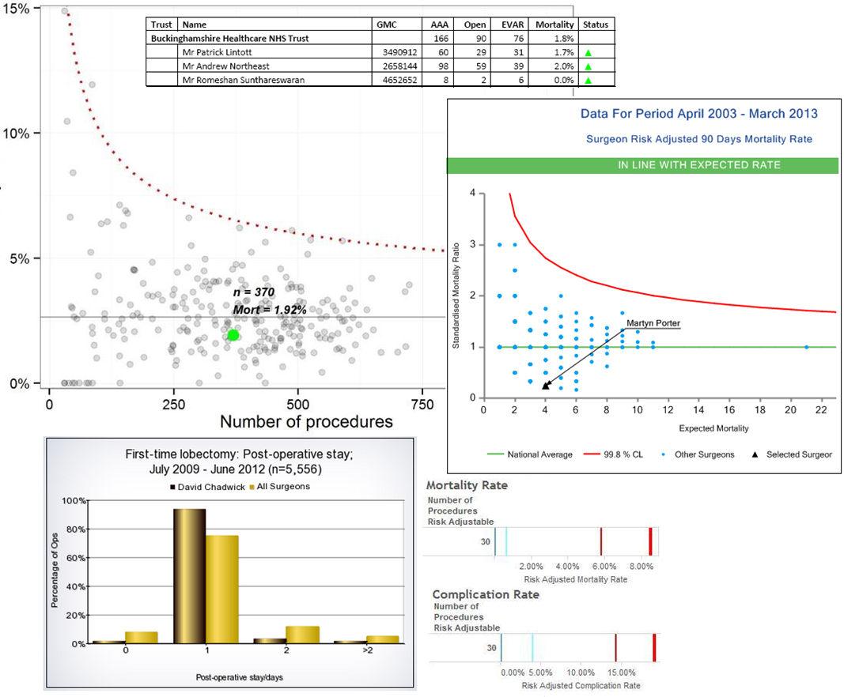
The information available.
Notes:
3 different examples of data from different Colleges/Societies
Aim to get consistant format
Make more accessible
More patient friendly in terms of narrative

Slide 28
Limitations
Not part of a National Clinical Audit
Not enough data
England only
Opt out
Complexity of data
Team data
Notes:
Data on the procedures that they carry out may not be collected by the National Clinical Audit for their specialty.
They may not have carried out enough procedures to be included in the analysis.
For clinical outcomes data to be reliable, it must be based on enough procedures. Consultants who have not submitted enough procedures to the audit are not included.
A doctor might have carried out low numbers of procedures as a responsible consultant if they only became a consultant towards the end of the analysis period, or if they stopped practising the procedures listed part way through the analysis period.
They may have retired or stopped carrying out the procedures on which data are published.
They may practise outside England. This initiative applies only to England, although some data for Scotland and Wales have been made available in some specialties.
They may have chosen to opt out of having their data published. Consultants may opt out because they believe that the data submitted about their practice is inaccurate or incomplete, they may not agree with outcomes data being published at consultant level, or they might be concerned about the public’s response to their outcomes data.

Slide 29
Patient feedback
Source: University Hospital of South Manchester website

Slide 30
Patient feedback on communication skills
Based on Picker Institute Report

Slide 31
Comparing feedback
Question | Your Score | Average Score | Significant difference
Speaking clearly | 10 | 9.6 | None
Explaining any risks/benefits of treatment options | 9.8 | 9.5 | None
Explaining what would happen next | 9.8 | 9.4 | None
Listening carefully | 9.5 | 9.4 | None
Treating you with respect and dignity | 9.4 | 9.6 | None
Explaining things | 9.4 | 9.5 | None
Letting you talk | 9.4 | 9.3 | None
Involving your companion in the consultation in the way you wanted | 9.4 | 9.4 | None
Making you feel at ease | 9.4 | 9.4 | None
Being prepared | 9.3 | 9.3 | None
Involving you as much as you wanted in decisions about your care and treatment | 9.3 | 9.1 | None
Treating you as an individual | 9.2 | 9.3 | None
Fully understanding your worries and concerns | 9.2 | 9.2 | None
Giving you emotional support | 8.6 | 9 | None
Examining you sensitively | - | 9.6 | -
Explaining the reasons for advice | - | 9.5 | -
Based on Picker Institute Report

Slide 32
Transparency
On your tables discuss what other governance information used in revalidation that you might make available to the public.
On a post it note write down your table’s favourite idea.
Time: 10 mins (8 to discuss; 2 to write)

Slide 33
Quality Accounts
What is a Quality Account?
A key mechanism through which health care organisations can demonstrate their focus on improving the quality of their service
Who
All providers of NHS care (except: Primary Care and Continuing Healthcare, organisations >£130k and > 50 employees)
Why
Outcome of Darzi Review
End of year sign off for quality
Notes:
Have you read your Quality Account How many involved in producing accounts?
Standrad framework in termms ofindicators but no reason data on realidation could not be included now.
How many people have considered inclusion

Slide 34
Quality Accounts
When
Returns from providers are due annually by 30 June
Quality Accounts published since 2010
Where
NHS Choices
Provider website
How
Submit to DH website or upload to choices
Notes:
Have you read your Quality Account How many involved in producing accounts?
Standrad framework in termms ofindicators but no reason data on realidation could not be included now.
How many people have considered inclusion

Slide 35
Quality Accounts and Revalidation
All organisations are designated bodies with statutory duties
Appraisal rates are a key measure.
Quality Account indicator considered for 2015/16
Confidence in quality of services.
Patients
Patient organisations
Regulators
Notes:
NHS England are undergoing a review to see how an indicator in a Quality Account for Medical Revalidation could be included
The indicator will enable the board and commissioners to focus on a key measure of the organisation’s statutory duties.
It will give readers confidence that the board was being open and honest about the quality of services being provided across the organisation and committed to driving continuous quality improvement.
It may be less meaningful to individual patients because the link between appraisal and the quality of services is not immediately obvious to the man in the street.
Our work with patient representatives suggests that organisations that represent patients such as AvMA (Action against medical accidents) and Healthwatch will understand the importance of this indicator.

Slide 36
Contact Information
If you require any further information please contact Michael Wright
Email: michael.wright10@nhs.net

