Slide 1
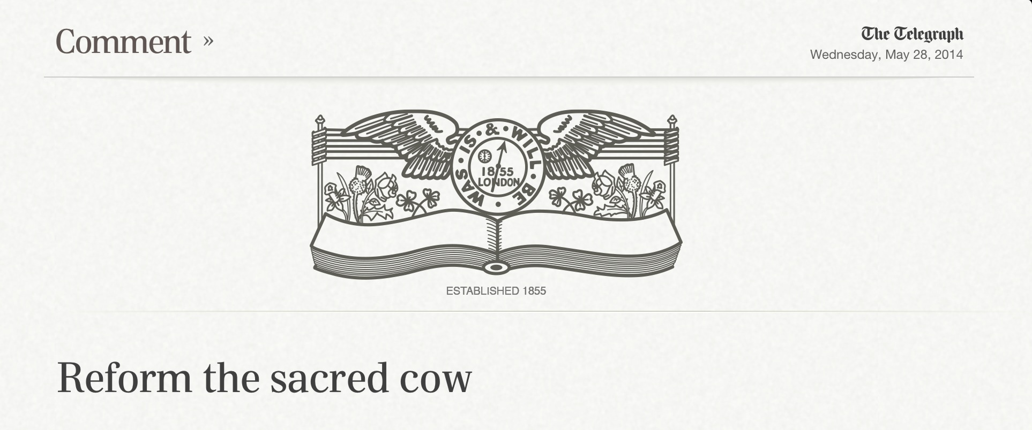
“If we ran our airline industry on the same basis, planes would be falling out of the sky all the time”
Verdict on the NHS, Robert Francis QC

