Slide 1
Do a leader’s personal values make them victims or saviours?
Dr Peter Brambleby
Independent Public Health Consultant
(With thanks to Right Care for sponsorship today)
p.brambleby@btinternet.com

Slide 2
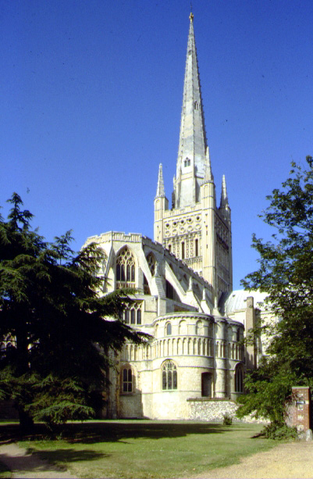

Slide 3
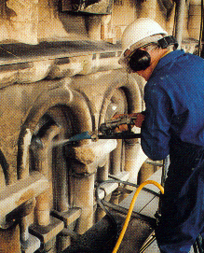
Stonemasonry
What
are
you
doing?
Delivering a contract
Earning a living
Restoring a cathedral

Slide 4
Medicine,
management, etc …
What
are
you
doing?
Meeting contract targets, budgets
Earning a living
Improving the health
of the population

Slide 5
1st story: building a cathedral, or a health care system
“Value” and “Values”:
Alignment of values is at the heart of the clinical manager’s role

Slide 6
2nd story: bridges and drains

Slide 7
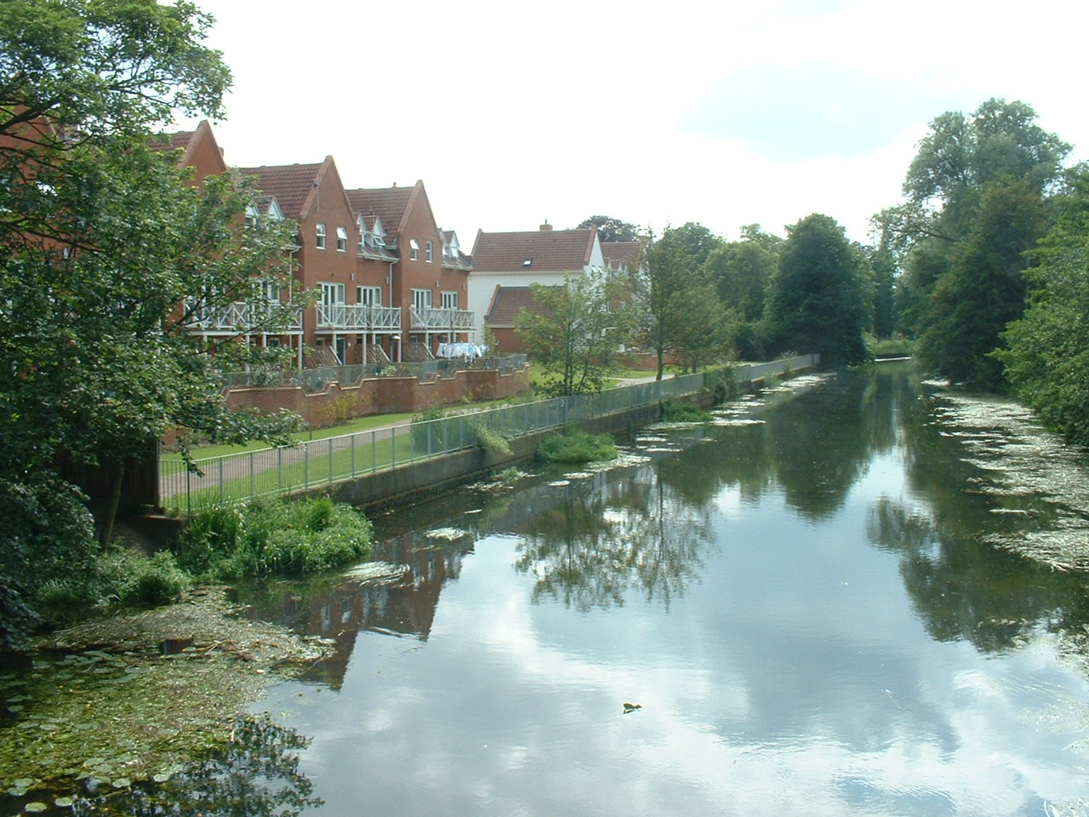
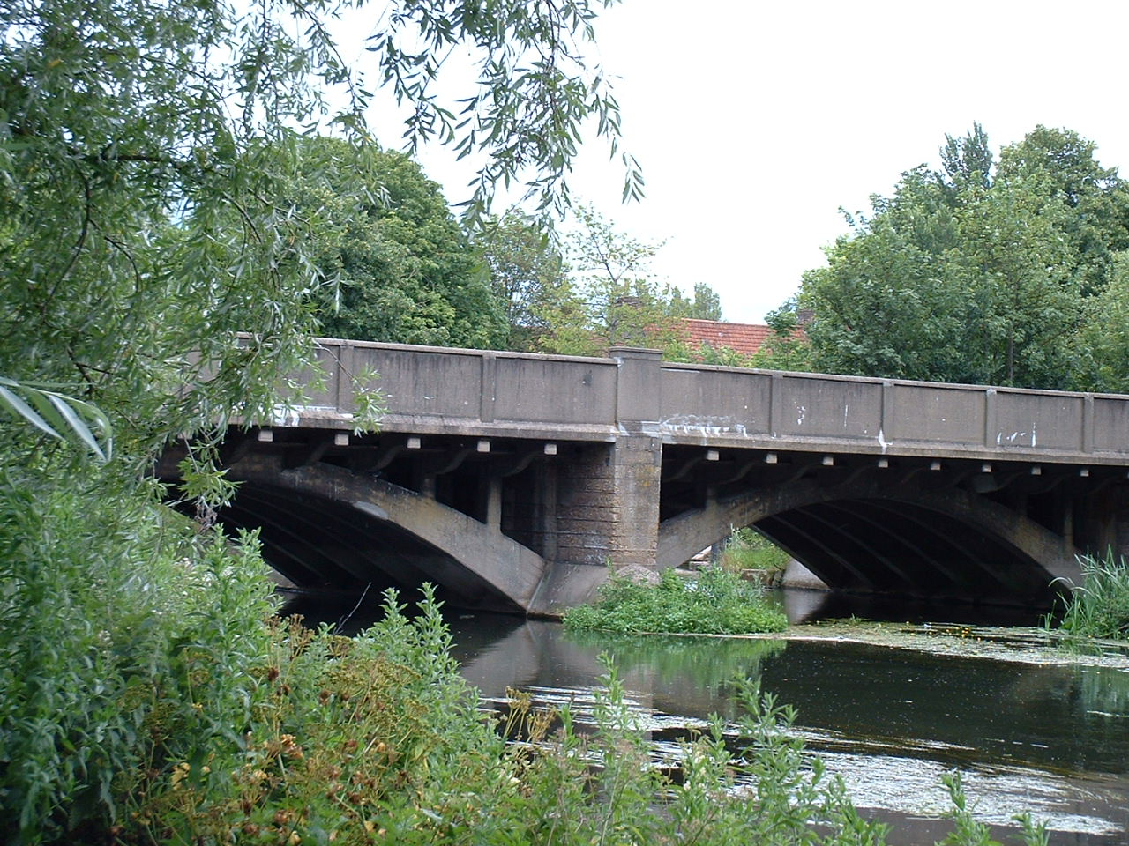
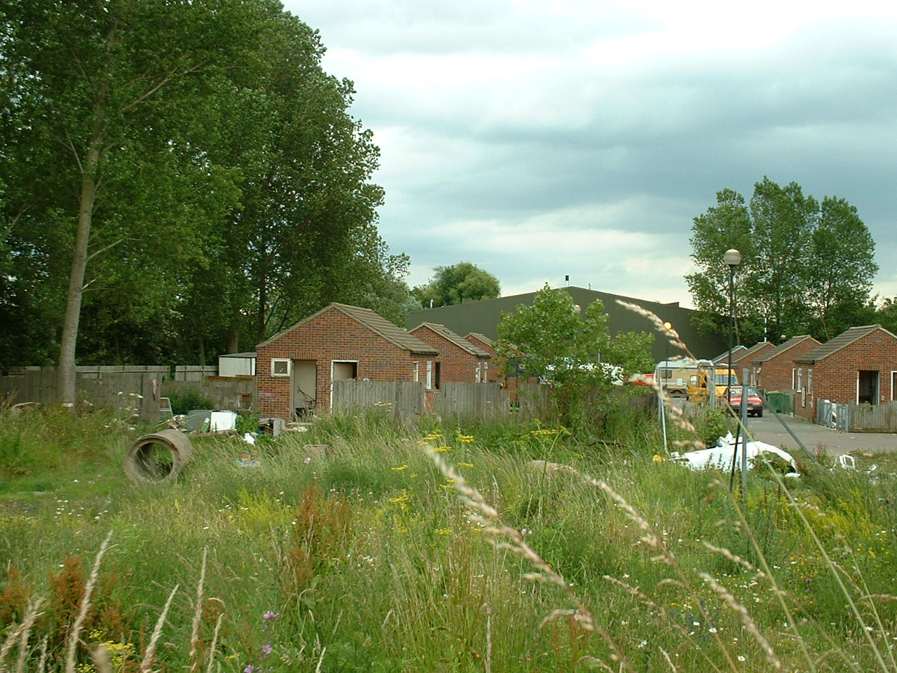

Slide 8
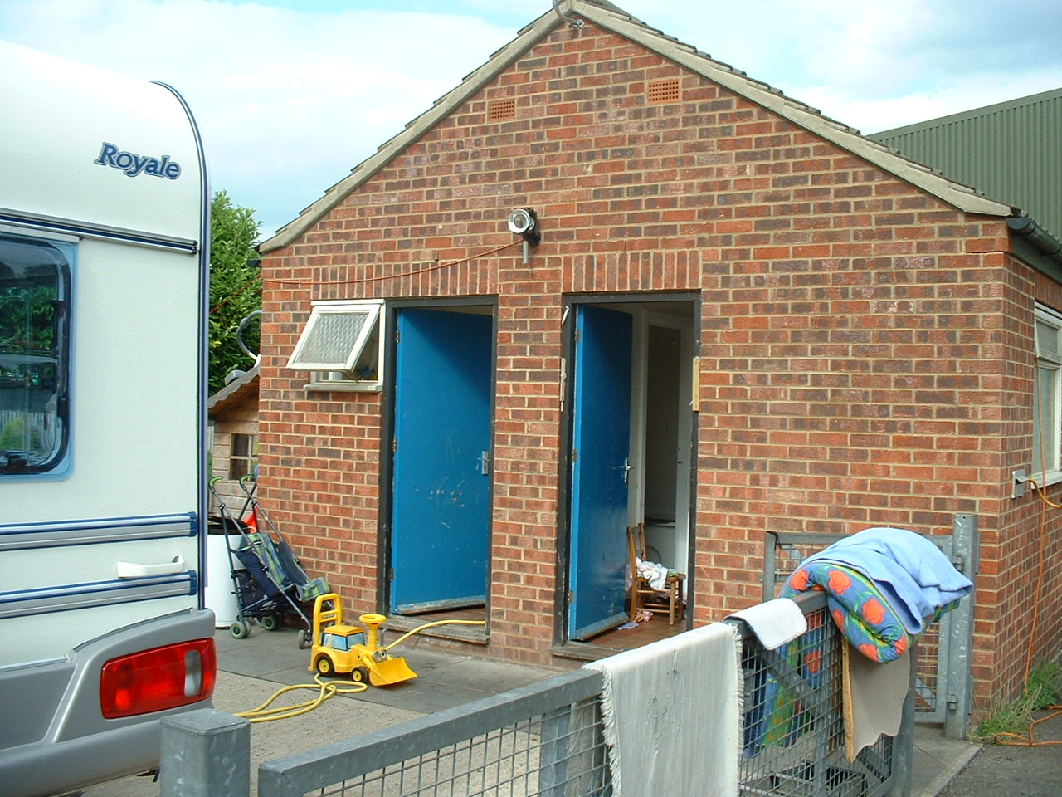
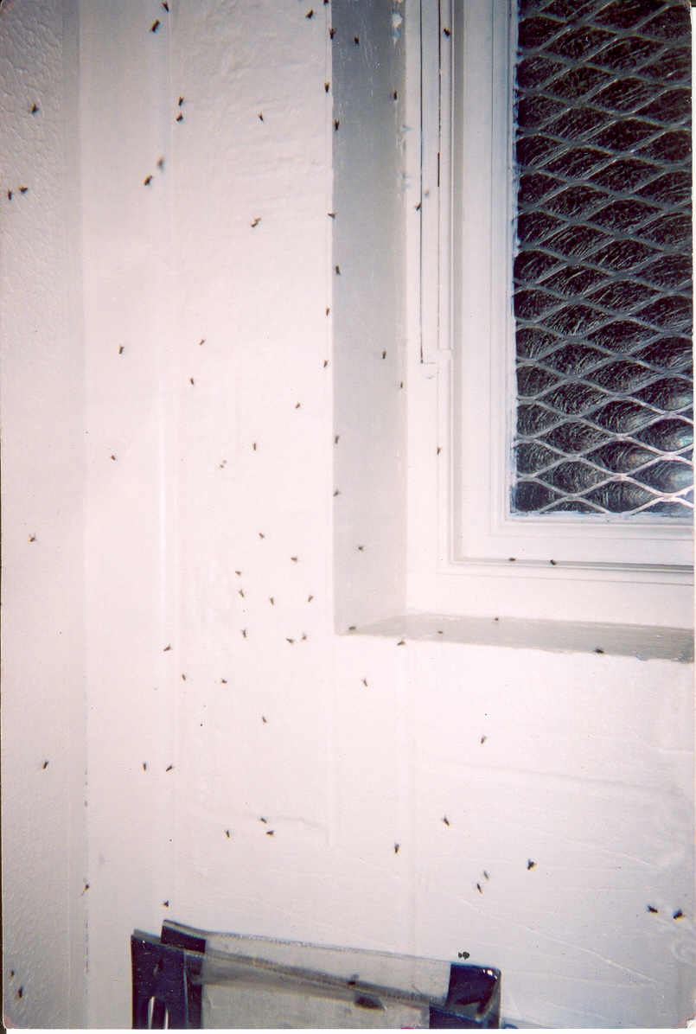

Slide 9
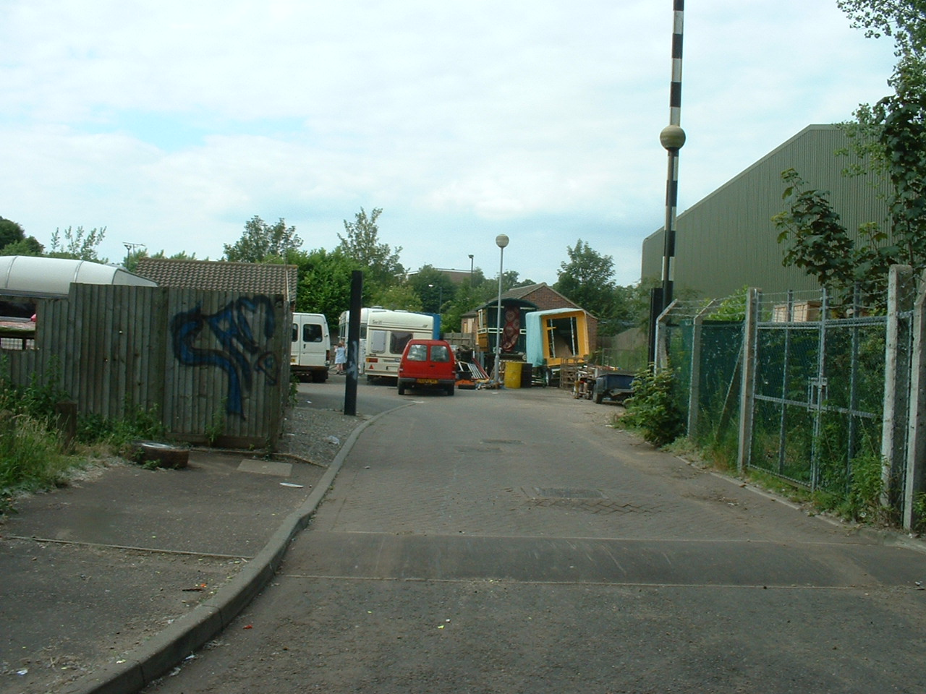
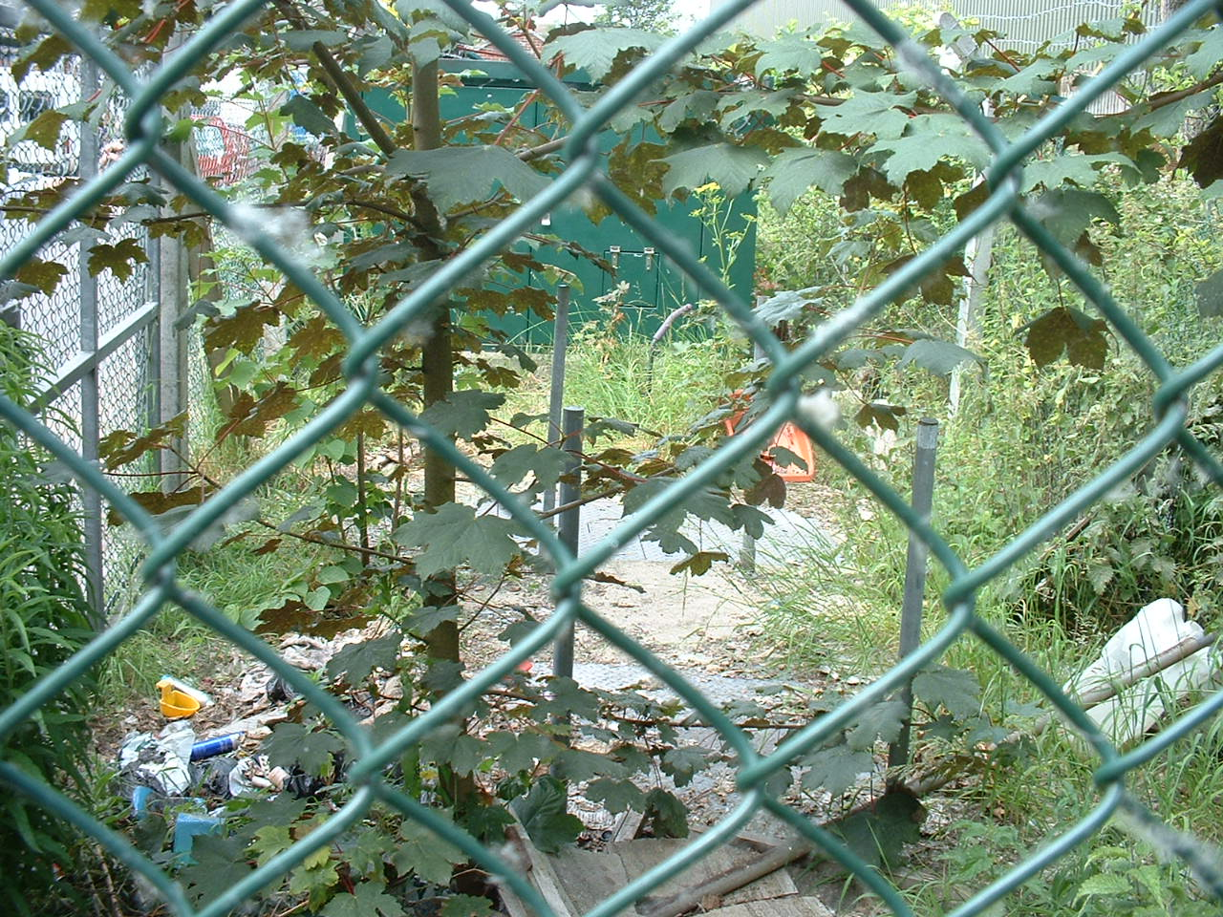
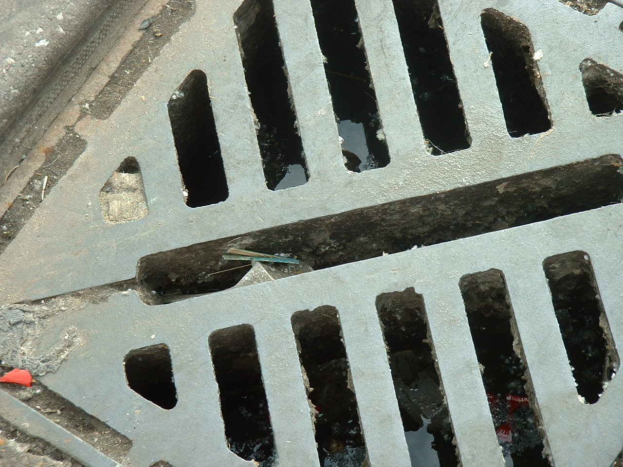
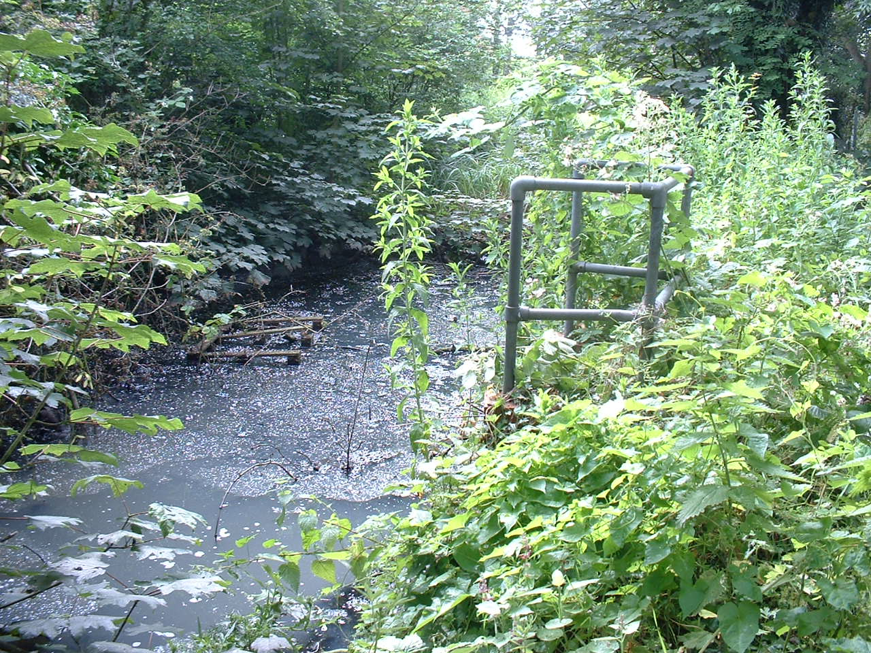

Slide 10
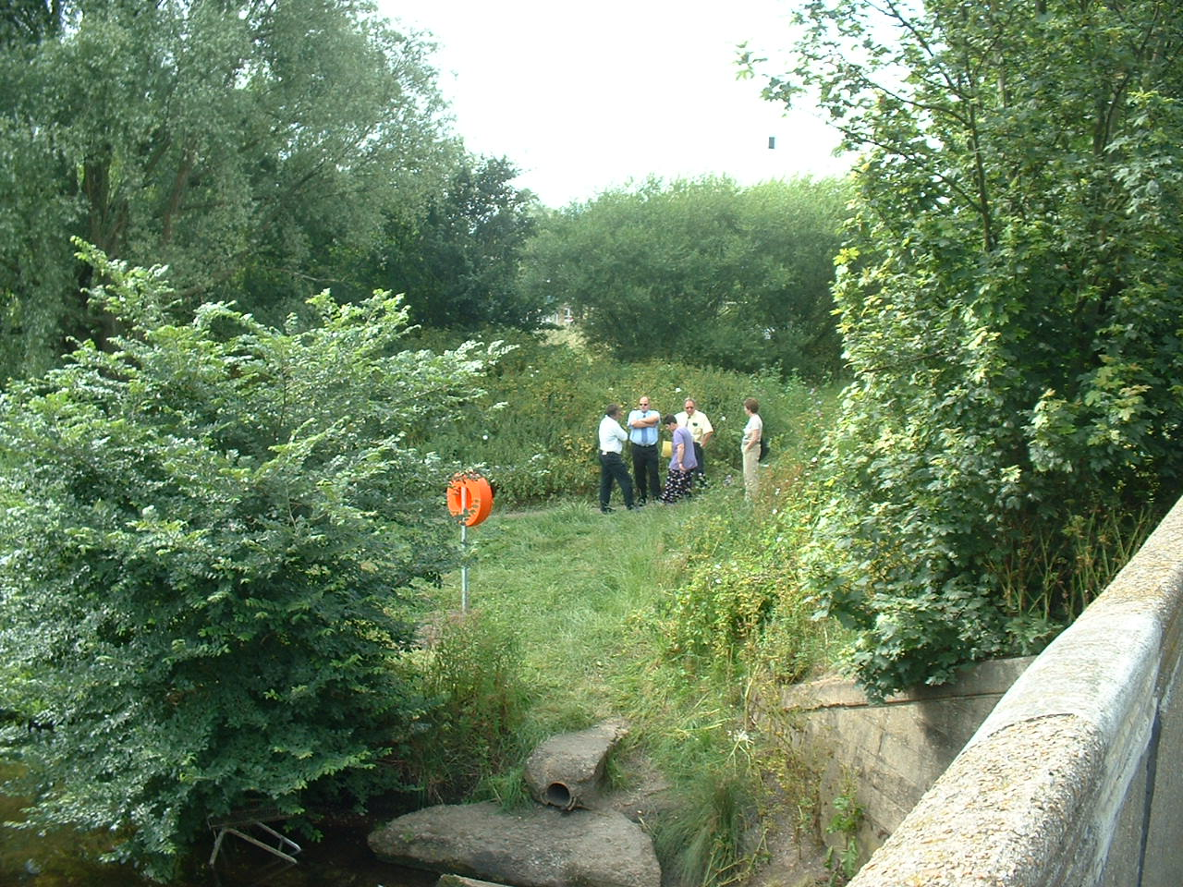
Sewage plus Flies
equals Big Risk

Slide 11
First action:
Flush drains and fix pumping station
Second Action:
Reduce fly breeding sites

Slide 12
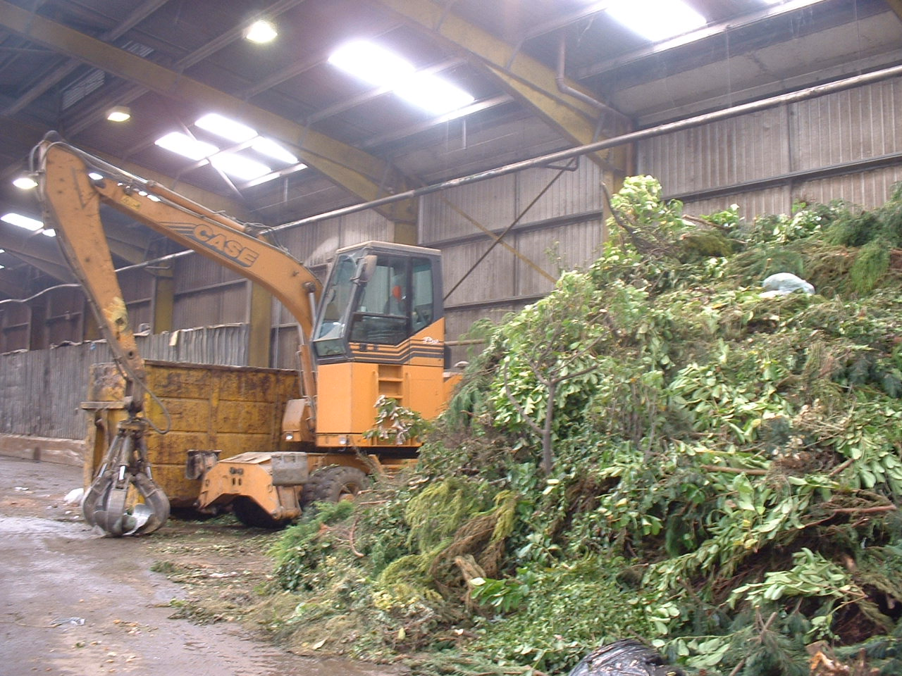
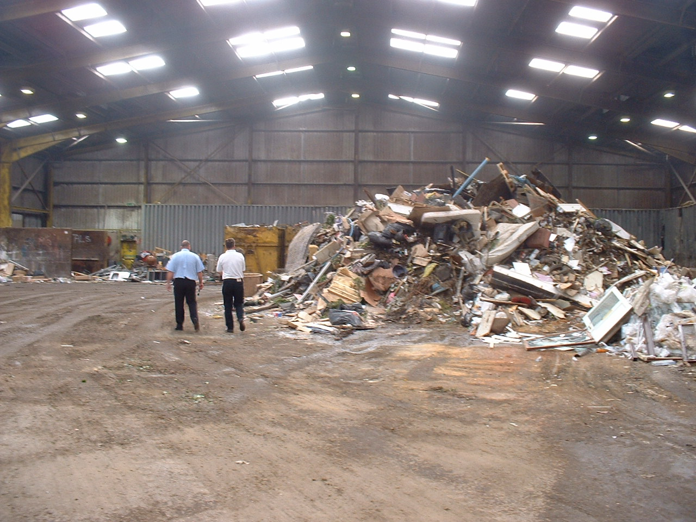
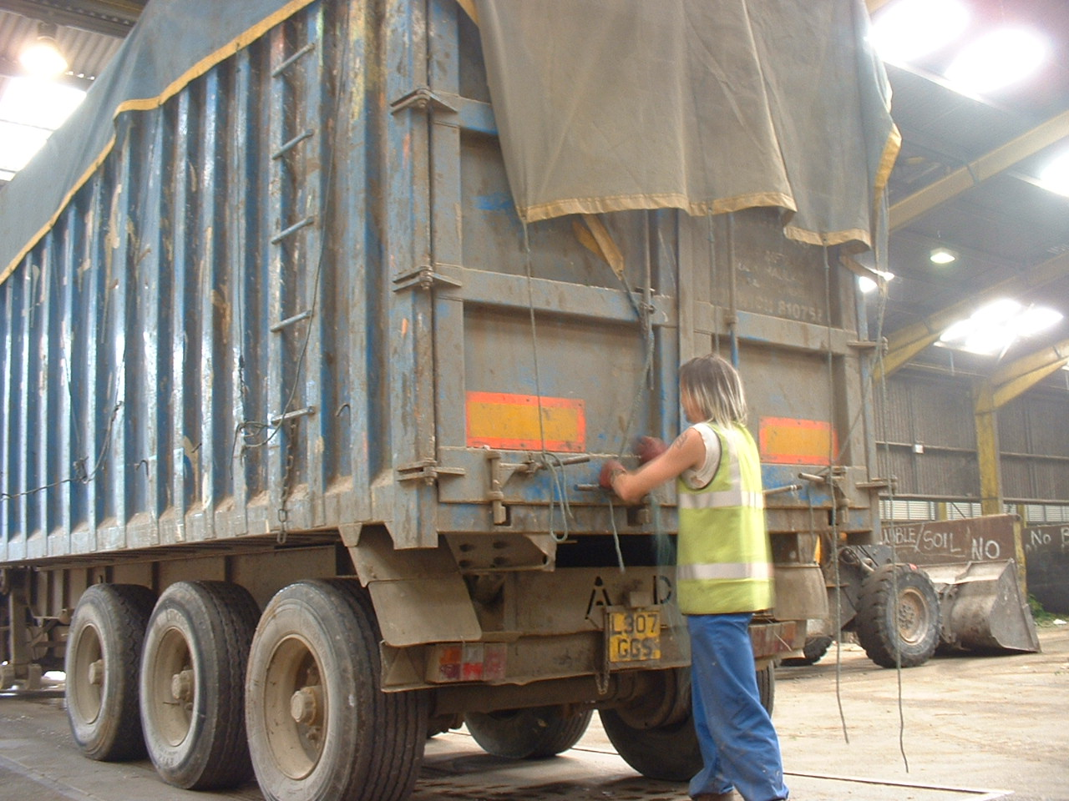

Slide 13
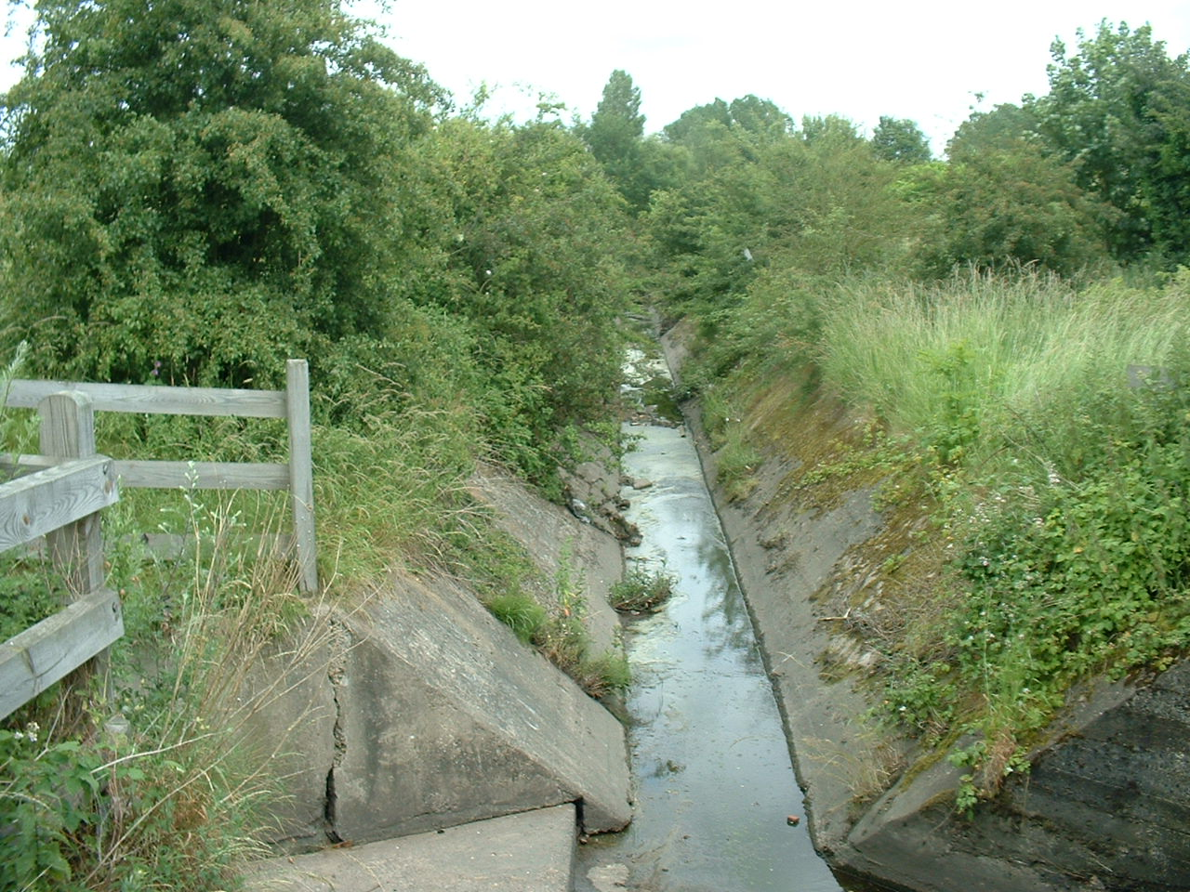
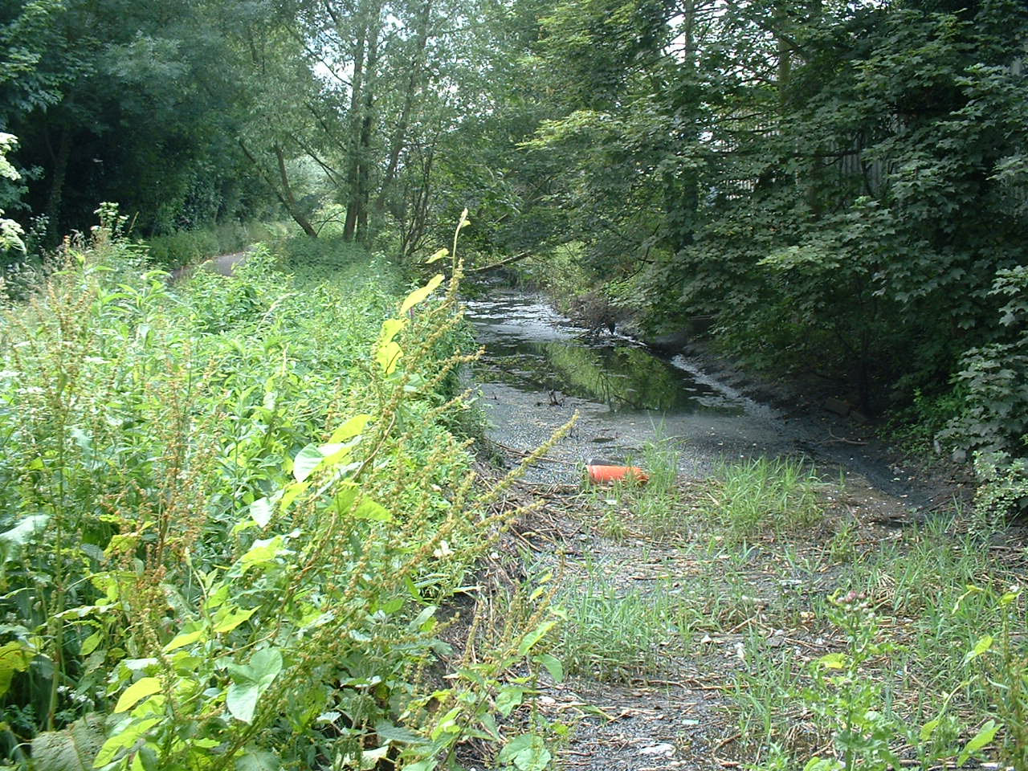
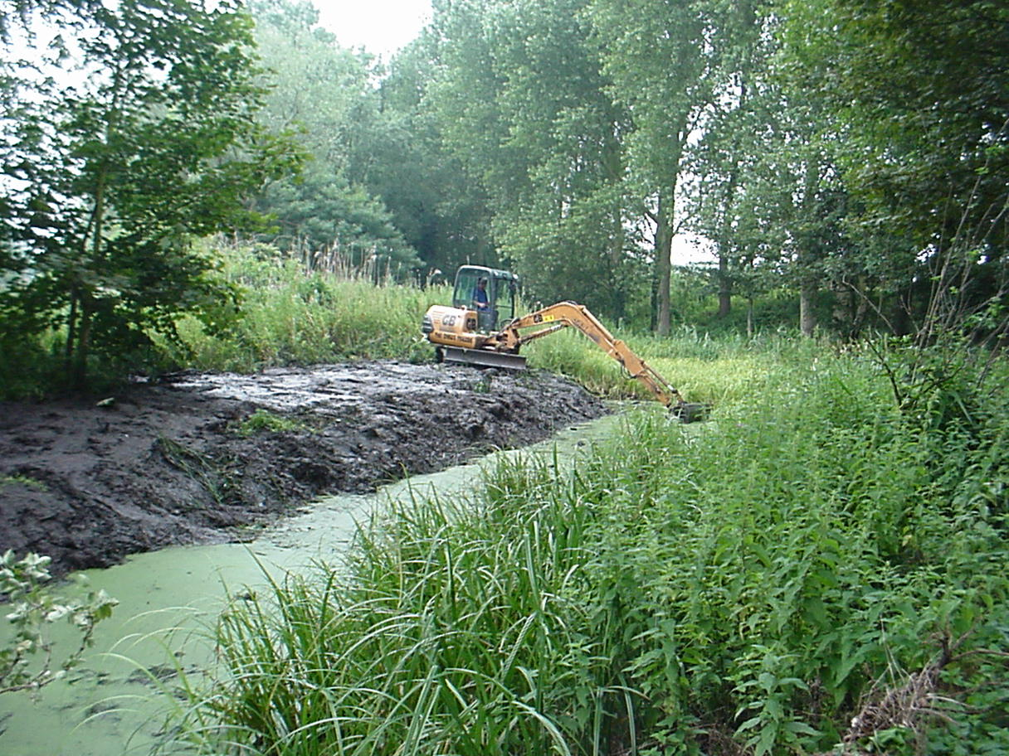

Slide 14
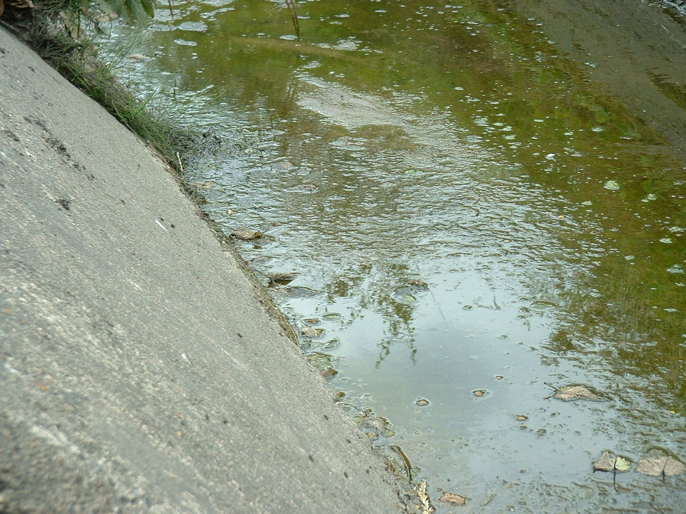
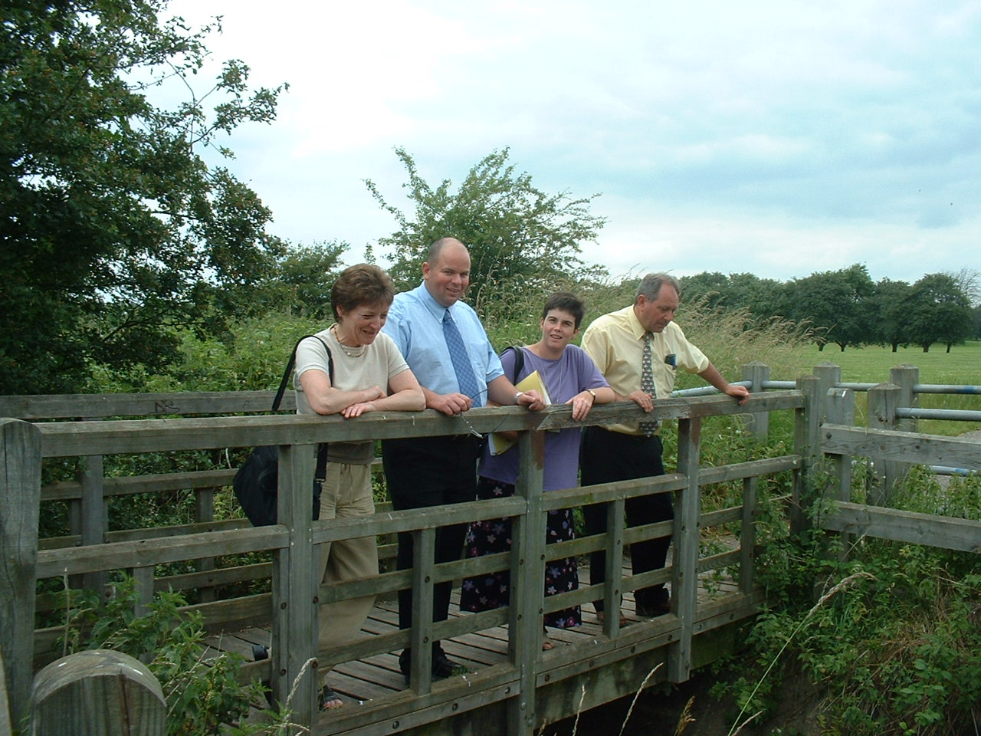
Cath & Malcolm
Environmental Health Officers
(City Council)
Adam
Anglian Water
(Private Sector)
Jacky
Health Visitor
(Norwich PCT)

Slide 15
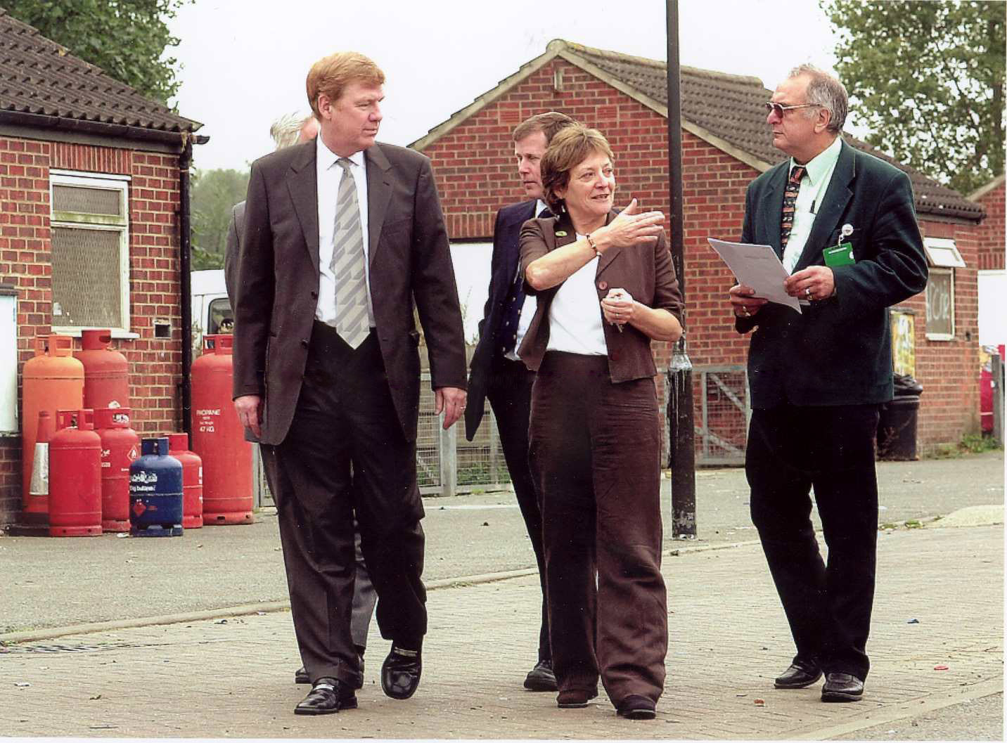
Sir Liam Donaldson
Chief Medical Officer
Photo: EDP

Slide 16
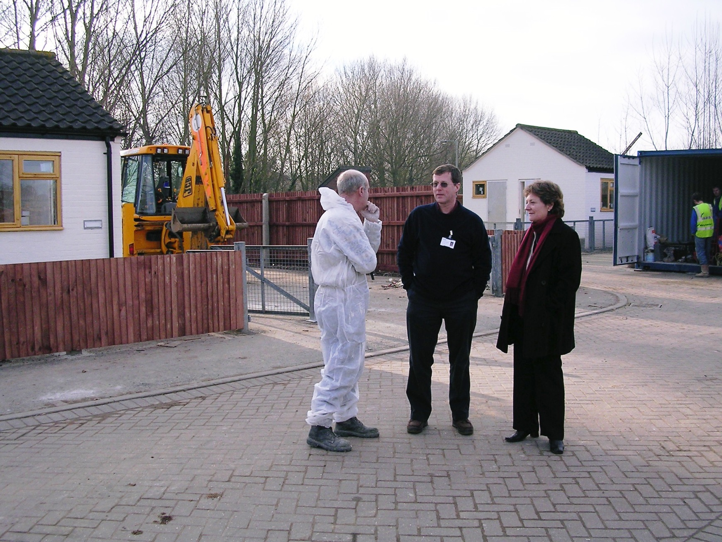

Slide 17
General point
Whether the problem is…
  flies
  teen pregnancy
  educational attainment
  heart disease
  road accidents, etc, etc
… the lessons are the same.

Slide 18
1. “Network” is a verb, as well as a noun

Slide 19
2. Build bridges with others who share an interest in health

Slide 20
3. Tackle problems upstream wherever possible!

Slide 21
4. It isn’t assessing needs that counts, it’s addressing them!

Slide 22
5. Share your experiences
Photo: EDP

Slide 23

6. Community means all of us: we are all victims … and saviours
No man is an island, entire of itself … any man’s death diminishes me, because I am involved in mankind … never send to know for whom the bell tolls; it tolls for thee
John Donne 1573-1631

Slide 24
3rd story: efficiency matters; assessing and addressing need in diabetes
In a publicly-funded health system, clinicians need to understand and own the opportunity costs of their actions and aspirations.
The pursuit of efficiency is ethical, because it seeks to mitigate the pain, disability or premature mortality of those who would otherwise miss out.

Slide 25
Croydon PCT’s total spend on diabetes compared to % patients with HbA1c of 7.5% or less, 2008/09 (From DH “SPOT “tool, www.yhpho.org.uk/spot)
Croydon

Slide 26
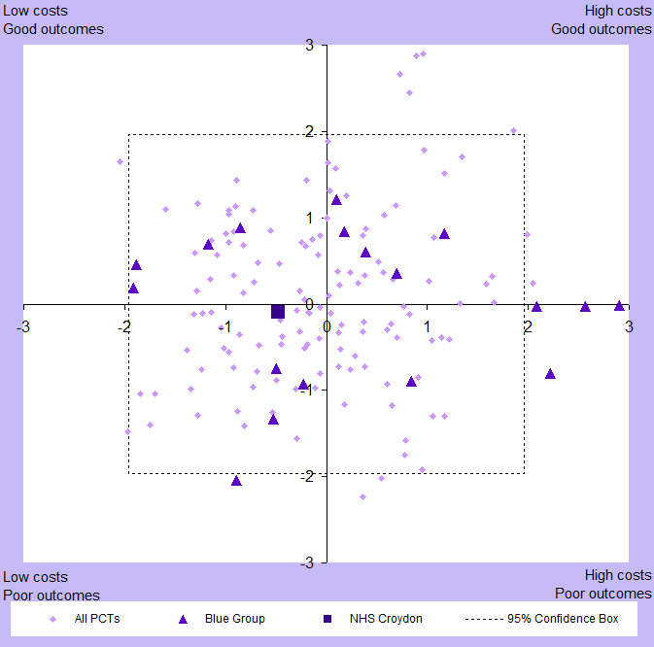
Croydon PCT’s total spend on diabetes compared to % of patients with HbA1c of 7% or less, 2009/10 (From DH “SPOT “tool, www.yhpho.org.uk/spot)
Croydon 09/10
Croydon 08/09 X

Slide 27
Final story: when values collide

Slide 28
Drawing the line
“In a democracy, values trump evidence and a politician has the right to make a decision that goes against an officer’s advice. When this happens the good professional either accepts it or resigns – both with good grace.”
  Sir Muir Gray, Oxford handbook of public health practice, 3rd edition. Personal effectiveness. p 494

Slide 29
“Value” vs “values”
Adding “value” in NHS sometimes seen as meeting top-down targets; driven, not lead
Inputs (finance) and outputs (activity) trumped outcomes and quality
Numbers trumped narrative
Risk-averse and therefore risky
Fear, cover-up, failure to learn

Slide 30
NHS Croydon finance
Interim deputy finance director was misstating the accounts
Internal and external auditors missed it
Special Ernst & Young audit: “at least £22 million” missing from 2010/11 accounts
But … NHS London concluded: “no-one responsible, no-one gained personally, no service adversely impacted, all lessons learned, no further action.”
I disagreed, resigned
No senior manager from NHS Croydon gave evidence to the local Health Overview & Scrutiny Committee

Slide 31

“Hansard”, 12 Jan 2014
Sir Richard Ottaway MP
“Our best idea is that it was the result of a combination of incompetence bordering on neglect and cover-up. A significant lack of documentation and a conspiracy of silence from the people in charge have made it all but impossible to ascertain the truth.”

Slide 32
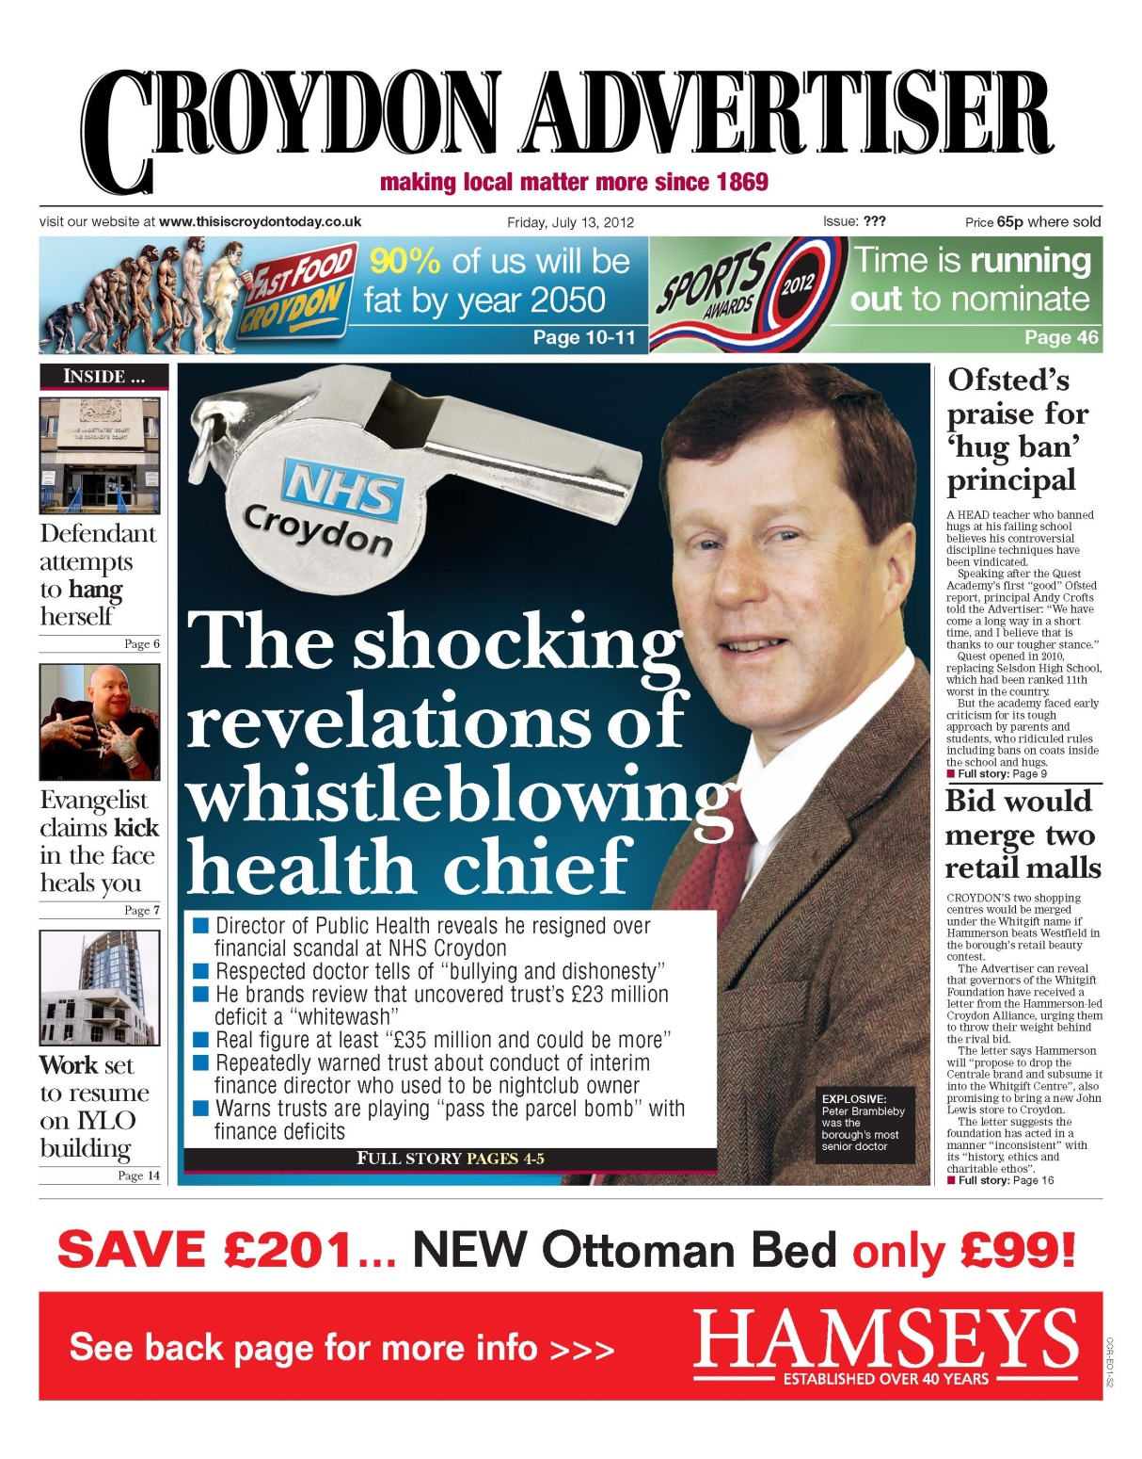
Whistle-blower: victim or saviour?

Slide 33
Discussion
Do a leader’s personal values make them victims or saviours?

