Slide 1
The Value of Physician Leadership
Peter B. Angood MD
Chief Executive Officer
American College of Physician Executives

Slide 2
Recent Non-Health Industry Foci
1980’s – Decade of Quality
1990’s – Decade of Innovation
2000’s – Decade of Execution
Is health care really ~20 years behind the growth & development of all other business sectors in our general economy?
(Wilson-Steele)

Slide 3
“ The acute care hospital is the most complex organization to lead and manage.”
Peter Drucker
But Health Care Is Not Just Hospitals:
Unique Problems & Patient Variability
Highly Complex Structures & Processes
Multiple Metrics & Outcomes Measures
Immature & Incomplete Evidence Base
Loosely Knit Team Systems
Variable Layers of Responsibility
Unpredictable Workloads & Case Mix
Work Hours, Fatigue & Variable Employee Support Systems

Slide 5
Changing Definition of “Hospital”
More Integration Opportunities
M&A Activity
Physician Integration
Community Coordination
More Risk Management
Increased Accountability
R. Umbdenstock-Healthcare Executive Mar/Apr 2014 (pp.78-79)

Slide 6
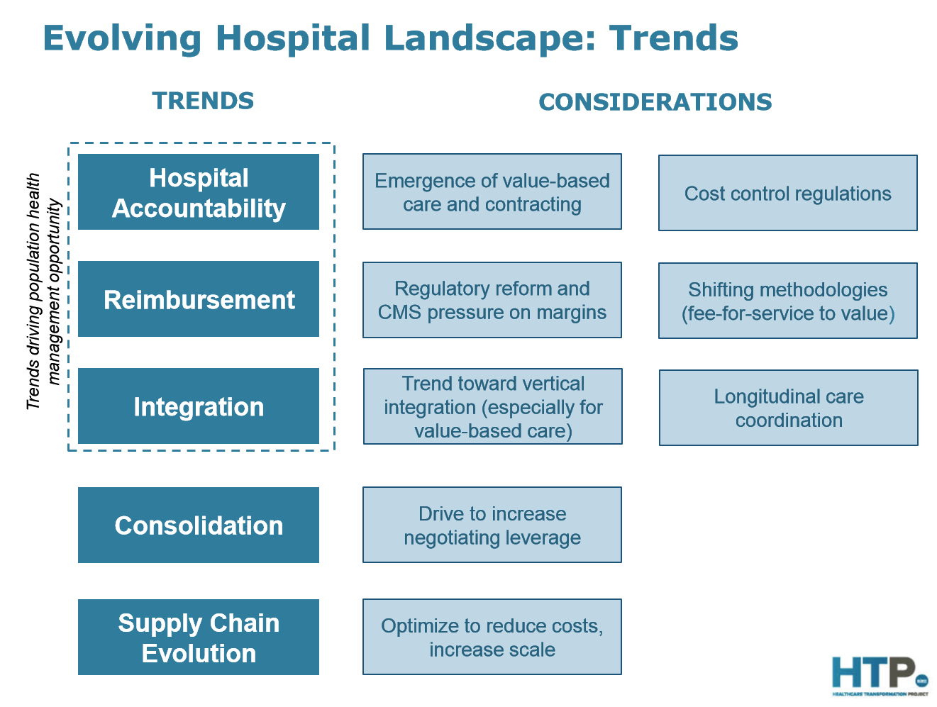

Slide 7
FSMB Updated Stats
Nearly 900,000 licensed physicians in the US (280 MDs/100,000 population)
Avg. age = 51yrs and ~76% are certified by an American Board
2/3 of physicians are still male but…
Female licensed physicians increased in past 2 years by 8%
compared with only 2% of male physicians
And 34% of female physicians are < 39 years
compared with only 18% of male physicians.
Actively licensed physician population grew faster in older population compared with younger groups
11% increase those > 60 years vs. 1% increase those < 49 years
26% of physicians are now over age 60 years,
a demonstrable actuarial need for an increased supply of physicians in order to avert a physician manpower shortage in the near future.
JMR 2013;99(2):11-24.

Slide 8
Earnings of Male & Female MDs
Gender earnings gap has decreased outside of healthcare industry,
But no real progress made in medicine.
1987-1990, male physicians earned $33,840, or 20%, more than female physicians.
1996-2000, the gap was $34,620, or 16.3%.
2006-2010, male physicians made $56,019, or 25.3%, more per year than female counterparts.
9-2-13 (http://archinte.jamanetwork.com/article.aspx?articleid=1733450)

Slide 9
Surge With Physician Employment
~75% increase in number of active physicians employed by hospitals since 2000
Late 2010 - 74% of hospital leaders planned to increase physician employment within next 12 to 36 months.
MGMA Survey
Share of physician searches for positions with hospitals hit 64% in 2013
up from 45% year earlier & 19% five years ago
Merritt Hawkins

Slide 10
Surge With Physician Employment
2001 to 2011, number of physicians & dentists employed by US hospitals grew by >40%
Am Hosp Assoc
Trend is accelerating - 3 in 10 physicians are now hospital employees
60% FP & Peds; 50% Surgeons; 25% Surg Spec are employed – not independent
AMA

Slide 11
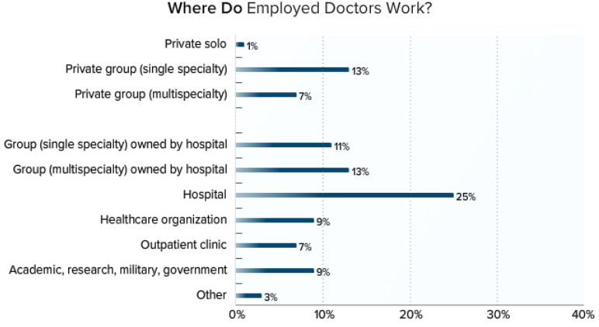
Medscape: Employed Doctors Report (~4600 MDs – 2014)

Slide 12
53 Global Health Care CEO’s
Challenges for Future:
Managing Change
Funding Care
Define/Measure Quality
Managing Regulation
Leadership Characteristics:
Innovative
Insightful on Patients
Insightful on Providers
Collaborative
Data Analytics
Humility
R. Herzlinger – Harvard University

Slide 13
53 Global Health Care CEO’s
Role of Academia in the Future of Health Care:
Must Present a Global View
Teach End-to-End Portrait of Health Care
Enable Critical Business Thinking
Use of Field-Based & Case-Based Learning
Mentoring Strategies
Facilitate Interactions with Real World Peers
Acceptance of Health Care Paradox
R. Herzlinger – Harvard University

Slide 14
American College of Physician Executives
ACPE has educated nearly 100,00 physicians

Slide 16
So What Are We Hearing Out There??

Slide 17
Physician Leadership & Integration
The 5 Vowels for HCOs Are:
Acceptance of MDs in Local Culture is Variable
Engagement is Complex
Integration is Pivotal
Opportunity for MDs to Facilitate HCOs’ Learning
Uncertainty by MDs on Future of Health Care
The 5 A’s for MDs Are:
Awareness of Leadership Interests
Assessment of Potential and Charting a Course
Acquire Knowledge and Early Experiences
Adjust Course/Approach
Accentuate Leadership

Slide 18
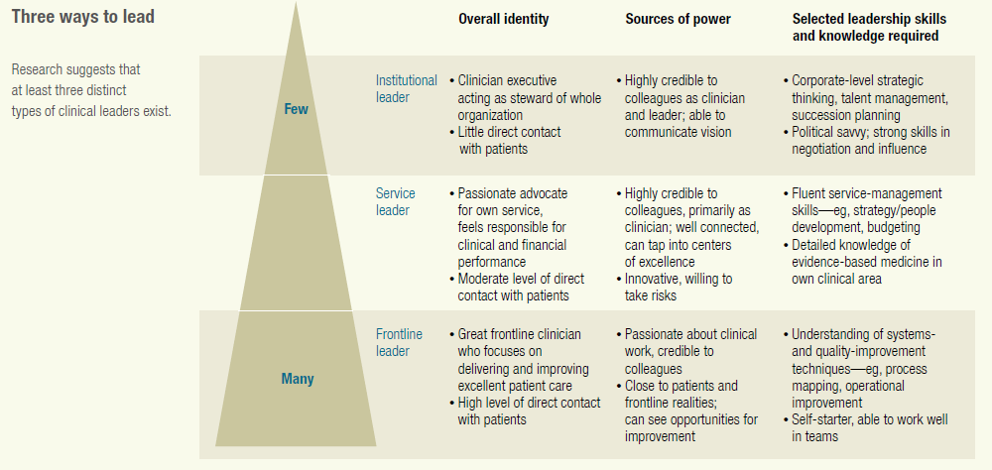

Slide 19
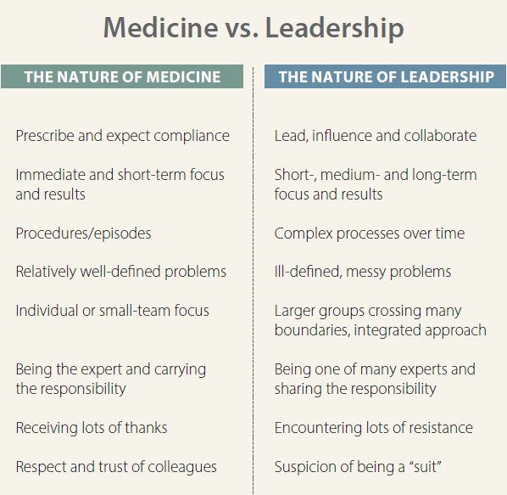

Slide 20
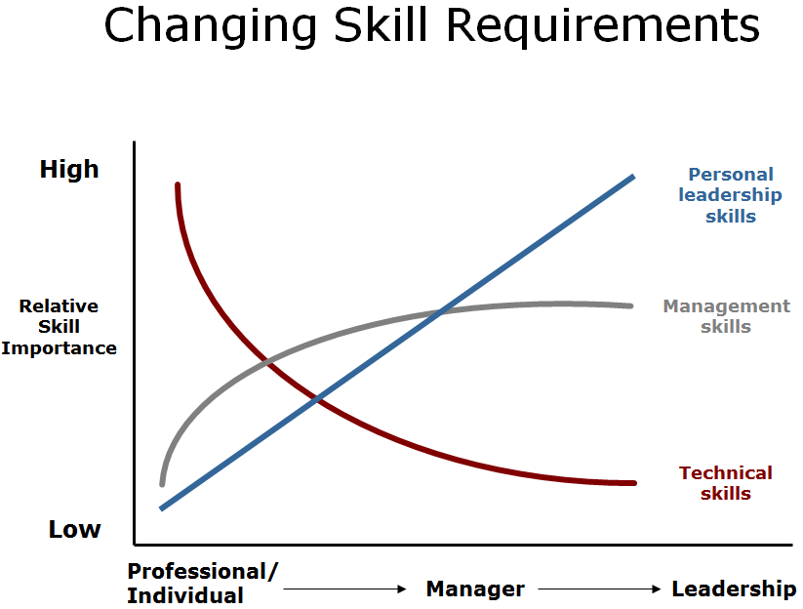

Slide 21
Competencies: Healthcare Leadership Alliance (HLA)
Leadership
Business Skills & Knowledge
Communication & Relationship Management
Knowledge of Health Care Environment
Professionalism

Slide 22
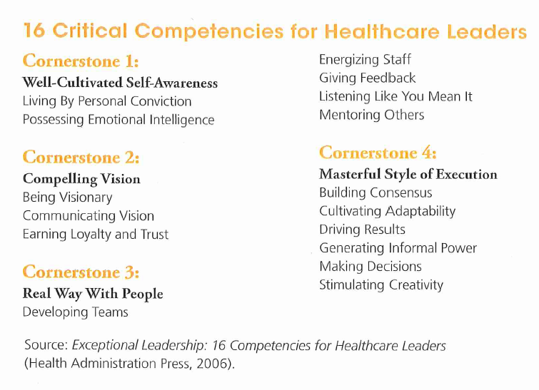

Slide 23
Physicians as Hospital Leaders
How are hospitals and health systems different when run by physicians?
Better understanding on nature of challenges & common knowledge base
Improved understanding of patient care operational issues
Unwilling to compromise quality/safety/labor for profit
Finance as a means not an end
Aligning differing values (RNs, MDs, etc.) & improved interactions
Greater value on physician leadership, compensate appropriately
Anticipate change within health care industry and selectively embrace new technologies/methods, e.g., new trends, governmental regulation
Better coordination with referral sources (private offices/clinics)
Less duplication of similar services within region, more collaboration among local hospitals
Greater insight into clinical/patient care activity on local and regional level
(Kearns et al - Physician Executive Journal, Jan/Feb 2009)

Slide 24
Physicians as Hospital Leaders
Rank | Organization | State | Name of CEO/Presdient | Physician?
1 | Johns Hopkins Hospital | MD | Paul B. Rothman | Yes
2 | Massachusetts General Hospital | MA | Peter Slavin | Yes
3 | Mayo Clinic | MN | John H. Noseworthy | Yes
4 | Cleveland Clinic | OH | Delos M. Cosgrove | Yes
5 | UCLA Medical Center | CA | David T. Feinberg | Yes
6 | Northwestern Memorial Hospital | IL | Dean M. Harrison | No
7 | New York-Presbyterian University Hospital of Columbia and Cornell | NY | Steven J. Corwin | Yes
8 | UCSF Medical Center | CA | Mark R. Laret | No
9 | Brigham and Women's Hospital | MA | Elizabeth G. Nabel | Yes
10 | UPMC-University of Pittsburgh Medical Center | PA | Jeffrey A. Romoff | No
11 | Hospital of the University of Pennsylvania | PA | Ralph W. Muller | No
12 | Duke University Medical Center | NC | Victor J. Dzau | Yes
13 | Cedars-Sinai Medical Center | CA | Thomas M. Priselac | No
14 | NYU Langone Medical Center | NY | Robert I. Grossman | Yes
15 | Barnes-Jewish Hospital/Washington University | MI | Richard Liekweg | No
16 | IU Health Academic Center | IN | Dan Evans | No
17 | Thomas Jefferson University Hospital | PA | Stephen K. Klasko | Yes
18 | University Hospitals Case Medical Center | OH | Thomas F. Zenty III | No
U.S. News Best Hospitals 2013-14: the Honor Roll

Slide 25
Physicians as Hospital Leaders
Among the nearly 6,500 hospitals in the United States, only 235 are run by physicians
(2009 - Academic Medicine)
Overall hospital quality scores 25% higher when doctors ran the hospital, compared with other hospitals.
For cancer care, doctor-run hospitals posted scores 33% higher scores
Physician-Leaders and Hospital Performance: Is There an Association?
(Goodall July 2011 - Social Science and Medicine)

Slide 26
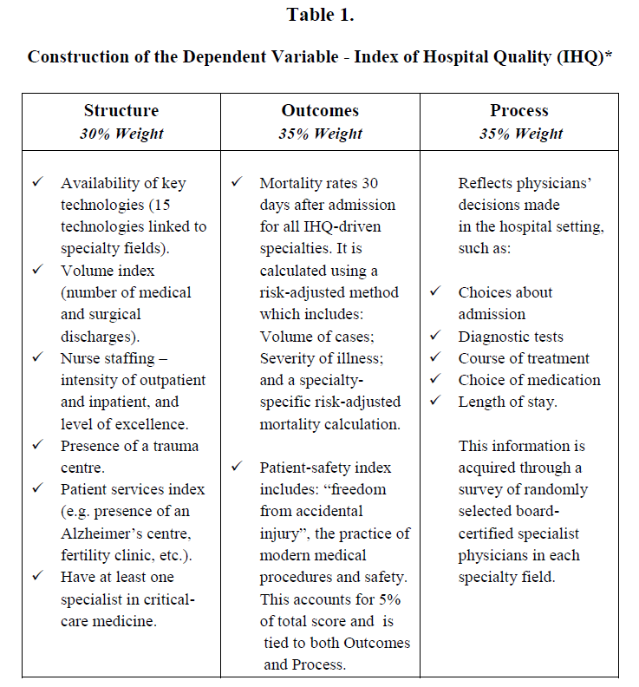
Goodall - Social Science and Medicine July 2011

Slide 27
Kaiser Health News Article
Physician-owned hospitals continue to emerge as among the biggest winners under two programs in the federal health law.
rewards or penalizes hospitals based on scores for quality measures.
penalizes hospitals where too many readmissions after discharge.
More than 260 hospitals owned by physicians; scattered in 33 states (prevalent in Texas, Louisiana, Oklahoma, California and Kansas) Physician Hospitals of America

Slide 28
Kaiser Health News Article
Of 161 physician-owned hospitals participating in the Medicare quality programs, 122 (75%) are bonused.
In contrast, other hospitals have 74 percent penalized.
Medicare is paying the average physician-owned hospital bonuses of 0.21 percent more for each patient during the fiscal year that runs through September
Meanwhile, average hospital not run by doctors is losing 0.30 percent per Medicare patient.

Slide 29
ACOs – The 1st Few Years
367 groups of providers formed ACOs
5.3 million Medicare patients serviced (1 in 8)
115,000 US doctors involved in some way
(Leavitt Partners)
ACO was program designed to align incentives of hospitals and physicians around healthier people
>50% are led by physician practices and leave out hospitals!

Slide 30
MSSP – Year 1 (CMS: 1/30/14)
Of 114 ACOs in the program, 54 ACOs saved money and 29 received bonuses (saved $380 million overall).
21 of 29 successful ACOs (bonuses) were physician-led.
29% of physician-led ACOs achieved savings greater than their MSR, versus 20% of the remaining participants (mainly hospital-sponsored)… i.e. 1/3 better performance
Physician-led ACOs more nimble in execution than hospitals. – e.g., improvements in care coordination, chronic disease management, and prevention… good primary care.

Slide 31
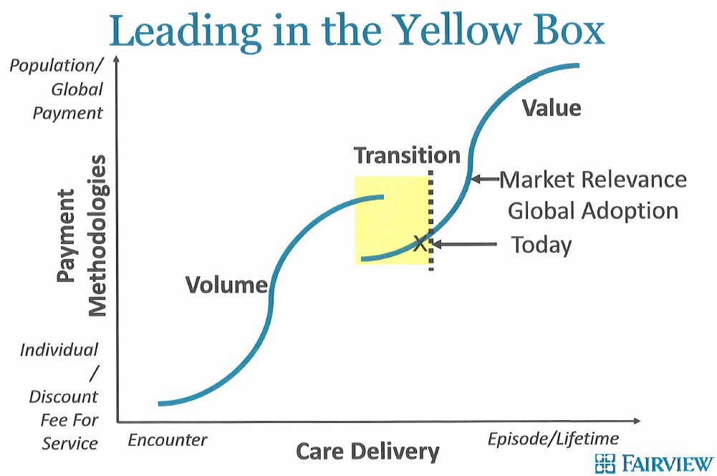

Slide 32
V = Q/C + A + E
Academic Medical Centers
Aligned Integrated Systems
Multi-Hospital Systems
Rural Hospitals
Stand-Alone Hospitals

Slide 33
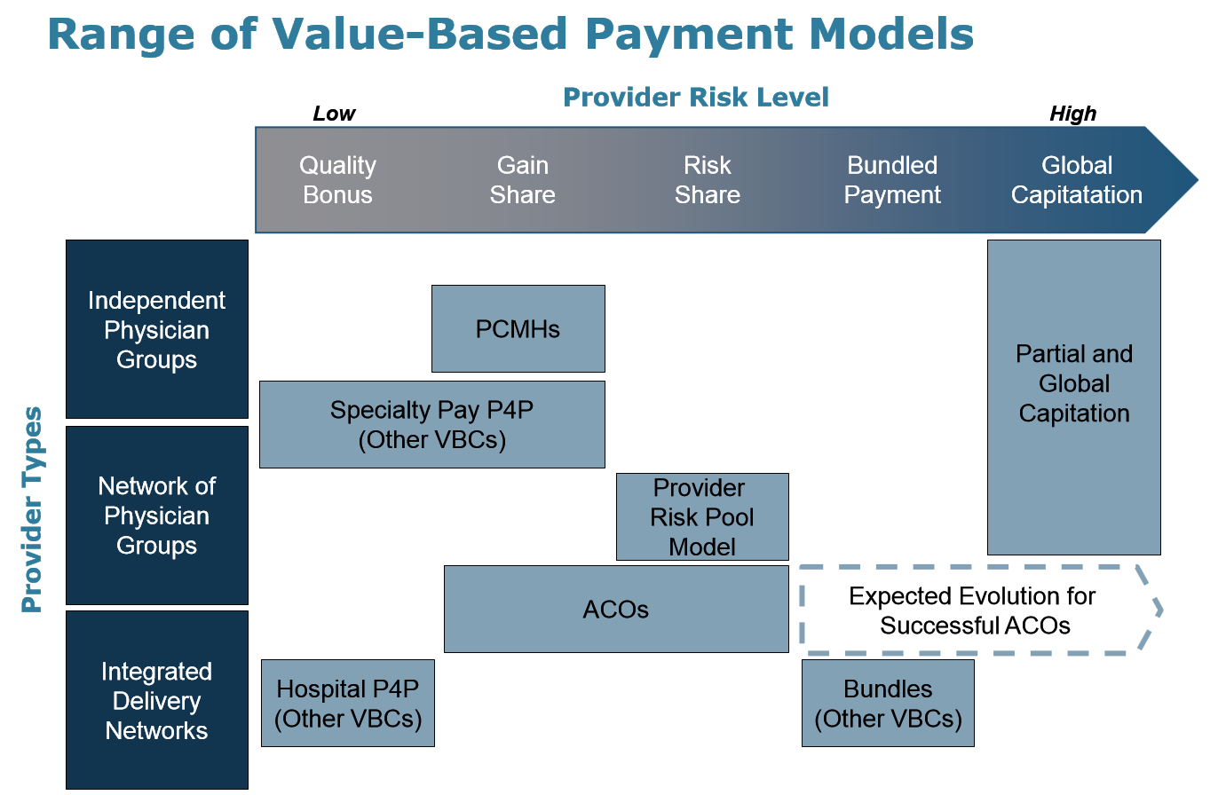

Slide 34
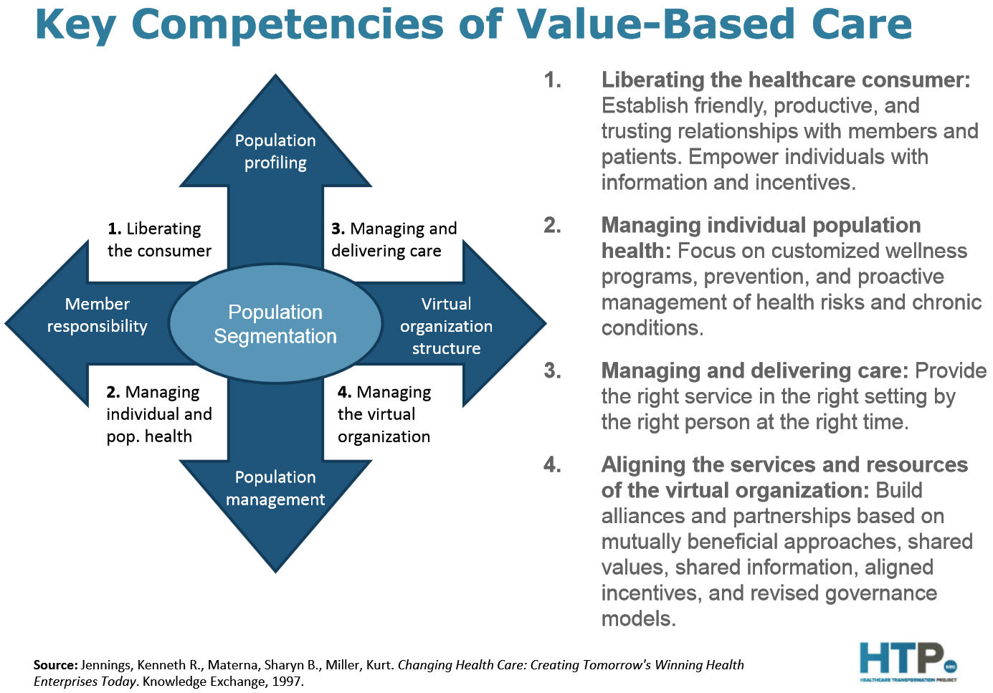

Slide 35
3 Major Options for MD Employment
Large Independent Medical Group
Private Insurance Company
Hospital or Health Care System
For Success With #3:
Vision
Data
Fair Trade
Competitive Compensation
Professinal Collegiality
Branding and Marketing
Physician Leadership
(P. Keckley)

Slide 37
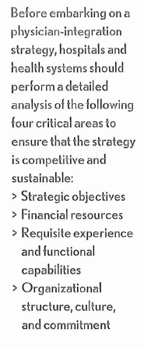
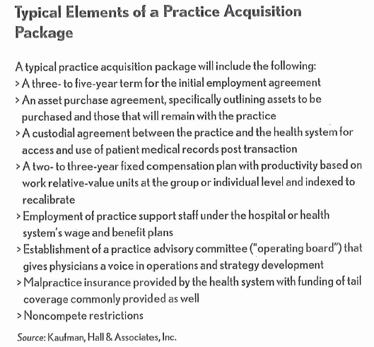

Slide 38
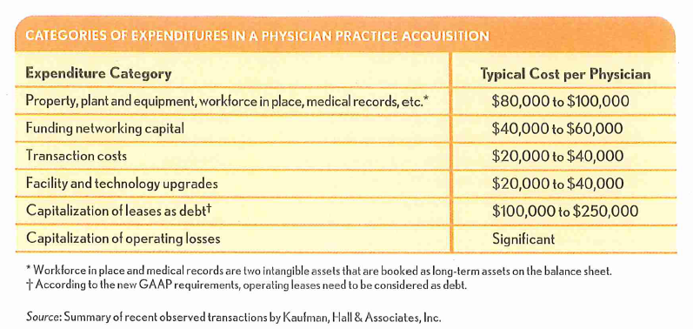
Paradox of Fee-4-Service with VBP & Bundled Payment Strategies
Median loss $176,463 for employing MD in 2012 (MGMA 2013)

Slide 39
Impact of Physician Employment?
Compared with rates in physicians' offices, Medicare payment rates for office visits in hospitals are 80% higher and, for example, echocardiograms are over 70% higher when billed as outpatient services
even after adjusting for differences in packaging
Translated into $1.5 billion in 2011 for Medicare
(2013 MedPAC Report to Congress on Medicare Payment Policy)

Slide 40
Early Results on Integration?
ACPE recently surveyed its physician leader membership about what happens to health care costs when a group or practice is bought by a hospital or health system. Nearly 500 responded:
Costs go up 32%
Stay mostly the same 15.9%
Costs go down 4.9%
Not sure 12.5%
Not applicable 34.7%
ACPE press release generated > 410 hits.
CNBC article… Dan Mangan (http://www.cnbc.com/id/100911258)

Slide 41
Recent Mayo Survey – 2,556 MDs
While 76% report general awareness of costs; 60% believe others have major responsibility to reduce costs
Only 36% believe MDs have a major responsibility
76% believe clinical guidelines should be followed – esp. for situations with marginal benefits (78%)
89% believe MDs need increased role with decreasing use of unnecessary tests; but 85% disagree with rationing or denial of care if services should go to others
78% believe MDs should be solely devoted to individual patient best interests regardless of costs
J. Tilburt, et al http://jama.jamanetwork.com/article.aspx?articleid=1719740

Slide 42
Issues/Approaches for Sustainability
Capital Requirements
Impact on Financial Performance (aggregate/within practice/across enterprise)
Implementation Risk
Impact on Current Operations
Impact on Clinical Delivery
Staffing Requirements
Contracting Obligations
Ability to Cover Geographic Needs
Ease of Replication

Slide 43
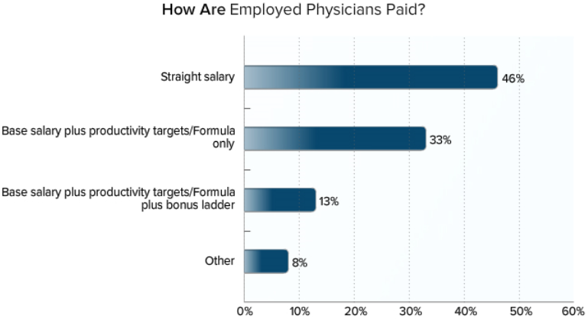
Medscape: Employed Doctors Report (~4600 MDs – 2014)

Slide 44
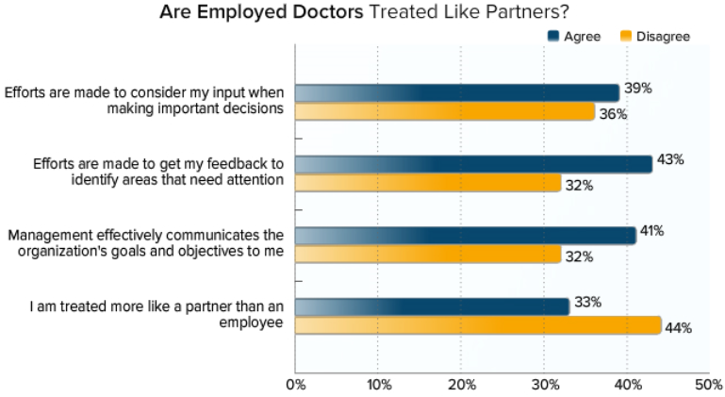
Medscape: Employed Doctors Report (~4600 MDs – 2014)

Slide 45
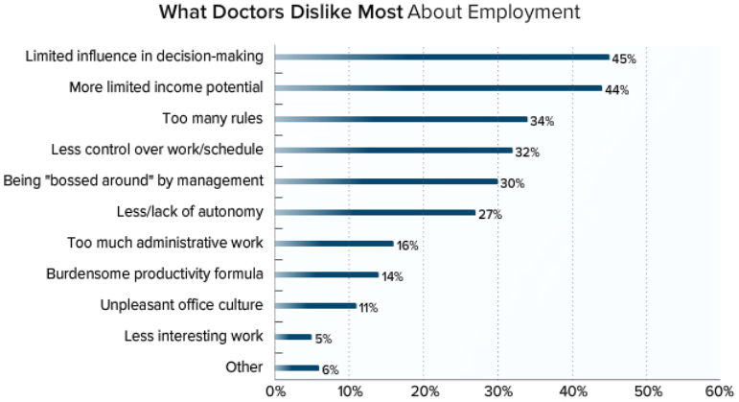
Medscape: Employed Doctors Report (~4600 MDs – 2014)

Slide 46
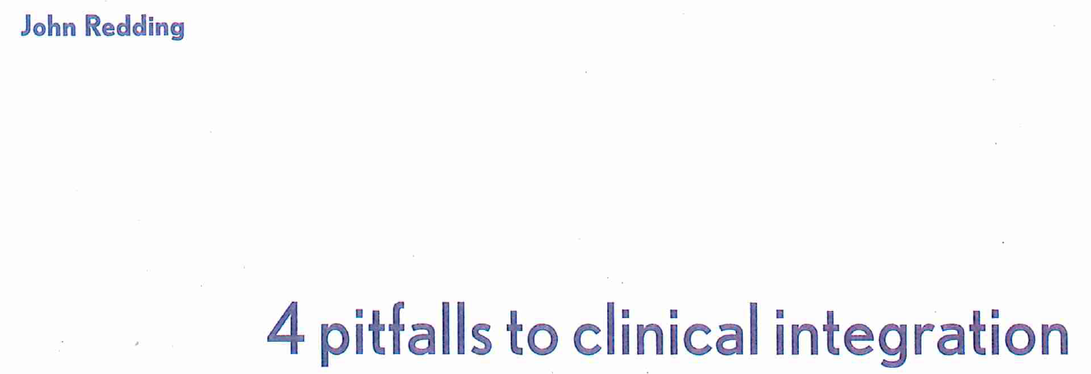
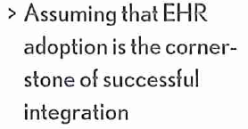
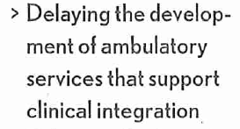
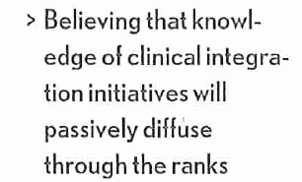
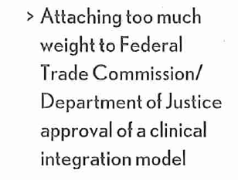

Slide 47
RAND/AMA Study – 10 Factors
Quality of Care
Electronic Health Records (EHR)
Autonomy & Work Control
Practice Leadership
Collegiality, Fairness, & Respect
Work Quantity & Pace
Work Content, Allied Health Professionals, & Support Staff
Payment, Income, & Practice Finances
Regulatory & Professional Liability Concerns
Health Reform
http://www.rand.org/content/dam/rand/pubs/research_reports/RR400/RR439/RAND_RR439.pdf

Slide 48
RAND/AMA Study - Implications
Physician practices need a knowledge base and resources for internal improvement
Paying attention to professional satisfaction may improve patient care and health system sustainability
Predictability and perceived fairness of physician incomes will affect professional satisfaction
Better EHR usability should be an industrywide priority and precondition for EHR certification
Reducing the cumulative burden of rules and regulations may improve professional satisfaction
http://www.rand.org/content/dam/rand/pubs/research_reports/RR400/RR439/RAND_RR439.pdf

Slide 49
ACPE Survey – MD Integration
80% either agreed or strongly agreed that the employed physicians within their health care organization were satisfied with the current integrated physician model
85% either agreed or strongly agreed that administrators were satisfied
53% said employed physicians were fully integrated into their hospital or health system, while 47% were not
Whether organizations had incentive plan to encourage and reward MDs for being engaged in performance initiatives, nearly evenly split, 51% “yes” and 49% “no.”
http://www.acpe.org/docs/default-source/survey/survey-shows-growing-approval-and-acceptance-of-integrated-employed-physicians.pdf?sfvrsn=4

Slide 50
Diminishers and Multipliers
http://journals.lww.com/academicmedicine/Fulltext/2014/03000/A_New_Leadership_Curriculum___The_Multiplication.9.aspx

Slide 51
Peter B. Angood MD peter.angood@acpe.org
Physician Leadership Works –
And, Is Valuable!
Thank You For The Attention

