Slide 1
International Policy Dialogue: a relational approach to support the influence of medical leadership in health care reform
Exploring a 12-Month Call to Translate Medical Leadership into Action

Slide 2
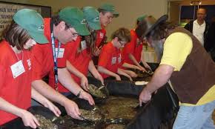
Purpose
Explore new ways of acting together to:
Grow medical leadership in member countries
Enhance the capacity of medical leaders to influence health reform in our respective jurisdictions
Mining our knowledge...

Slide 3
The Approach
Demonstrate the power of dialogue.
Introduce Deliberative Dialogue process that harnesses collective knowledge for action.
Gain input into a potential activity to stimulate collective action on issues of health reform.

Slide 4
Difference between Dialogue and Discourse
Conversations often are characterized by advocacy and debate whereby one person tries to impose his or her ideas on others, or win the argument.
Dialogue is characterized by open and honest inquiry—asking questions of clarification and understanding, rather than advocating for one’s own point of view.
There is a true desire to co-create understanding and meaning, by building on each other’s contributions.

Slide 5
What is dialogue?

Slide 6
Key skills of dialogue
Bertha Fries

Slide 7
A Policy Dialogue Approach
McMaster University Health forum’ Deliberative Dialogue Process
Dialogues consist of a multi-stage process that aim to ensure relevant evidence on pressing health concerns is used to fuel action for improving health outcomes through collective problem solving.
Bulletin of the World Health Organization:
Evidence briefs and deliberative dialogues: perceptions and intentions to act on what was learnt.
Kaelan A Moat ª, John N Lavis ^{b}, Sarah J Clancy ^{c}, Fadi El-Jardali ^{d}, Tomas Pantoja (2013).
lavisj@mcmaster.ca

Slide 8
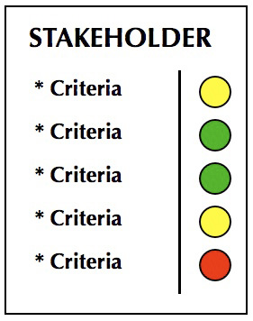
Key Principles of Deliberative Dialogue
Evidence-informed
Systems perspective
Structured, real dialogue of main actors who can “make a difference”
Commitment to action

Slide 9
Process re Deliberative Dialogue
8—12 m. process
Identification of topic that needs collective action.
Secretariat
Issue Brief (Systematic review of literature and key informants)
Stakeholder group dialogue (full day)
Summary report and KM strategies

Slide 11
The rationale for Deliberative Dialogue
No-one has all the expertise to solve the issues we face
Wicked issues in health care
Trans-disciplinary problems (Max-Neef)
Require knowledge arbitrage and collective action
Political
science
Business
Social
Sciences
Medicine
As well as difference professional
world views...

Slide 12
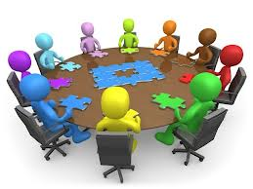
Table Discussion

Slide 13
Questions
Is dialogue—and the practices of dialogue as described in this session—often employed in your organization? Why or why not?
Consider the challenges of health reform in your country. What kinds of knowledge disciplines do those challenges require to understand, and resolve?
Does the idea of a Deliberative Dialogue—or a version of the same construct—have the potential of helping physicians in your country shape health reform at a policy level? Is this a process you would champion in your jurisdiction?
If you were advising the WFMM strategic planning group (that is meeting tomorrow), as to whether or not to consider building a DD into their future strategies, what would you say? How might they do it?

Slide 14
Q
&
A

Slide 15
Thank you
Graham Dickson,
gdickson@royalroads.ca

