Slide 1



Partnering for performance to drive reform
Professor Graham Dickson (Canada) and Professor Peter Spurgeon (UK)

Slide 2

Purpose
To explore:
What partnering for performance means
What the research says re having medical leaders as partners in health reform: how does it affect performance?
The need for medical leaders to become engaged as partners in health reform
Working together to get results...

Slide 3

What is Productive Health Reform?
Health reform is a transition from where we are at now to where we want to be that is defined within each country’s need as dictated by situation, circumstance and context.
Patient-centred care is the focal point for many jurisdictions.
It is multi-level: e.g., micro (unit, or consultancy-based), macro (hospital or organization-base) or mega (national/provincial) in scope.
Medical leadership is required at all levels for reform to be effective

Slide 4
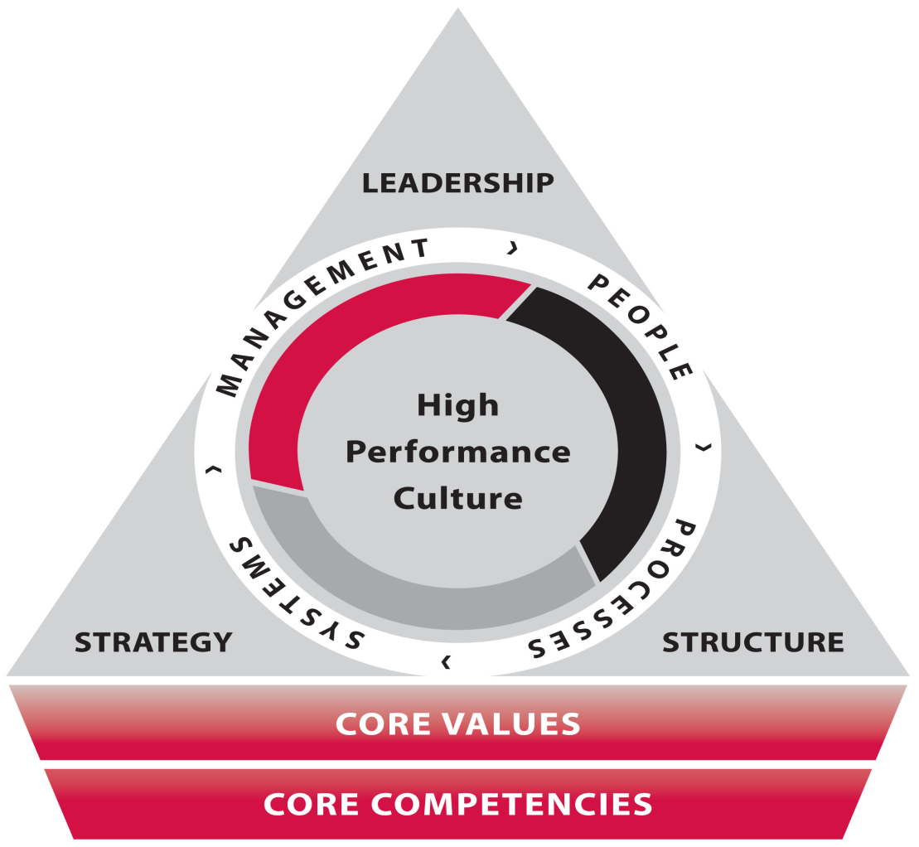
Performance
  The action or process of carrying out or accomplishing an action, task, or function
  In the context of this session, the action, task or function is productive health reform.

Slide 5

Partnership
  A relationship that is characterized by mutual cooperation and responsibility, as for the achievement of a specified goal.
  The state or condition of being a partner; participation; association; joint interest.
  In Law.
    a. the relation subsisting between partners.
    b. the contract creating this relation.
    c. the persons joined together as partners in business

Slide 6

Partnership (cont.)
  The mutual cooperation and sharing of responsibility between medical doctors and others (non-medical administrators, other professions, public) .
  The term physician engagement is used to characterize the degree to which we are committed, and successful, in forming partnerships between medical doctors and others.

Slide 7

Enhancing Engagement in Medical Leadership: A Focus on Medical Engagement
Professor Peter Spurgeon (Project Director)
Director, Institute of Cinical Leadership, Medical School,
University of Warwick

Slide 8
Enhancing Engagement in
Medical Leadership
Joint project undertaken by National Institute for Innovation and Improvement, and Academy of Medical Royal Colleges
Overall goal ‘create a culture of greater medical engagement in management and leadership with all doctors at every level’
Two key products
- Medical Leadership Competency Framework
- Medical Engagement Scale

Slide 9
Project Benefits
Benefits to the NHS and medical professionals include:
Greater commitment and capability to effect service change and improvement
Support the drive towards the new medical professionalism
Greater awareness by medical professionals of the contribution of effective management and leadership both in operational and strategic activities
Increase and strengthen the pool of medical managers and leaders available to take on senior roles within the service

Slide 10
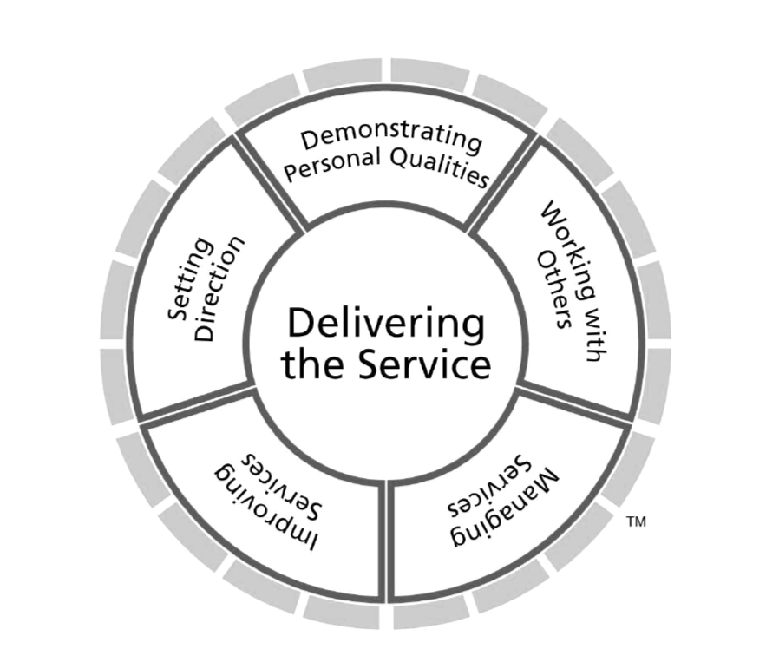
The Medical Leadership
Competency Framework
www.institute.nhs.uk/mlcf

Slide 11
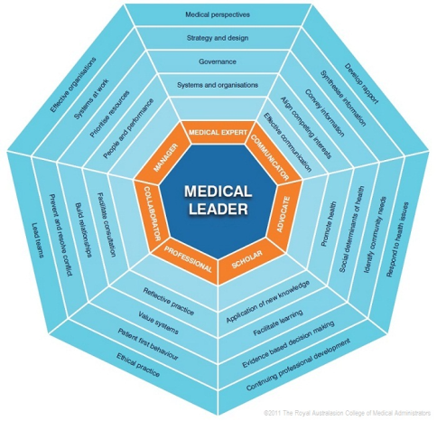
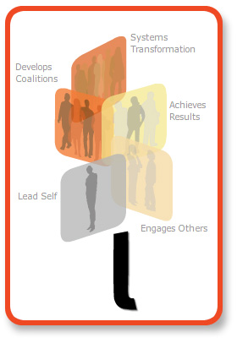
Other ‘constructions’ of leadership
Defining the territory of leadership: the power of frameworks
Canada: LEADS
Australia: RACMA

Slide 12
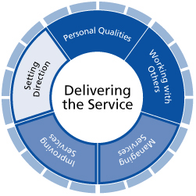
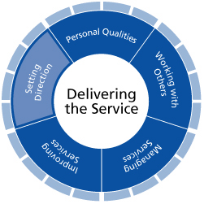
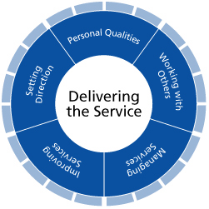
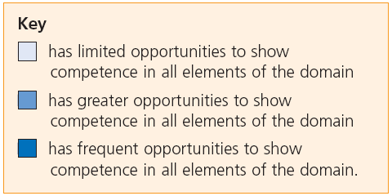
Medical Leadership Competency Framework
Application of the Framework will differ according to the career stage of the doctor and the type of role they fulfil. The following graphics demonstrate the emphasis that is likely to be given to the domains at each stage:
Undergraduate
Postgraduate
Post-Specialist Certification

Slide 13
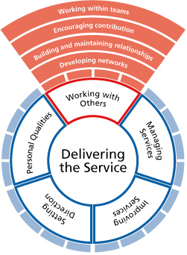
Medical Leadership Competency Framework
Working with Others
Doctors showing effective leadership by working with others in teams and networks to deliver and improve services.
This requires doctors to demonstrate competence in:
Developing networks: working in partnership with colleagues, patients, carers, service users and their representatives within and across systems and improve services
Building and maintaining relationships: listening, supporting others, gaining trust and showing understanding
Encouraging contribution: creating an environment where others have the opportunity to contribute
Working within teams: to deliver and improve services.

Slide 14
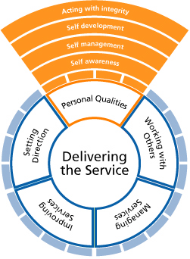
Medical Leadership Competency Framework
Personal Qualities
Doctors showing effective leadership need to draw upon their values, strengths and abilities to deliver high standards of care.
This requires doctors to demonstrate competence in:
Self awareness: being aware of their own values, principles, assumptions, and by being able to learn from experiences
Self management: organising and managing themselves while taking account of the needs and priorities of others
Self development: learning through participating in continuing professional development and from experience and feedback
Acting with integrity: behaving in an open and ethical manner

Slide 15
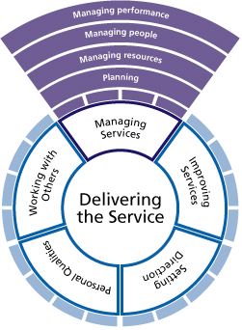
Medical Leadership Competency Framework
Managing Services
Doctors showing effective leadership are focused on the success of the organisation(s) in which they work.
Doctors are required to demonstrate competence in:
Planning: actively contributing to plans to achieve service goals
Managing resources: knowing that resources are available and using their influence to ensure that resources are used efficiently and safely
Managing people: providing direction, reviewing performance and motivating others
Managing performance: holding themselves and others accountable for service outcomes

Slide 16
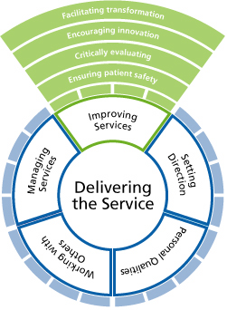
Medical Leadership Competency Framework
Improving Services
Doctors showing effective leadership make a real difference to people’s health by delivering high quality services and by developing improvements to service.
Ensuring patient safety: assessing and managing risk to patients associated with service improvement.
Critically evaluating: being able to think analytically, conceptually and to identify where services can be improved.
Encouraging innovation: creating a climate of continuous service improvement.
Facilitating transformation: actively contributing to change processes that lead to improving healthcare.

Slide 17
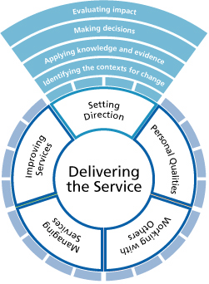
Medical Leadership Competency Framework
Setting Direction
Doctors showing effective leadership contribute to the vision and aspirations of the organisation and act in a manner consistent with its values.
Identifying the contexts for change: being aware of the range of factors to be taken into account
Applying knowledge and evidence: gathering information to produce an evidence-based challenge to systems and processes in order to identify opportunities for service improvements
Making decisions: integrating values with evidence to inform decisions
Evaluating Impact: measuring and evaluating outcomes, taking corrective action where necessary and by being held to account for their decisions.

Slide 18
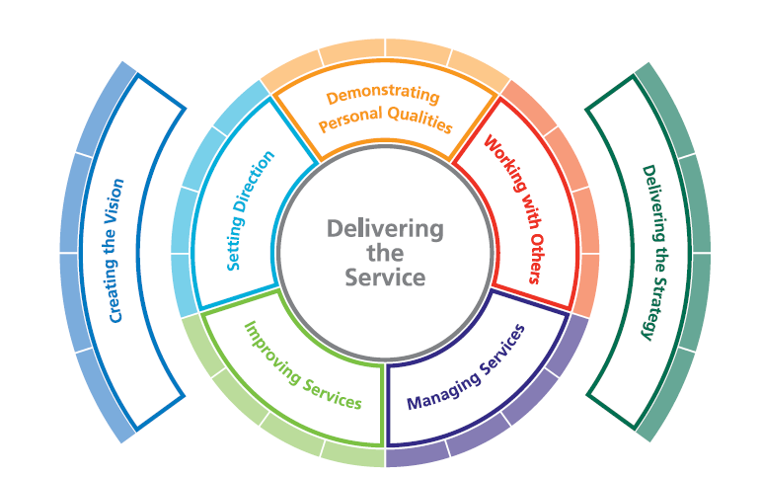
Leadership Framework
(All staff Groups)

Slide 19
From Competence to Engagement
Competence may be thought of as “can do” but engagement requires “will do”- the motivational aspect.
Engaged employees characterised by
  - belief and pride in their organisation
  - commitment to improve the outcome/ product
  understanding of the wider organisational context beyond
  their own job role
  - respect for colleagues
  - “willingness to go the extra mile”

Slide 20
Use of Term “Engagement”
Not
- as process of consultation
- as act “to do”
Rather
- Intra individual notion
- Reservoir of motivation
- Willingness to get involved
UK wide levels of engagement, across sectors said to be relatively low.
Approx 1/3 workforces truly engaged
Hence any increase in the 1/3 increases organisation capacity, and therefore performance

Slide 21
From Competence to Engagement cont’d.
So engagement is reciprocally beneficial
a) Organisation- performance, customer satisfaction, reduced absenteeism, turnover
b) Individual- improved job satisfaction, lower
burnout rate
Definition of engagement built into MES is therefore
“The active and positive contribution of doctors within their normal working roles to maintaining and enhancing the performance of the organisation which itself recognises this commitment in supporting and encouraging high quality care”
(Spurgeon, Barwell and Mazelan 2008)

Slide 22
Origins of the Medical Engagement Scale (MES)
Applied Research Ltd.- Established large database re: attitudinal, individual & cultural aspects of NHS
Existing measure of work satisfaction and personal commitment based on 23,782 NHS staff and 20+ health organisations
Best items from previously established scales selected as relevant to medical engagement and re-analysed using Factor Analysis
Scales adapted to focus on engagement- reliable, valid & relatively easy to administer and complete

Slide 23
MES Reliability & Validity
Overall items reduced to 30 with reliability scores (Cronbach’s alpha) ranging from 0.70 to 0.93
Inter-scale correlations with key core concepts of engagement suggest -
a) engagement is a conceptually distinct construct
b) the sub-scales are important as engagement is multidimensional
Scores from the pilot trust sites were statistically significant & in the predicted order i.e. top two are rated independently as excellent & have taken steps to promote medical engagement, the last is in the poorest performing category & the opportunistic site is in the middle

Slide 24
Scales and Definitions

Slide 25
MES Index: Position on Model for 4 Pilot Trusts

Slide 26
Meta-Scales: Position on Model for 4 Pilot Trusts
Meta-Scale 1:
Working in an open culture
Meta-Scale 2:
Having Purpose & Direction
Meta-Scale 3:
Feeling Valued & Empowered
16

Slide 27
The Levels of Medical Engagement
Embedded
Expanded
Energised
Expectant
Excluded
Doctors are fully involved at all levels in leading the design and delivery of service innovations
Doctors traditional roles have become expanded to embrace some aspects of managing healthcare
Doctors are keen to become more involved in the planning, design and delivery of services
Doctors understand the importance of becoming involved in the management agenda
Doctors are not part of the management process and confine their activities to their traditional role

Slide 28
Levels of Medical Engagement Summary for Trust 28

Slide 29
Levels of Medical Engagement for All Trusts in Current Sample
29
Notes:
29

Slide 30
CQC Ratings Against Top/Bottom MES Scores
The table below illustrates the quantitative data in more concrete terms by showing the difference in performance level achieved on Care Quality Commission ratings by those Trusts in the top 10 and bottom 10 on the MES.

Slide 31
CQC Ratings Against Top/Bottom MES Scores

Slide 32
MES Scales

Slide 33
Application to Performance
Benefits of Engagement (U.K.)
Better patient mortality rates
Fewer serious untoward accidents
Better financial management
Higher patient experience scores
Better resource utilisation
Achievement of service targets
USA hospitals with more engagement have better service performance and financial stability
Engagement has significant currency in private sector
“Engage for Success” national focus
U.K. levels of engagement quite low across all sectors

Slide 34
Medical Engagement and Organisational Performance
What can we learn from trusts with high levels of medical engagement?
Leadership, stable, relationship oriented, leading by example
A future-focused and outward-looking culture
Attention to selection and appointment of the right doctors to leadership and management
Providing support, development and leadership opportunities
Effective communication
Promotion of understanding, trust and respect between doctors and managers
Setting expectations, enforcing professional behaviour and firm decision-making
Clarity of roles and responsibilities and empowerment

Slide 35
Percentage of Respondents (n = 399) who fell into High, Medium and Low Normative Bands
 | High | Medium | Low
Medical Engagement Index | 20.5% | 9.8% | 69.7%
Meta-Scale 1: Working in a Collaborative Culture | 21.0% | 18.3% | 65.4%
Meta-Scale 2: Having Purpose and Direction | 14.8% | 10.0% | 79.7%
Meta-Scale 3: Feeling Valued & Empowered | 22.1% | 8.3% | 69.7%

Slide 36

Activity
Directions:
  At your table, discuss what health reform challenges—from a patient-centred focus-- you are facing in your own area of responsibility.
  To what extent are doctors truly engaged as it relates to health reform in your country?
  Would the MES engagement scale be useful to you in improving engagement?
Prepare to report out.

Slide 37
Q
&
A

Slide 38

Thank you
Peter Spuregon,
P.C.Spurgeon@warwick.ac.uk
Graham Dickson,
gdickson@royalroads.ca

