Slide 1
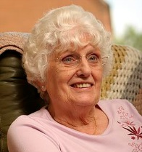
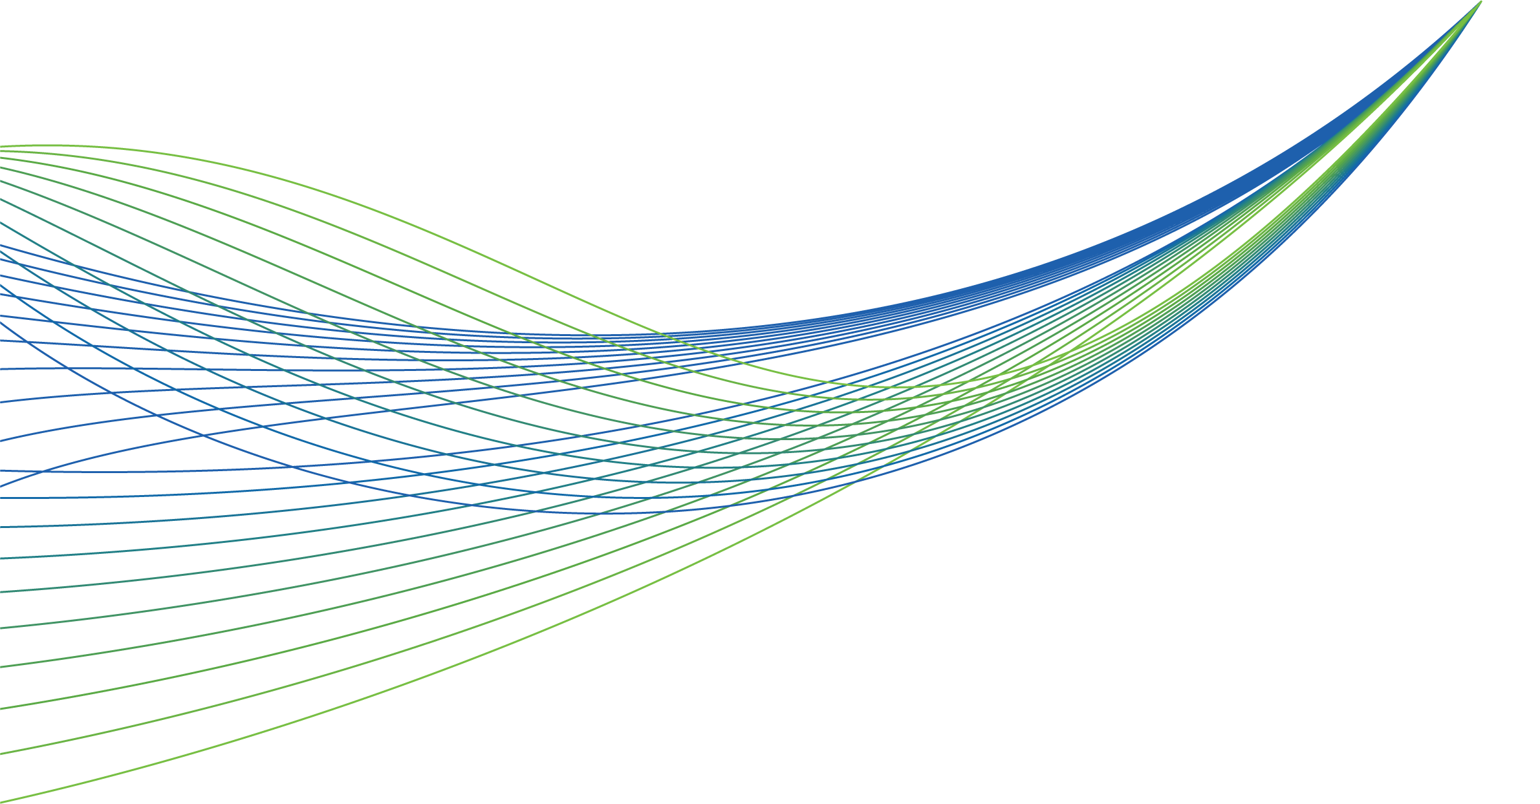
NHS RightCare scenario: The variation between standard and optimal pathways
January 2017
Betty’s story: Wound care
Appendix 1: Summary slide pack
January 2017

Slide 2
Betty’s story
This is the story of Betty’s experience of a wound care pathway, and how it could be so much better
At each stage we have modelled the costs of care, both financial to the commissioner, and also the impact on the person’s outcomes and experience.
In this scenario we examine a wound care pathway, comparing a sub-optimal but typical scenario against an ideal pathway.
1
2
4
3
It shows how the NHS RightCare methodology can help clinicians and commissioners improve the value and outcomes of the care pathway.
This document is intended to help commissioners and providers to understand the implications – both in terms of quality of life and costs – of shifting the care pathway.

Slide 3
Betty and the sub-optimal pathway
Betty is 70 - a retired shop assistant and has a good social network in the village
She has a health check aged 70. Her BMI is 30 and she is invited to see the Health Care Assistant (HCA) for lifestyle advice (the advice was not ideal)
At 74 she grazes her ankle on a walk and after five weeks of self management she visits her GP who issues antibiotics and after two more weeks refers Betty to the General Practice Nurse (GPN)
She is switched to antimicrobial dressing, has a second course of antibiotics and weekly appointments for six weeks (the dressings put a stop to Aquafit classes)
The wound is now very distressing and is having a significant impact on Betty’s life. The health professionals are unaware
Then another change of dressing (to be changed two to three times per week)
Three months on and still no improvement but the GPN is not confident with compression bandaging - better with the status quo than to make a risky mistake with the bandages!
Another month and then a referral to the dermatology dept. (an eight week wait) where the venous leg ulcer is confirmed, but not communicated effectively
It is several months before a doppler scan is undertaken - for a full assessment
A catalogue of incidents occur & Betty’s situation deteriorates further with many extended weeks of pain, discomfort and distress culminating in a five day hospital stay for cellulitis
It takes two years to heal Betty’s ulcer in the end with a reduced compression system that she could tolerate
Betty’s case is not unique

Slide 4
Betty and the sub-optimal pathway
Prevention Focus
Health and wellbeing
Care and quality
Funding and efficiency
Delayed healing
Increased side effects and complications
Delayed assessment
Greater understanding of need is required
Poor impact on the patient and staff
Expensive dressings and treatment
Hospital costs
Poorer outcomes
Poorer experience
Poorer use of resources

Slide 5
Would you want to avoid this?

Slide 6
Statistics
The annual cost of managing wounds in the NHS and associated comorbidities is £5.3 billion
1.5% of the UK population are estimated to have a leg ulcer (of patients recorded in an NHS setting with a wound within one year)
There is evidence of unwarranted variation in the assessment and treatment of leg ulcers (see the main paper and the research studies referenced.)
Wound care is 39% of a district nursing service workload (NHS Benchmarking 2016 annual audit)
Research has shown that the leakage and odour from leg ulcers can cause embarrassment, resulting in social isolation, low mood, depression and poor self-esteem. Interventions to improve leakage and odour have often proved to be inadequate.
Notes:
(rate of falls & 10 days)

Slide 7
Questions for GPs and commissioners
1
Do you know how many venous leg ulcers there are for your population?
2
What are the healing rates for venous leg ulcers in your locality?
3
Do you know how many of these have had an ABPI measurement to support diagnosis and treatment?
4
Who delivers care to people with leg ulcers?
5
What is the cost of managing leg ulcers in your locality?
6
Is there unwarranted variation in treatment and outcomes - how do you know?
7
What are the barriers to seamless care for people with leg ulceration?
8
Has any engagement activity taken place with patients with regards to wound care?

Slide 8
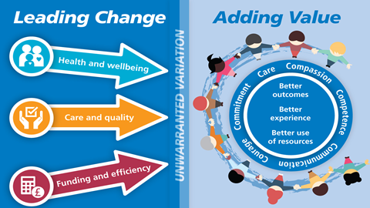
Betty and the optimal pathway
This time (aged 70) Betty’s Health Check is very informative with lots of proactive advice with a personalised care & support plan including an exercise on prescription programme
The GPN review (due to high risk factors) results in a recommendation for compression hosiery and regular reviews
At 74 Betty grazes her ankle whilst rambling and self manages for a few days until consulting the local pharmacist who refers to the lower leg wound pathway (developed by the CCG)
The GPN and the district nursing teams work closely together and so after only four days Betty is referred to the leg ulcer pathway for a full holistic and leg ulcer assessment.
Betty is reassured that pain relief has been carefully planned and she will not become dependent upon the medication
The Doppler assessment confirms a venous leg ulcer requiring high compression treatment
The faster the compression treatment starts, the faster healing takes place and that is Betty’s priority
Painkillers, bandages and education to Betty are well managed so that Betty keeps the bandages on and everyone can see the improvement; Betty is motivated to stick to the regime
Within eight weeks (start to finish) Betty’s leg is completely healed
Betty then continues to wear compression stockings as a preventative measure
Betty is able to have her knee replacement without any delays due to wound complications
Leading Change, Adding Value is a framework for all nursing, midwifery and care staff to use to reduce unwarranted variation

Slide 9
Betty and the optimal pathway
Prevention Focus
Health and wellbeing
Care and quality
Funding and efficiency
Faster healing
Reduced side effects
Timely
Timely assessment
Greater understanding of need
Reduced dressing costs
Better organisation of care
Better outcomes
Better experience
Better use of resources

Slide 10
Spend per 100,000 of the population on compression bandaging 2015/16

Slide 11
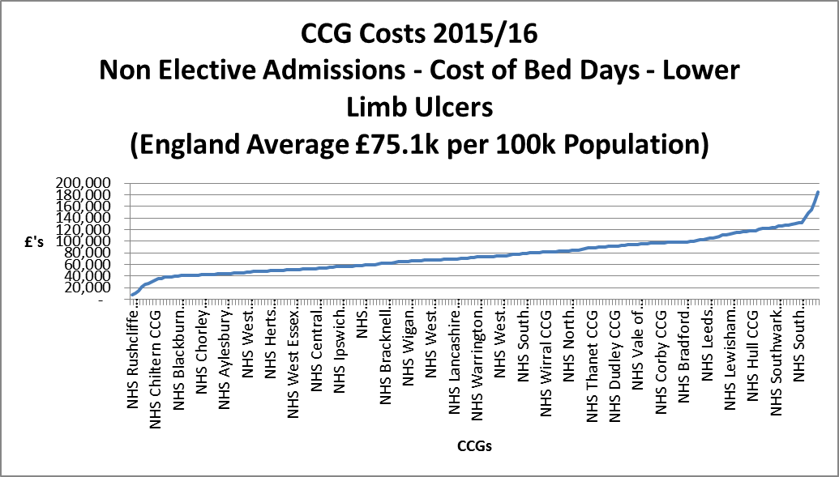

Slide 12
Financial information
Analysis by provider | Sub-optimal | Optimal
Acute | £1,703 | £0
Ambulance service | £466 | £0
Community teams | £2,167 | £12
Primary care | £1,334 | £346
Pharmacist | £3 | £3
Leg ulcer pathway | £0 | £144
Grand total | £5,673 | £505
In the suboptimal scenario:
- Dressings represent £1,353 (24%) of the total costs versus £88 in the optimal pathway.
- Clinical time represents £2,139 (38%) of the total costs versus £195 in the optimal pathway.

Slide 13
Financial information
Analysis by cost category | Sub-optimal | Optimal
Primary care management | £1,337 | £349
Community care | £2,167 | £156
Non-elective admissions | £2,169 | £0
Grand total | £5,673 | £505
 | Sub Optimal Clinical Time | Optimal Clinical Time | Sub Optimal Prevention | Optimal Prevention | Sub Optimal Dressings | Optimal Dressings | Sub Optimal Other
Primary care | £935 | £93 | £11 | £222 | £390 | £34 | £0
Community care | £1,204 | £102 | £0 | £0 | £964 | £54 | £0
Non-elective admissions | £0 | £0 | £0 | £0 | £0 | £0 | £2.169
Total | £2,139 | £195 | £11 | £222 | £1,354 | £88 | £2,169
Note: The sub-analysis table splits have been estimated by NHSE Community Nurse Lead
Not only is Betty’s health and quality of life much better in the optimal scenario, but the costs to the health economy are reduced 10 fold.

Slide 14
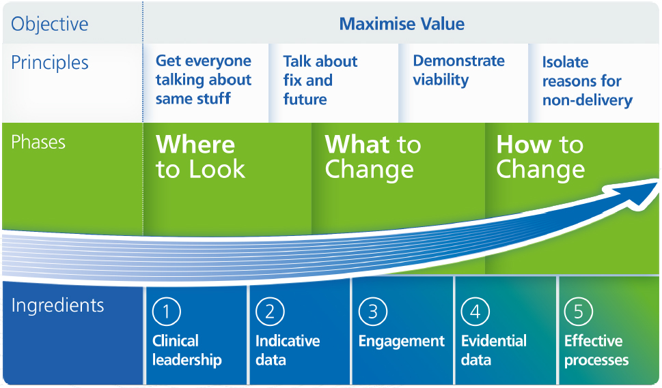
The NHS RightCare approach

Slide 15
Further information
For more information about Betty’s journey, NHS RightCare or long term conditions you can:
Email
rightcare@nhs.net
england.longtermconditions@nhs.net
Visit
https://www.england.nhs.uk/rightcare/
Tweet
@NHSRightCare

